Slide 1
An Economic View of Crowdsourcing and Online Labor Markets
John Horton
Harvard University
NIPS 2010 Workshop on CSS

Slide 2
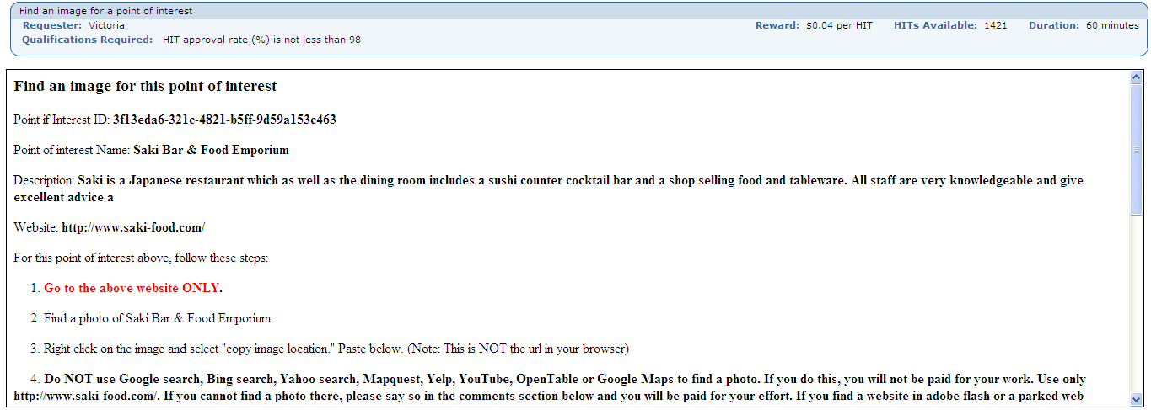
A HIT from Mechanical Turk (viewed last night):
Go to website for a point of interest
Grab the URL for a picture of that site
Paste it into the textbox

Slide 3
Should I ?
Gross payment:
Time it takes:
Took me 68s – implied wage of $2.12/hour
Perceptions of employer standards &
Probability of acceptance/rejection:
“Do NOT use Google search, Bing search, Yahoo search, Mapquest, Yelp,
YouTube, OpenTable or Google Maps to find a photo.
If you do this, you will not be paid for your work. ”

Slide 4
More broadly:
How did I find this task?
How does my situation (earnings, qualifications, etc.) affect my decisions?

Slide 5
This $.04 decision is related to:
Classic topics in economics:
Labor supply
Job Search
Decision-making under uncertainty
Contracts & employer perceptions
But, does this matter beyond MTurk?
Yes--these problems will exist in all online labor markets

Slide 6
Emergence of Online Labor Markets
API
It is becoming increasingly possible to build applications with a human in the loop.

Slide 7
If we use money in our crowdsourcing systems…
Economics Offers:
Collection of models and concepts for understanding labor markets and decision-making
Tools for doing causal research with observational data
Collection of facts about how people make economic choices
Economics Lacks:
Engineering focus
Tool-building focus
Concern with prediction (for example, most economists do not view inability to “predict” housing/banking crisis as a problem)

Slide 8
Agenda
My research
Job Search
Labor Supply
Perceptions of expectations (maps to quality)
Online Labor Markets
Development possibilities of online work
(or why I think this matters)

Slide 9
Job Search
“Task Search in a Human Computation Market”
(joint w/ Lydia Chilton, Rob Miller and Shiri Azenkot)
ACM-KDD/HCOMP 2010

Slide 10
Observing Search Behavior
A: Scraping “HITs Available”
B: Worker’s Survey
Scrape the results pages from MTurk every 30 seconds.
Determine the rate at which a type of HIT is being taken by workers
Premise: search methods which return HITs with higher rates of disappearance are the search methods which workers use more.
Quantitative, coarse results.
Post HITs asking how workers search for HITs.
Position the HITs in the search results such that they can most easily be found by particular kinds of search behavior that are not targeted by scraping:
Less popular sort categories
Qualitative and fine-grained results.

Slide 11
MTurk Search Interface
Search interface allows workers to sort by 6 task features

Slide 12
MTurk Task Search Interface
HIT groups aggregate all the tasks with the same descriptive metadata
requestor, description, reward
Each HIT lists the number of “HITs available.”

Slide 13
A: Scraping “HITs Available”

Slide 14
Data Collection
Scrape HITs pages of MTurk every 30 seconds for 1 day.
Record metadata for all HITs from the top 3 results pages from sort categories:
Highest Reward
Most HITs available
Title (A-Z)
Newest Created
Calculate disappearance rate for each sort category
This technique does not work for HITs with multiple assignments.

Slide 15
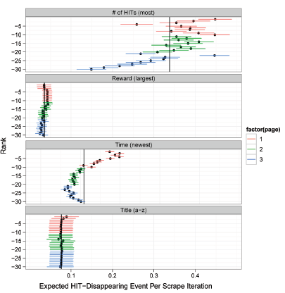
Results
Used HIT-specific random effect
measures pure positional fixed effects
4 sort categories:
Most HITs Available
Highest Reward
Newest Posted
Title (A-Z)
Workers are sorting by
Most HITs Available
Newest

Slide 16
B: Worker Survey

Slide 17
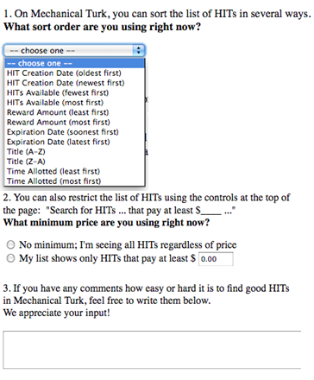
Procedure
~250 respondents
The task is a survey asking:
Which of the 12 sort categories they are presently using.
What page number of the results they found this HIT on.

Slide 18
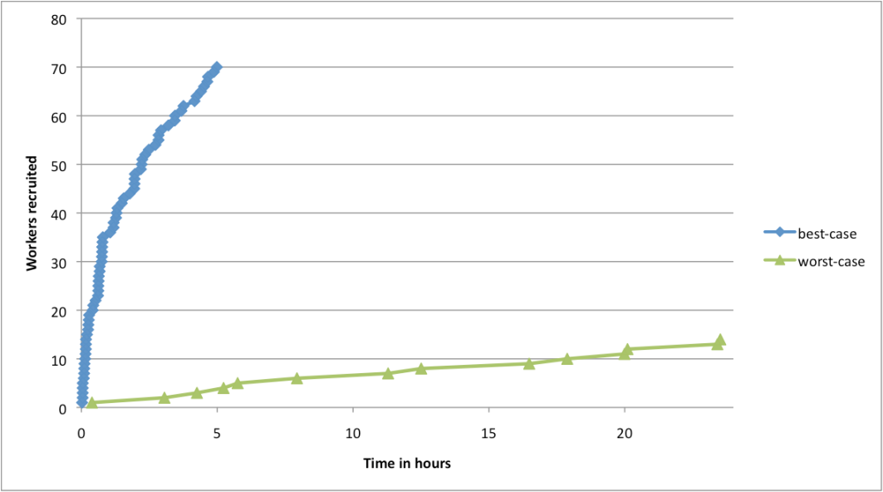
Results from Two Survey Postings
Best-case posting (easy to find, will show up on first page of):
Least HITs available
Newest
Least reward ($0.01)
Title (A-Z)
Worst-case posting (hard to find, will show up ~50 pages deep of:):
Least/Most HITs available (2 HITs)
Newest
Highest/Lowest Reward: ($0.05)
Title (A-Z)
Tasks get done faster in best-case posting.
(Roughly 30 times faster than worst-case)

Slide 19
Self-Reported Search Methods: Sort Category
HIT-Posting Method
HITs posted by Best-case method:
found mostly by newest (which accounts for them being taken so quickly.)
HITs posted by Worst- case method:
found by a variety of sort categories.
Sort Category

Slide 20
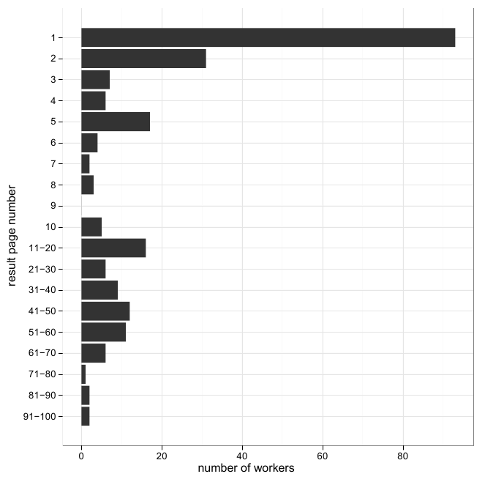
Self-Reported Search Methods: Page Number HIT is Found on
Position on page workers report finding the task.
(Mostly the first page, but with a considerable long tail)

Slide 21
Labor Supply
“The Labor Economics of Paid Crowdsourcing”
(joint w/ Lydia Chilton)
ACM-EC 2010

Slide 22
A Simple Rational Model of Crowdsourcing Labor Supply
We want a model that will predict a worker’s output
y = output
y* = the last unit of output from the worker
P(y) = payment as a function of output
p(y) = P’(y). In the case that P(y) = wage_rate*y, p(y) = wage_rate.
A rational user will supply output, y, to maximize Payment – Cost
Workers will rationally set y* (the last unit of work) where p(y*) = c(y*)
If p(y*) = ωt then a worker’s reservation wage is
We can experimentally determine p(y*) on AMT by offering users a task where they are offered less and less money to do small amounts of work until they elect not to work anymore. That payment is p(y*)
Notes:
I’m not 100% clear on what the deal is with marginal costs, so I sort of skipped that step. I’m not sure it’s super important.

Slide 23
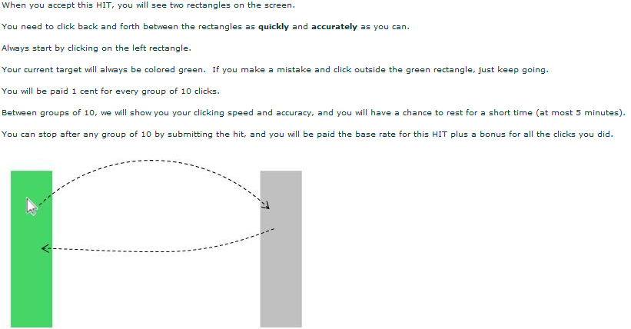
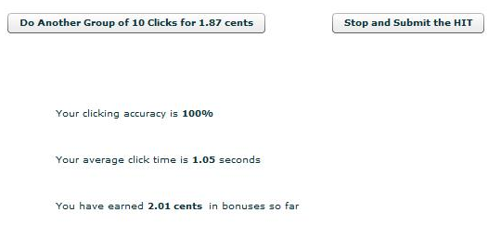
Measuring Reservation Wage
Instructions before starting
Message between
sets of 10 clicks
Notes:
(It would be really awesome to do a demo of the task. CS people like demos.)

Slide 24
Payment
In order to find reservation wage, the price for each set of 10 clicks decreased such that the wages approach P bar asymptotically:
Example:
Fractional payment problem: pay probabilistically
# Click groups (y) | Payment | Wages
1 | $0.07 | $0.0625
5 | $0.29 | $0.474
25 | $0.82 | $0.0118
Notes:
Any idea how to make P bar in ppt?

Slide 25
Two Experiments to test invariance of reservation wage
Δ Difficulty
Is time per click, total output and reservation wage affected by the distance between the targets. (300px apart and 600px apart)
Δ Price
s time per click, total output and reservation wage affected by offering different baseline price? (P bar)

Slide 26
Δ Difficulty Results
 | Easy (300 pixels) | Hard (600 pixels)
Average per block completion time | 6.05 sec | 10.93 sec
Average # of blocks completed | 19.83 blocks | 20.08 blocks
Log(average # of blocks completed) | 2.43 | 2.298
Log(reservation wage) | 0.41 | -0.12
92 participants
42 randomly assigned to “Easy”
72 self-reported females

Slide 27
Δ Difficulty Discussion
Harder task more time consuming, but no effect on output
Differences in imputed reservation wage
$.89/hour
$1.50/hour

Slide 28
Δ Price Results
 | Low (→10 cents) | High (→30 cents)
Average # of blocks completed | 19.83 blocks | 24.07 blocks
Log(average # of blocks completed) | 2.41 | 2.71
Log(reservation wage) | -0.345 | 0.45
Probability of completing fewer than 10 blocks | .45 | 0.273
198 participants
42 randomly assigned to “Easy”
72 self-reported females
Notes:
(I’m not sure how to express the different price structures here concisely)

Slide 29
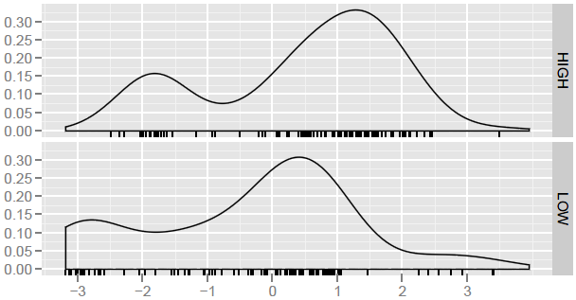
Δ Price Discussion
Lower price lowers output
But, difference in reservation wages:
$.71/hour LOW
$1.56/hour HIGH
Where does the model fail?:
Several possibilities
Some evidence for target earning
density
log(reservation wage)
Note implausibly low reservation wages
~4 cents/hour
Notes:
(We blocks completed graph is inten)

Slide 30
Evidence for Target Earning
Preference for
Y mod 5 = 0?
Try to earn as much as possible

Slide 31
Expectations and Output
“Employer Expectations, Peer Effects and Productivity: Evidence from a Series of Experiments” (working paper)

Slide 32
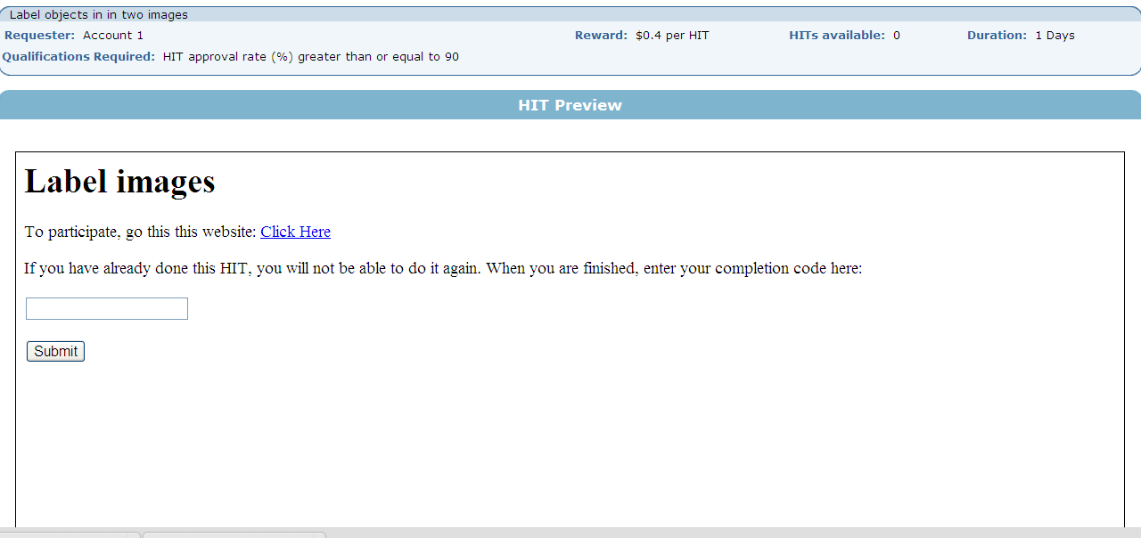
Job posting on MTurk

Slide 33
The Task: Image labeling
Hard problem
Realistic that we are asking Turkers
Graphical so easy to:
Convey expectations
Expose workers to the output of other workers

Slide 34
Experiment A
Do workers find the labeling costly?
Can employer-provided work samples shown influence labor supply?

Slide 35
Experiment A
Workers arrive
HIGH
Observe work sample with many labels
Label new image
Recruitment
Exposure to Employer Work Sample
Output
Label new image
LOW
Observe work sample
with few labels

Slide 36
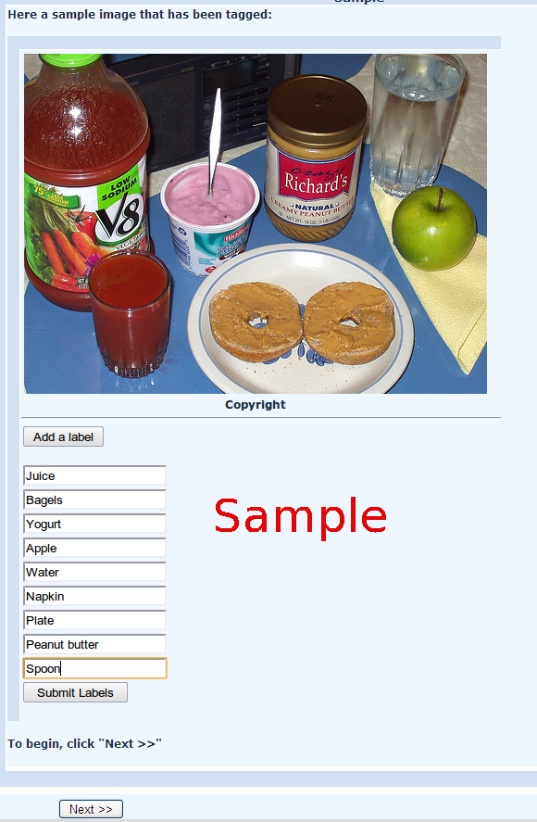
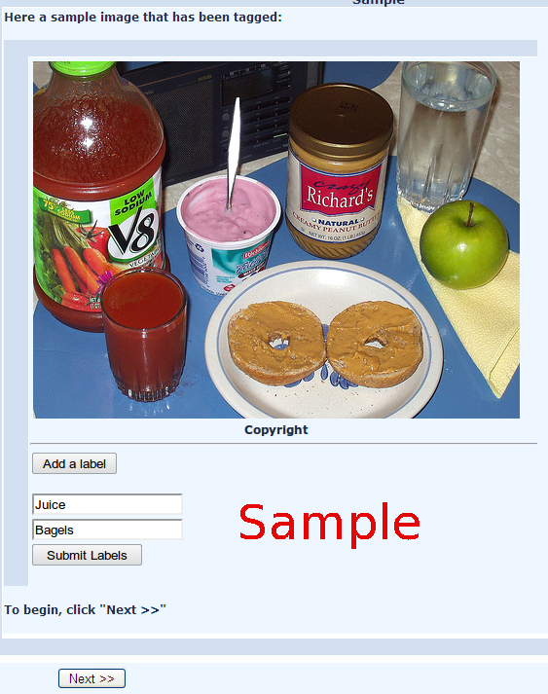
HIGH and LOW Group work samples

Slide 37
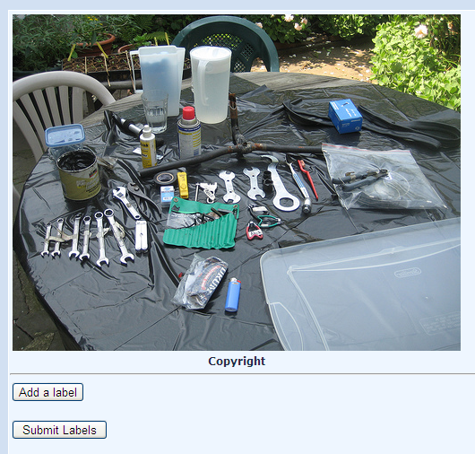
All workers label same image after exposure to work sample

Slide 38
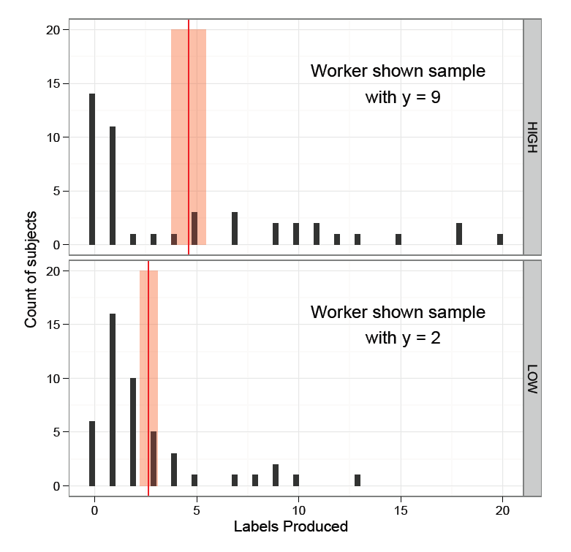
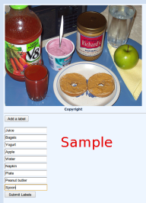
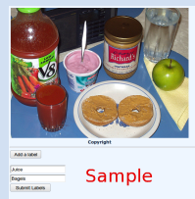
Greater output on intensive margin in HIGH
But lower on extensive margin

Slide 39
Experiment B
Will workers punish peers producing low output work?
“Output” defined as number of labels produced
What does punishment (if it exists) look like?

Slide 40
Experiment B
Workers arrive and observe same sample
Recruitment
Label an image
Observe and evaluate peer
Label an image
Evaluate worker producing many labels
GOOD
Evaluate worker producing few labels
BAD

Slide 41
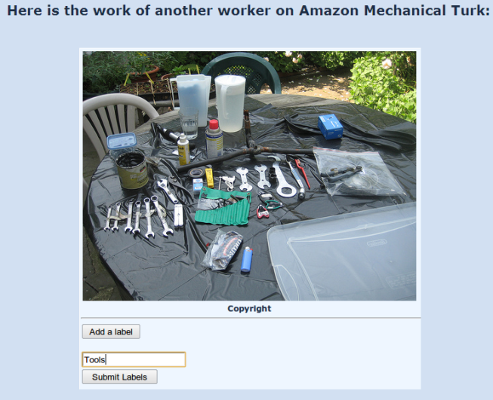
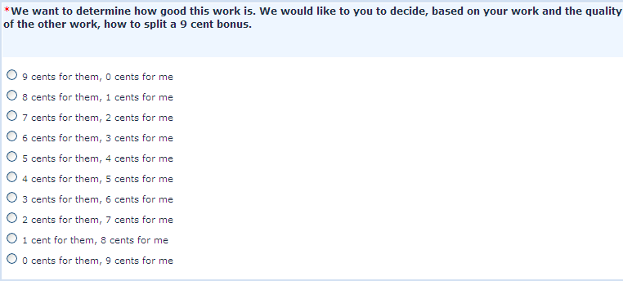
Inspects work from Peer
Then the split of a 9 cent bonus:
Then recommends approve/reject:

Slide 42
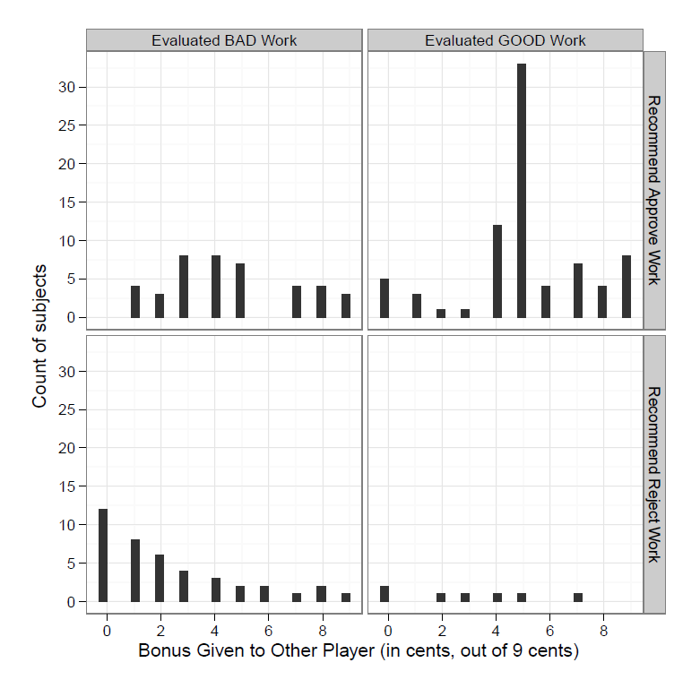
~ 50-50 split for GOOD work
(4 & 5 cents)
Very few rejections of good work
Not Shown:
Productive workers punish more

Slide 43
Experiment C
Is the relationship between productivity and punishment causal?
Are high-productivity “types” are just more prone to punishment?
Idea: try to induce changes in productivity w/o changing labor supply on the extensive margin, then follow-up with another labeling task

Slide 44
Experiment C
Workers arrive and observe same sample
Recruitment
Beliefs about employer expectations updated
Observe and evaluate peer
(same image)
Label an image; “NONE” (no notice)
Label an image; “CURB” notice after y =2
Evaluate low-output image
Evaluate low-output image

Slide 45
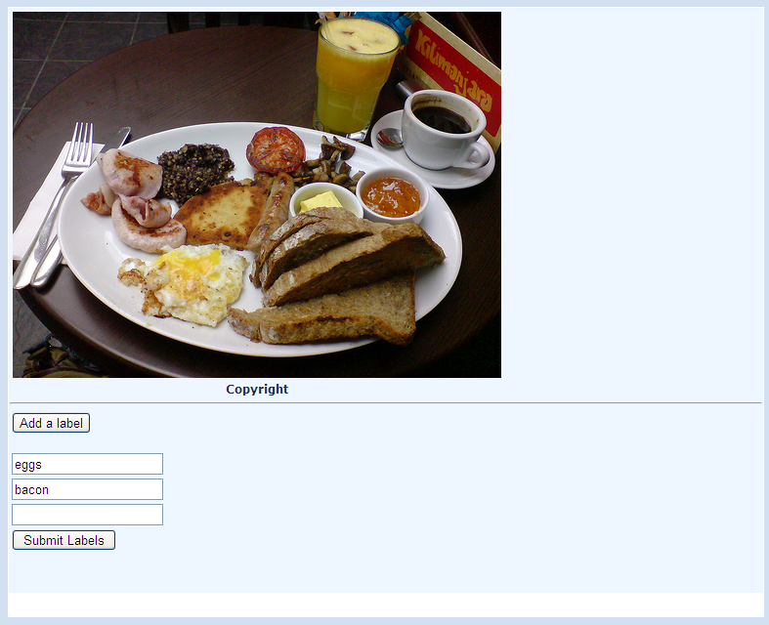
1. Worker starts labeling image
2. In NONE, no change in interface after 2nd label
3. In CURB,
notice after 2nd label
GOAL: Variation in on the intensive margin without inducing selection on the extensive margin

Slide 46
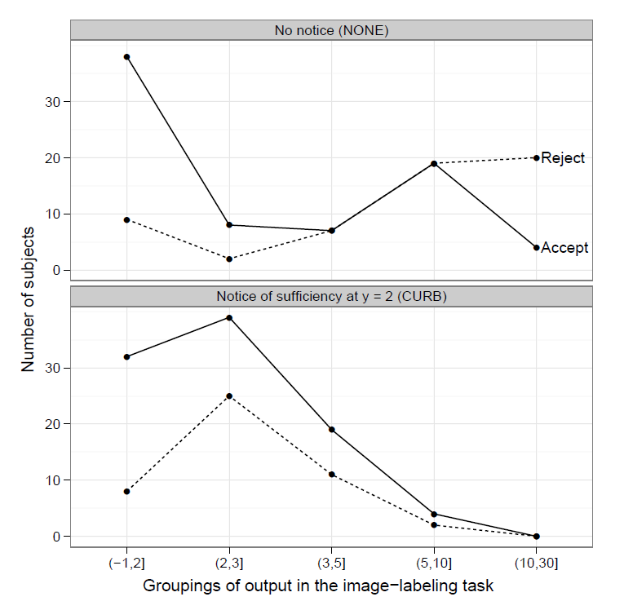

Slide 47
Experiment D
Does exposure to work of peers affect productivity in follow-on image labeling tasks?
Experiment D is just Experiment B (evaluation of good/bad work) plus a follow-on image labeling task

Slide 48
Experiment D
Workers arrive and observe same sample
Recruitment
Label an image
Observe and evaluate peer
Label an image
Evaluate worker producing many labels
GOOD
Evaluate worker producing few labels
BAD
Label an image
Label an image
Label another image

Slide 49
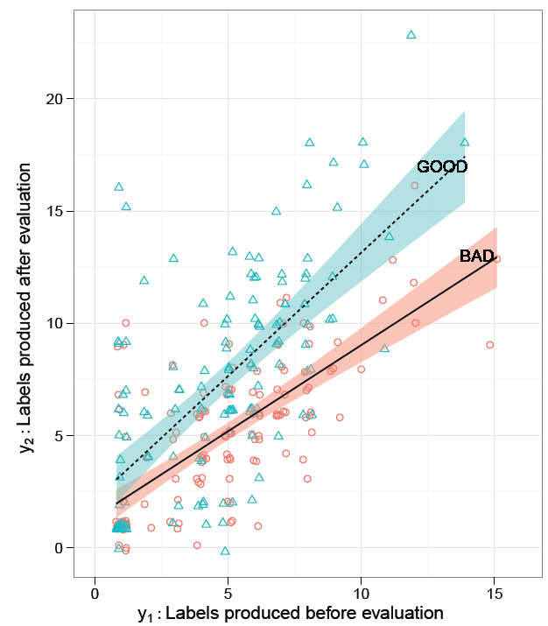
Lowest performers seem impervious

Slide 50
Online Labor Markets
“Online Labor Markets”
To appear as a short paper in: Workshop on Internet and Network Economics (WINE) 2010

Slide 51
Online Labor Markets: A Surprisingly Early Dispute
In late 1990s / early 2000s debate among economists about potential of OLMs
Malone “Dawn of the E-lance economy” with small teams of freelancers
Autor thought “E-lance” labor market unlikely due to informational problems (adverse selection and moral hazard)
“online dating sites are great, but people still need to talk before getting married”
What seems to be happening: they were both right
Online work sites are flourishing, but they do so by focusing on providing “high bandwidth” information
Even so, problems remain---see Panos Ipeirotis’ “Plea” to Amazon to fix Mturk
Open questions:
What are the incentives of platform creators?
What do they control & how do they control it?
What do we need from platforms in the future (Rob Miller @MIT is organizing a workshop at CHI partly about this)

Slide 52
How should we think about OLMs?
Supply
Ad Valorem Charge
More elastic
Labor price w/o OLM
Demand
Hours of intermediation “bought”
Note: Ad Valorem charges of ~10% imply very high elasticities, suggesting a competitive
Market in intermediation

Slide 53
Online Work as a Tool for Economic Development

Slide 54
Facts about labor markets
Throughout history, labor markets have been segmented by:
Geography (workers need to live “close” to work)
National borders (people are hostile to immigration)
Enormous cross-national differences in real wages
Most consequential violation of the law of one price
Remittances (earnings by workers abroad sent home) are three times greater than all foreign aid

Slide 55
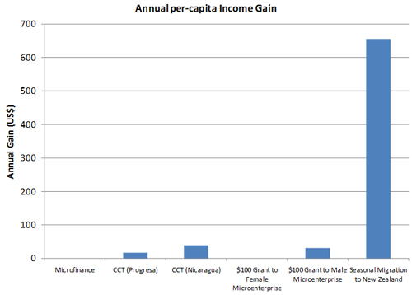
What interventions work?
From “The development impact of a best practice seasonal worker policy” by
John Gibson and David McKenzie. World Bank Policy Research Proposal (2010)

Slide 56
Online Work:
Can be done anywhere
Can be designed for people with low skills
Payments go directly to individuals
Low risk (compared to, e.g., agriculture)
Gives people the right incentives to invest in education and skills
Oster and Millet (2010) found that opening of a call center in India increased female school enrollment in surrounding villages

Slide 57
Charities are moving into this space…

Slide 58
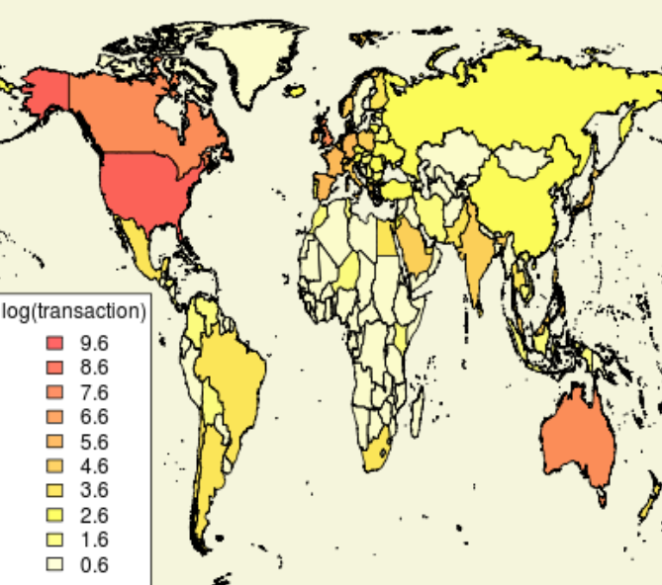
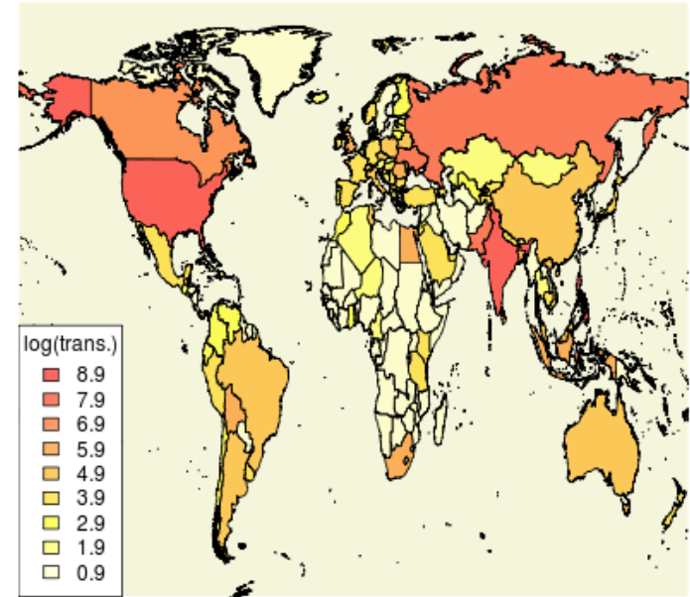
But I’m not sure this is necessary: The case of
Buyers
Workers
$
Labor

Slide 59
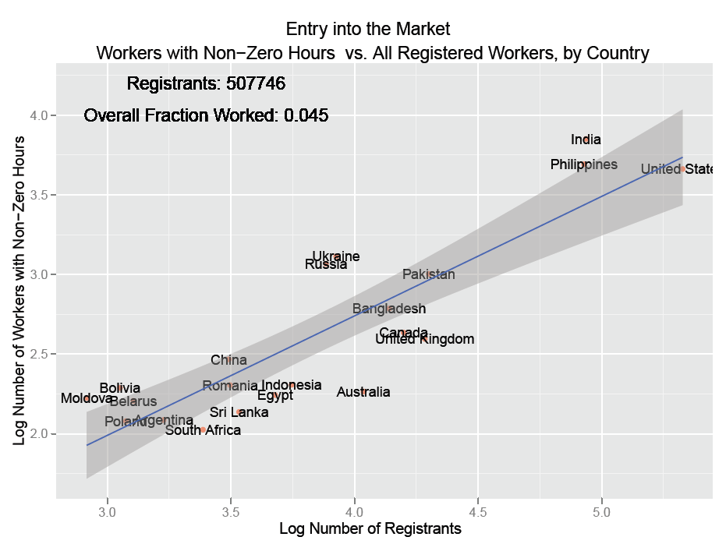

Slide 60
What can computer scientists & economists do?
Increase demand for online work
Create work amenable to remote completion
Think Games-With-A-Purpose, but for work
Work with lowest skill requirements = best distributional properties
Find ways to make human-in-the-loop systems more valuable: increasing quality, reliability etc.
Think about tasks where remoteness is a virtue
E.g., monitoring security cameras (physical presence permits shirking)
Start with reasonable assumptions about what technology might look like in 10, 15 or 20 years

Slide 61
Right now, most online work is programming, data entry, design, clerical, SEO etc.
Why not pay people to do this?

Slide 62
Example: Monitoring security cameras
Low-literacy requirement
Huge potential demand
millions of IP enabled cameras
It seems in principle possible to algorithmically ensure quality work

Slide 63
Questions and Comments
“An Economic View of Crowdsourcing and Online Labor Markets” By: John Horton Presented at: Computational Social Science and the Wisdom of Crowds, NIPS 2010

