Slide 1

Let the Market Drive Deployment
A Strategy for Transitioning to BGP Security
SIGCOMM 2011
Toronto, ON
Aug. 16, 2011
Phillipa Gill
University of Toronto
Michael Schapira
Princeton University
Sharon Goldberg
Boston University
Notes:
Load = 20 msges per second.

Slide 2
Incentives for BGP Security
Insecurity of Internet routing is well known:
S-BGP proposed in 1997 to address many issues
Challenges are being surmounted:
  Political: Rollout of RPKI as a cryptographic root trust
  Technical: Lots of activity in the IETF SIDR working group
The pessimistic view:
This is economically infeasible!
Why should ISPs bother deploying S*BGP?
No security benefits until many other ASes deploy!
Worse yet, they can’t make money from it!
Our view:
Calm down. Things aren’t so bad.
ISPs can use S*BGP to make money
…by attracting traffic to their network.

Slide 3

Outline
Part 1: Background
Part 2: Our strategy
Part 3: Evaluating our strategy
  Model
  Simulations
Part 4: Summary and recommendations

Slide 4
Traffic Attraction & Interception Attacks
  April 2010 : China Telecom intercepts traffic
ChinaTel path is shorter
?
ChinaTel 66.174.161.0/24
Level3, VZW, 22394 66.174.161.0/24
ISP 1
VZW, 22394 66.174.161.0/24
Level 3
China
Telecom
Verizon
Wireless
22394 66.174.161.0/24
22394
  This prefix and 50K others were announced by China Telecom
  Traffic for some prefixes was possibly intercepted
66.174.161.0/24

Slide 5
Securing the Internet: RPKI
  Resource Public Key Infrastructure (RPKI): Certified mapping from ASes to public keys and IP prefixes.
X
RPKI: Invalid!
?
ChinaTel 66.174.161.0/24
Level3, VZW, 22394 66.174.161.0/24
ISP 1
Level 3
China
Telecom
Verizon
Wireless
22394
  RPKI shows China Telecom is not a valid origin for this prefix.

Slide 6
But RPKI alone is not enough!
  Resource Public Key Infrastructure (RPKI): Certified mapping from ASes to public keys and IP prefixes.
?
ChinaTel, 22394 66.174.161.0/24
Level3, VZW, 22394 66.174.161.0/24
ISP 1
Level 3
China
Telecom
Verizon
Wireless
22394
  Malicious router can pretend to connect to the valid origin.

Slide 7
To stop this attack, we need S*BGP (e.g. S-BGP/soBGP) (1)
  S-BGP [1997]: RPKI + Cannot announce a path that was not announced to you.
VZW: (22394, Prefix)
Level3: (VZW, 22394, Prefix)
ISP 1: (Level3, VZW, 22394, Prefix)
ISP 1
Level 3
China
Telecom
Verizon
Wireless
VZW: (22394, Prefix)
Level3: (VZW, 22394, Prefix)
22394
VZW: (22394, Prefix)
Public Key Signature: Anyone with 22394’s public key can validate that the message was sent by 22394.

Slide 8
To stop this attack, we need S*BGP (e.g. S-BGP/soBGP) (2)
  S-BGP [1997]: RPKI + Cannot announce a path that was not announced to you.
VZW: (22394, Prefix)
Level3: (VZW, 22394, Prefix)
ISP 1: (Level3, VZW, 22394, Prefix)
ISP 1
Level 3
China
Telecom
Verizon
Wireless
22394
  Malicious router can’t announce a direct path to 22394, since 22394 never said
ChinaTel: (22394, Prefix)

Slide 9
Overview
S*BGP will necessarily go through a transition phase
How should deployment occur?
Our Goal: Come up with a strategy for S*BGP (S-BGP/soBGP) deployment.
How governments & standards groups invest resources
… to create market pressure for S*BGP deployment
We evaluate guidelines via a model & simulations
Model: ISPs care only about revenue, not security!
And run simulations on [UCLA Cyclops+IXP] AS graph data
Parallelize simulations on a 200-node DryadLINQ cluster

Slide 10
Outline
Part 1: Background
Part 2: Our strategy
Part 3: Evaluating our strategy
  Model
  Simulations
Part 4: Summary and recommendations

Slide 11
How to deploy S*BGP globally?
Pessimistic view:
No local economic incentives; only security incentives
Like IPv6, but worse, because entire path must be secure
Our view:
S*BGP has an advantage: it affects route selection
Route selection controls traffic flows
And an ISP that attracts more customer traffic earns more revenue.
Why should I upgrade if (security) benefits don’t kick in unless everyone else does?
8359

Slide 12
Stubs vs ISPs: Stubs are 85% of the Internet’s ASes!
  A stub is an AS with no customers.
  Stubs shouldn’t transit traffic. They only originate their own prefixes.
  ISP
  ISP
  ISP
Sprint
8359
13789
$
$
  Stub
X
18608
Loses $$!
  85% of ASes are stubs! We call the rest (15%) ISPs.

Slide 13
How can we create market pressure?
  Assume that secure ASes break ties on secure paths!
8359, 18608
38.101.185.0/24
13789, 18608
38.101.185.0/24
  ISP
  ISP
  ISP
Sprint
8359
13789
  AS 8359 attracts customer traffic
$
$
  Stub
18608
38.101.185.0/24
18608
18608
38.101.185.0/24
ISPs can use S*BGP to attract customer traffic & thus money

Slide 14
How can we create market pressure?
  Assume that secure ASes break ties on secure paths!
8359, 18608
38.101.185.0/24
13789: (18608, 38.101.185.0/24)
Sprint: (13789, 18608, 38.101.185.0/24)
Sprint
8359
13789
  AS 8359 loses traffic, feels pressure to deploy.
$
$
13789: (18608, 38.101.185.0/24)
18608
18608
38.101.185.0/24

Slide 15
Our Strategy: 3 Guidelines for Deploying S*BGP (1)
Secure ASes should break ties in favor of secure paths
ISPs “help” their stub customers deploy simplex S*BGP.
Bank of A
Bank of A
ISP1
A stub is an AS that does not transit traffic.
85% of ASes are stubs!
Boston U
Boston U

Slide 16
Simplex S*BGP: `Cheap’ S*BGP for Stubs
A stub never transits traffic
Only announces its own prefixes..
…and receives paths from provider
Sign but don’t verify!
(rely on provider to validate)
2 options for deploying S*BGP in stubs:
Have providers sign for stub customers. (Stubs do nothing)
Stubs run simplex S*BGP. (Stub only signs, provider validates)
  No hardware upgrade required
    Sign for ~1 prefix, not ~300K prefixes
    Use ~1 private key, not ~36K public keys
  Security impact is minor (we evaluated this):
    Stub vulnerable to attacks by its direct provider.
18608
38.101.185.0/24
  Stub
18608

Slide 17
Our Strategy: 3 Guidelines for Deploying S*BGP (2)
Secure ASes should break ties in favor of secure paths
ISPs “help” their stub customers deploy simplex S*BGP.
(possibly with some government subsidies)
3. Initially, a few early adopters deploy S*BGP (gov’t incentives, regulations, altruism, etc).
Bank of A
ISP1
Boston U

Slide 18
Outline
Part 1: Background
Part 2: Our strategy
Part 3: Evaluating our strategy
  Model
  Simulations
Part 4: Summary and recommendations

Slide 19
A model of the S*BGP deployment process
To start the process:
  Early adopter ASes have deployed S*BGP
  Their stub customers deploy simplex S*BGP
Each round:
  Compute utility for every insecure ISP
  If its ’ ‘s utility can increase by more than θ%
  when it deploys S*BGP,
  Then SP n decides to secure itself & all its stub customers
Stop when no new ISPs decide to become secure.
ISP n
ISP n
ISP n

Slide 20
How do we compute utility?
traffic
    Number of source ASes
routing through ISP n
to all customer destinations.
$
$
ISP n
ISP n
$
Important Note: ISP utility does not depend on security.
BGP Routing Policy Model:
1. Prefer customer paths
over peer paths
over provider paths
2. Prefer shorter paths
3. If secure, prefer secure paths
.
4. Arbitrary tiebreak
To determine routing,
we run simulations on the
[UCLA Cyclops] AS graph
with these routing policies:

Slide 21
Outline
Part 1: Background
Part 2: Our strategy
Part 3: Evaluating our strategy
  Model
  Simulations
Part 4: Summary and recommendations

Slide 22
Case Study of S*BGP deployment
Ten early adopters:
Five Tier 1s:
  Sprint (AS 1239)
  Verizon (AS 701)
  AT&T (AS 7018)
  Level 3 (AS 3356)
  Cogent (AS 174)
The five content providers source 10% of Internet traffic
Stubs break ties in favor of secure paths
Threshold θ = 5%.
Five Popular Content Providers
  Google (AS 15169)
  Microsoft (AS 8075)
  Facebook (AS 32934)
  Akamai (AS 22822)
  Limelight (AS 20940)
This leads to 85% of ASes deploying S*BGP
(65% of ISPs)

Slide 23
Simulation: Market pressure drives deployment (1)
Round 1
Round 0
Sprint
Round 4
13789
13789
8359
8359
18608
18608
  Stub

Slide 24
Simulation: Market pressure drives deployment (2)
Round 5
Sprint
Round 4
13789
8359
8342
18608
6731
6731
30733
  Stub
50197
50197
  Stub

Slide 25
Simulation: Market pressure drives deployment (3)
Round 6
Sprint
Round 7
8342
13789
8359
8342
9002
18608
6731
6731
30733
  Stub
50197
43975
41209
50197
41209
  Stub
  Stub
39575
39575

Slide 26
So who should be the early adopters?
Theorem: Finding the optimal set of early adopters is NP-hard. Approximating this within a constant factor is also NP-hard.

Slide 27
So who should be the early adopters?
Small target set suffices for small threshold
Higher threshold
requires a larger target set.
Easy to deploy
Hard to deploy

Slide 28
Outline
Part 1: Background
Part 2: Our strategy
Part 3: Evaluating our strategy
  Model
  Simulations
Part 4: Summary and recommendations

Slide 29
Summary and Recommendations
  How to create a market for S*BGP deployment?
  Many secure destinations via simplex S*BGP.
  Market pressure via S*BGP influence on route selection.
  Where should government incentives and regulation go?
  Focus on early adopters; Tier 1s, maybe content providers
  Subsidize ISPs to upgrade stubs to simplex S*BGP
  Other challenges and future work :
  ISPs can have incentives to turn off S*BGP
  BGP and S*BGP will coexist in the long run
  ISPs need tools to predict S*BGP impact on traffic

Slide 30
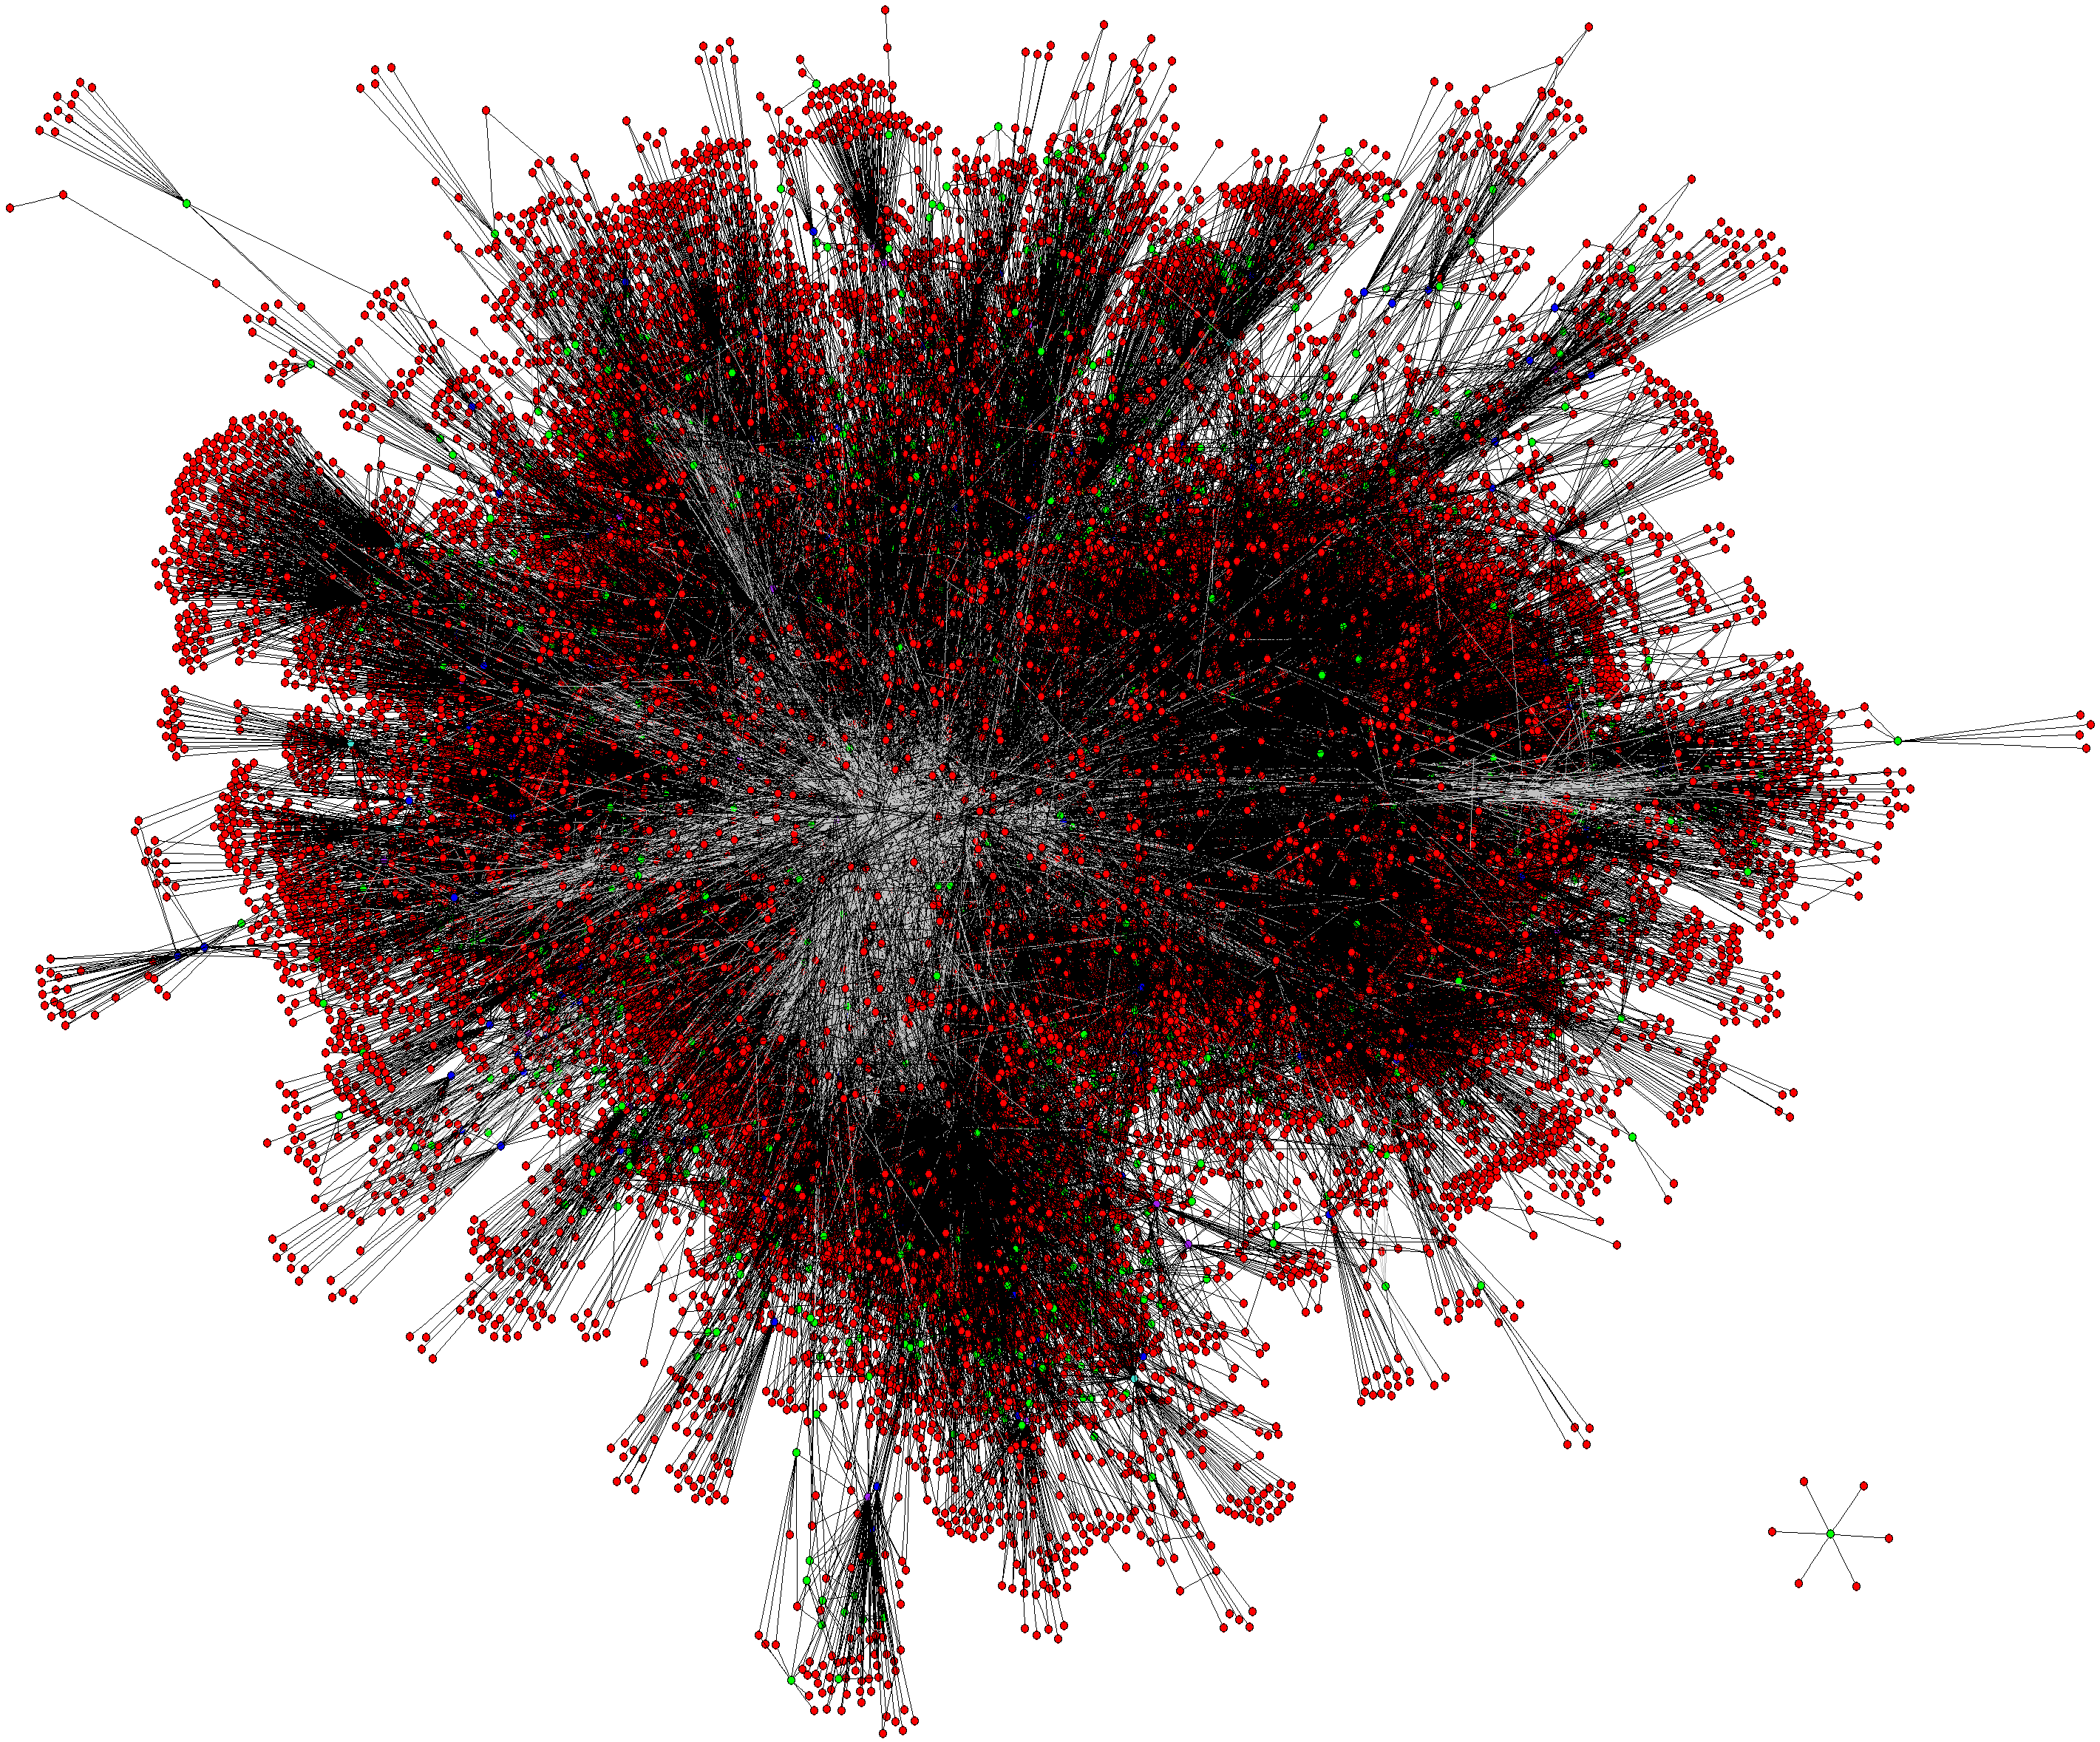
  Contact: phillipa@cs.toronto.edu
  http://www.cs.toronto.edu/~phillipa/sbgpTrans.html
  Thanks to Microsoft Research SVC and New England for supporting us with DryadLINQ.

Slide 31
Data Sources for ChinaTel Incident of April 2010
Example topology derived from Routeviews messages observed at the LINX Routeviews monitor on April 8 2010
  BGP announcements & topology was simplified to remove prepending
  We anonymized the large ISP in the Figure.
  Actual announcements at the large ISP were:
  From faulty ChinaTel router: “4134 23724 23724 for 66.174.161.0/24”
  From Level 3: “3356 6167 22394 22394 for 66.174.161.0/24”
Traffic interception was observed by Renesys blog
  http://www.renesys.com/blog/2010/11/chinas-18-minute-mystery.shtml
  We don’t have data on the exact prefixes for which this happened.
AS relationships: inferred by UCLA Cyclops

