Slide 1
CS590B/690B Detecting Network Interference (Spring 2018)
Lecture 18
Decoy Routing Part I
Phillipa Gill – Umass -- Amherst

Slide 2
Where we are
Last time:
Parrot is dead + Cover Your Acks
Today
Decoy routing overview
Telex
Tap Dance (video)
Recommended viewing: https://2459d6dc103cb5933875-c0245c5c937c5dedcca3f1764ecc9b2f.ssl.cf2.rackcdn.com/sec14/wustrow.mp4

Slide 3
Review questions
Why is imitating an existing protocol challenging?
How are some ways that SkypeMorph fails to evade detection?
What about Stegotorus?
What is key difference between Freewave and SkypeMorph?
How does Freewave try to evade detection?
Why does it fail?
What are the three types of mismatch that can cause mimicking to fail? Give examples

Slide 4
Today: decoy routing
Bake circumvention into network routing.
Four key papers:
Decoy Routing (FOCI 2011)
Cirripede (CCS 2011)
Telex (Usenix Security 2011)
Tap Dance (Usenix Security 2014)
Follow ons: (next class)
Routing Around Decoys (CCS2012)
No Way Home (NDSS 2014)

Slide 5
Challenge of cat and mouse
Circumvention schemes we’ve discussed so far require end-host participation + a proxy or relay server
Constant race between detecting circumvention and coming up with new ways to hide.
Censor blocks proxy IP
Circumvention tool tries to hide proxy IP
Put proxy in a dark net (unused IP address space)
Hard for censor to find, also hard for clients ☹
Circumventor hides services in more diverse/dynamic IP addresses
E.g., resource constrained home users
Basic idea: get circumvention on as many IPs as possible
→ blocking all IPs is not feasible.
But can they really get enough IPs to run the circumvention?...

Slide 6
What if hosts “look like” proxies?
Idea behind decoy routing: Make any/every host on the Internet look like a latent proxy server
Every destination IP acts like a proxy server
Goals: access to blacklisted sites with near normal latency and throughput
Preserve secrecy of contents + true destination
Threat model: Assume basic IP-filtering firewall.
Assume circumvention tool, methods, and algorithms are publicly known.
Key idea: It is hard to filter traffic based on an intermediate router
Packet contains destination IP, not intermediate hops on the path
A network has little control over the upstream paths taken by their packets
Filtering 1 router can have large collateral damage (if it transits traffic for a lot of prefixes)

Slide 7
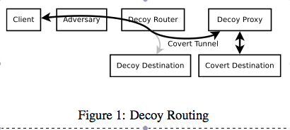
How it works
Decoy router can sit on any network path and act as a proxy (or forward client traffic to a decoy proxy).
But how can the client connect to the proxy?
Why can it not just address a packet to the proxy destination?
Solution: Connect to a decoy destination
Once connected covertly signal over TCP/IP flow that the decoy router should forward the packet to the proxy
Proxy then intercepts the TCP connection (drop connection to decoy destination) and act as a regular proxy.

Slide 8
How it circumvents
Makes IP filtering ineffective because the destination IP is meaningless
IP on the path is tunneling traffic elsewhere.
Nearly any IP address (depending on decoy router location) can be a decoy destination
Components of decoy routing:
Client software, decoy router, decoy proxy + covert signalling mechanism
Decoy router must be able to maintain line rate communication while looking for covert signaling
Decoy proxy needs to be able to hijack TCP session to communicate with the client

Slide 9
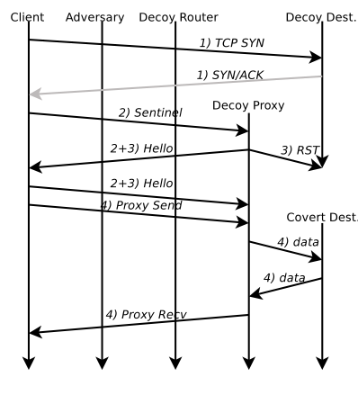
Timeline

Slide 10
Step 1: Connect to Decoy Destination
Client needs to find a path with a decoy router
Create TCP/IP connections to different destinations
Try inserting sentinels (covert requests) into the connection
E.g., put a special string in an HTTP cookie header
If a decoy proxy replies with a “hello” message the client knows there is a proxy on the path.

Slide 11
Step 2: Covertly requesting decoy routing
Example sentinels:
String generated by symmetric key (exchanged out of band)
Client tries a sequence of ports to signal the decoy routing
Series of payload lengths
… anything easily detectable by an IDS
Decoy routing paper:
Uses sentinel generated based on time and a secret key shared between the client and the proxy
Client includes this in the random number field in the Client TLS Hello message
Router forwards messages with sentinel to the proxy
Proxy allows client to finish TLS exchange with the decoy destination (so all clear text communication looks normal)
Proxy then sends “hello” in the TLS connection
TLS traffic should be shaped to match underlying destination

Slide 12
Step 3: Hijacking a tcp flow
Proxy sends a RST to the destination with the sequence number on the packet that the client uses to signal the proxying
It can match the header values
So the destination won’t try to send any RSTS or consider it out of order
Challenge: No assumption that path is symmetric
Proxy/decoy router can see traffic from client, but not necessarily from the server
Needs to glean server TCP options from the headers
Client can convey these values to the proxy via the covert channel (since the client does have communication with the server)

Slide 13
Step 4: Provide proxy services
Many standard proxy protocols
E.g., SOCKS proxy forwarded to a standard SOCKS server by the decoy proxy.

Slide 14
Vulnerabilities
Detection: censor can cut off Internet access to clients caught using decoy routing
Detection channels: MTU, IP TTL value, RTT
Decoy proxy can adjust these values to match and reduce risk
Censor can replay the TLS hello message and look for a response that looks like it is from a decoy proxy
Make sentinels such that they cannot be reused
Record a response from the decoy destination and forward that along to any repeated sentinels
Censor could hold TLS hellos and forward them to the correct destination and only forward that reply back to the client
Adversary could ID clients using the system
Clients can access decoy destinations but not the proxy service
Also DoS if the censor gets access to the user software and opens many connections

