Slide 1
CS590B/690B
Detecting network interference
(Spring 2018)
Lecture 11

Slide 2
Where we are
Social nets for flu tracking:
https://www.washingtonpost.com/news/to-your-health/wp/2014/03/19/a-better-flu-tracker-using-twitter-not-google/?utm_term=.60820416353b
Last time:
Case studies: China + Iran
Midterm
A2 was due last night
A3 due Friday (trace analysis with Wireshark + Q&A)
Questions?

Slide 3
Test your knowledge
What was the goal of the PAM 2011 paper?
What was a necessary first step that paper had to take?
How did they go about this?
Where did they find censors located?
Why would censors be distributed across the provinces?
Describe the Great Cannon and how it operates

Slide 4
Test your knowledge
What were the Green Dam and Blue Dam projects?
How did Concept Doppler test for blocking by the GFW?
How did Concept Doppler localize the Chinese censor?
How does LSA help Concept Doppler?
What are challenges/limitations of Concept Doppler?
What was the goal of the second reading?
What was a necessary first step that paper had to take?
How did they go about this?
Where did they find censors located?
Why would censors be distributed across the provinces?
Notes:
Host-based and ISP based censorshp projects
Issue queries with Falun until a RST was received
TTLs (with open TCP connection)
Helps them find keywords that are likely to be blocked for probing
Querying keywords takes too long; not exhaustive
Mapping where censorship happens in China
Map out chinese AS-topology
Get Ases from APNIC, prefixes from BGP, traceroute to these prefixes
In border ASes for CNC group but in the provinces for Ctelecom
Facilitate blocking intra-country traffic, avoid bottlenecks on international links

Slide 5
Today
Censorship + Social Media
Twitter spam for political censorship
  http://www.icir.org/vern/papers/kremlin-bots.leet11.pdf
  http://0b4af6cdc2f0c5998459-c0245c5c937c5dedcca3f1764ecc9b2f.r43.cf2.rackcdn.com/12385-foci13-verkamp.pdf
Censorship on Weibo
  http://xxx.tau.ac.il/pdf/1303.0597v1.pdf
  http://www.ccs.neu.edu/home/cbw/pdf/weibo-cosn13.pdf

Slide 6
OSN censorship
OSN = online social network
“Layer 8 censorship”
  Control the social network, perform in house filtering
    E.g., China: Weibo, Renren, etc.
  Get social network to cooperate with take down requests
    E.g., twitter
    https://rsf.org/en/news/dictators-can-thank-twitter-its-new-censorship-policy
  Social network itself can influence what is shown
    E.g., https://www.forbes.com/sites/kalevleetaru/2018/01/12/is-twitter-really-censoring-free-speech/#1e19e02165f5
    “Filter bubble”
  Spam + drown out conversation
    E.g., today’s reading
    Astroturfing

Slide 7
Aside: How to study take downs?
Groups working to track government take down requests
“Transparency reports” of companies
https://lumendatabase.org
Try to get content taken down + measure speed etc.
  We tried this … could not get content taken down :P

Slide 8
Related reading 1
Adapting Social Spam Infrastructure for Political Censorship.
Relevant concepts:
  Diluting hashtag content: injecting bogus messages containing the given hashtag to drown out legitimate messages
  Social network abuse detection: Many strategies for identifying sybil accounts in online social networks (e.g., social graph, distribution of posts, properties of the account).
    This paper relies on Twitter’s internal spam detector: based on frequent formation of relationships, posting duplicate content, posting to multiple hashtags, misleading content to trending topics.
  Spam-as-a-Service: marketplaces where parties can sell and trade resources (eg., e-mail addresses, fraudulent accounts, proxies, compromised hosts, etc.)

Slide 9
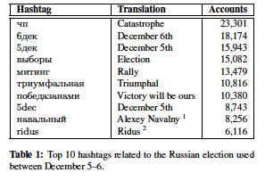
identifying automated accounts
Identify all accounts that post a tweet containing #триумфальная between Dec. 5-6, 2011
  This tag was previously reported to be a target of spam
To identify additional hashtags: Look at hashtags posted by this set of users during the Dec 5-6 time window with at least 1,500 participants.
  In total 20 hashtags posted by 46k accounts

Slide 10
Identifying automated accounts
Of the 46K accounts tweeting these 20 hashtags, 24K had been suspended by Twitter’s spam detection algorithm
1.6K additional accounts are included since they include similar looking e-mails and were created at the same time as many of the spam accounts
Analysis of the incident in three components:
  Tweets before/during the incident
  Account creation
  IP addresses used to access Twitter

Slide 11
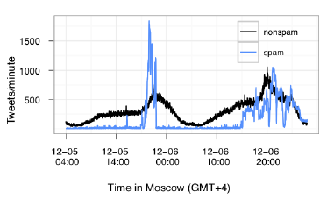
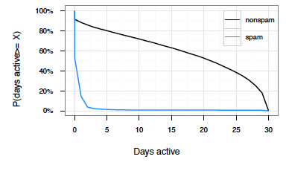
Tweets
440K tweets targeting the 20 hashtags
  Up to 1.8K tweets per minute
Spam accounts were active for many fewer days.
Sporadic periods of activity starting in May 2011.

Slide 12
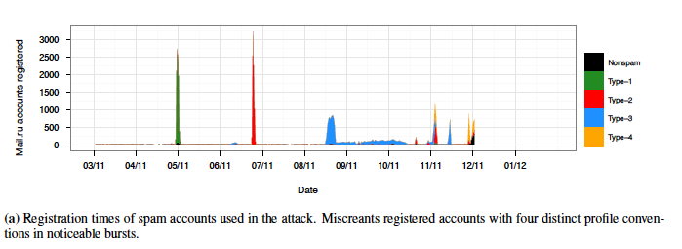
accounts
Bot accounts tended to have mail.ru e-mail addresses (99.5%)
Four “types” of account names used.
These heuristics/reg-exes allow them to identify nearly 1M more spam accounts 80% of which haven’t been identified by Twitter algorithm yet.

Slide 13
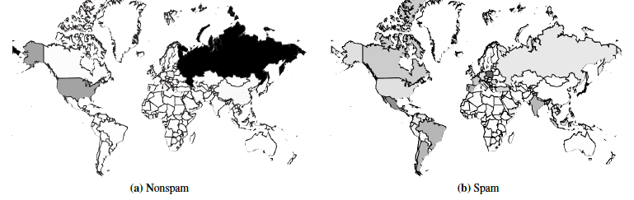
Ips registering accounts

Slide 14
impact
Relevant vs. realtime search results makes a difference
  Relevance based searches return 53% fewer spam tweets
  Taking 5 most recent relevant tweets results in 64% fewer spam tweets.
  Social graph + interests can help search mitigate message dilution attacks.

Slide 15
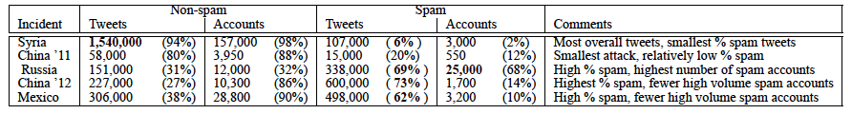
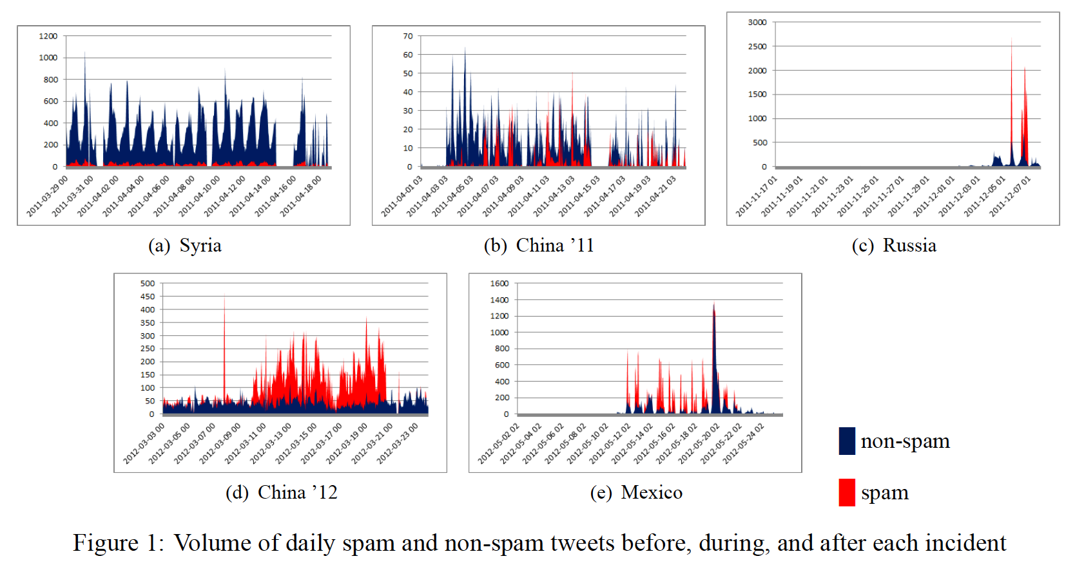
Other incidents
Five incidents, one theme.

Slide 16
Reading 2: Social media censorship in china
Western online social networks (OSNs) blocked
  …local alternatives provided
These local alternatives provide censors with a tighter rein on the content that is posted
  …since these products are in their jurisdiction

Slide 17
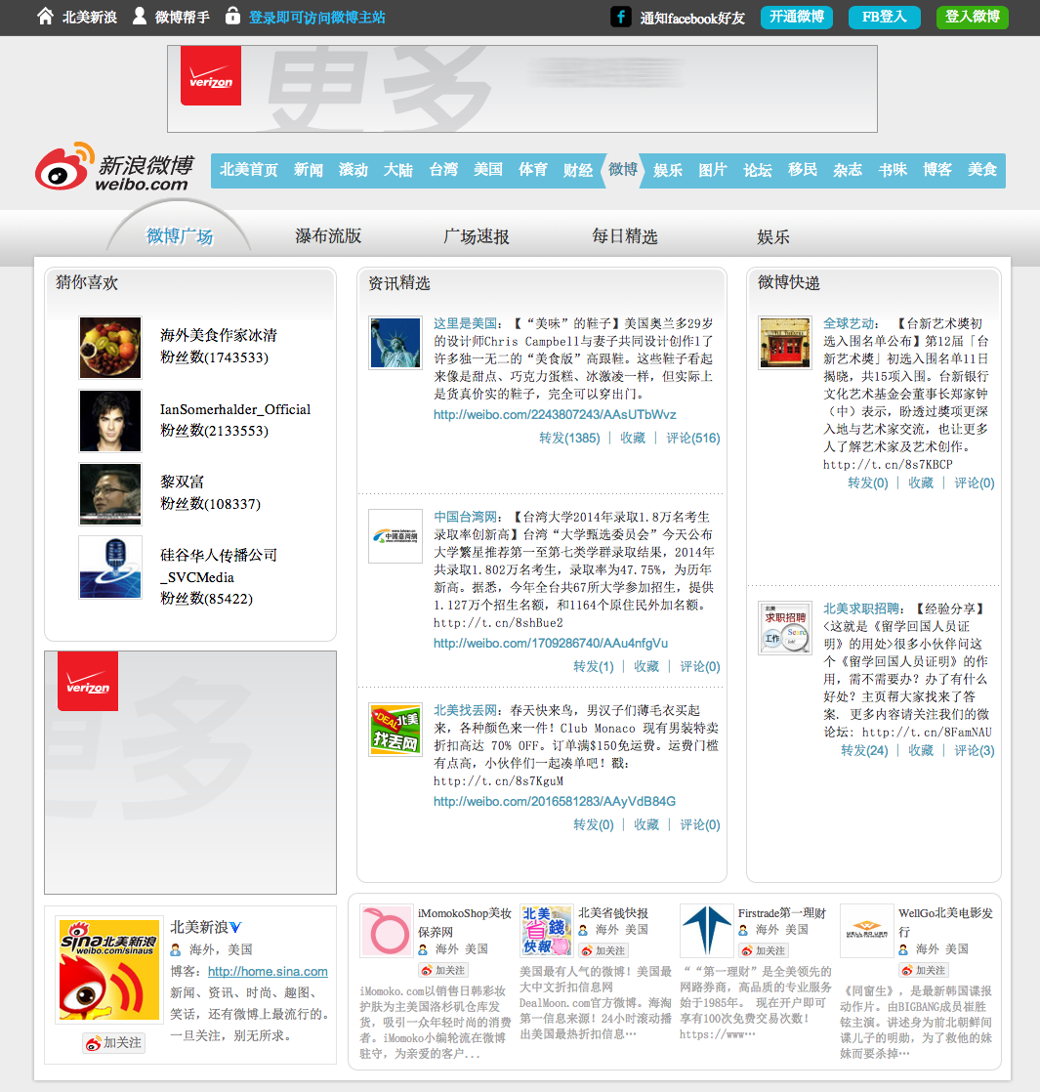
Social media in china

Slide 18
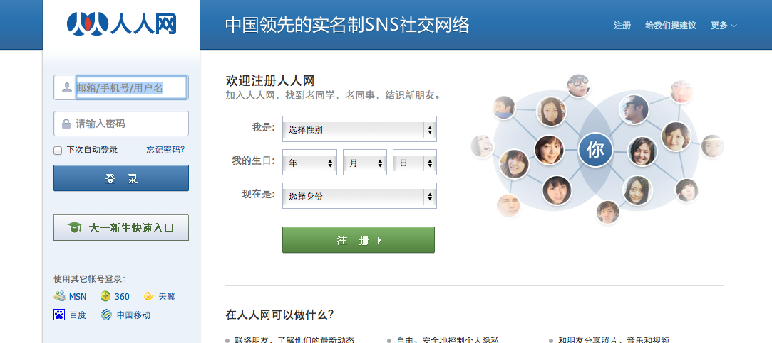
Social media in china

Slide 19
Weibo is a popular subject for research
Velocity of censorship
Identifying “sensitive users”
  Users who post about 25 previously-banned keywords
  Anyone these users retweet at least 5 times was potentially sensitive
    Monitored these users until they had 5 posts remove then added them to the set of ``sensitive’’ users.
15 days of this process: 3.5K users
  4.5K post deletions per day for these users
  ~12% of posts from sensitive users deleted
~1 minute granularity on monitoring these users
  Weibo accounts + 300 Tor circuits needed to accomplish this

Slide 20
Types of deletions
“general deletion” – when a query for a post results in “post does not exist”
“permission-denied deletion”/”system deletion” – when the query results in a “permission denied” error code
Relation of posts: if A is a repost of B; A is the “Child post” and B is the “parent post”
82% of deletions are of child posts; 75% have pictures either in the child or parent post.
Deletions happen fast: 30% within 30 minutes, 90% within a day.

Slide 21
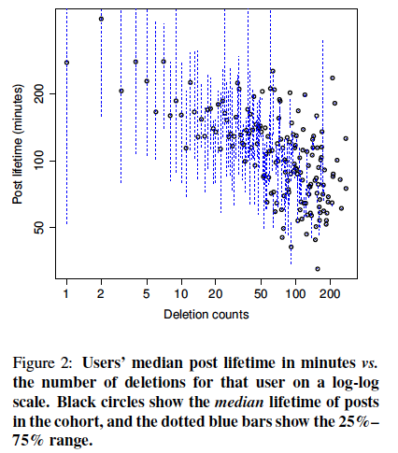
Factors that impact this rate
Keyword lists of content to block
Certain users targeted for blocking
  Users with more deletions are deleted faster
Reposts of an original post deleted at the same time as the original

Slide 22
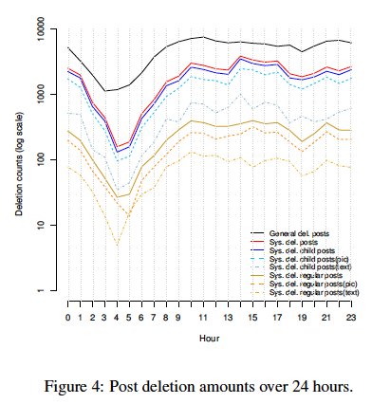
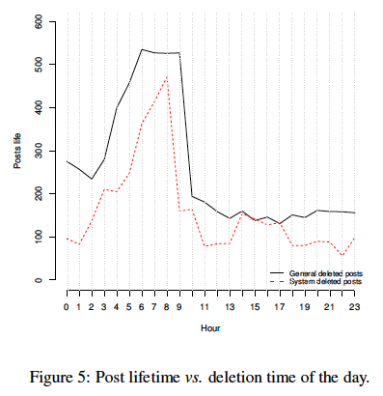
Speed of censorship
Less censorship when censorship workforce is likely off (nighttime)
Early morning posts live longer as the censors catch up

Slide 23
Weibo filtering mechanisms
Proactive filtering:
Explicit filtering: user is notified that their post cannot be posted because of sensitive content
Implicit filtering: user is notified that post is delayed because of “server data synchronization” seems to suggest post is delayed until it can be manually checked
Camouflaged posts: user can see the post, but other users cannot
Retroactive filtering:
Removing reposts
Retroactive keyword filtering (spike in deletion of posts with a given keyword)
User monitoring (users with many deletions get deleted fast)
Account closures (10% of sensitive users had accounts closed)
Search filtering (cannot search for certain words)
Sensitive topics appear to be filtered fro the public timeline

Slide 24
Evolving topics and word choice on Weibo
Gathering tweets from 280K politically active Weibo users for 44 days
NLP for trending topics
Censorship per topic varies with up to 82% censorship for some topics.

Slide 25
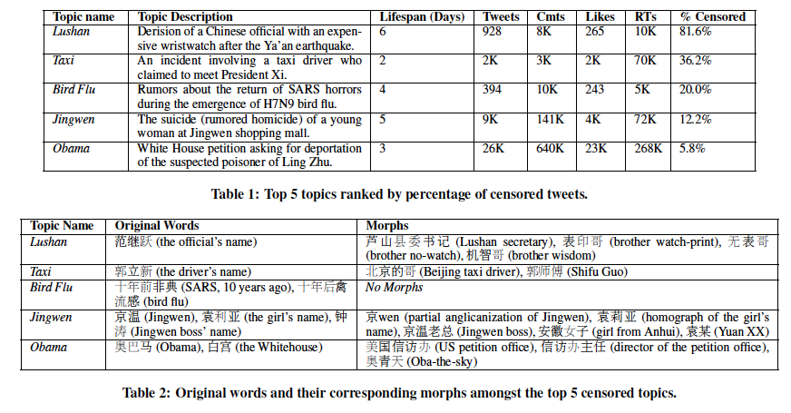
Users are resourceful

Slide 26
Hands on activity
Explore China Chats data
Study done by U New Mexico + The Citizen Lab
Monitoring keyword lists used by two Chinese Chat Clients
  TOM Skype ; SINA UC
https://china-chats.net/

Slide 27
Hands on activity
Explore China Chats data
Study done by U New Mexico + The Citizen Lab
Monitoring keyword lists used by two Chinese Chat Clients
  TOM Skype ; SINA UC
https://china-chats.net/

