Slide 1
CS590B/690B Detecting Network interference (Spring 2018)
Lecture 07
Phillipa gill – Umass -- Amherst

Slide 2
Where we are
Last time:
Challenges of measuring censorship
Principles to keep in mind when designing censorship measurements [ slides on Web ]
Creative solutions to the challenges
SpookyScan
Encore
Finishing up with Spookyscan today.
Questions?

Slide 3
Test your understanding
What types of information controls might we want to study?
What sort of data/applications would we want to study in each case?
What does the lack of ground truth mean for how we interpret censorship data?
What challenges arise because of the adversarial environment where we make censorship measurements?
How can we try to reduce these challenges on our work?
What data sources might we correlate with to validate censorship?
What is the dual-use that censorship measurements can exploit?
What is an important property of communication channels for censorship?
Can someone explain how SpookyScan works?
Notes:
This includes all L06 material (including spooky scan)

Slide 4
Today
Measurement platforms
ONI
OONI
Internet Censorship Lab
Measurement studies
ICLab + OONI Comparison

Slide 5
ONI = Opennet initiative
Collaboration between
the Citizen Lab at the Munk School of Global Affairs (UToronto)
Berkman Center for Internet & Society (Harvard)
SecDev Group (Ottawa)
Goal: investigate/expose and analyze Internet filtering in a credible non-partisan fashion
What they did/do:
Develop technical tools and methodologies for studying Internet filtering & surveillance
Build networks of local advocates and researchers to support research agenda
Advanced studies on implications of filtering on domestic and international law.

Slide 6
Iclab Slide deck description of ONI
http://www.cs.umass.edu/~phillipa/icl_slides.pdf

Slide 7
OONI = Open observatory of network interference
Open source tool for measuring censorship
Documentation includes specification for different censorship tests
E.g., how do you test for a block page?
Client measurement software: ooniprob
Backend : OONIB stores data collected from the ooniprobes
Test helpers: server side components that interact with clients during testing
Data can be accessed at this URL:
https://ooni.torproject.org/reports/
Philosophy: don’t collect anything that can’t be made public
Issues?

Slide 8

Why ICLab?
The Citizen Lab has developed a unique network of individuals around the world to measure censorship
…but software support is lacking
Running tests requires human coordination
Interpreting results is mostly manual
Existing approach has been in place for nearly 10 years
Idea: Let’s revisit the problem of designing a measurement platform for online information controls from the network measurement perspective
Notes:
Before diving into the technical detail I want to give a bit of background on where the idea for ICLab originated. Basically, during my post doctoral fellowship with the citizen lab I saw that they had created this really unique network of individuals around the world who wanted to help them measure censorship and other online information controls.
However, as I worked with them on different problems it became clear that as censorship and their investigations had evolved, the oirignal ONI software was maybe not the best way to leverage this network of individuals.
For example, a lot of the test running required human coordination. One infamous example of this was when we needed a result from qatar and the work flow was basically to ping the fellow in Saudi Arabia who would contact his colleague in Qatar and we would wait and hope data would come back so we didn’t have to repeat this procedure.
Also, a lot of the data analysis requires manual effort. And while I don’t think we’ll ever get away from manual analysis in censorship research, automation would really help to scale things up to more countries and locations and help improve the repeatability of analyses.
So with these observations in mind, and the fact that the existing approach had been around for almost 10 years we decided to try to revisit the problem of designing a measurement platform for online information controls. The idea would be to combine my background in network measurement with the Citizen Lab’s extensive experience working on real deployments in the field.
-------
Before diving into the technical detail I wanted to give a bit of background on where the idea of ICLab came from.
The idea came about during my post doctoral fellowship with the citizen lab where I saw that they had this really unique network of individuals who were ready and willing to run software and help the group gather measurements of online censorship and information controls.
But as we worked together over the year it became clear that their existing software solution was maybe not giving them the data and flexibility they needed.
A lot of the testing required human coordination. So one famous example is when we were working on a paper together and the workflow basically consisted of pinging a collaborator in Saudi Arabia who would contact his friend in qatar and then hopefully the data would come back, or you end up having to bother this person again.
Also a lot of the data analysis is manual. And I don’t think we’ll ever get away from having some manual analysis in censorship measurement, but a lot of tasks could be automated which would help with issues like scalability and repeatability of tests.
So given that the existing measurement infrastructure had been around for about 10 years now, the idea was to try to revisit the problem it was trying to solve and see if we could design something better using background I had from working on network measurement.

Slide 9
Censorship measurements 101
Basic approach
Fetch a Web page from a location with suspected censorship – the field
Fetch the same Web page simultaneously from a location without censorship – the lab
Compare the results
Notes:
Before I begin, I’d like to give some background on how censorshp measurement is currently done and how this impacts the design of ICLab.
To show why building a censorship measurement platform is so tricky, consider the basic approach used to check if a web page is blocked.
Basically you fetch the page from the region where you suspect the content is blocked, and you fetch the same page from a region where you would not expect to see blocking happening and compare the results.

Slide 10

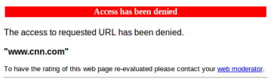
Censorship Measurement 101
Example:
Measured in the lab
Measured in the field
Standard question:
Is this Web site blocked?
Notes:
So you might get something like the following as a result if you wanted to test for censorship of CNN.
You get the proper Web page in the lab and you get what looks like a block page from the field.
Standard question to ask: Is this Web page blocked

Slide 11
Censorship Measurement 101
Example:
Measured in the lab
Measured in the field
(no html page returned)
Standard question:
Is this Web site blocked?
We need finer grained measurements to answer this question!
Notes:
Now what if we get a result like this, where the page renders fine in the lab, but we get no reply in the field.
Can we still answer the question of whether or not the content is blocked?
And I think most of us can agree that in this case it’s really hard to say conclusively without more detailed measurements. For example actually having packet captures that could show us if the client received a TCP reset or if they got a DNS reply directing them to query local host for the content.

Slide 12
Censorship Measurement 101
Example:
Measured in the lab
Measured in the field
(no html page returned)
Standard question:
Is this Web site blocked?
What if we want to ask more questions:
How was this site blocked?
What product was used to block it?
Who is blocking it?
Notes:
We might also want to ask more questions.
Like how was this site blocked? What product was used to block it? Is it something export controlled like Blue Coat/Netsweeper?
Also, who is blocking it? Is it the local ISP? Local government? An unrelated ISP who we happen to be routing through?

Slide 13
What does this mean for ICLab?
Platform should support a wide range of network measurement operations
Basics: HTTP request, Traceroute, DNS queries
Not-so-basics: HTTP header fingerprinting (Netalyzr test)
Even-less-basics: Customized IP TTL header to localize the censor in the network
Detecting other information controls: traffic differentiation, surveillance etc.
CoNtEnT tYpE: text/html
(sent by client)
CONTENT TYPE: text/html
(received by server)
Notes:
What this means for a platform like ICLab is that it needs to support a wide range of network measurements.
For starters, the basics like HTTP requests, Traceroutes, and DNS should be supported.
But also less basic measurements like HTTP header fingerprinting which is done by Netalyzr. The idea here is the measurement client sends headers with strange capitalization to their own server. If the message arrives with different header capitalization you can infer that there is a device on the path and possibly try to identify it.
On the more complex side you might even want to alter IP TTL values to localize where in the network the censoring device is. In the case of HTTP Proxy localization this could even mean that you need to be able to alter the IP TTL mid-TCP stream!

Slide 14
What does this mean for ICLab?
Impossible to know the complete set of measurements that need to be supported a priori
New censorship technologies emerge, we need to be able to keep up
Need to be able to implement and launch new experiments on demand
Need to be flexible about when, where, and what is run
How to do this well?
Our solution: Python experiment specification + Web UI
Trade off
Flexibility
Security for clients
Notes:
Need new measurements as technologies change and we want to ask new questions about censorship
Need to be able to launch experiments in specific locations quickly e.g., election, political unrest.
One of the big things we’ve been grappling with so far is how to balance this need for flexibility with user security and safey. Don’t want to give everyone root access coding
What this means is that it’s not possible for us to even know the complete set of measurements that will need to be supported by the platform.
As new censorship techniques emerge and new issues arise we will need to be able to develop and deploy new measurement techniques
So obviously this means that the platform needs to be extremely flexible in terms of when, where and what experiments are run
But also that we need to support implementing and launching completely new experiment programs on demand.
And this is really where we spent a lot of time this past year trying to find the right balance between allowing a lot of freedom in terms of how experiments are written vs. limiting the risks these experiments may pose to users of the platform. For example, initially we planned to expose a set of measurement primitives, but early feedback indicated that for many tests this wouldn’t be enough. On the other hand, allowing multiple disparate programs to run isn’t tenable either.

Slide 15
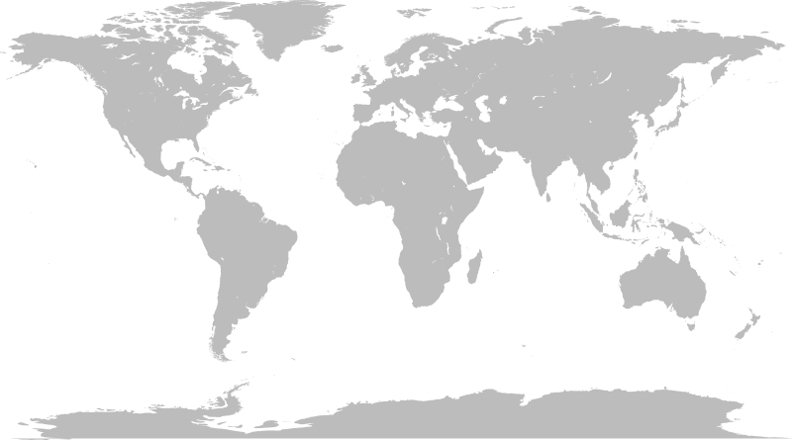
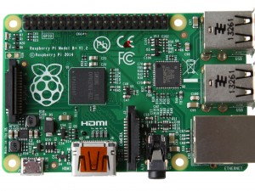

Overview of ICLab
Clients
.
.
.
.
.
.
.
.
.
.
.
.
.
.
.
Notes:
To overview our current system, the idea is to have a population of clients in the field running the software on an inexpensive computing device like a raspberry pi. And this is really the platform we are focusing on. But longer term this could include android as well.

Slide 16
Overview of ICLab
Clients
Experiments to run
+ relevant data
.
.
.
.
.
.
.
.
.
.
.
.
.
.
.
Results
Control Server
Notes:
These clients would receive commands from a central server that will send the clients experiments and any meta data (e.g., URL lists) for testing.
And when the experiments are run the clients would send the results back.

Slide 17
Overview of ICLab
Clients
Experiments to run
+ relevant data
.
.
.
.
.
.
.
.
.
.
.
.
.
.
.
Results
Control Server
Web page, reports,
papers
Data analysis code
(e.g., block page detection,
device fingerprinting)
Database
Notes:
Once it gets the data the server would load it into a database where analysis programs could run on it to do more sophisticated inferences (e.g., detecting block pages, fingerprinting devices etc.). The output of these programs could then be used as input to a Web page or blog reports about censorship.

Slide 18
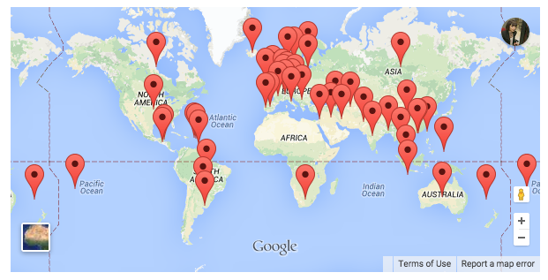
Overview of ICLab
Clients
Experiments to run
+ relevant data
.
.
.
.
.
.
.
.
.
.
.
.
.
.
.
Results
Control Server
Client + Server in limited beta
Volunteers beginning to deploy nodes
O(100s) of VPN endpoints online
Web page, reports,
papers
Data analysis code
(e.g., block page detection,
device fingerprinting)
Database
Notes:
In terms of where we are right now. The clent and server code are pre-alpha. This means we’re currently testing mainly on VPN connections and raspberry pis under our control, but we do have some code that I can demo to folks later or tomorrow.

Slide 19
Overview of ICLab
Clients
Experiments to run
+ relevant data
.
.
.
.
.
.
.
.
.
.
.
Block page detection algorithms
Evaluated and used to fingerprint products
Evaluated on 5 years of historial ONI data
Appears in IMC 2014
.
.
.
.
Results
Control Server
Web page, reports,
papers
Data analysis code
(e.g., block page detection,
device fingerprinting)
Database
Notes:
We’ve also started making progress on the data analysis methods, specifically block page detection and using blockpages to fingerprint censorship devices which we evaluated on 5 years worth of ONI data. That method and evaluation will appear in IMC this year.

Slide 20

Challenges of measuring
Securing communication between clients and server
Authentication
Server should only trust legitimate clients
Clients should only trust legitimate server!
…and what if the measurements are blocked?
Distinguishing failures from filtering
Packet captures
Correlations between clients and platforms
Vantage points
Access to a variety of regions
Need to keep volunteers safe!
Notes:
Adversarial measurement challenges

Slide 21


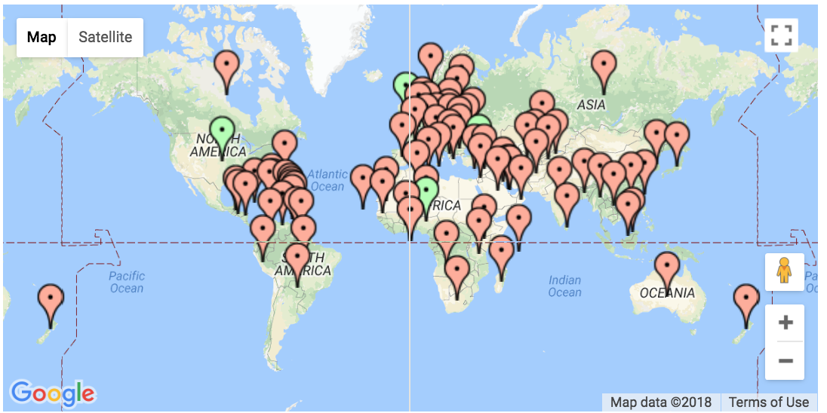
ICLab vantage points
VPNs
Volunteers
Notes:
Add icon next to bullets.

Slide 22

ICLab use case 1: Yemen conflict

Slide 23



Filtering products…
Dual use technology …
Keep employees off Facebook, keep schoolchildren safe from inappropriate content
…but in the wrong hands
Human rights violations
Surveillance
Censorship
…

Slide 24
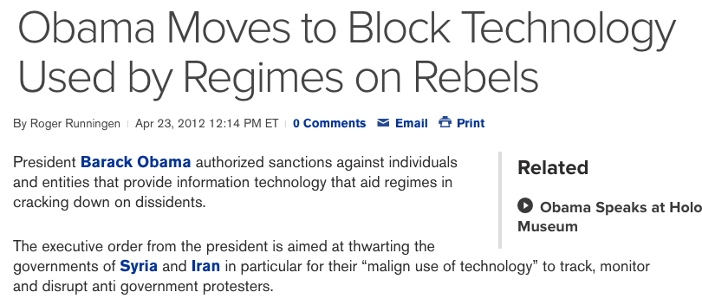
This has not gone unnoticed…
http://www.bloomberg.com/news/2012-04-23/obama-moves-to-block-technology-used-by-regimes-against-protests.html
Notes:
This fact has not gone unnoticed with the EU, US and Israel all putting sanctions in place to limit the export of these products.
============
The fact that we are shipping products for cnsorship and surveillance around the world hasn’t gone unnoticed. The US, Europe and Israel have all implemented various sanctions against export of these products to foreign governments.

Slide 25
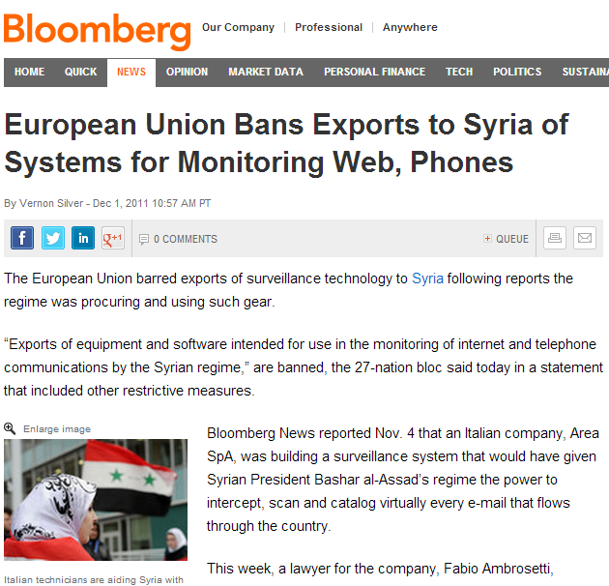
Challenge: How to identify specific filtering products?
Notes:
Challenge of enforcing sanctions.

Slide 26
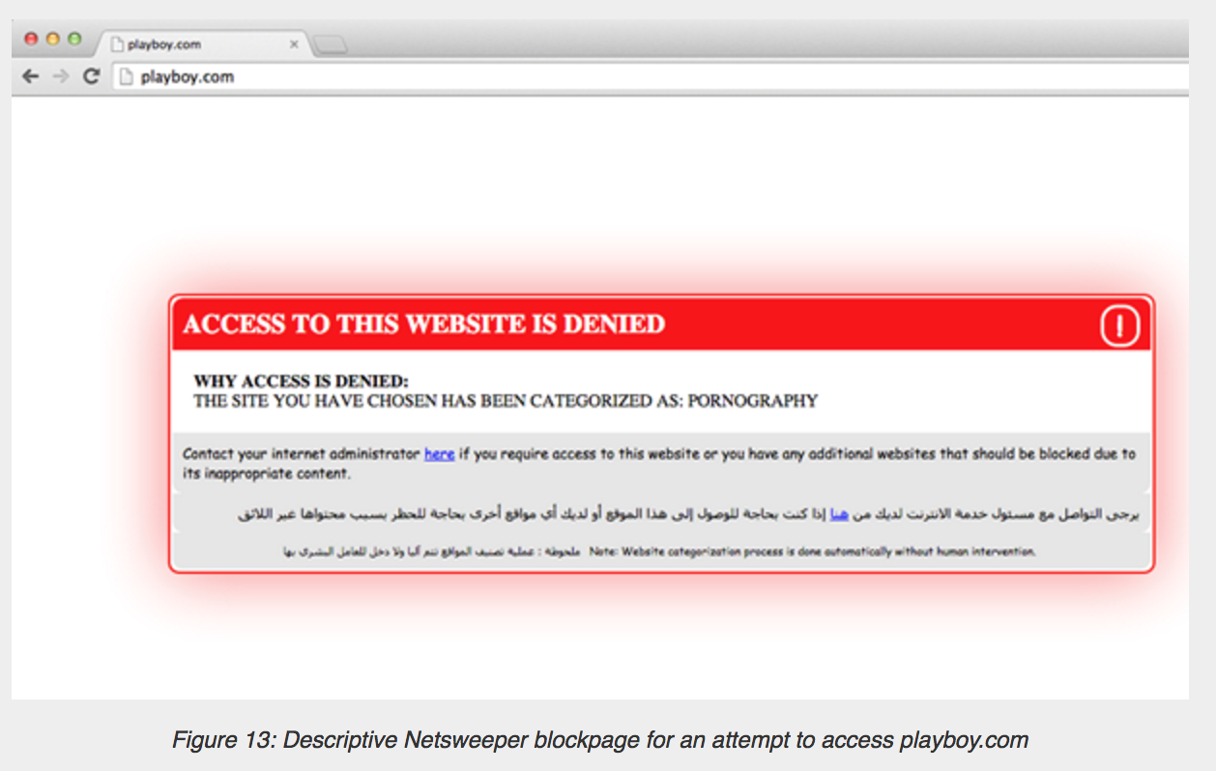
Verifying Netsweeper use in Yemen
Netsweeper known to be used in Yemen with this block page
**Tests run by a pseudonymous researcher who was already in the country.

Slide 27
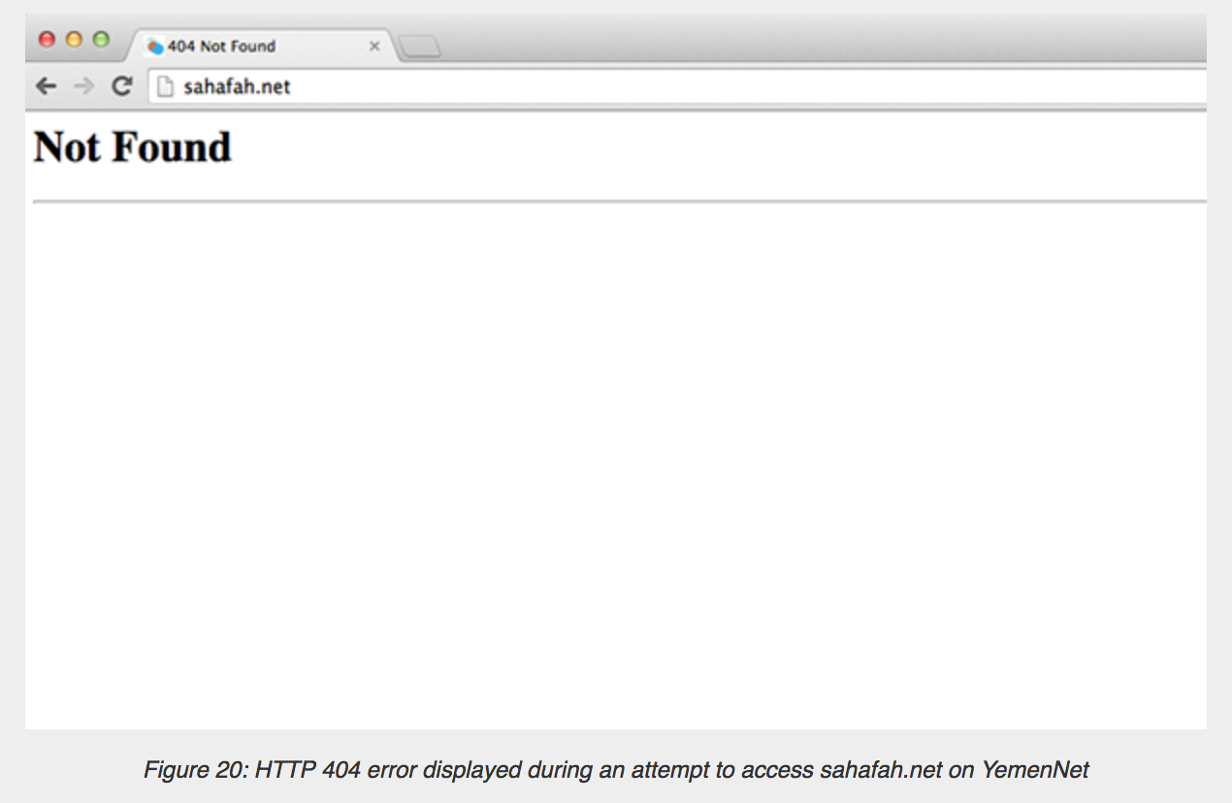
Verifying Netsweeper use in Yemen
Is this really an HTTP 404 from the server or is it filtering?

Slide 28
How to fingerprint the censor?
How to figure out if the HTTP404 is from the censor or the server?
Leverage IP TTL values to detect injected packets!
Networking refresher:
IP TTL set by a host, decremented by each hop along the path
Purpose: Avoid forwarding loops

Slide 29

Detecting injected packets using IP TTL header
Client
SYN
Censor
Server
SYNACK
TTL = 48
?
SYNACK
TTL = 128
ACK
HTTP GET …
HTTP 404
TTL = 110

Slide 30
Verifying Netsweeper is returning the HTTP 404 page
Same TTL value for the block page and 404 page!

Slide 31
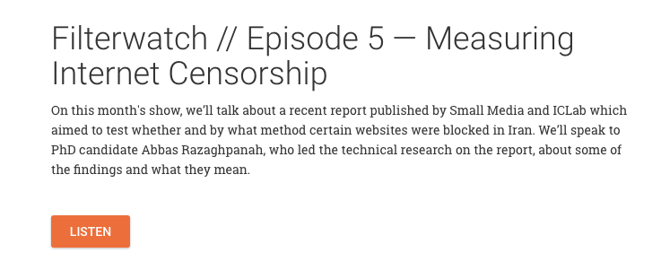
ICLab use case 2: filtering in iran
Monthly blog/podcast with SmallMedia UK.
Tests carried out using a virtual private server.

Slide 32
How do tech sanctions influence censorship?
URL | VPS1 | VPS2 | VPS3 | VPS4
https://developers.google.com | Server side | Server side | Server side | Server side
https://get.adobe.com/flashplayer | Local(RST) | OK | OK | Local(RST)
https://developer.android.com/studio/index.html | Server side | Server side | Server side | Server side
https://analytics.google.com | Server side | Server side | Server side | Server side
https://code.google.com/codejam | OK | OK | OK | OK
https://github.com | OK | OK | OK | OK
https://azure.microsoft.com | OK | OK | OK | OK
https://aws.amazon.com/ec2 | OK | OK | OK | OK
https://www.dropbox.com | OK | OK | OK | OK
https://www.netflix.com | OK | Local(DNS) | Local(RST) | OK
https://www.bitbucket.org | Local(RST) | Local(RST) | Local(RST) | Local(RST)
Notes:
More detail. On table contents.

Slide 33
How do tech sanctions influence censorship?
URL | VPS1 | VPS2 | VPS3 | VPS4
https://developers.google.com | Server side | Server side | Server side | Server side
https://get.adobe.com/flashplayer | Local(RST) | OK | OK | Local(RST)
https://developer.android.com/studio/index.html | Server side | Server side | Server side | Server side
https://analytics.google.com | Server side | Server side | Server side | Server side
https://code.google.com/codejam | OK | OK | OK | OK
https://github.com | OK | OK | OK | OK
https://azure.microsoft.com | OK | OK | OK | OK
https://aws.amazon.com/ec2 | OK | OK | OK | OK
https://www.dropbox.com | OK | OK | OK | OK
https://www.netflix.com | OK | Local(DNS) | Local(RST) | OK
https://www.bitbucket.org | Local(RST) | Local(RST) | Local(RST) | Local(RST)
Expected Local ISP blocking (DNS tampering, Injecting RSTs)
Blocked: Flashplayer, Netflix, Bitbucket
Notes:
More detail. On table contents.

Slide 34
How do tech sanctions influence censorship?
URL | VPS1 | VPS2 | VPS3 | VPS4
https://developers.google.com | Server side | Server side | Server side | Server side
https://get.adobe.com/flashplayer | Local(RST) | OK | OK | Local(RST)
https://developer.android.com/studio/index.html | Server side | Server side | Server side | Server side
https://analytics.google.com | Server side | Server side | Server side | Server side
https://code.google.com/codejam | OK | OK | OK | OK
https://github.com | OK | OK | OK | OK
https://azure.microsoft.com | OK | OK | OK | OK
https://aws.amazon.com/ec2 | OK | OK | OK | OK
https://www.dropbox.com | OK | OK | OK | OK
https://www.netflix.com | OK | Local(DNS) | Local(RST) | OK
https://www.bitbucket.org | Local(RST) | Local(RST) | Local(RST) | Local(RST)
Blocking of users by the server!
Sites: Google Developers, Analytics, Android
Notes:
More detail. On table contents.

Slide 35
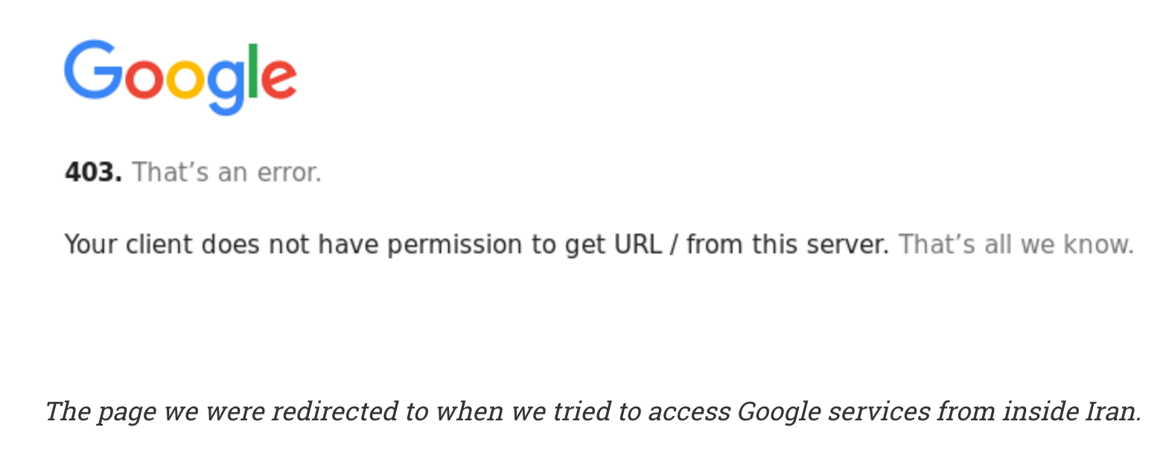
How do tech sanctions influence censorship?
403 Error returned by Google server.
Enforcing sanctions

Slide 36
How do tech sanctions influence censorship?
URL | VPS1 | VPS2 | VPS3 | VPS4
https://developers.google.com | Server side | Server side | Server side | Server side
https://get.adobe.com/flashplayer | Local(RST) | OK | OK | Local(RST)
https://developer.android.com/studio/index.html | Server side | Server side | Server side | Server side
https://analytics.google.com | Server side | Server side | Server side | Server side
https://code.google.com/codejam | OK | OK | OK | OK
https://github.com | OK | OK | OK | OK
https://azure.microsoft.com | OK | OK | OK | OK
https://aws.amazon.com/ec2 | OK | OK | OK | OK
https://www.dropbox.com | OK | OK | OK | OK
https://www.netflix.com | OK | Local(DNS) | Local(RST) | OK
https://www.bitbucket.org | Local(RST) | Local(RST) | Local(RST) | Local(RST)
… but its not consistent ...
Google CodeJam available,
No blocking of Github, Azure, AWS, Dropbox
Notes:
More detail. On table contents.

Slide 37
How do tech sanctions influence censorship?
URL | VPS1 | VPS2 | VPS3 | VPS4
https://developers.google.com | Server side | Server side | Server side | Server side
https://get.adobe.com/flashplayer | Local(RST) | OK | OK | Local(RST)
https://developer.android.com/studio/index.html | Server side | Server side | Server side | Server side
https://analytics.google.com | Server side | Server side | Server side | Server side
https://code.google.com/codejam | OK | OK | OK | OK
https://github.com | OK | OK | OK | OK
https://azure.microsoft.com | OK | OK | OK | OK
https://aws.amazon.com/ec2 | OK | OK | OK | OK
https://www.dropbox.com | OK | OK | OK | OK
https://www.netflix.com | OK | Local(DNS) | Local(RST) | OK
https://www.bitbucket.org | Local(RST) | Local(RST) | Local(RST) | Local(RST)
Local filtering varies between vantage points
Notes:
More detail. On table contents.

Slide 38
Measurement studies
Tradeoffs of Longitudinal Measurement Platforms (required reading)
Inferring Mechanics of Web Censorship Around the World
https://www.usenix.org/sites/default/files/conference/protected-files/verkamp_foci12_slides.pdf

Slide 39
Hands on activity
Look at OONI data:
https://ooni.torproject.org/reports/0.1/
Try installing OONI (if you have a Linux/Mac machine)
* Also can check out their Android app
Try installing/running ICLab https://www.iclab.org

