Slide 1
CS590/690 Detecting network interference (Spring 2018)
Lecture 04
Phillipa Gill
ACKs: Slides based on material from Nick weaver’s presentation at the connaught summer institute 2013
Also from: Kurose + Ross; Computer Networking a Top Down approach featuring the Internet (6th edition)

Slide 2
Administrative note
Assignment 1 warm up
Download/play with Wireshark
Investigate Bro www.bro-ids.org
Lots of tutorials here: https://www.bro.org/documentation/index.html
Project + A1 info coming after today.

Slide 3
Where we are
Last time:
TCP Resets for censorship
Fingerprinting Reset Injectors (NDSS 2009 paper)
On path vs. In path censorship
Questions?

Slide 4
Test your understanding
What is the difference between an in-path and on-path censor?
What are the pros of each approach?
Cons?
What are the two race conditions that can occur with reset injectors?
What headers would you look at to ID a reset injector?
How would you localize an injector to a specific location in the network?
If the TCP reset occurs before the HTTP GET what can you say about the trigger?
After?

Slide 5
Overview
Block IP addresses
IP layer
Disrupt TCP flows
TCP (transport layer)
Many possible triggers
Block hostnames
DNS (application layer)
Disrupt HTTP transfers
HTTP (application layer)
Today

Slide 6
Domain name system (dns)

Slide 7

DNS name resolution example
root DNS server
2
host at cis.poly.edu wants IP address for gaia.cs.umass.edu
3
TLD DNS server
4
5
iterated query:
contacted server replies with name of server to contact
“I don’t know this name, but ask this server”
local DNS server
dns.poly.edu
7
6
1
8
authoritative DNS server
dns.cs.umass.edu
requesting host
cis.poly.edu
gaia.cs.umass.edu

Slide 8
DNS: a distributed, hierarchical database
Root DNS Servers
…
…
com DNS servers
org DNS servers
edu DNS servers
yahoo.com
DNS servers
pbs.org
DNS servers
poly.edu
DNS servers
umass.edu
DNS servers
amazon.com
DNS servers

Slide 9
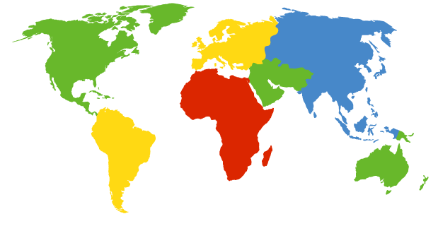
DNS: root name servers
contacted by local name server that can not resolve name
root name server:
contacts authoritative name server if name mapping not known
gets mapping
returns mapping to local name server
c. Cogent, Herndon, VA (5 other sites)
d. U Maryland College Park, MD
h. ARL Aberdeen, MD
j. Verisign, Dulles VA (69 other sites )
k. RIPE London (17 other sites)
i. Netnod, Stockholm (37 other sites)
e. NASA Mt View, CA
f. Internet Software C.
Palo Alto, CA (and 48 other sites)
m. WIDE Tokyo
(5 other sites)
13 root name “servers” worldwide
a. Verisign, Los Angeles CA
(5 other sites)
b. USC-ISI Marina del Rey, CA
l. ICANN Los Angeles, CA
(41 other sites)
g. US DoD Columbus, OH (5 other sites)

Slide 10
TLD, authoritative servers
top-level domain (TLD) servers:
responsible for com, org, net, edu, aero, jobs, museums, and all top-level country domains, e.g.: uk, fr, ca, jp
Network Solutions maintains servers for .com TLD
Educause for .edu TLD
authoritative DNS servers:
organization’s own DNS server(s), providing authoritative hostname to IP mappings for organization’s named hosts
can be maintained by organization or service provider

Slide 11
DNS records
DNS: distributed db storing resource records (RR)
RR format: (name, value, type, ttl)
type=A
name is hostname
value is IP address
type=CNAME
name is alias name for some “canonical” (the real) name
www.ibm.com is really
servereast.backup2.ibm.com
value is canonical name
type=NS
name is domain (e.g., foo.com)
value is hostname of authoritative name server for this domain
type=MX
value is name of mailserver associated with name

Slide 12
DNS protocol, messages
query and reply messages, both with same message format
2 bytes
2 bytes
msg header
identification: 16 bit # for query, reply to query uses same #
flags:
query or reply
recursion desired
recursion available
reply is authoritative
identification
flags
# questions
# answer RRs
# authority RRs
# additional RRs
questions (variable # of questions)
answers (variable # of RRs)
authority (variable # of RRs)
additional info (variable # of RRs)

Slide 13
DNS protocol, messages
2 bytes
2 bytes
identification
flags
# questions
# answer RRs
# authority RRs
# additional RRs
name, type fields
for a query
questions (variable # of questions)
RRs in response
to query
answers (variable # of RRs)
records for
authoritative servers
authority (variable # of RRs)
additional “helpful”
info that may be used
additional info (variable # of RRs)

Slide 14
DNS: caching, updating records
once (any) name server learns mapping, it caches mapping
cache entries timeout (disappear) after some time (TTL)
TLD servers typically cached in local name servers
thus root name servers not often visited
cached entries may be out-of-date (best effort name-to-address translation!)
if name host changes IP address, may not be known Internet-wide until all TTLs expire
update/notify mechanisms proposed IETF standard
RFC 2136

Slide 15
Ok … so now we know about DNS
… how can we block it!
A few things to keep in mind …
No cryptographic integrity of DNS messages
DNSSEC proposed but not widely implemented
Caching of replies means leakage of bad DNS data can persist

Slide 16
Blocking dns names

Slide 17
Blocking dns names

Slide 18

Types of false DNS responses
DNS RESPONSE A
192.168.5.2
DNS RESPONSE A
127.0.0.1
DNS RESPONSE A
159.106.121.75
NXDOMAIN
3rd Party DNS Server
(8.8.8.8)
DNS QTYPE A
www.censored.com
DNS Server
(2.1.2.3)
DNS RESPONSE A
1.2.3.5
(correct IP)
Block page server
(192.168.5.2)
Home connection
(2.1.2.4)
This diagram assumes ISP
DNS Server is complicit.

Slide 19
Blocking DNS names
Option A: get ISP resolver on board
(Previous slide)
Option B: On-path packet injection similar to TCP Resets
Can be mostly countered with DNS-hold-open:
Don’t take the first answer but instead wait for up to a second
Generally reliable when using an out of country recursive resolve
E.g., 8.8.8.8
Can be completely countered by DNS-hold-open + DNSSEC
Accept the first DNS reply which validates

Slide 20
Reading from Web …
Hold-On: Protecting Against On-Path DNS Poisoning
H. Duan, N. Weaver, Z. Zhao, M. Hu, J. Liang, J. Jiang, K. Li, and V. Paxson.
Idea: Once you receive a DNS packet, wait for a predefined “hold-on” period before accepting the result.
DNSSEC is still vulnerable to these injected packets and does not make hold-on unneccessary
Inject a reply with an invalid signature: client will reject
Use active measurements to determine the expected TTL and RTT to the server.

Slide 21
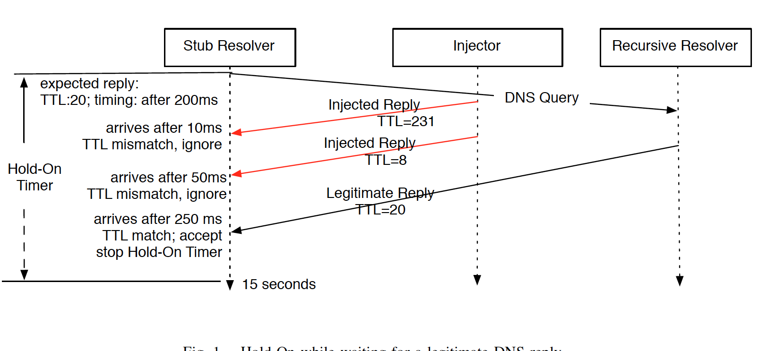
Hold-on in action

Slide 22
Link to FOCI2014 Talk video
https://www.usenix.org/conference/foci14/workshop-program/presentation/anonymous
^^^ This talk does a good job of overviewing the reading by anonymous.

Slide 23
Next time …
Filtering of Web requests at application layer.

Slide 24
Additional SLIDES

