Slide 1
CS590B/690B measuring network interference
(Spring 2018)
Prof. Phillipa Gill
Umass amherst, Computer Science
Lecture 01

Slide 2
Today
Administravia
Course information
Topics + organization
Mark breakdown
Background
What is censorship
3 case studies of how we think about global censorship

Slide 3
Course information
Instructor:
Phillipa Gill; office: 232 CS building
Email: phillipa@cs.umass.edu
Office hours: By appointment.
Course Web page:
https://people.cs.umass.edu/~phillipa/?p=cs590690s18
Web forum:
Discuss material covered in class, post + discuss interesting censorship related news
Sign up here: http://piazza.com/umass/spring2018/cse590690b

Slide 4
Course goals: Why are we here?
After spending a year post-docing with The Citizen Lab* I realized that Internet censorship research faces many Network Measurement challenges!
  *The Citizen Lab = an interdisciplinary research group in political science at the University of Toronto
Political scientists often lack the technical tools to efficiently interpret data about Internet censorship
Computer scientists often lack the political context needed to interpret the forces behind censorship results
This course is based on my experiences interacting political scientists to study censorship and network interference
By the end of this course: You should have relevant technical background to design and evaluate methodologies for measuring various aspects of network interference
Notes:
Mention different approach to finding vantage points in cs vs poli

Slide 5
Topics and organization
Part 1: Methods for performing censorship + how we measure them
  Blocking of Web content
  Traffic differentiation
  Case studies
  Censorship of online social networks
  Identifying specific censorship products
Part 2: Evading censorship
  Anonymization tools
  Attacks on anonymization tools
  Circumvention techniques
  Circumvention arms race
Organization:
  Mix of lecture/paper presentations
  Time permitting, in-class assignment work/Q&A

Slide 6
Mark breakdown
Component | CS590B | CS690B
Course Project | 25% | 25%
Midterm exams | 10%+10% | 10%+10%
Assignments | 40% (10% each) | 40% (10% each)
Paper Summaries | 10% | 10%
Paper Presentation | 15% | 15%
Total is 105% for each. Chance for 5% bonus.

Slide 7
Course components
Course project: Group of 2-3 students to complete a semester long project related to Internet censorship. You will pick an existing paper from the literature and repeat it.
  Goal: Expose you to the challenges of implementing and experimenting with different aspects of network measurements/network interference in the real world/with real data.
You may consider older papers that bear revisiting.
For your project you should carefully read the paper and figure out how you will repeat the study.
  Did they use public data sets that are collected on an ongoing basis?
  Did they use an infrastructure like PlanetLab where RIPE Atlas is a larger scale new alternative?
You will compare the results of your repetition of the study with the original, taking into account changing censorship behaviors, any improvements you made to the methodology etc.

Slide 8
Course components
20% Midterms: roughly ½ the course material on each
40% Assignments: 4-5 assignments.
  Goal: Give you experience with a breadth of measurement tools and techniques relevant in the censorship space
  Due at 11:59:59pm on specified date
    Working code is paramount
Paper summaries: Review one paper per lecture. Participate in online discussions on HotCRP system. Details will be posted to piazza.
Paper presentation: In class discussion of papers.
  Goal: Give you experience reading and thinking critically about research papers in this area.

Slide 9
Paper reviews
You are required to write (1) paper review for each lecture
  If there are multiple papers for a given lecture you will choose one based on your ID number
  Details on Web page (ask questions about this to Piazza)
Summarize high level goals of the paper, how does it go about achieving them?
  What problem does the paper solve? Why is this an important problem? Or is it an important problem?
  Strengths/weaknesses of the paper
  What you would do different, thoughts on assumptions, ideas for future work/improvements
Summaries lose 2% of value for each day late that they are submitted.

Slide 10
Paper Discussion
Prof. Gill will briefly summarize each paper
One paper will be chosen for discussion
Depending on your ID number you will argue for/against the paper
Last ~15 minutes of class will be dedicated to paper discussion
Think of this like a mock program committee meeting.
  Would we accept the paper if we were running a conference?
  Why/Why not?
  We may not reach a decision!

Slide 11
Late Policy
Each student is given 4 slip days that they can use at any time to extend a deadline
  You don’t need to ask me, just turn-in stuff late.
  Mark on your submission (assignment, paper summary, etc.) how many of your slip days you are using.
Assignments are due at 11:59:59, no exceptions
  1 second late = 1 hour late = 1 day late
  20% off per day late

Slide 12
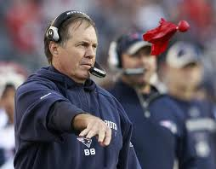
Grade Changes
Each student gets two challenges
  Modeled after NFL system
  If you ask for a regrade and you are wrong, you lose a challenge
  When you are out of challenges, you cannot ask for regrading
Must come to office hours with the following in writing:
  Specify the problem(s) you want regraded
  For each problem, explain why the grade is in error
Don’t sweat the small stuff
  If the change is <5% of the grade, don’t bother

Slide 13
Cheating
Do not do it
  Seriously, don’t make me say it again
Cheating is an automatic zero on the assignment
  Will be referred to the university for discipline and possible expulsion
See university academic integrity policy on the course Web page.

Slide 14
Final Grades
At the end of the semester, all of your grades will sum to up to 105 points
Final grades are based on a simple scale:
  A >92, A- 90-92, B+ 87-89, B 83-86, B- 80-82, …

Slide 15
Today
Administravia
Course information
Topics + organization
Mark breakdown
Background: Censorship
What is censorship
3 case studies of how we think about global censorship

Slide 16
What is censorship?
Censorship, the suppression of words, images, or ideas that are "offensive," happens whenever some people succeed in imposing their personal political or moral values on others. Censorship can be carried out by the government as well as private pressure groups. Censorship by the government is unconstitutional. – The American Civil Liberties Union
Key points:
Censorship in general is a non-technical problem
  Think banned books, suppression of news media etc.
In the United States censorship is unconstitutional
  Other countries?
  Are we forcing Western values on other countries?
  United Nations Universal Declaration of Human Rights provides some guidance of what speech should be protected globally
    E.g., political, minority religions, LGBT, etc.

Slide 17
This course
Focus primarily on technical issues relating to “Internet censorship”
  Internet censorship broadly defined to include many types of information controls/network interference
    Surveillance, traffic differentiation
  Technical issues:
    How is censorship implemented?
    How to we detect, measure, and circumvent censorship?
    Global impacts of national censorship:
      E.g., Pakistan hijacking worldwide YouTube traffic, China DNS censorship leakage
  Some social issues will be discussed (e.g., historical context today)

Slide 18
Global Censorship: History Lesson
Three Case Studies:
Telegraph Cable Cutting
High-Frequency Radio Jamming
Direct Broadcast Satellite TV Jamming
Why think about these examples?
Often times we lament the Internet for its lack of national borders
  …however it is not the first network with this property!
See how people have dealt with this problem in the past
ACKs: Thanks to Jon Penney for supplementary material in these slides.

Slide 19
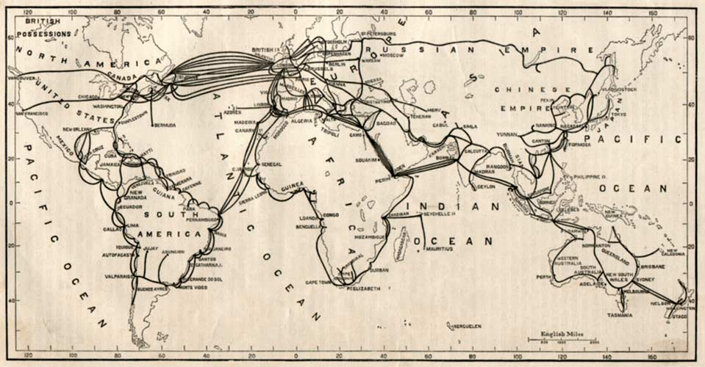
CASE STUDY 1
1850 – first submarine cables laid
…by 1900 the first global communications network!
Submarine cables 1895

Slide 20
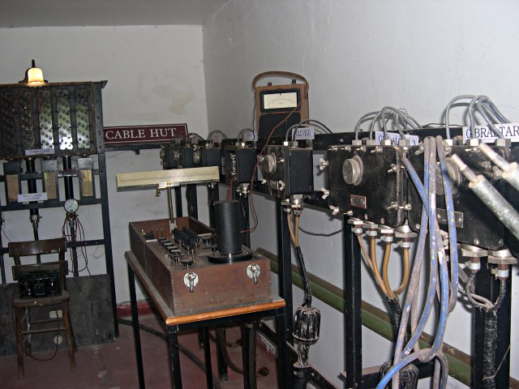
TWO VULNERABILITIES
Censorship @ network hubs and control points
Many of these points under control of Britain though Germany also heavily invested
Photo: Tony Atkin [CC-BY-SA-2.0]
Notes:
Vulnerable to censorship → under control of public / private companies in a handful of countries (e.g., germany/britain)
Censorship/disruption to weaken or isolate enemies.

Slide 21
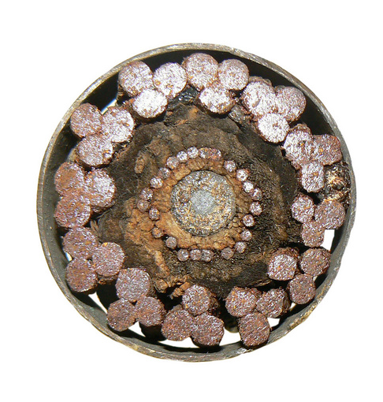
Two vulnerabilities
Cables vulnerable to physical attack (ie., severing)
Aside:
The Internet has this same vulnerability!
Undersea cables in regions with piracy are vulnerable (e.g., horn of Africa)
See https://www.nanog.org/meetings/abstract?id=1810 for more info.
Photo: Lichfield District Council [CC-BY-SA-2.0]

Slide 22
International response
1875 International Telegraph Convention
Finalized in St. Petersburg
“Right” to communicate by telegraph
No national security exception (unless notice given to sender)
No “cultural” or “morality” exception
Encryption expressly allowed
1884 Submarine Cables Convention
Prohibits submarine cable cutting
Prosecution by states party to treaty
Provisions for damage compensation
No provisions respecting war

Slide 23
These worked well…
… in peace times, but they didn’t address war time
In 1908 an exception was put in place:
  Telegrams sent by other state governments could be blocked without notice, if giving notice would pose a “dangerous” national security threat.
  Britain interpreted this exception to apply to existential threats (ie., war time)
  As a result pervasive surveillance, censorship, espionage during the war
  After the war? Result in permanent “peace time” state surveillance (creation of GCHQ in UK etc.)
  Does this sound familiar?
Submarine convention also didn’t account for war time
  Cable cutting likely the first premeditated act of WWI when Britain and France cut German cables spanning the Atlantic and North Sea in August 1914.
After the war private companies sought litigation for damages to cables + invention of wireless radio helped alleviate these issues

Slide 24
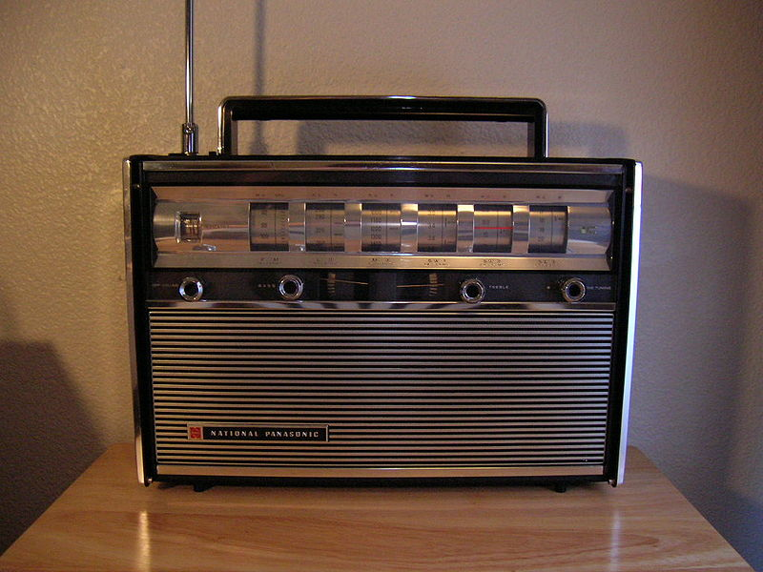
Case study 2
High frequency radio jamming
During WWII radio used for propaganda and radio jamming was a method to censor content
Some radio signals could propagate across borders
  Countries (e.g., Germany) used “broadcast defense” involving jamming of foreign radio.

Slide 25
International response
Post war “Free flow of information” codified in Universal Declaration of Human Rights (UDHR 1948)
Promoted by US and its allies (influenced by US first amendment)
Codified the right to “seek, receive, and impart information” (article 19 UDHR)
UN Declaration on Freedom of Information 1946
Declared information freedom a “fundamental human right”
This consensus dissolved during Cold War
Soviet states blocked Western radio (BBC, VOA)
International legal disputes between East and West with East arguing that restricting information is a sovereign right of states.

Slide 26
International disputes
Struggles over information flow and politics took place in international forums
International Telecommunications Union (ITU), UNESCO, UN General assembly
These organizations still play a role in Internet governance forums
Despite ITU resolutions condemning radio jamming, it continued in the Soviet Union.
IFRB: International Frequency Registration Board (ITU’s enforcement arm) performed monitoring of jamming activities
  Cold War politics made enforcement challenging
  Monitoring could enable “shaming” of entities that did not openly admit to jamming
This is a great motivation for research measuring Internet censorship
Notes:
Key point
Intl forums, however, hard to enforce on unwilling states.
IFRB’s most successful project was monitoring radio jamming. Made “cost” of jamming higher by making it transparent.

Slide 27
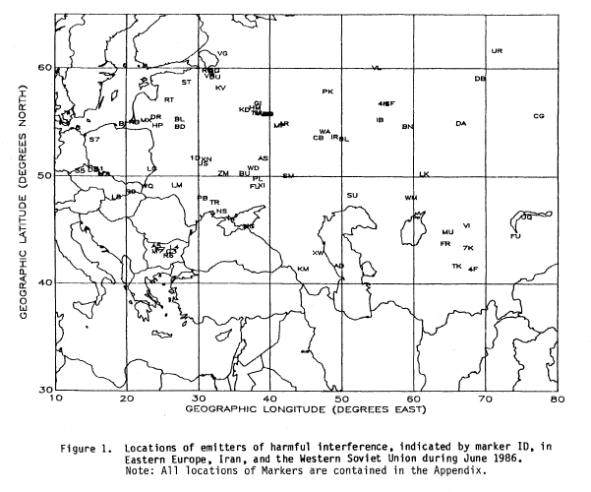
Outputs of ifrb monitoring

Slide 28
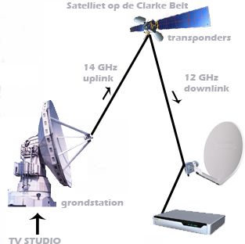
Case study 3
Direct broadcast satellite jamming
Ability to beam TV signals to targeted populations across borders.

Slide 29
International response
Debate about whether state sovereignty (e.g., over airwaves) justifies jamming
  Cultural and political power of television made the debate more complex
  International law gave way to international politics
3 main factions
  US + some Western nations advocating free-flow
  Soviets + Eastern Bloc allies pushing for full jamming powers
  Mainly developing countries arguing for more moderate regulation
    E.g., “prior consent” of nation in the General Assembly (this was never formalized)
    Complicated relevant law and weakened the case for free flow of information

Slide 30
Lessons?
War time information controls can become the norm in peace time
  Avoid viewing censorship-related issues as “cyber war”
  Can lead to justification of tighter controls
Monitoring and “naming and shaming” can be effective
  E.g., IFRB monitoring of radio jamming
  Can we have such a thing for Internet censorship?
As richness of media increases arguments become less clear cut
  Television vs. Radio
  Web 1.0 vs. Web 2.0 (Twitter/Facebook to organized rallies)

Slide 31
Next time …
Background on the Internet/protocols
Start of censorship techniques + measurement

