Slide 1
CSE390 – Advanced Computer Networks
Lecture 20: Routing Security
(Hijacking the Internet for fun and profit!)
Based on slides from J. Rexford @ Princeton U. Revised Fall 2014 by P. Gill

Slide 2
BGP: The Internet’s Routing Protocol (1)
A simple model of AS-level business relationships.
$
$
ISP 1
(peer)
ISP 1
Level 3
(peer)
Level 3
Stub
(customer)
$
stub
Verizon
Wireless
ISP 2
(provider)
ISP 2
$
$
22394
(also VZW)
Notes:
In this work we look at issues relating to security of routing on the internet, but first lets see what we mean when we talk about routing.
In this work we focus on routing between autonomous systems on the internet. So you can think of autonomous systems as the network run by an organization. So for example, AT&T’s network might be one autonomous system and the university of toronto’s network is another autonomous system.
Say the prefix is a block of ip addresses
Define AS
This topology corresponds to:
Large ISP 1 = ATT
Large ISP 2 = NTT
Verizon wireless is really “6167 --- 22394”
We have routeviews announcements for ATT and NTT below
======================= ATT = “Large ISP 1” FIXES THINGS ==============
updates.20100408.1600.lines: | TIME: 04/08/10 12:02:49 | TYPE: BGP4MP/MESSAGE/Update | FROM: 12.0.1.63 AS7018 | TO: 128.223.51.102 AS6447 | ORIGIN: IGP | ASPATH: 7018 3356 6167 22394 22394 | NEXT_HOP: 12.0.1.63 | COMMUNITY: 7018:5000 | ANNOUNCE | 72.103.0.0/19 | 166.180.96.0/19 | 66.174.161.0/24 | 166.180.115.0/24 | 166.153.208.0/20 | 166.180.119.0/24 | 166.153.38.0/24 | 166.145.112.0/20 | 166.145.118.0/24 | 166.145.48.0/24 | 70.203.128.0/20 | 166.145.16.0/24 | 166.180.192.0/19 | 166.145.22.0/24 | 70.201.0.0/19 | 70.204.128.0/20 | 151.144.43.0/24 | 151.144.144.0/24 | 166.145.44.0/24 | 166.153.40.0/24 | 66.174.56.0/24 | 166.180.193.0/24 | 151.144.95.0/24 | 166.145.117.0/24 | 70.205.0.0/18 | 70.200.128.0/19 | 166.145.12.0/24 | 166.145.116.0/24 | 151.144.46.0/24 | 166.180.240.0/24 | 166.153.33.0/24 | 72.103.32.0/20 | 70.205.192.0/19 | 166.153.176.0/24 | 166.153.36.0/24 | 166.145.54.0/24 | 166.180.224.0/24 | 166.180.225.0/24 | 166.180.249.0/24 | 166.180.243.0/24 | 166.180.195.0/24 | 166.180.251.0/24 | 166.180.230.0/24 | 166.180.229.0/24 | 166.180.197.0/24 | 166.180.234.0/24 | 166.180.250.0/24 | 166.180.235.0/24 | 166.180.233.0/24 | 166.180.245.0/24 | 166.180.226.0/24 | 166.180.227.0/24 | 166.180.242.0/24 | 166.180.241.0/24 | 166.180.238.0/24 | 166.180.194.0/24 | 166.180.246.0/24 | 166.180.196.0/24 | 151.144.47.0/24
And
================== NTT = “Large ISP 2” fixes things
updates.20100408.1549.lines: | TIME: 04/08/10 11:58:59 | TYPE: BGP4MP/MESSAGE/Update | FROM: 195.66.224.138 AS2914 | TO: 195.66.225.222 AS6447 | ORIGIN: IGP | ASPATH: 2914 3356 6167 22394 22394 | NEXT_HOP: 195.66.224.138 | MULTI_EXIT_DISC: 5 | COMMUNITY: 2914:420 2914:2201 2914:3200 65504:3356 | ANNOUNCE | 66.174.161.0/24 | 66.174.56.0/24

Slide 3
BGP: The Internet’s Routing Protocol (2)
  A stub is an AS with no customers that never transits traffic.
  (Transit = carry traffic from one neighbor to another)
$
ISP 1
  ISP
Level 3
  ISP
stub
Loses $
X
Verizon
Wireless
ISP 2
$
22394
  85% of ASes are stubs!
  We call the rest (15%) ISPs.
Notes:
In this study we distinguish between two different types of autonomous systems. The first are stubs that do not transit traffic. So forexample the stub in the slide here would not transit traffic between its two provider Ases because it would lose money in doing so. For stubs you can think of Internet as a cost, like electricity rather than a source of income. The second type of ASes are ISPs that transit traffic for other autonomous systems. For these Ases transiting traffic is a source of revenue and profit.

Slide 4
IP Address Ownership and Hijacking
IP address block assignment
  Regional Internet Registries (ARIN, RIPE, APNIC)
  Internet Service Providers
Proper origination of a prefix into BGP
  By the AS who owns the prefix
  … or, by its upstream provider(s) in its behalf
However, what’s to stop someone else?
  Prefix hijacking: another AS originates the prefix
  BGP does not verify that the AS is authorized
  Registries of prefix ownership are inaccurate

Slide 5
How to Hijack a Prefix
The hijacking AS has
  Router with eBGP session(s)
  Configured to originate the prefix
Getting access to the router
  Network operator makes configuration mistake
  Disgruntled operator launches an attack
  Outsider breaks in to the router and reconfigures
Getting other ASes to believe bogus route
  Neighbor ASes not filtering the routes
  … e.g., by allowing only expected prefixes
  But, specifying filters on peering links is hard

Slide 6
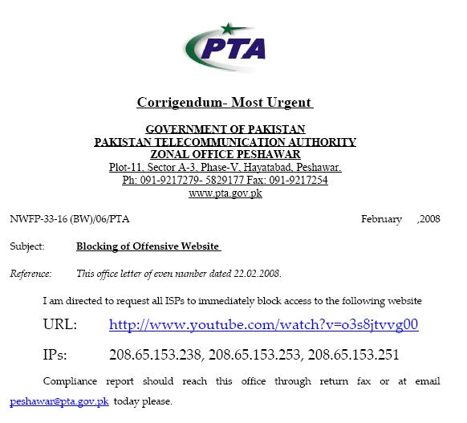
Pakistan Telecom: Sub-prefix hijack
  February 2008 : Pakistan Telecom hijacks YouTube
“The Internet”
Pakistan
Telecom
YouTube
I’m YouTube:
IP 208.65.153.0 / 22
Multinet
Pakistan
Telnor
Pakistan
Aga Khan
University
Notes:
-level of autonomous systems
-e.g., YouTube, AT&T, pakistan telecom
-routing is done on IP addresses, so when someone wants to go to YouTube they get YouTube’s IP address and YouTube announces to the world that they have the ip address and traffic is forwarded towards them. So here multinet would route to it’s provider pakistan telecom that then forwards the traffic on to youtube.
-these networks chosen for a specific reason which is that there was an incident in february 2008 pakistan telecom actually high jacked traffic going to youtube (misconfiguration).
-they announced to the world that they’re youtube and traffic destined to youtube was routed to them
-youtube was unavailable for a couple of hours as operators phone each other to figure out what was going on.

Slide 7
Pakistan Telecom: Sub-prefix hijack
  Here’s what should have happened….
“The Internet”
Hijack + drop packets going to YouTube
X
Pakistan
Telecom
YouTube
I’m YouTube:
IP 208.65.153.0 / 22
Multinet
Pakistan
Telnor
Pakistan
Aga Khan
University
  Block your own customers.

Slide 8
Pakistan Telecom: Sub-prefix hijack
  But here’s what Pakistan ended up doing…
“The Internet”
No, I’m YouTube!
IP 208.65.153.0 / 24
Pakistan
Telecom
Pakistan
Telecom
YouTube
I’m YouTube:
IP 208.65.153.0 / 22
Multinet
Pakistan
Telnor
Pakistan
Aga Khan
University
Notes:
Our works focuses on attacks of this flavor..

Slide 9
China Telecom: Interception
Level3, VZW, 22394 66.174.161.0/24
ISP 1
VZW, 22394 66.174.161.0/24
Level 3
China
Telecom
Verizon
Wireless
22394 66.174.161.0/24
22394
Paths chosen based on cost and length.
66.174.161.0/24
Notes:
B4 we start with attacks lets lookat how bgp works
We have this prefix
22.. Ann, verizon routes traffic to it, reannounces it
“ (level 3)
Some of you may remember a recent “interesting incident” that actually made it into the nytimes
Ctel ann prefix; this wrong, b\c it’s not suppose to originate
Lots of isps fell for this, we look at the data and there we a number of large isp, including thisone that remains nameless,that fell for this.
In fact we found that this happened for 50K prefix, including the DoD.
Also, even worse, renesys found that theres an interception
C tel is so big…
There have been many well publicized misconfigurations that illustrate the insecurity of BGP. For example consider the prefix on the last slide. In april 2010 China telecom announced a direct path to this prefix (as well as 50k other ones). So now ISP 1 has two paths to the prefix and needs to pick 1. Since the china telecom path is shorter ISP 1 will choose to route through it. And what’s interesting here, is that since China Telecom is so large they actually had a router in their network that still new the correct path to the prefix so the traffic went back out to level 3 and on to verizon.

Slide 10
China Telecom: Interception
  April 2010 : China Telecom intercepts traffic
ChinaTel path is shorter
?
ChinaTel 66.174.161.0/24
Level3, VZW, 22394 66.174.161.0/24
ISP 1
Level 3
China
Telecom
Verizon
Wireless
22394
  This prefix and 50K others were announced by China Telecom
  Traffic for some prefixes was possibly intercepted
66.174.161.0/24
Notes:
B4 we start with attacks lets lookat how bgp works
We have this prefix
22.. Ann, verizon routes traffic to it, reannounces it
“ (level 3)
Some of you may remember a recent “interesting incident” that actually made it into the nytimes
Ctel ann prefix; this wrong, b\c it’s not suppose to originate
Lots of isps fell for this, we look at the data and there we a number of large isp, including thisone that remains nameless,that fell for this.
In fact we found that this happened for 50K prefix, including the DoD.
Also, even worse, renesys found that theres an interception
C tel is so big…
There have been many well publicized misconfigurations that illustrate the insecurity of BGP. For example consider the prefix on the last slide. In april 2010 China telecom announced a direct path to this prefix (as well as 50k other ones). So now ISP 1 has two paths to the prefix and needs to pick 1. Since the china telecom path is shorter ISP 1 will choose to route through it. And what’s interesting here, is that since China Telecom is so large they actually had a router in their network that still new the correct path to the prefix so the traffic went back out to level 3 and on to verizon.

Slide 11
Canadian Bitcoin hijack (2/3/2014)
Bitcoin Background
Miners solve cryptographic puzzles using their computing power
  Once the puzzle is solved new bitcoins are created and the miner gets some reward
Mining is generic: mining pool dictates currency
  E.g., dogecoin, bitcoin etc.
Miners communicate with pool server using a protocol called ‘stratum’
  Mining server can redirect user to a different server (e.g., for load balancing)
http://www.secureworks.com/cyber-threat-intelligence/threats/bgp-hijacking-for-cryptocurrency-profit/

Slide 12
Canadian Bitcoin hijack (2/3/2014)
Hijacked users got directed to a mining server IP that was under the control of the hijacker and redirects them to a malicious mining pool.
Miners continue to receive tasks and solve puzzles but don’t get compensated. ☹
http://www.secureworks.com/cyber-threat-intelligence/threats/bgp-hijacking-for-cryptocurrency-profit/

Slide 13
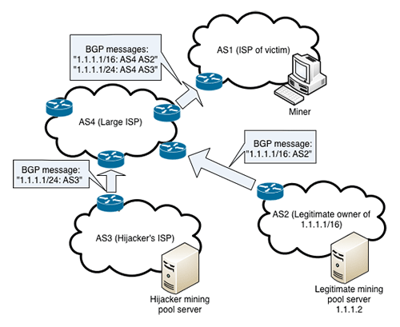
Canadian Bitcoin hijack (2/3/2014)

Slide 14
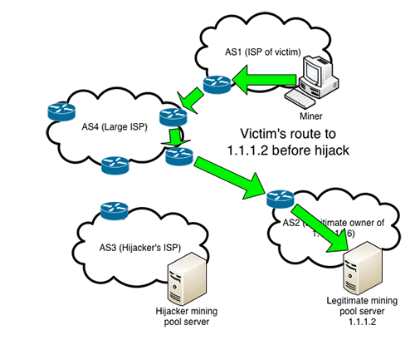
Canadian Bitcoin hijack (2/3/2014)

Slide 15
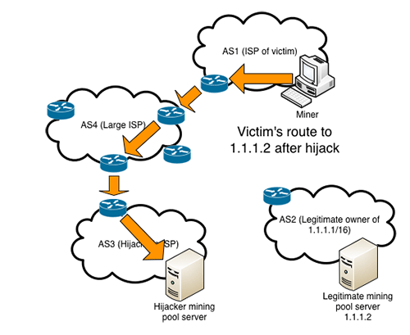
Canadian Bitcoin hijack (2/3/2014)

Slide 16
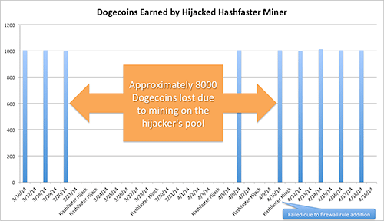
Canadian Bitcoin hijack (2/3/2014)
Estimated loss of $83,000

Slide 17

Bogus AS Paths to Hide Hijacking
Adds AS hop(s) at the end of the path
  E.g., turns “701 88” into “701 88 3”
Motivations
  Evade detection for a bogus route
  E.g., by adding the legitimate AS to the end
Hard to tell that the AS path is bogus…
  Even if other ASes filter based on prefix ownership
701
3
18.0.0.0/8
88
18.0.0.0/8

Slide 18
Path-Shortening Attacks
Remove ASes from the AS path
  E.g., turn “701 3715 88” into “701 88”
Motivations
  Make the AS path look shorter than it is
  Attract sources that normally try to avoid AS 3715
  Help AS 88 look like it is closer to the Internet’s core
Who can tell that this AS path is a lie?
  Maybe AS 88 *does* connect to AS 701 directly
701
3715
88
?

Slide 19
Attacks that Add a Bogus AS Hop
Add ASes to the path
  E.g., turn “701 88” into “701 3715 88”
Motivations
  Trigger loop detection in AS 3715
    Denial-of-service attack on AS 3715
    Or, blocking unwanted traffic coming from AS 3715!
  Make your AS look like is has richer connectivity
Who can tell the AS path is a lie?
  AS 3715 could, if it could see the route
  AS 88 could, but would it really care as long as it received data traffic meant for it?
701
88

Slide 20
Violating “Consistent Export” to Peers
Peers require consistent export
  Prefix advertised at all peering points
  Prefix advertised with same AS path length
Reasons for violating the policy
  Trick neighbor into “cold potato”
  Configuration mistake
Main defense
  Analyzing BGP updates
  … or data traffic
  … for signs of inconsistency
dest
Bad AS
BGP
data
src

Slide 21
Hijacking is Hard to Debug
Real origin AS doesn’t see the problem
  Picks its own route
  Might not even learn the bogus route
May not cause loss of connectivity
  E.g., if the bogus AS snoops and redirects
  … may only cause performance degradation
Or, loss of connectivity is isolated
  E.g., only for sources in parts of the Internet
Diagnosing prefix hijacking
  Analyzing updates from many vantage points
  Launching traceroute from many vantage points

Slide 22
Other Attacks
Attacks on BGP sessions
  Confidentiality of BGP messages
  Denial-of-service on BGP session
  Inserting, deleting, modifying, or replaying messages
Resource exhaustion attacks
  Too many IP prefixes (e.g., BGP “512K Day”)
  Too many BGP update messages
Data-plane attacks
  Announce one BGP routes, but use another

Slide 23
Outline
Control plane attacks on routing
Attacks on the BGP Session
Solutions to prevent prefix hijacks
Solutions to detect prefix hijacks
Data plane attacks
Wrap up

Slide 24
TCP Connection Underlying BGP Session
BGP session runs over TCP
  TCP connection between neighboring routers
  BGP messages sent over TCP connection
  Makes BGP vulnerable to attacks on TCP
Main kinds of attacks
  Against confidentiality: eavesdropping
  Against integrity: tampering
  Against performance: denial-of-service
Main defenses
  Message authentication or encryption
  Limiting access to physical path between routers
  Defensive filtering to block unexpected packets

Slide 25
Attacks Against Confidentiality
Eavesdropping
  Monitoring the messages on the BGP session
  … by tapping the link(s) between the neighbors
Reveals sensitive information
  Inference of business relationships
  Analysis of network stability
Reasons why it may be hard
  Challenging to tap the link
    Often, eBGP session traverses just one link
    … and may be hard to get access to tap it
  Encryption may obscure message contents
    BGP neighbors may run BGP over IPSec
BGP session
physical link

Slide 26
Attacking Message Integrity
Tampering
  Man-in-the-middle tampers with the messages
  Insert, delete, modify, or replay messages
Leads to incorrect BGP behavior
  Delete: neighbor doesn’t learn the new route
  Insert/modify: neighbor learns bogus route
Reasons why it may be hard
  Getting in-between the two routers is hard
  Use of authentication (signatures) or encryption
  Spoofing TCP packets the right way is hard
    Getting past source-address packet filters
    Generating the right TCP sequence number

Slide 27
Denial-of-Service Attacks, Part 1
Overload the link between the routers
  To cause packet loss and delay
  … disrupting the performance of the BGP session
Relatively easy to do
  Can send traffic between end hosts
  As long as the packets traverse the link
  (which you can figure out from traceroute)
Easy to defend
  Give higher priority to BGP packets
  E.g., by putting packets in separate queue
BGP session
physical link

Slide 28
Denial-of-Service Attacks, Part 2
Third party sends bogus TCP packets
  FIN/RST to close the session
  SYN flooding to overload the router
Leads to disruptions in BGP
  Session reset, causing transient routing changes
  Route-flapping, which may trigger flap damping
Reasons why it may be hard
  Spoofing TCP packets the right way is hard
    Difficult to send FIN/RST with the right TCP header
  Packet filters may block the SYN flooding
    Filter packets to BGP port from unexpected source
    … or destined to router from unexpected source

Slide 29
Exploiting the IP TTL Field
BGP speakers are usually one hop apart
  To thwart an attacker, can check that the packets carrying the BGP message have not traveled far
IP Time-to-Live (TTL) field
  Decremented once per hop
  Avoids packets staying in network forever
Generalized TTL Security Mechanism (RFC 3682)
  Send BGP packets with initial TTL of 255
  Receiving BGP speaker checks that TTL is 254
  … and flags and/or discards the packet others
Hard for third-party to inject packets remotely

Slide 30
Outline
Control plane attacks on routing
Attacks on the BGP Session
Solutions to prevent prefix hijacks
Solutions to detect prefix hijacks
Data plane attacks
Wrap up

Slide 31
Securing the Internet: RPKI
  Resource Public Key Infrastructure (RPKI): Certified mapping from ASes to public keys and IP prefixes.
X
RPKI: Invalid!
?
ChinaTel 66.174.161.0/24
Level3, VZW, 22394 66.174.161.0/24
ISP 1
Level 3
China
Telecom
Verizon
Wireless
22394
  RPKI shows China Telecom is not a valid origin for this prefix.
66.174.161.0/24
Notes:
One way we might solve this is using the cry
One way to solve this is to do origin authentication using RPKI which is a certified mapping between IP prefixes and the Ases that own them. So now ISP 1 can check the RPKI and see that china telecom is not a valid orignator of this prefix and choose the correct path to the prefix.

Slide 32
But RPKI alone is not enough!
  Resource Public Key Infrastructure (RPKI): Certified mapping from ASes to public keys and IP prefixes.
?
ChinaTel, 22394 66.174.161.0/24
Level3, VZW, 22394 66.174.161.0/24
ISP 1
Level 3
China
Telecom
Verizon
Wireless
22394
  Malicious router can pretend to connect to the valid origin.
66.174.161.0/24
Notes:
However, if instead of just being misconfigured, china telecom decided to behave maliciously, RPKI would not be enough. So for example china telecom could pretend they have a direct connection to the AS that owns the prefix by announcing China telecom 22394.

Slide 33
We need path validating protocols
soBGP: Secure origin BGP
  Origin authentication +
  …Trusted database that guarantees that a path exists
  ASes jointly sign + put their connectivity in the DB
  Stops ASes from announcing paths with edges that do not exist
  What challenges might soBGP face for deployment?
S-BGP: Secure BGP
  Each AS on the path cryptographically signs its announcement
  Guarantees that each AS on the path made the announcement in the path.

Slide 34
  S-BGP [1997]: RPKI + Cannot announce a path that was not announced to you.
VZW: (22394, Prefix)
Level3: (VZW, 22394, Prefix)
ISP 1: (Level3, VZW, 22394, Prefix)
ISP 1
Level 3
China
Telecom
Verizon
Wireless
VZW: (22394, Prefix)
Level3: (VZW, 22394, Prefix)
22394
VZW: (22394, Prefix)
Public Key Signature: Anyone with 22394’s public key can validate that the message was sent by 22394.

Slide 35
  S-BGP [1997]: RPKI + Cannot announce a path that was not announced to you.
VZW: (22394, Prefix)
Level3: (VZW, 22394, Prefix)
ISP 1: (Level3, VZW, 22394, Prefix)
ISP 1
Level 3
China
Telecom
Verizon
Wireless
22394
  Malicious router can’t announce a direct path to 22394, since 22394 never said
ChinaTel: (22394, Prefix)

Slide 36
S-BGP Secure Version of BGP
Address attestations
  Claim the right to originate a prefix
  Signed and distributed out-of-band
  Checked through delegation chain from ICANN
Route attestations
  Distributed as an attribute in BGP update message
  Signed by each AS as route traverses the network
  Signature signs previously attached signatures
S-BGP can validate
  AS path indicates the order ASes were traversed
  No intermediate ASes were added or removed

Slide 37
S-BGP Deployment Challenges
Complete, accurate registries
  E.g., of prefix ownership
Public Key Infrastructure
  To know the public key for any given AS
Cryptographic operations
  E.g., digital signatures on BGP messages
Need to perform operations quickly
  To avoid delaying response to routing changes
Difficulty of incremental deployment
  Hard to have a “flag day” to deploy S-BGP

Slide 38
S-BGP Deployment Challenges
Need ISPs to agree on and deploy a new protocol!
  These are competing organizations!
Economic incentives?
  Doesn’t improve performance
  Hard to convince customers to pay more for security
No benefit to unilateral deployment
  Need entire path to deploy SBGP/soBGP before you get any benefit!
  Like IPv6…. But worse ☹

Slide 39
Outline
Control plane attacks on routing
Attacks on the BGP Session
Solutions to prevent prefix hijacks
Solutions to detect prefix hijacks
Data plane attacks
Wrap up

Slide 40
Incrementally Deployable Schemes
Monitoring BGP update messages
  Use past history as an implicit registry
  E.g., AS that announces each address block
  E.g., AS-level edges and paths
Out-of-band detection mechanism
  Generate reports and alerts
  Internet Alert Registry: http://iar.cs.unm.edu/
  Prefix Hijack Alert System: http://phas.netsec.colostate.edu/
Soft response to suspicious routes
  Prefer routes that agree with the past
  Delay adoption of unfamiliar routes when possible
  Some (e.g., misconfiguration) will disappear on their own

Slide 41

Control Plane Vs. Data Plane
Control plane
  BGP is a routing protocol
  BGP security concerns validity of routing messages
  I.e., did the BGP message follow the sequence of ASes listed in the AS-path attribute
Data plane
  Routers forward data packets
  Supposedly along the path chosen in the control plane
  But what ensures that this is true?

Slide 42
Control plane anomaly types
Multiple origin AS (MOAS)
  AS that doesn’t normally announce a prefix begins to announce it
  Can be legitimate (anycast IPs, IP transfers)

Slide 43
Control plane anomaly types
Increase in prefixes originated by each AS
  E.g., China telecom incident, AS 23724 rapidly went from announcing few prefixes to announcing 50k prefixes
Valley-free violations
  Paths where an AS appears to transit traffic at a revenue loss.

Slide 44
Control plane anomaly types
New edges in the AS graphs
  May be because of false routing announcements (or new relationships)
  Edge V-A in below figure doesn’t actually exist!

Slide 45
Control plane anomaly types
Inconsistent prepending announcements
  Adversary may strip prepending to make their path look more appealing.

Slide 46
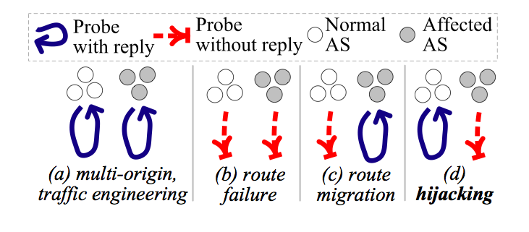
Correlating anomalies with the data plane
When a control plane anomaly is seen, correlate with data plane measurements to see the impact.
Paper: Argus (IMC 2012) http://www-net.cs.umass.edu/imc2012/papers/p15.pdf

Slide 47
Outline
Control plane attacks on routing
Attacks on the BGP Session
Solutions to prevent prefix hijacks
Solutions to detect prefix hijacks
Data plane attacks
Wrap up

Slide 48
Data-Plane Attacks, Part 1
Drop packets in the data plane
  While still sending the routing announcements
Easier to evade detection
  Especially if you only drop some packets
  Like, oh, say, BitTorrent or Skype traffic
Even easier if you just slow down some traffic
  How different are normal congestion and an attack?
  Especially if you let ping/traceroute packets through?

Slide 49
Data-Plane Attacks, Part 2
Send packets in a different direction
  Disagreeing with the routing announcements
Direct packets to a different destination
  E.g., one the adversary controls
What to do at that bogus destination?
  Impersonate the legitimate destination (e.g., to perform identity theft, or promulgate false information)
  Snoop on the traffic and forward along to real destination
How to detect?
  Traceroute? Longer than usual delays?
  End-to-end checks, like site certificate or encryption?

Slide 50
Fortunately, Data-Plane Attacks are Harder
Adversary must control a router along the path
  So that the traffic flows through him
How to get control a router
  Buy access to a compromised router online
  Guess the password
  Exploit known router vulnerabilities
  Insider attack (disgruntled network operator)
Malice vs. greed
  Malice: gain control of someone else’s router
  Greed: Verizon DSL blocks Skype to gently encourage me to pick up my landline phone to use Verizon long distance $ervice ☺

Slide 51
Outline
Control plane attacks on routing
Attacks on the BGP Session
Solutions to prevent prefix hijacks
Solutions to detect prefix hijacks
Data plane attacks
Wrap up

Slide 52
BGP is So Vulnerable
Several high-profile outages
  http://merit.edu/mail.archives/nanog/1997-04/msg00380.html
  http://www.renesys.com/blog/2005/12/internetwide_nearcatastrophela.shtml
  http://www.renesys.com/blog/2006/01/coned_steals_the_net.shtml
  http://www.renesys.com/blog/2008/02/pakistan_hijacks_youtube_1.shtml
Many smaller examples
  Blackholing a single destination prefix
  Hijacking unallocated addresses to send spam
Why isn’t it an even bigger deal?
  Really, most big outages are configuration errors
  Most bad guys want the Internet to stay up
  … so they can send unwanted traffic (e.g., spam, identity theft, denial-of-service attacks, port scans, …)

Slide 53
BGP is So Hard to Fix
Complex system
  Large, with around 30,000 ASes
  Decentralized control among competitive ASes
  Core infrastructure that forms the Internet
Hard to reach agreement on the right solution
  S-BGP with public key infrastructure, registries, crypto?
  Who should be in charge of running PKI and registries?
  Worry about data-plane attacks or just control plane?
Hard to deploy the solution once you pick it
  Hard enough to get ASes to apply route filters
  Now you want them to upgrade to a new protocol
  … all at the exact same moment?

Slide 54
Conclusions
Internet protocols designed based on trust
  The insiders are good guys
  All bad guys are outside the network
Border Gateway Protocol is very vulnerable
  Glue that holds the Internet together
  Hard for an AS to locally identify bogus routes
  Attacks can have very serious global consequences
Proposed solutions/approaches
  Secure variants of the Border Gateway Protocol
  Anomaly detection schemes, with automated response
  Broader focus on data-plane availability

Slide 55
End.

