Slide 1
CSE390 – Advanced Computer Networks
Lecture 6-7: Inter Domain Routing
(It’s all about the Money)
Based on slides from D. Choffnes Northeastern U. Revised Fall 2014 by P. Gill

Slide 2
Administravia
Assignment 2 released
Test the VMs (Brian Tria should have sent you log in info)
Good discussion leads posted to Piazza!
Don’t be shy to post follow ups/discussion

Slide 3
Network Layer, Control Plane
Function:
Set up routes between networks
Key challenges:
Implementing provider policies
Creating stable paths
Data Plane
Application
Presentation
Session
Transport
Network
RIP
OSPF
BGP
Control Plane
Data Link
Physical

Slide 4
Outline
BGP Basics
Stable Paths Problem
BGP in the Real World
Debugging BGP Path Problems

Slide 5
ASs, Revisited
AS-1
AS-3
Interior Routers
AS-2
BGP Routers

Slide 6
AS Numbers
Each AS identified by an ASN number
16-bit values (latest protocol supports 32-bit ones)
64512 – 65535 are reserved
Currently, there are ~ 40000 ASNs
AT&T: 5074, 6341, 7018, …
Sprint: 1239, 1240, 6211, 6242, …
Stony Brook U: 5719
Google 15169, 36561 (formerly YT), + others
Facebook 32934
North America ASs → ftp://ftp.arin.net/info/asn.txt

Slide 7
Inter-Domain Routing
Global connectivity is at stake!
Thus, all ASs must use the same protocol
Contrast with intra-domain routing
What are the requirements?
Scalability
Flexibility in choosing routes
Cost
Routing around failures
Question: link state or distance vector?
Trick question: BGP is a path vector protocol

Slide 8
BGP
Border Gateway Protocol
De facto inter-domain protocol of the Internet
Policy based routing protocol
Uses a Bellman-Ford path vector protocol
Relatively simple protocol, but…
Complex, manual configuration
Entire world sees advertisements
Errors can screw up traffic globally
Policies driven by economics
How much $$$ does it cost to route along a given path?
Not by performance (e.g. shortest paths)

Slide 9
BGP Relationships
Provider
Peer 2 has no incentive to route 1→ 3
Peers do not pay each other
$
Customer
Provider
Customer
Peer 1
Peer 2
Peer 3
Customer pays provider
Customer

Slide 10
Tier-1 ISP Peering
Inteliquent
Centurylink
Verizon Business
AT&T
So you want to be a tier 1 network?
All you have to do is get all the other tier 1s to peer with you!
(not that easy ☺)
Level 3
Sprint
XO Communications

Slide 11
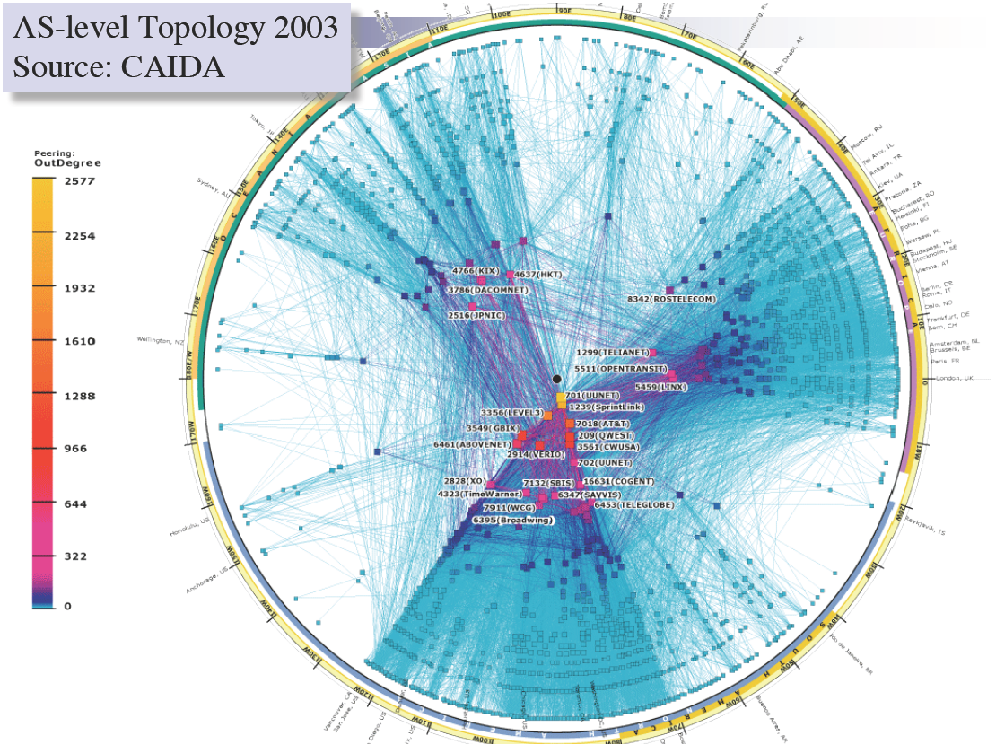

Slide 12
Peering Wars
Peer
Don’t Peer
Reduce upstream costs
Improve end-to-end performance
May be the only way to connect to parts of the Internet
You would rather have customers
Peers are often competitors
Peering agreements require periodic renegotiation
Peering struggles in the ISP world are extremely contentious agreements are usually confidential
Example: If you are a customer of my peer why should I peer with you? You should pay me too!
Incentive to keep relationships private!

Slide 13
Two Types of BGP Neighbors
Exterior routers also speak IGP
IGP
eBGP
eBGP
iBGP
iBGP

Slide 14
Full iBGP Meshes
Question: why do we need iBGP?
OSPF does not include BGP policy info
Prevents routing loops within the AS
iBGP updates do not trigger announcements
eBGP
iBGP

Slide 15
Path Vector Protocol
AS-path: sequence of ASs a route traverses
Like distance vector, plus additional information
Used for loop detection and to apply policy
E.g., pick cheapest/shortest path
Routing done based on longest prefix match
AS 4
120.10.0.0/16
AS 3
130.10.0.0/16
AS 5
AS 2
110.10.0.0/16
120.10.0.0/16: AS 2 → AS 3 → AS 4
130.10.0.0/16: AS 2 → AS 3
110.10.0.0/16: AS 2 → AS 5
AS 1

Slide 16
BGP Operations (Simplified)
Establish session on TCP port 179
AS-1
Exchange active routes
BGP Session
AS-2
Exchange incremental updates

Slide 17
Four Types of BGP Messages
Open: Establish a peering session.
Keep Alive: Handshake at regular intervals.
Notification: Shuts down a peering session.
Update: Announce new routes or withdraw previously announced routes.
announcement = IP prefix + attributes values

Slide 18
BGP Attributes
Attributes used to select “best” path
LocalPref
Local preference policy to choose most preferred route
Overrides default fewest AS behavior
Multi-exit Discriminator (MED)
Specifies path for external traffic destined for an internal network
Chooses peering point for your network
Import Rules
What route advertisements do I accept?
Export Rules
Which routes do I forward to whom?

Slide 19
Route Selection Summary
Highest Local Preference
Enforce relationships
Shortest AS Path
Lowest MED
Traffic engineering
Lowest IGP Cost to BGP Egress
When all else fails,
break ties
Lowest Router ID

Slide 20
Shortest AS Path != Shortest Path
4 hops
4 ASs
9 hops
2 ASs
Source
?
?
Destination

Slide 21
Hot Potato Routing
Pick the next hop with the shortest IGP route
Source
?
?
Destination

Slide 22
Importing Routes
From Provider
ISP Routes
From Peer
From Peer
From Customer

Slide 23
Exporting Routes
$$$ generating routes
Customer and ISP routes only
To Provider
To Peer
To Peer
To Customer
Customers get all routes

Slide 24
Modeling BGP
AS relationships
Customer/provider
Peer
Sibling, IXP
Gao-Rexford model
AS prefers to use customer path, then peer, then provider
Follow the money!
Valley-free routing
Hierarchical view of routing (incorrect but frequently used)
P-P
P-P
C-P
P-C
P-C
P-P

Slide 25
AS Relationships: It’s Complicated
GR Model is strictly hierarchical
Each AS pair has exactly one relationship
Each relationship is the same for all prefixes
In practice it’s much more complicated
Rise of widespread peering
Regional, per-prefix peerings
Tier-1’s being shoved out by “hypergiants”
IXPs dominating traffic volume
Modeling is very hard, very prone to error
Huge potential impact for understanding Internet behavior

Slide 26
Other BGP Attributes
AS_SET
Instead of a single AS appearing at a slot, it’s a set of Ases
Communities
Arbitrary number that is used by neighbors for routing decisions
Export this route only in Europe
Do not export to your peers
Usually stripped after first interdomain hop
Why?
Prepending
Lengthening the route by adding multiple instances of ASN
Why?

Slide 27
Outline
BGP Basics
Stable Paths Problem
BGP in the Real World
Debugging BGP Path Problems

Slide 28
What Problem is BGP Solving?
Underlying Problem | Distributed Solution
Shortest Paths | RIP, OSPF, IS-IS, etc.
??? | BGP
Knowing ??? can:
Aid in the analysis of BGP policy
Aid in the design of BGP extensions
Help explain BGP routing anomalies
Give us a deeper understanding of the protocol

Slide 29
The Stable Paths Problem
An instance of the SPP:
Graph of nodes and edges
Node 0, called the origin
A set of permitted paths from each node to the origin
Each set of paths is ranked
2 1 0
2 0
5
5 2 1 0
2
2
4 2 0
4 3 0
4
0
1
3
3 0
1 3 0
1 0

Slide 30
A Solution to the SPP
A solution is an assignment of permitted paths to each node such that:
Node u’s path is either null or uwP, where path uw is assigned to node w and edge u → w exists
Each node is assigned the highest ranked path that is consistent with their neighbors
2 1 0
2 0
5
5 2 1 0
2
Solutions need not use the shortest paths, or form a spanning tree
2
4 2 0
4 3 0
4
0
1
3
3 0
1 3 0
1 0

Slide 31
Simple SPP Example
1 0
1 3 0
2 0
2 1 0
1
2
2
Each node gets its preferred route
Totally stable topology
0
3
4
3 0
4 3 0
4 2 0
4 2 0
4 3 0

Slide 32
Good Gadget
1 3 0
1 0
2 1 0
2 0
1
2
2
Not every node gets preferred route
Topology is still stable
Only one stable configuration
No matter which node chooses first!
0
3
4
3 0
4 3 0
4 2 0

Slide 33
SPP May Have Multiple Solutions
1 2 0
1 0
1 2 0
1 0
1 2 0
1 0
1
1
1
0
0
0
2
2
2
2 1 0
2 0
2 1 0
2 0
2 1 0
2 0

Slide 34
Bad Gadget
1 3 0
1 0
2 1 0
2 0
That was only one round of oscillation!
This keeps going, infinitely
Problem stems from:
Local (not global) decisions
Ability of one node to improve its path selection
1
2
2
0
3
4
3 4 2 0
3 0
4 2 0
4 3 0

Slide 35
SPP Explains BGP Divergence
BGP is not guaranteed to converge to stable routing
Policy inconsistencies may lead to “livelock”
Protocol oscillation
Solvable
Can Diverge
Good Gadgets
Bad Gadgets
Must
Converge
Must
Diverge
Naughty Gadgets

Slide 36
Beware of Backup Policies
1 3 0
1 0
2 1 0
2 0
1
2
2
BGP is not robust
It may not recover from link failure
0
3
4
3 4 2 0
3 0
4 0
4 2 0
4 3 0

Slide 37
BGP is Precarious
If node 1 uses path 1 → 0, this is solvable
4 3 1 0
4 5 3 1 2 0
4 3 1 2 0
1 2 0
1 0
4
1
3 1 0
3 1 2 0
3
No longer stable
0
5
6
2
5 3 1 0
5 6 3 1 2 0
5 3 1 2 0
6 3 1 0
6 4 3 1 2 0
6 3 1 2 0
2 1 0
2 0

Slide 38
Can BGP Be Fixed?
Unfortunately, SPP is NP-complete
Possible Solutions
Static Approach
Dynamic Approach
Extend BGP to
detect and suppress
policy-based oscillations?
Automated Analysis
of Routing Policies
(This is very hard)
Inter-AS
coordination
These approaches are complementary

Slide 39
Outline
BGP Basics
Stable Paths Problem
BGP in the Real World
Debugging BGP Path Problems

Slide 40
Motivation
Routing reliability/fault-tolerance on small time scales (minutes) not previously a priority
Transaction oriented and interactive applications (e.g. Internet Telephony) will require higher levels of end-to-end network reliability
How well does the Internet routing infrastructure tolerate faults?
Notes:
Motivation → why we should care about convergence

Slide 41
Conventional Wisdom
Internet routing is robust under faults
Supports path re-routing
Path restoration on the order of seconds
BGP has good convergence properties
Does not exhibit looping/bouncing problems of RIP
Internet fail-over will improve with faster routers and faster links
More redundant connections (multi-homing) will always improve fault-tolerance

Slide 42
Delayed Routing Convergence
Conventional wisdom about routing convergence is not accurate
Measurement of BGP convergence in the Internet
Analysis/intuition behind delayed BGP routing convergence
Modifications to BGP implementations which would improve convergence times

Slide 43
Open Question
After a fault in a path to multi-homed site, how long does it take for majority of Internet routers to fail-over to secondary path?
Route Withdrawn
Routing table convergence
Stable end-to-end paths
Primary ISP
Customer
Backup ISP
Traffic

Slide 44
Bad News
With unconstrained policies:
Divergence
Possible create unsatisfiable policies
NP-complete to identify these policies
Happening today?
With constrained policies (e.g. shortest path first)
Transient oscillations
BGP usually converges
It may take a very long time…
BGP Beacons: focuses on constrained policies

Slide 45
16 Month Study of Convergence
Instrument the Internet
Inject BGP faults (announcements/withdrawals) of varied prefix and AS path length into topologically and geographically diverse ISP peering sessions
Monitor impact faults through
Recording BGP peering sessions with 20 tier1/tier2 ISPs
Active ICMP measurements (512 byte/second to 100 random web sites)
Wait two years (and 250,000 faults)

Slide 46
Measurement Architecture
Researchers pretending to be an AS
Researchers pretending to be an AS

Slide 47
Announcement Scenarios
Tup – a new route is advertised
Tdown – A route is withdrawn
i.e. single-homed failure
Tshort – Advertise a shorter/better AS path
i.e. primary path repaired
Tlong – Advertise a longer/worse AS path
i.e. primary path fails

Slide 48
Major Convergence Results
Routing convergence requires an order of magnitude longer than expected
10s of minutes
Routes converge more quickly following Tup/Repair than Tdown/Failure events
Bad news travels more slowly
Withdrawals (Tdown) generate several more announcements than new routes (Tup)

Slide 49
Example
BGP log of updates from AS2117 for route via AS2129
One withdrawal triggers 6 announcements and one withdrawal from 2117
Increasing AS path length until final withdrawal

Slide 50
Why So Many Announcements?
Events from AS 2177
Route Fails: AS 2129
Announce: 5696 2129
Announce: 1 5696 2129
Announce: 2041 3508 2129
Announce: 1 2041 3508 2129
Route Withdrawn: 2129
AS 2041
AS 3508
AS 1
AS 5696
AS 2129
AS 2117

Slide 51
How Many Announcements Does it Take For an AS to Withdraw a Route?
Answer: up to 19

Slide 52
BGP Routing Table Convergence Times
New Route
Long->Short Fail-over
Short->Long Fail-Over
Failure
Less than half of Tdown events converge within two minutes
Tup/Tshort and Tdown/Tlong form equivalence classes
Long tailed distribution (up to 15 minutes)

Slide 53
Failures, Fail-overs and Repairs
Bad news does not travel fast…
Repairs (Tup) exhibit similar convergence as long-short AS path fail-over
Failures (Tdown) and short-long fail-overs (e.g. primary to secondary path) also similar
Slower than Tup (e.g. a repair)
80% take longer than two minutes
Fail-over times degrade the greater the degree of multi-homing

Slide 54
Intuition for Delayed Convergence
There exists possible ordering of messages such that BGP will explore ALL possible AS paths of ALL possible lengths
BGP is O(N!), where N number of default-free BGP routers in a complete graph with default policy

Slide 55
Impact of Delayed Convergence
Why do we care about routing table convergence?
It impacts end-to-end connectivity for Internet paths
ICMP experiment results
Loss of connectivity, packet loss, latency, and packet re-ordering for an average of 3-5 minutes after a fault
Why?
Routers drop packets when next hop is unknown
Path switching spikes latency/delay
Multi-pathing causes reordering

Slide 56
In real life …
Discussed worst case BGP behavior
In practice, BGP policy prevents worst case from happening
BGP timers also provide synchronization and limits possible orderings of messages

Slide 57
Interdomain Routing Day 2
Review …
A1 returned at end of class + discuss A2

Slide 58
BGP: The Internet’s Routing Protocol
A simple model of AS-level business relationships.
$
$
ISP 1
(peer)
ISP 1
Level 3
(peer)
Level 3
Stub
(customer)
$
stub
Verizon
Wireless
ISP 2
(provider)
ISP 2
$
$
22394
(also VZW)
Notes:
In this work we look at issues relating to security of routing on the internet, but first lets see what we mean when we talk about routing.
In this work we focus on routing between autonomous systems on the internet. So you can think of autonomous systems as the network run by an organization. So for example, AT&T’s network might be one autonomous system and the university of toronto’s network is another autonomous system.
Say the prefix is a block of ip addresses
Define AS
This topology corresponds to:
Large ISP 1 = ATT
Large ISP 2 = NTT
Verizon wireless is really “6167 --- 22394”
We have routeviews announcements for ATT and NTT below
======================= ATT = “Large ISP 1” FIXES THINGS ==============
updates.20100408.1600.lines: | TIME: 04/08/10 12:02:49 | TYPE: BGP4MP/MESSAGE/Update | FROM: 12.0.1.63 AS7018 | TO: 128.223.51.102 AS6447 | ORIGIN: IGP | ASPATH: 7018 3356 6167 22394 22394 | NEXT_HOP: 12.0.1.63 | COMMUNITY: 7018:5000 | ANNOUNCE | 72.103.0.0/19 | 166.180.96.0/19 | 66.174.161.0/24 | 166.180.115.0/24 | 166.153.208.0/20 | 166.180.119.0/24 | 166.153.38.0/24 | 166.145.112.0/20 | 166.145.118.0/24 | 166.145.48.0/24 | 70.203.128.0/20 | 166.145.16.0/24 | 166.180.192.0/19 | 166.145.22.0/24 | 70.201.0.0/19 | 70.204.128.0/20 | 151.144.43.0/24 | 151.144.144.0/24 | 166.145.44.0/24 | 166.153.40.0/24 | 66.174.56.0/24 | 166.180.193.0/24 | 151.144.95.0/24 | 166.145.117.0/24 | 70.205.0.0/18 | 70.200.128.0/19 | 166.145.12.0/24 | 166.145.116.0/24 | 151.144.46.0/24 | 166.180.240.0/24 | 166.153.33.0/24 | 72.103.32.0/20 | 70.205.192.0/19 | 166.153.176.0/24 | 166.153.36.0/24 | 166.145.54.0/24 | 166.180.224.0/24 | 166.180.225.0/24 | 166.180.249.0/24 | 166.180.243.0/24 | 166.180.195.0/24 | 166.180.251.0/24 | 166.180.230.0/24 | 166.180.229.0/24 | 166.180.197.0/24 | 166.180.234.0/24 | 166.180.250.0/24 | 166.180.235.0/24 | 166.180.233.0/24 | 166.180.245.0/24 | 166.180.226.0/24 | 166.180.227.0/24 | 166.180.242.0/24 | 166.180.241.0/24 | 166.180.238.0/24 | 166.180.194.0/24 | 166.180.246.0/24 | 166.180.196.0/24 | 151.144.47.0/24
And
================== NTT = “Large ISP 2” fixes things
updates.20100408.1549.lines: | TIME: 04/08/10 11:58:59 | TYPE: BGP4MP/MESSAGE/Update | FROM: 195.66.224.138 AS2914 | TO: 195.66.225.222 AS6447 | ORIGIN: IGP | ASPATH: 2914 3356 6167 22394 22394 | NEXT_HOP: 195.66.224.138 | MULTI_EXIT_DISC: 5 | COMMUNITY: 2914:420 2914:2201 2914:3200 65504:3356 | ANNOUNCE | 66.174.161.0/24 | 66.174.56.0/24

Slide 59
BGP: The Internet’s Routing Protocol (2)
A stub is an AS with no customers that never transits traffic.
(Transit = carry traffic from one neighbor to another)
$
ISP 1
ISP
Level 3
ISP
stub
Loses $
X
Verizon
Wireless
ISP 2
$
22394
85% of ASes are stubs!
We call the rest (15%) ISPs.
Notes:
In this study we distinguish between two different types of autonomous systems. The first are stubs that do not transit traffic. So forexample the stub in the slide here would not transit traffic between its two provider Ases because it would lose money in doing so. For stubs you can think of Internet as a cost, like electricity rather than a source of income. The second type of ASes are ISPs that transit traffic for other autonomous systems. For these Ases transiting traffic is a source of revenue and profit.

Slide 60
BGP: The Internet’s Routing Protocol (3)
BGP sets up paths from ASes to destination IP prefixes.
ISP1, Level3, VZW, 22394
66.174.161.0/24
Level3, VZW, 22394 66.174.161.0/24
$
ISP 1
VZW, 22394 66.174.161.0/24
Level 3
stub
Verizon
Wireless
ISP 2
$
ISP2, Level3, VZW, 22394 66.174.161.0/24
22394
(also VZW)
A model of BGP routing policies:
Prefer cheaper paths. Then, prefer shorter paths.
Notes:
Say the prefix is a block of ip addresses
Define AS

Slide 61
Standard model of Internet routing
Proposed by Gao & Rexford 12 years ago
Based on practices employed by a large ISP
Provide an intuitive model of path selection and export policy
Customer
Path Selection:
1. LocalPref: Prefer customer paths
over peer paths
over provider paths
2. Prefer shorter paths
3. Arbitrary tiebreak
$
$
Peer
ISP
$
Provider

Slide 62
Standard model of Internet routing
Proposed by Gao & Rexford 12 years ago
Based on practices employed by a large ISP
Provide an intuitive model of path selection and export policy
Provider
Path Selection:
1. LocalPref: Prefer customer paths
over peer paths
over provider paths
2. Prefer shorter paths
3. Arbitrary tiebreak
Announcements
$
ISP
$
$
Export Policy:
Export customer path
to all neighbors.
Export peer/provider path
to all customers.
Provider
Customer

Slide 63
Standard model of Internet routing
Proposed by Gao & Rexford 12 years ago
Based on practices employed by a large ISP
Provide an intuitive model of path selection and export policy
Provider
Path Selection:
1. LocalPref: Prefer customer paths
over peer paths
over provider paths
2. Prefer shorter paths
3. Arbitrary tiebreak
Announcements
$
ISP
$
$
Export Policy:
Export customer path
to all neighbors.
Export peer/provider path
to all customers.
Provider
Customer

Slide 64
More complex routing example
Local ISP, AOL, Cogent, Georgia Tech
130.207.0.0/16
Cogent, Georgia Tech
130.207.0.0/16
U. Toronto
Paths chosen based on business relationships and length.
Local ISP
Cogent
Georgia
Tech
Princeton
AOL
Qwest
Georgia Tech
130.207.0.0/16
I have a packet for
130.207.20.23
AOL,Cogent, Georgia Tech
130.207.0.0/16
Qwest, Georgia Tech
130.207.0.0/16
Border gateway protocol (BGP) responsible for routing between autonomous systems (ASes)

Slide 65
Outline
BGP Basics
Stable Paths Problem
BGP in the Real World
Debugging BGP Path Problems

Slide 66
Control plane vs. Data Plane
Control:
Make sure that if there’s a path available, data is forwarded over it
BGP sets up such paths at the AS-level
Data:
For a destination, send packet to most-preferred next hop
Routers forward data along IP paths
How does the control plane know if a data path is broken?
Direct-neighbor connectivity
What if the outage isn’t in the direct neighbor?

Slide 67
Why Network Reliability Remains Hard
Visibility
IP provides no built-in monitoring
Economic disincentives to share information publicly
Control
Routing protocols optimize for policy, not reliability
Outage affecting your traffic may be caused by distant network
Detecting, isolating and repairing network problems for Internet paths remains largely a slow, manual process

Slide 68
Improving Internet Availability
New Internet design
Monitoring everywhere in the network
Visibility into all available routes
Any operator can impact routes affecting her traffic
Challenges
What should we monitor?
What do we do with additional visibility?
How to use additional control?

Slide 69
A Practical Approach
We can do this already in today’s Internet
Crowdsourcing monitoring
Use existing protocols/systems in unintended ways
Allows us to address problems today
Also informs future Internet designs

Slide 70
Operators Struggle to Locate Failures
“Traffic attempting to pass through Level3’s network in the Washington, DC area is getting lost in the abyss. Here's a trace from Verizon residential to Level3.” Outages mailing list, Dec. 2010
Mailing List User 1
1 Home router
2 Verizon in Baltimore
3 Verizon in Philly
4 Alter.net in DC
5 Level3 in DC
6 * * *
7 * * *
Mailing List User 2
1 Home router
2 Verizon in DC
3 Alter.net in DC
4 Level3 in DC
5 Level3 in Chicago
6 Level3 in Denver
7 * * *
8 * * *
Notes:
Why do they last so long?
Let’s take a look at how people deal with them today.
traceroute just trails off, didn’t receive a response from the destination.
Problem in DC? TR CAN’T TELL THE DIFFERENCE
No one on the mailing list ever indicated that they had any idea on the problem

Slide 71
Reasons for Long-Lasting Outages
Long-term outages are:
Repaired over slow, human timescales
Not well understood
Caused by routers advertising paths that do not work
E.g., corrupted memory on line card causes black hole
E.g., bad cross-layer interactions cause failed MPLS tunnel
Notes:
That example gives an idea of why problems last so long

Slide 72
Key Challenges for Internet Repair
Lack of visibility
Where is the outage?
Which networks are (un)affected?
Who caused the outage?
Lack of control
Reverse paths determined by possibly distant ASes
Limited means to affect such paths
Notes:
That example gives an idea of why problems last so long

Slide 73
Goals and Approach
Improve availability through:
Failure isolation and remediation
Identifying the AS(es) responsible for path changes
Key techniques:
Visibility
Active measurements from distributed vantage points
Passive collection of BGP feeds
Control
On-demand BGP prepending to route around outages
Active BGP measurements to identify alternative paths
Notes:
That example gives an idea of why problems last so long

Slide 74
LIFEGUARD: Locating Internet Failures Effectively and Generating Usable Alternate Routes Dynamically
Locate the ISP / link causing the problem
Building blocks
Example
Description of technique
Suggest that other ISPs reroute around the problem
74
Notes:
Once problem resolves, revert
Colin Scott built LIFEGUARD’s failure location

Slide 75
Building blocks for failure isolation
LIFEGUARD can use:
Ping to test reachability
Traceroute to measure forward path
Distributed vantage points (VPs)
PlanetLab for our experiments
Some can source spoof
Reverse traceroute to measure reverse path (NSDI ’10)
Atlas of historical forward/reverse paths between VPs and targets
75
Notes:
Want to build a system that works today, to locate problems even though paths are asym and failures uni.
So what tools do we have available?

Slide 76
How does LIFEGUARD locate a failure?
Before outage:
Historical
Current
Historical atlas enables reasoning about changes
Traceroute yields only path from GMU to target
Reverse traceroute reveals path asymmetry
76
Notes:
TARGET (not destination)
Only showing some reverse paths, but measure all
Current approach is painful, slow and often misleading
We need more information to reason about an outage

Slide 77
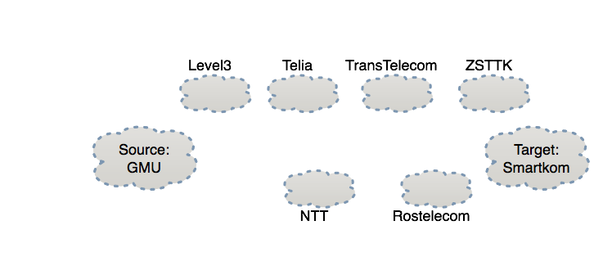
How does LIFEGUARD locate a failure?
During outage:
Problem with ZSTTK?
Ping? Fr:VP
Ping! To:VP
Historical
Current
Forward path works
77
Notes:
Other vantage points allow a richer view and direction isolation

Slide 78
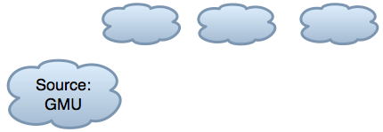
How does LIFEGUARD locate a failure?
During outage:
NTT:Ping? Fr:GMU
GMU:Ping! Fr:NTT
Historical
Current
Forward path works
78
Notes:
Test which hops have paths to GMU

Slide 79
How does LIFEGUARD locate a failure?
During outage:
Rostele: Ping? Fr:GMU
Historical
Current
Forward path works
Rostelcom is not forwarding traffic towards GMU
79
Notes:
Draw a line where all hops on one side have working path to GMU and all hops on other side don’t have a working path

Slide 80
How LIFEGUARD Locates Failures
LIFEGUARD:
Maintains background historical atlas
Isolates direction of failure, measures working direction
Tests historical paths in failing direction in order to prune candidate failure locations
Locates failure as being at the horizon of reachability
80
Notes:
Identifying where the problem is a big win
The operator can get in touch with the remote network causing the problem and YELL at them
But can we make the repair faster, without requiring the involvement of the other network?

Slide 81
Our Approach and Outline
LIFEGUARD: Locating Internet Failures Effectively and Generating Usable Alternate Routes Dynamically
Locate the ISP / link causing the problem
Suggest that other ISPs reroute around the problem
What would we like to add to BGP to enable this?
What can we deploy today, using only available protocols and router support?
81
Notes:
So if we can locate a problem, how can we fix it?
Two parts. Abstraction we want
Protocol modifications face difficult path to adoption
What can we do that would be usable unilaterally w/o involvement of other ISPs?

Slide 82
Our Goal for Failure Avoidance
Enable content / service providers to repair persistent routing problems affecting them, regardless of which ISP is causing them
Setting
Assume we can locate problem
Assume we are multi-homed / have multiple data centers
Assume we speak BGP
We use TransitPortal to speak BGP to the real Internet: 5 US universities as providers
Notes:
Do something themselves, FWD or REV, without requiring involvement of the ISP

Slide 83
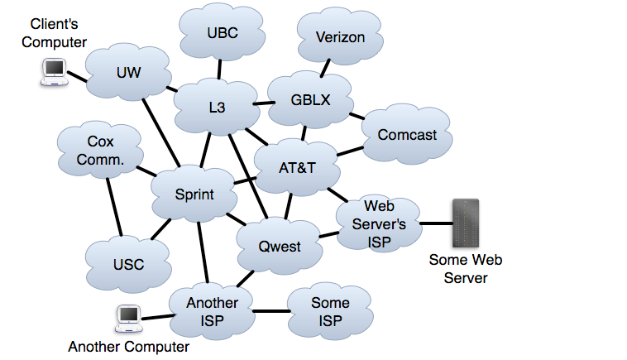
Self-Repair of Forward Paths
Notes:
Fix with path diversity.

Slide 84
A Mechanism for Failure Avoidance
Forward path: Choose route that avoids ISP or ISP-ISP link
Reverse path: Want others to choose paths to my prefix P that avoid ISP or ISP-ISP link X
Want a BGP announcement AVOID(X,P):
Any ISP with a route to P that avoids X uses such a route
Any ISP not using X need only pass on the announcement
84
Notes:
Not enough to get multiple providers
Remember, we are talking about problems when router is advertising a route that doesn’t work
No direct way to control what they choose
Want a BGP announcement

Slide 85
Ideal Self-Repair of Reverse Paths
AVOID(L3,WS)
AVOID(L3,WS)
AVOID(L3,WS)
85
Notes:
WS wants a way to control paths to it.
No direct control over path chosen
Signal “Don’t use L3 to reach the Web Server”

Slide 86
Do paths exist that AVOID problem?
LIFEGUARD repairs outages by instructing others to avoid particular routes.
Q: Do alternative routes exist?
A: Alternate policy-compliant paths exist in 90% of simulated AVOID(X,P) announcements.
Simulated 10 million AVOIDs on actual measured routes.
86
Notes:
Walk through simulation results.
Shows potential of having an avoid ABSTRACTION
But BGP is hard to change
Want to implement it now without changing protocol

Slide 87
Practical Self-Repair of Reverse Paths
UW → L3 → ATT → WS
L3 → ATT → WS
ATT → WS
Sprint → Qwest → WS
WS
AISP → Qwest → WS
Qwest → WS
87
Notes:
All it controls is what it announces - <CLICK>“hey guys, the server is over here, figure it out”
<CLICK THROUGH ANNOUNCEMENTS UNTIL FAILURE>
So how can it announce in a way that hints to others to route around L3?

Slide 88
Practical Self-Repair of Reverse Paths
UW → L3 → ATT → WS
UW → Sprint → Qwest → WS → L3→ WS
?
L3 → ATT → WS
ATT → WS
ATT → WS → L3→ WS
WS → L3→ WS
Sprint → Qwest → WS → L3→ WS
WS
Sprint → Qwest → WS
AVOID(L3,WS)
AISP → Qwest → WS → L3→ WS
Qwest → WS → L3→ WS
AISP → Qwest → WS
Qwest → WS
BGP loop prevention encourages switch to working path.
88
Notes:
I’m going to show you how we can announce AVOID using a technique known as BGP POISONING
Need first WS so neighbors know the next hop
Need other WS to signal that WS owns prefix
Let’s see what the effect of that announcement is

Slide 89
Other results
Results from real poisonings
Poisoning in the wild / poisoning anomalies
Case study of restoring connectivity
Making poisoning flexible
Monitoring broken path while it is disabled
Allowing ISPs w/o alternatives to use disabled route
LIFEGUARD’s scalability
Overhead and speed of failure location
Router update load if many ISPs deploy our approach
Alternatives to poisoning
Compatibility with secure routing (BGPSEC, etc.)
Comparing to other route control mechanisms
Notes:
Say bold ones
See paper for details

Slide 90
Can poisoning approximate AVOID effects?
LIFEGUARD’s poisoning repairs outages by disabling routes to induce route exploration.
Q: Does poisoning disrupt working routes?
A: No. As I will describe:
Under certain circumstances, we can disable a link without disabling the full ISP.
We can speed BGP convergence by carefully crafting announcements.
Notes:
I’m proposing approximating a hypothetical future BGP mechanism with a trick that’s available today
I want to talk about how well we can approximate it without disrupting paths that aren’t broken.
KEY: (1) The poison only applies to the one network / prefix
(2) Network owner gets to decide - the choice to poison is up to the destination of the traffic
(3) So they can choose if a problem warrants poison, if important traffic isn’t working
(4) Any optimizations just make it so they can use it in more cases

Slide 91
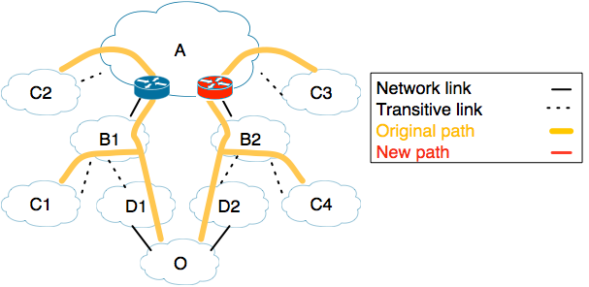
What if some routes in an ISP still work?
We only want C3 to change its route, to avoid A-B2
91
Notes:
We are a provider origin O, with clients C1-4
Suppose we locate the failure as being on an inter-domain link

Slide 92
What if some routes in an ISP still work?
We only want C3 to change its route, to avoid A-B2
Forward direction is easy: choose a different route
92
Notes:
Arrows are direction that traffic flows

Slide 93
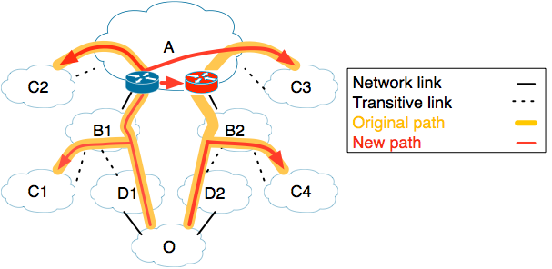
What if some routes in an ISP still work?
We only want C3 to change its route, to avoid A-B2
Forward direction is easy: choose a different route
93
Notes:
Let’s us avoid 90% of links in BGP-Mux 5-provider testbed

Slide 94
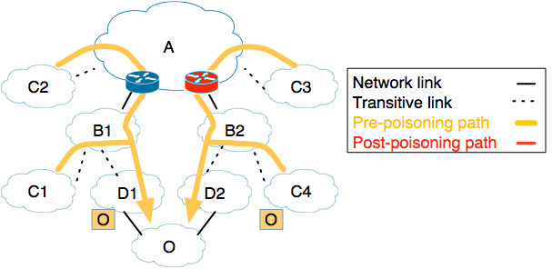
What if some routes in an ISP still work?
We only want C3 to change its route, to avoid A-B2
Poisoning seems blunt, disabling an entire ISP
94
Notes:
If we poison A, C2 will have to change route
If we stop advertising through P2, C4 will have to change route

Slide 95
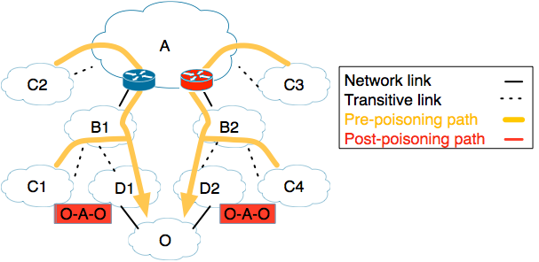
What if some routes in an ISP still work?
We only want C3 to change its route, to avoid A-B2
Poisoning seems blunt, disabling an entire ISP
95
Notes:
If we poison A, C2 will have to change route
If we stop advertising through P2, C4 will have to change route

Slide 96
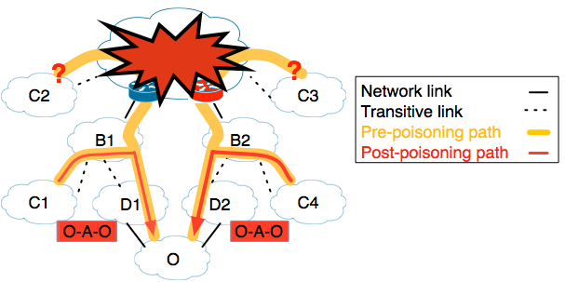
What if some routes in an ISP still work?
We only want C3 to change its route, to avoid A-B2
Poisoning seems blunt, disabling an entire ISP
96
Notes:
If we poison A, C2 will have to change route
If we stop advertising through P2, C4 will have to change route

Slide 97
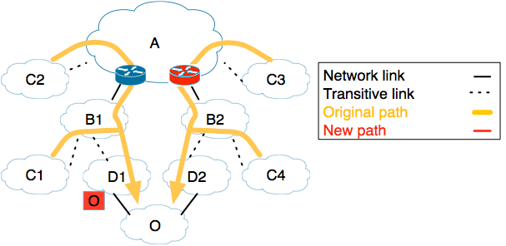
What if some routes in an ISP still work?
We only want C3 to change its route, to avoid A-B2
Poisoning seems blunt, disabling an entire ISP
Selective advertising via just D1 is also blunt
97
Notes:
If we poison A, C2 will have to change route
If we stop advertising through P2, C4 will have to change route

Slide 98
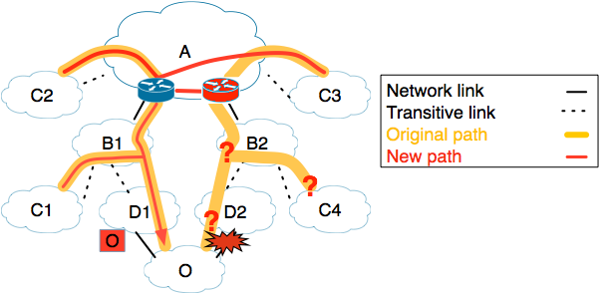
What if some routes in an ISP still work?
We only want C3 to change its route, to avoid A-B2
Poisoning seems blunt, disabling an entire ISP
Selective advertising via just D1 is also blunt
98
Notes:
If we poison A, C2 will have to change route
If we stop advertising through P2, C4 will have to change route

Slide 99
What if some routes in an ISP still work?
We only want C3 to change its route, to avoid A-B2
Poisoning seems blunt, disabling an entire ISP
If D1 and D2 (transitively) connect to different PoPs of A, selectively poison via D2 and not D1
99
Notes:
If we poison A, C2 will have to change route
If we stop advertising through P2, C4 will have to change route

Slide 100
What if some routes in an ISP still work?
We only want C3 to change its route, to avoid A-B2
Poisoning seems blunt, disabling an entire ISP
If D1 and D2 (transitively) connect to different PoPs of A, selectively poison via D2 and not D1
100
Notes:
Selectively poison A only via P2

Slide 101
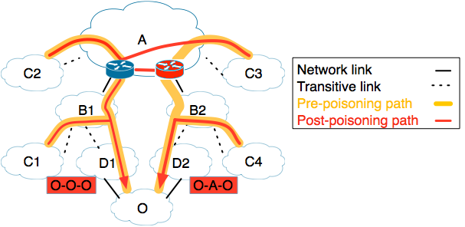
What if some routes in an ISP still work?
We only want C3 to change its route, to avoid A-B2
Poisoning seems blunt, disabling an entire ISP
If D1 and D2 (transitively) connect to different PoPs of A, selectively poison via D2 and not D1
101
Notes:
Selectively poison A only via P2

Slide 102
Can poisoning approximate AVOID effects?
LIFEGUARD’s poisoning repairs outages by disabling routes to induce route exploration.
Q: Does poisoning disrupt working routes?
A: No. As I will describe:
“Selective poisoning” can avoid 73% of links without disabling entire AS.
Real-world results from 5 provider BGP-Mux testbed
We can speed BGP convergence by carefully crafting announcements.
102
Notes:
The new announcement will go to even ISPs that have working paths, triggering their route selection process

Slide 103
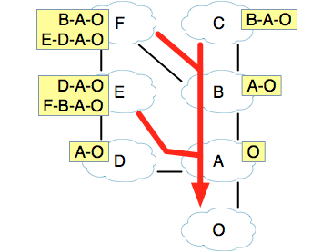
Naive Poisoning Causes Transient Loss
Some ISPs may have working paths that avoid problem ISP X
Naively, poisoning causes path exploration even for these ISPs
Path exploration causes transient loss
AVOID(X,P)
103
Notes:
These are their routing tables
For ones that receive more than one route, their chosen route is the top one
No one is using X, so with an ideal mechanism, no one would be affected, just pass on message

Slide 104
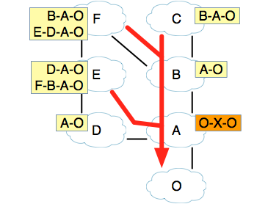
Naive Poisoning Causes Transient Loss
Some ISPs may have working paths that avoid problem ISP X
Naively, poisoning causes path exploration even for these ISPs
Path exploration causes transient loss
AVOID(X,P)
104

Slide 105
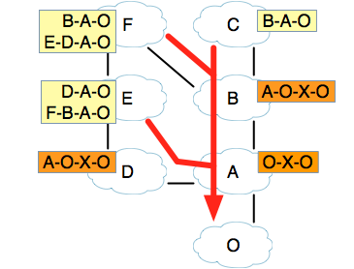
Naive Poisoning Causes Transient Loss
Some ISPs may have working paths that avoid problem ISP X
Naively, poisoning causes path exploration even for these ISPs
Path exploration causes transient loss
AVOID(X,P)
105

Slide 106
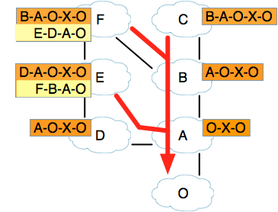
Naive Poisoning Causes Transient Loss
Some ISPs may have working paths that avoid problem ISP X
Naively, poisoning causes path exploration even for these ISPs
Path exploration causes transient loss
AVOID(X,P)
106

Slide 107
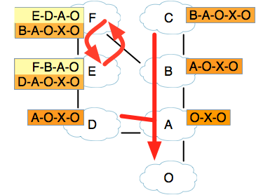
Naive Poisoning Causes Transient Loss
Some ISPs may have working paths that avoid problem ISP X
Naively, poisoning causes path exploration even for these ISPs
Path exploration causes transient loss
AVOID(X,P)
107
Notes:
Networks start using new routes, but a timer delays their announcements

Slide 108
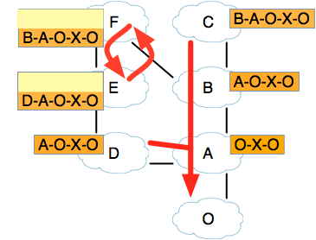
Naive Poisoning Causes Transient Loss
Some ISPs may have working paths that avoid problem ISP X
Naively, poisoning causes path exploration even for these ISPs
Path exploration causes transient loss
AVOID(X,P)
108
Notes:
E and F announce their new routes to each other, and neither will accept the other, to avoid the loop

Slide 109
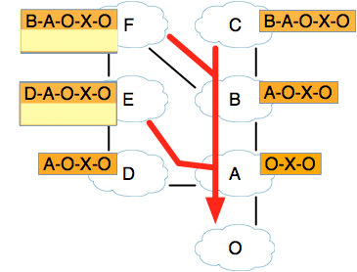
Naive Poisoning Causes Transient Loss
Some ISPs may have working paths that avoid problem ISP X
Naively, poisoning causes path exploration even for these ISPs
Path exploration causes transient loss
AVOID(X,P)
109
Notes:
So then they revert back to their original routes

Slide 110
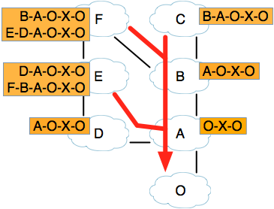
Naive Poisoning Causes Transient Loss
Some ISPs may have working paths that avoid problem ISP X
Naively, poisoning causes path exploration even for these ISPs
Path exploration causes transient loss
AVOID(X,P)
110

Slide 111
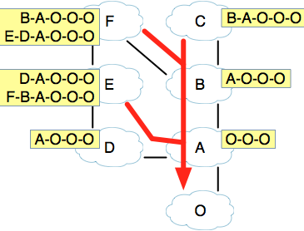
Prepend to Reduce Path Exploration
Most routing decisions based on: (1) next hop ISP (2) path length
Keep these fixed to speed convergence
Prepending prepares ISPs for later poison
AVOID(X,P)
111
Notes:
EXPLAIN PREPEND AS BASELINE

Slide 112
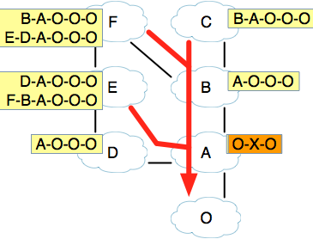
Prepend to Reduce Path Exploration
Most routing decisions based on: (1) next hop ISP (2) path length
Keep these fixed to speed convergence
Prepending prepares ISPs for later poison
AVOID(X,P)
112

Slide 113
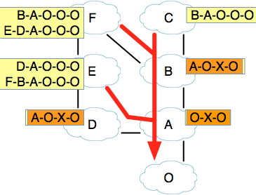
Prepend to Reduce Path Exploration
Most routing decisions based on: (1) next hop ISP (2) path length
Keep these fixed to speed convergence
Prepending prepares ISPs for later poison
AVOID(X,P)
113

Slide 114
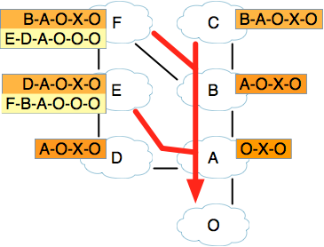
Prepend to Reduce Path Exploration
Most routing decisions based on: (1) next hop ISP (2) path length
Keep these fixed to speed convergence
Prepending prepares ISPs for later poison
AVOID(X,P)
114

Slide 115
Prepend to Reduce Path Exploration
Most routing decisions based on: (1) next hop ISP (2) path length
Keep these fixed to speed convergence
Prepending prepares ISPs for later poison
AVOID(X,P)
115

Slide 116
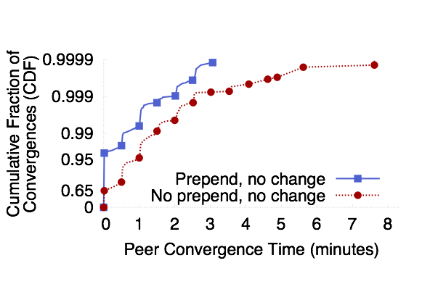
Prepending Speeds Convergence
With no prepend, only 65% of unaffected ISPs converge instantly
With prepending, 95% of unaffected ISPs re-converge instantly, 98%<1/2 min.
Also speeds convergence to new paths for affected peers
Notes:
Test this by announcing actual poisons to real internet using BGPMux
ISPs that were NOT using the path we poisoned
Explain axes - left is converged faster, BGP Collectors
So poisoning usually takes well under a minute.
LIFEGUARD’s failure location usually takes a couple minutes.
EC2 data showed that 80% of unavailability came from outages lasting over 10 minutes.
So LIFEGUARD can generate an automatic response quickly enough to potentially shave off most of that unavailability
Graph shows ISPs that did NOT have to change paths
Also, 60% of cases had loss under 1%, 98% under 2%

Slide 117
LIFEGUARD Summary
We increasingly depend on the Internet, but availability lags
Much of Internet unavailability due to long-lasting outages
LIFEGUARD: Let edge networks reroute around failures
Location challenge: Find problem, given unidirectional failures and tools that depend on connectivity
Use reverse traceroute, isolate directions, use historical view
Avoidance challenge: Reroute without participation of transit networks
BGP poisoning gives control to the destination
Well-crafted announcements ease concerns
Notes:
To improve Internet availability, we need to address long-lasting outages.
Providers should be able to repair failures affecting clients, without relying on action from operators along the path
I sketched how an ISP can locate failures affecting it and what type of BGP announcement they might like to make to take action.
By providing a means to approximate that announcement today, LIFEGUARD enables us to experiment with it and enables ISPs to deploy our approach unilaterally today.

Slide 118
Inter-Domain Routing Summary
BGP4 is the only inter-domain routing protocol currently in use world-wide
Issues?
Lack of security
Ease of misconfiguration
Poorly understood interaction between local policies
Poor convergence
Lack of appropriate information hiding
Non-determinism
Poor overload behavior

Slide 119
Lots of research into how to fix this
Security
BGPSEC, RPKI
Misconfigurations, inflexible policy
SDN
Policy Interactions
PoiRoot (root cause analysis)
Convergence
Consensus Routing
Inconsistent behavior
LIFEGUARD, among others

Slide 120
Why are these still issues?
Backward compatibility
Buy-in / incentives for operators
Stubbornness
Very similar issues to IPv6 deployment

