Slide 1
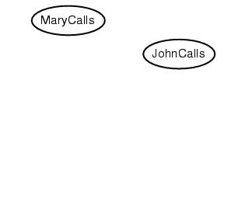
Example
Suppose we choose the ordering M, J, A, B, E
P(J | M) = P(J)?

Slide 2
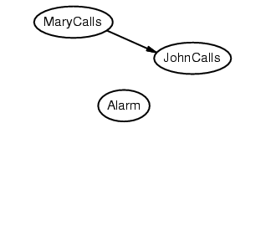
Example
Suppose we choose the ordering M, J, A, B, E
P(J | M) = P(J)? No
P(A | J, M) = P(A | J)? P(A | J, M) = P(A)?

Slide 3
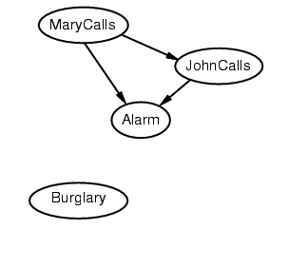
Example
Suppose we choose the ordering M, J, A, B, E
P(J | M) = P(J)? No
P(A | J, M) = P(A | J)? P(A | J, M) = P(A)? No
P(B | A, J, M) = P(B | A)?
P(B | A, J, M) = P(B)?

Slide 4
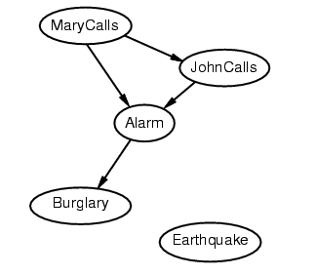
Example
Suppose we choose the ordering M, J, A, B, E
P(J | M) = P(J)? No
P(A | J, M) = P(A | J)? P(A | J, M) = P(A)? No
P(B | A, J, M) = P(B | A)? Yes
P(B | A, J, M) = P(B)? No
P(E | B, A ,J, M) = P(E | A)?
P(E | B, A, J, M) = P(E | A, B)?

Slide 5
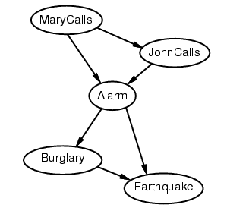
Example
Suppose we choose the ordering M, J, A, B, E
P(J | M) = P(J)? No
P(A | J, M) = P(A | J)? P(A | J, M) = P(A)? No
P(B | A, J, M) = P(B | A)? Yes
P(B | A, J, M) = P(B)? No
P(E | B, A ,J, M) = P(E | A)? No
P(E | B, A, J, M) = P(E | A, B)? Yes

Slide 6
Example contd.
Deciding conditional independence is difficult in noncausal directions
(Causal models and conditional independence seem hardwired for humans!)
Network is less compact: 1 + 2 + 4 + 2 + 4 = 13 numbers needed

Slide 7
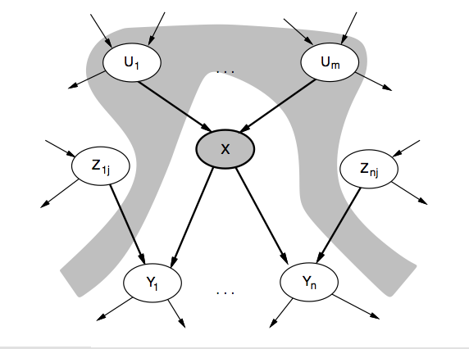
Independence

Slide 8
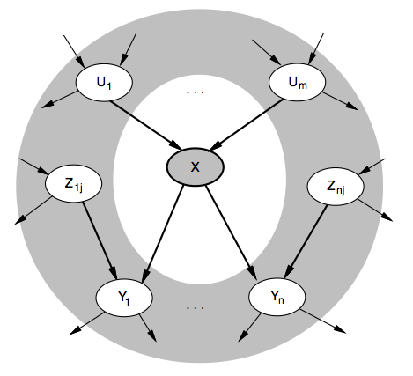
Independence

Slide 9
Example: River Pollution Diagnosis
Source: http://www.soc.staffs.ac.uk/research/groups/cies2/project.htm

Slide 10
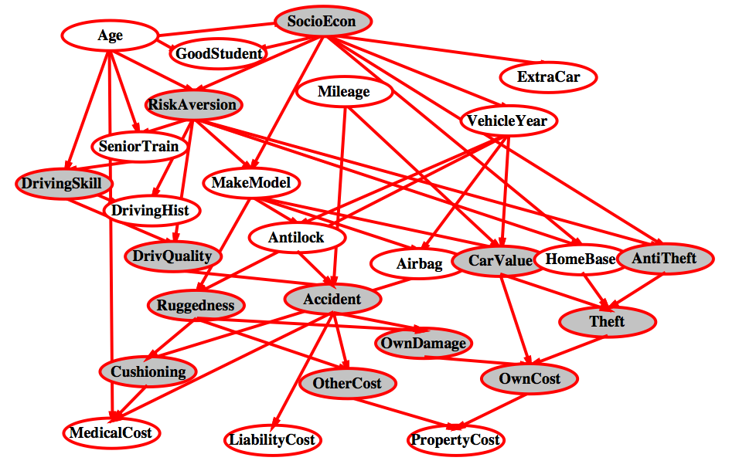
Example: Estimating auto insurance risk

Slide 11
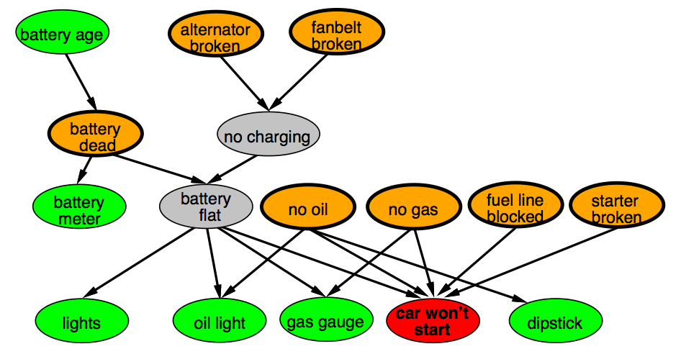
Example: Car diagnosis
Initial evidence, Testable variables, Hidden variables

