Slide 1
LPD Communication when the Warden Does Not Know When
Boulat A. Bash
Dennis Goeckel
Don Towsley

Slide 2
Introduction
How to conceal the presence of communication?
Encryption insufficient (may even look suspicious)
Need LPD=low probability of detection, a.k.a. “covert”, LPI
Why?
“metadata”
Communication not allowed
Foment social unrest
What are the fundamental limits of LPD communication?
Source: PraxisFilms

Slide 3
LPD communication work at ISIT
2012 (Cambridge)
Bash, Goeckel, Towsley: “Square root law for communication with low probability of detection on AWGN channels”
Fundamental limit on LPD communication
2013 (Istanbul)
Che, Bakshi, Jaggi “Reliable deniable communication: hiding messages in noise”
Secret codebook not needed in certain BSC scenarios
Bash, Guha, Goeckel, Towsley “Quantum Noise Limited Optical Communication with Low Probability of Detection”
Quantum-theoretic limits on LPD communication
Related work: experimental demonstration of LPD scaling laws on optical channels (UMass/BBN collaboration)
2014 (Honolulu)
Hou and Kramer “Effective Secrecy: Reliability, Confusion and Stealth”
Bash, Goeckel, Towsley “LPD Communication when the Warden Does Not Know When”
Kadhe, Jaggi, Bakshi, Sprintson ”Reliable, Deniable, and Hidable Communication over Multipath Networks”

Slide 4
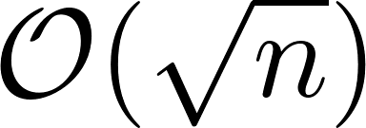
Scenario (ISIT 2012)
Alice has an AWGN channel to Bob
Willie prohibits transmissions; monitors channel
Alice and Bob prepare by sharing a secret
Alice can reliably
transmit LPD
bits to Bob in AWGN
channel uses.
Clipart source:
Artist Gerald_G, openclipart.org

Slide 5
Scenario
Alice’s message is short w/r/t total time available
Alice and Bob secretly agree on transmission time
Time period Willie has to monitor is a lot longer than message
I’ll transmit at .
Got it.
Has to extract
from using
Time
Does this:
contain + ?
Clipart source:
Artist Gerald_G, openclipart.org

Slide 6
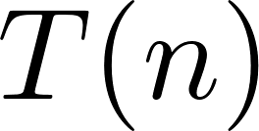
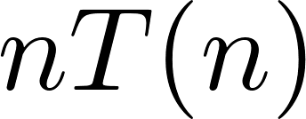
Main result
Alice can reliably transmit covert bits using a randomly selected -symbol slot , where total number of slots
No additional secret required if ,
Conversely, transmitting bits results either in detection by Willie or decoding errors
Slot used by Alice and Bob
slot 1 | slot 2 | ⋅ ⋅ ⋅ | slot t_{A} | ⋅ ⋅ ⋅ | slot T(n)
total symbol periods

Slide 7
Outline
Introduction
Hypothesis testing preliminaries
Achievability
Converse (proof idea)
Conclusion

Slide 8
Hypothesis testing
Willie attempts to classify observations of Alice’s channel as either noise or signal corrupted by noise
Binary hypothesis test
Willie’s probability of error
Alice desires
Willie decides he saw
Noise
Signal+Noise
quiet
Alice is
transmitting
LPD criterion

Slide 9
Intuition behind Willie’s metric
Detector ROC
Willie picks desired and uses a detector that maximizes
Alice can lower-bound by selecting appropriate covert symbol distribution
1
2ε
Desirable by Willie
and
Desirable by Alice
0
1

Slide 10
Outline
Introduction
Hypothesis testing preliminaries
Achievability
Converse (proof idea)
Conclusion

Slide 11
Achievability
Slot used by Alice and Bob
Theorem: Alice can reliably transmit bits to Bob in a single slot while maintaining for arbitrary .
Proof steps:
Construction
Analysis of Willie’s detector (main challenge)
Analysis of Bob’s decoder
slot 1 | slot 2 | ⋅ ⋅ ⋅ | slot t_{A} | ⋅ ⋅ ⋅ | slot T(n)
total symbol periods

Slide 12
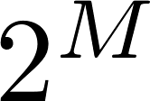
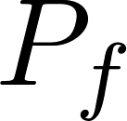
Construction
Alice and Bob’s secret random Gaussian codebook:
Used only once, to transmit in slot (also secret)
Willie knows construction, including , ,
But not the codebook itself
Messages
Codewords
0 | 0 | 0 | … | 0 | 0
0 | 0 | 0 | … | 0 | 1
 |  |  | …
 |  |  | …
…
…
1 | 1 | 1 | … | 1 | 1
 |  |  | …
bits
symbols

Slide 13
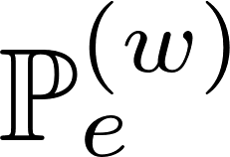
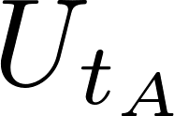
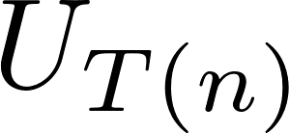
Analysis of Willie’s detector
Standard method does not work (KL divergence upper-bound for is too loose)
LRT optimal, analyze likelihood ratio directly:
Same whether Alice
transmits or not
Willie’s observations
When Alice transmits:
Slot used by Alice and Bob
 |  | ⋅ ⋅ ⋅ |  | ⋅ ⋅ ⋅
When Alice is quiet:
 |  | ⋅ ⋅ ⋅ |  | ⋅ ⋅ ⋅
slots
Different only here!

Slide 14
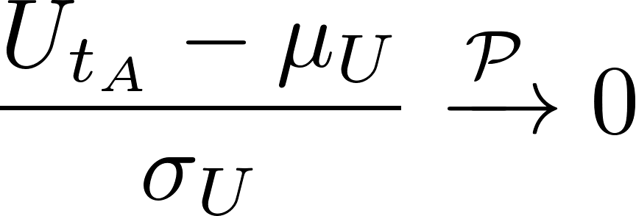
Analysis of Willie’s detector
Analyzing likelihood ratio:
Set
Then whether Alice transmits or not
Thus, for any choice of threshold ,
in distribution

Slide 15
Bob’s decoder
Bob attempts to ML-decode every slot
Alice “transmits” all-zero codeword on unused slots
Probability of decoding error in slot (see ISIT ‘12):
Union bound over slots:
Since , Bob doesn’t even need to decode bits if ,

Slide 16
Outline
Introduction
Hypothesis testing preliminaries
Achievability
Converse (proof idea)
Conclusion

Slide 17
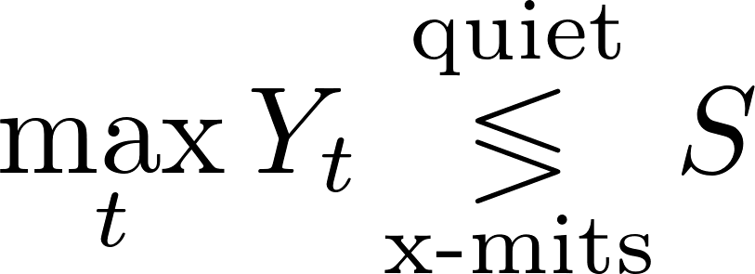
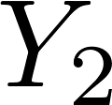
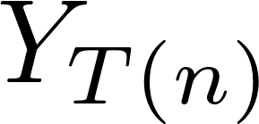
Converse proof idea
Willie uses max-power detector:
Detects codewords with
Alice cannot transmit bits using (proof as in ISIT 2012)
Alice’s transmission
 |  | ⋅ ⋅ ⋅ |  | ⋅ ⋅ ⋅ | ⋅ ⋅ ⋅
slots

Slide 18
Conclusion
We presented a new scaling law for LPD communication
Choice of transmission time is a cheap resource
Ongoing work
We have experimentally demonstrated LPD scaling laws on optical channels (UMass/BBN collaboration)
Extend to other channels
“Shadow networks”
Other resources for LPD communication

Slide 19
Thank you!
boulat@cs.umass.edu

Slide 20
Converse: proof details
Let Willie use max-power detector:
We show it detects codewords with
Proof that Alice cannot transmit bits using is identical to that in ISIT 2012

Slide 21
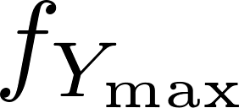
Converse: limiting false alarms
Willie observes slots, uses max-power detector:
To obtain desired , set
When Alice is quiet: , where
 |  | ⋅ ⋅ ⋅ | ⋅ ⋅ ⋅ | ⋅ ⋅ ⋅ | ⋅ ⋅ ⋅
slots

Slide 22
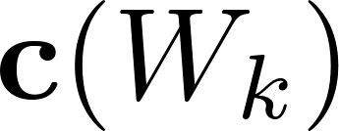
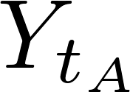
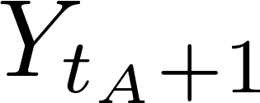
Converse: detecting Alice’s transmissions
Willie observes slots, uses max-power detector:
When Alice transmits :
 |  | ⋅ ⋅ ⋅ |  |  | ⋅ ⋅ ⋅
slots

Slide 23
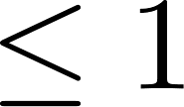
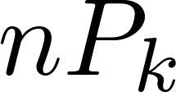
Converse : detecting Alice’s transmissions
When ,
When Alice transmits :
 |  | ⋅ ⋅ ⋅ |  |  | ⋅ ⋅ ⋅
slots
Alice’s codeword not here,
One of slots or contains at least half ‘s power
and are non-central chi-square r.v.’s

