Slide 1
Cloud Computing inside Virtualized Datacenters
V. Arun
College of Computer Science
University of Massachusetts Amherst

Slide 2
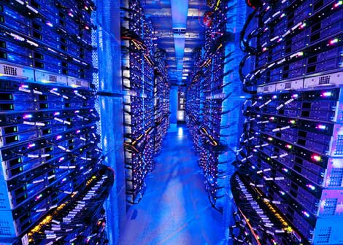
Data center networks
10’s to 100’s of thousands of hosts, often closely coupled, in close proximity:
e-business (e.g. Amazon)
content-servers (e.g., YouTube, Akamai, Apple, Microsoft)
search engines, data mining (e.g., Google)
challenges:
multiple applications, each serving massive numbers of clients
managing/balancing load, avoiding processing, networking, data bottlenecks
Inside a 40-ft Microsoft container,
Chicago data center

Slide 3
Data center networks
load balancer: application-layer routing
receives external client requests
directs workload within data center
returns results to external client (hiding data center internals from client)
Internet
Border router
Load
balancer
Load
balancer
Access router
B
Tier-1 switches
A
C
Tier-2 switches
TOR switches
Server racks
1
2
3
4
5
6
7
8

Slide 4
Data center networks
rich interconnection among switches, racks:
increased throughput between racks (multiple routing paths possible)
increased reliability via redundancy
Tier-1 switches
Tier-2 switches
TOR switches
Server racks
1
2
3
4
5
6
7
8

Slide 5
Key broad questions
How are massive numbers of commodity machines networked inside a data center?
Virtualization: How to effectively manage physical machine resources across client virtual machines?
How to reduce major capital and operational costs:
Server equipment
Power and cooling
Power and cooling
This lab: mainly gain some insights into the second question.

Slide 6
Common cloud computing models
Service models:
IaaS: Infrastructure as a Service (e.g., Amazon EC2, Microsoft Azure, Google Compute Engine)
PaaS: Platform as a Service (e.g., Google AppEngine)
SaaS: Software as a Service (Office360, Amazon DynamoDB)
Management:
Public clouds: Utility model, shared hardware, no control of hardware, self-managed (AWS, Azure, GCE)
Private clouds: More isolated (secure?), federal compliance, customizable hardware, customizable hardware sharing

Slide 7
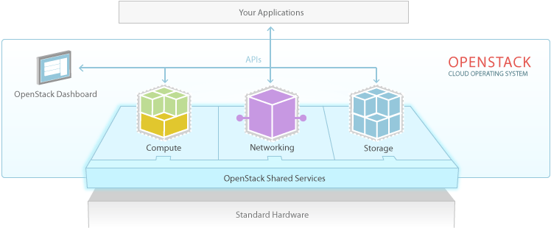
OpenStack: A cloud OS for private clouds
OpenStack is a cloud operating system that controls large pools of compute, storage, and networking resources throughout a datacenter, all managed through a dashboard that gives administrators control while empowering their users to provision resources through a web interface.

Slide 8
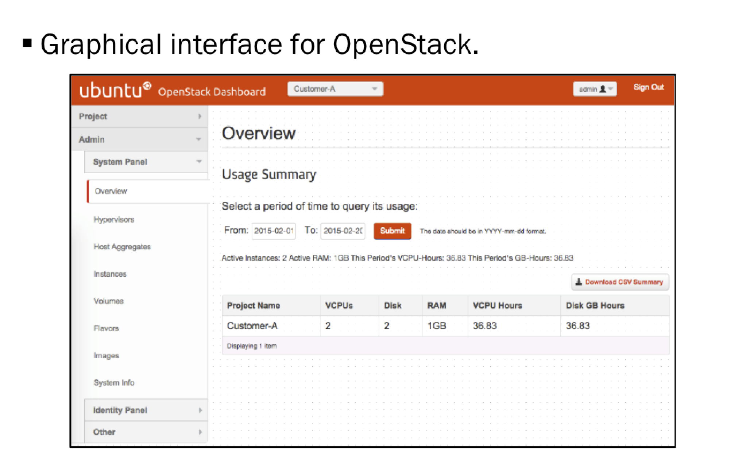
OpenStack UI

Slide 9
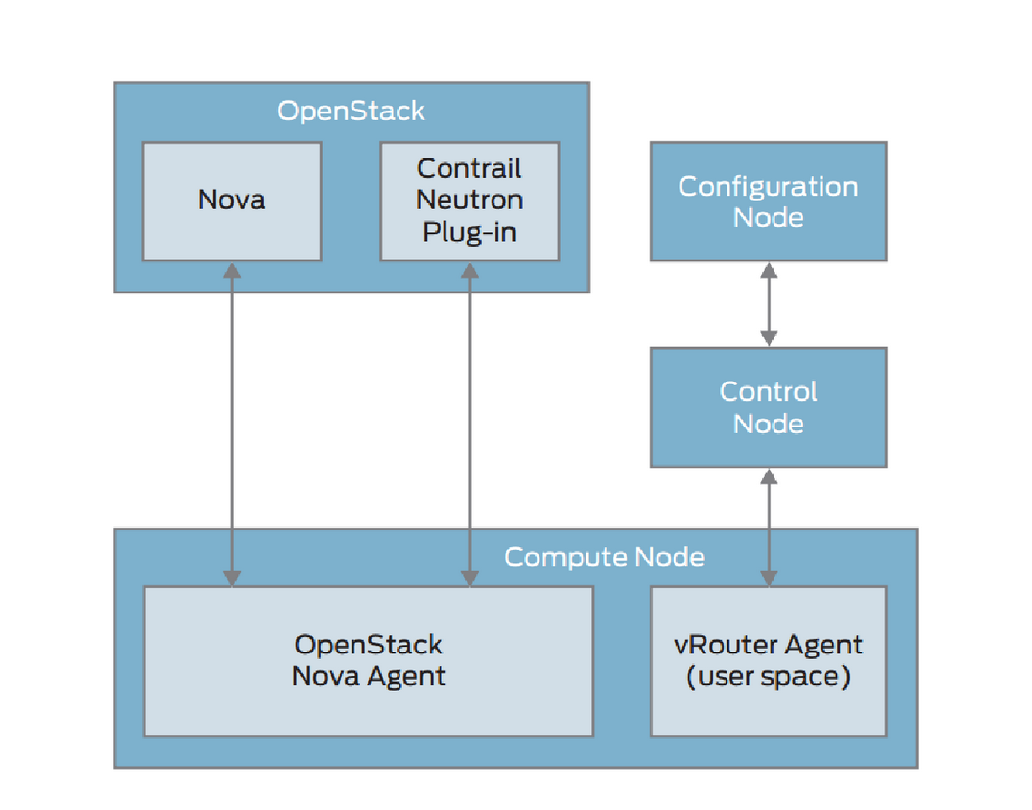
Where Contrail fits in
OpenContrail plugs into OpenStack’s networking component (Neutron)

Slide 10
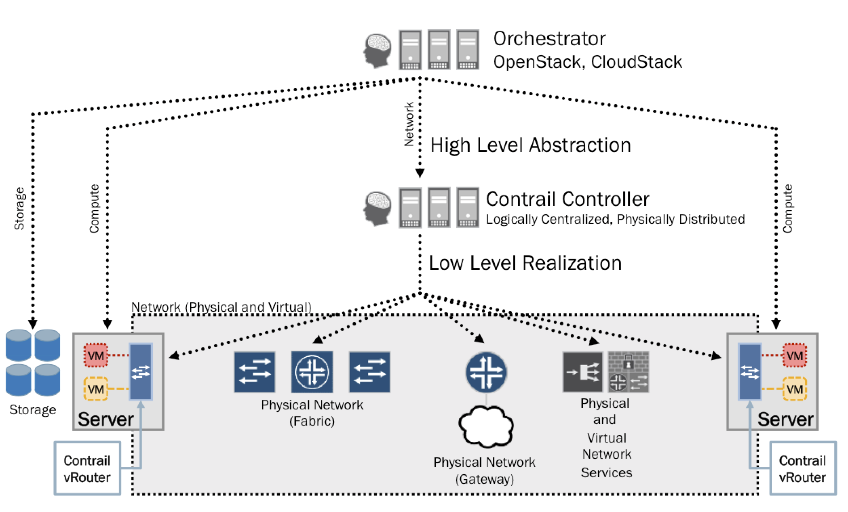
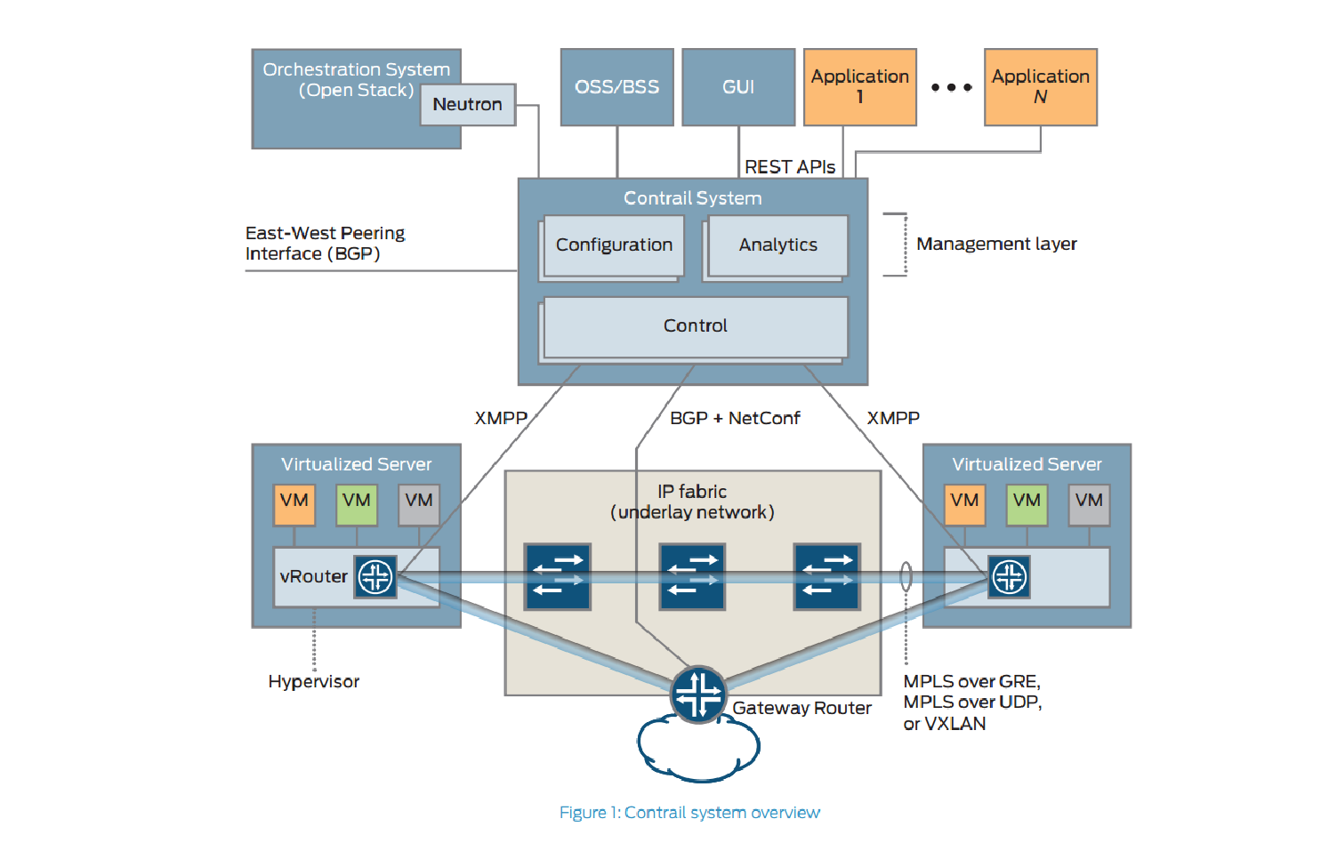
Contrail system overview

Slide 11
Contrail nodes
Configuration nodes: persistent configuration state
Control nodes: keeps ephemeral network state and and effects logically centralized control plane
Analytics nodes: Statistics from network elements
Compute nodes: General-purpose virtualized servers
Gateway nodes: Physical routers connecting tenant to external networks
Service nodes: Forwarding plane services (deep packet inspection, intrusion detection, WAN bandwidth optimizers, etc.) or “NFVs”

Slide 12
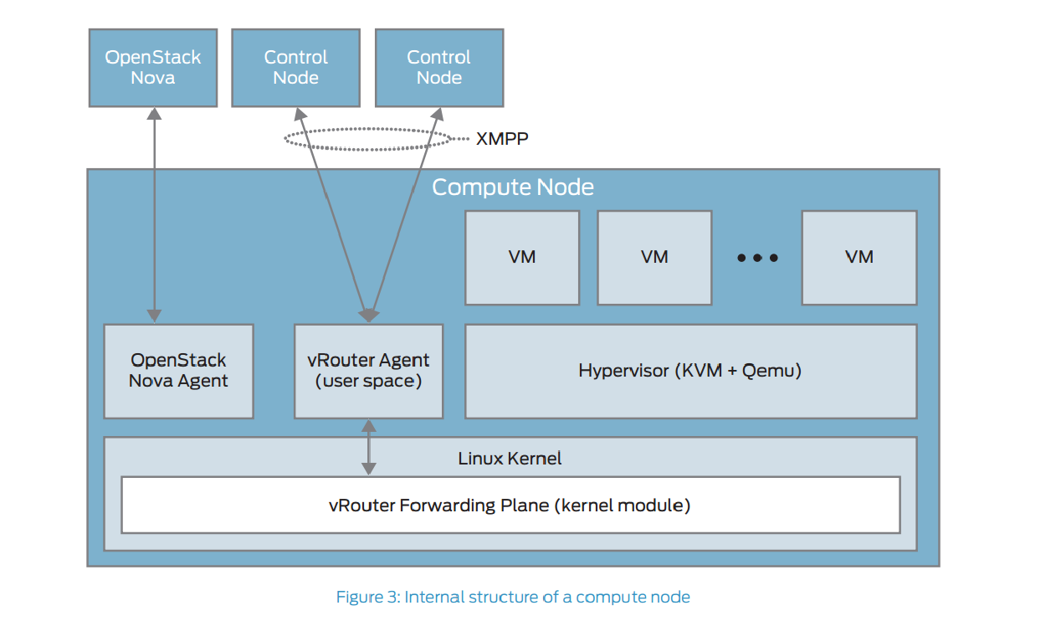
Internal structure of compute node

Slide 13
vRouter functions
vRouter agent
Exchanging control state
Receiving low-level config state
Reporting analytics, installing forwarding state
Proxying DHCP, ARP, DNS, etc.
vRouter forwarding plane
Encapsulating to-overlay packets and decapsulating from-overlay packets
Assigning packets to routing instance based on VNI
Implementing forwarding policy rules

Slide 14
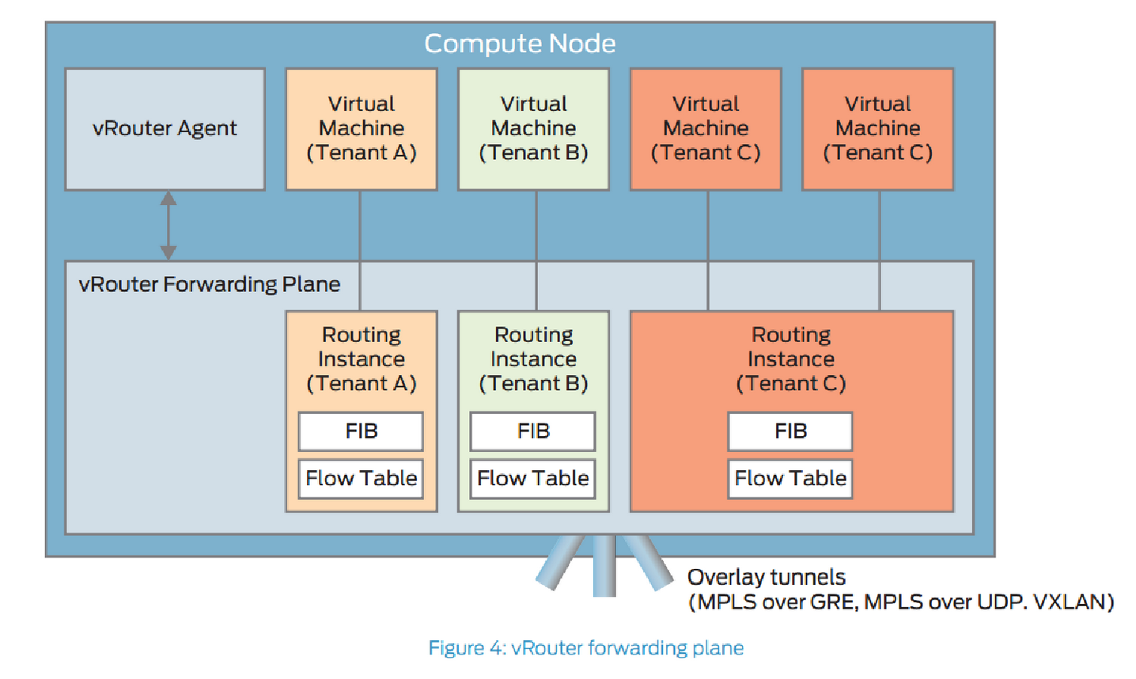
vRouter forwarding plane internals

Slide 15
Control nodes
Receive config state from configuration nodes (IF-MAP)
Exchange routes with each other using IBGP
Exchange routes with vRouters (XMPP)
Exchange routes with external gateways using BGP

Slide 16
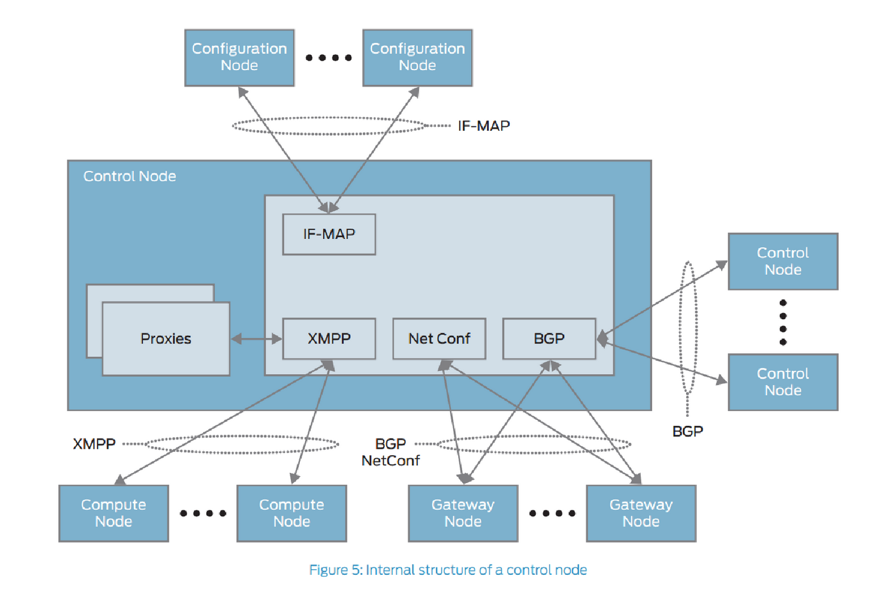
Control node internals
Network control protocol is BGP (not OpenFlow but analogous)

Slide 17
Configuration node functions
REST API for north-bound interface to OpenStack
Cassandra key-value store for persistent config storage
Schema transformer (high-level to low-level)
ZooKeeper for transactions to assign unique IDs

Slide 18
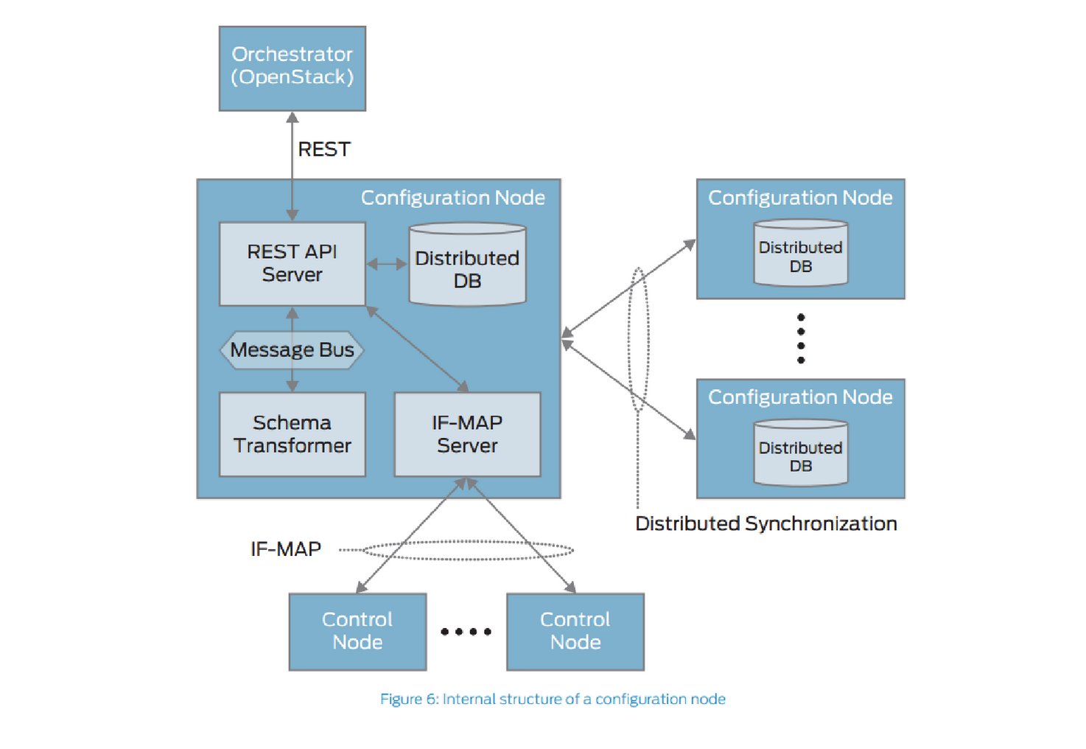
Configuration node

Slide 19
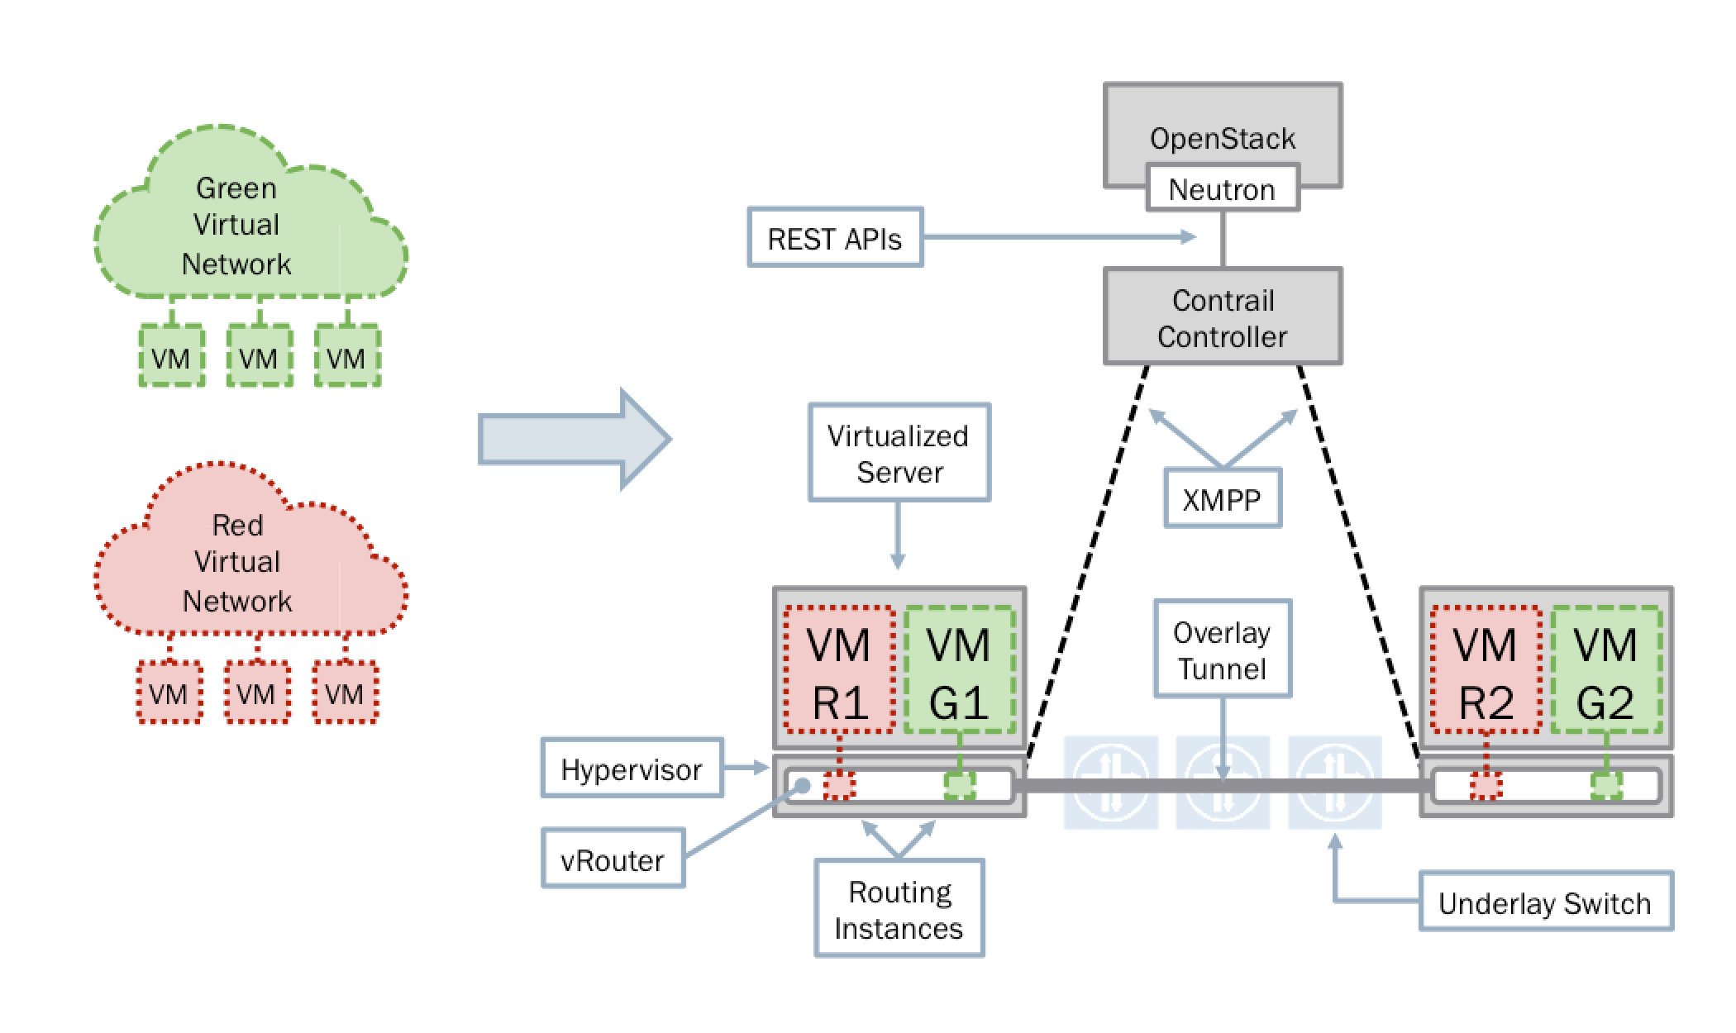
Multi-tenancy

Slide 20
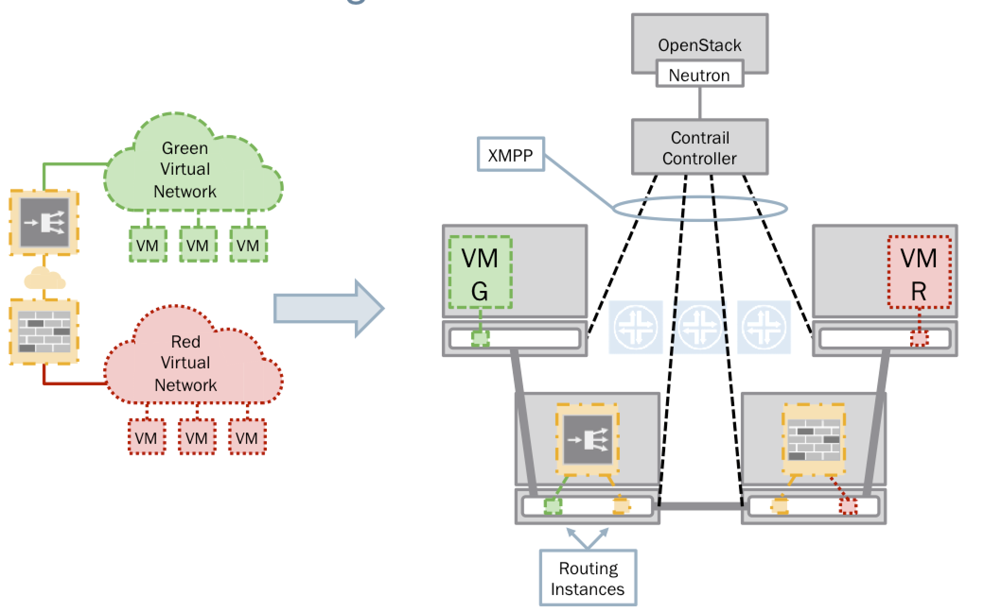
Service chaining

Slide 21
This lab
Familiarization with OpenStack and OpenContrail UIs
Create simple virtual networks with virtual servers and virtual routers
Create simple multi-tenant networks
Understand MPLS based tunneling mechanism for setting up flow rules
Understand virtualization, isolation, load balancing
Use tools like glance to load VM images

Slide 22
Virtual Circuits and MPLS tunneling

Slide 23
Connection, connection-less service
datagram network (Internet) provides network-layer connectionless service
virtual-circuit network (ATM) provides network-layer connection service
analogous to TCP/UDP connecton-oriented / connectionless transport-layer services, but:
service: host-to-host
no choice: network provides one or the other
implementation: primarily in network core

Slide 24
Virtual circuits (e.g., ATM)
source-to-dest path behaves like telephone circuit
performance-wise
network actions along source-to-dest path
call setup, teardown for each call before data can flow
every router on source-dest path maintains “state” for each passing connection
link, router resources (bandwidth, buffers) may be allocated to VC (dedicated resources = predictable service)

Slide 25
Virtual circuit implementation
VC consists of:
path from source to destination
VC numbers, one number for each link along path
entries in forwarding tables in routers along path
packet belonging to VC carries VC number (rather than dest address)
VC number typically changed on each link.
new VC number comes from forwarding table

Slide 26
Virtual circuit forwarding table
12
22
32
1
3
2
VC number
forwarding table in
northwest router:
interface
number
Incoming interface Incoming VC # Outgoing interface Outgoing VC #
1 12 3 22
2 63 1 18
3 7 2 17
1 97 3 87
… … … …
VC routers maintain connection state information!

Slide 27
Virtual circuit signaling
used to setup, maintain teardown VC
used in ATM, frame-relay, X.25
not used in today’s Internet
application
transport
network
data link
physical
application
transport
network
data link
physical
5. data flow begins
6. receive data
How does this compare to datagram networks like the Internet?
4. call connected
3. accept call
1. initiate call
2. incoming call

Slide 28
Datagram networks (e.g., Internet)
no call setup at network layer
routers: no state about end-to-end connections
no network-level concept of “connection”
packets forwarded using destination host address
application
transport
network
data link
physical
application
transport
network
data link
physical
1. send datagrams
2. receive datagrams

Slide 29
Datagram forwarding table
4 billion IP addresses, so rather than list individual destination address
list range of addresses
(aggregate table entries)
routing algorithm
local forwarding table
dest address
output link
address-range 1
address-range 2
address-range 3
address-range 4
3
2
2
1
IP destination address in
arriving packet’s header
1
3
2

Slide 30
Longest prefix matching
longest prefix matching
when looking for forwarding table entry for given destination address, use longest address prefix that matches destination address.
Destination Address Range
11001000 00010111 00010*** *********
11001000 00010111 00011000 *********
11001000 00010111 00011*** *********
otherwise
Link interface
0
1
2
3
examples:
DA: 11001000 00010111 00010110 10100001
which interface?
DA: 11001000 00010111 00011000 10101010
which interface?

Slide 31
Multiprotocol label switching (MPLS)
initial goal: high-speed IP forwarding using fixed length label (instead of IP address)
fast lookup using fixed length identifier (rather than longest prefix matching)
borrowing ideas from Virtual Circuit (VC) approach
but IP datagram still keeps IP address!
PPP or Ethernet
header
IP header
remainder of link-layer frame
MPLS header
label
Exp
S
TTL
20
3
1
5

Slide 32
MPLS capable routers
a.k.a. label-switched router
forward packets to outgoing interface based only on label value (don’t inspect IP address)
MPLS forwarding table distinct from IP forwarding tables
flexibility: MPLS forwarding decisions can differ from those of IP
use destination and source addresses to route flows to same destination differently (traffic engineering)
re-route flows quickly if link fails: pre-computed backup paths (useful for VoIP)

Slide 33
MPLS versus IP paths
R6
D
R4
R3
R5
A
R2
IP routing: path to destination determined by destination address alone
IP router

Slide 34
MPLS versus IP paths
entry router (R4) can use different MPLS routes to A based, e.g., on source address
R6
D
R4
R3
R5
A
R2
IP routing: path to destination determined by destination address alone
IP-only
router
MPLS routing: path to destination can be based on source and dest. address
fast reroute: precompute backup routes in case of link failure
MPLS and
IP router

Slide 35
MPLS signaling
modify OSPF, IS-IS link-state flooding protocols to carry info used by MPLS routing,
e.g., link bandwidth, amount of “reserved” link bandwidth
entry MPLS router uses RSVP-TE signaling protocol to set up MPLS forwarding at downstream routers
R6
RSVP-TE
D
R4
R5
modified
link state
flooding
A

Slide 36
MPLS forwarding tables
in out out
label label dest interface
10 A 0
in out out
label label dest interface
12 D 0
8 A 1
10 6 A 1
12 9 D 0
R6
0
0
D
1
1
R4
R3
R5
0
0
A
R2
in out out
label label dest interface
R1
in out out
label label dest interface
6 - A 0
8 6 A 0

