Slide 1
Internet routing
V. Arun
CS491G: Computer Networking Lab
University of Massachusetts Amherst
Slide material copyright 1996-2013
J.F Kurose and K.W. Ross, All Rights Reserved

Slide 2
Graph abstraction
5
v
3
w
2
5
u
2
1
z
3
1
2
x
y
1
graph: G = (N,E)
N = set of routers = { u, v, w, x, y, z }
E = set of links ={ (u,v), (u,x), (v,x), (v,w), (x,w), (x,y), (w,y), (w,z), (y,z) }

Slide 3
Graph abstraction: costs
5
c(x,x’) = cost of link (x,x’)
e.g., c(w,z) = 5
cost could always be 1, or
inversely related to bandwidth,
or related to congestion
v
3
w
2
5
u
2
1
z
3
1
2
x
y
1
cost of path (x₁, x₂, x₃,…, x_{p}) = c(x₁,x₂) + c(x₂,x₃) + … + c(x_{p-1},x_{p})
key question: what is the least-cost path between u and z ?
routing algorithm: algorithm that finds that least cost path

Slide 4
Routing algorithm classification
Q: global or decentralized information?
global:
all routers have complete topology, link cost info
“link state” algorithms
decentralized:
router knows physically-connected neighbors, link costs to neighbors
iterative process of computation, exchange of info with neighbors
“distance vector” algorithms
Q: static or dynamic?
static:
routes change slowly over time
dynamic:
routes change more quickly
  periodic update
  in response to link cost changes

Slide 5
4. Internet Routing: Outline
4.5 routing algorithms
  link state
  distance vector
  hierarchical routing
4.6 routing in the Internet
  RIP
  OSPF
  BGP

Slide 6
A Link-State Routing Algorithm
Dijkstra’s algorithm
net topology, link costs known to all nodes
  accomplished via “link state broadcast”
  all nodes have same info
computes least cost paths from one node (‘source”) to all other nodes
  gives forwarding table for that node
iterative: after k iterations, know least cost path to k dest.’s
notation:
c(x,y): link cost from node x to y; = ∞ if not direct neighbors
D(v): current value of cost of path from source to dest. v
p(v): predecessor node along path from source to v
N': set of nodes whose least cost path definitively known

Slide 7
Dijsktra’s Algorithm
5
1 Initialization:
2 N' = {u}
3 for all nodes v
4 if v adjacent to u
5 then D(v) = c(u,v)
6 else D(v) = ∞
7
Loop
???
until all nodes in N'
v
3
w
2
5
u
2
1
z
3
1
2
x
y
1

Slide 8
Dijsktra’s Algorithm
5
3
1 Initialization:
2 N' = {u}
3 for all nodes v
4 if v adjacent to u
5 then D(v) = c(u,v)
6 else D(v) = ∞
7
8 Loop
9 find w not in N' such that D(w) is a minimum
10 add w to N'
11 update D(v) for all v adjacent to w and not in N' :
12 D(v) = min( D(v), D(w) + c(w,v) )
13 /* new cost to v is either old cost to v or known
14 shortest path cost to w plus cost from w to v */
15 until all nodes in N'
v
w
2
5
u
2
1
z
3
1
2
x
y
1

Slide 9
Dijkstra’s algorithm: example
D(v)
p(v)
D(w)
p(w)
D(x)
p(x)
D(y)
p(y)
D(z)
p(z)
Step
N'
0
u
7,u
3,u
5,u
∞
∞
1
uw
6,w
5,u
11,w
∞
2
uwx
6,w
11,w
14,x
3
uwxv
10,v
14,x
4
uwxvy
12,y
5
uwxvyz
x
9
notes:
construct shortest path tree by tracing predecessor nodes
ties can exist (can be broken arbitrarily)
5
7
4
8
u
3
w
y
z
2
3
7
4
v

Slide 10
Dijkstra’s algorithm: another example
Step
0
1
2
3
4
5
N'
u
ux
uxy
uxyv
uxyvw
uxyvwz
D(v),p(v)
2,u
2,u
2,u
D(w),p(w)
5,u
4,x
3,y
3,y
D(x),p(x)
1,u
D(y),p(y)
∞
2,x
D(z),p(z)
∞
∞
4,y
4,y
4,y
5
v
3
w
2
5
u
2
1
z
3
1
2
x
y
1

Slide 11
Dijkstra’s algorithm: example (2)
resulting shortest-path tree from u:
v
w
u
z
x
y
resulting forwarding table in u:
destination
link
v
(u,v)
x
(u,x)
y
(u,x)
w
(u,x)
z
(u,x)

Slide 12
Dijkstra’s algorithm, discussion
algorithm complexity: n nodes
each iteration: need to check all nodes, w, not in N
n(n+1)/2 comparisons: O(n²)
more efficient implementations possible: O(nlogn)
oscillations possible:
e.g., support link cost equals amount of carried traffic:
A
A
A
A
1
1+e
2+e
0
0
2+e
2+e
0
D
B
D
B
D
B
D
B
0
0
1+e
1
0
0
1+e
1
0
C
e
0
0
1
0
0
1
C
C
1+e
C
1
e
initially
given these costs,
find new routing….
resulting in new costs
given these costs,
find new routing….
resulting in new costs
given these costs,
find new routing….
resulting in new costs

Slide 13
4. Internet Routing: Outline
4.5 routing algorithms
  link state
  distance vector
  hierarchical routing
4.6 routing in the Internet
  RIP
  OSPF
  BGP

Slide 14
Distance vector algorithm
Bellman-Ford equation (dynamic programming)
let
d_{x}(y) := cost of least-cost path from x to y
then
d_{x}(y) = min {c(x,v) + d_{v}(y) }
v
cost from neighbor v to destination y
cost to neighbor v
min taken over all neighbors v of x

Slide 15
Bellman-Ford example
5
clearly, d_{v}(z) = 5, d_{x}(z) = 3, d_{w}(z) = 3
v
3
w
2
5
u
z
B-F equation says:
2
1
3
1
2
d_{u}(z) = min { c(u,v) + d_{v}(z),
c(u,x) + d_{x}(z),
c(u,w) + d_{w}(z) }
= min {2 + 5,
1 + 3,
5 + 3} = 4
x
y
1
node achieving minimum is next
hop in shortest path, used in forwarding table

Slide 16
Distance vector algorithm
D_{x}(y) = estimate of least cost from x to y
  x maintains distance vector D_{x} = [D_{x}(y): y є N ]
node x:
  knows cost to each neighbor v: c(x,v)
  maintains its neighbors’ distance vectors. For each neighbor v, x maintains
  D_{v} = [D_{v}(y): y є N ]

Slide 17
Distance vector algorithm
key idea:
from time-to-time, each node sends its own distance vector estimate to neighbors
when x receives new DV estimate from neighbor, it updates its own DV using B-F equation:
D_{x}(y) ← min_{v}{c(x,v) + D_{v}(y)} for each node y ∊ N
under minor, natural conditions, the estimate D_{x}(y) converge to the actual least cost d_{x}(y)

Slide 18
Distance vector algorithm
iterative, asynchronous: each local iteration caused by:
local link cost change
DV update message from neighbor
distributed:
each node notifies neighbors only when its DV changes
  neighbors then notify their neighbors if necessary
each node:
wait for (change in local link cost or msg from neighbor)
recompute estimates
if DV to any dest has changed, notify neighbors

Slide 19
D_{x}(z) = min{c(x,y) +
D_{y}(z), c(x,z) + D_{z}(z)}
= min{2+1 , 7+0} = 3
D_{x}(y) = min{c(x,y) + D_{y}(y), c(x,z) + D_{z}(y)}
= min{2+0 , 7+1} = 2
node x
table
cost to
cost to
x y z
x y z
x
0 2 7
x
0
2
3
y
y
2 0 1
from
∞
∞
∞
from
z
∞
∞
∞
z
7 1 0
node y
table
cost to
x y z
y
2
1
x
∞
∞
z
∞
2 0 1
x
from
y
7
z
∞
∞
∞
node z
table
cost to
x y z
x
∞ ∞ ∞
from
y
∞
∞
∞
z
7
1
0
time

Slide 20
D_{x}(z) = min{c(x,y) +
D_{y}(z), c(x,z) + D_{z}(z)}
= min{2+1 , 7+0} = 3
D_{x}(y) = min{c(x,y) + D_{y}(y), c(x,z) + D_{z}(y)}
= min{2+0 , 7+1} = 2
node x
table
cost to
cost to
cost to
x y z
x y z
x y z
x
0 2 7
x
0
2
3
x
0 2 3
y
y
2 0 1
from
∞
∞
∞
from
y
2 0 1
z
z
from
∞
∞
∞
7 1 0
z
3 1 0
node y
table
cost to
cost to
cost to
x y z
x y z
x y z
y
2
1
x
∞
∞
x
0 2 7
∞
2 0 1
x
0 2 3
x
z
from
y
y
2 0 1
y
7
from
from
2 0 1
z
∞
∞
∞
z
7 1 0
z
3 1 0
node z
table
cost to
cost to
cost to
x y z
x y z
x y z
x
∞ ∞ ∞
x
0 2 7
x
0 2 3
y
y
2 0 1
from
y
∞
∞
from
2 0 1
from
∞
z
z
3 1 0
z
3 1 0
7
1
0
time
time

Slide 21
Distance vector: link cost changes
link cost changes:
node detects local link cost change
updates routing info, recalculates
distance vector
if DV changes, notify neighbors
1
y
4
1
x
z
50
“good
news
travels
fast”
t₀ : y detects link-cost change, updates its DV, informs its neighbors.
t₁ : z receives update from y, updates its table, computes new least cost to x , sends its neighbors its DV.
t₂ : y receives z’s update, updates its distance table. y’s least costs do not change, so y does not send a message to z.

Slide 22
Distance vector: link cost changes
link cost changes:
node detects local link cost change
bad news travels slow - “count to infinity” problem!
44 iterations before algorithm stabilizes!
60
y
4
1
x
z
50
poisoned reverse:
If Z routes through Y to get to X :
  Z tells Y its (Z’s) distance to X is infinite (so Y won’t route to X via Z)
will this completely solve count to infinity problem?

Slide 23
Comparison of LS and DV algorithms
message complexity
LS: with n nodes, E links, O(nE) msgs sent
DV: exchange between neighbors only
  convergence time varies
speed of convergence
LS: O(n²) algorithm requires O(nE) msgs
  may have oscillations
DV: convergence time varies
  may be routing loops
  count-to-infinity problem
robustness: what happens if router malfunctions?
LS:
  node can advertise incorrect link cost
  each node computes only its own table
DV:
  DV node can advertise incorrect path cost
  each node’s table used by others
    error propagate thru network

Slide 24
4. Internet Routing: Outline
4.5 routing algorithms
  link state
  distance vector
  hierarchical routing
4.6 routing in the Internet
  RIP
  OSPF
  BGP

Slide 25
Hierarchical routing
our routing study thus far - idealization
all routers identical
network “flat”
… not true in practice
scale: with 600 million destinations:
can’t store all dest’s in routing tables!
routing table exchange would swamp links!
administrative autonomy
internet = network of networks
each network admin may want to control routing in its own network

Slide 26
Hierarchical routing
aggregate routers into regions, “autonomous systems” (AS)
routers in same AS run same routing protocol
  “intra-AS” routing protocol
  routers in different AS can run different intra-AS routing protocol
gateway router:
at “edge” of its own AS
has link to router in another AS

Slide 27
Interconnected ASes
3c
3a
2c
3b
AS3
2a
1c
2b
AS2
1a
1b
1d
AS1
forwarding table configured by both intra- and inter-AS routing algorithm
  intra-AS sets entries for internal dests
  inter-AS & intra-AS sets entries for external dests
Intra-AS
Routing
algorithm
Inter-AS
Routing
algorithm
Forwarding
table

Slide 28
Inter-AS tasks
suppose router in AS1 receives datagram destined outside of AS1:
  router should forward packet to gateway router, but which one?
AS1 must:
learn which dests are reachable through AS2, which through AS3
propagate this reachability info to all routers in AS1
job of inter-AS routing!
3c
3a
3b
AS3
2c
other
networks
1c
2a
other
networks
1a
2b
1b
AS2
AS1
1d

Slide 29
Example: setting forwarding table in router 1d
suppose AS1 learns (via inter-AS protocol) that subnet x reachable via AS3 (gateway 1c), but not via AS2
  inter-AS protocol propagates reachability info to all internal routers
router 1d determines from intra-AS routing info that its interface I is on the least cost path to 1c
  installs forwarding table entry (x,I)
…
x
3c
3a
3b
AS3
2c
other
networks
1c
2a
other
networks
1a
2b
1b
AS2
AS1
1d

Slide 30
Example: choosing among multiple ASes
now suppose AS1 learns from inter-AS protocol that subnet x is reachable from AS3 and from AS2.
to configure forwarding table, router 1d must determine which gateway it should forward packets towards for dest x
  this is also job of inter-AS routing protocol!
…
x
3c
……
3a
3b
AS3
2c
other
networks
1c
2a
other
networks
1a
2b
1b
AS2
AS1
1d
?

Slide 31
Example: choosing among multiple ASes
now suppose AS1 learns from inter-AS protocol that subnet x is reachable from AS3 and from AS2.
to configure forwarding table, router 1d must determine towards which gateway it should forward packets for dest x
  this is also job of inter-AS routing protocol!
hot potato routing: send packet towards closest of two routers.
use routing info
from intra-AS
protocol to determine
costs of least-cost
paths to each
of the gateways
determine from
forwarding table the
interface I that leads
to least-cost gateway.
Enter (x,I) in
forwarding table
learn from inter-AS
protocol that subnet
x is reachable via
multiple gateways
hot potato routing:
choose the gateway
that has the
smallest least cost

Slide 32
4. Internet Routing: Outline
4.5 routing algorithms
  link state
  distance vector
  hierarchical routing
4.6 routing in the Internet
  RIP
  OSPF
  BGP

Slide 33
Intra-AS Routing
also known as interior gateway protocols (IGP)
most common intra-AS routing protocols:
  RIP: Routing Information Protocol
  OSPF: Open Shortest Path First
  IGRP: Interior Gateway Routing Protocol (Cisco proprietary)

Slide 34
RIP ( Routing Information Protocol)
included in BSD-UNIX distribution in 1982
distance vector algorithm
  distance metric: # hops (max = 15 hops), each link has cost 1
  DVs exchanged with neighbors every 30 sec in response message (aka advertisement)
  each advertisement: list of up to 25 destination subnets (in IP addressing sense)
from router A to destination subnets:
u
v
subnet hops
u 1
v 2
w 2
x 3
y 3
z 2
A
B
w
x
z
C
D
y

Slide 35
RIP: example
z
w
x
y
A
D
B
C
routing table in router D
destination subnet next router # hops to dest
w A 2
y B 2
z B 7
x -- 1
…. …. ....

Slide 36
RIP: example
A-to-D advertisement
dest next hops
w - 1
x - 1
z C 4
…. … ...
z
w
x
y
A
D
B
C
routing table in router D
destination subnet next router # hops to dest
w A 2
y B 2
z B 7
x -- 1
…. …. ....
A
5

Slide 37
RIP: link failure, recovery
if no advertisement heard after 180 sec --> neighbor/link declared dead
  routes via neighbor invalidated
  new advertisements sent to neighbors
  neighbors in turn send out new advertisements (if tables changed)
  link failure info quickly (?) propagates to entire net
  poison reverse used to prevent ping-pong loops (infinite distance = 16 hops)

Slide 38
RIP table processing
RIP routing tables managed by application-level process called route-d (daemon)
advertisements sent in UDP packets, periodically repeated
routed
routed
transport
(UDP)
transprt
(UDP)
network forwarding
(IP) table
network
(IP)
forwarding
table
link
link
physical
physical

Slide 39
EIGRP enhancements to the DV algorithm
Split-horizon
  In routing updates sent out interface X, do not include routing information about routes that refer to interface X as the outgoing interface
Route poisoning
  Advertize a failed route with a metric value of “infinity”. (16 in the case of RIP)
Poison reverse
  When learning of a failed route, suspend split-horizon rule for that route, and advertise a poisoned route.
Triggered update
  When a route fails, send an update immediately.
Holddown Process & Timer:

Slide 40
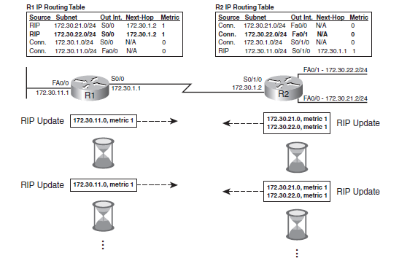
Example: Stable Network

Slide 41
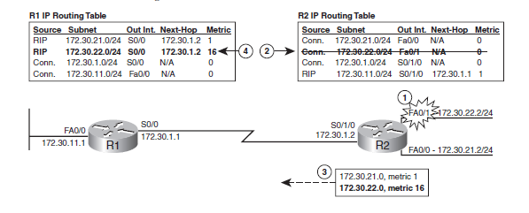
Example: Route Poisoning
  Advertize a failed route with a metric value of “infinity”. (16 in the case of RIP)

Slide 42
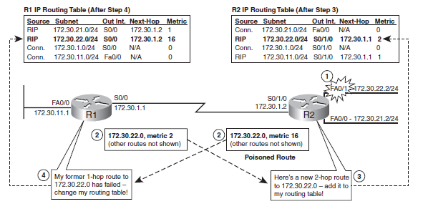
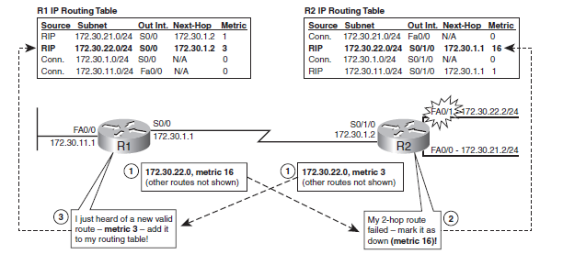
Example: Count-to-infinity
Continues until the advertised metric reach 16

Slide 43
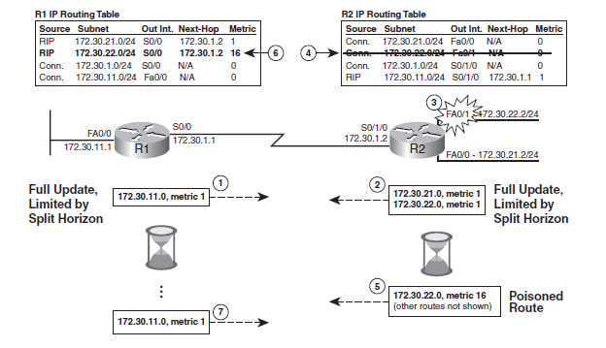
Example: Split Horizon
  In routing updates sent out interface X, do not include routing information about routes that refer to interface X as the outgoing interface

Slide 44
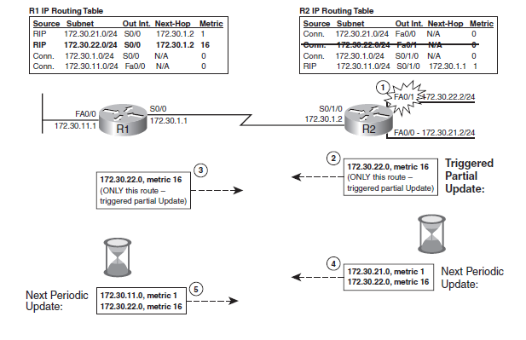
Example: Poison Reverse & Triggered Update
  Poison Reverse: When learning of a failed route, suspend split-horizon rule for that route, and advertise a poisoned route.
  Triggered Updates: When a route fails, send an update immediately.
Triggered
Poison
Reverse

Slide 45
OSPF (Open Shortest Path First)
“open”: publicly available
uses link state algorithm
  LS packet dissemination
  topology map at each node
  route computation using Dijkstra’s algorithm
OSPF advertisement carries one entry per neighbor
advertisements flooded to entire AS
  carried in OSPF messages directly over IP (rather than TCP or UDP
IS-IS routing protocol: nearly identical to OSPF

Slide 46
OSPF “advanced” features (not in RIP)
security: all OSPF messages authenticated (to prevent malicious intrusion)
multiple same-cost paths allowed (only one path in RIP)
for each link, multiple cost metrics for different TOS (e.g., satellite link cost set “low” for best effort ToS; high for real time ToS)
integrated uni- and multicast support:
  Multicast OSPF (MOSPF) uses same topology data base as OSPF
hierarchical OSPF in large domains.

Slide 47
Hierarchical OSPF
boundary router
backbone router
backbone
area
border
routers
area 3
internal
routers
area 1
area 2

Slide 48
Hierarchical OSPF
two-level hierarchy: local area, backbone.
  link-state advertisements only in area
  each nodes has detailed area topology; only know direction (shortest path) to nets in other areas.
area border routers: “summarize” distances to nets in own area, advertise to other Area Border routers.
backbone routers: run OSPF routing limited to backbone.
boundary routers: connect to other AS’s.

Slide 49
Internet inter-AS routing: BGP
BGP (Border Gateway Protocol): the de facto inter-domain routing protocol
  “glue that holds the Internet together”
BGP provides each AS a means to:
  eBGP: obtain subnet reachability information from neighboring ASs.
  iBGP: propagate reachability information to all AS-internal routers.
  determine “good” routes to other networks based on reachability information and policy.
allows subnet to advertise its existence to rest of Internet: “I am here”

Slide 50
BGP basics
BGP session: two BGP routers (“peers”) exchange BGP messages:
  advertising paths to destination prefixes (“path vector” protocol)
  exchanged over semi-permanent TCP connections
when AS3 advertises a prefix to AS1:
  AS3 promises it will forward datagrams towards that prefix
  AS3 can aggregate prefixes in its advertisement
3c
3a
BGP
message
3b
AS3
2c
other
networks
1c
2a
other
networks
1a
2b
1b
AS2
AS1
1d

Slide 51
BGP basics: distributing path information
using eBGP session between 3a and 1c, AS3 sends prefix reachability info to AS1.
  1c can then use iBGP do distribute new prefix info to all routers in AS1
  1b can then re-advertise new reachability info to AS2 over 1b-to-2a eBGP session
when router learns of new prefix, it creates entry for prefix in its forwarding table.
eBGP session
3a
3b
iBGP session
AS3
2c
other
networks
1c
2a
other
networks
1a
2b
1b
AS2
AS1
1d

Slide 52
Path attributes and BGP routes
advertised prefix includes BGP attributes
  prefix + attributes = “route”
two important attributes:
  AS-PATH: contains ASs through which prefix advertisement has passed: e.g., AS 67, AS 17
  NEXT-HOP: indicates specific internal-AS router to next-hop AS. (may be multiple links from current AS to next-hop-AS)
gateway router receiving route advertisement uses import policy to accept/decline
  e.g., never route through AS x
  policy-based routing

Slide 53
BGP route selection (import policy)
router may learn about more than 1 route to destination AS, selects route based on:
  local preference value attribute: policy decision
  shortest AS-PATH
  closest NEXT-HOP router: hot potato routing
  additional criteria

Slide 54
BGP re-announce (export policy)
Routers commonly use “valley-free” routing export policy
  Never advertise peer or provider routes to another peer or provider.
Examples (arrows indicate $ flow or customer → provider relationship, else peering):
Q: Which of the above routes are permitted by “valley free” export policy?

Slide 55
BGP messages
BGP messages exchanged between peers over TCP connection
BGP messages:
  OPEN: opens TCP connection to peer and authenticates sender
  UPDATE: advertises new path (or withdraws old)
  KEEPALIVE: keeps connection alive in absence of UPDATES; also ACKs OPEN request
  NOTIFICATION: reports errors in previous msg; also used to close connection

Slide 56
BGP routing policy
legend:
provider
B
network
X
W
A
customer
C
network:
Y
A,B,C are provider networks
X,W,Y are customer (of provider networks)
X is dual-homed: attached to two networks
  X does not want to route from B via X to C
  .. so X will not advertise to B a route to C

Slide 57
BGP routing policy (2)
legend:
provider
B
network
X
W
A
customer
C
network:
Y
A advertises path AW to B
B advertises path BAW to X
Should B advertise path BAW to C?
  No way! B gets no “revenue” for routing CBAW since neither W nor C are B’s customers
  B wants to force C to route to w via A
  B wants to route only to/from its customers!

Slide 58
Why different Intra-, Inter-AS routing ?
policy:
inter-AS: admin wants control over how its traffic routed, who routes through its net.
intra-AS: single admin, so no policy decisions needed
scale:
hierarchical routing saves table size, reduced update traffic
performance:
intra-AS: can focus on performance
inter-AS: policy may dominate over performance

