Slide 1

Dude, where’s that IP?
Circumventing measurement-based geolocation
Phillipa Gill*
Yashar Ganjali*,Bernard Wong**, David Lie***
*Dept. of Computer Science, University of Toronto
**Dept. of Computer Science, Cornell University
***Dept. of Electrical and Computer Engineering, University of Toronto

Slide 2
Motivation
Applications benefit from geolocating clients:
  Online advertising & search engines
  Restricting access to online content
    Multimedia
    Online gambling
  Fraud prevention
Looking forward:
  Geolocation to locate VMs hosted by cloud provider
  Location-based SLAs

Slide 3
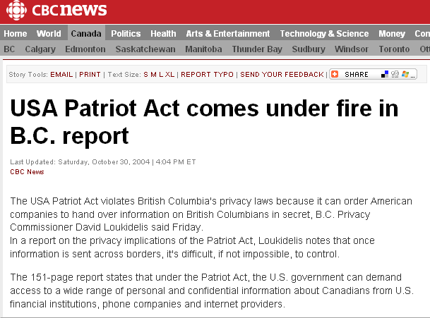
Motivation (con’t)
Targets have incentive to lie
Web clients:
  Gain access to content
  Commit fraud
Cloud computing:
  Need the ability to guarantee the result of geolocation

Slide 4

Our contributions
First to consider measurement-based geolocation of an adversary
Two models of adversarial geolocation targets
  Web client (end host)
  Cloud provider (network)
Evaluation of attacks on
delay and topology-based
geolocation.

Slide 5
Road map
Motivation & Contributions
Background
Adversary models
Evaluation
Conclusions
Future work

Slide 6
Geolocation background
Databases/passive approaches
  whois services
  Commercial databases
    Quova, MaxMind, etc.
  Drawbacks: coarse-grained, slow to update
Measurement-based geolocation
  Landmark machines with known locations
  Active probing of the target
  Constrain location of target

Slide 7
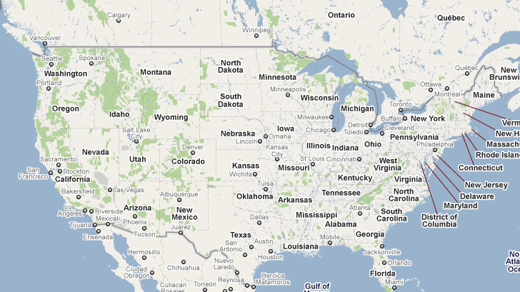
Measurement-based geolocation
Delay-based geolocation example
  Constraint-based geolocation [Gueye et al. ToN ‘06]
Ping other landmarks to calibrate
Distance-delay function
Ping!
Ping!
Ping!

Slide 8
Measurement-based geolocation
Delay-based geolocation example
  Constraint-based geolocation [Gueye et al. ToN ‘06]
2. Ping target
Ping!
Ping!
Ping!
Ping!

Slide 9
Measurement-based geolocation
Delay-based geolocation example
  Constraint-based geolocation [Gueye et al. ToN ‘06]
3. Map delay to distance from target
4. Constrain target location

Slide 10
Types of measurement-based geolocation:
Delay-based:
  Constraint-based geolocation (CBG) [Gueye et al. ToN ‘06]
  Computes region where target may be located
  Average accuracy: 78-182 km
Topology-aware:
  Octant [Wong et al. NSDI 2007]
  Considers delay between hops on path
  Geolocates nodes along the path
  Median accuracy: 35-40 km

Slide 11
Road map
Motivation & Contributions
Background
Adversary models
Evaluation
Conclusions
Future work

Slide 12
Simple adversary (e.g., Web client)
Knows the geolocation algorithm
Able to delay their response to probes
  i.e., increase observed delays
Landmark i

Slide 13
Sophisticated adversary
(e.g., Cloud provider)
Controls the network the target is located in
Network has multiple geographically distributed entry points
Adversary constructs network paths to mislead topology-aware geolocation
tar
target
landmark

Slide 14
Road map
Motivation & Contributions
Background
Adversary models
Evaluation
Conclusions
Future work

Slide 15
Evaluation
Questions:
  How accurately can an adversary mislead geolocation?
  Can they be detected?
Methodology:
  Collected traceroutes between 50 PlanetLab nodes.
  Each node takes turn as target
  Each target moved to a set of forged locations

Slide 16
Delay-adding attack
L1
Increase delay by time to travel difference of g1 and g2
Challenge: how to map distance to delay
Attack v1: speed of light
Attack v2: knowledge of the “best-line” function
L2
L3
Forged
location

Slide 17
Hop-adding attack
Multiple network entry points
In-degree 3 for each node
Fake node next to each forged location

Slide 18
Accuracy for the adversary
Best-case delay adding attack
Even in best-case delay-adding attack is less precise than hop-adding
Hop adding attack

Slide 19
Detectability: Delay-adding
Area of intersection
increases as delay is added
Abnormally large region sizes can reveal results that have been tampered with

Slide 20
Detectability: Hop-adding
Hop adding is able to mislead the algorithm without increasing region size!

Slide 21
Road map
Motivation
Background
Adversary models
Evaluation
Conclusions
Future work

Slide 22
Conclusions
Current geolocation approaches are susceptible to malicious targets
  Databases misled by proxies
  Measurement-based geolocation by attacks on delay and topology measurements
Topology-aware geolocation techniques are more susceptible to the sophisticated adversary
Delay-adding attacks limited by accuracy and detectability

Slide 23
Future work
Develop a framework for secure geolocation
Leverage the existence of desired location:
  Require the adversary to prove they are in the correct location
Goals:
  Provable security: Upper bound on what an adversary can get away with.
  Practical framework: Should be tolerant of variations in network delay

Slide 24
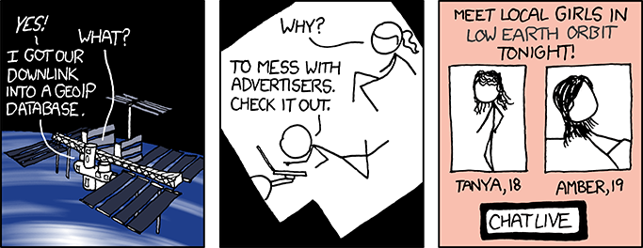
Questions?
Another reason not to trust databases!
Contact:
phillipa@cs.toronto.edu

Slide 25


Slide 26
