Slide 1
CS590B/690B Detecting Network Interference
Lecture 19
Attacks on Decoy Routing
Phillipa Gill – Umass -- Amherst

Slide 2
Review questions
What type of censor adversary does decoy routing assume?
How does it try to evade this type of censor?
Describe how decoy routing works.
What is a sentinel? What is its purpose? Give an example.
Why would operators be reluctant to deploy Telex/Cirripede?
What property of Tap Dance is meant to reduce operator reluctance?
What key observation does Tap Dance use to suppress a response from the legitimate server? Why does this type of packet not get a response from the server?

Slide 3
Today: decoy routing
Defending against decoy routing!
- Routing around decoys
- No way home.
ACKS: Slides courtesy Amir Houmansadr @ UMass.

Slide 4
Routing Around Decoys
Schuchard et al., ACM CCS 2012

Slide 5




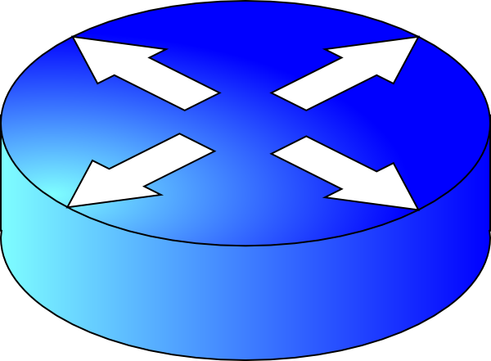
Routing Around Decoys (RAD)
Blocked
Non-blocked
Decoy AS
Gateway
The Non-Democratic
Republic of
Repressistan
Notes:
The basis of the RAD attack is the observation that ISPs in the censorship region are likely to have multiple paths to any given destination. Therefore, censors can instruct the ISPs under their influence to exclusively select routes that do not pass through the ISPs known to deploy decoy routers.

Slide 6
The Costs of Routing Around Decoys
Houmansadr et al., NDSS 2014

Slide 7
This paper
Concrete analysis based on real inter-domain routing data
As opposed to relying on the AS graph only
While technically feasible, RAD imposes significant costs to censors

Slide 8
Main intuition: Internet paths are not equal!
Standard decision making in BGP aims to maximize QoS and minimize costs

Slide 9
Degraded
Internet reachability
Blocked
Non-blocked
Decoy AS
Gateway
Decoy AS
The Non-Democratic
Republic of
Repressistan

Slide 10
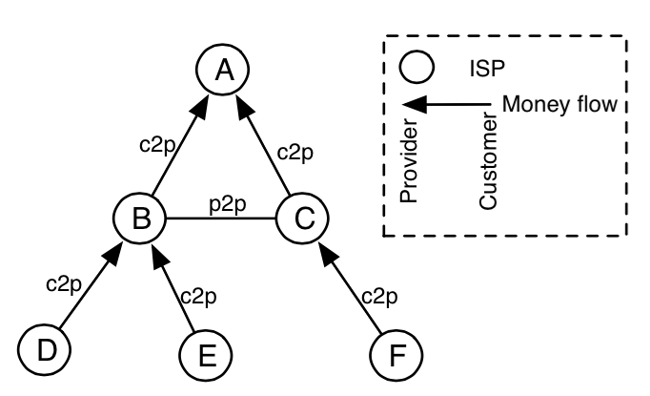
Path preference in BGP
ASes are inter-connected based on business relationships
Customer-to-provider
Peer-to-peer
Sibling-to-sibling
Standard path preference:
Customer
Peer/Sibling
Provider

Slide 11
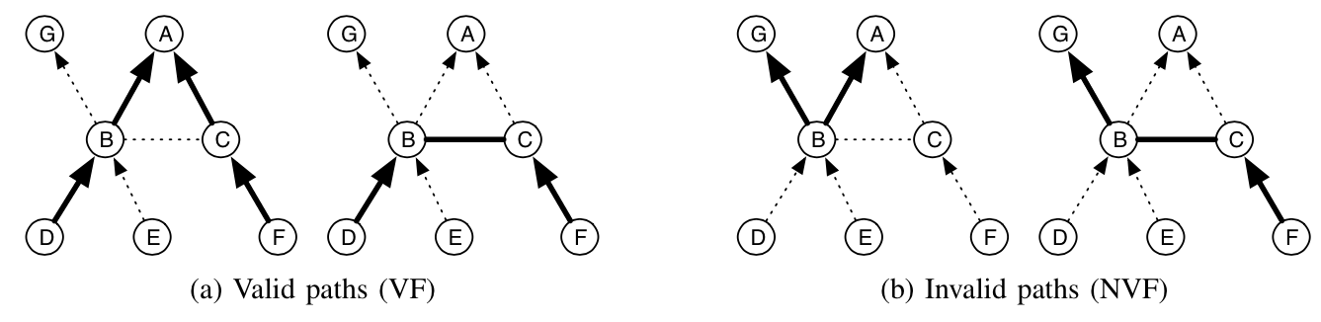
Valley-free routing
A valley-free Internet path:
each transit AS is paid by at least one neighbor AS in the path
ISPs widely practice valley-free routing
Notes:
Edges are not equal, in realy as graph satisfies gao’s. for business reasons ISPs strongly prefers through …

Slide 12

2. Non-valley-free routes
Blocked
Provider
Non-blocked
Decoy AS
Gateway
Customer
Provider
The Non-Democratic
Republic of
Repressistan
Notes:
if a Chinese AS does not have a decoy- free path to a certain destination, it can re-route traffic to that destination through one of the other 198 ASes in China, e.g., a customer AS or an AS with which it has no business relationship. This is a key factor in the success of the RAD attack, because it increases the number of alternative paths available to the RAD ASes. MPLS VPN

Slide 13
3. More expensive paths
Blocked
Customer
Non-blocked
Decoy AS
Gateway
Provider
The Non-Democratic
Republic of
Repressistan
Notes:
Dollar sign

Slide 14
4. Longer paths
Blocked
Non-blocked
Decoy AS
Gateway
The Non-Democratic
Republic of
Repressistan
Notes:
susceptible to higher network latencies, lower throughputs, and more frequent network failures

Slide 15

5. Higher path latencies
Blocked
Non-blocked
Decoy AS
Gateway
The Non-Democratic
Republic of
Repressistan
Notes:
Longer routes are not the only cause of higher latencies. The alternative paths selected by RBGP are likely to pass through less popular transit ASes that offer lower capacity, causing packets to experience higher latencies. This is confirmed by our simulations in Section VII, which show that, even when an RBGP path has the same length as the corresponding BGP path, it usually has higher latency.

Slide 16

6. New transit ASes
Blocked
Non-blocked
Decoy AS
Gateway
Edge AS
The Non-Democratic
Republic of
Repressistan
Notes:
Show picture of routers

Slide 17
7. Massive changes in transit load
Loses transit traffic
Blocked
Transit AS
Non-blocked
Decoy AS
Gateway
Transit AS
The Non-Democratic
Republic of
Repressistan
Over-loads

Slide 18
Simulations
Use CBGP simulator for BGP
Python wrapper
Datasets:
Geographic location (GeoLite dataset)
AS relations (CAIDA’s inferred AS relations)
AS ranking (CAIDA’s AS rank dataset)
Latency (iPlane’s Inter-PoP links dataset)
Network origin (iPlane’s Origin AS mapping dataset)
Analyze RAD for
Various placement strategies
Various placement percentages
Various target/deploying Internet regions

Slide 19
Costs for the Great Firewall of China
A 2% random decoy placement disconnects China from 4% of the Internet
Additionally:
16% of routes become more expensive
39% of Internet routes become longer
Latency increases by a factor of 8
The number of transit ASes increases by 150%
Transit loads change drastically (one AS increases by a factor of 2800, the other decreases by 32%)
Notes:
Random-no-ring-1
4% NVF

Slide 20
Strategic placement
RAD considers random selection for decoy ASes
This mostly selects edge ASes
Decoys should be deployed in transit ASes instead
For better unobservability
For better resistance to blocking
86% are edge ASes

Slide 21
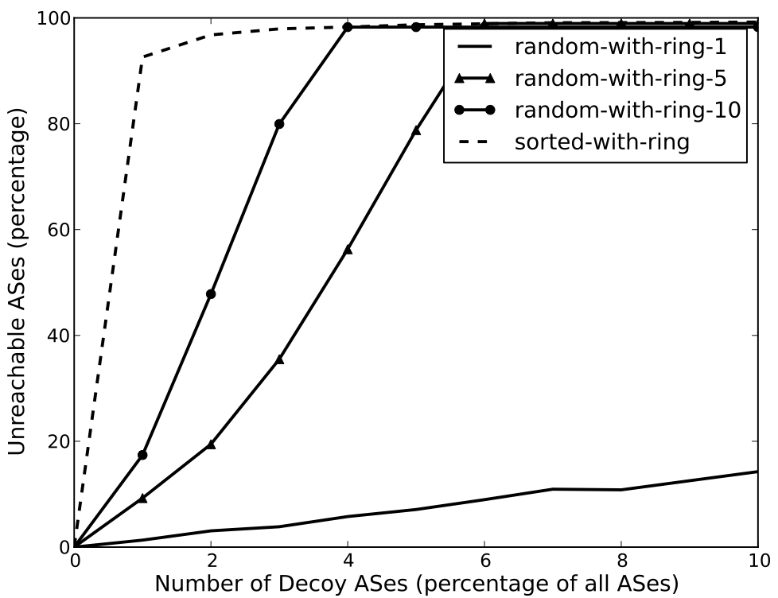
Strategic placement
20% unreachability
43% unreachability
4% unreachability

Slide 22
Lessons
RAD is prohibitively costly to the censors
Monetary costs, as well as collateral damage
Strategic placement of decoys significantly increases the costs to the censors
The RAD attack is more costly to less-connected state-level censors
Even a regional placement is effective
Analysis of inter-domain routing requires a fine-grained data-driven approach
Notes:
Business problem, not a graph problem.
Analysis based solely on the graph topology of the Internet may lead to mistaken conclusions about the feasibility of decoy routing

