Slide 1
CS590B/690B
Detecting Network Interference
(Spring 2018)
Lecture 17
Phillipa Gill – Umass -- Amherst

Slide 2
Where we are
Last time:
Attacks on Tor
  Timing attacks
Today:
Review/discussion
Covert channels
Why imitating existing protocols doesn’t work.

Slide 3
Review questions – Tor basics
What does it mean to be anonymous? Informally? Formally?
Where might an adversary compromise an anonymity network?
Why is confidentiality not enough to ensure anonymity?
Why might law enforcement want to be anonymous?
Why might dissidents want to be anonymous?
Why do you need multiple groups to ensure anonymity?
What is onion routing?
What are some weaknesses of Tor?

Slide 4
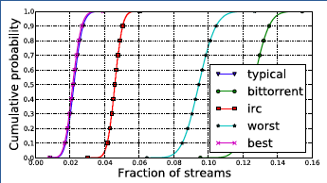
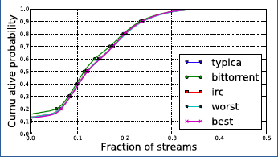
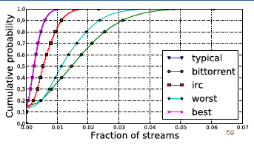
Review – Relay-based Timing Attacks
Why are these plots different for the different applications when we consider exit-relay or guard+exit-relay compromises but the same when we only consider guard-relay compromise?
Exit relay
Guard relay
Guard+Exit relay

Slide 5
Review – AS AWARE Tor clients
What are three fundamental challenges faced by AS-aware Tor clients?
How do users get routed and holding all the ASes differ in their approach to predicting network paths?
List the AS-level attacks discussed in RAPTor
What challenges do these attacks post to researchers developing AS-aware Tor clients?
How does an adversary on the reverse path learn packet timings and sizes?
Why is increasing the AS-level diversity of Tor relays challenging?

Slide 6
Where we are
Today:
Review/discussion
Covert channels
Why imitating existing protocols doesn’t work.

Slide 7
Challenge
Circumvention tools can get around censorship, but have a hard time not being observable
  Ie., they generally cannot hide the fact that users are using them
E.g., Tor is not completely effective for circumvention because a censor can just block the IPs of known relays
Users who are seen using these tools may face trouble from the government
.. And the censor can leverage observability to stop the system
  Reduce availability

Slide 8
Attempts to improve things
Sharing secrets between users
Tor Bridges: volunteer proxies who’s IPs are selectively shared with members of the Tor network.
  In contrast to publicly announced entry nodes.
Sharing secrets is hard to scale -> how to share with a large number of users but not the censors?
Obfuscation
  UltraSurf + Psiphon do this.
  However, these tools are not rigorously analyzed and can jeopardize users security
Pluggable transports
  Protocol level obfuscation (e.g., obfsproxy – performs TLS encryption but does not obfuscate timings).

Slide 9
Other Attempts…
Mask the traffic as a different type of traffic
  E.g., SkypeMorph morphs Tor traffic into Skype video
Integrate circumvention into the network infrastructure
  Use HTTPS + cooperative ISPs to conceal circumvented traffic
  …but hard to deploy

Slide 10
Skype morph
Tor obfuscation
Disguises communication between client and Tor relay as a Skype video call.
Pluggable transport: user can specify to disguise her traffic as a Skype video call and connect to a special SkypeMorph relay
Basic process: Client’s Skype log in makes a “call” to the relay, but drops the call and exchanges Tor traffic over the connection.
UDP-based implementation to match Skype.
Improves existing traffic shaping to preserve inter-packet delay between consecutive packets
Can perform better than regular steganography because the channel is encrypted (the data looks random anyways)

Slide 11
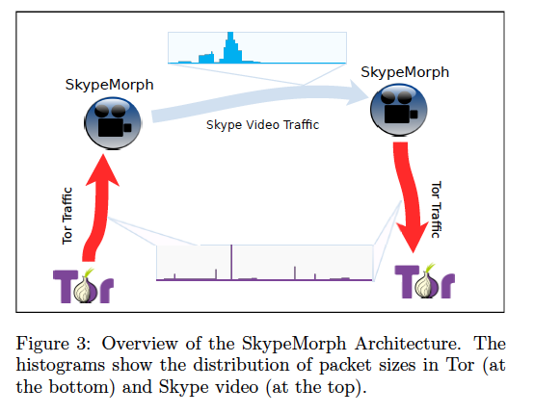
Skype Morph overview

Slide 12
freewave
Traffic obfuscation:
Hide covert traffic *within* an *actual* implementation of an application.
Server obfuscation:
Leverage oblivious participants in VOIP network

Slide 13
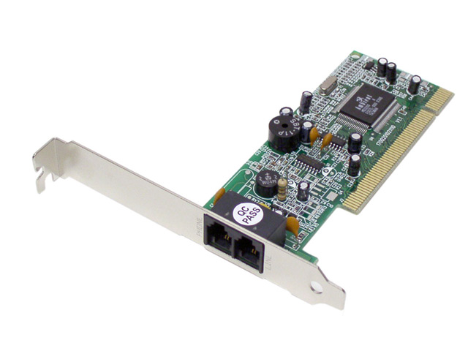
FreeWave: IP over Voice-over-IP
Target protocol: Voice-over IP (VoIP)
Why VoIP
  Widely used protocol (only 663 Million Skype users)
    Collateral damage to block
  Encrypted
How to hide?
  The dial-up modems are back!
http://dedis.cs.yale.edu/dissent/papers/freewave-slides.pptx

Slide 14




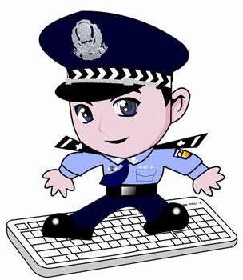

FreeWave architecture
FreeWave
Server
Client
http://dedis.cs.yale.edu/dissent/papers/freewave-slides.pptx

Slide 15
Threat model + Goals
User connects to the Internet via a censoring ISP which precludes access to specific destinations.
  + limits access to circumvention tools
ISP does not want to compromise usability of the network
  E.g. political/economic pressures
Goals
Unblockability: the systems needs to be unblockable by censors
Unobservability: should hide the fact that users are using the circumvention system
Security: anonymity, privacy and confidentiality of users need to be protected
Deployment feasibilty: avoid dependencies on other systems (e.g ISPs)
QoS: Needs to provide adequate bandwidth and latency appropriate for Web browsing.

Slide 16
Basic idea of Freewave
User downloads the Freewave Client and enters her VoIP ID and makes a call to the FreeWave server (by entering its VoIP ID).
Server is set up such that connections will go via an oblivious VoIP client (e.g., Skype supernode).
Since VoIP connection is encrypted censor cannot ID server’s VoIP ID and censor it.
Components:
VoIP client
Virtual Sound Card (virtual sound card interface: any application can use it the same way a physical sound card is utilized).
MoDem: application that translates network traffic into acoustic signals and vice versa (aka Modulator Demodulator)
Proxy: Server uses this to relay traffic received via VoIP connections to its final destination.

Slide 17
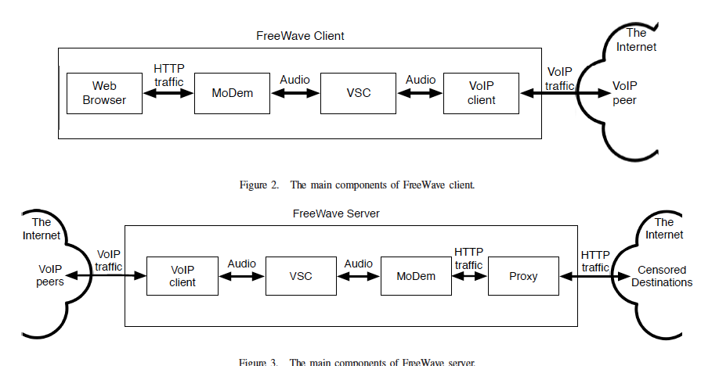
Basic components

Slide 18
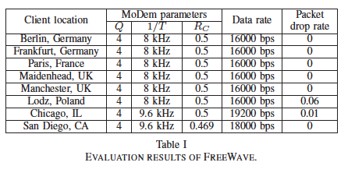
Performance
16-19 kbps

Slide 19
FreeWave’s unobservability
Traffic analysis (packet rates and sizes)
Fixed rate codecs (e.g., G.7 series)
  Not an issue ☺
Variable bit-rates (e.g., Skype’s SILK)
  Simple analysis
  Superimpose with recoded conversation

Slide 20
Where covert channels fail
Why imitating existing protocols doesn’t work.
-> Parrot is Dead
Idea: imitation doesn’t work
ACKs: http://dedis.cs.yale.edu/dissent/papers/parrot-slides.pptx
-> Cover your ACKS
Idea: even tunneling over another protocol isn’t enough

Slide 21
Parrot is dead
Goals of unobservable circumvention:
Censors should not be able to identify
circumvention traffic or end-hosts through
passive, active, or proactive techniques
Side note: Parrot is dead is a reference to this skit: https://www.youtube.com/watch?v=4vuW6tQ0218

Slide 22


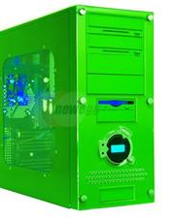



Let’s hide!
Censorship Region
The Internet

Slide 23
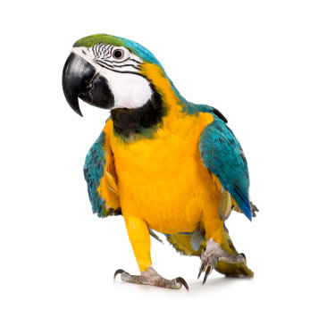
Parrot systems
Imitate a popular protocol
  SkypeMorph (CCS’12)
  StegoTorus (CCS’12)
  CensorSpoofer (CCS’12)

Slide 24
SkypeMorph
The Internet
Censorship Region
TCP control
SkypeMorph
Client
SkypeMorph
Bridge
A Tor node

Slide 25
SkypeMorph+
Let’s imitate the missing!
Hard to mimic dynamic behavior
  Active/proactive tests

Slide 26
Other tests
Test | Skype | SkypeMorph+
Flush Supernode cache | Serves as a SN | Rejects all Skype messages
Drop UDP packets | Burst of packets in TCP control | No reaction
Close TCP channel | Ends the UDP stream | No reaction
Delay TCP packets | Reacts depending on the type of message | No reaction
Close TCP connection to a SN | Initiates UDP probes | No reaction
Block the default TCP port | Connects to TCP ports 80 and 443 | No reaction

Slide 27
StegoTorus
The Internet
Censorship Region
HTTP
Who does this???
HTTP
Skype
StegoTorus
Client
StegoTorus
Bridge
A Tor node
Ventrilo
HTTP
Notes:
Looks strange!!!

Slide 28
Lesson 1
Unobservability by imitation is
fundamentally flawed!
You basically have to implement the entire protocol…
Bugs and all!

Slide 29
Lesson 2
Partial imitation is worse than no imitation!
Before you looked like a Tor user…
… now you look like a SkypeMorph users
K anonymity anyone?

Slide 30

Alternatives
Do not imitate, but Run the target protocol
IP over Voice-over-IP [NDSS’13]
Castle [EuroS&P’16]
Challenge: efficiency

Slide 31
Does running the protocol save you?
Paper: Cover your ACKs. Geddes et al. ACM CCS 2013
Observation: running over the original protocol isn’t enough.
There may be mismatches between the proxy protocol and the protocol you tunnel over!
3 types of mismatches:
  Architectural: e.g., reusing a P2P VoIP protocol to mimic a client-> proxy protocol
    E.g., FreeWave uses Skype SuperNodes extensively when the default is to use them as a last resort.
  Channel mismatches: e.g., codecs for VoIP are tolerant of loss, but covert traffic may not be. Means a censor can take actions which will only impact covert users.
  Content Mismatches: E.g., human speech vs. modem produced audio

Slide 32
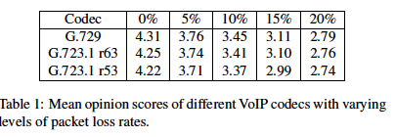
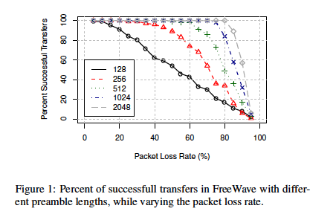
Loss tolerance
Preamble used by the modem to synchronize the messages. Just need to break synchronization.
Pretty high,
But only needs to
Happen for 0.25 of
A second for 2048
preamble
2 = “annoying”
3 = “slightly annoying”

Slide 33
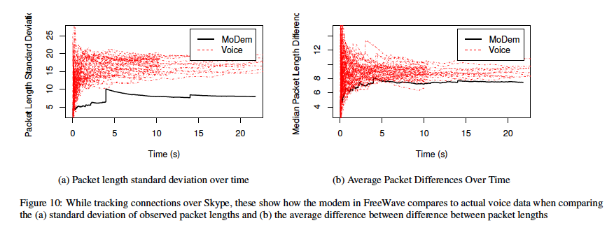
Content mismatch
While average packet-rate and size are not so bad, variance gives it away!

Slide 34
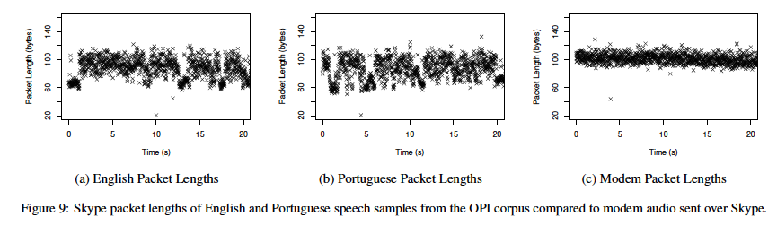
Packet length of speech vs. Modem

Slide 35
Discussion

