Slide 1
CS590B/690B Detecting Network Interference (Spring 2018)
Lecture 14
Phillipa Gill – Umass Amherst
(Web site fingerprinting Slides courtesy of R. Nithyanand)

Slide 2


Anonymity on the Internet
Challenge: By observing Internet traffic one can infer who is talking to whom
  Meta data is the message!
  Track communications over time…
    …behaviors, interests, activities
Tor aims to solve this:
Tor
Does not know destination
Does not know source
Notes:
One of the challenges of the Intenret is that it was not designed with anonymity in mind. So somebody observing network traffic can observe the source and destination of each connection and learn about what sites people are visiting even if the connection is encrypted.
As we’ve seen with the NSA revelations in recent years even this sort of meta data about who talks to who can be incredibly valuable for tracking peoples behaviors intersts and activities.
Tor is a system that tries to resolve this issue by providing users an anonymous way to access content online. It does this using encryption and by bouncing the users traffic off of three relays or Tor routers refered to as the entry, middle and exit relay. The basic idea is that someone observing at the entry relay only learns the identify of the source but not the destination and the exit knows the destination but not the source.
On the Internet, by default there is no anonymity, someone observing packets can easily observe the source and destination of the connection and infer who is talking to whom, even if they use encryption .
And as we’ve seen with the NSA relevations this meta data is actually quite critical, you can track communications, behaviors, interests and so on.
So what systems like to try to do is provide users with the ability to use the internet in an anonymous way.

Slide 3

Threat model
Middle
Tor
Exit
Entry
Relay-based attacks
Finger print Web sites based on packet timing
Exit relay can observe users’ traffic
(Today)
Network-based attacks
Timing attacks can deanonymize users
Actually being tried by gov’t agencies!
(Upcoming lectures)
Notes:
Constructs the path out of three Tor routers/relays.
- HOW ARE RELAYS chosen? → based on capacity/load
Client iteratively exchanges keys with relays on the path and tunnels to the next relay
- When the relay decrypts the message it learns the identity of the next hop on the path. In this way each relay only learns the hop before it and after it in the circuit.
- exit see the actual traffic so if the data contains information about the client the exit can learn who it is. → Tor browser is important.

Slide 4
Threat model
Which user is visiting the site?
Middle
Tor
Exit
Entry
Relay-based attacks
Finger print Web sites based on packet timing
Exit relay can observe users’ traffic
Network-based attacks
Timing attacks can deanonymize users
Actually being tried by gov’t agencies!
Notes:
Constructs the path out of three Tor routers/relays.
- HOW ARE RELAYS chosen? → based on capacity/load
Client iteratively exchanges keys with relays on the path and tunnels to the next relay
- When the relay decrypts the message it learns the identity of the next hop on the path. In this way each relay only learns the hop before it and after it in the circuit.
- exit see the actual traffic so if the data contains information about the client the exit can learn who it is. → Tor browser is important.

Slide 5






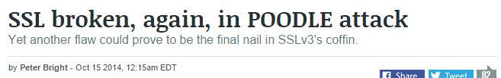
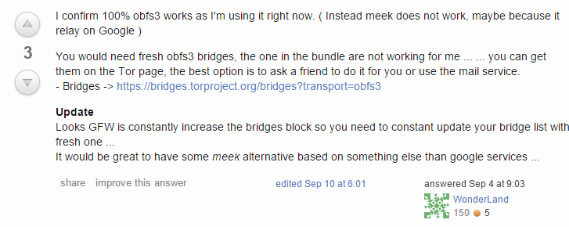

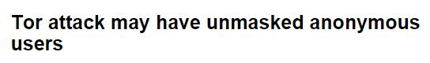



Attacks on Security, Privacy, and Anonymity on the Internet

Slide 6

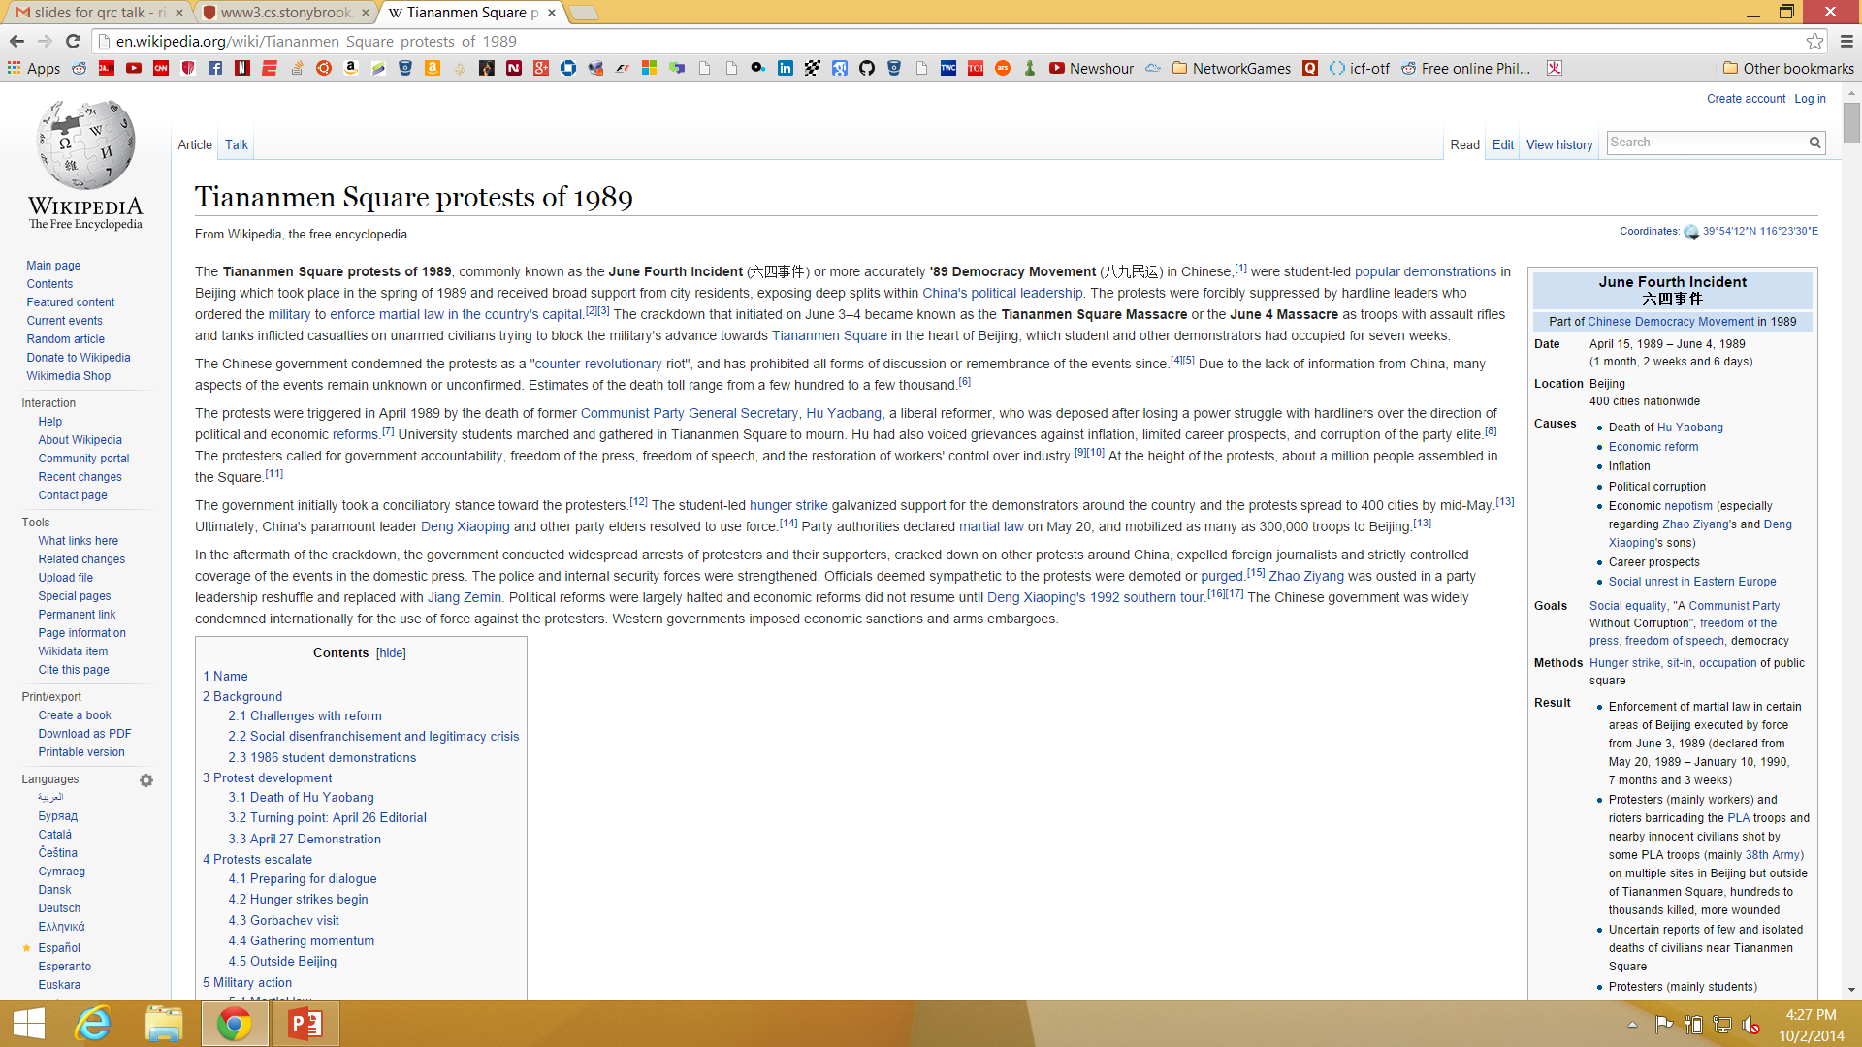


Website Fingerprinting Attacks
Blocked Webpage
Victim
Webpage Trace
+166 @ 0
-1412 @ 12
…
WWW
Proxy Server
Is Rishab trying to get to that blocked page again?
Trace: {(d₁, s₁, t₁), (d₂, s₂, t₂), …, (d_{n}, s_{n}, t_{n})}
“What webpage generated this trace?”

Slide 7
A Brief History of Website Fingerprinting Research
Type | Work
Attack | Levine and Liberatore [CCS 2006]
Attack | Hermann et al. [CCSW 2009]
Defense | Wright et al. [NDSS 2009]
Attack | Lu et al. [ESORICS 2010]
Defense | Luo et al. [NDSS 2011]
Attack | Panchenko et al. [CCS 2011]
Attack/Defense | Dyer et al. [S&P 2012]
Attack | Cai et al. [CCS 2012]
Attack | Wang and Goldberg [WPES 2013]
Attack/Defense | Wang et al. [Security 2014]

Slide 8
Contributions
Foundations: Understand what…
  It means for a defense to be secure.
  The security-overhead trade-off curve looks like.
Constructions: Build defenses that…
  Can provide security guarantees.
  Are efficient.
Evaluation: Allow researchers to…
  Translate closed-world results into open-world approximations.
  Compare defenses with different trade-offs.

Slide 9
Understanding Website Fingerprinting Defenses
Blocked Webpage
Victim
Webpage Trace
+166 @ 0
-1412 @ 12
…
WWW
Is Rishab trying to get to that blocked page?
Proxy Server
Trace: {(d₁, s₁, t₁), (d₂, s₂, t₂), …, (d_{n}, s_{n}, t_{n})}
“What webpage generated this trace?”
The goal is to prevent attackers from drawing definite conclusions about the site being visited.
  Transform traces from page loads by: adding, padding, merging, or delaying packets.

Slide 10
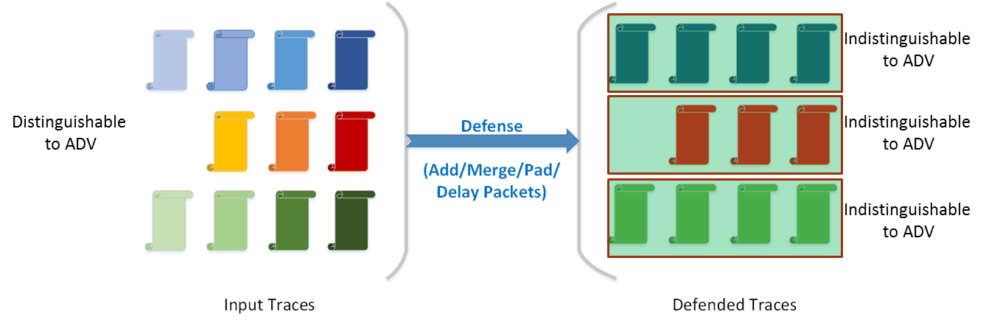
Security Definitions
Assumption: We are working with the optimal adversary (ADV). ADV can always distinguish between any pair of traces, unless they are exactly identical.
  E.g., load www.google.com and www.baidu.com. Even if the difference is only an extra byte in the 131st packet, our ADV knows which trace belongs to which site.

Slide 11
Security Definitions
Non Uniformly ε Secure: On average, ADV success rate is bounded by ε. There are no guarantees about the minimum level of protection for any site.
The above defense is (3/11)-Non Uniformly Secure.
Uniformly ε Secure: The maximum ADV success rate is always bounded by ε for any site. All sites are guaranteed to be protected to some degree.
The above defense is (1/3)-Uniformly Secure.

Slide 12
Building the Optimal Defense
The optimal non-uniform ε-defense (ε-OPT) over a set of n websites:
  Creates nε partitions of the n websites.
  Modifies each site trace so that it is identical to all other traces in its partition. (by buffering/merging/adding/padding packets).
  Minimizes the total number of bytes.
n = 12
ε = 1/3
Strongly NP-Complete via Binary Shortest Common Supersequence!

Slide 13
Dealing with NP-Completeness
Building the optimal defense (OPT) against an optimal adversary (ADV) is NP-complete.
Instead, we will build the optimal defense (OPT’) against a weaker adversary (ADV’).
Why?
  Derive a limit for the best that OPT can achieve against ADV.
  Give ideas to bootstrap a good heuristic defense against ADV.
How?
  Reduce information available to ADV.
  ADV can see a complete trace for each site (Trace={<dir₁, size₁, time₁>, …, <dir_{n}, size_{n}, time_{n}>})
  ADV’ can only see the total number of bytes loaded (T’={Σsize_{i}}).
ADV: Per-packet size, time, direction
ADV’: Total trace size

Slide 14
Building OPT’
The optimal non-uniform ε-defense (OPT’) against ADV’ over a set of n websites:
  Creates nε partitions of the n websites.
  Modifies each site trace so that it is identical to all other traces in its partition (by simply increasing total trace size).
  Minimizes the total number of bytes added to each trace.
Properties of OPT’:
  The range of OPT’ is a subset of the domain of OPT’ – i.e., it is an endofunction.
  The mapping of OPT’ is monotonically increasing.
  OPT’ is a deterministic algorithm.
w₁
w₂
w₃
w₄
Monotonically Increasing
w₅
w₆
Website sizes
Endofunction
Solvable in O(n²ε) time with simple dynamic programming!

Slide 15
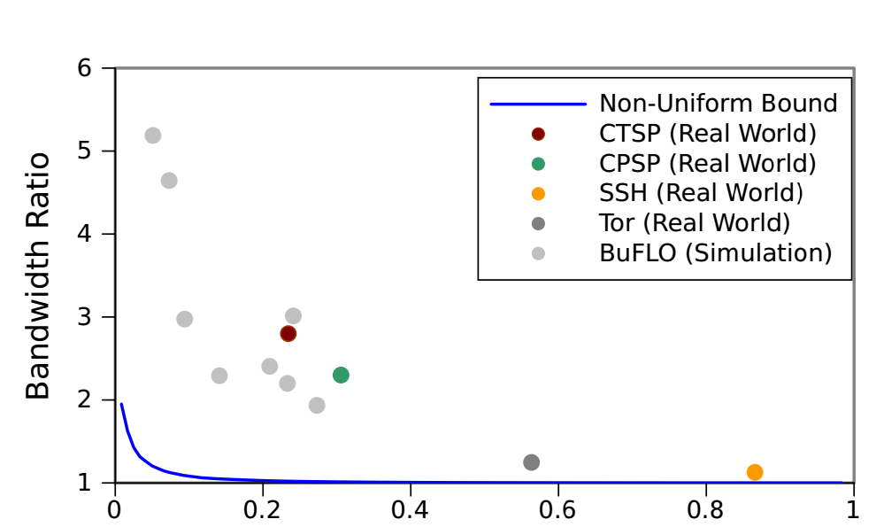
The Security-Bandwidth Trade-off
n = 6
ε = 1/3
OPT’
w₁
w₂
w₃
w₄
w₅
w₆
Website sizes
OH = (4W₄ + 2W₆ )/(ΣW_{i})
Accuracy of Panchenko Classifier

Slide 16
Conclusions
Foundations: Understand what…
  It means for a defense to be secure.
  The security-overhead trade-off curve looks like.
Constructions: Build defenses that…
  Can provide security guarantees.
  Are efficient.
Evaluation: Allow researchers to…
  Translate closed-world results into open-world approximations.
  Compare defenses with different trade-offs.

