Slide 1
CS590B/690B Detecting Network Interference (Spring 2018)
Lecture 13
Phillipa Gill – Umass Amherst

Slide 2
Last time
Fingerprinting filtering products
Questions?

Slide 3
Review questions
What is the meaning of “dual use technology” (in the context of filtering products)?
How can we learn about what products to suspect in a given network?
How can we validate that a given product is installed on a specific IP address?
How can we verify that a specific product is being used for censorship?
What factors make this challenging?
Notes:
Filtering products can be used in enterprise/academic networks vs. for national censorship
User reports, logos on block pages
What web
Create bogus domains/submit them to the product’s Web site
Need to know what categories of content the ISP is blocking. Need to create sites matching that content for submission

Slide 4
Today
Onion routing
Tor (an implementation of onion routing)
Slides by Roger Dingledine (via Jonathan Katz)
http://www.cs.umd.edu/~jkatz/security/f09/lectures/syverson.pdf
https://crysp.uwaterloo.ca/courses/cs458/W14-lectures/Module5.pdf

Slide 5
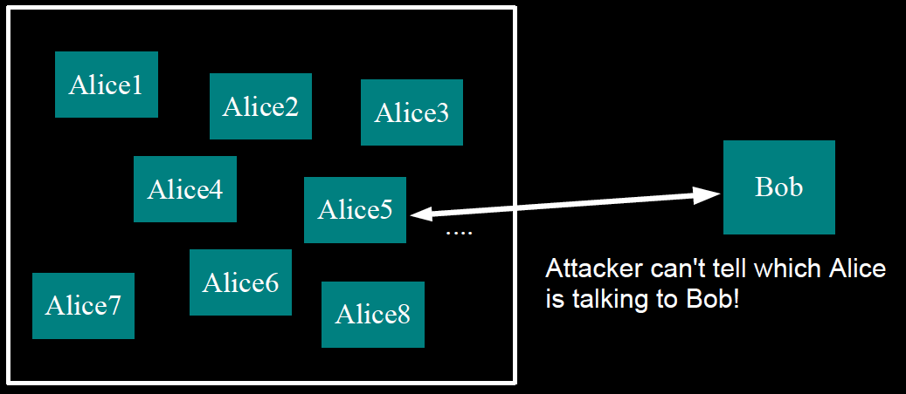
What is anonymity
Informally: You can’t tell who did what
Who wrote this blog post?
Who’s been viewing my Web pages?
Who’s been emailing patent attorneys?
Formally: Indistinguishability within an “anonymity set”

Slide 6
Anonymity
Can’t distinguish?
Anonymity set size?
Probability distribution within anonymity set?

Slide 7
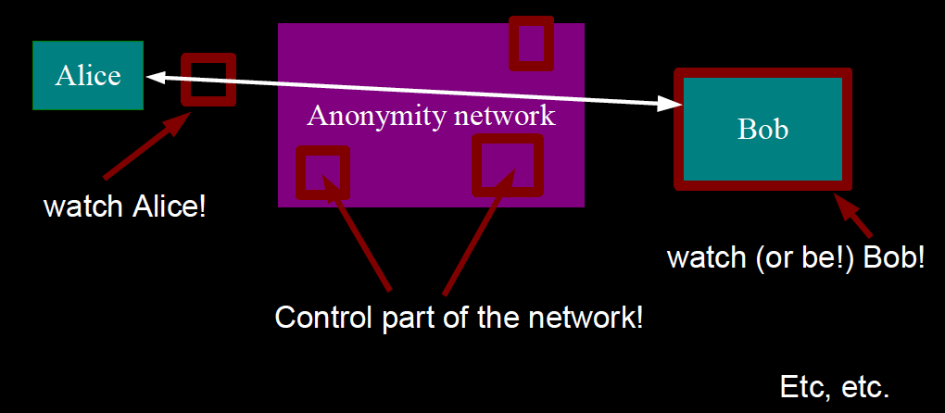
Assumptions…
We have to make some assumptions about what the attacker can do

Slide 8
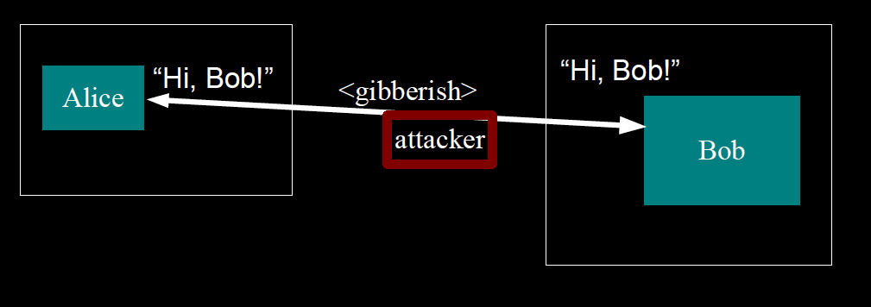
Anonymity != Confidentiality
Encryption does not give anonymity. It just protects the contents

Slide 9
Why do we care about anonymity?

Slide 10
Why anonymity?
Regular citizens don’t want to be tracked
People around the world experience censored Internet
Their speech on the Internet is also censored…
… can lead to arrest, persecution, or worse
Not just for dissidents…
… if you write something bad about your employer you could be fired
Law enforcement needs it too
Investigating a suspect: why is alice.fbi.gov reading my Web page?
Sting operation: why is alice.fbi.gov selling counterfeits on ebay?
Corporations
Are your employees reading a competitor’s jobs page?
Government
Hide list of IPs in Baghdad receiving .gov e-mail (untrusted ISP)
What does the CIA Google for? (untrusted service)

Slide 11
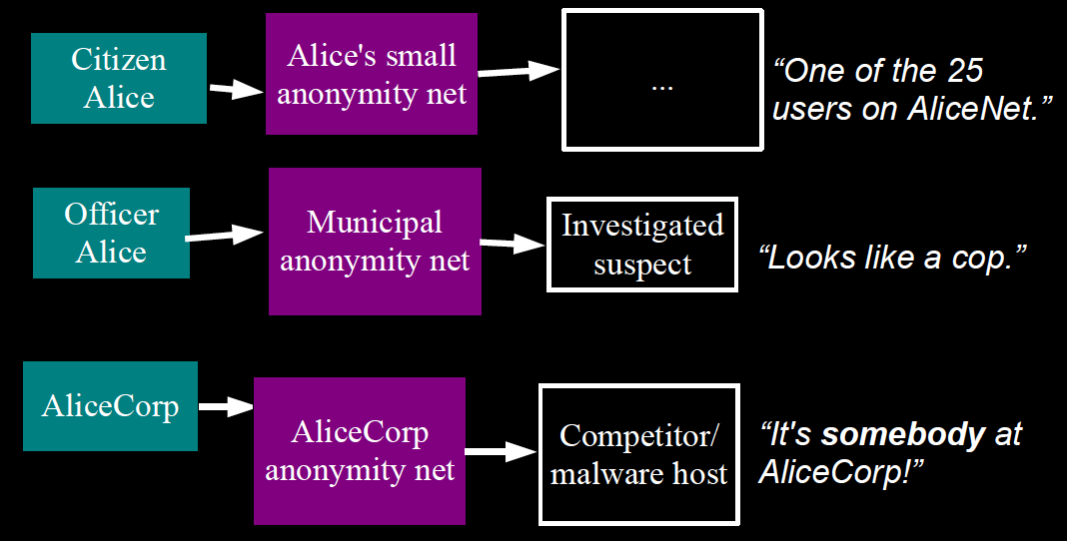
Can’t be anonymous by yourself
… anonymity loves company

Slide 12
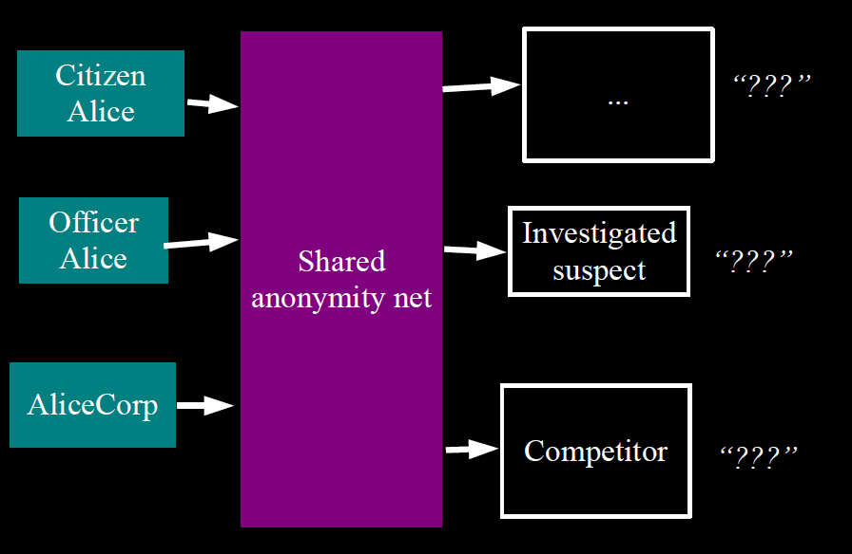
Can’t be anonymous by yourself
… anonymity loves company

Slide 13
Simple anonymity design

Slide 14
But an attacker who sees alice can see who she talks to

Slide 15
So add encryption

Slide 16
But the relay is a single point of failure

Slide 17
Also single point to bypass

Slide 18
Solution: multiple relays

Slide 19
Can tell Alice is talking but not to Whom

Slide 20
Can tell someone is talking to bob but not who it is

Slide 21
How it works

Slide 22
How it works

Slide 23
How it works

Slide 24
How it works

Slide 25
How it works

Slide 26
Tor: The Big picture
Freely available (open source)
Comes with spec + documentation, translated into 15+ languages
Several commercial imitators
Focus on usability/scalability/incentives
200,000+ active users including gov’t/law enforcement
Began in 1995
Now a 501 (c ) 3 with a handful of employees and many volunteers
Volunteers run relays, have options to configure traffic load
Issues with being responsible for the traffic exiting from exit nodes

Slide 27
Weaknesses/Attacks
Eavesdropping AS
AS on path between source and entry node + exit node and destination
Applications that leak IP address (technically not something Tor protects against)
Bad apple attack
Use leaked IP + analyze traffic patterns to deanonymize users
Run an exit node and eavesdrop
DoS
Carefully execute commands to exhaust resources on a relay
https://blog.torproject.org/blog/new-tor-denial-service-attacks-and-defenses

Slide 28
Stats about Tor
https://metrics.torproject.org/

Slide 29
Related anonymity systems
Aqua Slides from SIGCOMM 2013 by S. Le Blonde
Related reading
Dissent (optional reading)

Slide 30
Towards efficient traffic-analysis resistant anonymity networks
Stevens Le Blond David Choffnes Wenxuan Zhou
Peter Druschel Hitesh Ballani Paul Francis
Notes:
----- Meeting Notes (8/2/13 13:56) -----

Slide 31
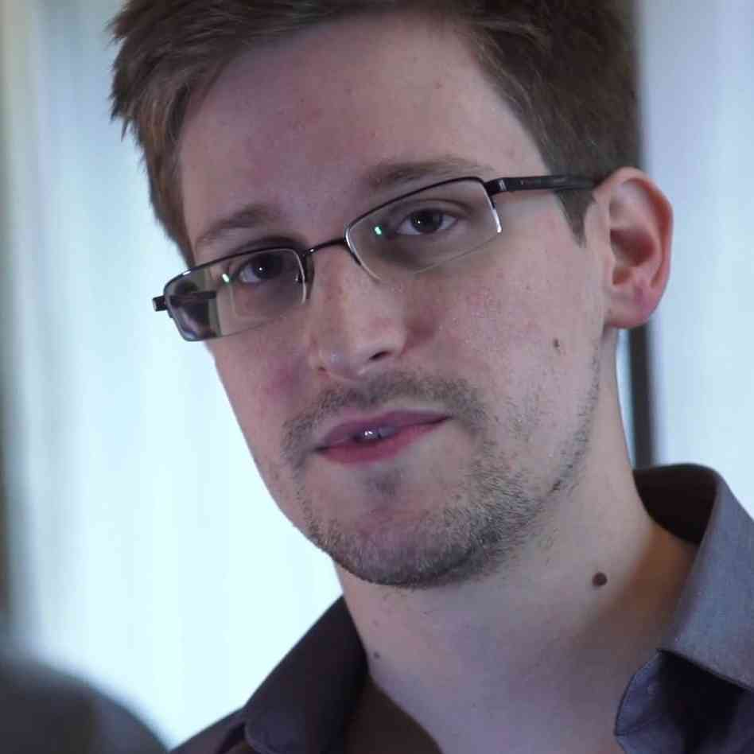
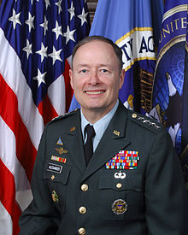
Snowden wants to communicate with Greenwald without Alexander to find out
Ed’s IP
Glenn’s IP

Slide 32
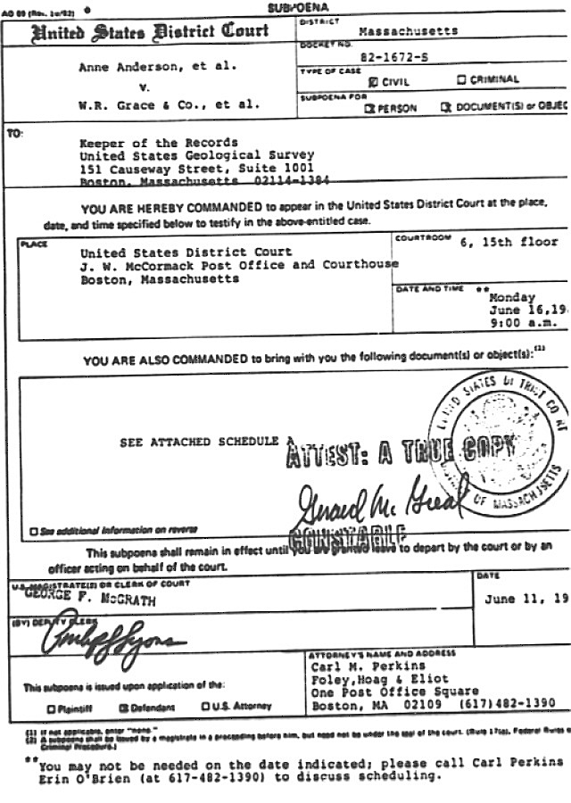
The problem of IP anonymity
Client
VPN proxy
Server
Proxies are single point of attack
(rogue admin, break in, legal, etc)
Notes:
----- Meeting Notes (8/2/13 14:01) -----
- UK-based VPN HideMyAss was compelled to reveal identity of user to US

Slide 33
Traffic analysis
Onion routing (Tor)
Proxy
Onion routing doesn’t resist
traffic analysis (well known)
Notes:
----- Meeting Notes (8/2/13 14:01) -----
- told that early Wikileaks used design that was vulnerable to TA

Slide 34
Outline
1) Overview
2) Design
3) Evaluation
4) Ongoing work

Slide 35
Anonymous Quanta (Aqua)
k-anonymity: Indistinguishable among k clients
BitTorrent
Appropriate latency and bandwidth
Many concurrent and correlated flows

Slide 36
Threat model
Global passive (traffic analysis) attack
Active attack
Edge mixes aren’t compromised
Notes:
----- Meeting Notes (8/2/13 14:01) -----
- told that early Wikileaks used design that was vulnerable to TA

Slide 37
Constant rate (strawman)
Padding
Defeats traffic analysis, but overhead proportional
to peak link payload rate on fully connected network
Notes:
----- Meeting Notes (8/2/13 14:01) -----
- told that early Wikileaks used design that was vulnerable to TA

Slide 38
Outline
Overview
Design
Padding at the core
Padding at the edges
Bitwise unlinkability
Receiver’s anonymity (active attacks)
3) Evaluation
4) Ongoing work

Slide 39
Multipath
Padding
Multipath reduces the
peak link payload rate
Notes:
----- Meeting Notes (8/2/13 14:01) -----
- told that early Wikileaks used design that was vulnerable to TA

Slide 40
Variable uniform rate
Reduces overhead by adapting to
changes in aggregate payload traffic

Slide 41
Outline
1) Overview
2) Design
Padding at the core
Padding at the edges
Bitwise unlinkability
Receiver’s anonymity (active attacks)
3) Evaluation
4) Ongoing work

Slide 42
k-anonymity sets (ksets)
Recv kset
Send kset
Padding
Provide k-anonymity by ensuring correlated
rate changes on at least k client links

Slide 43
Forming efficient ksets
1
2
Peers’ rates
3
1
2
3
Are there temporal and spatial
correlations among BitTorrent flows?
Epochs

Slide 44
Outline
Overview
Design
Padding at the core
Padding at the edges
Bitwise unlinkability
Receiver’s anonymity (active attacks)
3) Evaluation
4) Ongoing work

Slide 45
Methodology: Trace driven simulations
Month-long BitTorrent trace with 100,000 users
20 million flow samples per day
200 million traceroute measurements
Models of anonymity systems
Constant-rate: Onion routing v2
Broadcast: P5, DC-Nets
P2P: Tarzan
Aqua

Slide 46
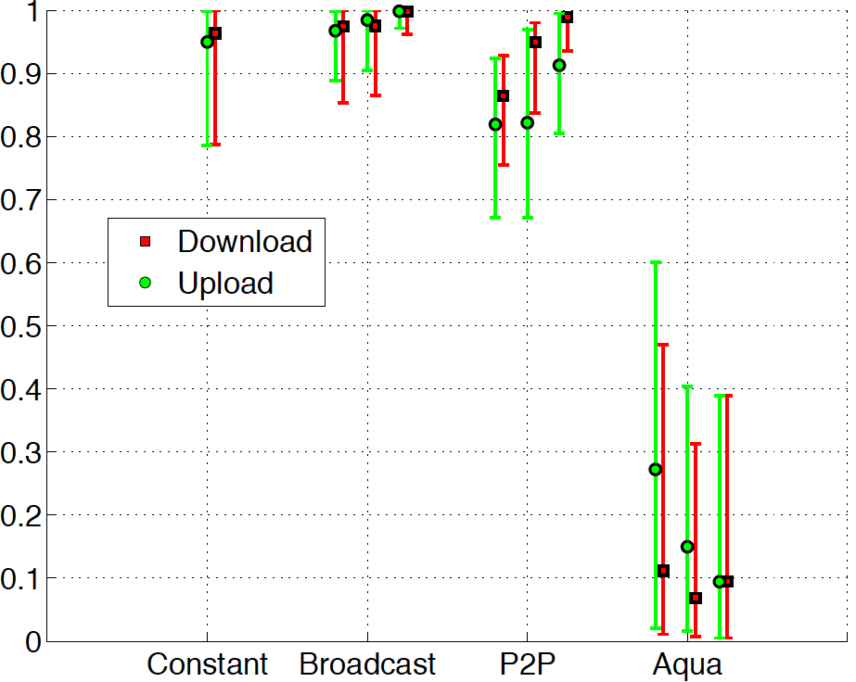
Overhead @ edges
Overhead
Models
Much better bandwidth efficiency

Slide 47
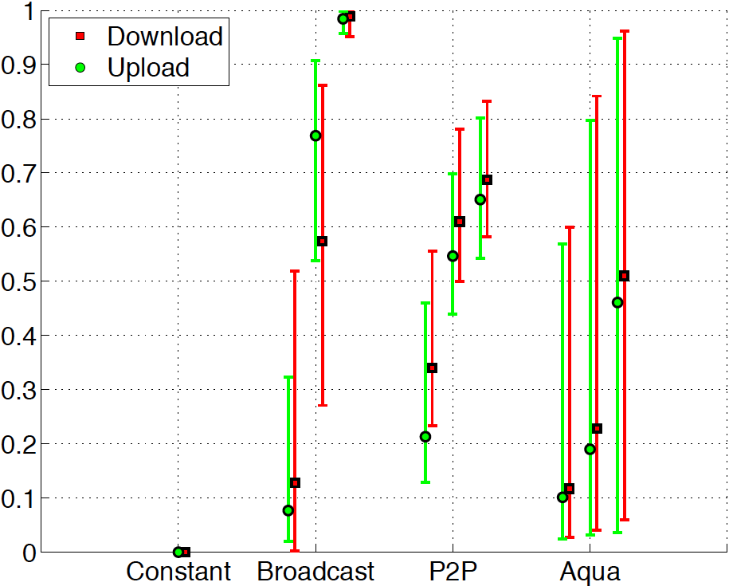
Throttling @ edges
Throttling
Models
Efficiently leverages
correlations in BitTorrent flows

Slide 48
Outline
1) Overview
2) Design
2) Evaluation
3) Ongoing work

Slide 49
Ongoing work
Prototype implementation
Aqua for VoIP traffic
“tiny-latency” (RTT <330ms)
Intersection attacks
Workload independence

Slide 50
Take home messages
Efficient traffic-analysis resistance by exploiting existing correlations in BitTorrent traffic
At core:
Multipath reduces peak payload rate
Variable uniform rate adapts to changes in aggregate payload traffic
At edges, ksets:
Provide k-anonymity by sync rate on k client links
Leverage temporal and spatial correlations of BitTorrent flows

Slide 51
Hands on activity
Install and run Tor
https://www.torproject.org/projects/torbrowser.html.en
Run Wireshark while connecting through Tor
Explore tor metrics data

Slide 52
Dissent: Accountable Anonymous Group Messaging
Henry Corrigan-Gibbs and Bryan Ford
Department of Computer Science Yale University
17th ACM Conference on Computer and Communications Security October 6, 2010

Slide 53
“Wikileaks” Problem
Alice
Bob
Eve
Chris
Image courtesy NASA Johnson Space Center

Slide 54
Alice
Bob
Eve
Chris

Slide 55
Alice
Bob
Has a 646 MB classified military video from Iraq
Eve
Chris

Slide 56
Alice
Bob
Is this video authentic?
Eve
Chris

Slide 57
Alice
Bob
Wants to:
Anonymously publish video to the group
Solicit anonymous comments
Eve
Chris

Slide 58
Alice
Bob
Eve
Chris

Slide 59
Wants to:
Break anonymity
Stop initial video publication
Alter Alice and Bob’s reviews
Submit many bad reviews
Alice
Bob
Eve
Chris

Slide 60
The Question
How can group members communicate efficiently and anonymously when:
all network communication is public,
Eve wants to block communication, and
group members’ messages are of vastly different lengths?

Slide 61
Limitations of Existing Schemes
Method |  | Weakness
Mix Nets, Tor |  | Traffic analysis attacks
Group and Ring Signatures |  | Traffic analysis attacks
Voting Protocols |  | Short, fixed-length messages
DC Nets |  | Anonymous DoS attacks
Brickell-Shmatikov Shuffle |  | Anonymous DoS attacks and fixed message length

Slide 62
Outline
Introduction to Dissent
How Dissent works
Overall protocol: Variable-length shuffle
Key component: Fixed-length shuffle
Prototype and experimental results
Goals for future work

Slide 63
Outline
Introduction to Dissent
How Dissent works
Overall protocol: Variable-length shuffle
Key component: Fixed-length shuffle
Prototype and experimental results
Goals for future work

Slide 64
Dissent
Dissent is a protocol for latency-tolerant sender-anonymous broadcast within a pre-defined group of nodes:
Each group member secretly submits one message per protocol round
Group members run the protocol
The protocol reveals to all members a permutation of the message set
No group member knows the permutation
We call this a shuffle protocol

Slide 65
Dissent guarantees…
Integrity: Messages are received unmodified
Anonymity: To identify the sender of a message, all other members must collude
Accountability: Members interfering with message transmission will eventually be identified
N.B.: These definitions are very informal. Please refer to our paper for precise definitions.

Slide 66
Our Contributions
Dissent builds upon the Brickell-Shmatikov anonymous data collection protocol (KDD 2006), adding:
Accountability: Alice, Bob, and Chris can identify Eve if she tries to alter messages or block protocol progress
Communication efficiency with variable-length messages: Group members do not have to pad their messages to a fixed length

Slide 67
Outline
Introduction to Dissent
How Dissent works
Overall protocol: Variable-length shuffle
Key component: Fixed-length shuffle
Prototype and experimental results
Goals for future work

Slide 68
Conceptual Description
Follows one group member (Chris) and his 646 MB video
Every other group member follows the same steps as Chris in parallel
We assume:
Every member has a signature verification key for every other group member
Existence of a wrapper protocol handling group membership, liveness, protocol initiation, etc. (See paper for details on the wrapper.)

Slide 69
Issue 1: Traffic Analysis
How can Chris broadcast his 646 MB video anonymously if attackers are listening in?
Neither message structure nor length should identify Chris as the true sender
Therefore:
All other group members must also broadcast a 646 MB message
Messages should look like random strings

Slide 70
Issue 1: Traffic Analysis
Publish
zxmncoak929j9aksjdq9wldk0w
alkj38f82hlkd029sjlkjd0981lkjlkj
vmdnvmdnduuz093ufoilkjksdlka
0988j4fkskjdcka83masjkjsdlkqwkd
Alice
Bob
Chris
Eve

Slide 71
Issue 2: Recovery
How can members recover Chris’ video from the 646 MB random-looking strings?
Assume Alice, Bob, and Eve send pseudo-random strings known to Chris
Then:
Chris sends the XOR of his video with Alice, Bob, and Eve’s pseudo-random strings
i.e., three serial one-time pad encryptions
Reminiscent of Chaum’s DC net

Slide 72
Issue 2: Recovery
The 646MB Video
⊕
⊕
⊕
zxmncoak929j9aksjdq9wldk0w
alkj38f82hlkd029sjlkjd0981lkjlkj
vmdnvmdnduuz093ufoilkjksdlka
0988j4fkskjdcka83masjkjsdlkqwkd
Alice
Bob
Chris
Eve

Slide 73
Issue 3: Assignment
How can Chris efficiently assign 646 MB strings to Alice, Bob, and Eve?
Chris anonymously broadcasts (somehow) a table of assignments along with the length of his message
Each assignment contains:
A PRF seed encrypted for each member
A cleartext hash of the string assigned to each member

Slide 74
Issue 3: Assignment
Length: 0 bytes
 | Seed | Hash
A | {dfwv}_{A} | td82
B | {ert3}_{B} | 3flk
C | {09fg}_{C} | df3f
E | {fg4h}_{E} | vce3
Length: 0 bytes
 | Seed | Hash
A | {v9ek}_{A} | 2d2t
B | {2fva}_{B} | nve0
C | {afbf}_{C} | 3ren
E | {d2g5}_{E} | sdvz
Length: 646 MB
 | Seed | Hash
A | {dkad}_{A} | 092f
B | {f23d}_{B} | f9ja
C | {d3g5}_{C} | jh2m
E | {afef}_{E} | vnsk
Length: 0 bytes
 | Seed | Hash
A | {dsfr}_{A} | d1fs
B | {fv24}_{B} | hvae
C | {sdfb}_{C} | 0jd2
E | {s5eg}_{E} | fewh
Alice
Bob
Chris
Eve

Slide 75
Issue 3: Assignment
Length: 646 MB
 | Enc. Seed | Hash
A | {dkad}_{A} | 092f
B | {f23d}_{B} | f9ja
C | {d3g5}_{C} | jh2m
E | {afef}_{E} | vnsk
Length: 0 bytes
 | Seed | Hash
A | {dfwv}_{A} | td82
B | {ert3}_{B} | 3flk
C | {09fg}_{C} | df3f
E | {fg4h}_{E} | vce3
Length: 0 bytes
 | Seed | Hash
A | {v9ek}_{A} | 2d2t
B | {2fva}_{B} | nve0
C | {afbf}_{C} | 3ren
E | {d2g5}_{E} | sdvz
Length: 646 MB
 | Seed | Hash
A | {dkad}_{A} | 092f
B | {f23d}_{B} | f9ja
C | {d3g5}_{C} | jh2m
E | {afef}_{E} | vnsk
Length: 0 bytes
 | Seed | Hash
A | {dsfr}_{A} | d1fs
B | {fv24}_{B} | hvae
C | {sdfb}_{C} | 0jd2
E | {s5eg}_{E} | fewh
Alice
Bob
Chris
Eve

Slide 76
Issue 3: Assignment
Length: 0 bytes
 | Enc. Seed | Hash
A | {dfwv}_{A} | td82
B | {ert3}_{B} | 3flk
C | {09fg}_{C} | df3f
E | {fg4h}_{E} | vce3
Publish
Length: 0 bytes
 | Seed | Hash
A | {dfwv}_{A} | td82
B | {ert3}_{B} | 3flk
C | {09fg}_{C} | df3f
E | {fg4h}_{E} | vce3
Length: 0 bytes
 | Seed | Hash
A | {v9ek}_{A} | 2d2t
B | {2fva}_{B} | nve0
C | {afbf}_{C} | 3ren
E | {d2g5}_{E} | sdvz
Length: 646 MB
 | Seed | Hash
A | {dkad}_{A} | 092f
B | {f23d}_{B} | f9ja
C | {d3g5}_{C} | jh2m
E | {afef}_{E} | vnsk
Length: 0 bytes
 | Seed | Hash
A | {dsfr}_{A} | d1fs
B | {fv24}_{B} | hvae
C | {sdfb}_{C} | 0jd2
E | {s5eg}_{E} | fewh
Alice
Bob
Chris
Eve

Slide 77
Issue 3: Assignment
Length: 0 bytes
 | Enc. Seed | Hash
A | {v9ek}_{A} | 2d2t
B | {2fva}_{B} | nve0
C | {afbf}_{C} | 3ren
E | {d2g5}_{E} | sdvz
Length: 0 bytes
 | Seed | Hash
A | {dfwv}_{A} | td82
B | {ert3}_{B} | 3flk
C | {09fg}_{C} | df3f
E | {fg4h}_{E} | vce3
Length: 0 bytes
 | Seed | Hash
A | {v9ek}_{A} | 2d2t
B | {2fva}_{B} | nve0
C | {afbf}_{C} | 3ren
E | {d2g5}_{E} | sdvz
Length: 646 MB
 | Seed | Hash
A | {dkad}_{A} | 092f
B | {f23d}_{B} | f9ja
C | {d3g5}_{C} | jh2m
E | {afef}_{E} | vnsk
Length: 0 bytes
 | Seed | Hash
A | {dsfr}_{A} | d1fs
B | {fv24}_{B} | hvae
C | {sdfb}_{C} | 0jd2
E | {s5eg}_{E} | fewh
Alice
Bob
Chris
Eve

Slide 78
Issue 3: Assignment
Length: 0 bytes
 | Enc. Seed | Hash
A | {dsfr}_{A} | d1fs
B | {fv24}_{B} | hvae
C | {sdfb}_{C} | 0jd2
E | {s5eg}_{E} | fewh
Length: 0 bytes
 | Seed | Hash
A | {dfwv}_{A} | td82
B | {ert3}_{B} | 3flk
C | {09fg}_{C} | df3f
E | {fg4h}_{E} | vce3
Length: 0 bytes
 | Seed | Hash
A | {v9ek}_{A} | 2d2t
B | {2fva}_{B} | nve0
C | {afbf}_{C} | 3ren
E | {d2g5}_{E} | sdvz
Length: 646 MB
 | Seed | Hash
A | {dkad}_{A} | 092f
B | {f23d}_{B} | f9ja
C | {d3g5}_{C} | jh2m
E | {afef}_{E} | vnsk
Length: 0 bytes
 | Seed | Hash
A | {dsfr}_{A} | d1fs
B | {fv24}_{B} | hvae
C | {sdfb}_{C} | 0jd2
E | {s5eg}_{E} | fewh
Alice
Bob
Chris
Eve

Slide 79
Issue 3: Assignment
Length: 0 bytes
 | Seed | Hash
A | {dfwv}_{A} | td82
B | {ert3}_{B} | 3flk
C | {09fg}_{C} | df3f
E | {fg4h}_{E} | vce3
Length: 0 bytes
 | Seed | Hash
A | {v9ek}_{A} | 2d2t
B | {2fva}_{B} | nve0
C | {afbf}_{C} | 3ren
E | {d2g5}_{E} | sdvz
Length: 646 MB
 | Seed | Hash
A | {dkad}_{A} | 092f
B | {f23d}_{B} | f9ja
C | {d3g5}_{C} | jh2m
E | {afef}_{E} | vnsk
Length: 0 bytes
 | Seed | Hash
A | {dsfr}_{A} | d1fs
B | {fv24}_{B} | hvae
C | {sdfb}_{C} | 0jd2
E | {s5eg}_{E} | fewh
Alice
Bob
Chris
Eve

Slide 80
Issue 3: Assignment
Publish
Length: 0 bytes
 | Seed | Hash
A | {dfwv}_{A} | td82
B | {ert3}_{B} | 3flk
C | {09fg}_{C} | df3f
E | {fg4h}_{E} | vce3
Length: 0 bytes
 | Seed | Hash
A | {v9ek}_{A} | 2d2t
B | {2fva}_{B} | nve0
C | {afbf}_{C} | 3ren
E | {d2g5}_{E} | sdvz
Length: 646 MB
 | Seed | Hash
A | {dkad}_{A} | 092f
B | {f23d}_{B} | f9ja
C | {d3g5}_{C} | jh2m
E | {afef}_{E} | vnsk
Length: 0 bytes
 | Seed | Hash
A | {dsfr}_{A} | d1fs
B | {fv24}_{B} | hvae
C | {sdfb}_{C} | 0jd2
E | {s5eg}_{E} | fewh
Alice
Bob
Chris
Eve

Slide 81
Issue 4: Anonymity
How can Chris transmit his assignment table anonymously?
The assignment contains the length of Chris’ message, so it must not be traceable to him
Dissent uses a modification of the Brickell-Shamikov data collection protocol to shuffle the fixed-length assignment tables
Final ordering of tables determines ordering in which members broadcast their pseudo-random strings

Slide 82
Issue 4: Anonymity
Fixed-length Shuffle
Length: 0 bytes
 | Seed | Hash
A | {dfwv}_{A} | td82
B | {ert3}_{B} | 3flk
C | {09fg}_{C} | df3f
E | {fg4h}_{E} | vce3
Length: 0 bytes
 | Seed | Hash
A | {v9ek}_{A} | 2d2t
B | {2fva}_{B} | nve0
C | {afbf}_{C} | 3ren
E | {d2g5}_{E} | sdvz
Length: 646 MB
 | Seed | Hash
A | {dkad}_{A} | 092f
B | {f23d}_{B} | f9ja
C | {d3g5}_{C} | jh2m
E | {afef}_{E} | vnsk
Length: 0 bytes
 | Seed | Hash
A | {dsfr}_{A} | d1fs
B | {fv24}_{B} | hvae
C | {sdfb}_{C} | 0jd2
E | {s5eg}_{E} | fewh
Alice
Bob
Chris
Eve

Slide 83
Putting it together…
Each group member generates a fixed-length assignment table
Members use fixed-length shuffle to anonymize these assignment tables
Members (except sender) use assigned PRF seeds to generate a psuedo-random string for each anonymous message
Strings corresponding to each message XOR to the sender’s message

Slide 84
Variable-length is better
Fixed-length
Variable-length
A
Padding
A
Assignment Tables
B
Padding
B
C
Message
C
Message
E
Padding
E
NL_{max} bits
L_{total} + kN bits
Notes:
Message set sizes

Slide 85
Outline
Introduction to Dissent
How Dissent works
Overall protocol: Variable-length shuffle
Key component: Fixed-length shuffle
Prototype and experimental results
Goals for future work

Slide 86
Fixed-Length Shuffle
A verifiable secret shuffle
Adds accountability to Brickell-Shmatikov shuffle
Two possible outcomes:
Shuffle succeeds, messages delivered, secret permutation unrecoverable
Shuffle fails, messages unrecoverable, at least one attacker exposed

Slide 87
Issue 1: Anonymity
How do members anonymize their messages?
We use onion routing / mix network to provide anonymity:
Members serially encrypt their message with the public key of each group member in a pre-determined order
Each group member sequentially decrypts, permutes, and forwards the message set

Slide 88
Message set under onion encryption
{{{{A}_{E}}_{C}}_{B}}_{A}
{{{{B}_{E}}_{C}}_{B}}_{A}
{{{{C}_{E}}_{C}}_{B}}_{A}
{{{{E}_{E}}_{C}}_{B}}_{A}

Slide 89
Message set under onion encryption
{{{{A}}}} {{{{B}}}}
{{{{C}}}}
{{{{E}}}}
{{{{A}_{E}}_{C}}_{B}}_{A}
{{{{B}_{E}}_{C}}_{B}}_{A}
{{{{C}_{E}}_{C}}_{B}}_{A}
{{{{E}_{E}}_{C}}_{B}}_{A}

Slide 90
Message set under onion encryption
Permuted plaintext message set
{{{{A}}}} {{{{B}}}}
{{{{C}}}}
{{{{E}}}}
B A
E
C
{{{E}}} {{{B}}}
{{{A}}}
{{{C}}}
{{C}} {{A}}
{{E}}
{{B}}
{E} {C}
{A}
{B}
Decrypt, Permute
Decrypt, Permute
Decrypt, Permute
Decrypt, Permute
Alice
Bob
Chris
Eve

Slide 91
Issue 2: Integrity
How do members ensure that their message is in the output message set?
Group members submit a “Go” or “No-go” message after seeing the permuted message set to confirm that their message is in the set
Members use a second layer of onion encryption so that Go/No-Go messages don’t break anonymity
One-time-use secondary keypair

Slide 92
Message set under primary and secondary onion encryption
{{{{ α = [[[[A]_{E}]_{C}]_{B}]_{A} }_{E}}_{C}}_{B}}_{A} {{{{ β = [[[[B]_{E}]_{C}]_{B}]_{A} }_{E}}_{C}}_{B}}_{A}
{{{{ γ = [[[[C]_{E}]_{C}]_{B}]_{A} }_{E}}_{C}}_{B}}_{A}
{{{{ ε = [[[[E]_{E}]_{C}]_{B}]_{A} }_{E}}_{C}}_{B}}_{A}

Slide 93
Message set under primary and secondary onion encryption
{{{{α}_{E}}_{C}}_{B}}_{A} {{{{β}_{E}}_{C}}_{B}}_{A}
{{{{γ}_{E}}_{C}}_{B}}_{A}
{{{{ε}_{E}}_{C}}_{B}}_{A}

Slide 94
Message set under primary and secondary onion encryption
{{{{α}}}} {{{{β}}}}
{{{{γ}}}}
{{{{ε}}}}
{{{{α}_{E}}_{C}}_{B}}_{A} {{{{β}_{E}}_{C}}_{B}}_{A}
{{{{γ}_{E}}_{C}}_{B}}_{A}
{{{{ε}_{E}}_{C}}_{B}}_{A}

Slide 95
Message set under primary and secondary onion encryption
Permuted ciphertext set under secondary onion encryption
{{{{α}}}} {{{{β}}}}
{{{{γ}}}}
{{{{ε}}}}
β α
ε
γ
{{{ε}}} {{{β}}}
{{{α}}}
{{{γ}}}
{{γ}} {{α}}
{{ε}}
{{β}}
{ε} {γ}
{α}
{β}
Decrypt, Permute
Decrypt, Permute
Decrypt, Permute
Decrypt, Permute
Alice
Bob
Chris
Eve

Slide 96
Message set under primary and secondary onion encryption
Permuted ciphertext set under secondary onion encryption
{{{{α}}}} {{{{β}}}}
{{{{γ}}}}
{{{{ε}}}}
[[[[B]]]] [[[[A]]]]
[[[[E]]]]
[[[[C]]]]
{{{ε}}} {{{β}}}
{{{α}}}
{{{γ}}}
{{γ}} {{α}}
{{ε}}
{{β}}
{ε} {γ}
{α}
{β}
Decrypt, Permute
Decrypt, Permute
Decrypt, Permute
Decrypt, Permute
Alice
Bob
Chris
Eve

Slide 97
Issue 2: Integrity
Permuted ciphertext set
[[[[E]]]] | [[[[A]]]] | [[[[E]]]] | [[[[C]]]]
Go
No-Go
Go
Go
Alice
Bob
Chris
Eve

Slide 98
Issue 2: Integrity
If all group members report Go, then each member publishes her secondary private key
All members can decrypt each ciphertext in the set, and the permutation is kept secret

Slide 99
Issue 3: Accountability
How do group members expose an attacker?
If any group member reports No-Go, then each member:
Destroys her secondary private key, rendering the messages unrecoverable, and
Publishes a proof of her correctness: signed intra-group transmissions and information necessary to replay anonymization process

Slide 100
Issue 3: Accountability
Once group members destroy secondary private keys, they can safely reveal the secret permutation
Alice’s signed outgoing message set
Bob’s signed outgoing message set
Bob
+ proof that Bob correctly decrypted and permuted Alice’s message set

Slide 101
Fixed-Length Shuffle Recap
Group members encrypt their message with two layers of onion encryption
Each group member permutes the set and decrypts a layer of primary key encryption
Members send a Go or No-Go message indicating whether or not to decrypt
Members publish either their secondary private keys OR proofs of their correctness

Slide 102
Outline
Introduction to Dissent
How Dissent works
Overall protocol: Variable-length shuffle
Key component: Fixed-length shuffle
Prototype and experimental results
Goals for future work

Slide 103
Prototype
Implemented fixed-length and full Dissent (variable-length) protocols in Python
Used Emulab, a network testbed, to run performance tests
100ms node-to-node latency, 5Mbps link bandwidth
Up to 44 nodes
Did not implement “blame” phases

Slide 104
Time required for transmission in a 16-node group – Balanced
Time (minutes) – log scale
50
Variable-Length
(Dissent)
5
Fixed-Length Only
0.5
4KB
64KB
1MB
16MB
Total size of message set – log scale

Slide 105
Time required for transmission in a 16-node group – One Sender
Time (minutes) – log scale
50
Fixed-Length Only
5
Variable-Length (Dissent)
0.5
4KB
64KB
1MB
16MB
Total size of message set – log scale

Slide 106
Prototype
Broadcasting a 16 MB file in a 16-node group took 3.6 times longer using Dissent than broadcasting file without encryption or anonymization
Refer to paper for full results
Round time over message set size
Round time broken down by component
Round time over group size

Slide 107
Outline
Introduction to Dissent
How Dissent works
Overall protocol: Variable-length shuffle
Key component: Fixed-length shuffle
Prototype and experimental results
Goals for future work

Slide 108
Future Work
Use a more efficient fixed-length shuffle
Brickell-Shmatikov shuffle requires serial interactivity
Reduce size complexity of assignment tables
Reuse one fixed-length shuffle for many message transfers
Implement protocol on large scale

Slide 109
Wrap-Up
Dissent is a sender-anonymous protocol for broadcast within a group
Dissent contributes:
Accountability, the ability to identify group members who try to block message transmission
Communication efficiency, under variable message lengths
Dissent has the potential to be a practical tool for anonymous latency-tolerant group messaging

Slide 110
Acknowledgements
The anonymous CCS reviewers
Vitaly Shmatikov, Michael Fischer, Bimal Viswanath, Animesh Nandi, Justin Brickell, Jacob Strauss, Chris Lesniewski-Laas, Pedro Fonseca, Philip Levis
All of you for listening

Slide 111
Questions?

Slide 113
Time required to send varying message sizes in a 16-node group
Time (minutes)
Message Transfer
Fixed-Length Shuffle
Total size of message set – log scale

Slide 114
Time required to send 1MB of data (balanced) using Dissent
Time (minutes)
Total Time
Shuffle
Time
Number of Nodes

Slide 115
Definitions
Integrity: All honest group members have the messages of all other honest diners, or know that the shuffle failed
Anonymity: No subset of members of size ≤ N – 2 can match another member to her message with probability better than random guessing
Accountability: No honest group member has a proof that an honest member is faulty, and either (a) all honest members obtain the message of all other honest members, or (b) all honest members expose at least one faulty member

Slide 116
Protocol Components
Generate Assignment Tables
Fixed-Length Shuffle
Based on Brick-Shmat
Assigns pseudo-rand strings to group members
Shuffles assignment tables
Shuffles accusations
Transmission of Pseudo-Rand Strings
Transmits pseudo-random strings and anonymized messages

