Slide 1
CS590B/690B Detecting Network Interference Spring 2018
Lecture 12

Slide 2
Where we are
Nearly finished first half of course!
So far, focus mainly on measurement of censorship
Measuring censorship at different layers of the protocol stack
Network layer (IP filtering)
Transport (RST injection)
Application (DNS injection, HTTP proxies, Online social network censorship)
Measuring different information controls (traffic differentiation)
Challenges and proposed platforms (ONI, OONI, Spookyscan)
Measuring censorship around the world (Iran, China, Pakistan)

Slide 3
What’s next?
Today: Last bit of measurement – how to identify specifically which product is used for censorship
Next few lectures … How to protect against online information controls
Anonymization tools
Circumvention tools

Slide 4
Filtering products…
Dual use technology …
Keep employees off Facebook, keep schoolchildren safe from inappropriate content
…but in the wrong hands
Human rights violations
Surveillance
Censorship
…

Slide 5




Huge market for censorship/surveillance products
Estimated sales of $5 billion per year for surveillance/wiretapping products*
Products developed by Western countries!
*http://www.washingtonpost.com/world/national-security/trade-in-surveillance-technology-raises-worries/2011/11/22/gIQAFFZOGO_story.html
Notes:
This has resulted in a huge market for censorship and surviellance products such as those seen on the screen here.
Many of these companies are american such as web sense or bluecoat and netsweper is acutally a canadian company located close to where I did my phd. The important thing to note here is that these are products designed by companies in the west being used to violate human rights around the world
The willingness of governemets to invest in filtering has led to a booming market for filtering and surveillance products. The slide here shows some of the key players in the field. many of these companies are located in western countreis wwith websense and smartfilter being located in the US and netsweeper being located in canada just down the highway from where I did my phd.

Slide 6

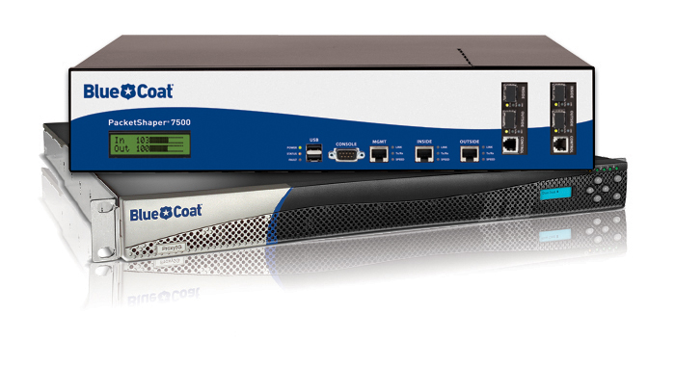


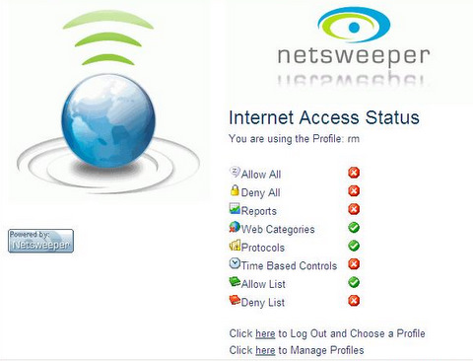

Examples of Filtering products …

Slide 7
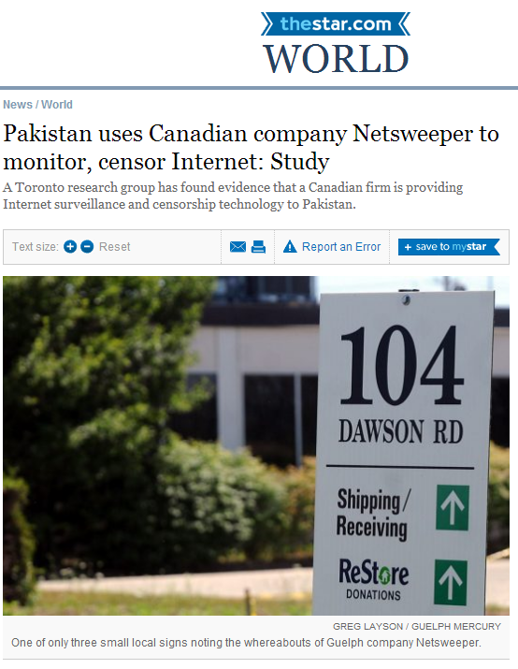

Slide 8
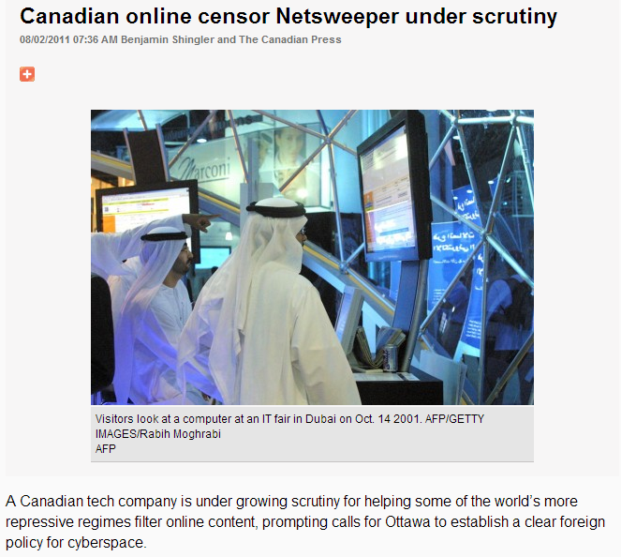

Slide 9
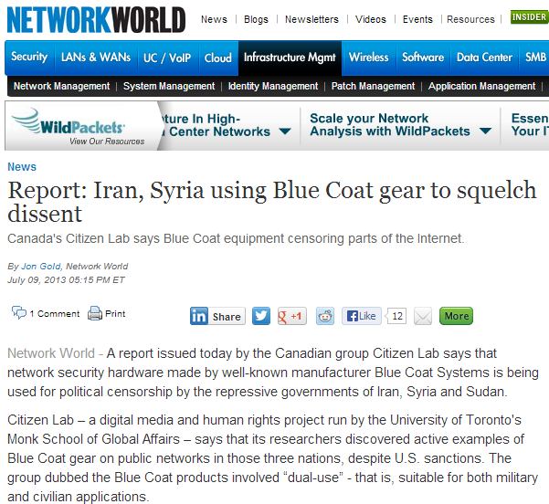

Slide 10
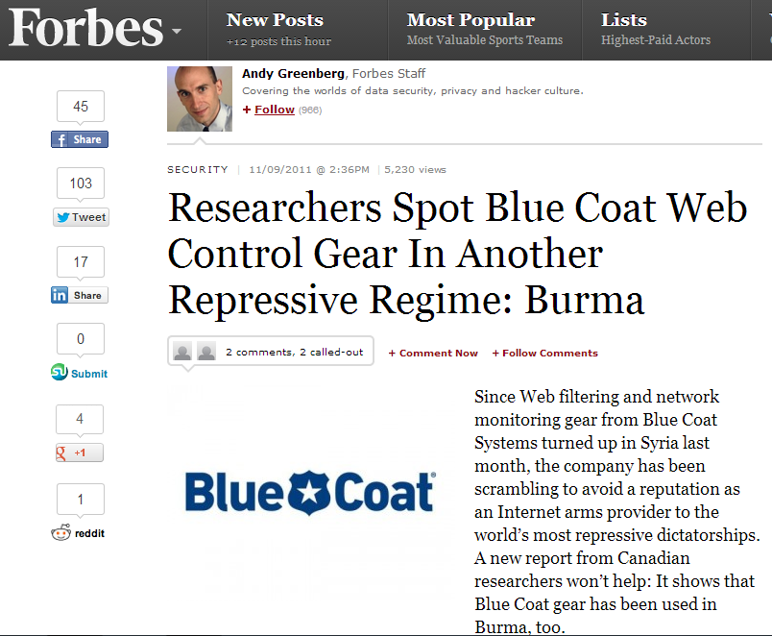

Slide 11
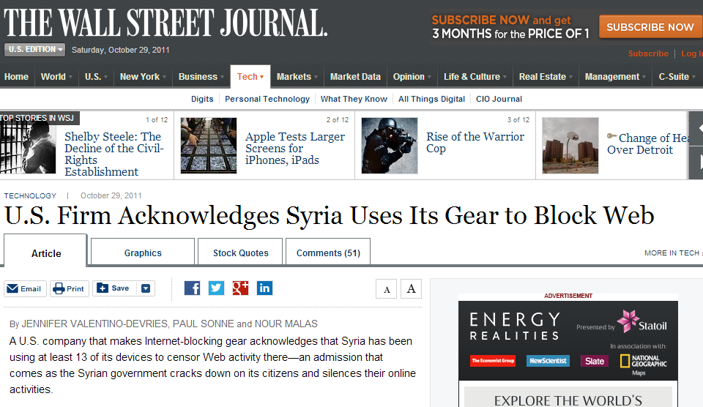

Slide 12
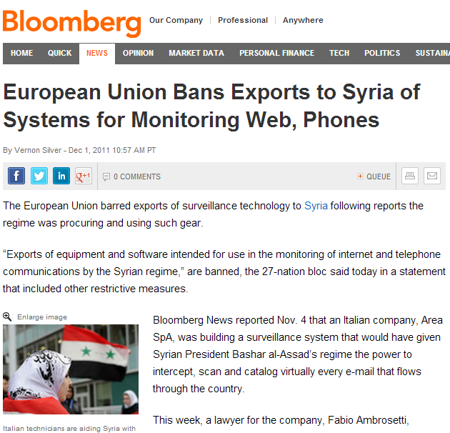
US has similar sanctions in place for Iran + Syria

Slide 13

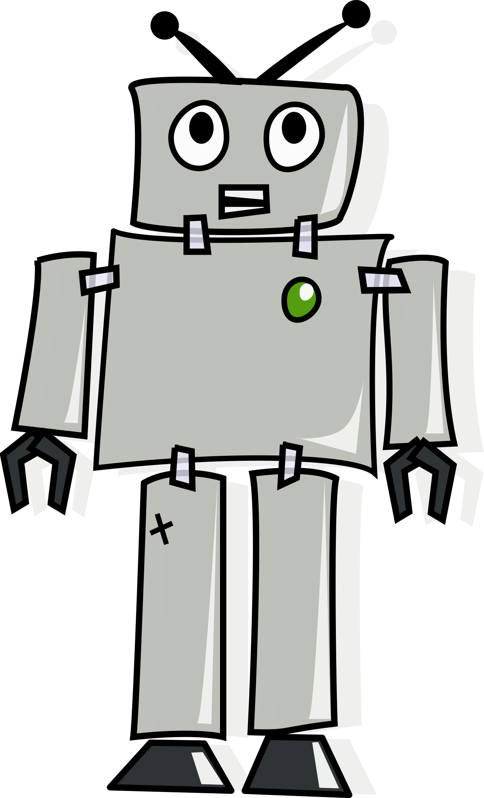
How to enforce restrictions?
… and monitor emerging issues …
Need techniques to identify installations of these products in regions around the world
AND confirm that they are used for censorship
Our approach: Mix of manual and automated analysis
Find suspected installations
Verify installation is still active
Confirm that it is being used for censorship

Slide 14
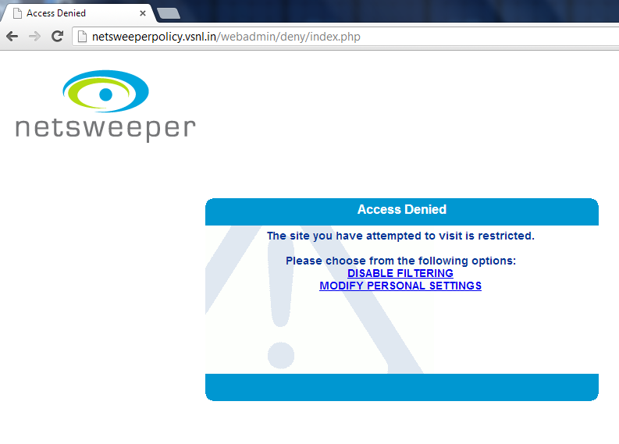
Finding suspected installations
Observe the logo of the product on a block page…

Slide 15
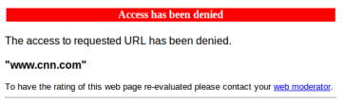
Finding suspected installations
Observe the logo of the product on a block page…
… getting more challenging as products work to conceal themselves

Slide 16
Finding suspected installations
Observe the logo of the product on a block page…
… getting more challenging as products work to conceal themselves
Look for user reports of the product being used
…incomplete, requires technically savvy users
Scans of publicly accessible IP address space
…requires that the product be configured with a globally routable IP address
Scan data from Shodan search engine
Use keywords gained from manual analysis
What we use

Slide 17
Ok … but what to scan for?
Signatures/strings to look for derived from hands on testing/observations of censorship
Manual investigations by Citizen Lab

Slide 18
Final set of terms
Terms are intentionally broad
Product | Shodan Keywords
Blue Coat | “proxysg”, “cfru=“
McAfee SmartFilter | “mcafee web gateway”, “url blocked”
Netsweeper | “netsweeper”, “webadmin”, “webadmin/”, “webadmin/deny”, “8080/webadmin/”
Websense | “blockpage.cgi”, “gateway websense”
Manual investigations by Citizen Lab

Slide 19
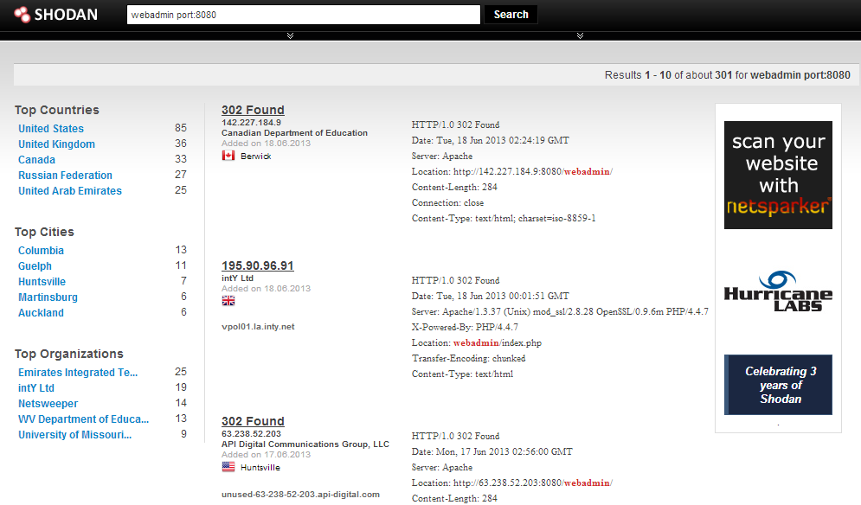
Terms used to search scan data
Shodan results are not necessarily fresh…
Need to confirm that these IPs are still hosting the product!
Programmatic searches with Shodan acct.

Slide 20

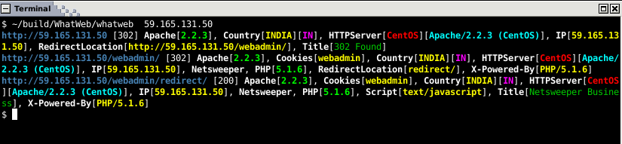
Verifying that installations are active
http://www.morningstarsecurity.com/research/whatweb
Notes:
http://www.morningstarsecurity.com/research/whatweb

Slide 21
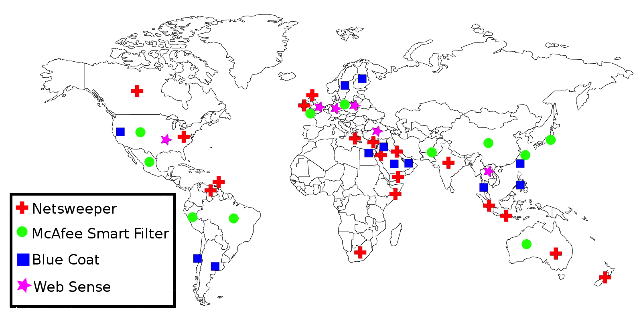
Where we found installations

Slide 22
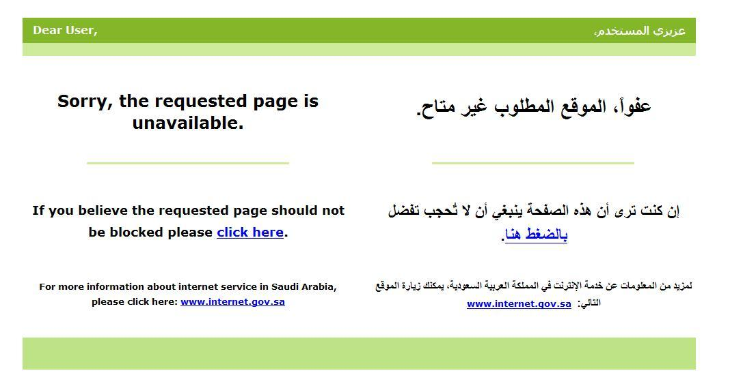
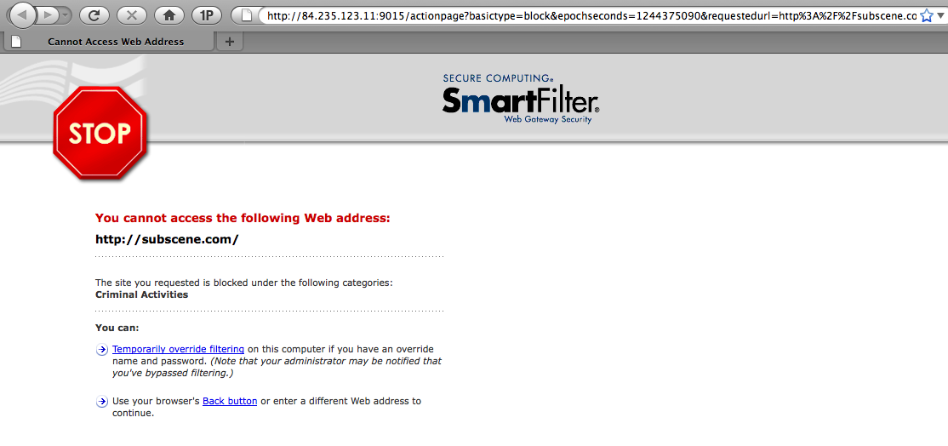
OK … so we’ve found an installation
Is it being used for censorship?
Can be easy ….
… or not

Slide 23
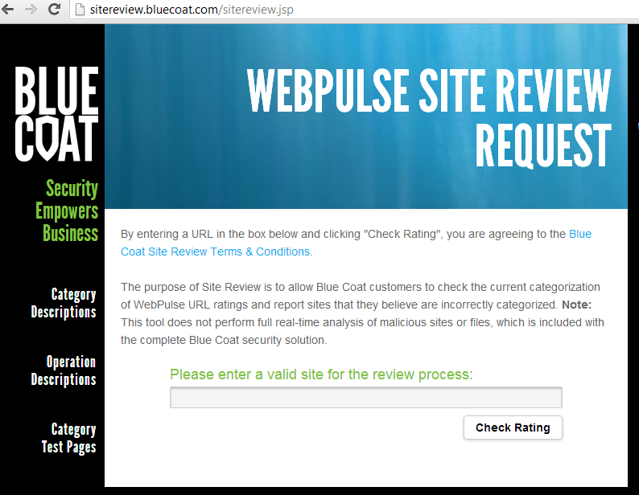
Our solution
Leverage the fact that URLs are a key feature for vendors
…and they accept user submitted URLs for classification
Manual submission and testing of URLs

Slide 24
Confirming censorship
Create a set of 10 domains hosting censored content
e.g., Glype proxy script
These domains have not been used previously
http://bargaindeputy.com
http://zipzoodle.com
http://thatsit.com
http://steamrafts.com
http://notabigdeal.com
http://electroacoustic.com
http://whatandthehow.com
http://elasticmanniquin.com
http://swimstartz.com
http://evadingape.com
1. Check that these sites are not blocked

Slide 25
Confirming censorship
Create a set of 10 domains hosting censored content
e.g., Glype proxy script
These domains have not been used previously
http://bargaindeputy.com
http://zipzoodle.com
http://thatsit.com
http://steamrafts.com
http://notabigdeal.com
http://electroacoustic.com
http://whatandthehow.com
http://elasticmanniquin.com
http://swimstartz.com
http://evadingape.com
2. Submit half of these domains to the suspected vendor

Slide 26
Confirming censorship
3. Test these sites again
These sites should be blocked
… and these sites should not
http://bargaindeputy.com
http://zipzoodle.com
http://thatsit.com
http://steamrafts.com
http://notabigdeal.com
http://electroacoustic.com
http://whatandthehow.com
http://elasticmanniquin.com
http://swimstartz.com
http://evadingape.com
Submitted Sample
Control group

Slide 27
Results
Product | Country | ISP | Submited sites blocked | Confirmed
BlueCoat | UAE | Etisalat | 0/3 | N
BlueCoat | Qatar | Ooredoo | 0/3 | N
McAfee SmartFilter | Qatar | Ooredoo | 0/5 | N
McAfee SmartFilter | Saudi Arabia | Bayanat Al-Oula | 5/5 | Y
McAfee SmartFilter | Saudi Arabia | Nournet | 5/5 | Y
McAfee SmartFilter | UAE | Etisalat | 5/5 | Y
McAfee SmartFilter | UAE | Etisalat | 5/5 | Y
Netsweeper | Qatar | Ooredoo | 6/6 | Y
Netsweeper | UAE | Du | 5/6 | Y
Netsweeper | Yemen | YemenNet | 6/6 | Y

Slide 28
What are these products censoring?
URL lists and categorization by Citizen lab + their regional partners
 | McAfee SmartFilter (UAE) | Netsweeper (Yemen) | Netsweeper (UAE) | Netsweper (Qatar)
Media Freedom | X | X | X | X
Human Rights | X |  | X | X
Political Reform | X |  | X | X
LGBT | X | X | X | X
Religious Criticism | X |  | X | X
Minority Groups and Religions | X | X | X | X
Many of these categories of speech protected under UN declaration of human rights
Different categories exposed by Netsweeper: http://denypagetests.netsweeper.com/

Slide 29
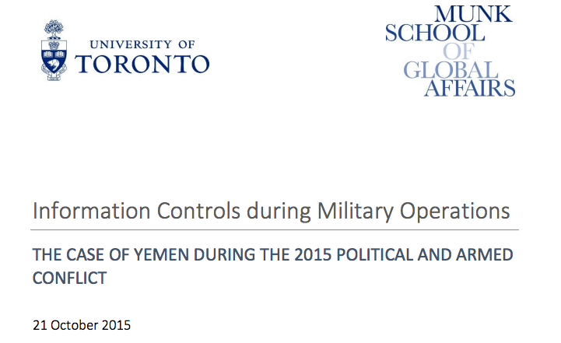
ICLab use case 1: Yemen conflict

Slide 30
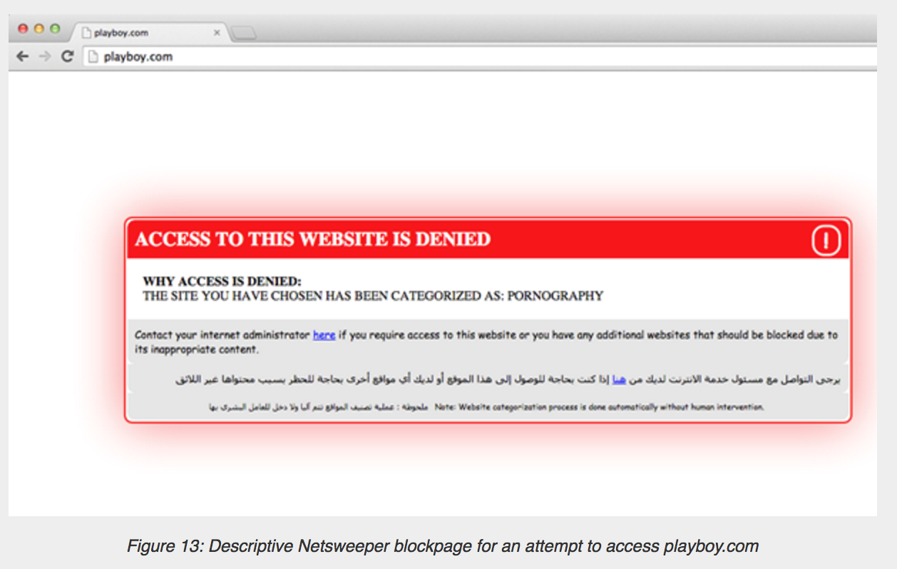
Verifying Netsweeper use in Yemen
Netsweeper known to be used in Yemen with this block page
**Tests run by a pseudonymous researcher who was already in the country.

Slide 31
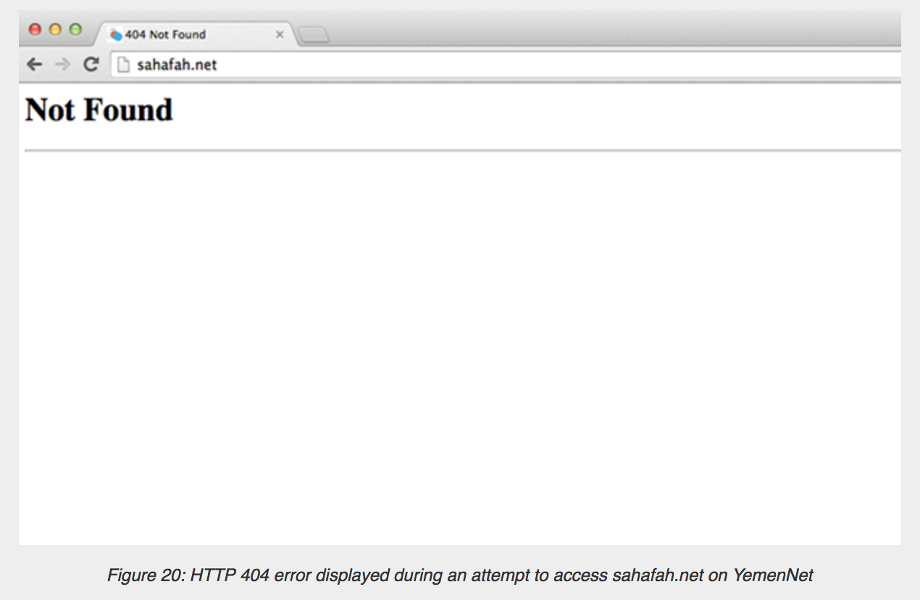
Verifying Netsweeper use in Yemen
Is this really an HTTP 404 from the server or is it filtering?

Slide 32
How to fingerprint the censor?
How to figure out if the HTTP404 is from the censor or the server?
Leverage IP TTL values to detect injected packets!
Networking refresher:
IP TTL set by a host, decremented by each hop along the path
Purpose: Avoid forwarding loops

Slide 33
Detecting injected packets using IP TTL header
Client
SYN
Censor
Server
SYNACK
TTL = 48
?
SYNACK
TTL = 128
ACK
HTTP GET …
HTTP 404
TTL = 110

Slide 34
Verifying Netsweeper is returning the HTTP 404 page
Same TTL value for the block page and 404 page!

Slide 35
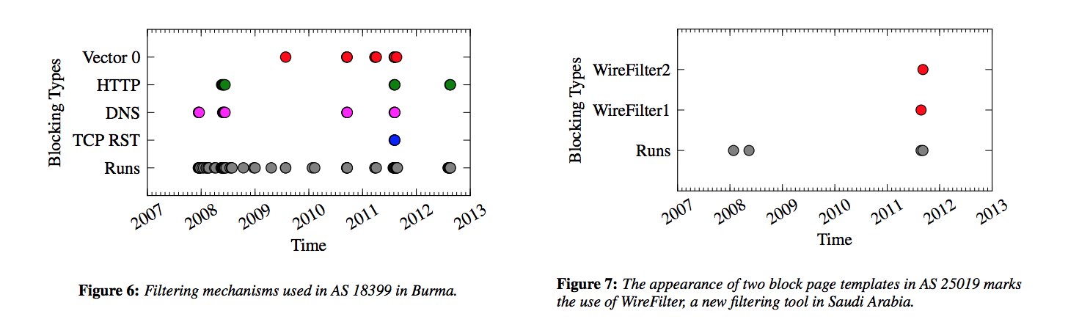
Other techniques …
Looking for block page regular expressions
Frequency of HTML tags in common between block pages
May indicate a template
Only ~30 tag frequencies in 5 years of ONI data.

Slide 36
Hands On Activity
Test out Shodan
https://www.shodan.io/
How might we improve on the techniques from the required reading?
What factors would benefit from improvements?

