Slide 1
CS590B/690B – Measuring Network Interference (Spring 2018)
Lecture 08
Prof. Phillipa Gill – Umass -- Amherst

Slide 2
Administravia
Project
Proposal Due Mar. 1
Proposal/midterm report are to help make sure you are on track/give an opportunity for feedback
More office hours Friday (Mar 2).
Come discuss your proposal

Slide 3
Where we are
Last time:
Measurement Platforms
Questions?

Slide 4
Test your understanding
What types of information controls might we want to study?
What sort of data/applications would we want to study in each case?
What does the lack of ground truth mean for how we interpret censorship data?
What challenges arise because of the adversarial environment where we make censorship measurements?
How can we try to reduce these challenges on our work?
What data sources might we correlate with to validate censorship?
What is the dual-use that censorship measurements can exploit?
What is an important property of communication channels for censorship?
Can someone explain how SpookyScan works?
Notes:
This includes all L06 material (including spooky scan)

Slide 5
Today
Traffic Differentiation & Net Neutrality

Slide 6
Traffic differentiation
The act of identifying and discriminating against certain types of Internet traffic
Example:
Comcast + BitTorrent

Slide 7
Comcast's interference affects all types of content, meaning that, for instance, an independent movie producer who wanted to distribute his work using BitTorrent and his Comcast connection could find that difficult or impossible — as would someone pirating music.

Slide 8
The result?

Slide 9
What exactly is traffic differentiation?
Traffic is identified and performance is degraded
How can traffic be identified?
IP address
Port
Host name
Payload
Flow level characteristics
Large body of work on “traffic classification” to identify different types of traffic
Many products: e.g., Sandvine
How might performance be degraded?
Lower priority queues
Spoofing dupacks (tested but not deployed)

Slide 10
Underlying issue: Net neutrality
They want to deliver vast amounts of information over the Internet. And again, the Internet is not something that you just dump something on. It's not a big truck. It's a series of tubes.
And if you don't understand, those tubes can be filled and if they are filled, when you put your message in, it gets in line and it's going to be delayed by anyone that puts into that tube enormous amounts of material, enormous amounts of material.
Notes:
Idea that

Slide 11
Net neutrality
The principle that ISPs and governments should treat data on the Internet equally
No discrimination (performance or cost) based on
User, content, site, application, etc.
Debated since early 00’s
Mainly in context of last-mile providers wanting to block certain sites/protocols
Example: A local ISP approached a colleague for a collaboration on traffic classification… guess why?
Vint Cerf (co-inventor of IP), Tim Berners-Lee (creator of Web) speak out in favor of Net Neutrality

Slide 12
History of Net neutrality in US
2008 FCC serves cease and desist to Comcast in relation to BitTorrent blocking
June 2010 US court of appeals rules that FCC doesn’t have power to regulate ISP networks or management of its practices
Dec. 2010 FCC Open Internet Order: bans cable television and phone providers from preventing access to competing services (eg., Netflix)
2012 variety of complaints: vs. AT&T (for restricting Facetime), Comcast (for restricting Netflix)
Jan. 2014 court says FCC doesn’t have authority to enforce net neutrality because ISPs are not “common carriers”
Common carrier is liable for goods it carries
E.g., oil pipelines
ISPs treated like common carriers but not liable for third party content (e.g., slander, copyright infringement)

Slide 13
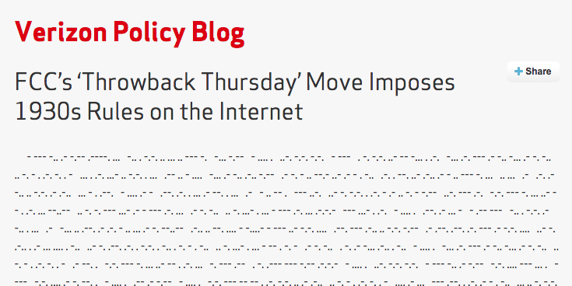
History of Net neutrality in US (2)
As of Jan. ‘14 FCC could not enforce net neutrality because ISPs were not common carriers
Issue: should ISPs be reclassified as common carriers (under Title II of the Communications act of 1934)
Feb. 2015 – FCC votes to apply common carrier status to ISPs
Mar. 2015 – FCC published new net neutrality rules
Now net neutrality applies also to mobile networks

Slide 14
Alternate views on Net neutrality
FCC rules about ``no blocking, no throttling and no paid prioritization’’ sound good but don’t address the real problem
Key issue: lack of competition
If ISPs had to compete on price and service there would be incentives for them to provide good performance
Without competition…
… ISPs can leave congested interconnects until content providers yield and pay for private interconnects
Two technical mechanisms:
Traffic differentiation: identify + degrade
Interconnect congestion: refuse to provide higher bandwidth
…forces content providers into paid private peerings
Currently outside of the scope of the current FCC rules!

Slide 15
How can technology help?
Increasing transparency of traffic differentiation
Give users tools to detect traffic differentiation when it happens
Glasnost (optional reading)
Readings/presentations:
Differentiation detector
Measure interconnect congestion
https://www.caida.org/publications/presentations/2015/mapping_internet_interdomain_congestion_aims/mapping_internet_interdomain_congestion_aims.pdf

Slide 16
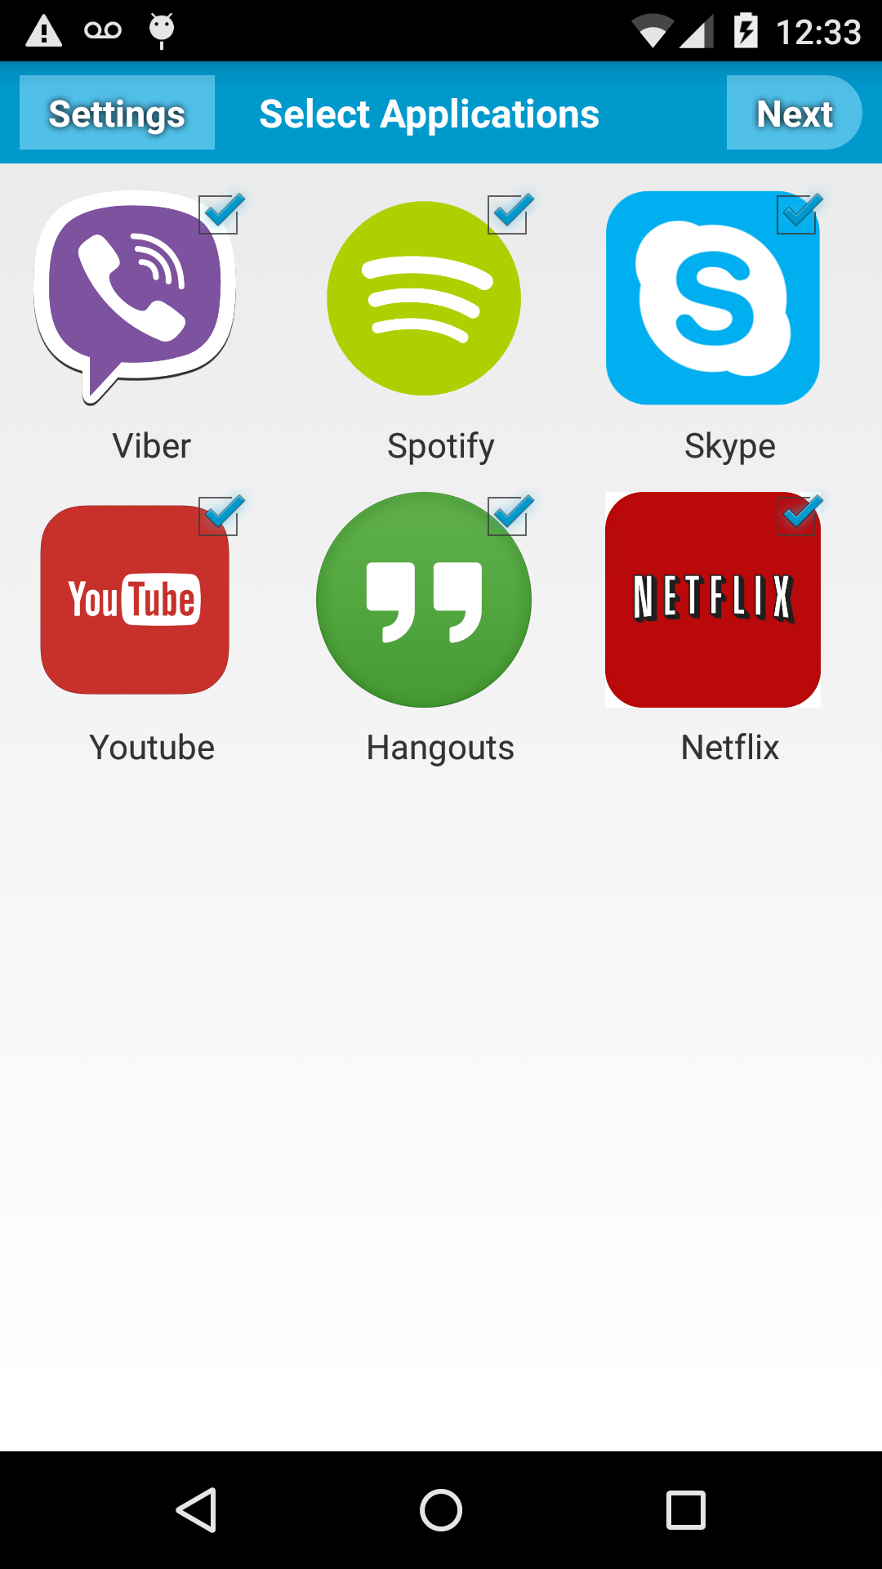
Hands on activity
Try Differentiation detector app
Wehe in Android & Apple Store

