Slide 1
CS590/690
Detecting network interference
Spring 2018
Lecture 06
Prof. Phillipa Gill

Slide 2
Where we are
Last time:
In-path vs. On-path censorship
Proxies
Detecting page modifications with Web Trip-Wires
Finished up background on measuring censorship
Questions?

Slide 3
Test your understanding
What is the purpose of the HTTP 1.1 host header?
What is the purpose of the server header?
Why might it not be a good header to include?
What is a benefit of an in-path censor?
What are the two mechanisms for proxying traffic?
  Pros/cons of these?
How can you detect a flow terminating proxy?
How can you detect a flow rewriting proxy?
What are two options in terms of targeting traffic with proxies?
How can partial proxying be used to characterize censorship?

Slide 4
Today
Challenges of measuring censorship
Potential solutions

Slide 5
So far…
… we’ve had a fairly clear notion of censorship
And mainly focused on censors that disrupt communication
  Usually Web communication
… but in practice things are more complicated
Defining, detecting, and measuring censorship at scale pose many challenges
Optional reading: Burnett & Feamster – On Web page

Slide 6
How to define “censorship”
Censorship is well defined in the political setting…
  What we mean when we talk about “Internet censorship” is less clear
  E.g., copyright takedowns? Surveillance? Blocked content?
    → broader class of “information controls”
The following are 3 types of information controls we can try to measure:
  Blocking (complete: page unavailable, partial: specific Web objects blocked)
  Performance degradation (Degrade performance to make service unusable, either to get users to not use a service or to get them to use a different one)
  Content manipulation (manipulation of information. Removing search results, “sock puppets” in online social networks)

Slide 7
Challenge 1: What should we measure?
Issue 1: Censorship can take many forms? Which should we measure? How can we find ground truth?
  If we do not observe censorship does that mean there is no censorship?
Issue 2: Distinguishing positive from negative content manipulation. Personalization vs. manipulation?
  How might we distinguish these?
  Another option: make result available to the user and let them decide
Issue 3: Accurate detection may require a lot of data.
  Unlike regular Internet measurement, the censor can try to hide itself!
  Need more data to find small-scale censorship rather than wholesale Internet shut down
  Distinguishing failure from censorship is a challenge!
    E.g., IP packet filters

Slide 8
Challenge 2: How to measure
Issue 1: Adversarial measurement environment
  Your measurement tool itself might be blocked.
  www.citizenlab.org has been blocked in China for a long time!
  Need covert channel/circumvention tools to send data back.
    Should have deniability
  The end-host monitoring itself maybe be compromised
    E.g., government agent downloads your software and sends back bogus data
Issue 2: How to distribute the software
  Running censorship measurements may incriminate users
  Distribute “dual use” software.
    Network debugging/availability testing (censorship is just one such cause of unavailability)
  Give users availability data. Let them draw conclusions…

Slide 9
Principle 1: correlate independent data sources
Example: Software in the region indicates that the user cannot access the service.
Can correlate with:
  Web site logs: did other regions experience the outage? Was the Web site down?
  Home routers: e.g., use platforms like Bismark to test availability and correlate with user submitted results.
  DNS lookups: what was observed as results at DNS resolvers at that time? Does it support the hypothesis of censorship?
  BGP messages: look for anomalies that could indicate censorship or just network failure.

Slide 10
Principle 2: Separate measurements and analysis
Client collects data but inferences of censorship happen in a separate location
Central location can correlate results from a large number of clients + data sources
Also helps with defensibility of the dual use property
  Software itself isn’t doing anything that looks like censorship detection
Helpful when you want to go back over the data as well!
  E.g., testing new detection schemes on existing data

Slide 11
Principle 3: Separate information production from consumption
The channels used for gathering censorship information
  E.g., user submitted reports, browser logs, logs from home routers
… should be decoupled from results dissemination.
Different sets of users can access the information than collected it
  Improved deniability
  Just because you access the information does not mean you helped collect it
Makes it more difficult for the censor to disrupt the channels

Slide 12
Principle 4: Dual use scenarios whenever possible
Censorship is just another type of reachability problem!
Many network debugging and diagnosis tools already gather information that can be used for both these issues and censorship
E.g., services like SamKnows already perform tests of reachability to popular sites
  Anomalies in reachability could also indicate censorship
If censorship measurement is a side effect and not a purpose of the tool
  … users will be more willing to deploy
  … governments may be less likely to block

Slide 13
Principle 5: Adopt existing robust data channels
Leverage tools like Collage, Tor, Aqua, etc. for transporting data when necessary:
  From the platform to the client software (e.g., commands)
  From the client to the platform (e.g., results data)
  From the platform to the public (e.g., reports of censorship)
Each channel gives different properties
  Anonymity (e.g., Tor)
  Deniability (e.g., Collage)
  Traffic analysis resistance (e.g., Aqua)

Slide 14
Principle 6: heed and adapt to changing situations/threats
Censorship technology may change with time
  Cannot have a platform that runs only one type of experiment
  Need to be able to specify multiple types of experiments
Talk with people on the ground
  Monitor the situation
  E.g., some regions may be too dangerous to monitor: Syria, N. Korea etc.

Slide 15
Ethics/legality of censorship measurements
Complicated issue!
Using systems like VPNs, VPS, PlanetLab in the region pose least risk to people on the ground
  Representativeness of results?
Realistically, even in countries where there is low Internet penetration attempting to access blocked sites will not be significant enough to raise flags
  10 years of ONI data collection support this
  However, many countries have broadly defined laws
  And querying a “significant amount” of blocked sites might raise alarms.
Informed consent is critical before performing any tests.

Slide 16
So far. .. Many problems … ☹
… some solutions?
Be creative
Leverage existing measurement platforms to study censorship from outside of the region
  E.g., RIPE ATLAS (need to be a bit careful here)
  querying DNS resolvers,
  sending probes to find collateral censorship
  Look for censorship in BGP routing data
Another solution: Spookyscan (reading on Web page)

Slide 17
Ethical considerations
Different measurement techniques have different levels of risk
In-country measurements
  How risky is it to have people access censored sites?
  What is the threshold for risk?
  Risk-benefit trade off?
  How to make sure people are informed?
Side channel measurements
  Causes unsuspecting clients to send RSTs to a server
  What is the risk?
  Not stateful communication …
    … but what about a censor that just looks at flow records?
  Mitigation idea: make sure you’re not on a user device
Javascript-based measurements
  Is lack of consent enough deniability?

Slide 18
Encore: Lightweight Measurement of Web Censorship with Cross-Origin Requests
Governments around the world realize Internet is a key communication tool
  … working to clamp down on it!
How can we measure censorship?
Main approaches:
User-based testing: Give users software/tools to perform measurements
  E.g., ONI testing, ICLab
External measurements: Probe the censor from outside the country via carefully crafted packets/probes
  E.g., IPID side channels, probing the great firewall/great cannon

Slide 19
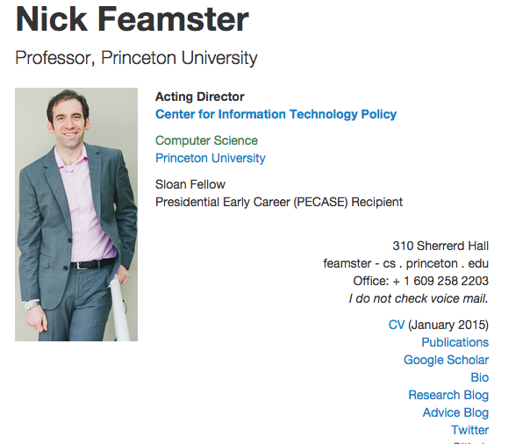


Encore: Lightweight Measurement of Web Censorship with Cross-Origin Requests
Censorship measurement challenges:
Gaining access to vantage points
Managing user risk
Obtaining high fidelity technical data
Encore key idea:
Script to have browser query Web sites for testing

Slide 20
Encore: Lightweight Measurement of Web Censorship with Cross-Origin Requests
Issues…
Informed consent?
  Users can opt out … after the test has already run
  Does consent increase risk?
    … no consent = plausible deniability?
What is the risk of having users query sites?
  Magnitude of risk vs. likelihood of bad event
Censorship measurement is inherently risky
  Risk benefit trade offs

Slide 21
Hands on activity
Try spookyscan !
http://spookyscan.cs.unm.edu/scans/censorship
How can we find IP addresses for different clients and servers?
Clients: www.shodanhq.com search os:freebsd
Servers: dig!
Check out Encore:
http://www.cs.princeton.edu/~feamster/
→ Look at source here
http://encore.noise.gatech.edu/stats.html?referer=http%3A%2F%2Fwww.cs.princeton.edu%2F~feamster%2F

