Slide 1
CS590B/690B Detecting Network Interference (Spring 2018)
Lecture 05
Prof. Phillipa Gill – Umass -- Amherst
ACKs: Slides based on material from Nick weaver’s presentation at the connaught summer institute 2013
Also from: Kurose + Ross; Computer Networking a Top Down approach featuring the Internet (6th edition)

Slide 2
Where we are
Last time:
On-path DNS injection
Hold-on to circumvent injection
Measuring China’s DNS filtering from the outside
Questions?

Slide 3
Administravia
Assignment 1 & Project Info are posted

Slide 4
Test your understanding
What are the three pieces of DNS resolution?
What optimization does DNS have to reduce load on root and TLD servers?
What are the downsides of this optimization?
Name 3 ways a DNS host name can be blocked (blocking techniques)
What options does a censor have when returning/injecting a DNS reply? (what type of IPs might it return?)
What does Hold-On use to distinguish injected from true DNS responses? (2 metrics)
How does it obtain these values?
What are two techniques used by anonymous to measure DNS censorship in China from outside the country?

Slide 5
Overview
Block IP addresses
IP layer
Disrupt TCP flows
TCP (transport layer)
Many possible triggers
Block hostnames
DNS (application layer)
Disrupt HTTP transfers
HTTP (application layer)
Today

Slide 6
Networking 101: HTTP
HTTP (Hyper Text Transfer Protocol) is what most people think of when they talk about “the web”
Client-server request/response protocol
Client requests “I want file X from host Y that is on this server”
Server replies
Content can be any filetype
E.g. “HyperText Markup Language” (HTML) pages
Embedded programs (JavaScript, Flash, etc) which run on the browser
No cryptographic integrity

Slide 7


HTTP overview
HTTP: hypertext transfer protocol
Web’s application layer protocol
client/server model
client: browser that requests, receives, (using HTTP protocol) and “displays” Web objects
server: Web server sends (using HTTP protocol) objects in response to requests
HTTP request
PC running
Firefox browser
HTTP response
HTTP request
server
running
Apache Web
server
HTTP response
iphone running
Safari browser

Slide 8
HTTP request message
two types of HTTP messages: request, response
HTTP request message:
ASCII (human-readable format)
carriage return character
request line
(GET, POST,
HEAD commands)
line-feed character
GET /index.html HTTP/1.1\r\n
Host: www-net.cs.umass.edu\r\n
User-Agent: Firefox/3.6.10\r\n
Accept: text/html,application/xhtml+xml\r\n
Accept-Language: en-us,en;q=0.5\r\n
Accept-Encoding: gzip,deflate\r\n
Accept-Charset: ISO-8859-1,utf-8;q=0.7\r\n
Keep-Alive: 115\r\n
Connection: keep-alive\r\n
\r\n
header
lines
carriage return,
line feed at start
of line indicates
end of header lines

Slide 9
HTTP response message
status line
(protocol
status code
status phrase)
HTTP/1.1 200 OK\r\n
Date: Sun, 26 Sep 2010 20:09:20 GMT\r\n
Server: Apache/2.0.52 (CentOS)\r\n
Last-Modified: Tue, 30 Oct 2007 17:00:02 GMT\r\n
ETag: "17dc6-a5c-bf716880"\r\n
Accept-Ranges: bytes\r\n
Content-Length: 2652\r\n
Keep-Alive: timeout=10, max=100\r\n
Connection: Keep-Alive\r\n
Content-Type: text/html; charset=ISO-8859-1\r\n
\r\n
data data data data data ...
header
lines
data, e.g.,
requested
HTML file

Slide 10
HTTP response status codes
status code appears in 1st line in server-to-client response message.
some sample codes:
200 OK
request succeeded, requested object later in this msg
301 Moved Permanently
requested object moved, new location specified later in this msg (Location:)
400 Bad Request
request msg not understood by server
404 Not Found
requested document not found on this server
505 HTTP Version Not Supported

Slide 11
OK … SO WHERE ARE WE NOW?
We’ve so far talked about a bunch of different blocking techniques
Packet filtering/BGP manipulation
Injecting RSTs
Injecting DNS replies
Those can all be used to block HTTP (and other types of content)
Today’s focus: proxies and blocking mechanisms that act specifically on HTTP traffic.

Slide 12
In-path censorship
Rather than sitting as a wiretap, actually intercept all traffic
Now the censor can remove undesired packets
Two possible mechanisms:
Flow Terminating
Flow Rewriting
Two possible targets:
Partial Proxying
Complete Proxying

Slide 13
Flow Terminating proxies

Slide 14

Flow terminating
SYN
SYN
SYNACK
SYNACK
ACK
ACK
External Server
Proxy
Two separate TCP connections.
Buys the censor some time to process content.
No worry about having to match state because the proxy is the end point (from client’s point of view)
External Server might see client IP, might see Proxy IP

Slide 15
Flow rewriting proxies
Slide borrowed stolen from N. Weaver.

Slide 16
Flow Rewriting
SYN
SYN
SYNACK
SYNACK
ACK
ACK
External Server
Proxy

Slide 17
Flow Rewriting
Block Page
Censored keyword
External Server
Proxy

Slide 18
Partial vs. complete proxying

Slide 19
Detecting and using partial proxies

Slide 20
Detecting complete terminating proxies

Slide 21
Reading from webpage
Detecting In-Flight Page Changes with Web Tripwires. C. Reis, S. Gribble, T. Kohno, and N. Weaver.
Common assumption: ISPs could modify content in flight but with few exceptions this does not happen
This paper shows that this assumption is false
They find a diverse range of agents that modify pages
ISPs insert ads to gain revenue
Users block ads to prevent annoyance
Malware writers insert exploits
HTTPS doesn’t completely solve the problem
Terminating proxy with certificate can MITM

Slide 22
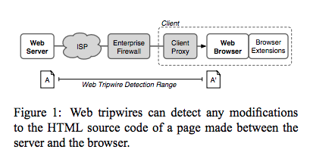
Web Trip wires

Slide 23
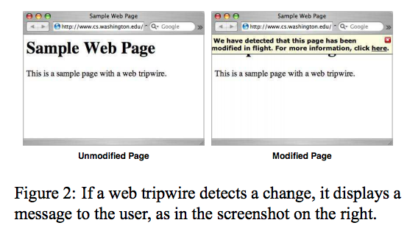
Example trip wire page

Slide 24
Web trip wires
Need to deliver three items
The Web page
Trip wire script
Representation of what the page should be (checksum or raw content in an encoded string to prevent modifications)
Challenge: Dynamic pages (need to generate the ‘known good’ page while servicing the request)
One solution: send a separate static page and check that for modifications
Would miss targeted alterations to pages.
Comparison metrics:
# of script tags
Compare DOM: hard because browser dependent
Compare HTML string: requires the Tripwire script re-fetch the page from the server

Slide 25
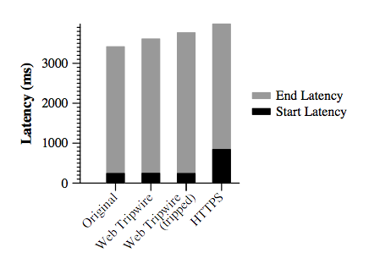
Performance overhead
17% more data transferred
But still small relative to other site content.

Slide 26
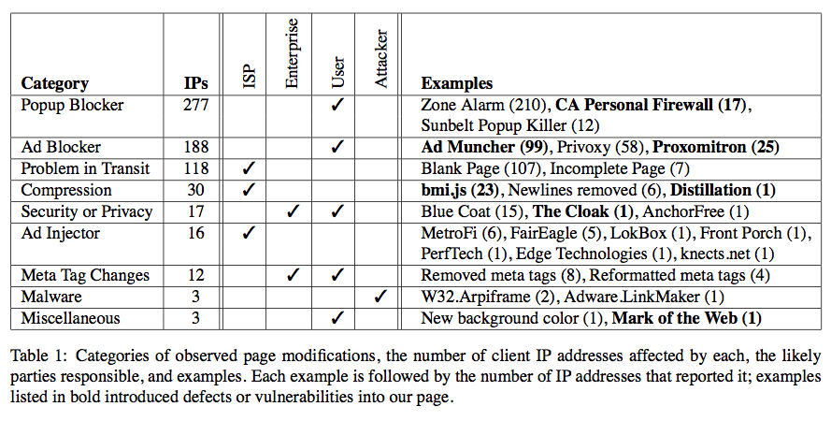
Modifications found

Slide 27
Challenges for deployment
Trip-wires requires that the server cares about modifications and implements the trip-wire
What if the user wants to detect changes?

Slide 28
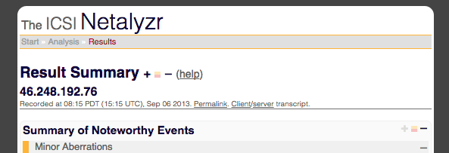
Reading 2
Here be Web proxies. Nicholas Weaver, Christian Kreibich, Martin Dam, and Vern Paxson. PAM 2014.
Netalyzr includes tests for Web proxies
This paper analyzes the results
Notes:
Explain what netalyzr is!

Slide 29
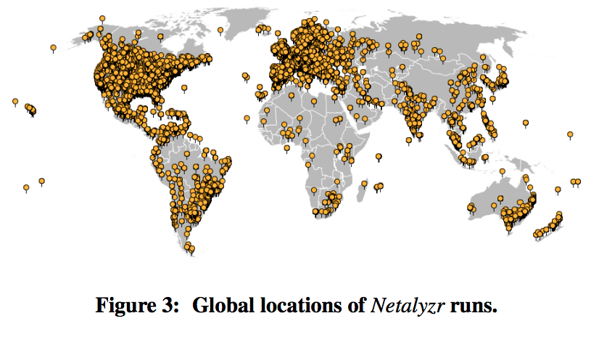
Netalyzr coverage ca. 2010

Slide 30
Tests for proxies
Non-responsive server test (116K clients)
Configure their own server to send a RST
If they successfully open a connection the response is from a proxy
Proxy traceroute (17K clients)
Connect to traceroute server which waits for SYN from proxy
Once it gets the SYN send SYNACKs with incrementing TTL until ACK (not Time exceeded) received
HTTP404 Fetches (448K clients)
Fetch 3 different 404 pages, look for modifications
HTTP Header casing
Send: HoSt: www.google.com see if server receives the header unmodified (vs. host or HOST).
Non HTTP Fetch
s/HTTP/ICSI
… more in paper

Slide 31
Notable findings …
Client-side Antivirus (6% of clients)
E.g., software on host modifying HTTP headers
Caches (2.3% of clients)
Save upstream bandwidth
Security and Censor Proxies (0.55% of clients)
Security products via the ‘via’ header
Other products via HTTP header insertions
Transcoding (0.54% of clients)
Save downstream bandwidth via coding images
404 Rewriters (0.11% of clients)
Error monetization

Slide 32
Interesting types of proxies
Dark Proxies
8% of clients
Proxies seen via the non-responsive server test
But no other content modifications
What is it doing?
Country-level Proxies
95% of clients in Bahrain
85% of clients in Singapore
79% of clients in Lebanon
62% of clients in UAE
48% of clients in Thailand

Slide 33
Hands on activity
Try running Netalyzr
http://netalyzr.icsi.berkeley.edu/
See: “NetalyzrLinks.rtf” in this directory: https://goo.gl/oF7uXh
Where were these Netalyzr tests run?
Do they seem to use the same censorship product?
What can you learn about these connections from Netalyzr?

