Slide 1
CS590/690
Internet censorship (Spring 2018)
Lecture 03
ACKs: Slides based on material from Nick weaver’s presentation at the connaught summer institute 2013

Slide 2
Where we are
Last time:
Background on Internet protocols/routing
Censorship at the network layer.
Questions?

Slide 3
Test your understanding
What is a network censor?
How might a censor identify content to block?
Name an interior domain protocol
Name an inter-domain protocol
Name two ways to filter based on IP address
What are pros (for the censor) of each approach?
Cons?
What do we mean by “collateral damage” of censorship?
How did the Egyptian government take down the Internet?
How did the Libyan government take down the Internet?
What data can we use to understand this sort of event?

Slide 4
Overview
Block IP addresses
  IP layer
Disrupt TCP flows
  TCP (transport layer)
  Many possible triggers
Block hostnames
  DNS (application layer)
Disrupt HTTP transfers
  HTTP (application layer)
Today

Slide 5
Tcp: Transmission control protocol
TCP is used for reliable, in-order communication
Connection established using a “three-way handshake”
All data is ACKnowledged
  If no ACK is received packets will be resent
Connection normally closed with a FIN (finish) packet
  Indicates that this side has no more information to send
Connections can also be closed with a RST (reset) packet
  Indicates a problem: both sides should stop communicating
  Some software makes liberal use of RSTs.

Slide 6
Why inject tcp reset packets?
A TCP Reset (RST) tells the other side of the connection:
  There will be no more data from this source on this connection
  This source will not accept any more data, so no more data should be sent
Once a side has decided to abort the connection, the only subsequent packets sent on this connection may be RSTs in response to data.
Once a side accepts a RST it will treat the connection as aborted
… but RSTs are quite common, 10-15% of ALL flows are terminated by a RST rather than a FIN
  For HTTP, it can be over 20%: Web servers/browsers often time out with RST instead of FIN
  Thus we cannot treat RSTs as “adversarial”

Slide 7
types of censors
Last time we discussed IP blocking via ACLs which is an example of an in-path censor.
Censors can also operate on-path: a wiretap, (intrusion detection system (IDS), deep packet inspection (DPI)) + attached network connection
  Censor can see all the packets
  Censor can add their own packets through packet injection
  Censor cannot remove packets
Can censor:
  DNS requests (by injecting bogus replies)
  Web requests to given hosts (including HTTPS)
  Web requests over HTTP for forbidden content
    Latter two possible via injecting TCP RST packets!

Slide 8
Limitations of on-path censors

Slide 9
Why on-path censors?
In-path device must process the traffic
  If they fail, they fail closed (connection gone!)
On-path devices are safer
  Tapping a link is “safe” (in network operator terms)
  Easy to parallelize (just mirror traffic to more filters)
  Less disruptive to install and use
Limitations:
  Can’t censor single replies
  Censorship is always detectable
    Censor cannot perfectly mimic the other endpoint.

Slide 10
On path censor example
Notes:
Mirroring is only on the active link. If that link goes down traffic on back up link may not be censored.

Slide 11
Detecting on-path censorship
Not only is the act of censorship detectable, the mechanism, is detectable
Since censor creates new packets but can’t remove existing packets
Since the injected packets can be identified, fingerprinting is also possible.
Using packets which trigger censorship but with a short TTL can localize the censor in the network
Leads to tricky cross-layer network measurements (easier with DNS)
Detection limitation: Can only detect an on-path censor when it is active
A censor which doesn’t create an effect on measured traffic is not detectable
E.g., DPI used for surveillance

Slide 12
Race conditions: data after reset
TCP packets are tracked by sequence numbers
  The next packet’s sequence number should be the previous packet’s sequence number plus the packet length
What is a sender is still sending data when the RST is injected?
  The receiver will see both a reset and a subsequent data packet, where the packet’s sequence number + length > the reset packet’s sequence number

Slide 13


Race conditions: Data after reset
Such a packet arrangement is out of specification
No TCP stack should generate such a sequence! It would imply that the stack decided to abort the connection yet keep sending anyway
Data seq = 32 ack = 1
RST seq = 2 ack = 32
Data after RST? Doesn’t make sense!
Data seq = 238 ack = 32
Web Server
(208.80.154.238)

Slide 14
Race conditions: reset after data
What if the reset injector is just slow?
  It takes time to determine that a flow should be blocked…
  … in the mean time traffic is flying by!
Result is a reset after data race condition
  Reset packet appears after the data packet
  Reset’s sequence number is less than the data packet’s sequence number plus its length

Slide 15
Race conditions: Reset after data
This is also out of specification
Why would a TCP stack do a retroactive abort?
Worse, such resets should be ignored by the receiver:
The received reset is “out-of-window”
Data seq = 32 ack = 1
RST after data? Huh?
Data seq = 238 ack = 32
RST seq = 2 ack = 32
Web Server
(208.80.154.238)

Slide 16
Building a reliable RST injector enables detection
Thus a reliable packet injector must anticipate the reset after data condition
  Instead of sending one reset it needs to send multiple resets with increasing sequence number
This is detectable as a “reset sequence change condition”
  An end host should never generate such resets as the host can always generate an in-sequence reset
An unreliable injector can only be detected when a race condition occurs
A reliable injector always can be detected.

Slide 17
Fingerprinting rst injectors

Slide 18
Related reading
Detecting Forged TCP Reset Packets. Weaver et al. NDSS 2009.
Detection criteria for anomalous RSTs:
  RST_SEQ_DATA: RST sequence number is < sequence of data
  DATA_SEQ_RST: Data is seen after the RST packets
  RST_SEQ_CHANGE: back to back RSTs with increasing sequence numbers that exceed the current sequence number of the data
Three more detectors of “odd” situations
  RST_ACK_CHANGE: RSTs with nonsensical ACK numbers (not a definitive sign of an injector but suspicious)
  SYN_RST: A RST packet received right after a SYN from a host. Can be legit for Web browsers but can indicate interference.
  SYN_ACK_RST: SYNACK follows by RST.

Slide 19
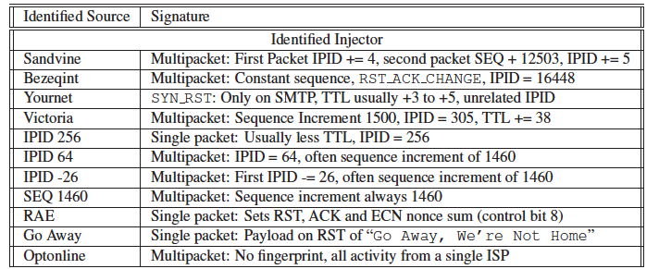
Evaluation
Detectors implemented in Click and run on datasets from 4 institutions
Identified injectors (other unusual uses of RSTs logged in the paper)

Slide 20
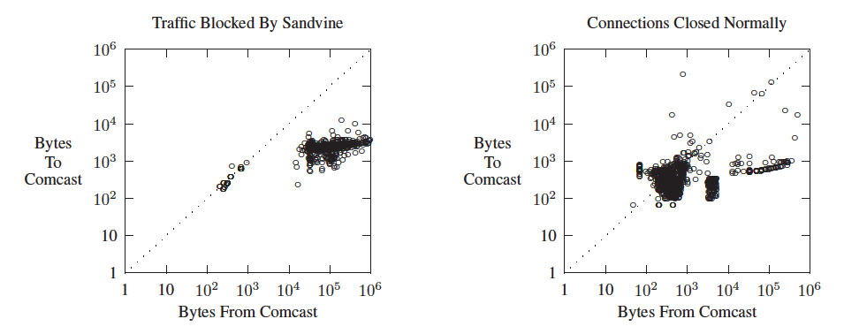
p2p blocking by comcast
Public statement is that they block uploaders. Data supports this.

Slide 21
Can we just ignore these RSTs?
As of 2006, yes but both ends of the connection need to ignore the RSTs.
  Reading on Web page:
    Ignoring the Great Firewall of China. Clayton et al. Workshop on Privacy Enhancing Technologies (PETS).
Client cannot do it unilaterally.
  Injectors will just send RSTs to the server and the client
These experiments are also not very recent.
  Potential project: Repeat these experiments using new measurement platforms like SEATTLE or Dasu.

Slide 22
Remember … RSTs are a mechanism
They don’t tell us anything about what triggers the mechanism
Some clues ..
  When the RST is sent
    Before the HTTP GET
    After the HTTP GET
  Still not definitive
Need purpose build experiments
  Run tests towards your own server
  Put blocked keyword in host name
  … in HTML body content
Potential project: design + implement experiments that test for censorship triggers

