Slide 1
CS590/690 Internet censorship (Spring 2018)
Lecture 02
ACKs: Slides based on material from Nick weaver’s presentation at the connaught summer institute 2013

Slide 2






What is a network censor
An entity that desires that some identifiable communication is blocked from being transmitted over the network
Without the authority to compel the content provider to remove the content
Without the authority to compel the client to install software of the censor’s choosing
Requires that the censor act on network traffic
Image from Watch, Learn, Drive
http://watch-learn-drive.com/Learners_Online/New_places/Traffic_lights/TL_5.html
Notes:
Needs to operate on network traffic. Needs to be efficient and scalable. Censorship systems are like other systems!

Slide 3
How to identify and block?
Identification: The piece of information that allows the censor to identify content to be blocked is referred to as the censorship trigger
Example: IP address, hostname, URL, keywords etc.
Blocking: The technical means used to restrict access to the content
Example: dropping packets, forging TCP RST packets or DNS responses
In the next few lectures we will be exploring censorship as it exploits different triggers and blocking mechanisms at different layers of the Internet Protocol stack.

Slide 4
Networking 101
Bit Torrent, Web (Facebook, Twitter)
Protocols on the Internet divided into logical layers
These layers work together to get traffic where it is going.
Headers of upper layers encapsulate lower layer protocols
A network censor can disrupt any layer!
Application layer
(DNS, HTTP, HTTPS)
Transport Layer
(TCP, UDP)
Network Layer
(IP, ICMP)
Link Layer
(Ethernet, 802.11)
Physical Layer
(satellite, fiber)

Slide 5
Networking 101
So how does our traffic get where its going?
Each device has an IP
ISP B
Between networks border gateway protocol (BGP) is used to exchange routes
C
Prefix: 3.1.2.0/24
C
Prefix: 3.1.2.0/24
ISP C
ISP A
2.1.2.5
Prefix: 3.1.2.0/24
(2.1.2.5)
B, C
Prefix: 3.1.2.0/24
Web Server
(3.1.2.3)
DNS Server
(2.1.2.3)
Within a network routes are learned via “interior gateway protocols” (e.g., OSPF, IS-IS )
Home connection
(2.1.2.4)
Notes:
When the user wants to access the Web server they learn the path via BGP.

Slide 6
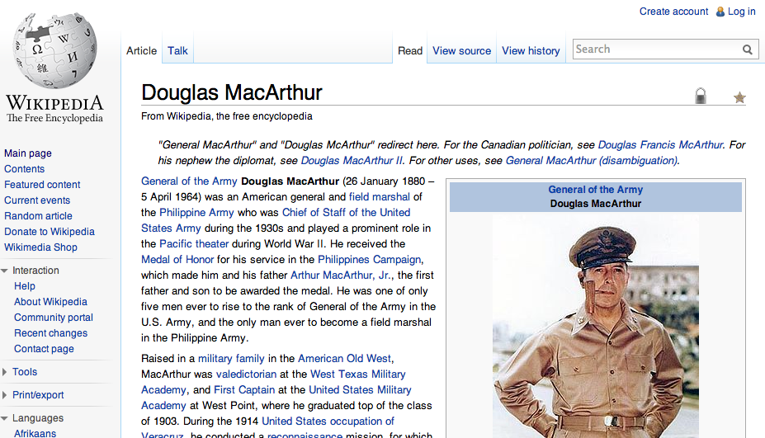

Networking 101
HTTP STATUS 200
Content Length: 523
Content Type: text/html
<!DOCTYPE html>
<html lang="en" dir="ltr" class="client-nojs">
<head>
<meta charset="UTF-8" /><title>Douglas MacArthur - Wikipedia, the free encyclopedia</title>
<meta name="generator" content="MediaWiki 1.23wmf10" />
…ok but humans don’t request IP addresses
… they want content!
ISP B
HTTP GET /wiki/Douglas_MacArthur HTTP 1.1
Host: en.wikipedia.org
ISP C
SYNACK
DNS A
208.80.154.238
ISP A
SYN
DNS QTYPE A
En.wikipedia.org
(2.1.2.5)
ACK
Web Server
(208.80.154.238)
DNS Server
(2.1.2.3)
Home connection
(2.1.2.4)

Slide 7
Many opportunities to censor
Block IP addresses
IP layer
Block hostnames
DNS (application layer)
Disrupt TCP flows
TCP (transport layer)
Many possible triggers
Disrupt HTTP transfers
HTTP (application layer)
Will be going through a variety of these today + next few lectures.

Slide 8
Internet protocol 101
Relevant fields:
IPID: set by the sender of the IP packet. Some OSes increment globally for each IP packet generated by the host; some maintain per flow counters, use a constant or random values.
TTL: counter gets decremented by each hop on the path until it reaches 0 and an ICMP Time Exceeded Message is generated. Useful for probing/locating censors.
Source IP: IP of the sender of this packet
Destination IP: IP of the recipient of this packet

Slide 9
IP-based blocking
Option 1: Configure routers using an access control list (ACL) to drop traffic to a given IP address.
This is an example of in-path blocking
(censor can remove packets)
Source: 136.159.220.20
Destination: 46.82.174.68
Drop traffic to:
8.7.198.45
203.98.7.65
46.82.174.68
59.24.3.173
93.46.8.89
Image from Watch, Learn, Drive
http://watch-learn-drive.com/Learners_Online/New_places/Traffic_lights/TL_5.html

Slide 10
IP-based blocking
Option 1: Configure routers using an access control list (ACL) to drop traffic to a given IP address.
Source: 136.159.220.20
Destination: 46.82.174.70
Drop traffic to:
8.7.198.45
203.98.7.65
46.82.174.68
59.24.3.173
93.46.8.89
Image from Watch, Learn, Drive
http://watch-learn-drive.com/Learners_Online/New_places/Traffic_lights/TL_5.html

Slide 11
IP-Based blocking
Advantages (for the censor)
Quick and easy to configure
Routers have efficient techniques for IP matching
Disadvantages
Need to know the IP
Easily evadable!
High collateral damage: IP != Web host
Noticeable if high profile site is hosted on the same system
60% of Web servers are hosted with 10,000 or more other Web servers (Shue et al. 2007)
Location of the censor can be determined from within the censored network
Just need to traceroute to the blocked IP (use TCP port 80 SYNs in case ACL is selective).
Can determine location from censored host as well
Assuming ICMP Time Expired messages are blocked.

Slide 12
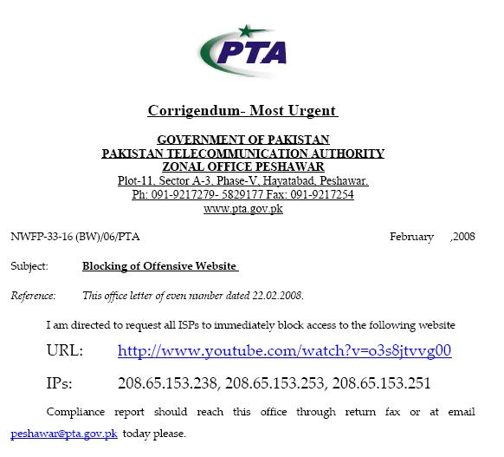
IP-BASED BLOCKING
Option 2: Use BGP to block IPs
February 2008 : Pakistan Telecom hijacks YouTube
“The Internet”
Pakistan
Telecom
YouTube
I’m YouTube:
IP 208.65.153.0 / 22
Multinet
Pakistan
Telnor
Pakistan
Aga Khan
University
Notes:
-level of autonomous systems
-e.g., YouTube, AT&T, pakistan telecom
-routing is done on IP addresses, so when someone wants to go to YouTube they get YouTube’s IP address and YouTube announces to the world that they have the ip address and traffic is forwarded towards them. So here multinet would route to it’s provider pakistan telecom that then forwards the traffic on to youtube.
-these networks chosen for a specific reason which is that there was an incident in february 2008 pakistan telecom actually high jacked traffic going to youtube (misconfiguration).
-they announced to the world that they’re youtube and traffic destined to youtube was routed to them
-youtube was unavailable for a couple of hours as operators phone each other to figure out what was going on.

Slide 13
IP-BASED BLOCKING
Here’s what should have happened….
“The Internet”
Hijack + drop packets going to YouTube
X
Pakistan
Telecom
YouTube
I’m YouTube:
IP 208.65.153.0 / 22
Multinet
Pakistan
Telnor
Pakistan
Aga Khan
University
Block your own customers.

Slide 14
IP-BASED BLOCKING
But here’s what Pakistan ended up doing…
“The Internet”
No, I’m YouTube!
IP 208.65.153.0 / 24
Pakistan
Telecom
Pakistan
Telecom
YouTube
I’m YouTube:
IP 208.65.153.0 / 22
Multinet
Pakistan
Telnor
Pakistan
Aga Khan
University
Notes:
Our works focuses on attacks of this flavor..

Slide 15
Why was the Pakistan incident so bad?
They announced a more specific prefix
BGP routing is based on longest prefix match
There is no global route authentication in place!
ISPs should filter announcements from their customers that are clearly wrong
(As an ISP you should know what IP address space is in use by your customers)
In reality this is harder than it seems ☹

Slide 16
Ip-based blocking
Option 2: BGP route poisoning
Instead of configuring router ACLs, just advertise a bogus route
Causes routers close to the censor to route traffic to the censor, which just drops the traffic
How to detect this type of censorship?
BGP looking glass servers in the impacted region
Sometimes global monitors as well …
Challenges
Can cause international collateral damage!
Will block all content on a given prefix
Could announce a /32 to get a single address but most ISPs will not propagate beyond a /24

Slide 17
Known users of ip-based blocking
Pakistan using IP-based blocking for YouTube address ranges
Can interfere with other Google services
China
Some reports of IP blocking
Many URLs redirected to small set of IP-addresses, possibly this is the set used for ACLs
UK
Uses IP blocking of the Pirate Bay’s IP address
Australia
IP blocking for Melbourne Free University IPs (precise motivation unclear…)
https://www.eff.org/deeplinks/2013/04/australian-networks-censor-community-education-site
In general, too much collateral damage of IP-based blocking.

Slide 18
Other uses of ip-based blocking
Internet “kill switches”
Required reading: Analysis of Country-wide Internet Outages Caused by Censorship. Dainotti et al. IMC 2011
Example: Internet shut downs in Egypt + Libya in 2011
Egypt:
Jan. 25, 2011: protests start in the country
Government orders service providers to “shut down” the Internet
Jan. 27 @ 22:34 UTC: several sources report withdrawal in the Internet’s global routing table of almost all routes to Egyptian networks
This lasted for 5.5 days!
Libya
Feb. 17, 2011: Protests start in the country
The government controls most of the country’s communication infrastructure
Feb. 18 (6.8 hours), 19th (8.3 hrs), March 3rd (3.7 days): Three different connectivity disruptions

Slide 19
Rough idea what this looks like
Rest of Internet
Nat. Telco, ISP 2
Prefix 2
Nat. Telco, ISP 1
Prefix 1
Withdrawal
National Telco
ISP 1
Prefix 1
ISP 2
Prefix 2
Regional ISP 1
Regional ISP 2
Prefix 1
Prefix 2

Slide 20
Some Context
Egypt
3165 IPv4 and 6 IPv6 prefixes delegated to Egypt by AfriNIC
They are managed by 51 autonomous systems
Filtering type: BGP only
Libya
13 IPv4 prefixes, no IPv6
3 autonomous systems operate in the country
Filtering type: mix of BGP, packet filtering, satellite signal jamming

Slide 21
How to measure this?
BGP
BGP Updates logged by RIPE-NCC RIS + Routeviews at route collectors
Active Traceroute Probing
CAIDA manages “Archipelago Measurement Infrastructure” (Ark)
Traceroutes from ~ 80 hosts to all /24 prefixes
Internet Background Radiation
Traffic received by the UCSD Network Telescope
… an unallocated /8: represents unsolicited packets (scans, worms, etc.)

Slide 22
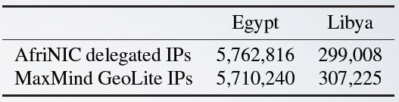
Data selection
IP ranges associated with the country of interest
Delegations from Regional Internet Registries (RIR)
Commercial geolocation database
Gather prefixes to be monitored by looking at BGP announcements. For each IP range
Look up for an exact match of the BGP prefix
Find all more specific (strict subset, longer) prefixes
Otherwise, retrieve the longest BGP prefix containing the prefix.

Slide 23
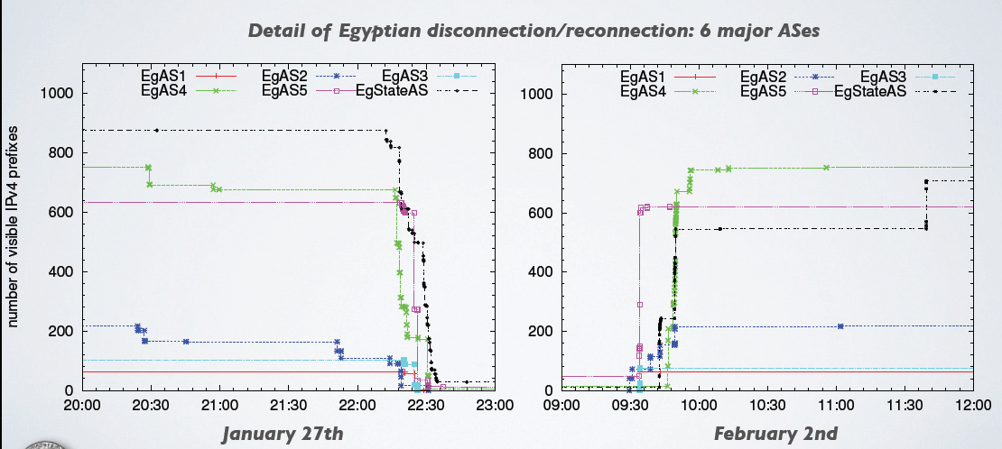
BGP disconnection in egypt
Synchronization of withdrawals and announcements between Egyptian ASes

Slide 24
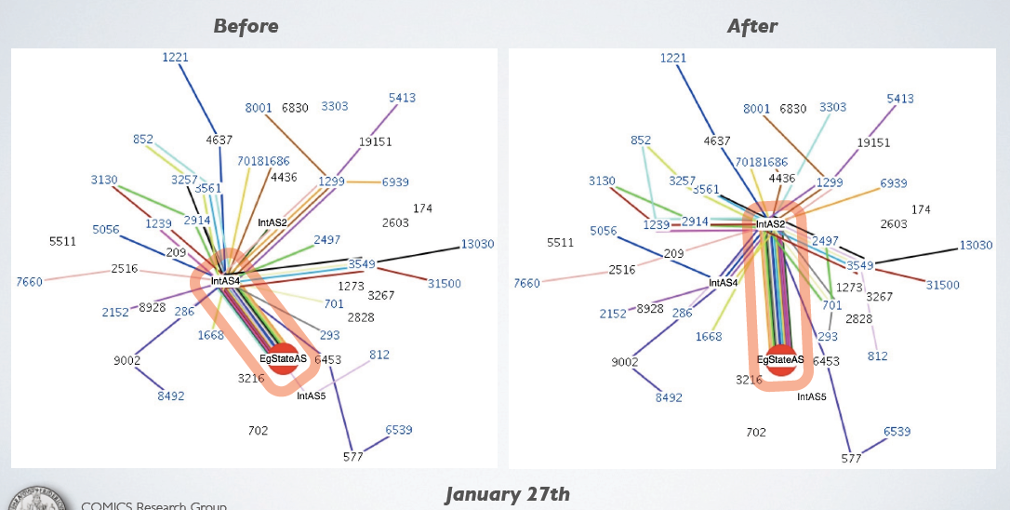
Long lasting effects
Path changes. These plots generated using BGPlay

Slide 25
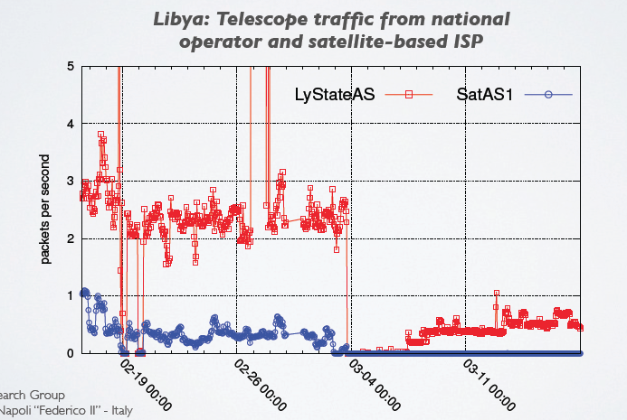
BGP cannot take down satellite links
Probable signal jamming!
Third Libyan outage. SatAS1 was BGP-reachable, only small amount of traffic reaches the telescope

Slide 26
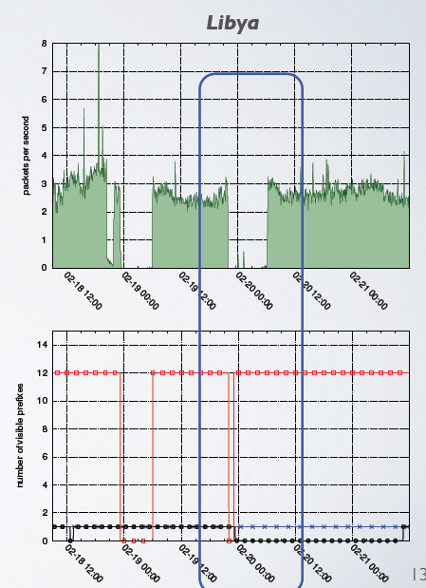
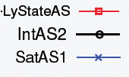
Advantages of multiple data sets
Telescope (top plot) shows traffic decreasing to nearly 0, while BGP data (bottom plot) shows prefixes are still reachable.
→ Packet level filtering/satellite jamming in use

Slide 27
Hands-on activity
Look up Dyn reports of country-wide outages (eg., Sudan, Libya, Egypt) or censorship-related incidents (eg., Pakistan, China Telecom 2010 incident)
https://dyn.com/blog/
Load BGPPlay data from around the time of the incident. What can you see?
http://bgplay.routeviews.org/ (you will need Java)
Post interesting screen shots from BGPlay to Piazza!
Alternative BGPPlay Source:
https://stat.ripe.net/
Look up the impacted prefixes and ASNs

Slide 28
Next time …
We continue our journey up the protocol stack with blocking at the transport layer

