Slide 1
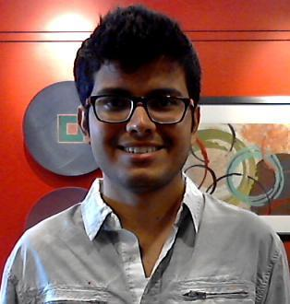
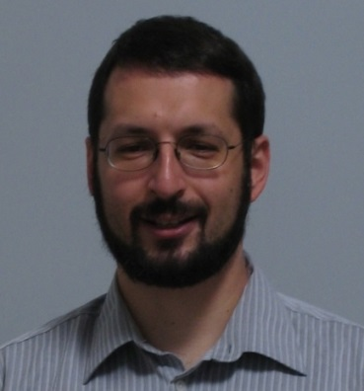

Knowing a Good HOG Filter When You See It:
Efficient Selection of Filters for Detection
Ejaz Ahmed¹, Gregory Shakhnarovich², and Subhransu Maji³
¹ University of Maryland, College Park
² Toyota Technological Institute at Chicago
³ University of Massachusetts, Amherst

Slide 2
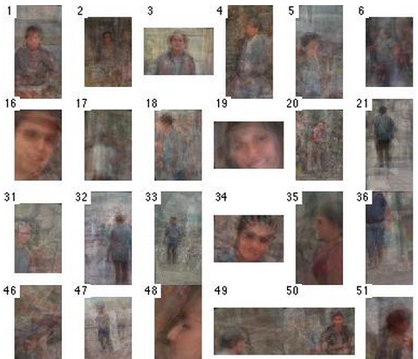
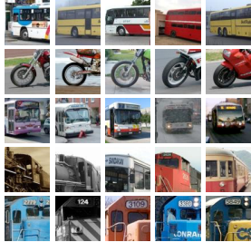
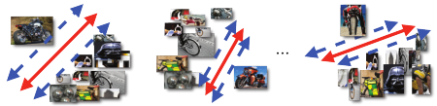
Visual Category as Collection of filters
Poselets
Mid Level Discriminative Patches
Exemplar SVMs
Notes:
A common way to represent diverse categories is to represent them as mixture of models
These models can be part based, for example in Poselets and DPM
Or can be defined globally, for example in ESVM
How these components are defined and discovered varies over different methods
Our focus on a common architecture, which has two major steps
candidate generation step
candidate selection step

Slide 3
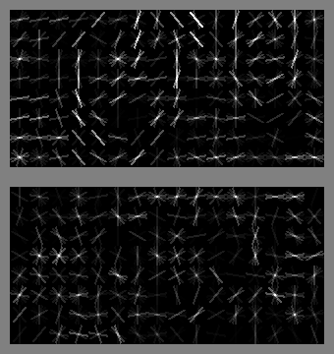
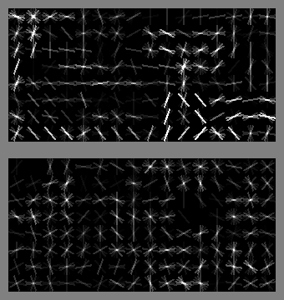
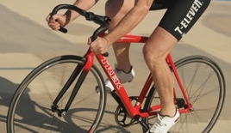
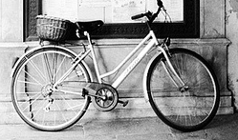
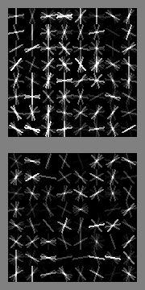
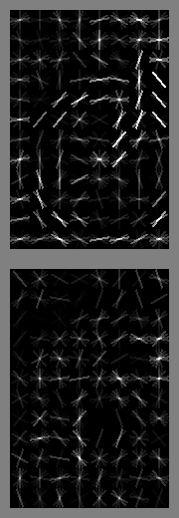
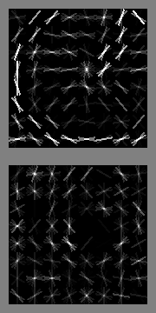
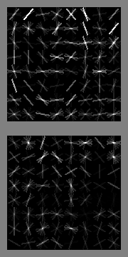
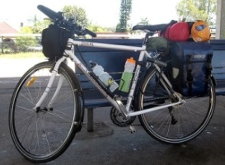
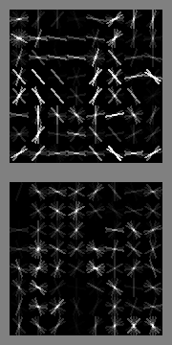
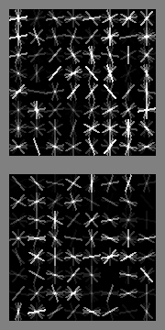
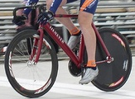
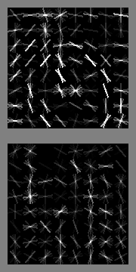
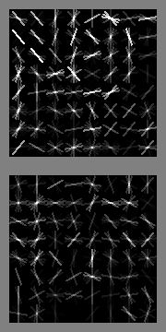
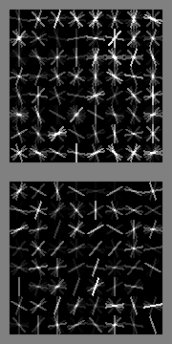
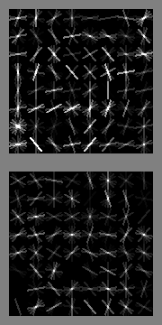
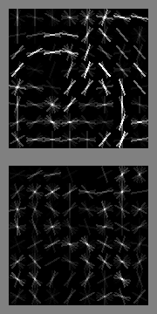
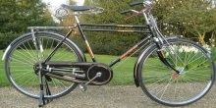
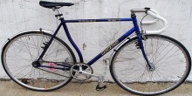
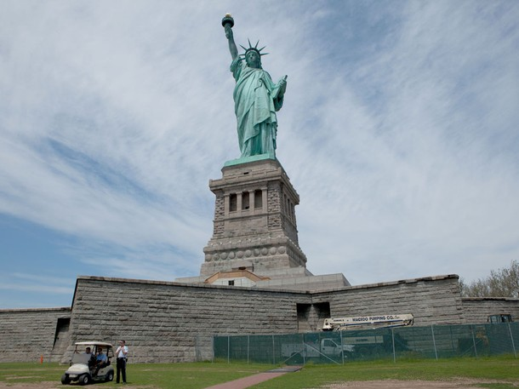
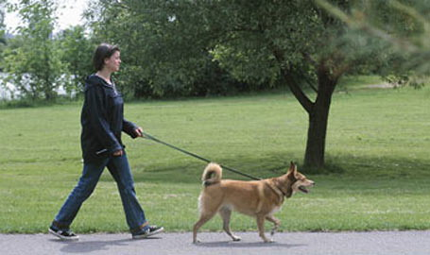
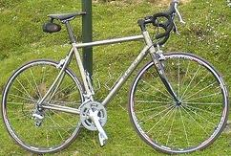
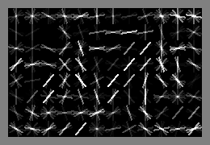
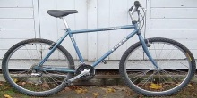
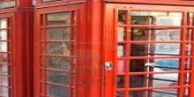
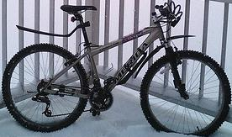
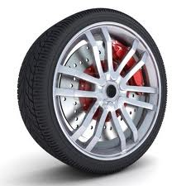
Candidate Generation
Generation of a large pool of filters.
Candidate Generation
Pool of Filters
Filters are generated using positives and negatives examples.
Filter
(SVM Classifier)
Positives
Negatives
Notes:
Candidate generation step involves generating a large pool of filters or classifiers given a category.
Filters are generated using +ve and –ve examples using linear classifiers such as SVM, LDA or recently introduced CNNs
Modestly expensive

Slide 4
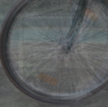
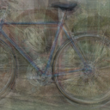
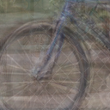
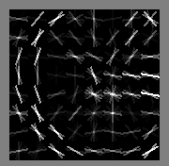
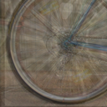
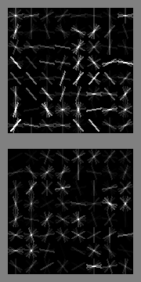
Candidate Selection
Impractical to use all generated filters.
Pool of Filters (N)
Selected Filters (n)
(n << N)
Candidate
Selection
Two sources of inefficiency
good
bad
  Redundancy
  Noise
Notes:
Impractical to use all generated filters
Therefore these architectures select a small subset of filters from the large pool
There are 2 sources of inefficiency
redundancy – many candidates are highly similar to each other.
Noise
Not all the filters which are generated are discriminative

Slide 5
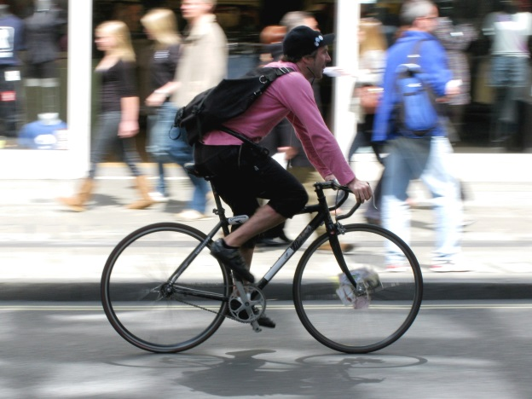
Candidate Selection Cont…
Expensive Evaluation
Pool of Filters (N)
Run as detector
Selected Filters (n)
(n << N)
Bottleneck
Notes:
Conventionally done using expensive explicit evaluation.
Each of the filters is run as a detector often in a sliding window fashion classifying thousands of sub windows.
Greedy selection of diverse filters.
Bottleneck

Slide 6
What we Propose
Expensive Evaluation
Pool of Filters (N)
Run as detector
Selected Filters (n)
(n << N)
By passes explicit evaluation
fast
Our Contribution : fast automatic selection of a subset of discriminative and non redundant filters given a collection of filters
Notes:
We propose a method which selects a subset of filters by-passing their explicit evaluation on training data.
More generally speaking we present a method which automatically selects a subset of discriminative and non redundant filters given a collection of filters.

Slide 7
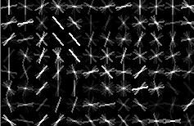
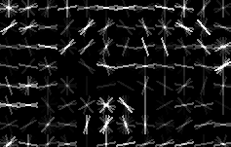

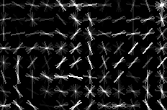

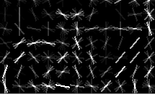
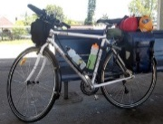
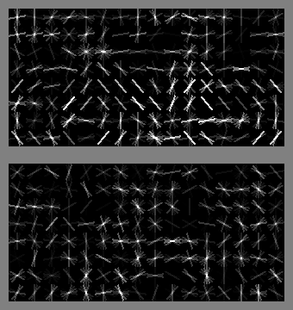
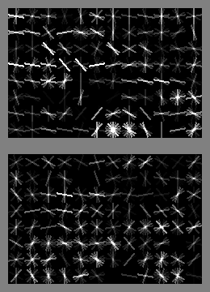
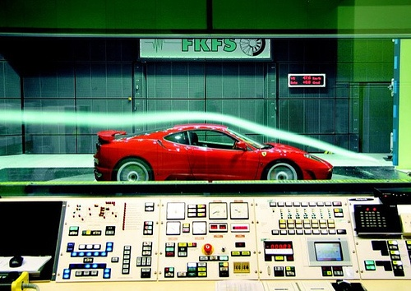
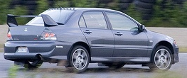
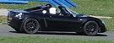
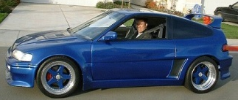










Category Independent Model
fast
N candidates
(w , λ)
fast
fast
slow
Test Category
Images +/-
Pool (Candidate Filters)
N >> n
Selected Filters (n)
n selected
Can rank filters as accurately as a direct evaluation on thousands of examples.
Notes:
Given a set of categories for training we learn a model which ranks filters using their intrinsic properties.
Combine ranking scores with a diversity inducing penalty
Components of the automatic selection procedure once learned, on a set of categories can be applied to a novel category. In that sense it is category independent method for filter selection.
Our method can rank filters as accurately as a direct evaluation on thousands of examples.
We show the usefulness of our approach on two popular methods, Poselets and ESVMs

Slide 8

Poselets
Poselets are semantically aligned discriminative patterns that capture parts of object.
Patches are often far visually, but they are close semantically
Notes:
Poselets are semantically aligned discriminative patterns that capture parts of object.
Patches are often far visually, but are close semantically.

Slide 9






Poselet Architecture
Candidate Generation :
Candidate Selection :
Notes:
Candidate genration step for poselets involves generating thousands of random windows over the object. Clustering them using keypoint annotations and training linear SVMs for each cluster/poselet.
Candidate selection step involves evaluation on each poselet on a held out set followed a greedy coverage based method to select complementary poselets.
Its takes 20 Hrs to train a poselet model for a category on a 6 core machine
24 % of the time is spent in candidate genration
Overwhelming 76% is spent for selection

Slide 10






ESVM
SVM for each positive example
Test time
Redundant Exemplars
Save significantly in training time if we can quickly select small set of relevant exemplars.
Notes:
Each positive example is used to learn a HOG filter, that discriminates positive from background instances.
Number of exemplars = number of positive instances.
Each of these exemplars are run as detectors during test time
Exemplars are likely to be redundant
We can save significantly in training time if we can quickly select small set of relevant exemplars.

Slide 11



Good / Bad Filters
Good Filters
Bad Filters
Gradient orientation within a cell (active simultaneously)
Gradient orientation of neighboring cells (lines, curves)
Notes:
Good filters across categories exhibit common traits, low clutter and gradients are spatially correlated.
Neighboring gradient orientation bins are active simultaneously – due to the fact that template has to account for small variation in local gradeint in order to be robust.
Dominant orientation bins of neighboring cells tend to coincide forming line segments - Contours of objects often exhibit such traits
Or disagree by an angle forming curves and corners

Slide 12







Features for filter Ranking
Norm: consistent with high degree of alignment.
Normalized Norm: Makes norm invariant to filter dimension.
Cell Covariance: Different orientation bins within a cell are highly structured. Gao et al. ECCV 2012
Cell Cross Covariance: Strong correlation between filter weights in nearby spatial locations.
Decreasing Norm
Cell Covariance
Cell Cross Covariance

Slide 13


Learning to Rank Filters
$Φ(f)$– representation of filter $f$
Goal : model ranking score of $f$ by a linear function$<\text{w}\text{,}Φ(f)\text{>}$
Training data : $\{f\text{g}\text{,}\text{i}\text{\}}$ , $\text{y}\text{g}\text{,}i$
  $\text{g}\text{ = 1,}…,G$ where $G$ is number of training categories.
  $i=1, …, N$ where N is number of filters per category.
  $\text{y}\text{g}\text{,}i$ is estimated quality, obtained by expensive method.
$f\text{g}\text{,}i$ is ordered in descending value of $\text{y}\text{g}\text{,}i$
$Δ\text{g}\text{,}\text{i}\text{,}\text{j}\text{=}$ $\text{y}\text{g}\text{,}i$- $\text{y}\text{g}\text{,}\text{j}$, for $i>j$ measures how much better $f\text{g}\text{,}i$ is from $f\text{g}\text{,}\text{j}$
$δΦ\text{g}\text{,}\text{i}\text{,}\text{j}= Φ\left(f\text{g}\text{,}\text{i}\right)−Φ\left(f\text{g}\text{,}j\right)$
Slack rescaled hinge loss

Slide 14



Greedy approximation for Diversity
Selected parts should be individually good and complimentary.
First filter - $argmaxi$ $ŷi$
$t$ filters selected so far
Select next filter using following
0.9
0.1
Added to selected set
0.4
Selected Filters
Not yet Selected
Notes:
Relax diversity term
Replace max with k^{th} order similarity
Makes less likely that we reject a good filter because a single other selected filter is somewhat similar to it.

Slide 15

LDA Acceleration
Our Selection Method
SVM bootstrapping
(w , λ)
Good
performance
N SVM filters
(Candidate Generation)
n Selected Filters
(SVM)
Poor performance
LDA
(w , λ)
n Selected Filters
(LDA)
SVM bootstrapping
N LDA filters
(Candidate Generation)
Selection with
LDA Acceleration
n Selected Filters
(SVM)
Good
performance
Notes:
Instead of SVM filter one can learn to rank using LDA filters
Σ is covariance matrix of HOG features
μ₊ mean positive features
μ₋ mean negative features
Σ and μ₋ estimated once for all categories
LDA filter by themselves do not perform very well.
Performance of LDA filters and SVM filters is highly correlated.
Select filters using LDA filters and train SVM filters only for selected filters.

Slide 16

















Experiments with Poselets
Test category
Filters used for training from remaining categories
800 poselet filters for each category
Goal : given a category select 100 out of 800 filters
Ranking task
Detection task

Slide 17
Performance of Ranker
Predicted ranking vs true ranking as per AP scores.
Norm
(svm)
Σ – Norm
(svm)
Gao et al. ECCV 2012
Rank
(lda)
Rank
(svm)
<
<
<
Notes:
Oracle
10%
Random
Norm (svm)
Σ – norm (svm)
Rank (svm)
Rank (lda)
+ Div – above algorithms with diversity term added.

Slide 18
Detection Results
Speed up w.r.t. Oracle
Rank (lda) + Div
2X Seeds
By constructing a poselet detector using selected filters
8x
3x
Rank (svm) + Div
1x
Oracle (expensive evaluation)
3x
Σ – Norm (svm) + Div
3x
Norm (svm) + Div
Rank (lda) + Div
8x
Increasing Performance
Rank (svm)
3x
10% Val
2.4x
Order of magnitude Speed up.
Improved performance than Oracle
Σ – Norm (svm)
3x
Norm (svm)
3x
Random
8x

Slide 19


Experiments with exemplar SVMs
Each category has 630 exemplars on average.
Goal select 100 exemplars such that they reproduce result for optimal set of 100 exemplars.
Optimal set – weights of each exemplar in the final scoring model. (Oracle)
Frequency of exemplars
Frequent Exemplar
Rare Exemplar
Notes:
we have some experiments with exemplar SVM, and the results show that our ranking approach is effective there as well (on an architecture different from poselets).

Slide 20
Conclusion
We have presented an automatic mechanism for selecting diverse set of discriminative filters.
Order of magnitude improvement in training time.
Our approach is applicable to any discriminative architecture that uses a collection of filters.
Insight into what makes a good filter for object detection.
Can be used as an attention mechanism during test time
  Reduce number of convolutions / hashing lookups.
Bottom line: One can tell whether a filter is useful for a category without knowing what that category is, just by “looking” at the filter.
Notes:
Our method can rank filters as accurately as a direct evaluation on thousands of examples for the category.

