Slide 1
Dude, where’s that IP? Circumventing measurement-based geolocation
Phillipa Gill
University of Toronto
Yashar Ganjali & David Lie
University of Toronto
Bernard Wong
Cornell University

Slide 2
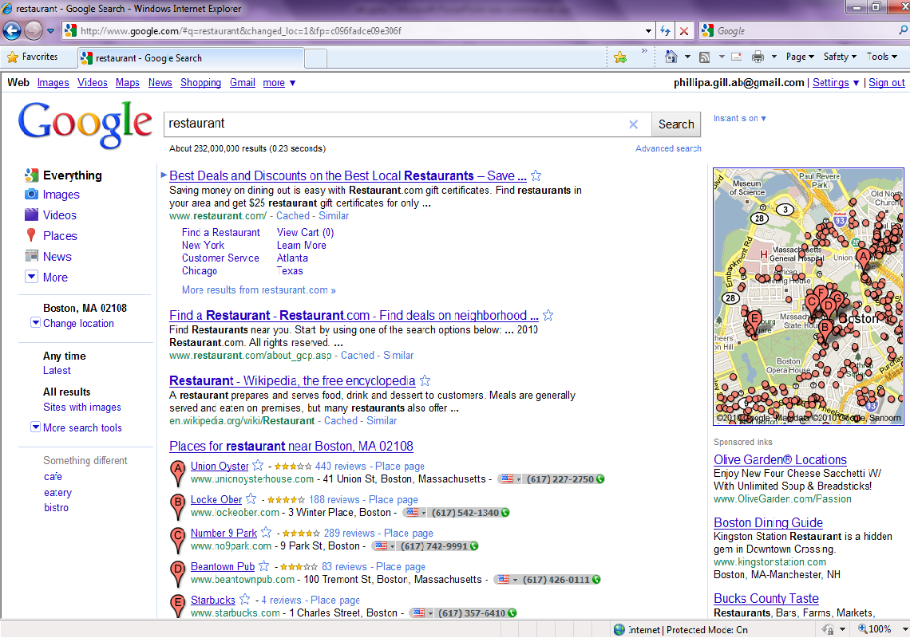
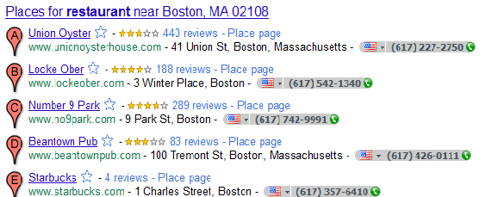

Geolocation applications: Custom content
Local search results
Targeted advertisements

Slide 3
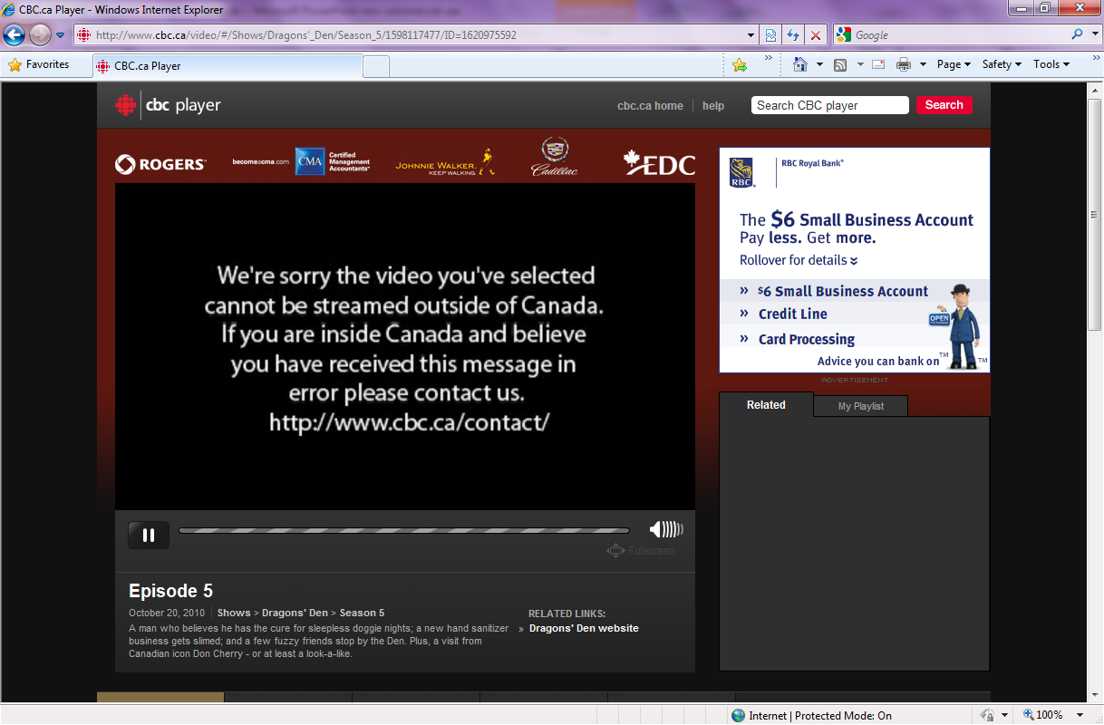
Geolocation applications: Access control

Slide 4
Geolocation applications: Fraud prevention
Proof of work [Kaiser and Feng 2010]
Clients forced to solve computational puzzles,
Hardness of puzzle based on distance
Online payment fraud
Use location to flag suspicious transactions

Slide 5
Behind the scenes
HTTP GET
[128.197.11.23]
Web server
Deny access
User
(Boston, MA)
128.197.11.23 ??
128.197.11.23
Boston, MA
USA
02116
Geolocation Database

Slide 6
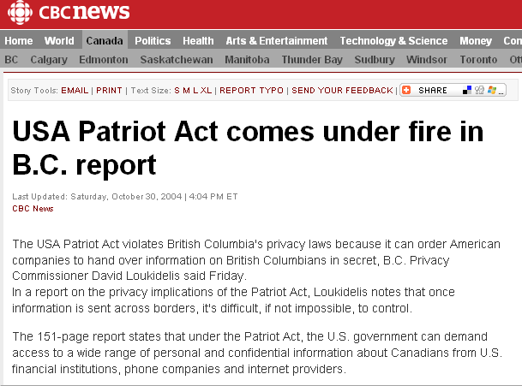
Future application of geolocation
Enforcing regional restrictions in cloud computing
Use geolocation to locate virtual machines

Slide 7
Motivation
Targets have incentive to lie
Content providers:
Restrict access to content
Prevent fraud
Cloud computing users:
Need the ability to guarantee the result of geolocation

Slide 8

Our contributions
First to consider measurement-based geolocation of an adversary
Two models of adversarial geolocation targets
Web client (end host)
Cloud provider (network)
Evaluation of attacks on
delay and topology-based
geolocation.

Slide 9
Road map
Motivation & Contributions
Background
Adversary models
Evaluation
Conclusions
Ongoing/Future work

Slide 10
Geolocation background
Databases/passive approaches
whois services
Commercial databases
Quova, MaxMind, etc.
Drawbacks:
coarse-grained
slow to update
proxies

Slide 11
Coarse grained geolocation
traceroute to 74.125.229.18 (Google)
1 80.82.140.226 0.209 ms 0.129 ms 0.328 ms
2 80.82.140.42 0.539 ms 0.525 ms 0.498 ms
3 80.82.140.43 0.472 ms 0.451 ms 0.427 ms
4 195.66.226.125 1.066 ms 1.077 ms 1.075 ms
5 209.85.252.76 1.022 ms 0.943 ms 0.979 ms
6 216.239.43.192 76.558 ms 76.454 ms 75.900 ms
7 209.85.251.9 91.356 ms 93.749 ms 93.941 ms
8 64.233.175.34 92.907 ms 93.624 ms 94.090 ms
9 74.125.229.18 93.307 ms 93.389 ms 90.771 ms
LINX(UK)
Google (USA?)
Notes:
Delay difference between LINX and google implies google IP is not in the us!

Slide 12
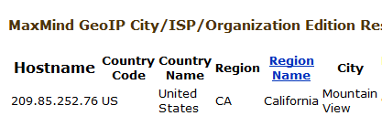
Coarse grained geolocation
traceroute to 74.125.229.18 (Google)
1 80.82.140.226 0.209 ms 0.129 ms 0.328 ms
2 80.82.140.42 0.539 ms 0.525 ms 0.498 ms
3 80.82.140.43 0.472 ms 0.451 ms 0.427 ms
4 195.66.226.125 1.066 ms 1.077 ms 1.075 ms
5 209.85.252.76 1.022 ms 0.943 ms 0.979 ms
6 216.239.43.192 76.558 ms 76.454 ms 75.900 ms
7 209.85.251.9 91.356 ms 93.749 ms 93.941 ms
8 64.233.175.34 92.907 ms 93.624 ms 94.090 ms
9 74.125.229.18 93.307 ms 93.389 ms 90.771 ms
LINX(UK)
Google (USA?)

Slide 13
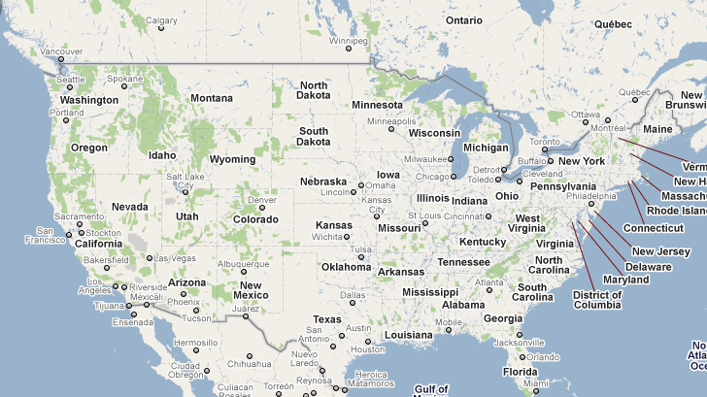
Delay-based geolocation
Example:
Constraint-based geolocation [Gueye et al. ToN ‘06]
Ping other landmarks to calibrate
Distance-delay “best-line” function
Ping!
Ping!
Ping!

Slide 14
Delay-based geolocation
Example
Constraint-based geolocation [Gueye et al. ToN ‘06]
2. Ping target
Ping!
Ping!
Ping!
Ping!

Slide 15
Delay-based geolocation
Example
Constraint-based geolocation [Gueye et al. ToN ‘06]
3. Map delay to distance from target
4. Constrain target location

Slide 16

Topology-aware geolocation
Delay-based geolocation assumes direct paths
“as the crow flies”
Ping!
Ping!
reality

Slide 17
Topology-aware geolocation
Takes into account circuitous network paths

Slide 18
Types of measurement-based geolocation:
Delay-based:
Constraint-based geolocation (CBG) [Gueye et al. ToN ‘06]
Computes region where target may be located
Reported average accuracy: 78-182 km
Topology-aware:
Octant [Wong et al. NSDI 2007]
Considers delay between hops on path
Geolocates nodes along the path
Reported median accuracy: 35-40 km

Slide 19
Road map
Motivation & Contributions
Background
Adversary models
Evaluation
Conclusions
Future work

Slide 20
Simple adversary (e.g., Web client)
Knows the geolocation algorithm
Able to delay their response to probes
i.e., increase observed delays
Cannot decrease delay
Landmark i

Slide 21
Sophisticated adversary (e.g., Cloud provider)
Controls the network the target is located in
Network has multiple geographically distributed entry points
Adversary constructs network paths to mislead topology-aware geolocation
tar
target
landmark

Slide 22
Road map
Motivation & Contributions
Background
Adversary models
Evaluation
Conclusions
Future work

Slide 23
Evaluation
Questions:
How accurately can an adversary mislead geolocation?
Can they be detected?
Error for the
adversary
Geolocation result
True location
False location
Distance of attempted move

Slide 24
Methodology
Collected traceroutes between 50 PlanetLab nodes
Each node takes turn as target
Each target moved to a set of forged locations
Landmarks
Forged Locations

Slide 25
Results overview
Adversary Type
 | Simple | Sophisticated
Delay-based
Topology-aware
Geolocation method

Slide 26
Results overview
Adversary Type
 | Simple | Sophisticated
Delay-based
Topology-aware
?
?
Geolocation method

Slide 27
Delay adding attack
Increase delay by time to travel g2-g1
Challenge: how to map distance to delay
Our attack:
V1: Speed of light approximation
V2: Adversary knows “best-line” function
g2
False location
g1
True location
Notes:
Note this does not work if g2 < g1

Slide 28
Delay-adding attack
Landmark 1
Landmark 3
Landmark 2

Slide 29
Delay-adding attack
Landmark 1
Landmark 3
Landmark 2

Slide 30
Can it be detected?
Area of intersection
increases as delay is added
Abnormally large region sizes can reveal results that have been tampered with

Slide 31
How accurate can the attack be?
700 M/KM
NYC-SFO
400 M/KM
Trade off between accuracy and detectability

Slide 32
Results overview
Adversary Type
 | Simple | Sophisticated
Delay-based
Topology-aware
Limited Accuracy
Detectable using region size
Geolocation method
?

Slide 33
Adding delay to topology-aware geolocation
Landmark 1 add delay
Landmark 1
Landmark 2 add delay
Landmark 2

Slide 34
Adding delay to topology-aware geolocation
Landmark 1 add delay
Detectable!
Landmark 1
Landmark 2 add delay
Landmark 2

Slide 35
Results overview
Adversary Type
 | Simple | Sophisticated
Delay-based
Topology-aware
Limited Accuracy
Detectable using region size
Geolocation method
?

Slide 36
Hop-adding attack
Sophisticated adversary
Can alter traceroute paths after they enter the adversary’s network
Has a WAN with multiple entry points
Challenge: how to design the non-existent paths
Our attack:
Leverage existing network entry points
Use a non-existent (simulated) network to generate fake paths

Slide 37
Hop-adding attack: Simulated network
Multiple network entry points
In-degree 3 for each node
Fake node next to each forged location

Slide 38
How accurate can the attack be?
Adversary can move from EU to US 100% of the time.
NYC-SFO
Even moving long distances sophisticated adversary has high accuracy

Slide 39
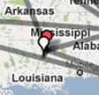
Can it be detected?
Region size does not increase
Hop adding is able to mislead the algorithm without increasing region size!

Slide 40
Results overview
Adversary Type
 | Simple | Sophisticated
Delay-based
Topology-aware
Limited Accuracy
Detectable using region size
Geolocation method
High accuracy
Difficult to detect

Slide 41
Road map
Motivation
Background
Adversary models
Evaluation
Conclusions
Future work

Slide 42
Conclusions
Current geolocation approaches are susceptible to malicious targets
Databases misled by proxies
Measurement-based geolocation by attacks on delay and topology measurements
Developed and evaluated adversary models for measurement-based geolocation techniques
Topology-aware geolocation better in benign case, worse in adversarial setting!

Slide 43
Future work
Develop a framework for secure geolocation
Require the adversary to prove they are in the correct location
Goals:
Provable security: Upper bound on what an adversary can get away with.
Practical framework: Should be tolerant of variations in network delay

Slide 44
Thanks!
Paper appears in: Usenix Security 2010
http://www.cs.toronto.edu/~phillipa
Contact:
phillipa@cs.toronto.edu

