Slide 1
Understanding Network Failures in Data Centers:
Measurement, Analysis and Implications
SIGCOMM 2011
Toronto, ON
Aug. 18, 2011
Phillipa Gill University of Toronto | Navendu Jain & Nachiappan Nagappan Microsoft Research

Slide 2
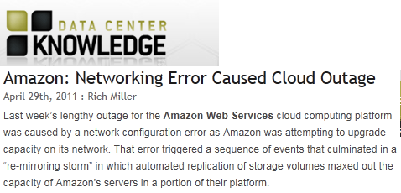
Motivation

Slide 3
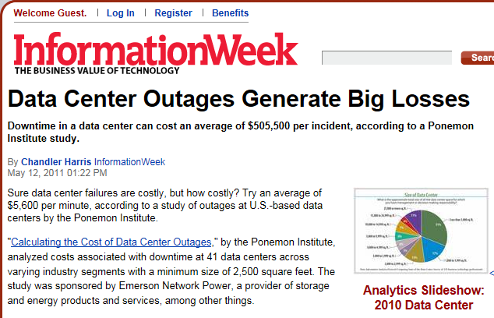
Motivation
$5,600 per minute
We need to understand failures to prevent and mitigate them!

Slide 4
Overview
Our goal: Improve reliability by understanding network failures
Failure characterization
  Most failure prone components
  Understanding root cause
What is the impact of failure?
Is redundancy effective?
Our contribution: First large-scale empirical study of network failures across multiple DCs
Methodology to extract failures from noisy data sources.
Correlate events with network traffic to estimate impact
Analyzing implications for future data center networks

Slide 5
Road Map
Motivation
Background & Methodology
Results
Characterizing failures
Do current network redundancy strategies help?
Conclusions

Slide 6

Data center networks overview
Internet
Access routers/network “core” fabric
Load balancers
Aggregation “Agg” switch
Top of Rack (ToR) switch
Servers

Slide 7
Data center networks overview
Which components are most failure prone?
Internet
How effective is redundancy?
?
What is the impact of failure?
What causes failures?

Slide 8


Failure event information flow
Failure is logged in numerous data sources
Ticket ID: 34
LINK DOWN!
LINK DOWN!
LINK DOWN!
Syslog, SNMP traps/polling
Troubleshooting
Tickets
5 min traffic averages on links
Network event logs
Diary entries,
root cause
Network traffic logs
Troubleshooting

Slide 9
Data summary
One year of event logs from Oct. 2009-Sept. 2010
  Network event logs and troubleshooting tickets
Network event logs are a combination of Syslog, SNMP traps and polling
  Caveat: may miss some events e.g., UDP, correlated faults
Filtered by operators to actionable events
  … still many warnings from various software daemons running
Key challenge: How to extract failures of interest?

Slide 10
Extracting failures from event logs
Defining failures
  Device failure: device is no longer forwarding traffic.
  Link failure: connection between two interfaces is down. Detected by monitoring interface state.
Dealing with inconsistent data:
  Devices:
    Correlate with link failures
  Links:
    Reconstruct state from logged messages
    Correlate with network traffic to determine impact
Network event logs

Slide 11
Reconstructing device state
Devices may send spurious DOWN messages
Verify at least one link on device fails within five minutes
  Conservative to account for message loss (correlated failures)
LINK DOWN!
DEVICE DOWN!
Aggregation switch 1
Top-of-rack switch
Aggregation switch 2
LINK DOWN!
This sanity check reduces device failures by 10x

Slide 12
Reconstructing link state
Inconsistencies in link failure events
  Note: our logs bind each link down to the time it is resolved
LINK DOWN!
LINK UP!
UP
Link state
DOWN
time
What we expect

Slide 13
Reconstructing link state
Inconsistencies in link failure events
  Note: our logs bind each link down to the time it is resolved
LINK DOWN 2!
LINK UP 2!
LINK DOWN 1!
LINK UP 1!
UP
Link state
?
?
DOWN
1. Take the earliest of the down times
time
2. Take the earliest of the up times
How to deal with discrepancies?
What we sometimes see.

Slide 14

Identifying failures with impact
Correlate link failures with network traffic
Network traffic logs
Only consider events where traffic decreases
BEFORE
AFTER
$$\frac{traffic during}{traffic before}<1$$
time
DURING
LINK DOWN
LINK UP
Summary of impact:
  28.6% of failures impact network traffic
  41.2% of failures were on links carrying no traffic
    E.g., scheduled maintenance activities
Caveat: Impact is only on network traffic not necessarily applications!
  Redundancy: Network, compute, storage mask outages

Slide 15
Road Map
Motivation
Background & Methodology
Results
Characterizing failures
  Distribution of failures over measurement period.
  Which components fail most?
  How long do failures take to mitigate?
Do current network redundancy strategies help?
Conclusions

Slide 16
Visualization of failure panorama: Sep’09 to Sep’10
All Failures 46K
Widespread failures
Long lived failures.
Link Y had failure on day X.

Slide 17
Visualization of failure panorama: Sep’09 to Sep’10
Failures with Impact 28%
All Failures 46K
Component failure: link failures on multiple ports
Load balancer update
(multiple data centers)

Slide 18
Which devices cause most failures?
Internet
?

Slide 19
Which devices cause most failures?
Top of rack switches have few failures…
(annual prob. of failure <5%)
…but a lot of downtime!
Load
Balancer 1
Load
Balancer 2
Top of
Rack 1
Load
Balancer 3
Top of
Rack 2
Aggregation
Switch
Device Type
Load balancer 1: very little downtime relative to number of failures.

Slide 20

How long do failures take to resolve?
Internet

Slide 21
How long do failures take to resolve?
Load balancer 1: short-lived transient faults
Median time to repair:
4 mins
Load Balancer 1
Load Balancer 2
Top of Rack 1
Load Balancer 3
Top of Rack 2
Aggregation Switch
Overall
Correlated failures on ToRs connected to the same Aggs.
Median time to repair: 5 minutes
Mean: 2.7 hours
Median time to repair:
ToR-1: 3.6 hrs
ToR-2: 22 min

Slide 22
Summary
Data center networks are highly reliable
  Majority of components have four 9’s of reliability
Low-cost top of rack switches have highest reliability
  <5% probability of failure
…but most downtime
  Because they are lower priority component
Load balancers experience many short lived faults
  Root cause: software bugs, configuration errors and hardware faults
Software and hardware faults dominate failures
  …but hardware faults contribute most downtime

Slide 23
Road Map
Motivation
Background & Methodology
Results
Characterizing failures
Do current network redundancy strategies help?
Conclusions

Slide 24
Is redundancy effective in reducing impact?
Redundant devices/links to mask failures
This is expensive! (management overhead + $$$)
Internet
Goal: Reroute traffic along available paths
X
How effective is this in practice?

Slide 25

Measuring the effectiveness of redundancy
Idea: compare traffic before and during failure
Measure traffic on links:
Before failure
During failure
Compute “normalized traffic” ratio:
  Compare normalized traffic over redundancy groups to normalized traffic on the link that failed
Acc. router
(primary)
Acc. router
(backup)
X
$$\frac{traffic during}{traffic before}\sim 1$$
Agg.
switch
(primary)
Agg.
switch
(backup)

Slide 26
Is redundancy effective in reducing impact?
Less impact lower in the topology
… but redundancy masks it
Redundancy is least effective for AggS and AccR
Core link failures have most impact…
Internet
Overall increase of 40% in terms of traffic due to redundancy

Slide 27
Road Map
Motivation
Background & Methodology
Results
Characterizing failures
Do current network redundancy strategies help?
Conclusions

Slide 28
Conclusions
Goal: Understand failures in data center networks
  Empirical study of data center failures
Key observations:
  Data center networks have high reliability
  Low-cost switches exhibit high reliability
  Load balancers are subject to transient faults
  Failures may lead to loss of small packets
Future directions:
  Study application level failures and their causes
  Further study of redundancy effectiveness

Slide 29
Thanks!
Contact: phillipa@cs.toronto.edu
Project page:
http://research.microsoft.com/~navendu/netwiser

