Slide 1

Let the Market Drive Deployment
A Strategy for Transitioning to BGP Security
Columbia University
New York, NY
Nov. 17, 2011
Phillipa Gill
University of Toronto
Michael Schapira
Hebrew University of Jerusalem
& Google NYC
Sharon Goldberg
Boston University

Slide 2
Incentives for BGP Security
Insecurity of Internet routing is well known:
S-BGP proposed in 1997 to address many issues
…but no deployment yet.
Challenges to deployment are being surmounted:
  Political: Rollout of RPKI as a cryptographic root trust
  Technical: Lots of activity in the IETF SIDR working group, DHS, FCC etc.
The pessimistic view:
This is economically infeasible!
Why should ISPs bother deploying S*BGP?
No security benefits until many other ASes deploy!
Worse yet, they can’t make money from it!
Our view:
Calm down. Things aren’t so bad.
ISPs can use S*BGP to make money.

Slide 3

Outline
Part 1: Background
Part 2: Our strategy
Part 3: Evaluating our strategy
  Model
  Simulations
Part 4: Summary and recommendations

Slide 4
BGP: The Internet’s Routing Protocol (1)
A simple model of AS-level business relationships.
$
$
ISP 1
(peer)
ISP 1
Level 3
(peer)
Level 3
Stub
(customer)
$
stub
Verizon
Wireless
ISP 2
(provider)
ISP 2
$
$
22394
(also VZW)

Slide 5
BGP: The Internet’s Routing Protocol (2)
  A stub is an AS with no customers that never transits traffic.
  (Transit = carry traffic from one neighbor to another)
$
ISP 1
  ISP
Level 3
  ISP
stub
Loses $
X
Verizon
Wireless
ISP 2
$
22394
  85% of ASes are stubs!
  We call the rest (15%) ISPs.

Slide 6
BGP: The Internet’s Routing Protocol (3)
Level3, VZW, 22394 66.174.161.0/24
ISP 1
VZW, 22394 66.174.161.0/24
Level 3
China
Telecom
Verizon
Wireless
22394 66.174.161.0/24
22394
Paths chosen based on cost and length.
66.174.161.0/24

Slide 7
Traffic Attraction & Interception Attacks
  April 2010 : China Telecom intercepts traffic
ChinaTel path is shorter
?
ChinaTel 66.174.161.0/24
Level3, VZW, 22394 66.174.161.0/24
ISP 1
Level 3
China
Telecom
Verizon
Wireless
22394
  This prefix and 50K others were announced by China Telecom
  Traffic for some prefixes was possibly intercepted
66.174.161.0/24

Slide 8
Securing the Internet: RPKI
  Resource Public Key Infrastructure (RPKI): Certified mapping from ASes to public keys and IP prefixes.
X
RPKI: Invalid!
?
ChinaTel 66.174.161.0/24
Level3, VZW, 22394 66.174.161.0/24
ISP 1
Level 3
China
Telecom
Verizon
Wireless
22394
  RPKI shows China Telecom is not a valid origin for this prefix.
66.174.161.0/24

Slide 9
But RPKI alone is not enough!
  Resource Public Key Infrastructure (RPKI): Certified mapping from ASes to public keys and IP prefixes.
?
ChinaTel, 22394 66.174.161.0/24
Level3, VZW, 22394 66.174.161.0/24
ISP 1
Level 3
China
Telecom
Verizon
Wireless
22394
  Malicious router can pretend to connect to the valid origin.
66.174.161.0/24

Slide 10
To stop this attack, we need S*BGP (e.g. S-BGP/soBGP) (1)
  S-BGP [1997]: RPKI + Cannot announce a path that was not announced to you.
VZW: (22394, Prefix)
Level3: (VZW, 22394, Prefix)
ISP 1: (Level3, VZW, 22394, Prefix)
ISP 1
Level 3
China
Telecom
Verizon
Wireless
VZW: (22394, Prefix)
Level3: (VZW, 22394, Prefix)
22394
VZW: (22394, Prefix)
Public Key Signature: Anyone with 22394’s public key can validate that the message was sent by 22394.

Slide 11
To stop this attack, we need S*BGP (e.g. S-BGP/soBGP) (2)
  S-BGP [1997]: RPKI + Cannot announce a path that was not announced to you.
VZW: (22394, Prefix)
Level3: (VZW, 22394, Prefix)
ISP 1: (Level3, VZW, 22394, Prefix)
ISP 1
Level 3
China
Telecom
Verizon
Wireless
22394
  Malicious router can’t announce a direct path to 22394, since 22394 never said
ChinaTel: (22394, Prefix)

Slide 12

S*BGP must impact route selection
It is not enough to sign and verify
  If we want security, S*BGP must impact BGP routing policy.
How should security impact routing?
  Ideally: Prefer secure routes over all others
  Reality: Cost (business relationship) and path length may be preferred over security.
Our strategy doesn't require prioritizing security
over economics or path length
security
cost & performance

Slide 13
Challenges to S*BGP deployment
RPKI is a necessity – now on the horizon!
Incentives for deployment?
We’ve seen similar problems before:
Spread of innovations in social networks [Morris 2001, Kempe et al. 2003]
  Nodes adopt innovations when local utility exceeds a threshold
  Utility only depends on immediate neighbors!
  Network protocol adoption [Ratnasamy et al. 2005]
  Client demand for innovation creates financial incentive
  Relied on additional mechanisms to route traffic to upgraded networks
S-BGP adoption [Chang et al. 2006]
  Assumed security benefits would be sufficient incentive
  Security is an intangible benefit

Slide 14
Overview
S*BGP will necessarily go through a transition phase
How should deployment occur?
Our Goal: Come up with a strategy for S*BGP (S-BGP/soBGP) deployment.
How governments & standards groups invest resources
To enable a small set of ASes to create market pressure…
…and drive voluntary deployment by many other ASes!
Measure of success: number of ASes deploying S*BGP
Does not quantify security improvement.
We are currently working to quantifying the security during partial deployment.

Slide 15
Outline
Part 1: Background
Part 2: Our strategy
Part 3: Evaluating our strategy
  Model
  Simulations
Part 4: Summary and recommendations

Slide 16
How to deploy S*BGP globally?
Pessimistic view:
No local economic incentives; only security incentives
Like IPv6, but worse, because entire path must be secure.
Our view:
S*BGP has an advantage: it affects route selection
  Even if it comes after cost and length in decision process.
This can drive traffic towards ISPs deploying S*BGP
ISPs want to attract more traffic destined to customers
Even if they don’t care about security!
ISPs would be the ones forced to upgrade all of their equipment to support this initiative, but how would it benefit them? As commercial companies, if there is little to no benefit (potential to increase profit), why would they implement a potentially costly solution? The answer is they won’t.
[http://www.omninerd.com/articles/Did_China_Hijack_15_of_the_Internet_Routers_BGP_and_Ignorance]

Slide 17
Our Strategy: 3 Guidelines for Deploying S*BGP (1)
Secure ASes should break ties in favor of secure paths
Equally good paths to the destination?
(in terms of cost and path length)
Pick the secure one!
Sprint

Slide 18
How this creates incentives
Sprint needs to break the tie between equally good paths.
8359, 18608
38.101.185.0/24
13789, 18608
38.101.185.0/24
  ISP
  ISP
Sprint
8359
13789
  AS 8359 delivers more traffic to his customer
$
$
18608
38.101.185.0/24
18608
18608
38.101.185.0/24
ISPs can use S*BGP to attract customer traffic & thus money

Slide 19
How this creates incentives
Sprint uses security to break the tie!
8359, 18608
38.101.185.0/24
13789: (18608, 38.101.185.0/24)
Sprint: (13789, 18608, 38.101.185.0/24)
Sprint
8359
13789
  AS 8359 delivers less traffic to his customer
$
$
13789: (18608, 38.101.185.0/24)
18608
38.101.185.0/24
18608
ISPs can use S*BGP to attract customer traffic & thus money

Slide 20
Our Strategy: 3 Guidelines for Deploying S*BGP (1)
Secure ASes should break ties in favor of secure paths
Cheap S*BGP for stubs (e.g., simplex S*BGP)
Bank of A
Bank of A
ISP1
A stub is an AS that has no customers.
85% of ASes are stubs!
Boston U
Boston U

Slide 21
Simplex S*BGP: Cheap S*BGP for Stubs
A stub never transits traffic
Only announces its own prefixes..
…and receives paths from provider
Sign but don’t verify!
(rely on provider to validate)
2 options for deploying S*BGP in stubs:
Have providers sign for stub customers. (Stubs do nothing)
Stubs run simplex S*BGP. (Stub only signs, provider validates)
  No hardware upgrade required
    Sign for own prefixes, not ~300K prefixes
    Use ~1 private key, not ~36K public keys
  Security impact is minor (we evaluated this):
    Stub vulnerable to attacks by its direct provider.
18608
38.101.185.0/24
  Stub
X
18608

Slide 22
Our Strategy: 3 Guidelines for Deploying S*BGP (2)
Secure ASes should break ties in favor of secure paths
Cheap S*BGP for stubs (e.g., simplex S*BGP)
(possibly with some government subsidies)
Initially, we need a few early adopters deploy S*BGP. (gov’t incentives, PR, concern for security, etc).
Who should these ASes be?
Bank of A
ISP1
Boston U

Slide 23
Outline
Part 1: Background
Part 2: Our strategy
Part 3: Evaluating our strategy
  Model
  Simulations
Part 4: Summary and recommendations

Slide 24
Model: S*BGP deployment process
Initial state:
  Early adopter ASes have deployed S*BGP
  Their stub customers deploy simplex S*BGP
Each round with state S:
  Compute utility for each ISP n given state S
  … and S with ISP n deploying S*BGP
  If utility increases enough ISP n chooses to deploy S*BGP
Termination:
  Process continues until no new ISP wants to change their deployment decision
ISP n
ISP n
ISP n

Slide 25
How do we compute ISP utility? (1)
    Utility_{n}(S) = ∑
    Customer traffic thru ISP n to dest d
_{all dests}
Important Note: ISP utility does not depend on security.
traffic
Captures the idea that:
ISPs profit by transiting traffic
to their customers
i.e., Weighted sum of source ASes
routing through ISP n (on all edges)
to customers only.
$
$
ISP n
$
customers

Slide 26
How do we compute ISP utility? (2)
  Let S be the state of the network (i.e. who deploys S*BGP)
  Can compute utility if we know S and ASes' routing policies
    Utility_{n}(S) = ∑
    Customer traffic thru ISP n to dest d
_{all dests}
Ranking function:
1. Prefer customer paths
over peer paths
over provider paths
2. Prefer shorter paths
3. If secure, prefer secure paths
.
4. Arbitrary tiebreak
Export Policy:
Export customer path
  to all neighbors.
Export peer/provider path
to all customers.

Slide 27
Our Model: ISP S*BGP Decision Rule
  An ISP deploys S*BGP if it increases its utility by θ %
  Let S be the state of the network (i.e. who deploys S*BGP)
  ISP n decides to deploy iff
  Utility_{n} (S with n deploying) > (1 + θ ) Utility_{n}(S)
θ is the deployment threshold,
Models % profit that is reinvested in S*BGP deployment
When an ISP deploys, it deploys simplex S*BGP in all its stubs.
ISP n

Slide 28
Outline
Part 1: Background
Part 2: Our strategy
Part 3: Evaluating our strategy
  Model
  Simulations
Part 4: Summary and recommendations

Slide 29





Simulations Overview
Large scale simulations! Each round, we compute:
Paths between all pairs of ASes O(n²)
  once for each ISP O(n) (to evaluate revenue increase)
  Each iteration: O(n³) !
Run over the entire AS level topology, n=36,000
Custom algorithms, parallelized on 200-node DryadLINQ cluster
Many simulations run to understand robustness
Early adopter sets
Deployment thresholds θ
Traffic sourced by content providers
AS Graphs [UCLA Cyclops + IXP] + Augmented topology

Slide 30
Case Study of S*BGP deployment
Ten early adopters:
Five Tier 1s:
  Sprint (AS 1239)
  Verizon (AS 701)
  AT&T (AS 7018)
  Level 3 (AS 3356)
  Cogent (AS 174)
The five content providers source 10% of Internet traffic
Stubs break ties in favor of secure paths
Threshold θ = 5%.
Five Popular Content Providers
  Google (AS 15169)
  Microsoft (AS 8075)
  Facebook (AS 32934)
  Akamai (AS 22822)
  Limelight (AS 20940)
This leads to 85% of ASes deploying S*BGP
(65% of ISPs)

Slide 31
Simulation: Market pressure drives deployment (1)
Round 1
Round 0
Sprint
Round 4
13789
13789
8359
8359
18608
18608
  Stub

Slide 32
Simulation: Market pressure drives deployment (2)
Round 5
Sprint
Round 4
13789
8359
8342
18608
6731
6731
30733
  Stub
50197
50197
  Stub

Slide 33
Simulation: Market pressure drives deployment (3)
Round 6
Sprint
Round 7
8342
13789
8359
8342
9002
18608
6731
6731
30733
  Stub
50197
41209
50197
43975
41209
  Stub
  Stub
39575
39575

Slide 34
Changes in Utility as Deployment Progresses (1)
Sprint
8359
8342
6731
6731
30733
50197
50197
Let’s zoom in on utility of each of these three ISPs…

Slide 35
Changes in Utility as Deployment Progresses (2)
ASes that deploy see initial gains
But return to approx.
their original utility
ASes that do not deploy cannot gain traffic
round

Slide 36
Tiebreak Sets: The Source of Competition (1)
Sprint
13789
8359
18608
Sprint’s tiebreak set to destination AS18608 is
{AS 13789, AS 8359}
Thus, these two ISPs compete for traffic!

Slide 37
Tiebreak Sets: The Source of Competition (2)
80% of tiebreak sets have only 1 path!
Average tiebreak set size is tiny = 1.18 !
We also get ~same results (not shown)
if only ISPs break ties on secure paths (i.e., 15% of ASes)
➔ Global deployment even if 96% of routing decisions are unaffected by security.

Slide 38
So who should be the early adopters?
Theorem: Finding the optimal set of early adopters is NP-hard. Approximating this within a constant factor is also NP-hard.
Small target set suffices for small threshold
Higher threshold
requires a larger target set.

Slide 39
Simplex S*BGP vs. Market-pressure
Market pressure
Few ISPs on.
Most adoption via
Simplex S*BGP
Turning on just
the content providers
doesn’t do much!

Slide 40
The Content Providers (CP) as early adopters?
  Cyclops AS graph has poor visibility into CP connectivity
  CP degree ~10x less than degree of largest Tier 1 ISP
  We augment graph so CP degree ≈ Tier 1 degree
  CP average path lengths drop from 3.5 to about 2.1
  How much traffic is sourced by the 5 CPs?
  Sweep through values x = {10%, 20%, 33%, 50%}
  Tier 1s are usually more influential early adopters…
  except if x is large (>33%) and threshold θ is small (<15%)
  Why? Tier 1s still transit more traffic than the CPs source,
  … and can leverage simplex S*BGP

Slide 41
Outline
Part 1: Background
Part 2: Our strategy
Part 3: Evaluating our strategy
  Model
  Simulations
Part 4: Summary and recommendations

Slide 42
Summary and Recommendations
  How to create a market for S*BGP deployment?
  Market pressure via S*BGP influence on route selection.
  Many secure destinations via simplex S*BGP.
  Where should government incentives and regulation go?
  Focus on early adopters; Tier 1s, maybe content providers
  Subsidize ISPs to upgrade stubs to simplex S*BGP
  Other challenges and future work :
  ISPs need tools to predict S*BGP impact on traffic
    How to handle traffic shifts?
  BGP and S*BGP will coexist in the long run
    What does this mean for security?

Slide 43
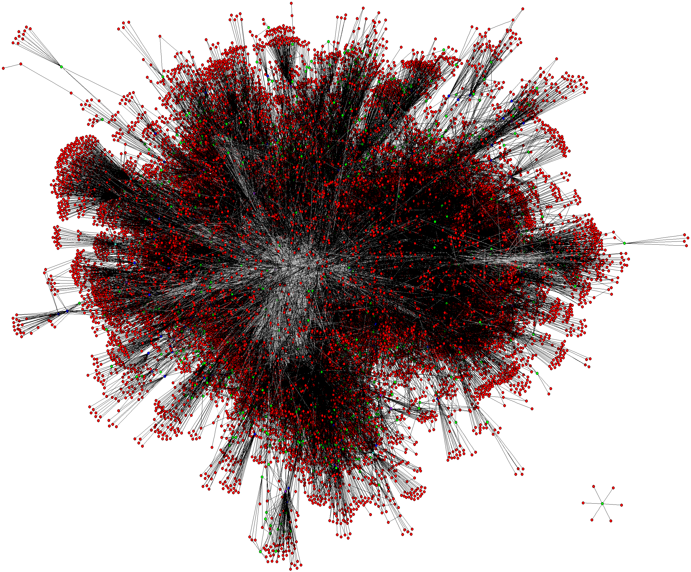
  Contact: phillipa@cs.toronto.edu
  http://www.cs.toronto.edu/~phillipa/sbgpTrans.html
  Thanks to Microsoft Research SVC and New England for supporting us with DryadLINQ.

Slide 44
Data Sources for ChinaTel Incident of April 2010
Example topology derived from Routeviews messages observed at the LINX Routeviews monitor on April 8 2010
  BGP announcements & topology was simplified to remove prepending
  We anonymized the large ISP in the Figure.
  Actual announcements at the large ISP were:
  From faulty ChinaTel router: “4134 23724 23724 for 66.174.161.0/24”
  From Level 3: “3356 6167 22394 22394 for 66.174.161.0/24”
Traffic interception was observed by Renesys blog
  http://www.renesys.com/blog/2010/11/chinas-18-minute-mystery.shtml
  We don’t have data on the exact prefixes for which this happened.
AS relationships: inferred by UCLA Cyclops

