Slide 1
CSE390 – Advanced Computer Networks
Lecture 22: Software designed networking
Based on slides by J. Rexford @ Princeton & N. Mckeown @ Stanford & S. Shenker @ Berkeley. Updated by P. Gill Fall 2014.

Slide 2
Data, Control, and Management Planes

Slide 3
Timescales
 | Data | Control | Management
Time-scale | Packet (nsec) | Event (10 msec to sec) | Human (min to hours)
Tasks | Forwarding, buffering, filtering, scheduling | Routing, circuit set-up | Analysis, configuration
Location | Line-card hardware | Router software | Humans or scripts

Slide 4
Data and Control Planes
Processor
control plane
data plane
Switching
Fabric
Line card
Line card
Line card
Line card
Line card
Line card

Slide 5
Data Plane
Streaming algorithms on packets
Matching on some bits
Perform some actions
Wide range of functionality
Forwarding
Access control
Mapping header fields
Traffic monitoring
Buffering and marking
Shaping and scheduling
Deep packet inspection
Processor
Switching
Fabric

Slide 6
Switch: Match on Destination MAC
MAC addresses are location independent
Assigned by the vendor of the interface card
Cannot be aggregated across hosts in LAN
mac1
mac2
mac3
host
host
...
host
mac1
mac2
mac3
mac4
mac5
host
switch
mac5
host
mac4

Slide 7
Router: Match on IP Prefix
IP addresses grouped into common subnets
Allocated by ICANN, regional registries, ISPs, and within individual organizations
Variable-length prefix identified by a mask length
1.2.3.4
1.2.3.7
1.2.3.156
5.6.7.8
5.6.7.9
5.6.7.212
host
host
...
host
host
host
...
host
LAN 1
LAN 2
router
router
router
WAN
WAN
1.2.3.0/24
Prefixes may be nested. Routers identify the longest matching prefix.
5.6.7.0/24
forwarding table

Slide 8
Forwarding vs. Routing
Forwarding: data plane
Directing a data packet to an outgoing link
Individual router using a forwarding table
Routing: control plane
Computing paths the packets will follow
Routers talking amongst themselves
Individual router creating a forwarding table

Slide 9
Example: Shortest-Path Routing
Compute: path costs to all nodes
From a source u to all other nodes
Cost of the path through each link
Next hop along least-cost path to s
link
v
(u,v)
v
2
y
w
(u,w)
3
1
1
x
(u,w)
x
4
z
u
y
(u,v)
2
1
w
5
t
z
(u,v)
4
3
s
(u,w)
6
s
t
(u,w)

Slide 10
Distributed Control Plane
Link-state routing: OSPF, IS-IS
Flood the entire topology to all nodes
Each node computes shortest paths
Dijkstra’s algorithm
link
v
(u,v)
2
w
(u,w)
v
y
3
1
x
(u,w)
1
x
4
u
z
y
(u,v)
2
1
5
z
(u,v)
t
w
4
3
s
(u,w)
s
t
(u,w)
10

Slide 11
Distributed Control Plane
Distance-vector routing: RIP, EIGRP
Each node computes path cost
… based on each neighbors’ path cost
Bellman-Ford algorithm
d_{u}(z) = min{c(u,v) + d_{v}(z),
c(u,w) + d_{w}(z)}
v
2
y
3
1
1
x
4
u
z
2
1
5
t
w
4
3
s

Slide 12
Traffic Engineering Problem
Management plane: setting the weights
Inversely proportional to link capacity?
Proportional to propagation delay?
Network-wide optimization based on traffic?
2
3
1
1
3
2
3
1
5
4
3

Slide 13
Traffic Engineering: Optimization
Inputs
Network topology
Link capacities
Traffic matrix
Output
Link weights
Objective
Minimize max-utilized link
Or, minimize a sum of link congestion
2
3
1
1
3
2
1
5
4
3

Slide 14
Transient Routing Disruptions
Topology changes
Link weight change
Node/link failure or recovery
Routing convergence
Nodes temporarily disagree how to route
Leading to transient loops and blackholes
1
5
1
10
1
10
4
3
4
3
4
3

Slide 15
Management Plane Challenges
Indirect control
Changing weights instead of paths
Complex optimization problem
Uncoordinated control
Cannot control which router updates first
Interacting protocols and mechanisms
Routing and forwarding
Naming and addressing
Access control
Quality of service
…

Slide 16
Software Defined Networking (high level view)

Slide 17
Control/Data Separation
decouple control and data planes by providing open standard API

Slide 18
(Logically) Centralized Controller
Controller Platform

Slide 19
Protocols ➔ Applications
Controller Application
Controller Platform

Slide 20
Outline
What are Software Defined Networks?
Why SDN?
The Consequences
For industry
For research
For standards and protocols

Slide 21
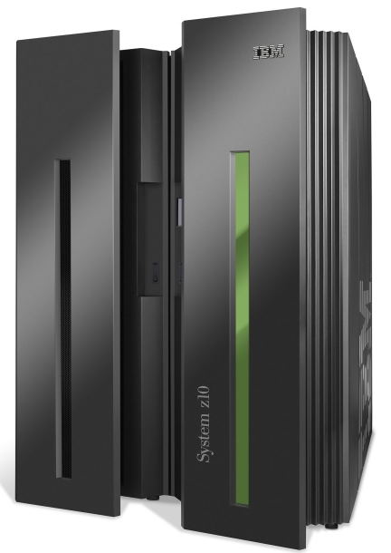
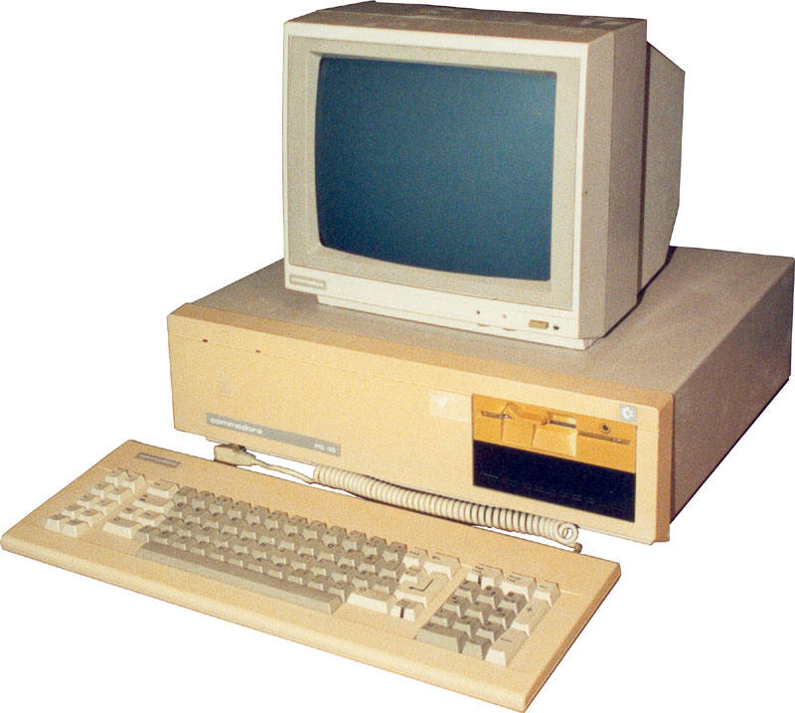
App
App
App
App
App
App
App
App
App
App
App
Specialized
Applications
Open Interface
Windows
(OS)
Linux
Mac
OS
Specialized
Operating
System
or
or
Open Interface
Specialized
Hardware
Microprocessor
Vertically integrated
Closed, proprietary
Slow innovation
Small industry
Horizontal
Open interfaces
Rapid innovation
Huge industry
Notes:
The mainframe industry in the 1980s was vertical and closed: it consisted of specialized hardware, operating system and applications --- all from the same company.
A revolution happened when open interfaces started to appear. The industry became horizontal. Innovation exploded.

Slide 22
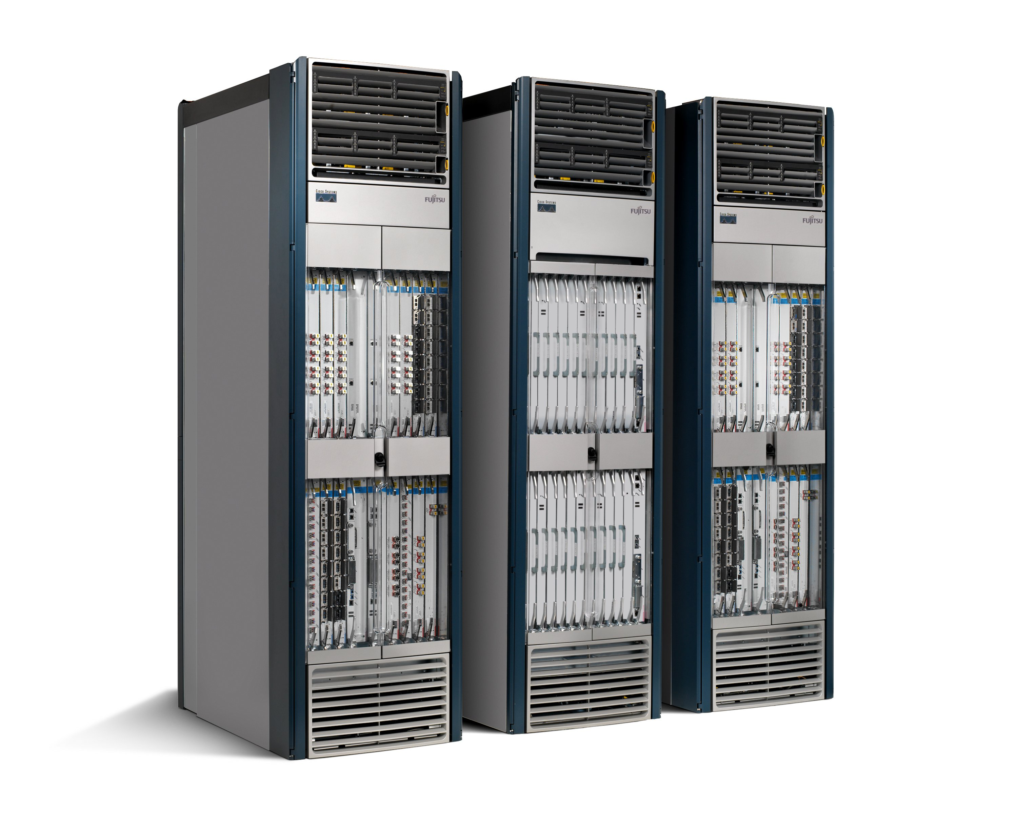
22
App
App
App
App
App
App
App
App
App
App
App
Specialized
Features
Open Interface
Control
Plane
Control
Plane
Control
Plane
or
or
Specialized
Control
Plane
Open Interface
Specialized
Hardware
Merchant
Switching Chips
Vertically integrated
Closed, proprietary
Slow innovation
Horizontal
Open interfaces
Rapid innovation

Slide 23
Routing, management, mobility management, access control, VPNs, …
Feature
Feature
Million of lines of source code
6,000 RFCs
OS
Custom Hardware
Billions of gates
Bloated
Power Hungry
Vertically integrated, complex, closed, proprietary
Networking industry with “mainframe” mind-set

Slide 24
The network is changing
Feature
Feature
Network OS
Feature
Feature
OS
Custom Hardware
Feature
Feature
OS
Feature
Feature
Custom Hardware
OS
Feature
Feature
Custom Hardware
OS
Custom Hardware
Feature
Feature
OS
Custom Hardware

Slide 25
Software Defined Network (SDN)
3. Consistent, up-to-date global network view
2. At least one Network OS probably many. Open- and closed-source
Feature
Feature
Network OS
1. Open interface to packet forwarding
Packet
Forwarding
Packet
Forwarding
Packet
Forwarding
Packet
Forwarding
Packet
Forwarding

Slide 26
Network OS
Network OS: distributed system that creates a consistent, up-to-date network view
Runs on servers (controllers) in the network
NOX, ONIX, Trema, Beacon, Maestro, … + more
Uses forwarding abstraction to:
Get state information from forwarding elements
Give control directives to forwarding elements

Slide 27
Software Defined Network (SDN)
Control Program A
Control Program B
Network OS
Packet
Forwarding
Packet
Forwarding
Packet
Forwarding
Packet
Forwarding
Packet
Forwarding

Slide 28
Control Program
Control program operates on view of network
Input: global network view (graph/database)
Output: configuration of each network device
Control program is not a distributed system
Abstraction hides details of distributed state

Slide 29
Forwarding Abstraction
Purpose: Abstract away forwarding hardware
Flexible
Behavior specified by control plane
Built from basic set of forwarding primitives
Minimal
Streamlined for speed and low-power
Control program not vendor-specific
OpenFlow is an example of such an abstraction

Slide 30
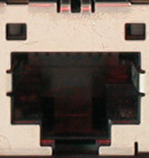
OpenFlow Basics
Control Program A
Control Program B
Network OS
OpenFlow Protocol
Ethernet Switch
Control Path
OpenFlow
Data Path (Hardware)

Slide 31
OpenFlow Basics
Control Program A
Control Program B
Network OS
“If header = p, send to port 4”
Packet
Forwarding
“If header = q, overwrite header with r, add header s, and send to ports 5,6”
“If header = ?, send to me”
Flow
Table(s)
Packet
Forwarding
Packet
Forwarding

Slide 32
Plumbing Primitives
32
Primitive is <Match, Action>
Match arbitrary bits in headers:
Match on any header, or new header
Allows any flow granularity
Action
Forward to port(s), drop, send to controller
Overwrite header with mask, push or pop
Forward at specific bit-rate
Header
Data
Match: 1000x01xx0101001x

Slide 33
General Forwarding Abstraction
Small set of primitives
“Forwarding instruction set”
Protocol independent
Backward compatible
Switches, routers, WiFi APs, basestations, TDM/WDM

Slide 34
Example 1: OSPF and Dijkstra
OSPF
RFC 2328: 245 pages
Distributed System
Builds consistent, up-to-date map of the network: 101 pages
Dijkstra’s Algorithm
Operates on map: 4 pages

Slide 35
Example
OSPF = Dijkstra
IS-IS
OSPF
IS-IS
Network OS
Distributed System
Distributed
System
Distributed
System
OS
Packet
Forwarding
Custom Hardware
Packet
Forwarding
Packet
Forwarding
Packet
Forwarding

Slide 36
Outline
What are Software Defined Networks?
Why SDN?
The Consequences
For industry
For research
For standards and protocols

Slide 37
Great talk by Scott Shenker http://www.youtube.com/watch?v=WVs7Pc99S7w
(Story summarized here)

Slide 38
Networking
Networking is
“Intellectually Weak”
behind other fields
about the mastery of complexity
Good abstractions tame complexity
Interfaces are instances of those abstractions
No abstraction => increasing complexity
We are now at the complexity limit

Slide 39
By comparison: Programming
Machine languages: no abstractions
Had to deal with low-level details
Higher-level languages: OS and other abstractions
File system, virtual memory, abstract data types, ...
Modern languages: even more abstractions
Object orientation, garbage collection,…

Slide 40
Programming Analogy
What if programmers had to:
Specify where each bit was stored
Explicitly deal with internal communication errors
Within a programming language with limited expressibility
Programmers would redefine problem by:
Defining higher level abstractions for memory
Building on reliable communication primitives
Using a more general language

Slide 41
Specification Abstraction
Network OS eases implementation
E.g., Helps manage distributed state
Next step is to ease specification
E.g., How do you specify what the system should do?
Key goals
Provide abstract view of network map
Control program operates on abstract view
Develop means to simplify specification

Slide 42
Software Defined Network (SDN)
Abstract Network View
Virtualization
Control Program A
Control Program B
Global Network View
Network OS
Packet
Forwarding
Packet
Forwarding
Packet
Forwarding
Packet
Forwarding
Consequence:
Work on Nework Programming Languages Pyretic, Frenetic etc.
Packet
Forwarding

Slide 43
Outline
What are Software Defined Networks?
Why SDN?
The Consequences
For industry
For research
For standards and protocols

Slide 44
SDN in development
Domains
Data centers
Enterprise/campus
Cellular backhaul
Enterprise WiFi
WANs
Products
Switches, routers: About 15 vendors
Software: About 6 vendors and startups
New startups (6 so far). Lots of hiring in networking.

Slide 45
Open Networking Foundation (ONF)
New non-profit standards organization (Mar 2011)
Defining standards for SDN, starting with OpenFlow
Board of Directors
Google, Facebook, Microsoft, Yahoo, DT, Verizon
39 Member Companies
Cisco, VMware, IBM, Juniper, HP, Broadcom, Citrix, NTT, Intel, Ericsson, Dell, Huawei, …
http://www.OpenNetworkingFoundation.org

Slide 46
Cellular industry
Recently made transition to IP
Billions of mobile users
Need to securely extract payments and hold users accountable
IP is bad at both, yet hard to change
SDN enables industry to customize their network

Slide 47
Telco Operators
Global IP traffic growing 40-50% per year
End-customer monthly bill remains unchanged
Therefore, CAPEX and OPEX need to reduce 40-50% per Gb/s per year
But in practice, reduces by ~20% per year
SDN enables industry to reduce OPEX and CAPEX
…and to create new differentiating services

Slide 48
Example: New Data Center
Cost
200,000 servers
Fanout of 20 ➔ 10,000 switches
$5k vendor switch = $50M
$1k commodity switch = $10M
Savings in 10 data centers = $400M
Control
More flexible control
Tailor network for services
Quickly improve and innovate

Slide 49
Consequences for research
Ease of trying new ideas
Existing tools: NOX, Beacon, switches, Mininet
More rapid technology transfer
GENI, Ofelia and many more
A stronger foundation to build upon
Provable properties of forwarding
New languages and specification tools

Slide 50
Consequences for standards
Standards will define the interfaces
The role of standards will change:
Network owners will define network behavior
Features will be adopted without standards
Programming world
Good software is adopted, not standardized

Slide 51
Summary
Networks becoming
More programmatic
Defined by owners and operators, not vendors
Faster changing, to meet operator needs
Lower opex, capex and power
Abstractions
Will shield programmers from complexity
Make behavior more provable
Will take us places we can’t yet imagine

Slide 52
Administravia …
Assignment 4 due December 13
Internet in the News (10% of final grade)
Due next Monday Dec. 1 on Piazza
Reading/commenting on others’ Internet in the News part of participation mark
Recent news: http://www.newsweek.com/china-could-shut-down-us-power-grid-cyber-attack-says-nsa-chief-286119
Lots of topics, pick something you find interesting
No class Wednesday!
Next Monday → Mobile networks!

