Slide 1
CSE390 Advanced Computer Networks
Lecture 15: Online Social Networks
(The network is people)
Based on slides by A. Mislove, F. Schneider, and W. Willinger. Updated by P Gill. Fall 2014

Slide 2






What are (online) social networks?
Social networks are graphs of people
Graph edges connect friends
`Friend’ has different implications
How hard is it to be Facebook `friends’?
Online social networking
Social network hosted by a Web site
Friendship represents shared interest or trust
Online friends may have never met

Slide 3
What are online social networks used for?
Popular for sharing content
Photos (Flickr), videos (YouTube), blogs (LiveJournal), profiles (Facebook, Orkut)
Fixed broadband (Sandvine Q1 2014)
YouTube 5.5% upload, 13.2% down
Facebook 2.2% upload, 2.0% down
Popular with users on the go
Mobile (Sandvine Q1 2014)
YouTube 3.8% up, 17.6% down
Facebook 27.0% up, 14.0% down

Slide 4
Why are social networks interesting?
Popular way to connect
Estimated 1.32B users online each day
Average American spends 40 minutes/day on the site
Changing the flow of information
Formerly few ``writers’’ many ``readers’’ online
Now anyone can write!
What does this mean for Internet traffic?
Important in regions with strict media controls
E.g., Iran, Egypt using social media platforms to get word out in times of unrest
Useful in times of disaster
Notes:
Stats:
http://www.dailymail.co.uk/sciencetech/article-2703440/Theres-no-escape-Facebook-set-record-stock-high-results-beats-expectations-1-32-BILLION-users-30-mobile.html

Slide 5
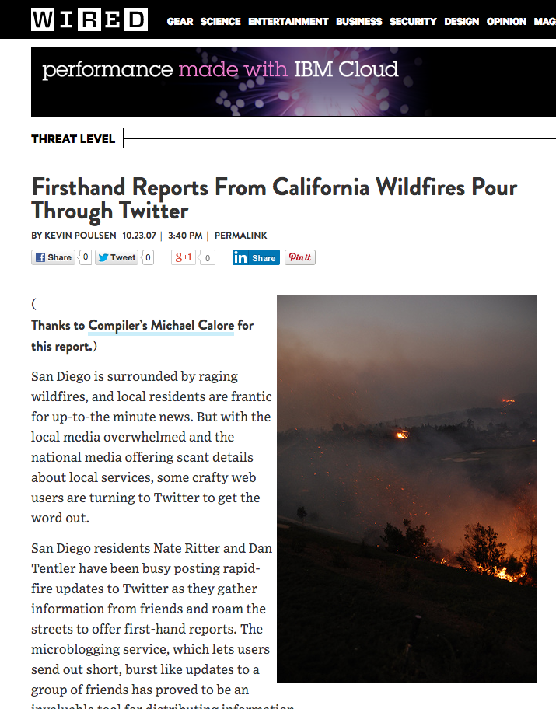
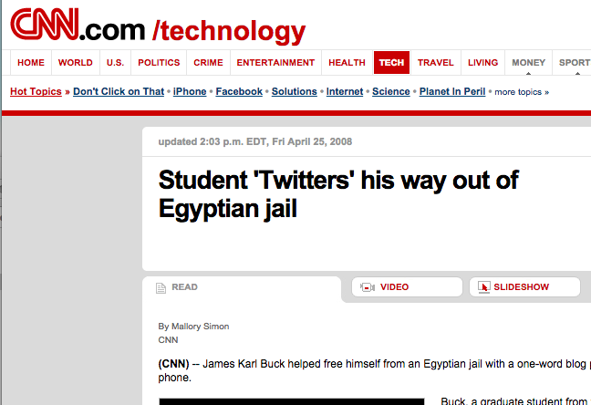
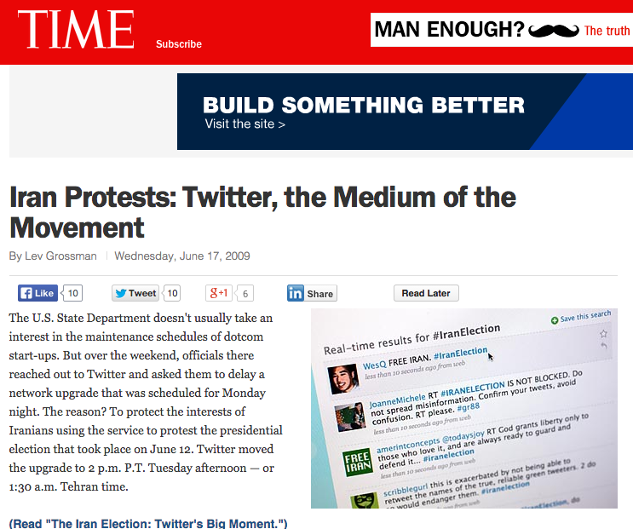
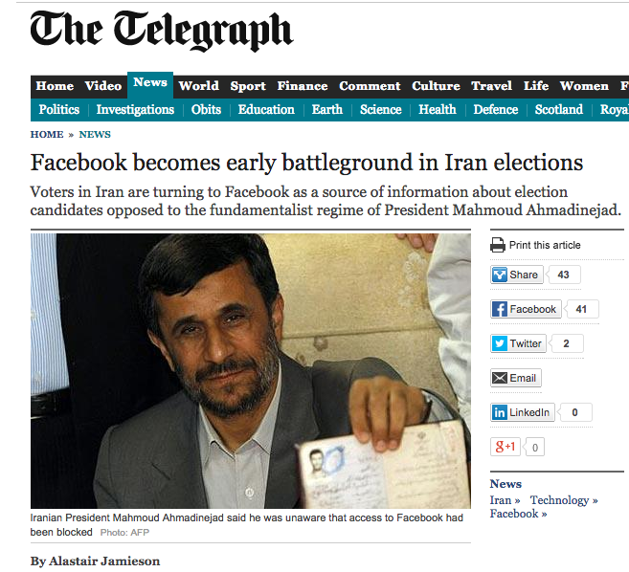
Notable incidents …

Slide 6
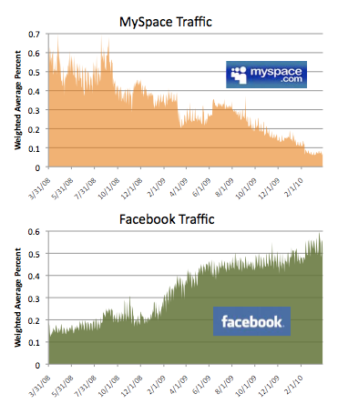
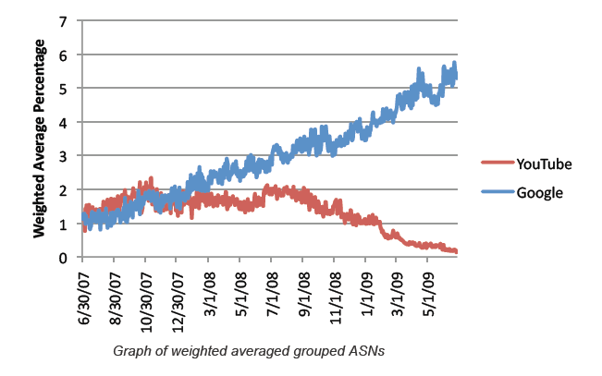
Not just a social phenomenon…
Facebook now contains photo and video
→ Content delivery challenges!
YouTube is a large fraction of Google’s traffic!
Understanding properties of these networks is important to understand how we build systems to support them!

Slide 7
Outline
Graph Properties of OSNs
(Mislove et al 2007)
The Demise of MySpace
(Torkjazi et al 2009)
How do people use OSNs
(Schneider et al 2009)

Slide 8

Required reading: Mislove et al. 2007
One of the first measurement studies of online social networks (OSNs)
Large-scale measurement study and analysis of multiple online social networks
11 M users, 328 M links
Four diverse OSNs
Flickr: photosharing
LiveJournal: blogging
Orkut: social networking
YouTube: video sharing
Goals:
Measure OSNs at scale
Understand their static structural properties

Slide 9
How to measure OSNs at scale?
Sites are reluctant to give out data
Cannot enumerate user list in general
Instead, performed crawls of the user graph
Picked known seed user
Crawled all of his friends
Added new users to list
Continued until all known users crawled
Effectively performed a BFS of graph

Slide 10
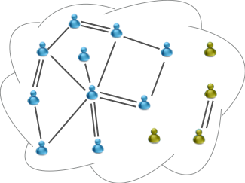
Challenges faced
Obtaining data using crawling presents unique challenges
Need to crawl quickly!
Underlying network changes rapidly
Consistent snapshot is hard to get
Crawling completely
Social networks aren’t necessarily connected
Some users have no links! Or are in small clusters.
Need to estimate the crawl coverage

Slide 11
How fast could they crawl?
Crawled using a cluster of 58 machines
Used APIs where available
Otherwise, used screen scraping
Crawls took varying times
Flickr, YouTube 1 day
LiveJournal 3 days
Orkut (Partial) 39 days)
Crawls subject to rate-limiting
Discovered appropriate rates

Slide 12
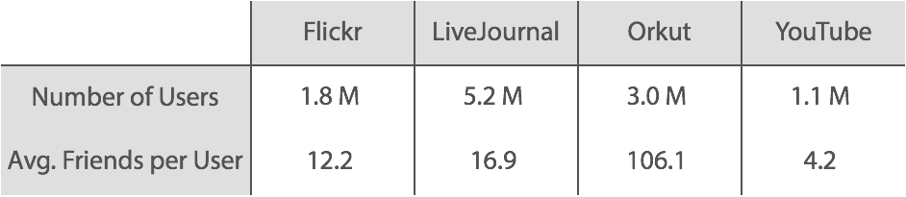
Data collected
Able to crawl a large portion of the network
Node degrees vary by orders of magnitude
However, networks share many key properties
To ground analysis, will compare to Web ^{[Broder et al.,}

Slide 13
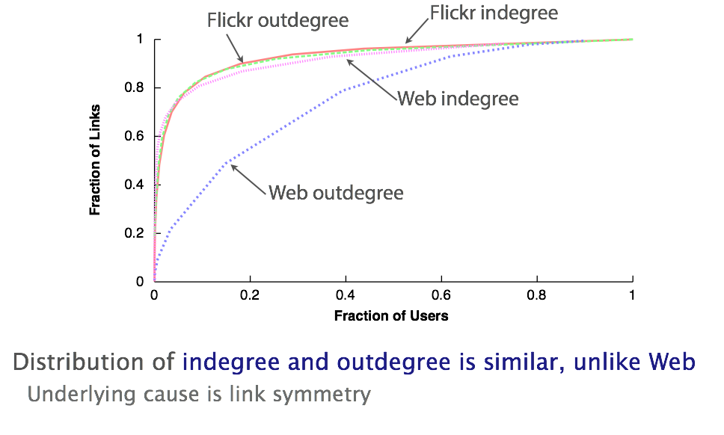
How are links distributed

Slide 14
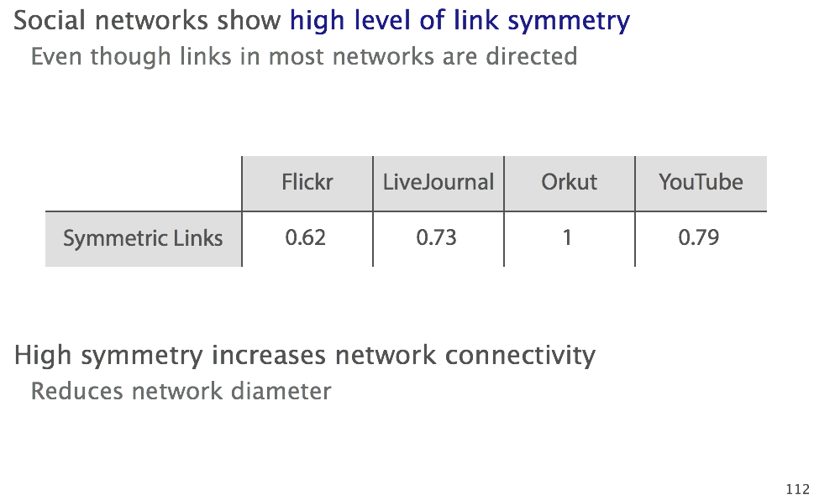
What fraction of links are symmetric?
Notes:
http://mathworld.wolfram.com/GraphDiameter.html Longest shortest path.

Slide 15
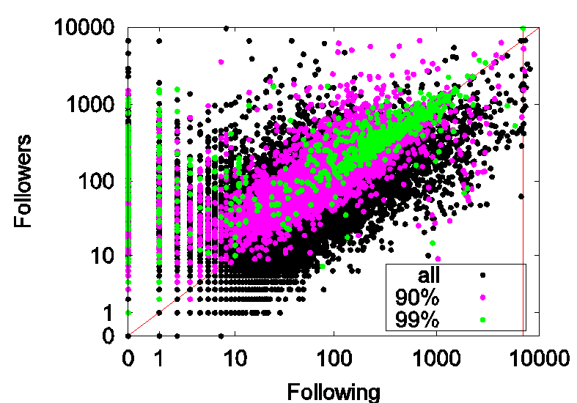
Aside: User relationships on Twitter
Broadcasters
News outlets, radio stations
No reason to follow anyone
Post playlists, headlines
13

Slide 16
Aside: User relationships on Twitter
Acquaintances
Similar number of followers and following
Along the diagonal
Green portion is top 1-percentile of tweeters
14

Slide 17
Aside: User relationships on Twitter
Miscreants?
Some people follow many users (programmatically)
Hoping some will follow them back
Spam, widgets, celebrities (at top)
15

Slide 18
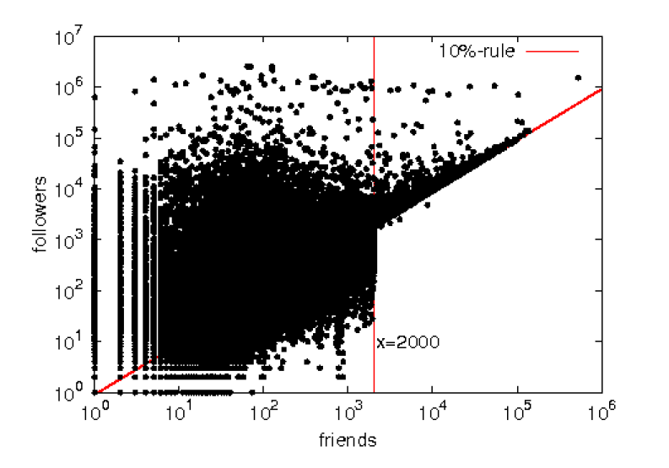
Aside: User relationships on Twitter
Twitter noticed the miscreants…
… enacted the 10% rule (you can follow 10% more people than follow you)

Slide 19
Implications of high symmetry
High link symmetry implies indegree equals outdegree
Users tend to receive as many links as the give
Unlike other complex networks, such as the Web
Sites like cnn.com receive much links more than they give
Implications is that ‘hubs’ become ‘authorities’
May impact search algorithms (PageRank, HITS)
So far, observed networks are power-law with high symmetry
Take a closer look next

Slide 20
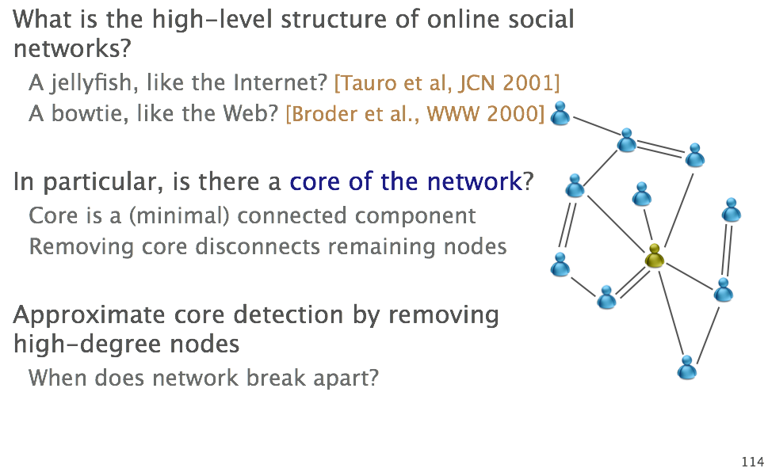
Complex network structure

Slide 21
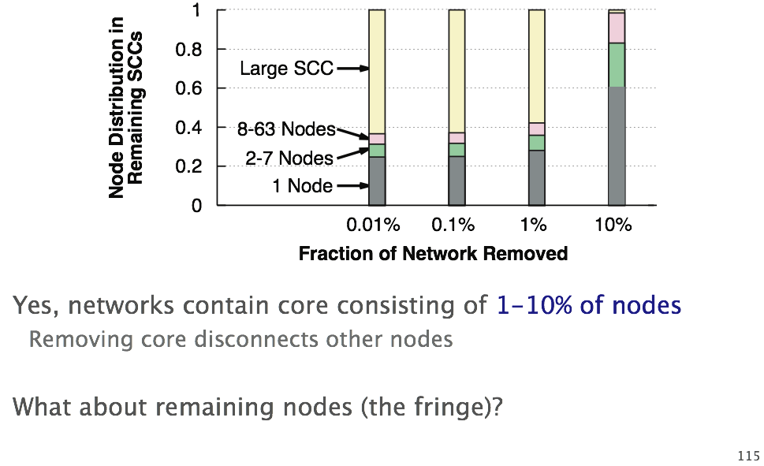
Does a core exist?

Slide 22
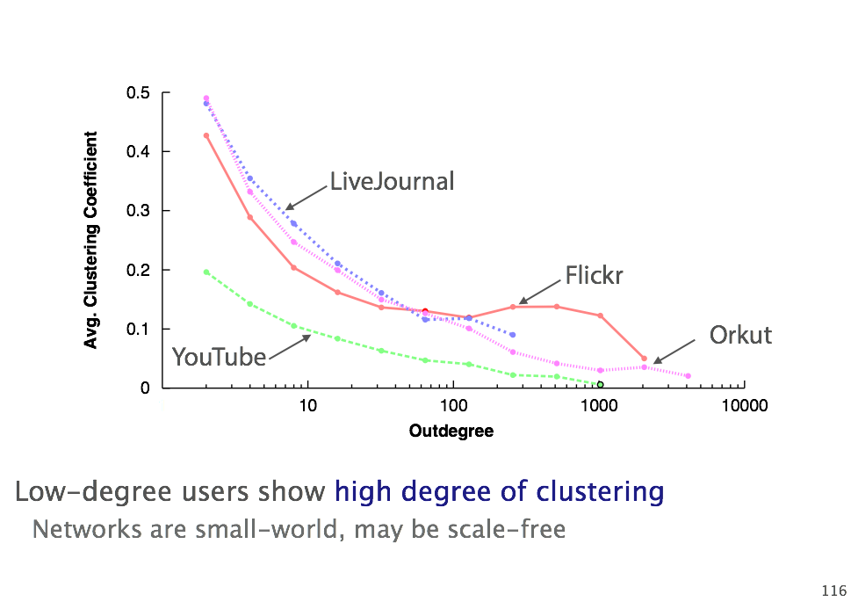
How clustered is the fringe?
Notes:
Small-world : everyone can reach each other within a small number of hops

Slide 23
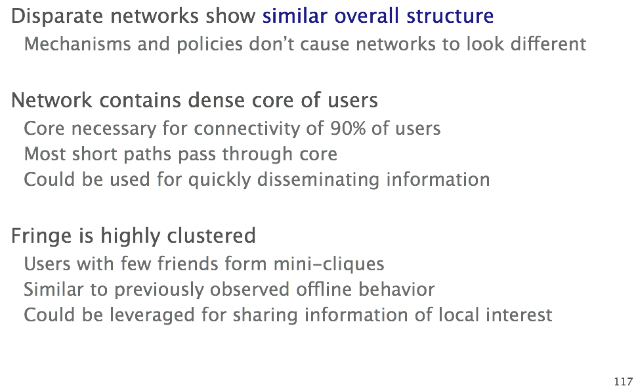
Implications

Slide 24
Outline
Graph Properties of OSNs
(Mislove et al 2007)
The Demise of MySpace
(Torkjazi et al 2009)
How do people use OSNs
(Schneider et al 2009)

Slide 25
Hot Today, Gone Tomorrow…
Slides borrowed from W. Willinger
Paper: Hot Today, Gone Tomorrow: On the Migration of MySpace Users. M. Torkjazi, R. Rejaie, and W. Willinger.

Slide 26
Motivation
A majority of empirical studies of Online Social Networks (OSNs) has focused on their associated friendship graphs
What about the temporal dynamics of OSNs?
What about the “active” portion of an OSN?
A majority of empirical studies of OSNs has examined the growth of these systems
What about the patterns of decline in user population?
What about changes over time in user activity?
A majority of empirical studies of OSNs has been based on connectivity information
What about timing information?
How to obtain relevant timing information?

Slide 27
This Study
We examine the evolution of user population and user activity in MySpace
User arrival/activity/departure, life cycle of MySpace
Why MySpace?
It is one of the largest and most popular OSNs
It provides several features making our study feasible
Main challenges
OSNs are often studied when they are popular and the number of departure is negligible
Popular OSNs tend to hide the information about user departures

Slide 28
MySpace Features (I)
Provides explicit profile status
Public
Private
Invalid
Availability of users’ last login
Enables assessment of the level of activity among users
Importantly, allows inference of population growth of MySpace (see later for details)
Global visibility
http://www.myspace.com/user_id
8/17/2009
WOSN 2009 - Barcelona
28
Notes:
28

Slide 29
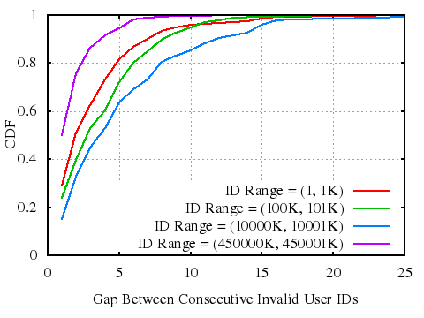
MySpace Features (II)
Monotonic assignment of numeric ID
Searched periodically for currently smallest unassigned ID and checked that all larger IDs are unassigned; after waiting for a short period, we observed that the smallest unassigned ID (and others after it) are now assigned.
Found no apparent patterns in gaps between consecutive invalid IDs
No evidence for re-assignement of deleted IDs
Makes the selection of random samples of MySpace users easy.
No visible pattern

Slide 30
Measurement
Feb. 26th 2009: MySpace ID space [1 … 455,881,700]
50 parallel samplers to collect 360K users in less than 12 hours (0.1% of MySpace population)
Using HTML parser to post-process the downloaded profiles and extract
User s’ profile status (invalid, public, private)
Users’ last login date
Users’ friend list (only for public profiles)
Unable to parse last login info for 0.96% of public and 0.08% of private profiles
Last login info is not provided or is provided with obvious errors (e.g. 1/1/0001)

Slide 31
On the Population size of MySpace
Total | Invalid | Public | Private
362K | 149K (41.2%) | 150K (41.5%) | 63K (17.3%)
Population of valid MySpace users (Feb. 26, 2009) was about (41.5 + 17.3)% of 455,881,700 = 268M
Compare with www.myspace.com/tom who has 266,029,430 friends (Aug. 13, 2009)
How has MySpace grown during the past years?
How many “active” users are there in MySpace?

Slide 32
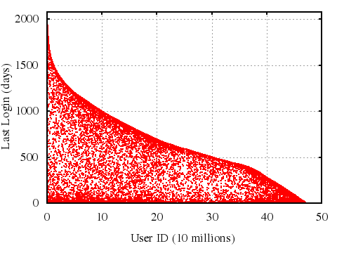
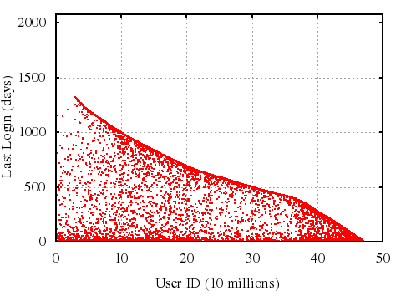
On User Arrival
What does user ID say about account creation time?
Plot user ID vs. last login of that user for all our users
Public users
Private users

Slide 33
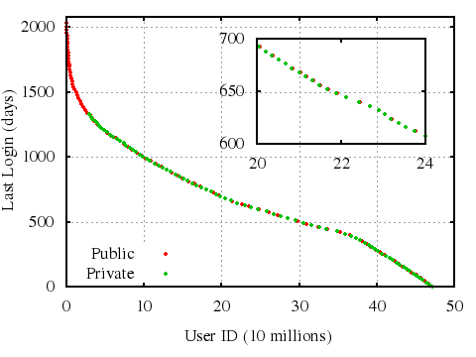
On User Arrival
What does user ID say about account creation time?
“Clean edge”
=
users whose last login
is shortly after their
account creation time
=
“MySpace tourists”
Tourists
32% of public and 18% of private users are tourists
Discovery of “tourists” enables accurate estimation of user account creation time based on their associated user ID
8/17/2009
WOSN 2009 - Barcelona
33
Notes:
33

Slide 34
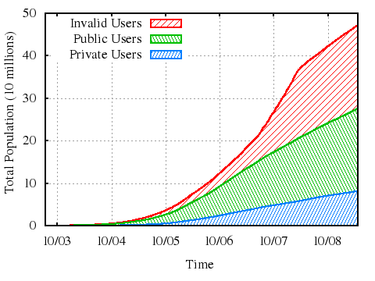
On MySpace’s Growth
Estimating the user population of MySpace in the past?
April 2008
Use the observed uniform spread of tourists across entire ID space
Estimate account creation time by last login time
Estimate account creation time of all sampled accounts based on their ID.
Slope of the top line shows the growth rate of MySpace population
Exponential growth until about April 2008
Visible knee around April 2008 followed by a slow-down in growth

Slide 35
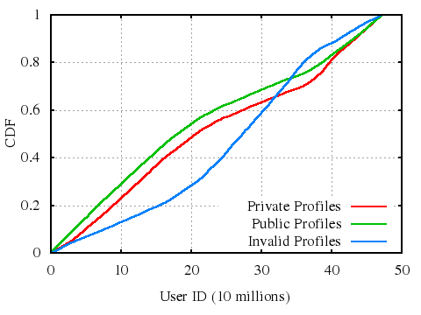
On User Departure
Are newer users more likely to leave than older ones?
More public and private profiles in the first half of ID space
More invalid profiles in the second half of ID space
Users joining the system earlier have been more likely to keep their accounts than newer users
8/17/2009
WOSN 2009 - Barcelona
35
Notes:
35

Slide 36
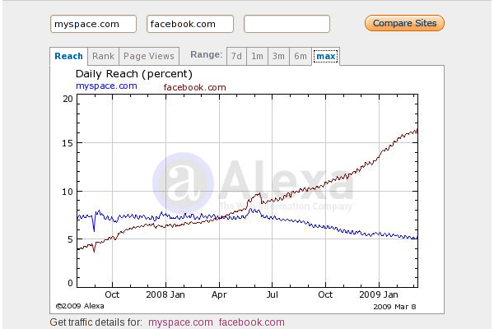
MySpace Life Cycle (I)
Possible reasons behind MySpace’s decline?
Slow-down in the growth rate of MySpace is related to emergence of Facebook
Informal evidence (Alexa.com): Daily accesses to Facebook surpassed that of MySpace, at around April 2008

Slide 37
Outline
Graph Properties of OSNs
(Mislove et al 2007)
The Demise of MySpace
(Torkjazi et al 2009)
How do people use OSNs
(Schneider et al 2009)

Slide 38
Understanding Online Social Network Usage from a Network Perspective
F. Schneider, A. Feldmann, B. Krishnamurthy, and W. Willinger. ACM Internet Measurement Conference 2009
Slides borrowed from F. Schneider.
This study differs from a lot of related work by looking at OSN behavior at the network traffic level
Vs. crawling the application-level social graph

Slide 39
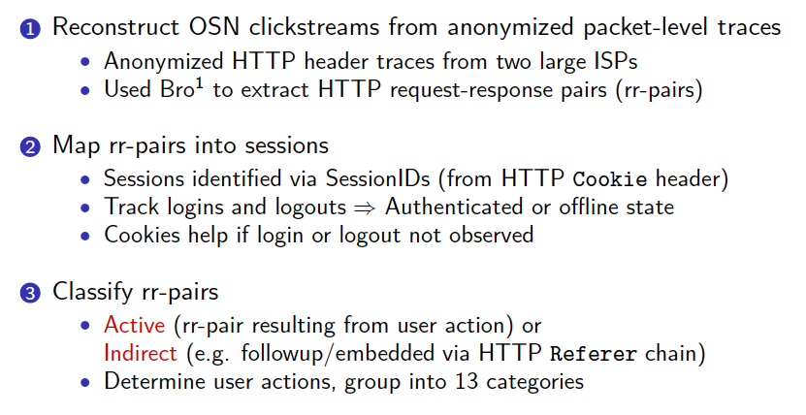
General Approach

Slide 40
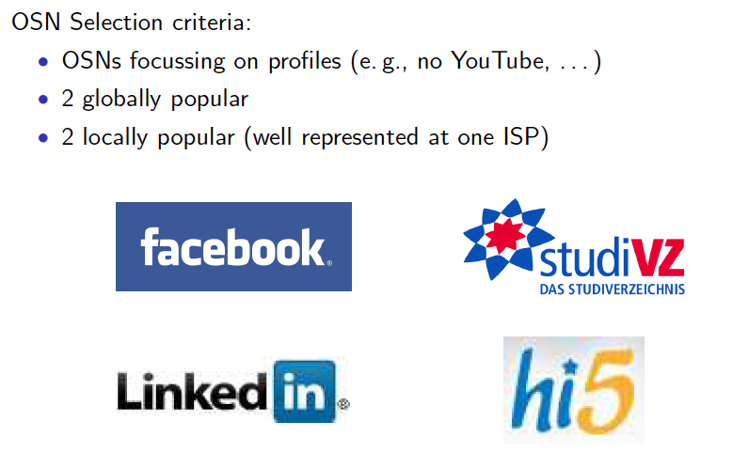
OSNs studied

Slide 41
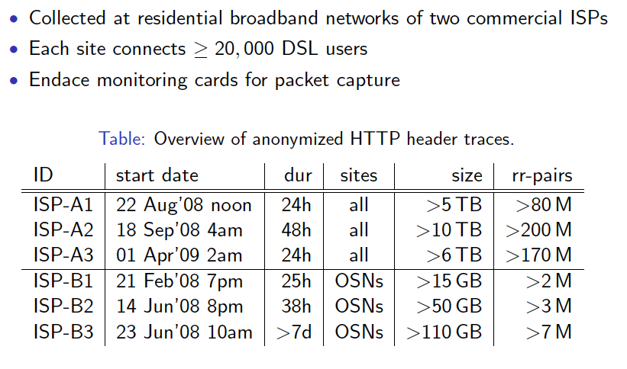
HTTP Traces

Slide 42
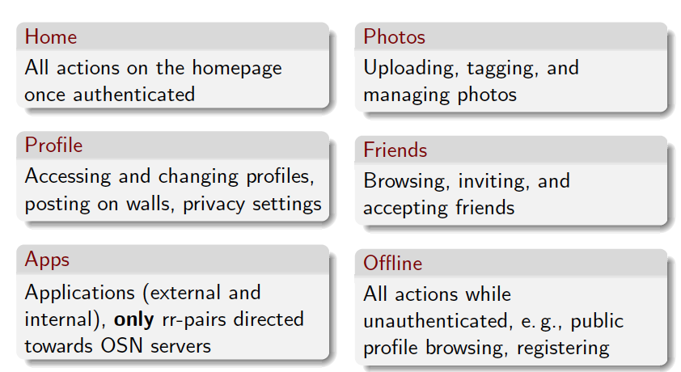
Categories of pages
Pages manually classified based on small user generated traces in the lab setting

Slide 43
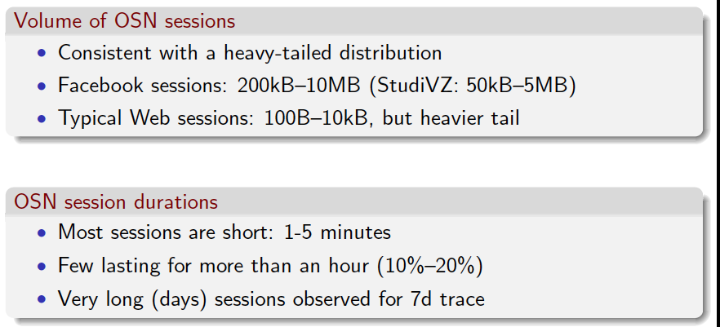
Session Characteristics

Slide 44
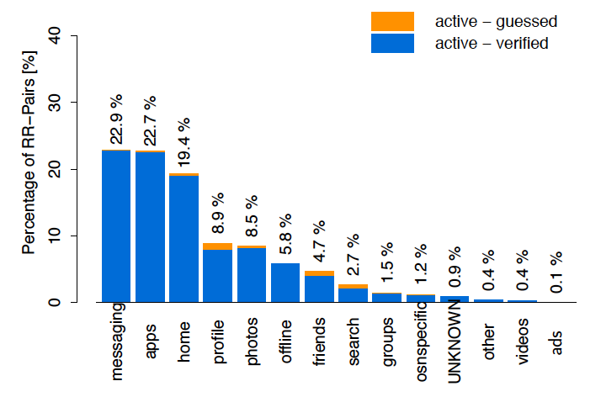
Action popularity

Slide 45
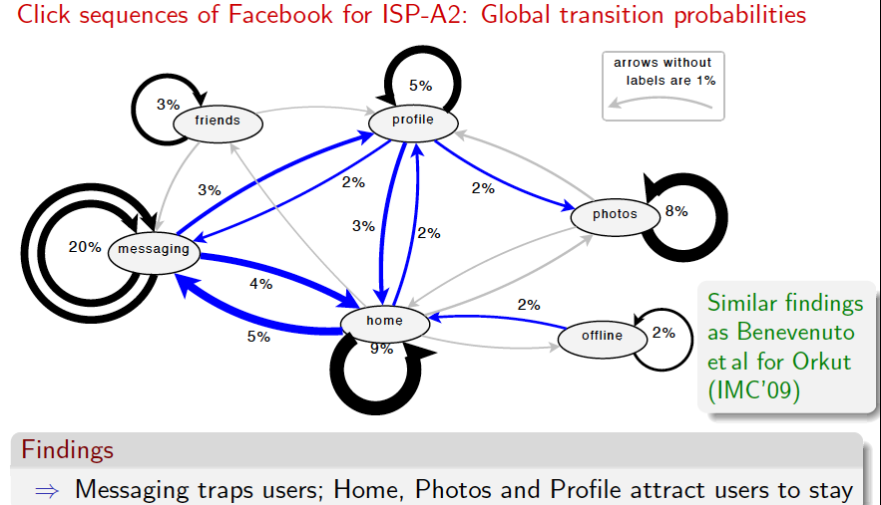
Feature sequences

Slide 46
OSNs: Wrap up
Many different types of OSNs
Photos, video, profile-based
Some extremely popular source of much Internet traffic
Facebook, YouTube
New ones emerging
Instagram, snapchat
Old ones fading
MySpace, Friendster
Studying their properties can inform how we build networks and systems to support them!

Slide 47
End

Slide 48



BitTorrent Overview
Tracker
Swarm
Seeder
Leechers

