Slide 1
CSE390
Advanced Computer Networks
Lecture 1: Logistics
(a.k.a., the most important thing that won’t be on any exam)
Based on slides from D. Choffnes Northeastern U. Revised Fall 2014 by P. Gill

Slide 2
Hello!
Welcome to CSE390 – Advanced Computer Networks
  Are you in the right classroom?
  Okay, good.
Who am I?
  Professor Phillipa Gill
  phillipa@cs.stonybrook.edu
  Computer Science 1418
  Office Hours: 10-11 Mondays, 10-12 Wednesdays in CS1418.

Slide 3
Why Take This Course?
How many of you have checked your e-mail, FB, text…
  Today?
  In the past hour?
  Since I started talking?

Slide 4



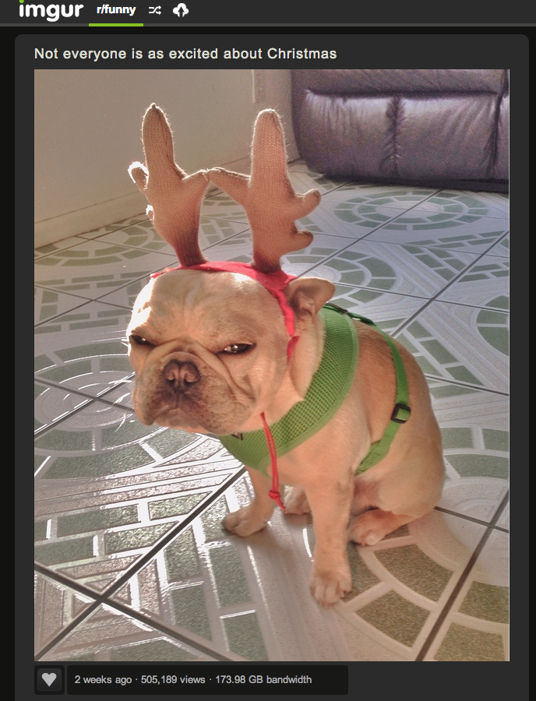

Computer networks are ubiquitous
Networks touch every part of our daily life
  Web search
  Social networking
  Watching movies
  Ordering merchandise
  Wasting time

Slide 5
Computer networks are ubiquitous
Networking is one of the most critical topics in CS
  There would be no…
    Big Data
    Cloud
    Apps or Mobile Computing
  … without networks

Slide 6
Goals
Fundamental understanding about computer networks
  Layered approach covering routing algorithms and protocols up the stack
  Not just how it works, but how did it end up that way?
  Issues arising with new popular applications online
  How might we rethink protocols and assumptions of the past ☺
Focus on software and protocols
  Not hardware
  Minimal theory
We will be putting concepts into historical perspective via relevant readings

Slide 7
Online Resources
http://www.cs.stonybrook.edu/~phillipa/index.php?p=cse390f14
Class forum is on Piazza
  Sign up today!
  Install their iPhone/Android app
When in doubt, post to Piazza
  Piazza is preferable to email
  Use folders (assignment1, lecture2 etc.)

Slide 8
Teaching Style
I am a network researcher
  Things make sense to me that may not make sense to you
  I talk fast if nobody stops me
Solution: ask questions!
  Seriously, ask questions
  Standing up here in silence is very awkward
  I will stand here until you answer my questions
Help me learn your names
  Say your name before each question

Slide 9
Workload
Assignments (4 of them) | 30%
Midterm | 20%
Final | 20%
Participation | 20%
Internet in the News | 10%

Slide 10
Assignments
There are four assignments distributed throughout the term
  Designed to give you hands on experience and help drive home concepts
  Assignments may have associated readings to help you solve them
  Due at 11:59:59pm on specified date
  Working code is paramount

Slide 11
Assignment Logistics
Languages
  Some assignments will require bro (www.bro-ids.org) an event driven language for parsing packet traces
  When language is not specified (e.g., bro, Graphviz) you are free to use the language of your choosing.
Bro can be installed on Linux or Mac machines.
  For your convenience you can log into a VM with Bro already installed
  SSH into: allv21.all.cs.sunysb.edu using your Unix log in
Assignment questions?
  Post them on Piazza!

Slide 12
Late Policy
Each student is given 4 slip days that they can use at any time to extend a deadline
  You don’t need to ask me, just turn-in stuff late
Assignments are due at 11:59:59, no exceptions
  1 second late = 1 hour late = 1 day late
  20% off per day late

Slide 13
Exams (40%)
Midterm and Final (20% each)
  Midterm 80 minutes in class. Final time/date TBD.
  The final will be cumulative
All exams are:
  Closed book, closed notes, leave the laptop at home
  If I see a smartphone, I will take it and sell it on craigslist

Slide 14
Participation & Paper Reading (20%)
You will read research papers in this class
  Some are classics, foundations of existing networks
  Others propose newer, more advanced designs
List of papers are on the website
  1-2 papers per week, to be read before lecture
Each paper will have a discussion lead assigned to it 1 week prior to its associated lecture
  You may volunteer for a specific paper if it is of particular interest for you (FCFS!)
  …But all papers will need covering

Slide 15
Participation & Paper Reading (20%)
Leader posts a summary of the paper highlighting its strengths and weaknesses to Piazza
  Use the Piazza folder for the corresponding lecture!
  Summary is due midnight the night before the associated lecture
Responses to the summary are due:
  11:59pm Wednesday (for Monday lecture papers)
  11:59pm Friday (for Wednesday lecture papers)
You will be expected to lead discussion when it is your turn and engage in paper responses/discussions for at least 12 papers

Slide 16
Participation & Paper Reading (20%)
One paper is assigned for Wednesday
  First week of class, exception to the one week rule.
  Any volunteers?
  The Design Philosophy of the DARPA Internet Protocols. David D. Clark. SIGCOMM 1988

Slide 17
Internet in the News (10%)
Find a news article relating to networking and the Internet that you find interesting - this should be fun ☺
  Look in news media, technical press, blogs, advocacy Web sites (e.g., EFF)
  Potential topics: NSA surveillance, Wikileaks, large outages…
Post a write up of the article to Piazza (use iin folder)
  Write up should include any relevant technical/background and detail to understand the topic
  This detail may require going beyond the initial article!
You may post your Internet in the News write up at any point in the term prior to 11:59pm on December 1.
  As part of participation you are expected to comment and discuss the issues posted by your colleagues

Slide 18
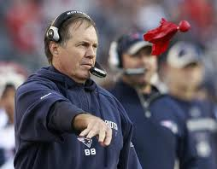
Grade Changes
Each student gets two challenges
  Modeled after NFL system
  If you ask for a regrade and you are wrong, you lose a challenge
  When you are out of challenges, you cannot ask for regrading
Must come to office hours with the following in writing:
  Specify the problem(s) you want regraded
  For each problem, explain why the grade is in error
Don’t sweat the small stuff
  If the change is <5% of the grade, don’t bother

Slide 19
Cheating
Do not do it
  Seriously, don’t make me say it again
Cheating is an automatic zero
  Will be referred to the university for discipline and possible expulsion
See university academic integrity policy on the course Web page.

Slide 20
Final Grades
At the end of the semester, all of your grades will sum to 100 points
  30 + 20 + 20 + 10 + 20 = 100
Final grades are based on a simple scale:
  A >92, A- 90-92, B+ 87-89, B 83-86, B- 80-82, …
Keep an eye out for bonus marks along the way ☺
Internet in the news
Assignments
Exams
Participation

Slide 21
Questions?
www.cs.stonybrook.edu/~phillipa

