Slide 1
CSE390 Advanced Computer Networks
Lecture 12-13: Internet Connectivity + IXPs
(The Underbelly of the Internet)
Based on slides by D. Choffnes (NEU), C. Labovitz, A. Feldmann, revised by P. Gill Fall 2014.

Slide 2
Outline
Internet Connectivity
  The shift from hierarchy to flat
  Measuring the shift
IXPs

Slide 3
The Internet as a Natural System
You’ve learned about the TCP/IP Internet
  Simple abstraction: Unreliable datagram transmission
  Various layers
  Ancillary services (DNS)
  Extra in-network support
So what is the Internet actually being used for?
  Emergent properties impossible to predict from protocols
  Requires measuring the network
  Constant evolution makes it a moving target

Slide 4
Measuring the capital-I Internet*
Measuring the Internet is hard
Significant previous work on
  Router and AS-level topologies
  Individual link / ISP traffic studies
  Synthetic traffic demands
But limited “ground-truth” on inter-domain traffic
  Most commercial arrangements under NDA
  Significant lack of uniform instrumentation
*Mainly borrowed stolen from Labovitz 2010

Slide 5
Conventional Wisdom (i.e., lies)
Internet is a global scale end-to-end network
  Packets transit (mostly) unmodified
  Value of network is global addressability /reachability
Broad distribution of traffic sources / sinks
An Internet “core” exists
  Dominated by a dozen global transit providers (tier 1)
  Interconnecting content, consumer and regional providers

Slide 6



Does this still hold?
Emergence of ‘hyper giant’ services
How much traffic do these services contribute?
Hard to answer!
  Reading on Web page: Labovitz 2010 tries to look at this.

Slide 7
Methodology
Focus on inter-domain traffic
Leverage widely deployed commercial Internet monitoring infrastructure
  Add export of coarse grain traffic statistics (ASNs, AS Paths, protocols, ports, etc)
Cajole carriers into participation
  110+ ISPs/content providers
  Including 3,000 edge routers and 100,000 interfaces
  Estimated 25% of all inter-domain traffic
Wait two years…

Slide 8
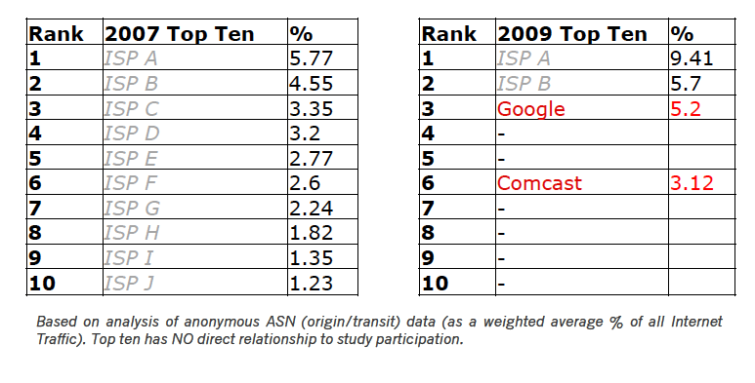
Change in Carrier Traffic Demands
In 2007 top ten match “Tier 1” ISPs
In 2009 global transit carry significant volumes
  But Google and Comcast join the list
  Significant fraction of ISP A traffic is Google transit

Slide 9
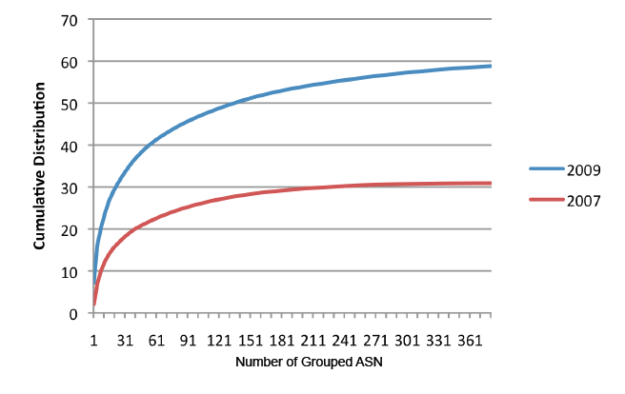
Consolidation of Content
In 2009, 150 ASes contribute 50% of traffic!
In 2007 1,000s of ASes contribute 50% of traffic

Slide 10
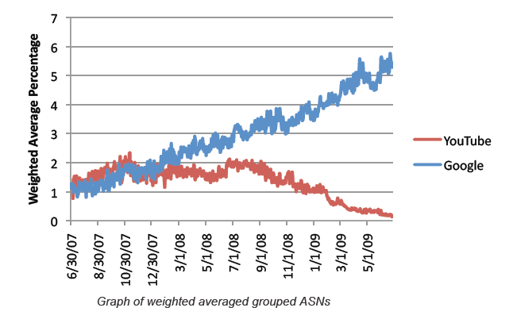
Case Study: Google
Over time Google begins delivering YT’s traffic
As of 2009 Google is 6% of traffic

Slide 11
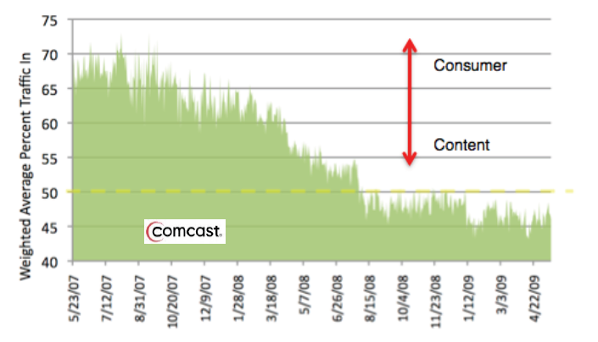
Case Study: Comcast
2007 Comcast looks like ‘eyeball’ provider (more traffic in than out)
2009 this shifts. They look more like transit/content
Wholesale transit, video distribution etc.

Slide 12
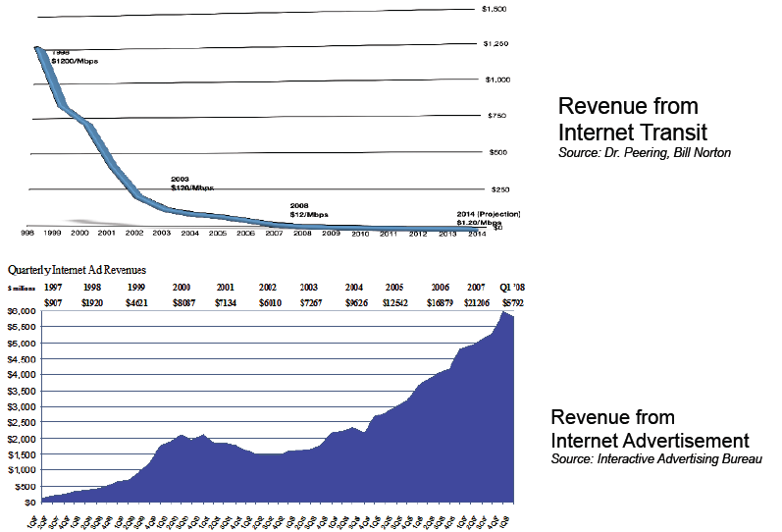
Market forces at play

Slide 13
Market intuition
Commoditization of IP and hosting/CDN
  Drop in price of transit
  Drop in price of video/CDN
  Economics of scale → Cloud computing
Consolidation
  Big get bigger (economics of scale)
  Acquisitions (e.g., Google + YT)
New economic models
  Paid peering, paid content
Disintermediation
  Direct connections between content + consumer
  Cost + performance considerations

Slide 14
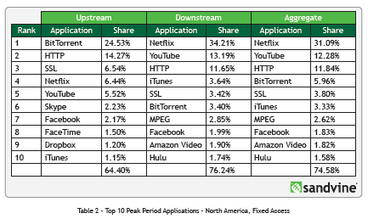
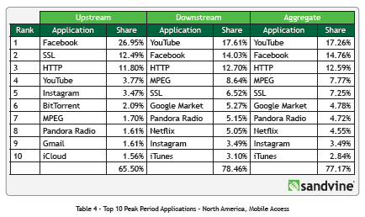
New applications + ways to access them
Fixed vs. Mobile Usage

Slide 15

The shift from hierarchy to flat
$
Verizon
AT&T
Tier 1 ISPs
(settlement free peering)
Money follows the arrows.
$$$
Sprint
$
$
Tier 2 ISPs
Regional Access
Provider
Regional Access
Provider
$
Tier 3 ISPs
$
Local Access
Provider
Local Access
Provider
$
$
Autonomous systems (ASes) connect to each other based on business relationships.
Businesses/consumers

Slide 16
The shift from hierarchy to flat
Verizon
AT&T
Tier 1 ISPs
(settlement free peering)
Sprint
Tier 2 ISPs
Regional Access
Provider
Regional Access
Provider
Content provider no longer needs to pay for transit!
More “eyeballs” less $$
Local Access Provider doesn’t have to pay for consumer access to content!
Tier 3 ISPs
Local Access
Provider
$
Local Access
Provider
$
IXP
$
Businesses/consumers

Slide 17
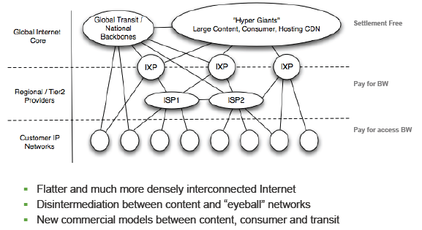
A new Internet model

Slide 18
Outline
Internet Connectivity
  The shift from hierarchy to flat
  Measuring the shift
IXPs

Slide 19
First saw this in 2008
traceroute to 74.125.229.18 (Google)
1 80.82.140.226 0.209 ms 0.129 ms 0.328 ms
2 80.82.140.42 0.539 ms 0.525 ms 0.498 ms
3 80.82.140.43 0.472 ms 0.451 ms 0.427 ms
4 195.66.226.125 1.066 ms 1.077 ms 1.075 ms
5 209.85.252.76 1.022 ms 0.943 ms 0.979 ms
6 216.239.43.192 76.558 ms 76.454 ms 75.900 ms
7 209.85.251.9 91.356 ms 93.749 ms 93.941 ms
8 64.233.175.34 92.907 ms 93.624 ms 94.090 ms
9 74.125.229.18 93.307 ms 93.389 ms 90.771 ms
LINX(UK)
Conjecture: Google is buying up dark fibre and building up a WAN to cut costs.

Slide 20
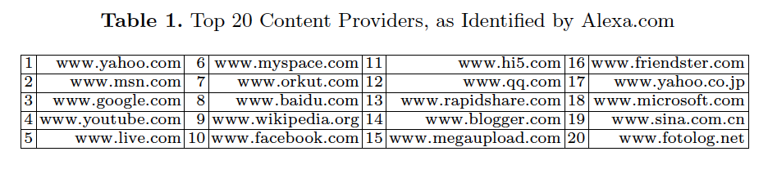
We wondered how prevalent this was
Idea: Traceroute to large content providers see where the traceroute enters their network
  Optional reading: The Flattening Internet Topology: Natural Evolution, Unsightly Barnacles or Contrived Collapse? Gill et al. http://www3.cs.stonybrook.edu/~phillipa/papers/PAM08.pdf

Slide 21
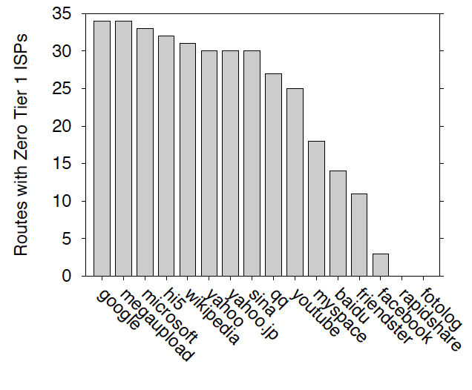
What we saw: Paths with no Tier 1s
60% of paths with no tier 1 ISP
(30 out of 50)

Slide 22
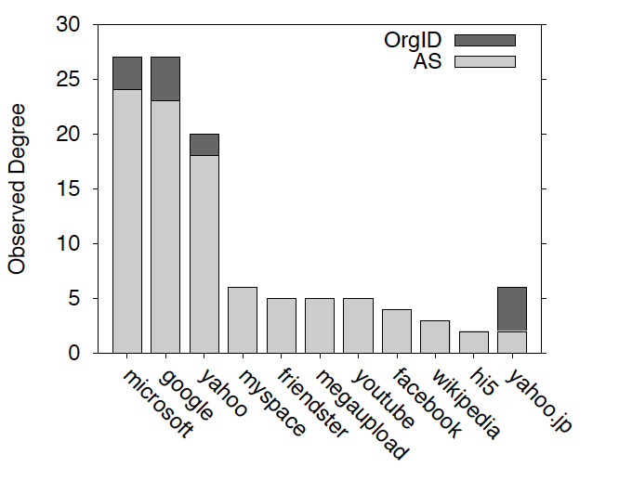
Relative degree of top content providers
We saw many more neighboring ASes for the top content providers
(not just a few providers)
These numbers are actually way lower than the true degree of these ASes

Slide 23
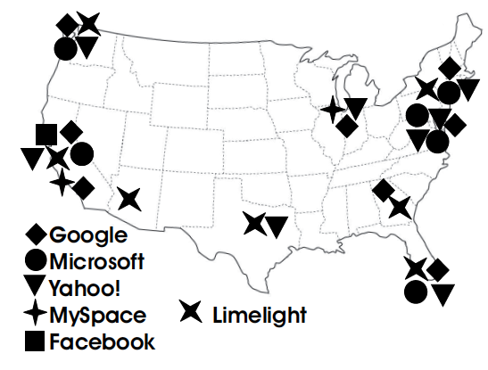
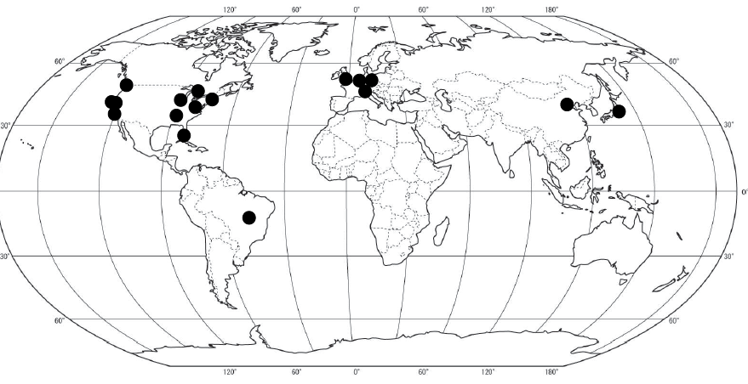
An initial map of connectivity
Google

Slide 24
This study suggested something was happening…
…But didn’t exhaustively measure the phenomenon
Only traceroute data from a limited set of VPs
  50 paths to each domain
Observing and measuring flattening requires measurements of the entire Internet topology

Slide 25
Measuring the Internet’s topology
What do we mean by topology?
  Internet as graph
  Edges? Nodes?
  Node = Autonomous System (AS); edge = connection.
Edges labeled with business relationship
Customer → Provider
Peer -- Peer
AT&T
Sprint
SBU

Slide 26
So how do we measure this graph?
Passive approach: BGP route monitors
  Coverage of the topology
  Amount of visibility provided by each neighbor
Active approach: Traceroute
  From where?
  Traceroute gives series of IP addresses not ASes
Active approach: TransitPortal
  Much more control over what we see
  …scalability/coverage?

Slide 27


Passive approach: BGP Route Monitors
Receive BGP announcements from participating ASes at multiple vantage points
Regional ISP
www.routeviews.org
“originally motivated by interest on the part of operators in determining how the global routing system viewed their prefixes and/or AS space”
www.routeviews.org

Slide 28
Going from BGP Updates to a Topology
Example update:
TIME: 03/22/11 12:10:45
FROM: 12.0.1.63 AS7018
TO: 128.223.51.102 AS6447
ASPATH: 7018 4134 9318 32934 32934 32934
69.171.224.0/20
AT&T (AS7018) it telling
Routeviews (AS 6447) about this route.
This /20 prefix can be reached via the above path

Slide 29
Going from BGP Updates to a Topology
Key idea
  The business relationships determine the routing policies
  The routing policies determine the paths that are chosen
  So, look at the chosen paths and infer the policies
Example: AS path “7018 4134 9318” implies
  AS 4134 allows AS 7018 to reach AS 9318
  China Telecom allows AT&T to reach Hanaro Telecom
  Each “triple” tells something about transit service

Slide 30

Why are peering links hard to see?
The challenge:
  BGP announcements do not reflect complete connectivity information
  They are an agreement to transit traffic for the AS they are advertised to…
Regional ISP won’t see the peering edge!
Neither will Routeviews
Local ISP will only tell his customers about the peering link.
Regional ISP
(ASes only transit traffic if it generates revenue!)
Local ISP, Small business
Local ISP, Google
Local ISP
  Combination of no valley routing policy and a lack of monitors in stub ASes mean missing up to 90% of peering links of content providers! (Oliveria et al. 2008)
$
Small
business

Slide 31
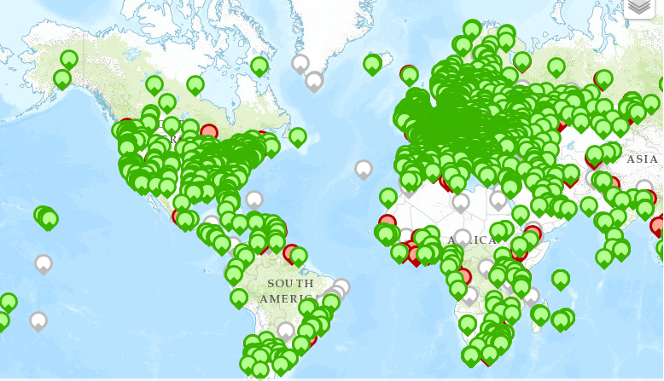
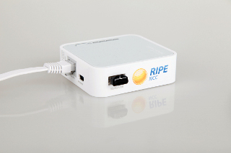
Active approach: Traceroute
Issue: Need control over end hosts to run traceroute
  How to get VPs?
http://www.traceroute.org/
  Collection of O(100) servers that will run traceroute
  Hosted by ISPs/other network operators (e.g. universities)
RIPE Atlas
  Distribute specialized hardware to volunteers
  O(1000s) of probes
Dasu
  Bittorrent plug in that does measurements
  O(200) ASes with Dasu clients

Slide 32
Where the sidewalk ends (CoNEXT 2009) (1/2)
Mock traceroute:
IP ISP 1 (client1)
…
IP ISP 1 (router)
IP ISP 2 (router)
…
IP ISP 2 (client2)
Idea: Leverage traceroutes from P2P clients to extend the AS graph
NB: going from traceroute to AS connectivity is non-trivial!
Routeviews will not be able to see this peering link because of “valley free” routing.
Regional ISP
As part of Ono these clients randomly traceroute to other (nearby) peers.
Local ISP1
$
Local ISP2
Vuze clients running Ono* plug in (Dasu predecessor)
(992K IPs, 3,700 ASes)
*D. Choffnes and F. Bustamante. Taming the Torrent: A practical approach to reducing cross-ISP traffic in P2P systems, SIGCOMM 2008.

Slide 33
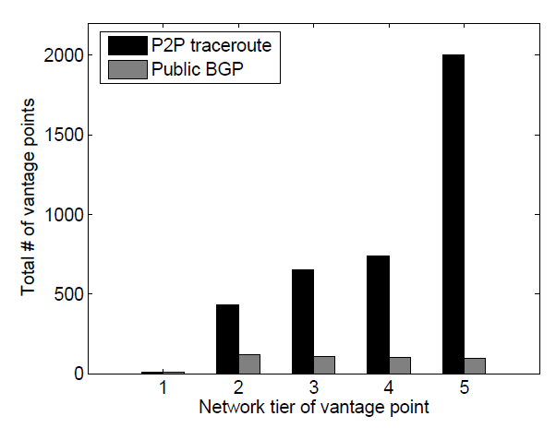
Where the sidewalk ends (CoNEXT 2009) (2/2)
23,914 new AS links
13% more customer provider links
41% more peering links
“stubs”
Tier 1s

Slide 34
Active Approach: Transit Portal
Motivation: Traceroute/BGP monitors will only show us paths that are in use…
  … not full connectivity
Need to explore back up paths to find all the full AS-level topology
Transit Portal solution:
  AS + Prefix controlled by researchers
  Border of the research AS made up by participating institutions
  BGPMux at each institution acts as border router, multiplexes TP users, sends BGP updates out.

Slide 35
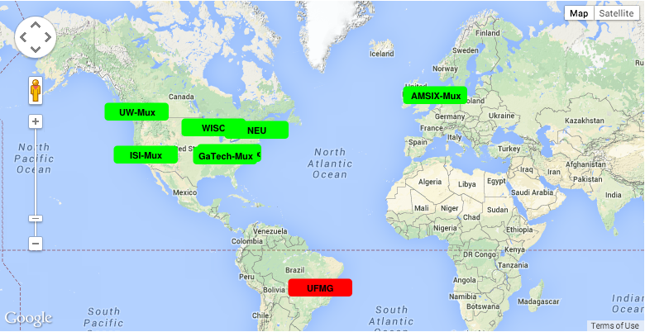
Transit Portal Coverage
(SBU coming soon!)

Slide 36
Using TP to explore connectivity
Similar idea as LIFEGUARD …
B, TP
Prefix
B
C, TP
Prefix
Traceroute VP
TP
Prefix
C
A
TP
A, B, TP
Prefix
Prefix
D
D, TP
Prefix

Slide 37
Using TP to explore connectivity
Similar idea as LIFEGUARD …
B
C, TP, B, TP
Prefix
Traceroute VP
TP, B, TP
Prefix
C
A
TP
A, C, TP, B, TP
Prefix
Prefix
D
D, TP, B, TP
Prefix

Slide 38
Using TP to explore connectivity
Similar idea as LIFEGUARD …
B
Traceroute VP
TP, B, C, TP
Prefix
C
A
TP
A, D, TP, B, C TP
Prefix
This is a simplified view …
in reality AS prepending to keep path lengths from impacting decisions
Prefix
D
D, TP, B, C, TP
Prefix

Slide 39
This isn’t the end of the story…
ASes may have more complex business relationships
  Geographic relationships
    E.g., peer in one region, provider in another
  Per-prefix relationships
    E.g., Amazon announcing a prefix to a specific provider
      AS14618 enterprise portion of Amazon
2914
6453
16509
14618
4755

Slide 40
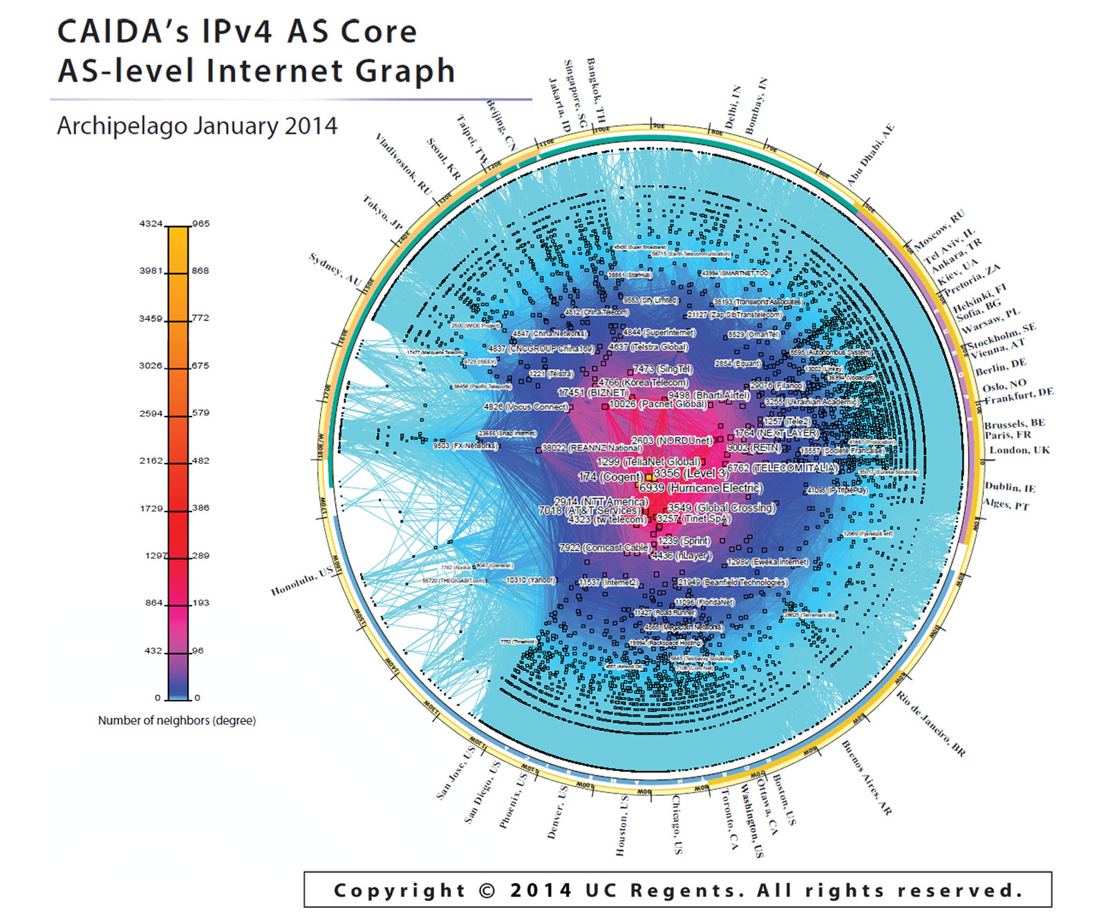
The outputs ….
15412 12041 p2c
15412 12486 p2c
15412 12880 p2c
15412 13810 p2c
15412 15802 p2c
15412 17408 p2c
15412 17554 p2c
15412 17709 p2c
15412 18101 p2c
15412 19806 p2c
19809 p2c
…

Slide 41
Outline
Internet Connectivity
  The shift from hierarchy to flat
  Measuring the shift
IXPs
  Based on slides by A. Feldmann

Slide 42
How do ASes connect?
Point of Presence (PoP)
  Usually a room or a building (windowless)
  One router from one AS is physically connected to the other
  Often in big cities
  Establishing a new connection at PoPs can be expensive
Internet eXchange Points
  Facilities dedicated to providing presence and connectivity for large numbers of ASes
  Many fewer IXPs than PoPs
  Economies of scale

Slide 43
IXPs Definition
Industry definition (according to Euro-IX)
  A physical network infrastructure operated by a single entity with the purpose to facilitate the exchange of Internet traffic between Autonomous Systems
  The number of Autonomous Systems connected should be at least three and there must be a clear and open policy for others to join.
  https://www.euro-ix.net/what-is-an-ixp

Slide 44


Internet eXchange Points

Slide 45
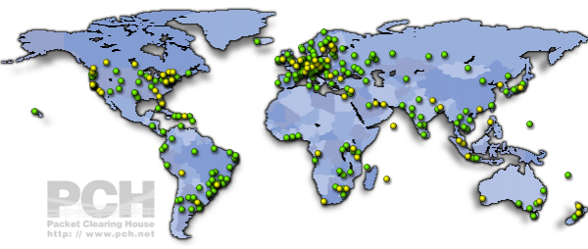
IXPs worldwide
https://prefix.pch.net/applications/ixpdir/

Slide 46
Inside an IXP

Slide 47
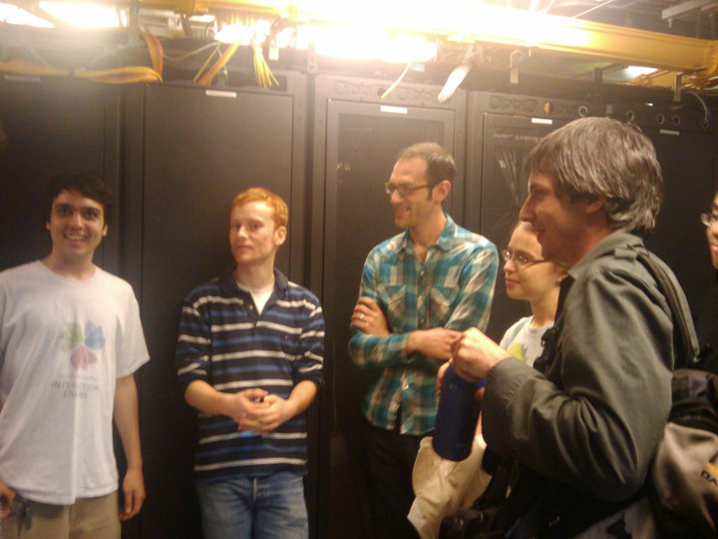
Inside an IXP
Connection fabric
  Can provide illusion of all-to-all
  connectivity
  Lots of routers and cables
Also a route server
  Collects and distributes routes
  from participants

Slide 48
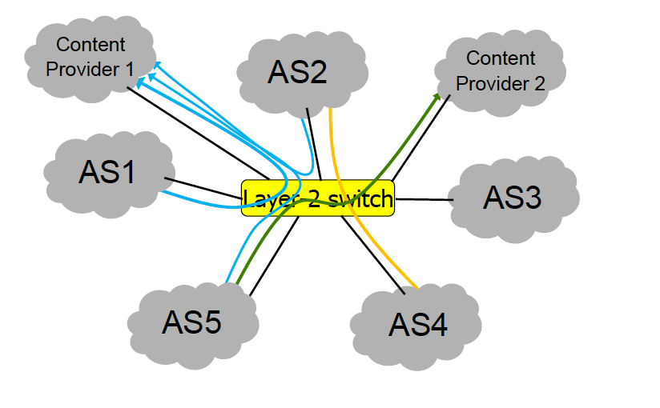
Structure
IXPs offer connectivity to ASes enable peering

Slide 49
IXPs -- Peering
Peering – Why? E.g., Giganews:
  “Establishing open peering arrangements at neutral Internet Exchange Points is a highly desirable practice because the Internet Exchange members are able to significantly improve latency, bandwidth, fault-tolerance, and the routing of traffic between themselves at no additional costs.”
IXPs – Four types of peering policies
  Open Peering – inclination to peer with anyone, anywhere
    Most common!
  Selective Peering – Inclination to peer, with some conditions
  Restrictive Peering – Inclination not to peer with any more entities
  No Peering – No, prefer to sell transit
  http://drpeering.net/white-papers/Peering-Policies/Peering-Policy.html

Slide 50
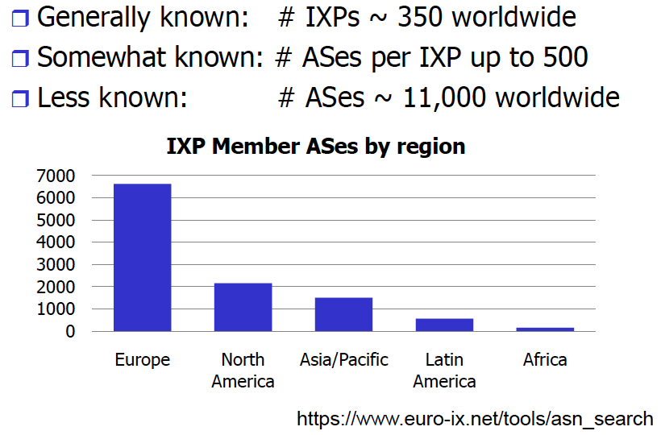
IXPs – Publicly available information

Slide 51
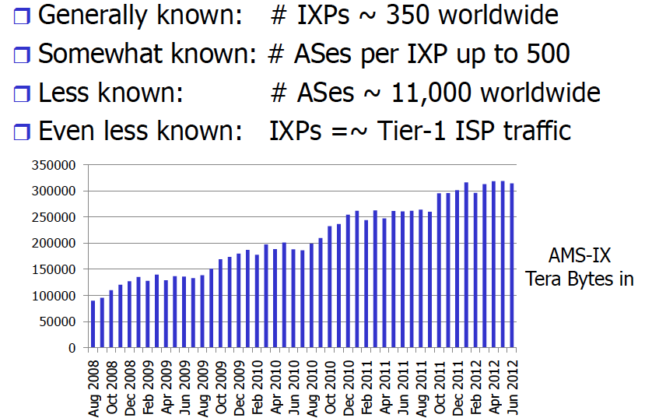
IXPs- Publicly available information
Unknown: # of peerings at IXPs

Slide 52
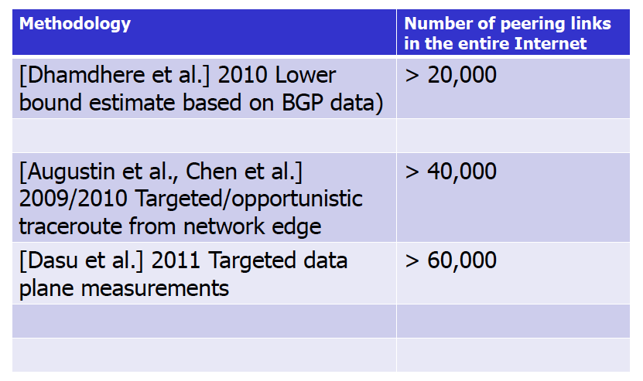
Peering links – Current Estimates?

Slide 53
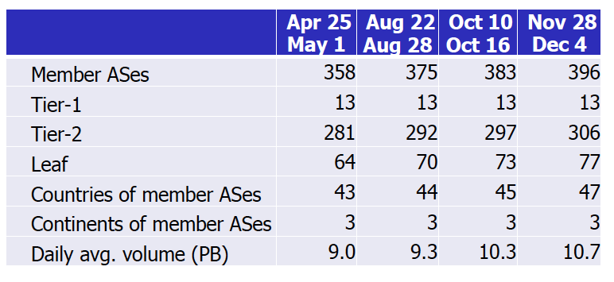
Reading on Web page (Ager et al. SIGCOMM 2012)
Data from a major European IXP
9 months of sFlow records collected in 2011

Slide 54
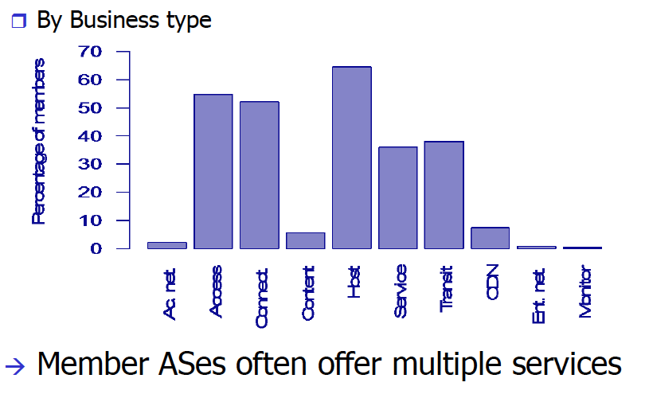
IXP Members/participants

Slide 55
How much traffic is at IXPs?*
We don’t know for sure!
  Seems to be a lot, though.
  One estimate: 43% of exchanged bytes are not visible to us
  Also 70% of peerings are invisible
*Mainly borrowed stolen from Feldmann 2012

Slide 56
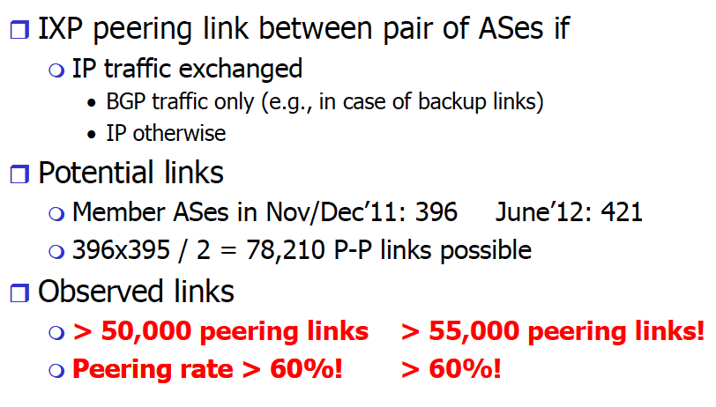
IXP peerings

Slide 57
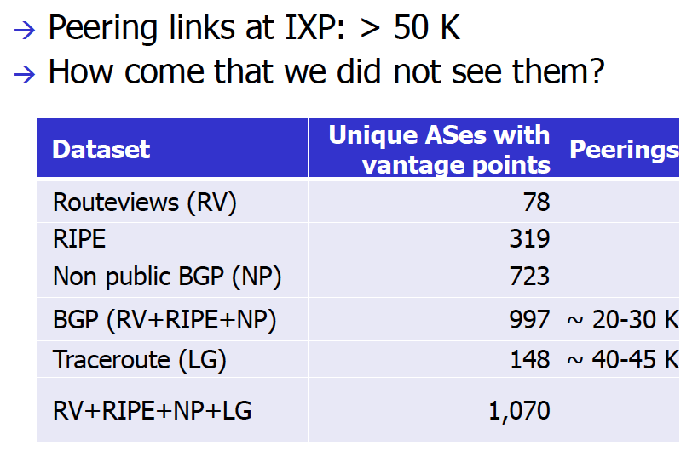
Public view of IXP peerings

Slide 58
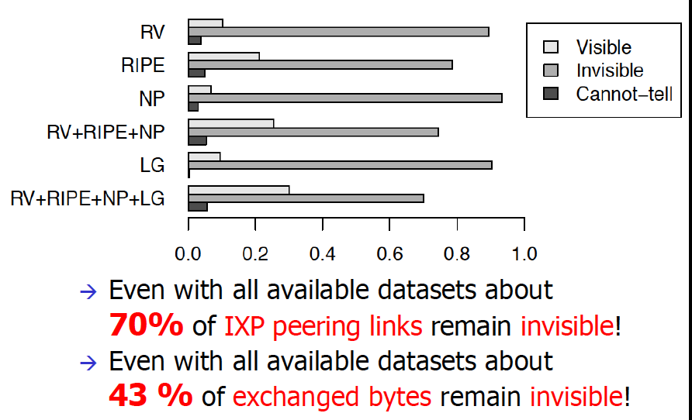
Visibility of IXP peerings

Slide 59
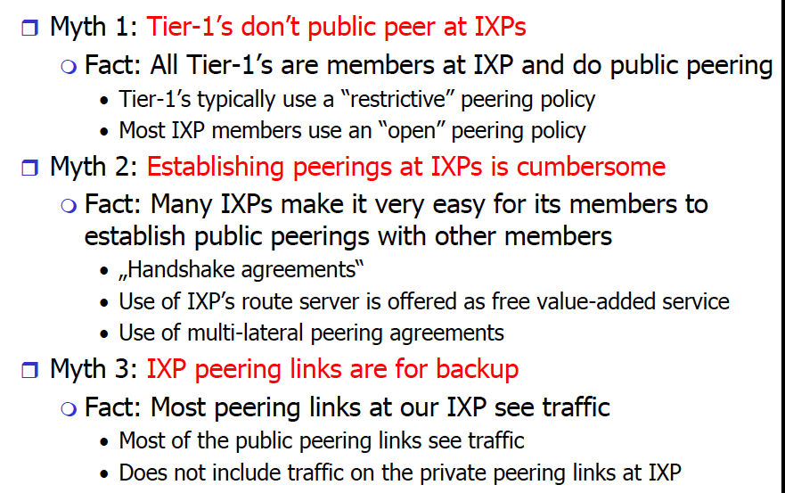
Interesting observations

Slide 60
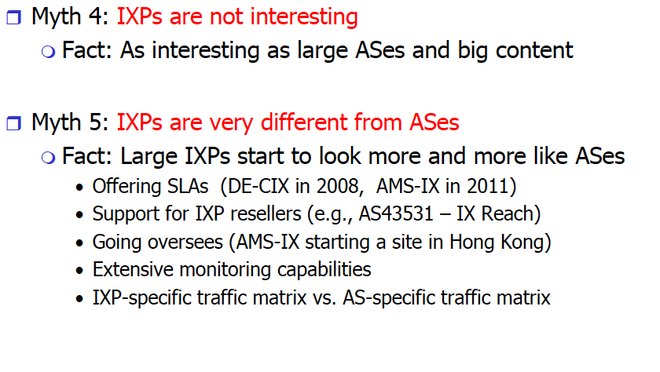
Interesting observations (2)

Slide 61
Revised model 2012+

