Slide 1
CSE 390 Advanced Computer Networks
Lecture 2: History
(Hint: Al Gore is not involved)
Based on slides from D. Choffnes Northeastern U. Revised Fall 2014 by P. Gill

Slide 2
What is a Comm. Network?
A communications network is a network of links and nodes arranged so that messages may be passed from one part of the network to another
What are nodes and links?
People and roads
Telephones and switches
Computers and routers
What is a message?
Information
Networks are key for:
Speed
Distance

Slide 3
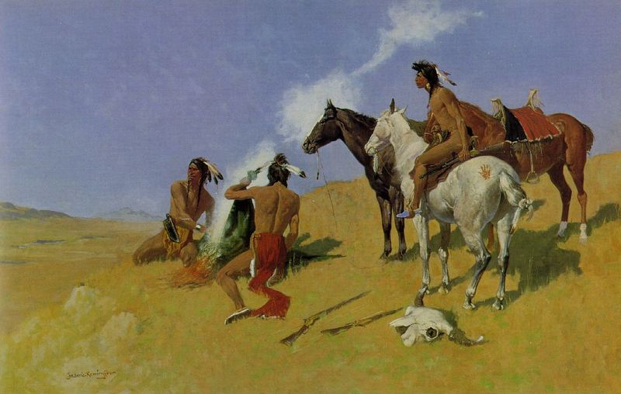
Networks are Fundamental
Smoke Signals!

Slide 4
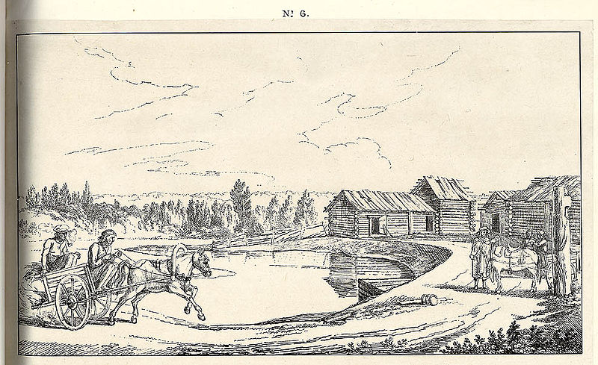
Networks are Old
2400 BC: courier networks in Egypt
550 BC: postal service invented in Persia
Problems:
Speed
Reliability
Security
Notes:
speed: time it takes to travel between points
Reliability, will the courier/mailman make it on his journey? Will he have an accident?
Mailman can be attacked. Mailman himself could even try to manipulate the contents of letters.

Slide 5
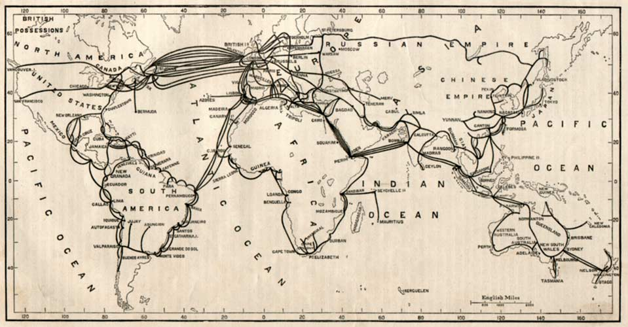
Submarine Cables + The Telegraph
1850 – first submarine cables laid
…by 1900 the first global communications network!
Submarine cables 1895

Slide 6
Towards Electric Communication
1837: Telegraph invented by Samuel Morse
Distance: 10 miles
Speed: 10 words per minute
In use until 1985!
Key challenge: how to encode information?
Originally used unary encoding
A • B •• C ••• D •••• E •••••
Next generation: binary encoding
A •– B –••• C –•–• D –•• E •
Higher compression = faster speeds

Slide 7
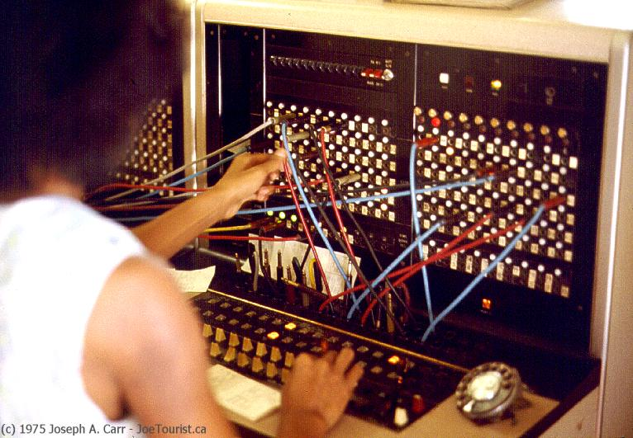
Telephony
1876 – Alexander Graham Bell invents the telephone
Key challenge: how to scale the network?
Originally, all phones were directly connected
O(n²) complexity; n*(n–1)/2
1878: Switching
1937: Trunk lines + multiplexing
Advantages
Easy to use
Switching mitigates complexity
Makes cable management tractable
Problems
Manual switching
1918: cross country call took 15 minutes to set up

Slide 8
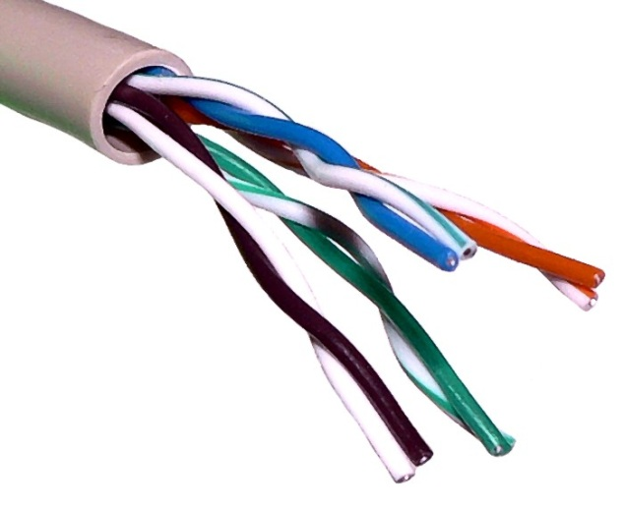
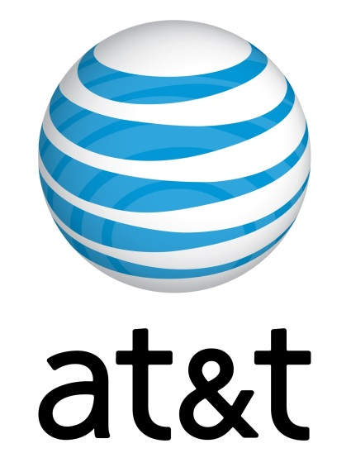
Growth of the Telephone Network
1881: Twisted pair for local loops
1885: AT&T formed
1892: Automatic telephone switches
1903: 3 million telephones in the US
1915: First transcontinental cable
1927: First transatlantic cable
1937: first round-the-world call
1946: National numbering plan

Slide 9
Crazy idea: Packet switching
Telephone networks are circuit switched
Each call reserves resources end-to-end
Provides excellent quality of service
Problems
Resource intense (what if the circuit is idle?)
Complex network components (per circuit state, security)
Packet switching
No connection state, network is store-and-forward
Minimal network assumptions
Statistical multiplexing gives high overall utilization

Slide 10
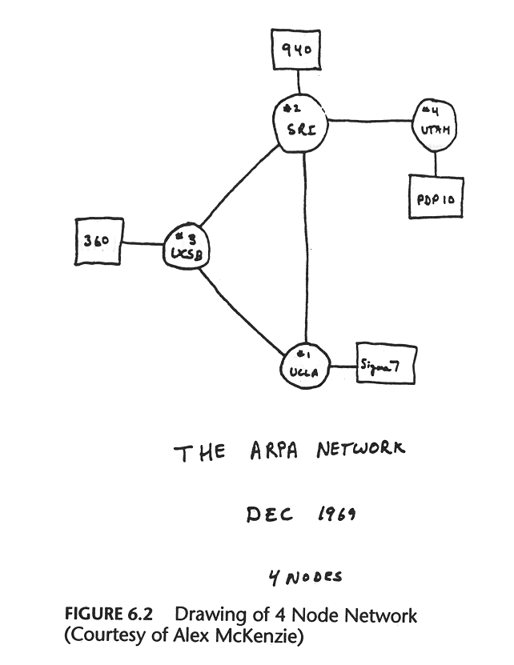
The World’s Most Successful Computer Science Research Project

Slide 11
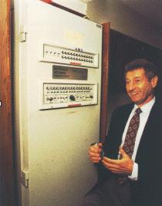
History of the Internet
1961: Kleinrock @ MIT: packet-switched network
1962: Licklider’s vision of Galactic Network
1965: Roberts connects computers over phone line
1967: Roberts publishes vision of ARPANET
1969: BBN installs first
InterfaceMsgProcessor at UCLA
1970: Network Control Program (NCP)
1972: Public demonstration of ARPANET
1972: Kahn @ DARPA advocates
Open Architecture
1972: Vint Cerf @ Stanford writes TCP
Notes:
It seems reasonable to envision, for a time 10 or 15 years hence, a 'thinking center' that will incorporate the functions of present-day libraries together with anticipated advances in information storage and retrieval. – Licklider’ Quote
NCP – abstract host-host communication protocol. Idea of having levels of protocols: e.g., Telnet, FTP …

Slide 12
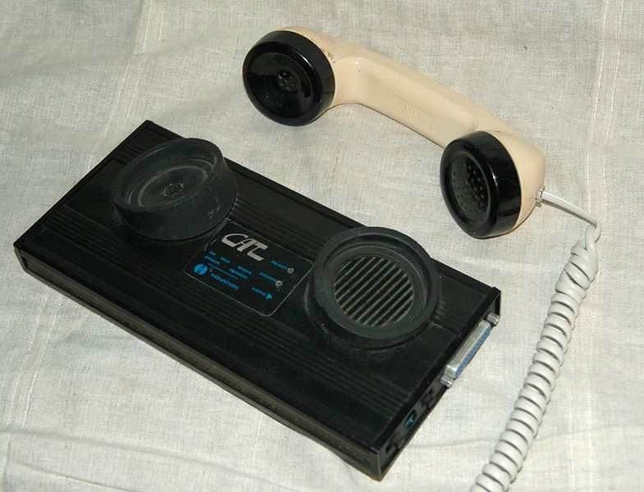
From Humans to Computers
1958: First use of a modem
Machine to machine communication
Analog vs. digital signals
Many different computer networks
Local vs. global
LAN, WAN
Private vs. public
Internet2, NIPRNet
General purpose vs. special purpose
E.g. credit cards, banks, defense
Technology
Satellite, Copper, Fiber
Circuit switched, packet switched

Slide 13
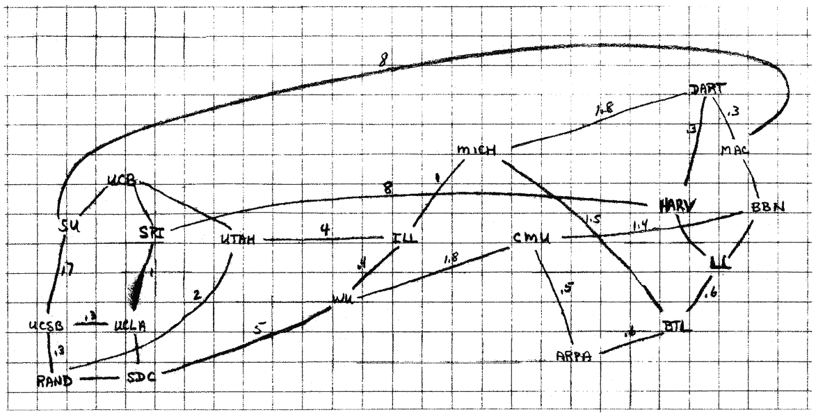
The 1960s

Slide 14
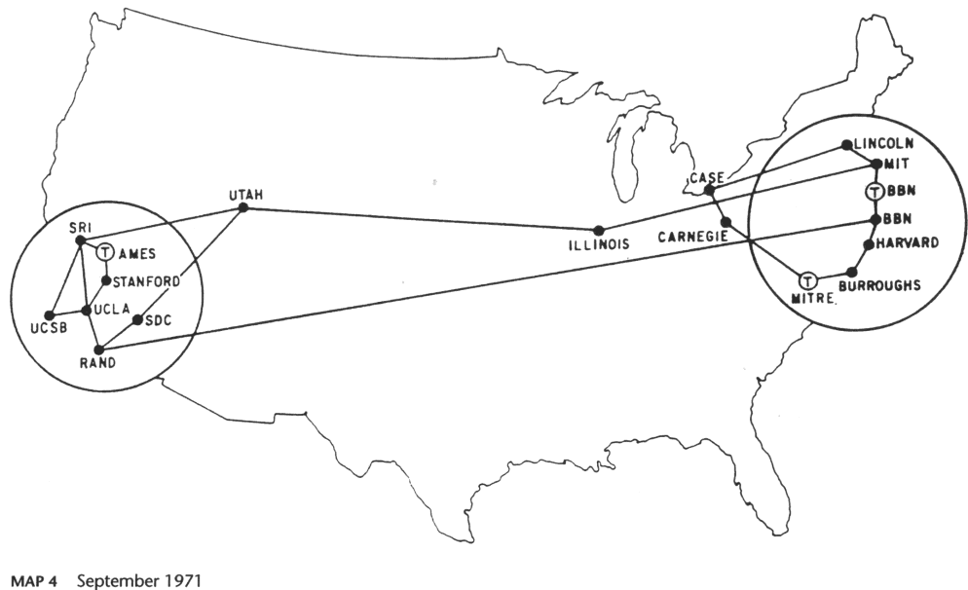
1971
Notes:
vRemote Access. In September, 1971, the first Terminal Interface Processor (TIP) was deployed, enabling individual computer terminals to dial directly into the ARPANET, thereby greatly increasing the ease of network connections and leading to significant growth.

Slide 15
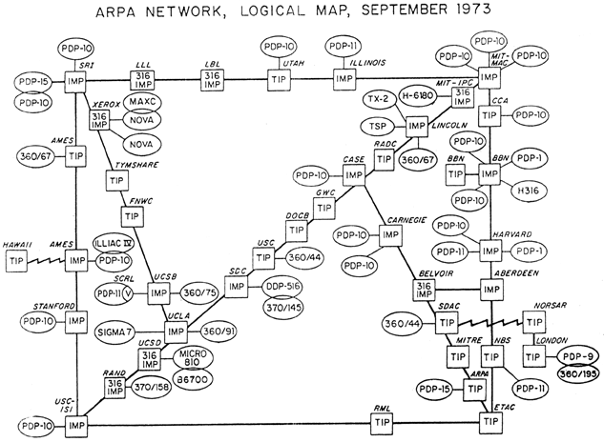
1973
Satellite Link to Hawaii
First international connections
(London + Norway)
Notes:
1973. By the end of 1973 there were 37 sites on the ARPANET, including a satellite link from California to Hawaii.
Also in 1973, the University College of London in England and the Royal Radar Establishment in Norway become the first international connections to the ARPANET.

Slide 16
Growing Pains
Problem: early networks used incompatible protocols

Slide 17
Kahn’s Ground Rules
Each network is independent, cannot be forced to change
A network of networks
Each running their own set of protocols
Best-effort communication (i.e. no guarantees)
Boxes (routers/gateways) connect networks
Boxes that do not maintain state → keep them simple!
No global control
Principles behind the development of IP
Led to the Internet as we know it
Internet is still structured as independent networks

Slide 18
The Birth of Routing
Trivia
Kahn believed that there would only be ~20 networks.
He was way off.
Why?

Slide 19
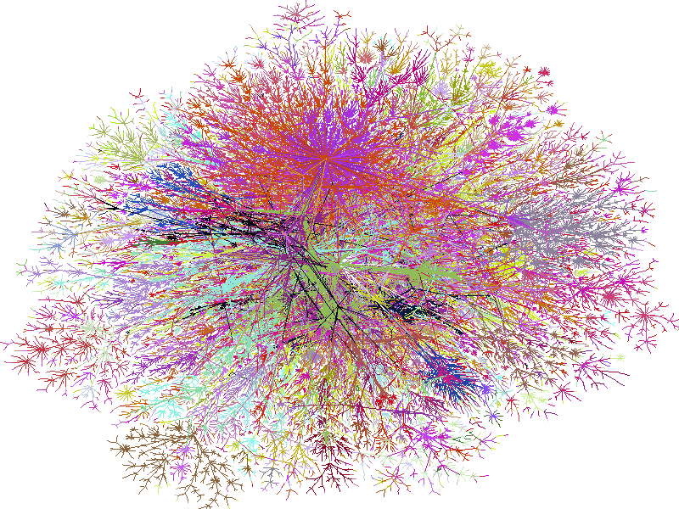
2000

Slide 20
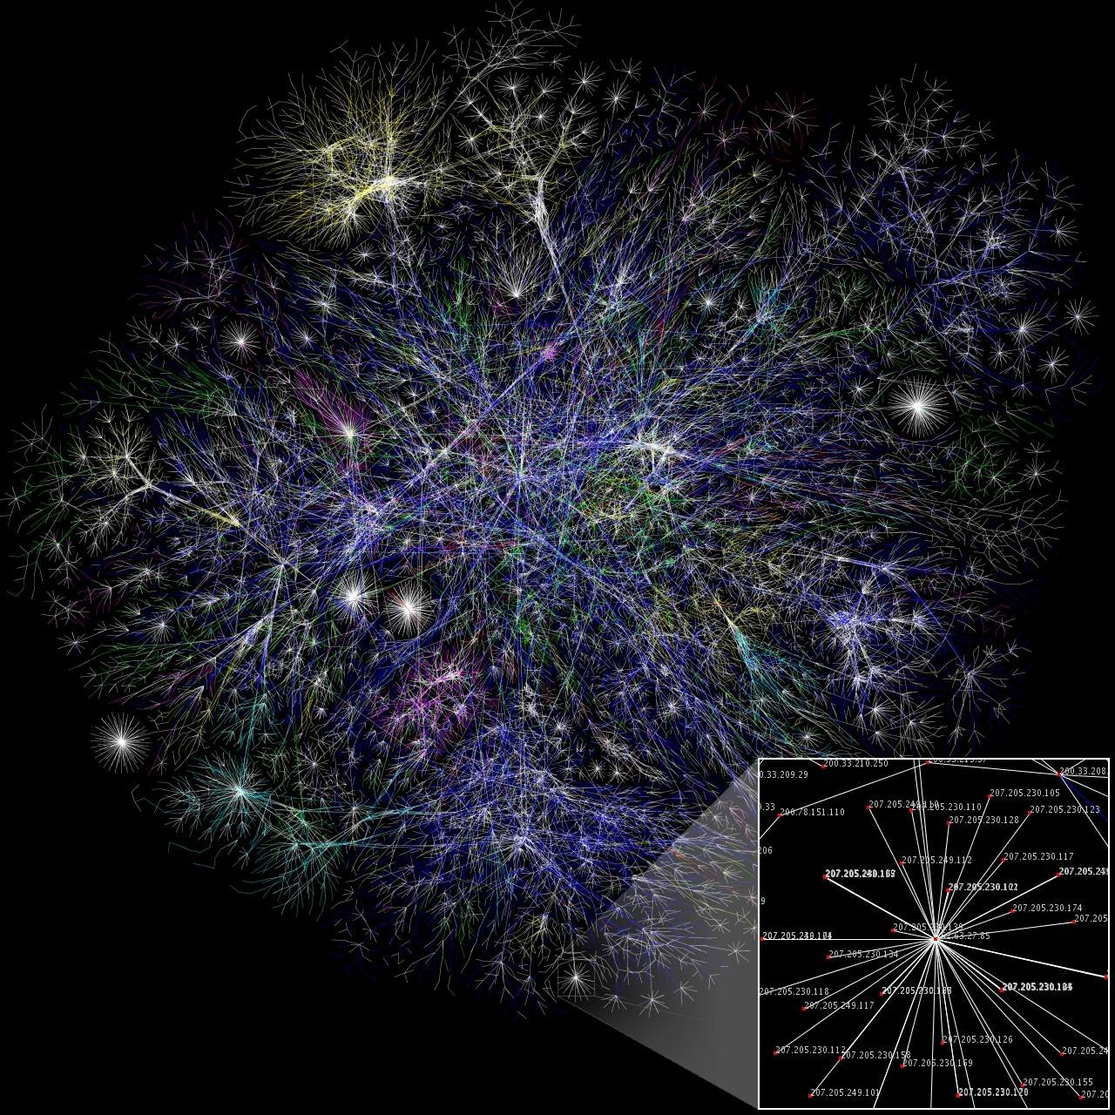
2006

Slide 21
2009

Slide 22
More Internet History
1974: Cerf and Kahn paper on TCP (IP kept separate)
1980: TCP/IP adopted as defense standard
1983: ARPANET and MILNET split
1983: Global NCP to TCP/IP flag day
198x: Internet melts down due to congestion
1986: Van Jacobson saves the Internet (BSD TCP)
1987: NSFNET merges with other networks
1988: Deering and Cheriton propose multicast
1994: NSF backbone dismantled, private backbone
1999-present: The Internet boom and bust … and boom
2007: Release of iPhone, rise of Mobile Internet
What is next?
Notes:
In 1983, an unclassified military only network called MILNET split off from the ARPANET, remaining connected only at a small number of gateways for exchange of electronic mail that could be easily disconnected for security reasons if required. MILNET later become part of the DoD Defense Data Network, or DDN.
In 1984, the US Department of Defense made TCP/IP the standard for all military computer networking, which gave it a high profile and stable funding.

Slide 23
Internet Applications Over Time
1972: Email
1973: Telnet – remote access to computing
1982: DNS – “phonebook” of the Internet
1985: FTP – remote file access
1989: NFS – remote file systems
1991: The World Wide Web (WWW) goes public
1995: SSH – secure remote shell access
1995-1997: Instant messaging (ICQ, AIM)
1998: Google
1999: Napster, birth of P2P
2001: Bittorrent
2004: Facebook
2005: YouTube
2007: The iPhone
What is next?

Slide 24
Takeaways
Communication is fundamental to human nature
Key concepts have existed for a long time
Speed/bandwidth
Latency
Switching
Packets vs. circuits
The Internet has changed the world
Promise of free ($) and free (freedom) communication
Shrunk the world
What made the Internet so successful? Stay tuned!
Encoding
Cable management
Multiplexing
Routing

