Slide 1
CSE 390 – Advanced Computer Networks
Lecture 11: HTTP/Web
(The Internet’s first killer app)
Based on slides from Kurose + Ross, and Carey Williamson (UCalgary). Revised Fall 2014 by P. Gill

Slide 2
Outline
HTTP Connection Basics
HTTP Protocol
Cookies, keeping state + tracking

Slide 3
Web and HTTP
First, a review…
web page consists of objects
object can be HTML file, JPEG image, Java applet, audio file,…
web page consists of base HTML-file which includes several referenced objects
each object is addressable by a URL, e.g.,
www.someschool.edu/someDept/pic.gif
host name
path name

Slide 4


HTTP overview
HTTP: hypertext transfer protocol
Web’s application layer protocol
client/server model
client: browser that requests, receives, (using HTTP protocol) and “displays” Web objects
server: Web server sends (using HTTP protocol) objects in response to requests
HTTP request
PC running
Firefox browser
HTTP response
HTTP request
server
running
Apache Web
server
HTTP response
iphone running
Safari browser

Slide 5
HTTP overview (continued)
uses TCP:
client initiates TCP connection (creates socket) to server, port 80
server accepts TCP connection from client
HTTP messages (application-layer protocol messages) exchanged between browser (HTTP client) and Web server (HTTP server)
TCP connection closed
HTTP is “stateless” (in theory…)
server maintains no information about past client requests
aside
protocols that maintain “state” are complex!
past history (state) must be maintained
if server/client crashes, their views of “state” may be inconsistent, must be reconciled

Slide 6
HTTP connections
non-persistent HTTP
at most one object sent over TCP connection
connection then closed
downloading multiple objects required multiple connections
persistent HTTP
multiple objects can be sent over single TCP connection between client, server

Slide 7
Example Web Page
Harry Potter Movies
As you all know,
the new HP book
will be out in June
and then there will
be a new movie
shortly after that…
“Harry Potter and
the Bathtub Ring”
hpface.jpg
page.html
castle.gif

Slide 8
Client
Server
Non-Persistent HTTP
TCP SYN
G
page.html
The “classic” approach
in HTTP/1.0 is to use one
HTTP request per TCP
connection, serially.
TCP FIN
TCP SYN
G
hpface.jpg
TCP FIN
TCP SYN
G
castle.gif
TCP FIN

Slide 9
Client
Server
Concurrent (parallel) TCP
connections can be used
to make things faster.
TCP SYN
G
C
S
C
S
page.html
S
S
TCP FIN
G
G
hpface.jpg
castle.gif
F
F

Slide 10
Persistent HTTP
non-persistent HTTP issues:
requires 2 RTTs per object
OS overhead for each TCP connection
browsers often open parallel TCP connections to fetch referenced objects
persistent HTTP:
server leaves connection open after sending response
subsequent HTTP messages between same client/server sent over open connection
client sends requests as soon as it encounters a referenced object
as little as one RTT for all the referenced objects

Slide 11
Non-persistent HTTP: response time
RTT: time for a packet to travel from client to server and back
HTTP response time:
one RTT to initiate TCP connection
one RTT for HTTP request and first few bytes of HTTP response to return
This assumes HTTP GET piggy backed on the ACK
file transmission time
non-persistent HTTP response time =
2RTT+ file transmission time
initiate TCP
connection
RTT
request
file
RTT
time to
transmit
file
file
received
time
time

Slide 12
Client
Server
Persistent HTTP
TCP SYN
G
page.html
The “persistent HTTP”
approach can re-use the
same TCP connection for
Multiple HTTP transfers,
one after another, serially.
Amortizes TCP overhead,
but maintains TCP state
longer at server.
G
hpface.jpg
G
castle.gif
Timeout
TCP FIN

Slide 13
Client
Server
TCP SYN
G
page.html
GG
The “pipelining” feature
in HTTP/1.1 allows
requests to be issued
asynchronously on a
persistent connection.
Requests must be
processed in proper order.
Can do clever packaging.
hpface.jpg
castle.gif
Timeout
TCP FIN

Slide 14
Outline
HTTP Connection Basics
HTTP Protocol
Cookies, keeping state + tracking

Slide 15
HTTP request message
two types of HTTP messages: request, response
HTTP request message:
ASCII (human-readable format)
carriage return character
request line
(GET, POST,
HEAD commands)
line-feed character
GET /index.html HTTP/1.1\r\n
Host: www-net.cs.umass.edu\r\n
User-Agent: Firefox/3.6.10\r\n
Accept: text/html,application/xhtml+xml\r\n
Accept-Language: en-us,en;q=0.5\r\n
Accept-Encoding: gzip,deflate\r\n
Accept-Charset: ISO-8859-1,utf-8;q=0.7\r\n
Keep-Alive: 115\r\n
Connection: keep-alive\r\n
\r\n
header
lines
carriage return,
line feed at start
of line indicates
end of header lines

Slide 16
HTTP request message: general format
method
sp
URL
sp
version
cr
lf
request
line
header field name
value
cr
lf
~
~
header
lines
~
~
header field name
value
cr
lf
cr
lf
~
entity body
~
body
~
~

Slide 17
Uploading form input
POST method:
web page often includes form input
input is uploaded to server in entity body
URL method:
uses GET method
input is uploaded in URL field of request line:
www.somesite.com/animalsearch?monkeys&banana

Slide 18
Method types
HTTP/1.0:
GET
POST
HEAD
asks server to leave requested object out of response
HTTP/1.1:
GET, POST, HEAD
PUT
uploads file in entity body to path specified in URL field
DELETE
deletes file specified in the URL field

Slide 19
HTTP response message
status line
(protocol
status code
status phrase)
HTTP/1.1 200 OK\r\n
Date: Sun, 26 Sep 2010 20:09:20 GMT\r\n
Server: Apache/2.0.52 (CentOS)\r\n
Last-Modified: Tue, 30 Oct 2007 17:00:02 GMT\r\n
ETag: "17dc6-a5c-bf716880"\r\n
Accept-Ranges: bytes\r\n
Content-Length: 2652\r\n
Keep-Alive: timeout=10, max=100\r\n
Connection: Keep-Alive\r\n
Content-Type: text/html; charset=ISO-8859-1\r\n
\r\n
data data data data data ...
header
lines
data, e.g.,
requested
HTML file

Slide 20
HTTP response status codes
status code appears in 1st line in server-to-client response message.
some sample codes:
200 OK
request succeeded, requested object later in this msg
301 Moved Permanently
requested object moved, new location specified later in this msg (Location:)
400 Bad Request
request msg not understood by server
404 Not Found
requested document not found on this server
505 HTTP Version Not Supported

Slide 21
Trying out HTTP (client side) for yourself
1. Telnet to your favorite Web server:
telnet cis.poly.edu 80
opens TCP connection to port 80
(default HTTP server port) at cis.poly.edu.
anything typed in sent
to port 80 at cis.poly.edu
2. type in a GET HTTP request:
GET /~ross/ HTTP/1.1
Host: cis.poly.edu
by typing this in (hit carriage
return twice), you send
this minimal (but complete)
GET request to HTTP server
3. look at response message sent by HTTP server!
(or use Wireshark to look at captured HTTP request/response)

Slide 22
Outline
HTTP Connection Basics
HTTP Protocol
Cookies, keeping state + tracking

Slide 23
User-server state: cookies
example:
Susan always access Internet from PC
visits specific e-commerce site for first time
when initial HTTP requests arrives at site, site creates:
unique ID
entry in backend database for ID
many Web sites use cookies
four components:
1) cookie header line of HTTP response message
2) cookie header line in next HTTP request message
3) cookie file kept on user’s host, managed by user’s browser
4) back-end database at Web site

Slide 24
Cookies: keeping “state” (cont.)
client
server
ebay 8734
usual http request msg
Amazon server
creates ID
1678 for user
cookie file
usual http response
set-cookie: 1678
backend
database
create
entry
ebay 8734
amazon 1678
usual http request msg
cookie: 1678
cookie-
specific
action
access
usual http response msg
one week later:
access
ebay 8734
amazon 1678
usual http request msg
cookie: 1678
cookie-
specific
action
usual http response msg

Slide 25
Cookies (continued)
aside
what cookies can be used for:
authorization
shopping carts
recommendations
user session state (Web e-mail)
cookies and privacy:
cookies permit sites to learn a lot about you
you may supply name and e-mail to sites
how to keep “state”:
protocol endpoints: maintain state at sender/receiver over multiple transactions
cookies: http messages carry state

Slide 26
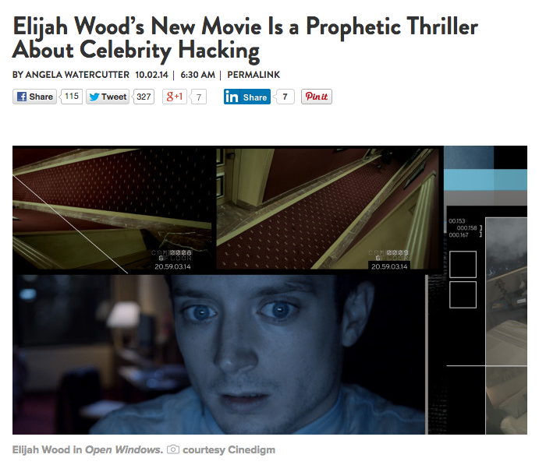
Cookies + Third Parties
Example page (from Wired.com)

Slide 27


How it works
And it’s not just Facebook!
Wired.com
GET article.html
GET sharebutton.gif
Cookie: FBCOOKIE
Facebook now knows you visited this Wired article.
Works for all pages where ‘like’/’share’ button is embedded!

Slide 28
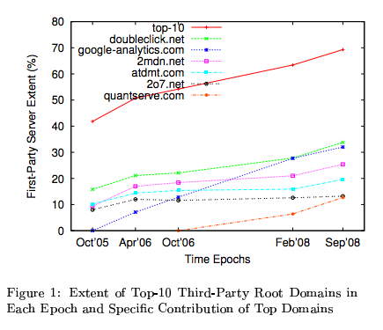
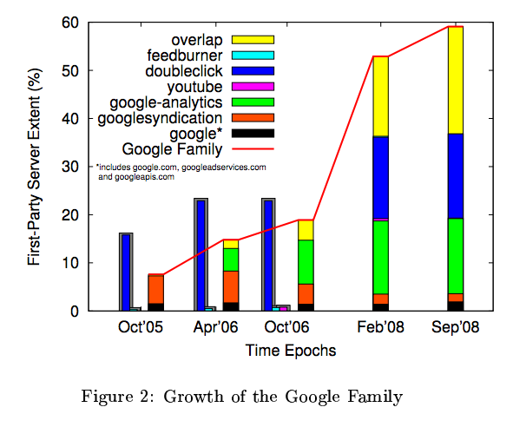
This has been going on for a while…

Slide 29
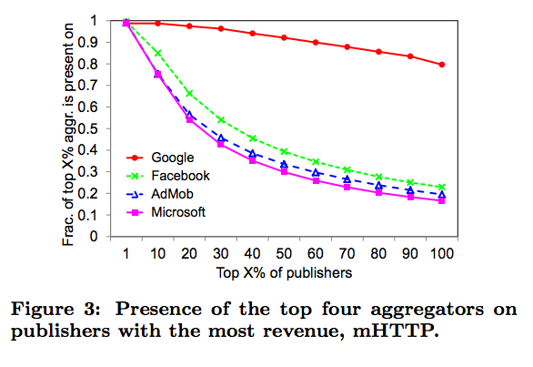
More recent results (2011)

Slide 30

What can we do about it?
Different ad block products (block cookies/connections to third party sites)
Ghostery, Ad Block etc.
Doesn’t completely solve the problem…
Trackers getting smarter. Use browser features to fingerprint
E.g., combination of installed extensions/fonts etc.
Surprisingly unique!
Optional fun reading:
Cookieless monster: http://www.securitee.org/files/cookieless_sp2013.pdf

Slide 31
CSE 390 – Advanced Computer Networks
Lecture 11: Content Delivery Networks
(Over 1 billion served … each day)
Based on slides by D. Choffnes @ NEU. Revised Fall 2014 by P. Gill

Slide 32
Outline
Motivation
CDN basics
Prominent example: Akamai

Slide 33
Content in today’s Internet
Most flows are HTTP
Web is at least 52% of traffic
Median object size is 2.7K, average is 85K (as of 2007)
HTTP uses TCP, so it will
Be ACK clocked
For Web, likely never leave slow start
Is the Internet designed for this common case?
Why?

Slide 34
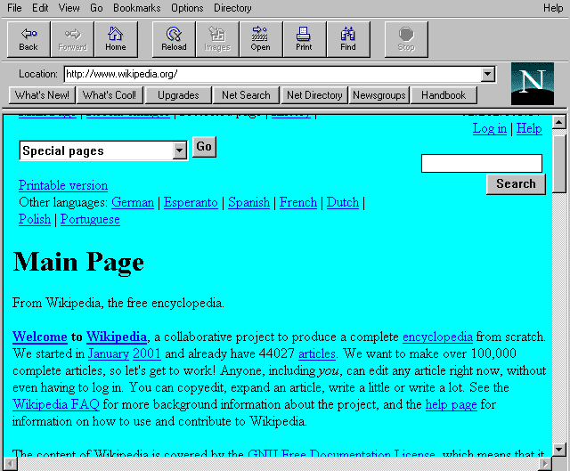
Evolution of Serving Web Content
In the beginning…
…there was a single server
Probably located in a closet
And it probably served blinking text
Issues with this model
Site reliability
Unplugging cable, hardware failure, natural disaster
Scalability
Flash crowds (aka Slashdotting)

Slide 35
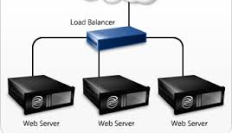
Replicated Web service
Use multiple servers
Advantages
Better scalability
Better reliability
Disadvantages
How do you decide which server to use?
How to do synchronize state among servers?

Slide 36
Load Balancers
Device that multiplexes requests across a collection of servers
All servers share one public IP
Balancer transparently directs requests to different servers
How should the balancer assign clients to servers?
Random / round-robin
When is this a good idea?
Load-based
When might this fail?
Challenges
Scalability (must support traffic for n hosts)
State (must keep track of previous decisions)
RESTful APIs reduce this limitation

Slide 37
Load balancing: Are we done?
Advantages
Allows scaling of hardware independent of IPs
Relatively easy to maintain
Disadvantages
Expensive
Still a single point of failure
Location!
Where do we place the load balancer for Wikipedia?

Slide 38
Popping up: HTTP performance
For Web pages
RTT matters most
Where should the server go?
For video
Available bandwidth matters most
Where should the server go?
Is there one location that is best for everyone?

Slide 39

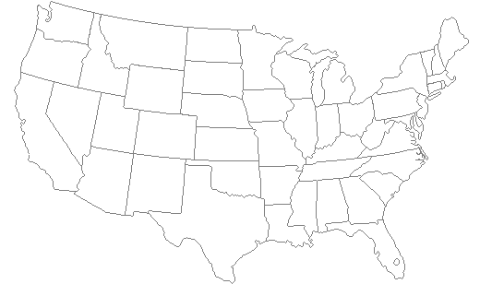
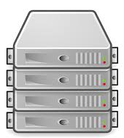
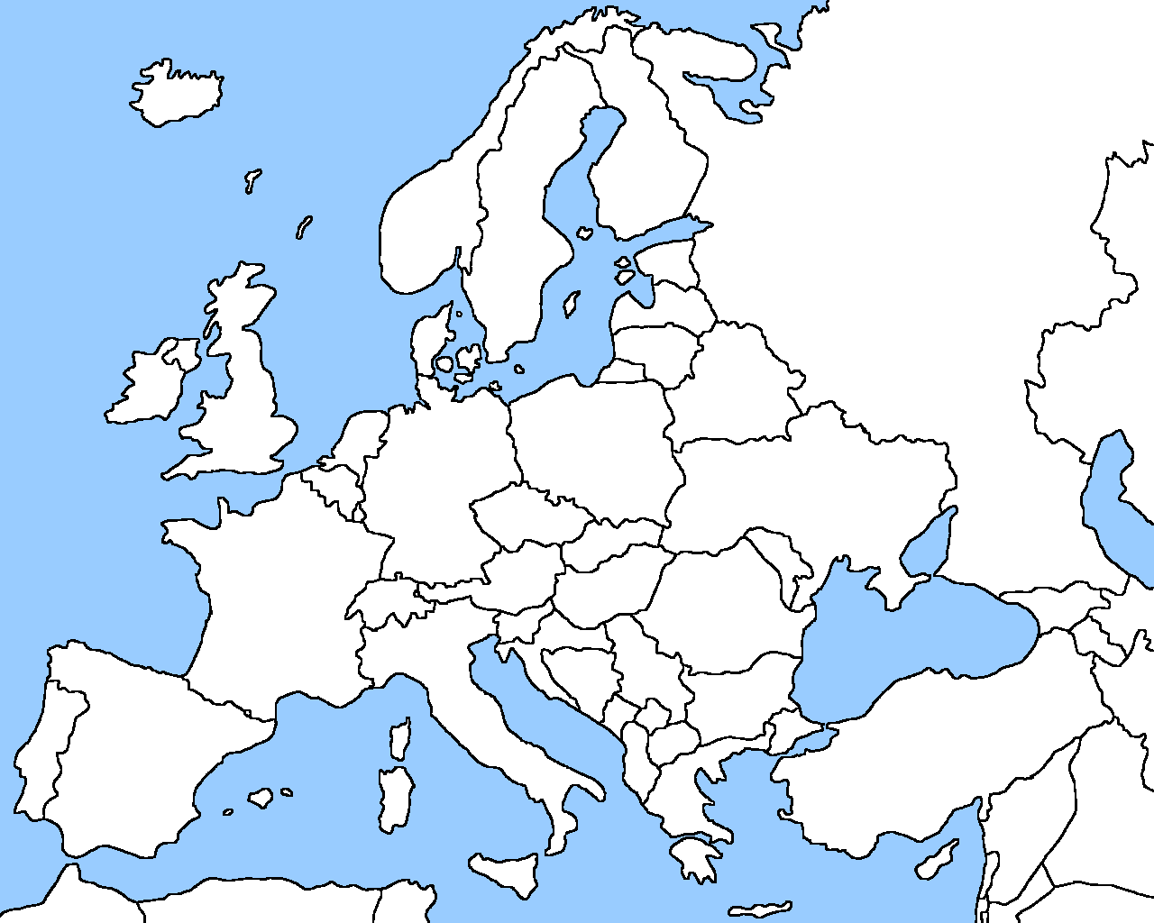
Server placement

Slide 40
Why speed matters
Impact on user experience
Users navigating away from pages
Video startup delay

Slide 41

Why speed matters
Impact on user experience
Users navigating away from pages
Video startup delay
Impact on revenue
Amazon: increased revenue 1% for every 100ms reduction in page load time (PLT)
Shopzilla:12% increase in revenue by reducing PLT from 6 seconds to 1.2 seconds
Ping from BOS to LAX: ~100ms

Slide 42
Strawman solution: Web caches
ISP uses a middlebox that caches Web content
Better performance – content is closer to users
Lower cost – content traverses network boundary once
Does this solve the problem?
No!
Size of all Web content is too large ☹
Web content is dynamic and customized
Can’t cache banking content
What does it mean to cache search results?

Slide 43
Outline
Motivation
CDN basics
Prominent example: Akamai

Slide 44
What is a CDN?
Content Delivery Network
Also sometimes called Content Distribution Network
At least half of the world’s bits are delivered by a CDN
Probably closer to 80/90%
Primary Goals
Create replicas of content throughout the Internet
Ensure that replicas are always available
Directly clients to replicas that will give good performance

Slide 45
Key Components of a CDN
Distributed servers
Usually located inside of other ISPs
Often located in IXPs (coming up next)
High-speed network connecting them
Clients (eyeballs)
Can be located anywhere in the world
They want fast Web performance
Glue
Something that binds clients to “nearby” replica servers

Slide 46
Examples of CDNs
Akamai
147K+ servers, 1200+ networks, 650+ cities, 92 countries
Limelight
Well provisioned delivery centers, interconnected via a private fiber-optic connected to 700+ access networks
Edgecast
30+ PoPs, 5 continents, 2000+ direct connections
Others
Google, Facebook, AWS, AT&T, Level3, Brokers

Slide 47
Inside a CDN
Servers are deployed in clusters for reliability
Some may be offline
Could be due to failure
Also could be “suspended” (e.g., to save power or for upgrade)
Could be multiple clusters per location (e.g., in multiple racks)
Server locations
Well-connected points of presence (PoPs)
Inside of ISPs

Slide 48
Mapping clients to servers
CDNs need a way to send clients to the “best” server
The best server can change over time
And this depends on client location, network conditions, server load, …
What existing technology can we use for this?
DNS-based redirection
Clients request www.foo.com
DNS server directs client to one or more IPs based on request IP
Use short TTL to limit the effect of caching

Slide 49
CDN redirection example
choffnes$ dig www.fox.com
;; ANSWER SECTION:
www.fox.com. 510 IN CNAME www.fox-rma.com.edgesuite.net.
www.fox-rma.com.edgesuite.net. 5139 IN CNAME a2047.w7.akamai.net.
a2047.w7.akamai.net. 4 IN A 23.62.96.128
a2047.w7.akamai.net. 4 IN A 23.62.96.144
a2047.w7.akamai.net. 4 IN A 23.62.96.193
a2047.w7.akamai.net. 4 IN A 23.62.96.162
a2047.w7.akamai.net. 4 IN A 23.62.96.185
a2047.w7.akamai.net. 4 IN A 23.62.96.154
a2047.w7.akamai.net. 4 IN A 23.62.96.169
a2047.w7.akamai.net. 4 IN A 23.62.96.152
a2047.w7.akamai.net. 4 IN A 23.62.96.186

Slide 50
DNS Redirection Considerations
Advantages
Uses existing, scalable DNS infrastructure
URLs can stay essentially the same
TTLs can control “freshness”
Limitations
DNS servers see only the DNS resolver IP
Assumes that client and DNS server are close. Is this accurate?
Small TTLs are often ignored
Content owner must give up control
Unicast addresses can limit reliability

Slide 51
CDN Using Anycast
Anycast address
An IP address in a prefix announced from multiple locations
120.10.0.0/16
AS 41
AS 32
AS 31
120.10.0.0/16
AS 20
AS 3
AS 1
AS 2
?

Slide 52
Anycasting Considerations
Why do anycast?
Simplifies network management
Replica servers can be in the same network domain
Uses best BGP path
Disadvantages
BGP path may not be optimal
Stateful services can be complicated

Slide 53
Optimizing Performance
Key goal Send clients to server with best end-to-end performance
Performance depends on
Server load
Content at that server
Network conditions
Optimizing for server load
Load balancing, monitoring at servers
Generally solved

Slide 54
Optimizing performance: caching
Where to cache content?
Popularity of Web objects is Zipf-like
Also called heavy-tailed and power law
N_{r} ~ r⁻¹
Small number of sites cover large fraction of requests
Given this observation, how should cache-replacement work?

Slide 55
Optimizing performance: Network
There are good solutions to server load and content
What about network performance?
Key challenges for network performance
Measuring paths is hard
Traceroute gives us only the forward path
Shortest path != best path
RTT estimation is hard
Variable network conditions
May not represent end-to-end performance
No access to client-perceived performance

Slide 56
Optimizing performance: Network
Example approximation strategies
Geographic mapping
Hard to map IP to location
Internet paths do not take shortest distance
Active measurement
Ping from all replicas to all routable prefixes
56B * 100 servers * 500k prefixes = 500+MB of traffic per round
Passive measurement
Send fraction of clients to different servers, observe performance
Downside: Some clients get bad performance

Slide 57
Outline
Motivation
CDN basics
Prominent example: Akamai

Slide 58
Akamai case study
Deployment
147K+ servers, 1200+ networks, 650+ cities, 92 countries
highly hierarchical, caching depends on popularity
4 yr depreciation of servers
Many servers inside ISPs, who are thrilled to have them
Why?
Deployed inside100 new networks in last few years
Customers
250K+ domains: all top 60 eCommerce sites, all top 30 M&E companies, 9 of 10 to banks, 13 of top 15 auto manufacturers
Overall stats
5+ terabits/second, 30+ million hits/second, 2+ trillion deliveries/day, 100+ PB/day, 10+ million concurrent streams
15-30% of Web traffic

Slide 59
Somewhat old network map

Slide 60
Akamizing Links
Embedded URLs are Converted to ARLs
<html>
<head>
<title>Welcome to xyz.com!</title>
</head>
<body>
<img src=“http://www.xyz.com/logos/logo.gif”>
<img src=“http://www.xyz.com/jpgs/navbar1.jpg”>
<h1>Welcome to our Web site!</h1> <a href=“page2.html”>Click here to enter</a> </body> </html>
AK

Slide 61


DNS Redirection
Web client’s request redirected to ‘close’ by server
Client gets web site’s DNS CNAME entry with domain name in CDN network
Hierarchy of CDN’s DNS servers direct client to 2 nearby servers
Hierarchy of CDN DNS servers
Customer DNS servers
Internet
Multiple redirections to find nearby edge servers
Web replica servers
(3)
(4)
Client is given 2 nearby web replica servers (fault tolerance)
(5)
Client gets CNAME entry with domain name in Akamai
(2)
(6)
Client requests translation for yahoo
LDNS
(1)
Web client

Slide 62
Mapping Clients to Servers
Maps IP address of client’s name server and type of content being requested (e.g., “g” in a212.g.akamai.net) to an Akamai cluster.
Special cases: Akamai Accelerated Network Partners (AANPs)
Probably uses internal network paths
Also may require special “compute” nodes
General case: “Core Point” analysis

Slide 63
Core points
Core point X is the first router at which all paths to nameservers 1, 2, 3, and 4 intersect.
Traceroute once per day from 300 clusters to 280,000 nameservers.

Slide 64
Core Points
280,000 nameservers (98.8% of requests) reduced to 30,000 core points
ping core points every 6 minutes

Slide 65
Server clusters

Slide 66
Key future challenges
Mobile networks
Latency in cell networks is higher
Internal network structure is more opaque
Is this AT&T mobile client in Seattle or NYC?
Video
4k/8k UHD = 16-30K Kbps compressed
25K Tbps projected
Big data center networks not enough (5 Tbps each)
Multicast (from end systems) potential solution

Slide 67
Administravia/next time
Assignment 2
Updated trace 1 in the assignment folder.
Submission details will be available by Friday
Try capturing your own traces for testing as well ☺
Questions?
Midterm:
Next class. 80 minutes 8:30-9:50
closed book, no calculators
Please arrive on time (regardless of when you arrive the exam will end at the same time!)

