Slide 1
CSE390 – Advanced Computer Networks
Lecture 16: Data center networks
(The Underbelly of the Internet)
Based on slides by D. Choffnes @ NEU. Updated by P. Gill Fall 2014.

Slide 2
“The Network is the Computer”
Network computing has been around forever
Grid computing
High-performance computing
Clusters
Highly specialized
Nuclear simulation
Stock trading
Weather prediction
All of a sudden, datacenters/the cloud are HOT
Why?

Slide 3
The Internet Made Me Do It
Everyone wants to operate at Internet scale
Millions of users
Can your website survive a flash mob?
Zetabytes of data to analyze
Webserver logs
Advertisement clicks
Social networks, blogs, Twitter, video…
Not everyone has the expertise to build a cluster
The Internet is the symptom and the cure
Let someone else do it for you!

Slide 4
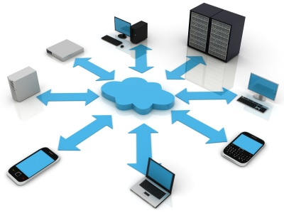
The Nebulous Cloud
What is “the cloud”?
Everything as a service
Hardware
Storage
Platform
Software
Anyone can rent computing resources
Cheaply
At large scale
On demand

Slide 5
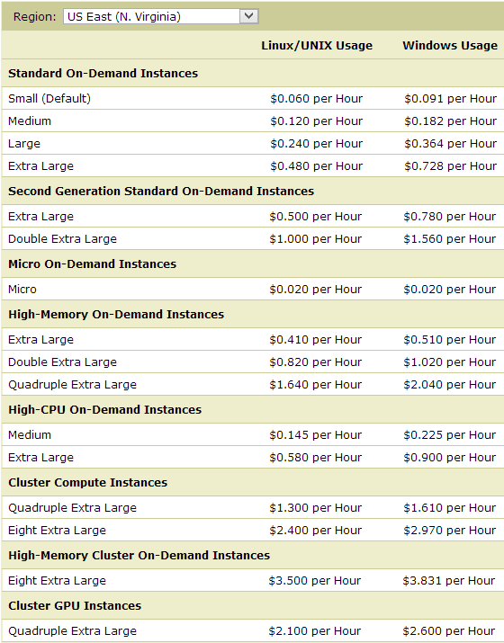
Example: Amazon EC2
Amazon’s Elastic Compute Cloud
Rent any number of virtual machines
For as long as you want
Hardware and storage as a service

Slide 6

Example: Google App Engine
Platform for deploying applications
From the developers perspective:
Write an application
Use Google’s Java/Python APIs
Deploy app to App Engine
From Google’s perspective:
Manage a datacenter full of machines and storage
All machines execute the App Engine runtime
Deploy apps from customers
Load balance incoming requests
Scale up customer apps as needed
Execute multiple instances of the app

Slide 7
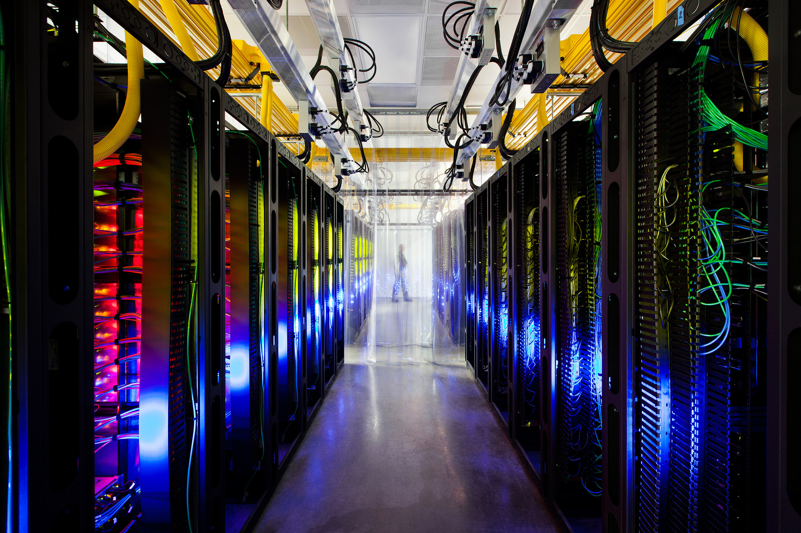

Slide 8
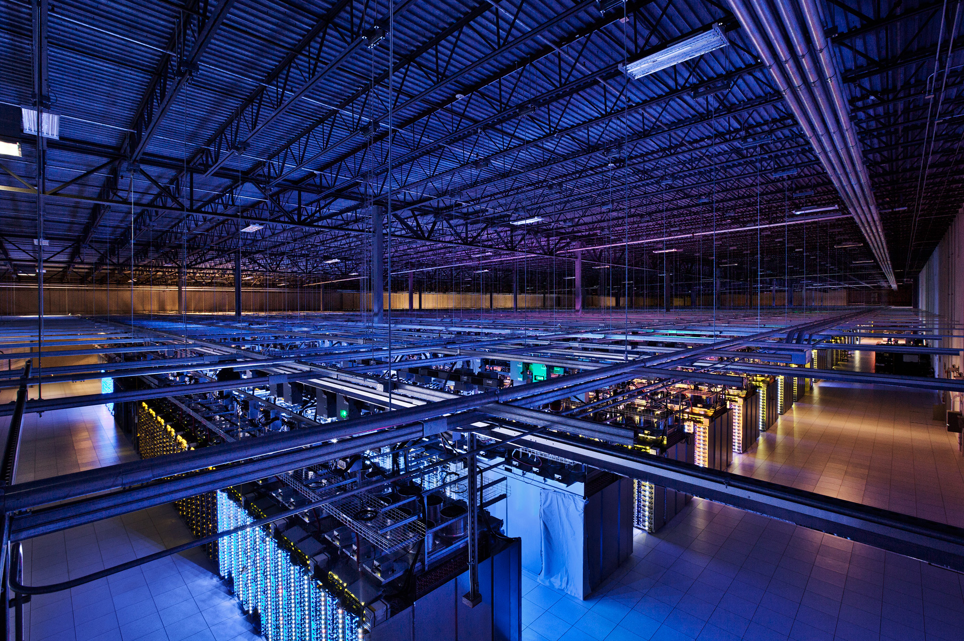

Slide 9
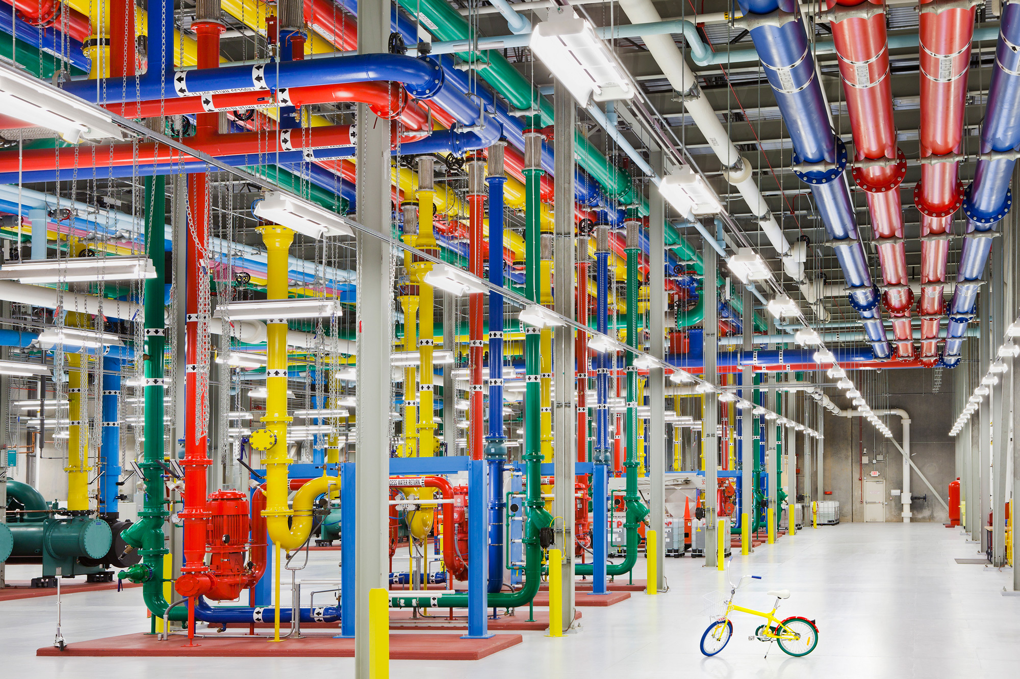

Slide 10

Data center networks overview
Internet
Access routers/network “core” fabric
Load balancers
Aggregation “Agg” switch
Top of Rack (ToR) switch
Servers
Notes:
Before looking at properties of failures lets first take a step back and look at the architecture of the data center network ...
This slide shows an example of a data center network architecture. It is a hierarchical structure with servers at the bottom of the topology. Servers connect to Top of Rack or ToR switches which in turn connect to a redundant set of aggregation switches. Each aggregation switch connects to a set of load balancers that are used to distribute traffic across servers. The Aggregation switches then connect to access and core routers that provide connectivity to the Internet.

Slide 11
Advantages of Current Designs
Cheap, off the shelf, commodity parts
No need for custom servers or networking kit
(Sort of) easy to scale horizontally
Runs standard software
No need for “clusters” or “grid” OSs
Stock networking protocols
Ideal for VMs
Highly redundant
Homogeneous

Slide 12
Lots of Problems
Datacenters mix customers and applications
Heterogeneous, unpredictable traffic patterns
Competition over resources
How to achieve high-reliability?
Privacy
Heat and Power
30 billion watts per year, worldwide
May cost more than the machines
Not environmentally friendly
All actively being researched

Slide 13
Today’s Topic : Network Problems
Datacenters are data intensive
Most hardware can handle this
CPUs scale with Moore’s Law
RAM is fast and cheap
RAID and SSDs are pretty fast
Current networks cannot handle it
Slow, not keeping pace over time
Expensive
Wiring is a nightmare
Hard to manage
Non-optimal protocols

Slide 14
Outline
Intro
Network Topology and Routing
Transport Protocols
Google and Facebook
DCTCP
D3
Reliability

Slide 15



Problem: Oversubscription
#Racksx40x1 Gbps → 1x10 Gbps
1:80-240
40x1Gbps → 1x10 Gbps
1:4
Bandwidth gets scarce as you move up the tree
Locality is key to performance
All-to-all communication is a very bad idea
40x1 Gbps Ports
1:1
40 Machines
1 Gbps Each
Notes:
Port bundling

Slide 16
Consequences of Oversubscription
Oversubscription cripples your datacenter
Limits application scalability
Bounds the size of your network
Problem is about to get worse
10 GigE servers are becoming more affordable
128 port 10 GigE routers are not
Oversubscription is a core router issue
Bottlenecking racks of GigE into 10 GigE links
What if we get rid of the core routers?
Only use cheap switches
Maintain 1:1 oversubscription ratio

Slide 17
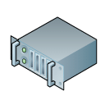
Fat Tree Topology
To build a K-ary fat tree
K-port switches
K³/4 servers
(K/2)² core switches
K pods, each with K switches
In this example K=4
4-port switches
K³/4 = 16 servers
(K/2)² = 4 core switches
4 pods, each with 4 switches
Pod

Slide 18
Fat Tree at a Glance
The good
Full bisection bandwidth
Lots of redundancy for failover
The bad
Need custom routing
Paper uses NetFPGA
Cost → 3K²/2 switches
48 port switches = 3456 switch
The ugly
OMG TEH WIRES!!!! → (K³+2K²)/4
48 port switches = 28800

Slide 19
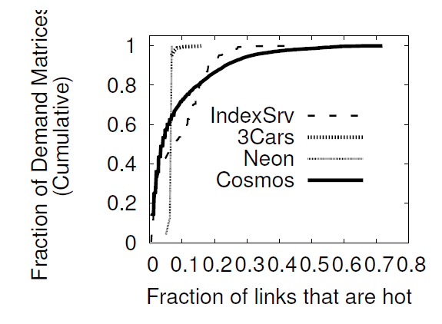
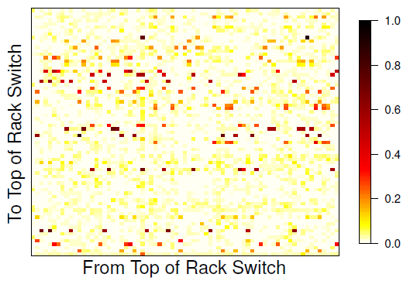
Is Oversubscription so Bad?
Oversubscription is a worst-case scenario
If traffic is localized, or short, there is no problem
How bad is the problem?

Slide 20

Idea: Flyways
Paper: http://research.microsoft.com/pubs/157700/flyways_sigcomm11.pdf
Challenges
Additional wiring
Route switching

Slide 21
Wireless Flyways
Why use wires at all?
Connect ToR servers wirelessly
Why can’t we use Wifi?
Massive interference
Key issue: Wifi is not directed

Slide 22
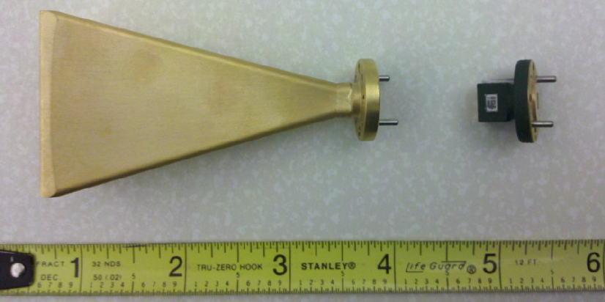
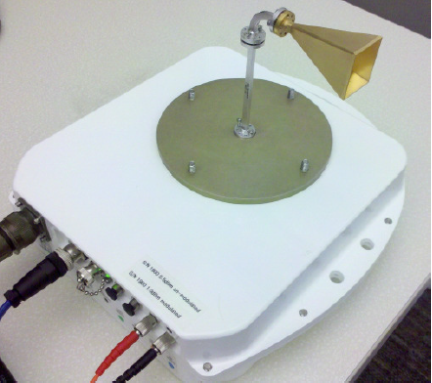
Direction 60 GHz Wireless

Slide 23
Implementing 60 GHz Flyways
Pre-compute routes
Measure the point-to-point bandwidth/interference
Calculate antenna angles
Measure traffic
Instrument the network stack per host
Leverage existing schedulers
Reroute
Encapsulate (tunnel) packets via the flyway
No need to modify static routes

Slide 24
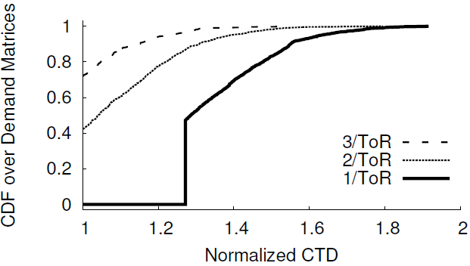
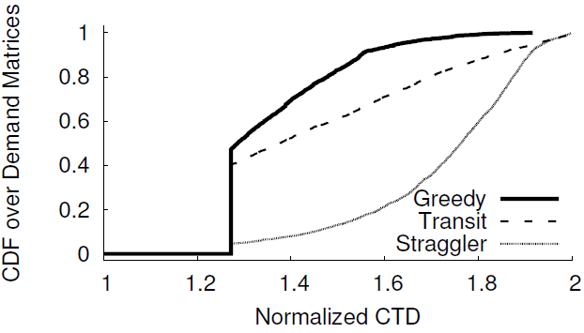
Results for 60 GHz Flyways
How many antennas per rack?
Hotspot fan-out is low
You don’t need that many antennas per rack
Adding a 2nd antenna 40% of flows complete as fast as non-oversubscribed network.
CTD = time for last flow to complete (completion time of the demands)
Which traffic to put on the flyway?
Prediction/scheduling is super important
Better schedulers could show more improvement
Traffic aware schedulers?

Slide 25
Problems with Wireless Flyways
Problems
Directed antennas still cause directed interference
Objects may block the point-to-point signal

Slide 26
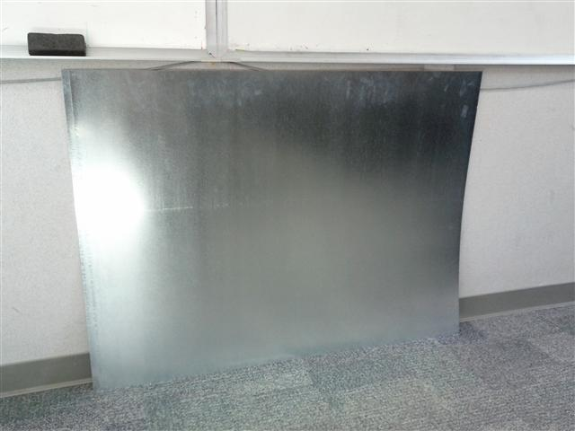
3D Wireless Flyways
Prior work assumes 2D wireless topology
Reduce interference by using 3D beams
Bounce the signal off the ceiling!
Stainless Steel Mirrors
60 GHz Directional Wireless

Slide 27
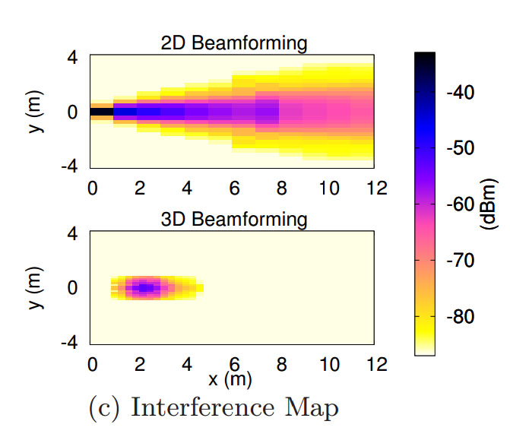
Comparing Interference
2D beam expands as it travels
Creates a cone of interference
3D beam focuses into a parabola
Short distances = small footprint
Long distances = longer footprint

Slide 28
Scheduling Wireless Flyways
Problem: connections are point-to-point
Antennas must be mechanically angled to form connection
Each rack can only talk to one other rack at a time
How to schedule the links?
Proposed solution
Centralized scheduler that monitors traffic
Based on demand (i.e. hotspots), choose links that:
Minimizes interference
Minimizes antenna rotations (i.e. prefer smaller angles)
Maximizes throughput (i.e. prefer heavily loaded links)
NP-Hard scheduling problem
Greedy algorithm for approximate solution

Slide 29
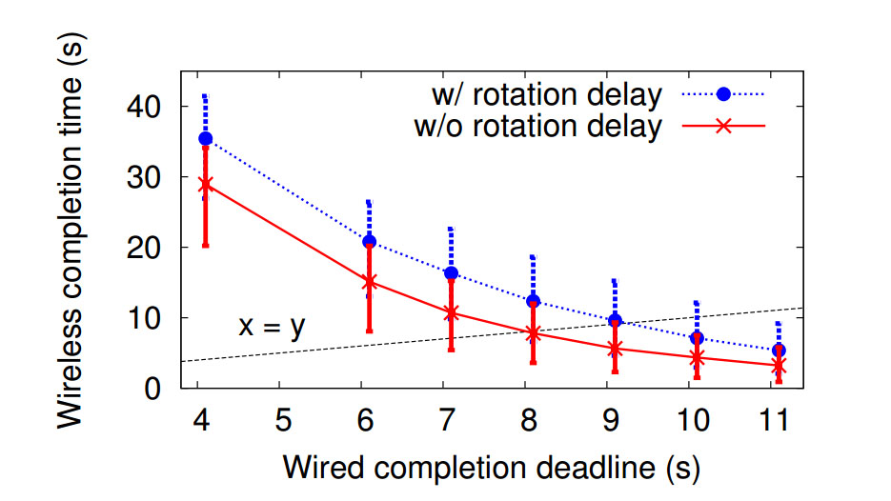
Other issues
Ceiling height
Antenna targeting errors
Antenna rotational delay

Slide 30
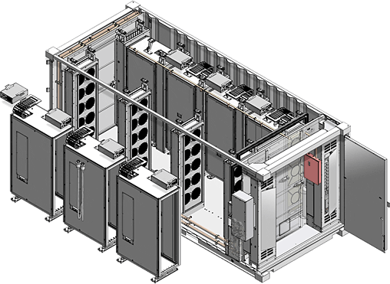
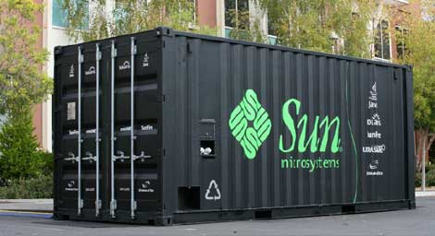
Modular Datacenters
Shipping container “datacenter in a box”
1,204 hosts per container
However many containers you want
How do you connect the containers?
Oversubscription, power, heat…
Physical distance matters (10 GigE → 10 meters)

Slide 31
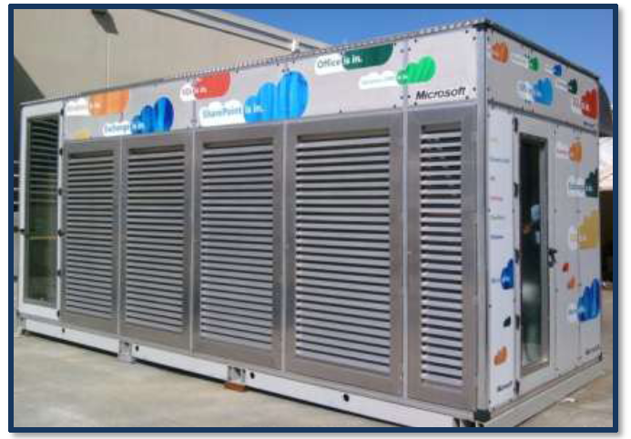
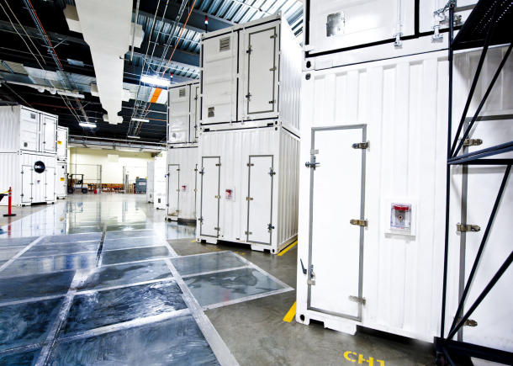
MSFT’s Chicago DC is containers!

Slide 32
Possible Solution: Optical Networks
Idea: connect containers using optical networks
Distance is irrelevant
Extremely high bandwidth
Optical routers are expensive
Each port needs a transceiver (light → packet)
Cost per port: $10 for 10 GigE, $200 for optical

Slide 33
Helios: Datacenters at Light Speed
Idea: use optical circuit switches, not routers
Uses mirrors to bounce light from port to port
No decoding!
Mirror
Optical
Router
Optical
Switch
Transceiver
Transceiver
In Port
Out Port
In Port
Out Port
http://cseweb.ucsd.edu/~vahdat/papers/helios-sigcomm10.pdf
Tradeoffs
Router can forward from any port to any other port
Switch is point to point
Mirror must be mechanically angled to make connection

Slide 34

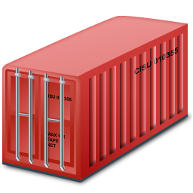
Dual Optical Networks
Typical, packet switch network
Connects all containers
Oversubscribed
Optical routers
Fiber optic flyway
Optical circuit switch
Direct container-to-container links, on demand

Slide 35
Circuit Scheduling and Performance
Centralized topology manager
Receives traffic measurements from containers
Analyzes traffic matrix
Reconfigures circuit switch
Notifies in-container routers to change routes
Circuit switching speed
~100ms for analysis
~200ms to move the mirrors

Slide 36
Outline
Intro
Network Topology and Routing
Transport Protocols
Google and Facebook
DCTCP
Reliability

Slide 37
Transport on the Internet
TCP is optimized for the WAN
Fairness
Slow-start
AIMD convergence
Defense against network failures
Three-way handshake
Reordering
Zero knowledge congestion control
Self-induces congestion
Loss always equals congestion
Delay tolerance
Ethernet, fiber, Wi-Fi, cellular, satellite, etc.

Slide 38
Datacenter is not the Internet
The good:
Possibility to make unilateral changes
Homogeneous hardware/software
Single administrative domain
Low error rates
The bad:
Latencies are very small (250µs)
Agility is key!
Little statistical multiplexing
One long flow may dominate a path
Cheap switches have queuing issues
Incast

Slide 39
Partition/Aggregate Pattern
User Request
Response
Common pattern for web applications
Search
E-mail
Responses are under a deadline
~250ms
Web Server
Aggregators
Workers

Slide 40
Problem: Incast
Aggregator sends out queries to a rack of workers
1 Aggregator
39 Workers
Each query takes the same time to complete
All workers answer at the same time
39 Flows→ 1 Port
Limited switch memory
Limited buffer at aggregator
Packet losses :(
Aggregator
Workers

Slide 41
Problem: Buffer Pressure
In theory, each port on a switch should have its own dedicated memory buffer
Cheap switches share buffer memory across ports
The fat flow can congest
the thin flow!

Slide 42

Problem: Queue Buildup
Long TCP flows congest the network
Ramp up, past slow start
Don’t stop until they induce queuing + loss
Oscillate around max utilization
Short flows can’t compete
Never get out of slow start
Deadline sensitive!
But there is queuing on arrival

Slide 43


Industry Solutions Hacks
Limits search worker responses to one TCP packet
Uses heavy compression to maximize data
Largest memcached instance on the planet
Custom engineered to use UDP
Connectionless responses
Connection pooling, one packet queries

Slide 44
Dirty Slate Approach: DCTCP
Goals
Alter TCP to achieve low latency, no queue buildup
Work with shallow buffered switches
Do not modify applications, switches, or routers
Idea
Scale window in proportion to congestion
Use existing ECN functionality
Turn single-bit scheme into multi-bit

Slide 45

Explicit Congestion Notification
Use TCP/IP headers to send ECN signals
Router sets ECN bit in header if there is congestion
Host TCP treats ECN marked packets the same as packet drops (i.e. congestion signal)
But no packets are dropped :)
Sender receives feedback
No Congestion
Congestion
ECN-bit set in ACK

Slide 46
ECN and ECN++
Problem with ECN: feedback is binary
No concept of proportionality
Things are either fine, or disasterous
DCTCP scheme
Receiver echoes the actual EC bits
Sender estimates congestion (0 ≤ α ≤ 1) each RTT based on fraction of marked packets
cwnd = cwnd * (1 – α/2)

Slide 47
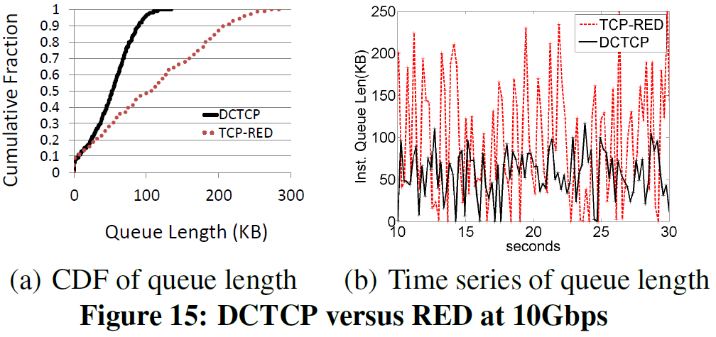
DCTCP vs. TCP+RED

Slide 48
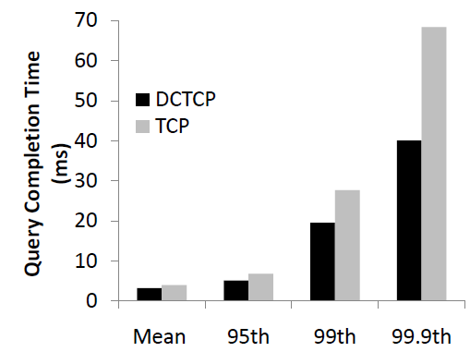
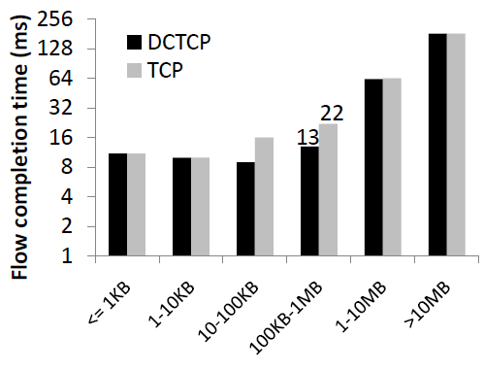
Flow/Query Completion Times

Slide 49
Shortcomings of DCTCP
Benefits of DCTCP
Better performance than TCP
Alleviates losses due to buffer pressure
Actually deployable
But…
No scheduling, cannot solve incast
Competition between mice and elephants
Queries may still miss deadlines
Network throughput is not the right metric
Application goodput is
Flows don’t help if they miss the deadline
Zombie flows actually hurt performance!

Slide 50
Outline
Intro
Network Topology and Routing
Transport Protocols
Google and Facebook
DCTCP
Reliability

Slide 51
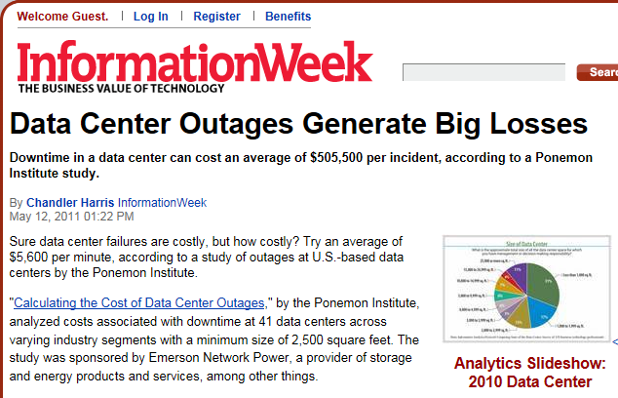
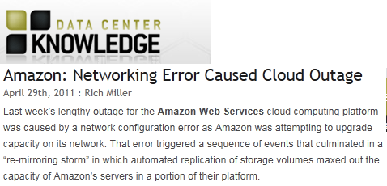
Motivation
$5,600 per minute
We need to understand failures to prevent and mitigate them!
Notes:
As we have seen in many high profile incidents reliability of data center networks is crucial to service availability. For example, Amazon experienced a high profile outage this past April when upgrading a network link. This outage had severe impact on numerous popular online services. These outages that impact numerous services hosted in the same data centers have high cost to organizations hosting them. For example this study finds that on average unplanned outages cost $5600 per minute.
The overarching goal of our research is to improve the reliability of services hosted in data centers by getting a better understanding of causes and properties of failure events.
=======
When failures occur in cloud computing systems they make big news. In particular, you are probably familiar with the Amazon EC2 outage that happened in April 2011. This incident made major news not only because Amazon failed but because this failure impacted many sites that were hosted on Amazon. [http://ec2disabled.com/] such as Reddit and Hootsuite a social media site.
In addition to noticeable customer outages in cloud computing can be extremely costly [http://www.informationweek.com/news/hardware/data_centers/229500121]. One study finds that data center outages can cost $5600/minute on average and an average outage duration of 90 minutes leads to an average of half a million dollars per incident. The survey reported on in this article also finds that 95% of organizations surveyed had at least 1 unplanned outage.
Networking can play a role in these outages and in fact a network upgrade combined with configuration error that caused traffic to flow along a lower capacity secondary link.
In this study we shed light on network faults to enable the development strategies for mitigating their impact.
Amazon outage, since many services share a common substrate in cloud computing when there is an outage many services are impacted
As a result these outages are extremely expensive average of half a million per incident
Networking has a role to play in terms of preventing outages (e.g., Amazon outage was a configuration error when upgrading network capacity. We need tools to prevent configuration errors and better mitigate failures once they have happened!)
A common pattern across these outages is that network gets the blame’ which motivates this work of understanding network reliability in DCs
------
From: http://aws.amazon.com/message/65648/
At 12:47 AM PDT on April 21st, a network change was performed as part of our normal AWS scaling activities in a single Availability Zone in the US East Region. The configuration change was to upgrade the capacity of the primary network. During the change, one of the standard steps is to shift traffic off of one of the redundant routers in the primary EBS network to allow the upgrade to happen. The traffic shift was executed incorrectly and rather than routing the traffic to the other router on the primary network, the traffic was routed onto the lower capacity redundant EBS network.
For a portion of the EBS cluster in the affected Availability Zone, this meant that they did not have a functioning primary or secondary network because traffic was purposely shifted away from the primary network and the secondary network couldn’t handle the traffic level it was receiving.
-----
What is meant by cost: Utilizing activity-based costing, our methods capture information about both direct and indirect
costs, including but not limited to the following areas:
▪ Damage to mission critical data
▪ Impact of downtime on organizational productivity
▪ Damages to equipment and other assets
▪ Cost to detect and remediate systems and core business processes
▪ Legal and regulatory impact, including litigation defense cost
▪ Lost confidence and trust among key stakeholders
▪ Diminishment of marketplace brand and reputation

Slide 52
Overview
Our goal: Improve reliability by understanding network failures
Failure characterization
Most failure prone components
Understanding root cause
What is the impact of failure?
Is redundancy effective?
Our contribution: First large-scale empirical study of network failures across multiple DCs
Methodology to extract failures from noisy data sources.
Correlate events with network traffic to estimate impact
Analyzing implications for future data center networks
Notes:
….towards this goal we take the initial step of understanding the properties of network failures in a data center network. We consider the properties of network failures along 3 dimensions
-What are the properties of failures. Which components are most failure prone, what causes failure and how long does failure take to resolve.
-we also consider the impact of failures on network traffic and
-how effective network level redundancy is at masking impact.
Our main contribution here is the first large scale empirical study of failures in a data center network comprised of multiple data centers hosting numerous popular online services.
-part of our contribution comes in the form of methodology to extract and reconstruct failures in our very rich, but sometimes noisy data set.
-further we correlate the network failures with network traffic to understand impact
-and finally we consider implications of our findings for future data center network architectures.
===
-> which components are most failure prone? Is there a specific part of the network where attention should be focused to maximize reliability?
-> what are the main causes of failure? Is it a software issue that may be remedied by writing better code or are failures caused by intrinsic hardware problems?
We want to determine the impact of failures. Many failure alerts may be present in the system but we want to understand how much impact they have on network traffic? How do these impacts potentially impact traffic flows?
-> Finally data center networks are built to have redundant components so we look at how effective this redundancy is in terms of mitigating failure impact. As we see in the Amazon case, sometimes configuration errors can render redundancy ineffective.
To meet this goal we perform the first large scale study of network failures in data centers.
We do this by analyzing logged failure events in a production data center network comprised of multiple data centers.
Due to the scale of the network the volume of messages logged by the various components was extremely large so we needed to develop a methodology to extract failures with impact from the set of all logs. We also correlate between failure logs and network traffic to get a better understanding of how failures we consider impact network traffic.
Finally, we draw implications of our results for future data center network designs.

Slide 53
Data center networks overview
Which components are most failure prone?
Internet
How effective is redundancy?
?
What is the impact of failure?
What causes failures?
Notes:
Using this topology as a guide we can think about what questions we would like to answer about data center network reliability.
First we want to understand which components are most failure prone. For example, are certain parts of the topology more impacted by failures and are their components we can focus on to mitigate most of the failures.
Next we want to understand what are the causes of failures. Are they software problems where redesigning software will help or intrinsic hardware problems that need to be designed around.
We also want to know what the impact of network failures is on network flows in the data center.
Finally, since we have redundant sets of components in our network we want to see how effective they are in masking failure events.

Slide 54


Failure event information flow
Failure is logged in numerous data sources
Ticket ID: 34
LINK DOWN!
LINK DOWN!
LINK DOWN!
Syslog, SNMP traps/polling
Troubleshooting
Tickets
5 min traffic averages on links
Network event logs
Diary entries,
root cause
Network traffic logs
Troubleshooting
Notes:
Before we can try to answer these questions with our data we need to understand how failures are logged. In our network failures are logged by multiple sources. For example if we have a link between two devices that fails it will be logged in network event logs which detect the failure via Syslog, SNMP traps and polling. The network event logging system will also automatically generate a trouble shooting ticket associated with the event.
Before we try to analyze failure events in our network its important to understand the logging infrastructure that tracks failure events.
… talk through logging components.
We also have access to network traffic logs that we can correlate with the network event logs to understand the impact of logged events.
Challenges:
High volume -> needed a precise definition of failure for our study in order to reduce volume.
Noisy data sources -> needed to reconstruct link and device state using heuristics
Correlating failures with additional data -> Correlate with traffic averages to determine impact.

Slide 55
Data summary
One year of event logs from Oct. 2009-Sept. 2010
Network event logs and troubleshooting tickets
Network event logs are a combination of Syslog, SNMP traps and polling
Caveat: may miss some events e.g., UDP, correlated faults
Filtered by operators to actionable events
… still many warnings from various software daemons running
Key challenge: How to extract failures of interest?
Notes:
Our main source of data in this study is the network event logs. These are 1 year of events from Oct. 2009 until Oct. 2010 in the data centers that make up our network. Each failure event contains information on the component that failed, for example if it was a link, switch, or router. It also contains information about the severity of the event, whether it is a warning or more serious incident. It also contains a small textual description of the event as well as the time at which the event was resolved.
The logs are generated using data from SNMP polling and traps as well as syslog messages. Since all of this logging is best effort it may be the case that occasionally messages are lost (for example because of UDP messages being lost).
The logs are also filtered by the administrators to remove some spurious messages. For example, Syslog link down messages are ignored because they tend to occur on port flapping which does not impact connectivity. However, there was still a large number of events that were not necessarily severe. For example, warnings logged by software daemons running on load balancers.
We took a bottom up approach in terms of extracting events of interest from these logs by extracting events relating to device and link failures.

Slide 56
Extracting failures from event logs
Defining failures
Device failure: device is no longer forwarding traffic.
Link failure: connection between two interfaces is down. Detected by monitoring interface state.
Dealing with inconsistent data:
Devices:
Correlate with link failures
Links:
Reconstruct state from logged messages
Correlate with network traffic to determine impact
Network event logs
Notes:
To extract device and link failures we first had to define what is meant by failure. For devices these were messages where switches, routers or load balancers reported that they were “down”. In this case “down” does not necessarily mean the device is replaced but that it is not functioning for forwarding traffic. So a device that repeatedly power cycles will manifest as multiple device failure events.
Link failures on the otherhand indicate that the connection between two devices on specific interfaces is down. This is measured by monitoring the interface state on devices and raising an alert if the state is no longer connected.
Even with these more precise definitions of failure we still had an extremely large number of events. So we used some sanity tests to reconstruct state for the links and devices to rule out spurious notifications. For link failures we were also able to correlate failures with network traffic and identify failure events where the event impacted network traffic.

Slide 57
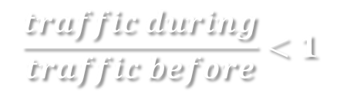
Identifying failures with impact
Correlate link failures with network traffic
Network traffic logs
Only consider events where traffic decreases
BEFORE
AFTER
$$\frac{traffic during}{traffic before}<1$$
time
DURING
LINK DOWN
LINK UP
Summary of impact:
28.6% of failures impact network traffic
41.2% of failures were on links carrying no traffic
E.g., scheduled maintenance activities
Caveat: Impact is only on network traffic not necessarily applications!
Redundancy: Network, compute, storage mask outages
Notes:
Once we have reconstructed the states for all the link failures we observe we then correlate these failure events with network traffic to verify that the failures we observe in the logs indeed impact network traffic. So how we do this is we have the time of the link down and link up messages. We then look at network logs and observe the traffic on the link before and during the failure. We say that a failure had impact if traffic on the link experiencing the failure decreases during the failure. We only require that traffic decrease because our traffic logs were in 5 minute bins and the majority of failures lasted less than 5 minutes. So the link may have been up for a portion of the 5 minute interval.
The effect of ruling out failures where traffic did not decrease during failure was that only 28% of our failures impact network traffic and that 41% of the failures happened on links that were not carrying traffic at the time. These are likely maintenance events.
One thing to bear in mind here is that when we talk about impact we’re looking at impact in terms of network traffic and not necessarily applications. So our notion of failure or availability here should not be interpreted as being application outages.
Correlate link failures with network traffic
Only consider failures where network traffic decreased
5 minute traffic averages mean traffic will not always be zero

Slide 58
Visualization of failure panorama: Sep’09 to Sep’10
Failures with Impact 28%
All Failures 46K
Component failure: link failures on multiple ports
Widespread failures
Long lived failures.
Link Y had failure on day X.
Load balancer update
(multiple data centers)
Notes:
We can now take a global view of link failures in our network. This figure shows at a high level view the distribution of failures across space and time …
See impact of only considering failures with impact
Observe if there are widespread or long lived failures

Slide 59
Which devices cause most failures?
Internet
Notes:
We next look more in detail at where in the network failures occur by considering which components are most failure prone. The goal here is to understand if there is specific part of the network that we can prioritize in order to improve reliability the most.

Slide 60
Which devices cause most failures?
Top of rack switches have few failures…
(annual prob. of failure <5%)
…but a lot of downtime!
Load
Balancer 1
Load
Balancer 2
Top of
Rack 1
Load
Balancer 3
Top of
Rack 2
Aggregation
Switch
Device Type
Load balancer 1: very little downtime relative to number of failures.
Notes:
We first look at which devices fail the most.
This graph shows the fraction of failures and downtime attributed to each device type
We see that load balancer 1 has the most failures, but very little down time
This is opposite to what we see for top of rack switches where there is very few failures. ToRs have the lowest probability of failure of any device with ToRs having failure rates of less than 5% (more detail on probability of failure is in the paper).
… but the highest amount of downtime. This is because ToRs are not a high priority component for repairs because of application level redundancy of compute and storage.

Slide 61

How long do failures take to resolve?
Internet

Slide 62
How long do failures take to resolve?
Load balancer 1: short-lived transient faults
Median time to repair:
4 mins
Load Balancer 1
Load Balancer 2
Top of Rack 1
Load Balancer 3
Top of Rack 2
Aggregation Switch
Overall
Correlated failures on ToRs connected to the same Aggs.
Median time to repair: 5 minutes
Mean: 2.7 hours
Median time to repair:
ToR-1: 3.6 hrs
ToR-2: 22 min
Notes:
We now take a look at the properties of the failures of these devices.
This plot shows the CDF of time to repair (ie., time between when a failure starts and ends) for the different devices
Here we can see the cause of ToRs having high downtime. Steps = correlated downtime of ToRs connecting to the same Agg.
When we look at failures for load balancer 1 we can see that many of them are short lived with most being resolved in 5 minutes (so mostly self healing software issues).

Slide 63
Summary
Data center networks are highly reliable
Majority of components have four 9’s of reliability
Low-cost top of rack switches have highest reliability
<5% probability of failure
…but most downtime
Because they are lower priority component
Load balancers experience many short lived faults
Root cause: software bugs, configuration errors and hardware faults
Software and hardware faults dominate failures
…but hardware faults contribute most downtime
Notes:
stress on criticality of control plane/middleboxes/LBs in DC network ops -- not just high bisection bandwidth.
Low cost switches are reliable-> good for proposals leveraging commodity components
Load balancers have software issues -> more thought needs to go into how middle boxes are managed in data centers.

Slide 64
Is redundancy effective in reducing impact?
Redundant devices/links to mask failures
This is expensive! (management overhead + $$$)
Internet
Goal: Reroute traffic along available paths
X
How effective is this in practice?

Slide 65
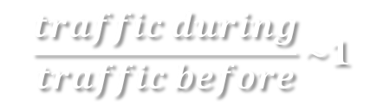
Measuring the effectiveness of redundancy
Idea: compare traffic before and during failure
Measure traffic on links:
Before failure
During failure
Compute “normalized traffic” ratio:
Compare normalized traffic over redundancy groups to normalized traffic on the link that failed
Acc. router
(primary)
Acc. router
(backup)
X
$$\frac{traffic during}{traffic before}\sim 1$$
Agg.
switch
(primary)
Agg.
switch
(backup)

Slide 66
Is redundancy effective in reducing impact?
Less impact lower in the topology
… but redundancy masks it
Redundancy is least effective for AggS and AccR
Core link failures have most impact…
Internet
Overall increase of 40% in terms of traffic due to redundancy
Notes:
We observe that redundancy isn’t completely effective in terms of mitigating failures.

Slide 67
Outline
Intro
Network Topology and Routing
Transport Protocols
Google and Facebook
DCTCP
D3
Reliability

Slide 68
Big Open Problem
Measurement data
Real datacenter traces are very hard to get
Are they representative?
Really, what is a ‘canonical’ datacenter?
Application dependent
Makes results very hard to quantify
Cross-paper comparisons
Reproducibility

