Slide 1
CSE390 Advanced Computer Networks
Lecture 17: Internet Censorship
(Roadblocks on the information superhighway …)
Based on slides by N. Weaver. Updated by P Gill. Fall 2014

Slide 2
What is censorship?
Censorship, the suppression of words, images, or ideas that are "offensive," happens
whenever some people succeed in imposing their personal political or moral values on others.
Censorship can be carried out by the government as well as private pressure groups. Censorship by the government is unconstitutional.
– The American Civil Liberties Union

Slide 3
What is censorship?
Key points:
Censorship in general is a non-technical problem
  Think banned books, suppression of news media etc.
In the United States censorship is unconstitutional
  Other countries?
  Are we forcing Western values on other countries?
  United Nations Universal Declaration of Human Rights provides some guidance of what speech should be protected globally
    E.g., political, minority religions, LGBT, etc.

Slide 4






What is a network censor
An entity that desires that some identifiable communication is blocked from being transmitted over the network
Without the authority to compel the content provider to remove the content
Without the authority to compel the client to install software of the censor’s choosing
Requires that the censor act on network traffic
Image from Watch, Learn, Drive
http://watch-learn-drive.com/Learners_Online/New_places/Traffic_lights/TL_5.html
Notes:
Needs to operate on network traffic. Needs to be efficient and scalable. Censorship systems are like other systems!

Slide 5
How to identify and block?
Identification: The piece of information that allows the censor to identify content to be blocked is referred to as the censorship trigger
  Example: IP address, hostname, URL, keywords etc.
Blocking: The technical means used to restrict access to the content
  Example: dropping packets, forging TCP RST packets or DNS responses
In the next few slides we will be exploring censorship as it exploits different triggers and blocking mechanisms at different layers of the Internet Protocol stack.

Slide 6
Networking 101
Bit Torrent, Web (Facebook, Twitter)
Protocols on the Internet divided into logical layers
These layers work together to get traffic where it is going.
Headers of upper layers encapsulate lower layer protocols
A network censor can disrupt any layer!
Application layer
(DNS, HTTP, HTTPS)
Transport Layer
(TCP, UDP)
Network Layer
(IP, ICMP)
Link Layer
(Ethernet, 802.11)
Physical Layer
(satellite, fiber)

Slide 7
Networking 101
So how does our traffic get where its going?
Each device has an IP
ISP B
Between networks border gateway protocol (BGP) is used to exchange routes
C
Prefix: 3.1.2.0/24
C
Prefix: 3.1.2.0/24
ISP C
ISP A
2.1.2.5
Prefix: 3.1.2.0/24
(2.1.2.5)
B, C
Prefix: 3.1.2.0/24
Web Server
(3.1.2.3)
DNS Server
(2.1.2.3)
Within a network routes are learned via “interior gateway protocols” (e.g., OSPF, IS-IS )
Home connection
(2.1.2.4)
Notes:
Unhide for SysSec class.
When the user wants to access the Web server they learn the path via BGP.

Slide 8
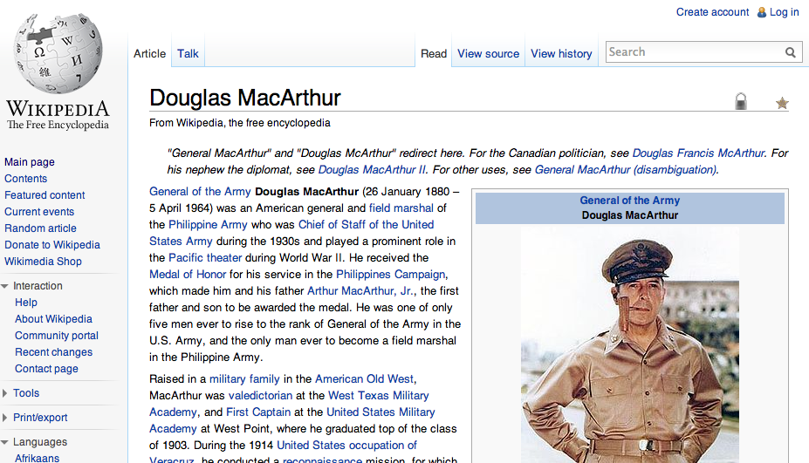

Networking 101
HTTP STATUS 200
Content Length: 523
Content Type: text/html
<!DOCTYPE html>
<html lang="en" dir="ltr" class="client-nojs">
<head>
<meta charset="UTF-8" /><title>Douglas MacArthur - Wikipedia, the free encyclopedia</title>
<meta name="generator" content="MediaWiki 1.23wmf10" />
…ok but humans don’t request IP addresses
… they want content!
ISP B
HTTP GET /wiki/Douglas_MacArthur HTTP 1.1
Host: en.wikipedia.org
ISP C
SYNACK
DNS A
208.80.154.238
ISP A
SYN
DNS QTYPE A
En.wikipedia.org
(2.1.2.5)
ACK
Web Server
(208.80.154.238)
DNS Server
(2.1.2.3)
Home connection
(2.1.2.4)

Slide 9
Many opportunities to censor
Block IP addresses
  IP layer
Block hostnames
  DNS (application layer)
Disrupt TCP flows
  TCP (transport layer)
  Many possible triggers
Disrupt HTTP transfers
  HTTP (application layer)

Slide 10
Internet protocol 101
Relevant fields:
IPID: set by the sender of the IP packet. Some OSes increment globally for each IP packet generated by the host; some maintain per flow counters, use a constant or random values.
TTL: counter gets decremented by each hop on the path until it reaches 0 and an ICMP Time Exceeded Message is generated. Useful for probing/locating censors.
Source IP: IP of the sender of this packet
Destination IP: IP of the recipient of this packet

Slide 11
IP-based blocking
Option 1: Configure routers using an access control list (ACL) to drop traffic to a given IP address.
This is an example of in-path blocking
(censor can remove packets)
Source: 136.159.220.20
Destination: 46.82.174.68
Drop traffic to:
8.7.198.45
203.98.7.65
46.82.174.68
59.24.3.173
93.46.8.89
Image from Watch, Learn, Drive
http://watch-learn-drive.com/Learners_Online/New_places/Traffic_lights/TL_5.html

Slide 12
IP-based blocking
Option 1: Configure routers using an access control list (ACL) to drop traffic to a given IP address.
Source: 136.159.220.20
Destination: 46.82.174.70
Drop traffic to:
8.7.198.45
203.98.7.65
46.82.174.68
59.24.3.173
93.46.8.89
Image from Watch, Learn, Drive
http://watch-learn-drive.com/Learners_Online/New_places/Traffic_lights/TL_5.html

Slide 13
IP-Based blocking
Advantages (for the censor)
  Quick and easy to configure
  Routers have efficient techniques for IP matching
Disadvantages
  Need to know the IP
    Easily evadable!
  High collateral damage: IP != Web host
    Noticeable if high profile site is hosted on the same system
    60% of Web servers are hosted with 10,000 or more other Web servers (Shue et al. 2007)
  Location of the censor can be determined from within the censored network
    Just need to traceroute to the blocked IP (use TCP port 80 SYNs in case ACL is selective).
  Can determine location from censored host as well
    Assuming ICMP Time Expired messages are blocked.

Slide 14
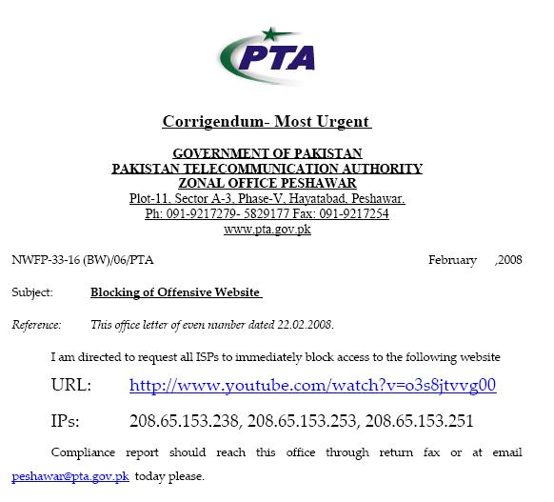
IP-BASED BLOCKING
Option 2: Use BGP to block IPs
  February 2008 : Pakistan Telecom hijacks YouTube
“The Internet”
Pakistan
Telecom
YouTube
I’m YouTube:
IP 208.65.153.0 / 22
Multinet
Pakistan
Telnor
Pakistan
Aga Khan
University
Notes:
-level of autonomous systems
-e.g., YouTube, AT&T, pakistan telecom
-routing is done on IP addresses, so when someone wants to go to YouTube they get YouTube’s IP address and YouTube announces to the world that they have the ip address and traffic is forwarded towards them. So here multinet would route to it’s provider pakistan telecom that then forwards the traffic on to youtube.
-these networks chosen for a specific reason which is that there was an incident in february 2008 pakistan telecom actually high jacked traffic going to youtube (misconfiguration).
-they announced to the world that they’re youtube and traffic destined to youtube was routed to them
-youtube was unavailable for a couple of hours as operators phone each other to figure out what was going on.

Slide 15
IP-BASED BLOCKING
  Here’s what should have happened….
“The Internet”
Hijack + drop packets going to YouTube
X
Pakistan
Telecom
YouTube
I’m YouTube:
IP 208.65.153.0 / 22
Multinet
Pakistan
Telnor
Pakistan
Aga Khan
University
  Block your own customers.

Slide 16
IP-BASED BLOCKING
  But here’s what Pakistan ended up doing…
“The Internet”
No, I’m YouTube!
IP 208.65.153.0 / 24
Pakistan
Telecom
Pakistan
Telecom
YouTube
I’m YouTube:
IP 208.65.153.0 / 22
Multinet
Pakistan
Telnor
Pakistan
Aga Khan
University
Notes:
Our works focuses on attacks of this flavor..

Slide 17
Why was the Pakistan incident so bad?
They announced a more specific prefix
  BGP routing is based on longest prefix match
There is no global route authentication in place!
  ISPs should filter announcements from their customers that are clearly wrong
  (As an ISP you should know what IP address space is in use by your customers)
  In reality this is harder than it seems ☹

Slide 18
Ip-based blocking
Option 2: BGP route poisoning
Instead of configuring router ACLs, just advertise a bogus route
  Causes routers close to the censor to route traffic to the censor, which just drops the traffic
How to detect this type of censorship?
  BGP looking glass servers in the impacted region
  Sometimes global monitors as well …
Challenges
  Can cause international collateral damage!
  Will block all content on a given prefix
    Could announce a /32 to get a single address but most ISPs will not propagate beyond a /24

Slide 19
Known users of ip-based blocking
Pakistan using IP-based blocking for YouTube address ranges
  Can interfere with other Google services
China
  Some reports of IP blocking
  Many URLs redirected to small set of IP-addresses, possibly this is the set used for ACLs
UK
  Uses IP blocking of the Pirate Bay’s IP address
Australia
  IP blocking for Melbourne Free University IPs (precise motivation unclear…)
  https://www.eff.org/deeplinks/2013/04/australian-networks-censor-community-education-site
In general, too much collateral damage of IP-based blocking.

Slide 20
Overview
Block IP addresses
  IP layer
Disrupt TCP flows
  TCP (transport layer)
  Many possible triggers
Block hostnames
  DNS (application layer)
Disrupt HTTP transfers
  HTTP (application layer)

Slide 21
Tcp: Transmission control protocol
TCP is used for reliable, in-order communication
Connection established using a “three-way handshake”
All data is ACKnowledged
  If no ACK is received packets will be resent
Connection normally closed with a FIN (finish) packet
  Indicates that this side has no more information to send
Connections can also be closed with a RST (reset) packet
  Indicates a problem: both sides should stop communicating
  Some software makes liberal use of RSTs.

Slide 22
Why inject tcp reset packets?
A TCP Reset (RST) tells the other side of the connection:
  There will be no more data from this source on this connection
  This source will not accept any more data, so no more data should be sent
Once a side has decided to abort the connection, the only subsequent packets sent on this connection may be RSTs in response to data.
Once a side accepts a RST it will treat the connection as aborted
… but RSTs are quite common, 10-15% of ALL flows are terminated by a RST rather than a FIN
  For HTTP, it can be over 20%: Web servers/browsers often time out with RST instead of FIN
  Thus we cannot treat RSTs as “adversarial”

Slide 23
types of censors
Last time we discussed IP blocking via ACLs which is an example of an in-path censor.
Censors can also operate on-path: a wiretap, (intrusion detection system (IDS), deep packet inspection (DPI)) + attached network connection
  Censor can see all the packets
  Censor can add their own packets through packet injection
  Censor cannot remove packets
Can censor:
  DNS requests (by injecting bogus replies)
  Web requests to given hosts (including HTTPS)
  Web requests over HTTP for forbidden content
    Latter two possible via injecting TCP RST packets!

Slide 24
Limitations of on-path censors

Slide 25
Why on-path censors?
In-path device must process the traffic
  If they fail, they fail closed (connection gone!)
On-path devices are safer
  Tapping a link is “safe” (in network operator terms)
  Easy to parallelize (just mirror traffic to more filters)
  Less disruptive to install and use
Limitations:
  Can’t censor single replies
  Censorship is always detectable
    Censor cannot perfectly mimic the other endpoint.

Slide 26
On path censor example
Notes:
Mirroring is only on the active link. If that link goes down traffic on back up link may not be censored.

Slide 27
Detecting on-path censorship
Not only is the act of censorship detectable, the mechanism, is detectable
Since censor creates new packets but can’t remove existing packets
Since the injected packets can be identified, fingerprinting is also possible.
Using packets which trigger censorship but with a short TTL can localize the censor in the network
Leads to tricky cross-layer network measurements (easier with DNS)
Detection limitation: Can only detect an on-path censor when it is active
A censor which doesn’t create an effect on measured traffic is not detectable
E.g., DPI used for surveillance

Slide 28
Race conditions: data after reset
TCP packets are tracked by sequence numbers
  The next packet’s sequence number should be the previous packet’s sequence number plus the packet length
What is a sender is still sending data when the RST is injected?
  The receiver will see both a reset and a subsequent data packet, where the packet’s sequence number + length > the reset packet’s sequence number

Slide 29
Race conditions: Data after reset
Such a packet arrangement is out of specification
No TCP stack should generate such a sequence! It would imply that the stack decided to abort the connection yet keep sending anyway
Data seq = 32 ack = 1
RST seq = 2 ack = 32
Data after RST? Doesn’t make sense!
Data seq = 238 ack = 32
Web Server
(208.80.154.238)

Slide 30
Race conditions: reset after data
What if the reset injector is just slow?
  It takes time to determine that a flow should be blocked…
  … in the mean time traffic is flying by!
Result is a reset after data race condition
  Reset packet appears after the data packet
  Reset’s sequence number is less than the data packet’s sequence number plus its length

Slide 31
Race conditions: Reset after data
This is also out of specification
Why would a TCP stack do a retroactive abort?
Worse, such resets should be ignored by the receiver:
The received reset is “out-of-window”
Data seq = 32 ack = 1
RST after data? Huh?
Data seq = 238 ack = 32
RST seq = 2 ack = 32
Web Server
(208.80.154.238)

Slide 32
Building a reliable RST injector enables detection
Thus a reliable packet injector must anticipate the reset after data condition
  Instead of sending one reset it needs to send multiple resets with increasing sequence number
This is detectable as a “reset sequence change condition”
  An end host should never generate such resets as the host can always generate an in-sequence reset
An unreliable injector can only be detected when a race condition occurs
A reliable injector always can be detected.

Slide 33
Fingerprinting rst injectors

Slide 34
Can we just ignore these RSTs?
As of 2006, yes but both ends of the connection need to ignore the RSTs.
Client cannot do it unilaterally.
  Injectors will just send RSTs to the server and the client

Slide 35
Remember … RSTs are a mechanism
They don’t tell us anything about what triggers the mechanism
Some clues ..
  When the RST is sent
    Before the HTTP GET
    After the HTTP GET
  Still not definitive
Need purpose build experiments
  Run tests towards your own server
  Put blocked keyword in host name
  … in HTML body content

Slide 36
Overview
Block IP addresses
  IP layer
Disrupt TCP flows
  TCP (transport layer)
  Many possible triggers
Block hostnames
  DNS (application layer)
Disrupt HTTP transfers
  HTTP (application layer)

Slide 37
Domain name system (dns)

Slide 38
How can we block DNS?
A few things to keep in mind …
No cryptographic integrity of DNS messages
  DNSSEC proposed but not widely implemented
Caching of replies means leakage of bad DNS data can persist

Slide 39
Blocking dns names

Slide 40
Blocking dns names

Slide 41
Blocking DNS names
Option A: get ISP resolver on board
  (Previous slide)
Option B: On-path packet injection similar to TCP Resets
  Can be mostly countered with DNS-hold-open:
    Don’t take the first answer but instead wait for up to a second
  Generally reliable when using an out of country recursive resolve
    E.g., 8.8.8.8
  Can be completely countered by DNS-hold-open + DNSSEC
    Accept the first DNS reply which validates

Slide 42
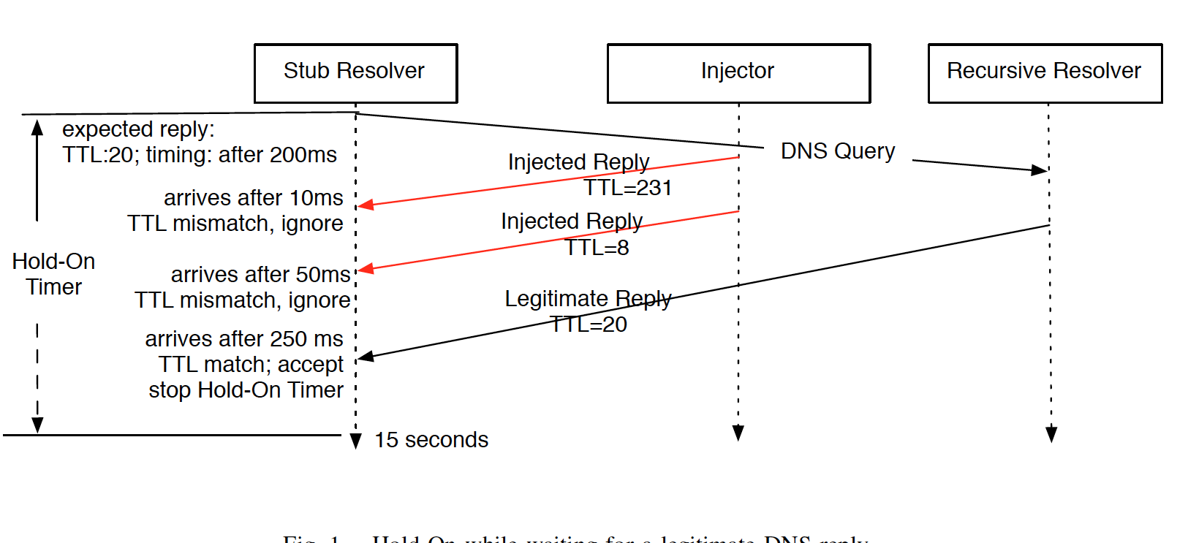
Hold-on in action

Slide 43
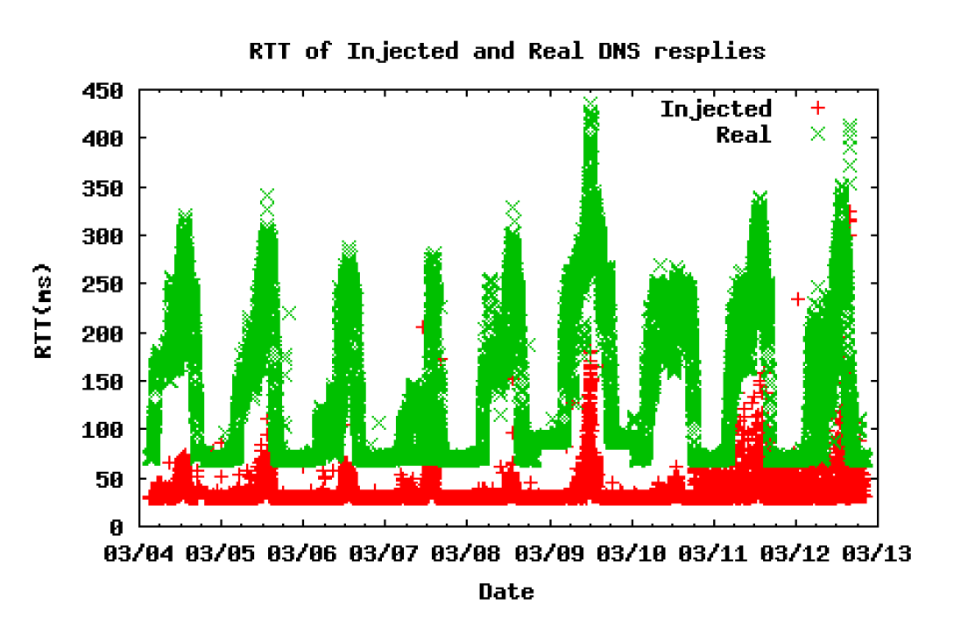
Checking feasibility: RTT

Slide 44
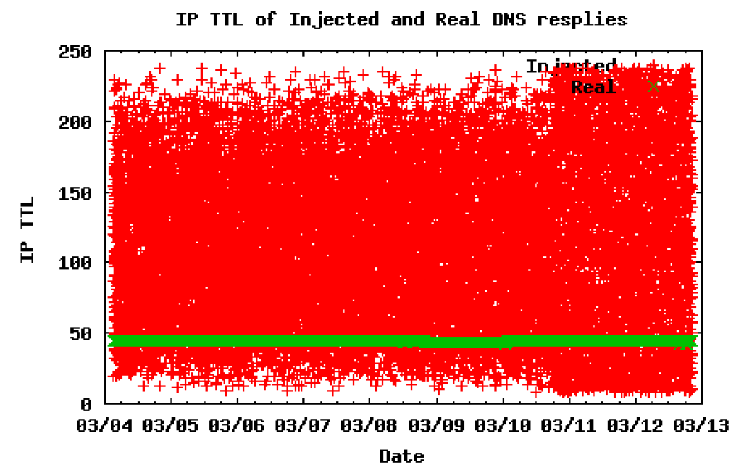
Checking feasibility: ttl

Slide 45
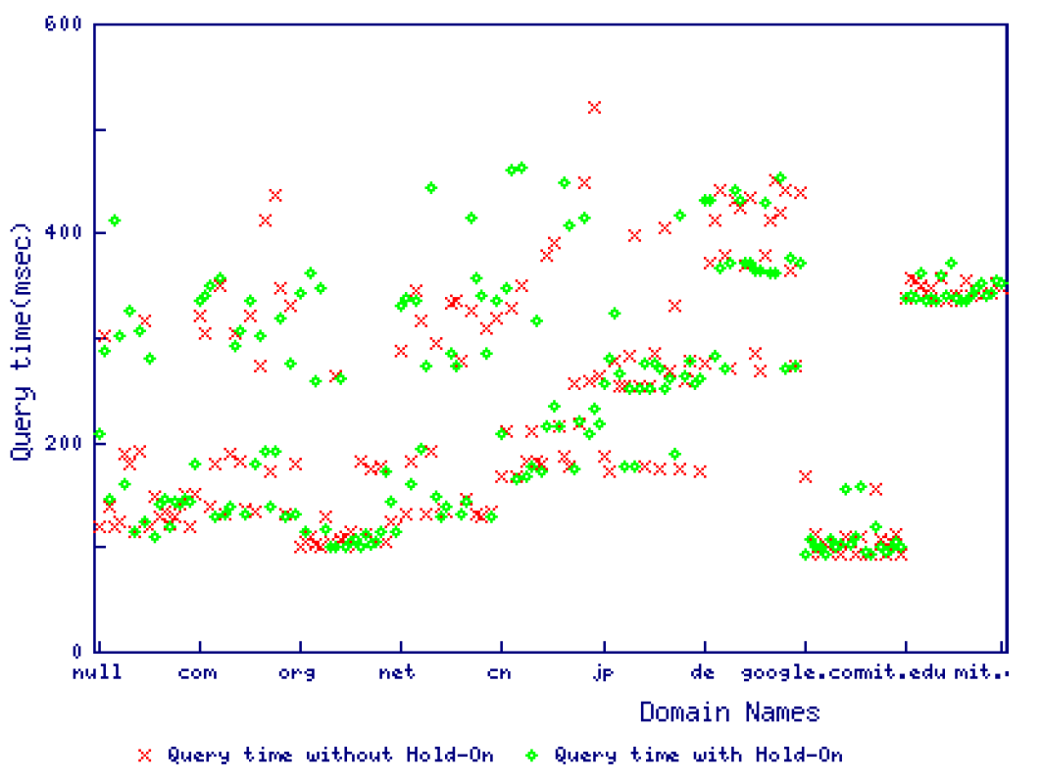
Performance of Hold-on
Lesson: You don’t have to wait that long to get the legitimate reply
Notes:
Potential project, create a browser plug in that implements hold-on.

Slide 46
Overview
Block IP addresses
  IP layer
Disrupt TCP flows
  TCP (transport layer)
  Many possible triggers
Block hostnames
  DNS (application layer)
Disrupt HTTP transfers
  HTTP (application layer)

Slide 47
Networking 101: HTTP
HTTP (Hyper Text Transfer Protocol) is what most people think of when they talk about “the web”
Client-server request/response protocol
  Client requests “I want file X from host Y that is on this server”
  Server replies
Content can be any filetype
E.g. “HyperText Markup Language” (HTML) pages
  Embedded programs (JavaScript, Flash, etc) which run on the browser
No cryptographic integrity

Slide 48
HTTPS ADDS ENCRYPTION
The TLS (Transport Layer Security) protocol
  Sits “between” TCP and HTTP
Uses cryptographic certificates to authenticate the server
  One of ~300 entities vouch for (or vouch for someone who vouches for) the server
    Who do you trust? CNNIC? US DOD? Your browser trusts them...
    These days, however, fake certs get noticed: Certificate pinning in Google Chrome, certificate observatories and notaries, etc...
Without a fake certificate, the data is cryptographically protected
  But does not protect the TCP control messages
  And does not protect against traffic analysis: Certificate effectively asserts what is the hostname! Also watching dataflow can often infer content

Slide 49
OK … SO WHERE ARE WE NOW?
We’ve so far talked about a bunch of different blocking techniques
  Packet filtering/BGP manipulation
  Injecting RSTs
  Injecting DNS replies
Those can all be used to block HTTP (and other types of content)
Our focus now: proxies and blocking mechanisms that act specifically on HTTP traffic.

Slide 50
In-path censorship
Rather than sitting as a wiretap, actually intercept all traffic
  Now the censor can remove undesired packets
Two possible mechanisms:
  Flow Terminating
  Flow Rewriting
Two possible targets:
  Partial Proxying
  Complete Proxying

Slide 51
Flow Terminating proxies

Slide 52
Flow terminating
SYN
SYN
SYNACK
SYNACK
ACK
ACK
External Server
Proxy
Two separate TCP connections.
Buys the censor some time to process content.
No worry about having to match state because the proxy is the end point (from client’s point of view)
External Server might see client IP, might see Proxy IP

Slide 53
Flow rewriting proxies

Slide 54
Flow Rewriting
SYN
SYN
SYNACK
SYNACK
ACK
ACK
External Server
Proxy

Slide 55
Flow Rewriting
Block Page
Censored keyword
External Server
Proxy

Slide 56
Partial vs. complete proxying

Slide 57
Detecting and using partial proxies

Slide 58
Detecting complete terminating proxies

Slide 59
Overview
Block IP addresses
  IP layer
Disrupt TCP flows
  TCP (transport layer)
  Many possible triggers
Block hostnames
  DNS (application layer)
Disrupt HTTP transfers
  HTTP (application layer)
Fingerprinting filtering products

Slide 60


Trend: New economic models of attacks
Traditional spam: Financially-motivated adversaries targeting many users
$
Notes:
A trend with this sort of malware is that it changes the way we think about the economics of spam and security.
You can imagine your flight by night spammer ….

Slide 61


Trend: New economic models of attacks
Traditional spam: Financially-motivated adversaries targeting many users
Targeted threats: Politically-motivated actors honing in on specific targets
$
information

Slide 62




Huge market for censorship/surveillance products
Estimated sales of $5 billion per year for surveillance/wiretapping products*
Products developed by Western countries!
*http://www.washingtonpost.com/world/national-security/trade-in-surveillance-technology-raises-worries/2011/11/22/gIQAFFZOGO_story.html

Slide 63
Filtering products…
Dual use technology …
  Keep employees off Facebook, keep schoolchildren safe from inappropriate content
…but in the wrong hands
  Human rights violations
  Surveillance
  Censorship
  …

Slide 64
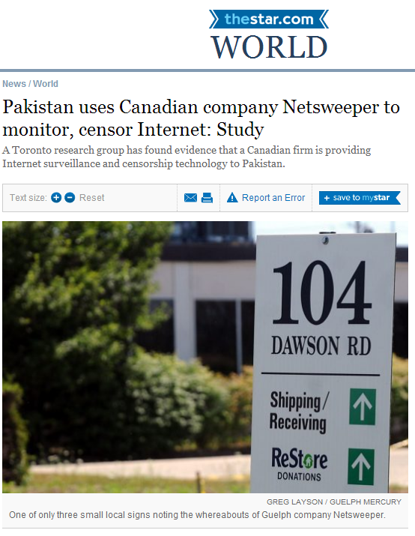

Slide 65
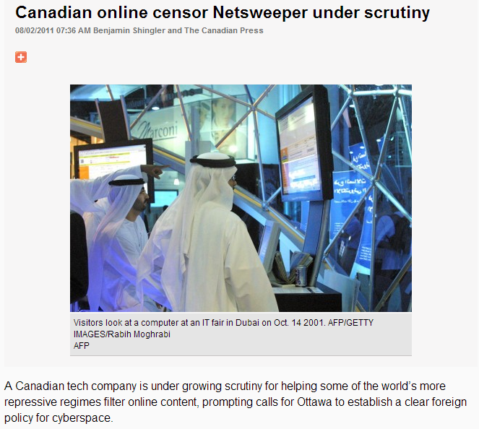

Slide 66
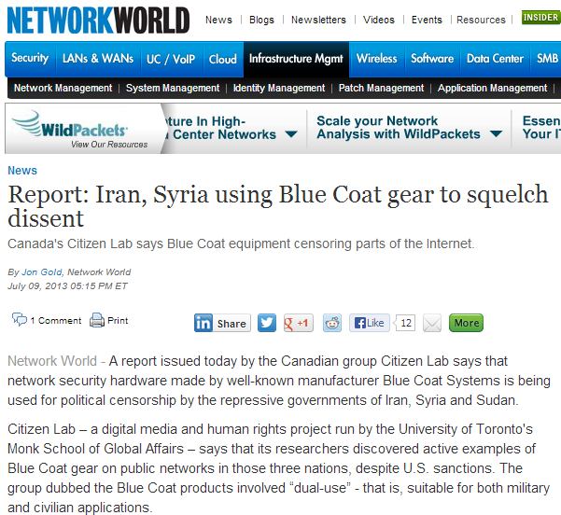

Slide 67
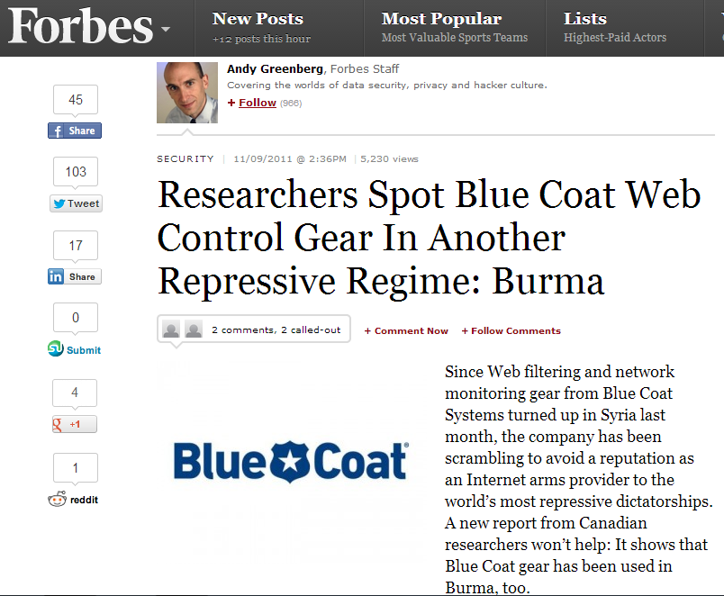

Slide 68
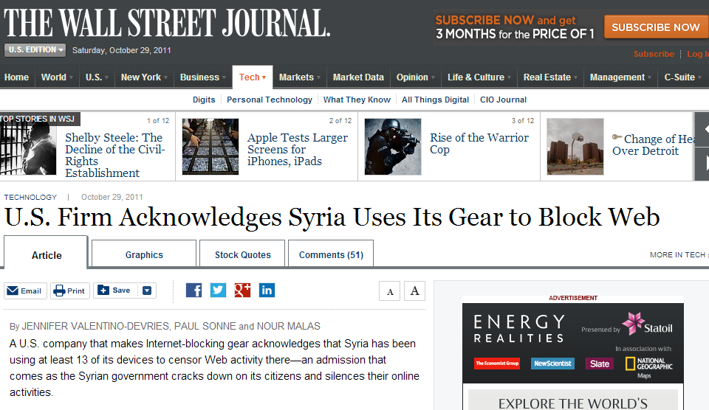

Slide 69
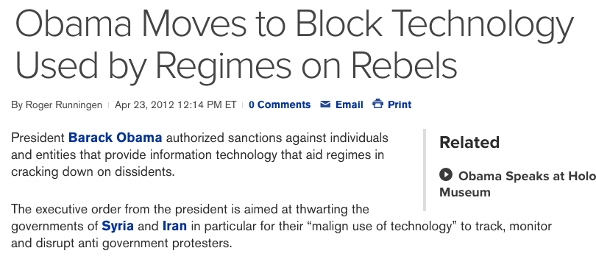
This has not gone unnoticed…
http://www.bloomberg.com/news/2012-04-23/obama-moves-to-block-technology-used-by-regimes-against-protests.html
Notes:
This fact has not gone unnoticed with the EU, US and Israel all putting sanctions in place to limit the export of these products.
============
The fact that we are shipping products for cnsorship and surveillance around the world hasn’t gone unnoticed. The US, Europe and Israel have all implemented various sanctions against export of these products to foreign governments.

Slide 70
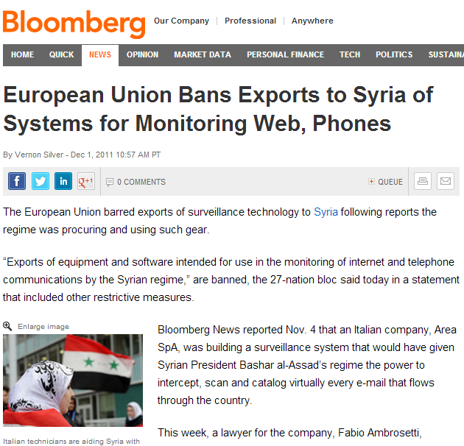

Slide 71
How to enforce restrictions?
… and monitor emerging issues …
Need techniques to identify installations of these products in regions around the world
AND confirm that they are used for censorship

Slide 72
Step 1: find suspected installations
Observe the logo of the product on a block page…
  … getting more challenging as products work to conceal themselves
Look for user reports of the product being used
  …incomplete, requires technically savvy users (see previous bullet)
Scans of publicly accessible IP address space
  …requires that the product be configured with a globally routable IP address
  Best we have right now …

Slide 73
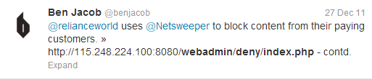
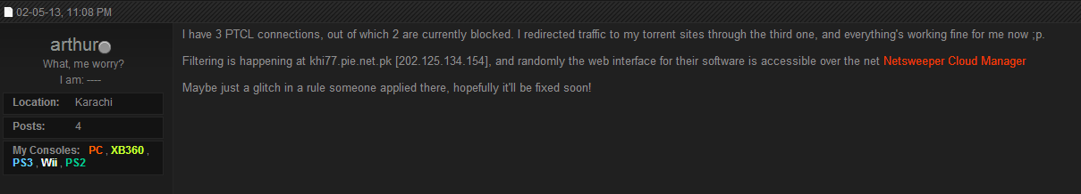
Examples of user reports

Slide 74
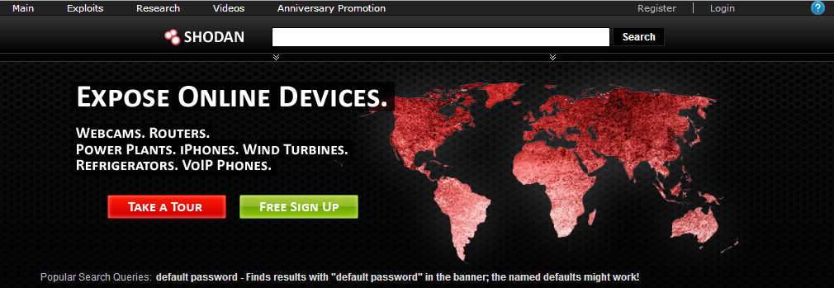
Sources of Scan data
Shodan
Internet Census (ethics?)

Slide 75
Ok … but what to scan for?
Signatures/strings to look for derived from hands on testing/observations of censorship

Slide 76

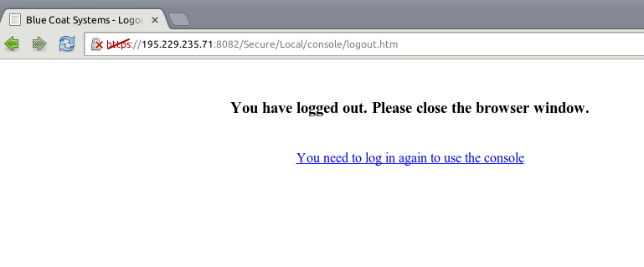

Slide 79
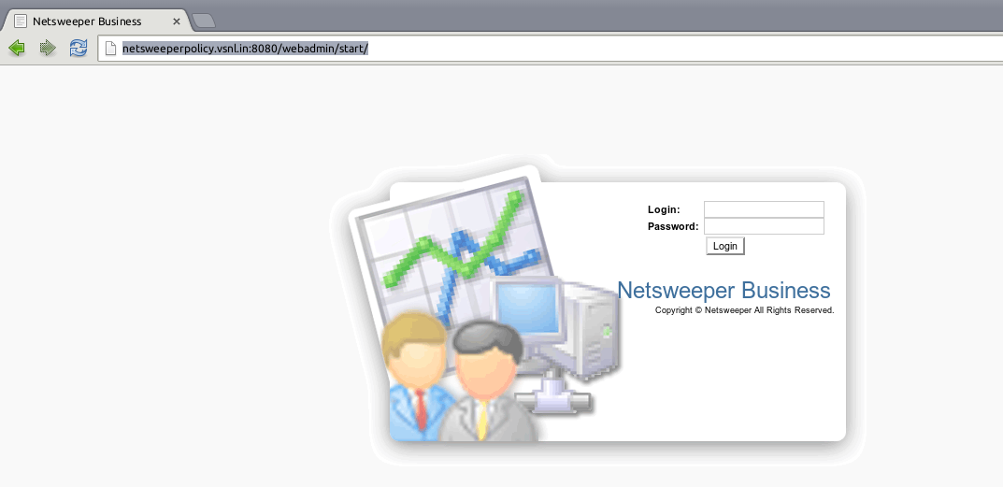
Netsweeper

Slide 80
Netsweeper

Slide 81
Netsweeper

Slide 82
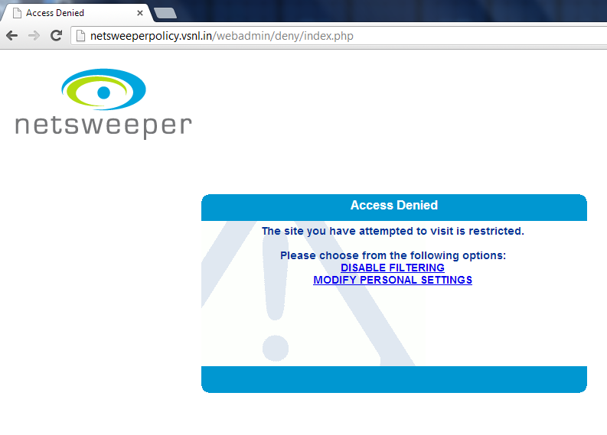
Netsweeper

Slide 83
netsweeper

Slide 84
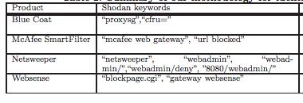
Terms to search for (Shodan)

Slide 85
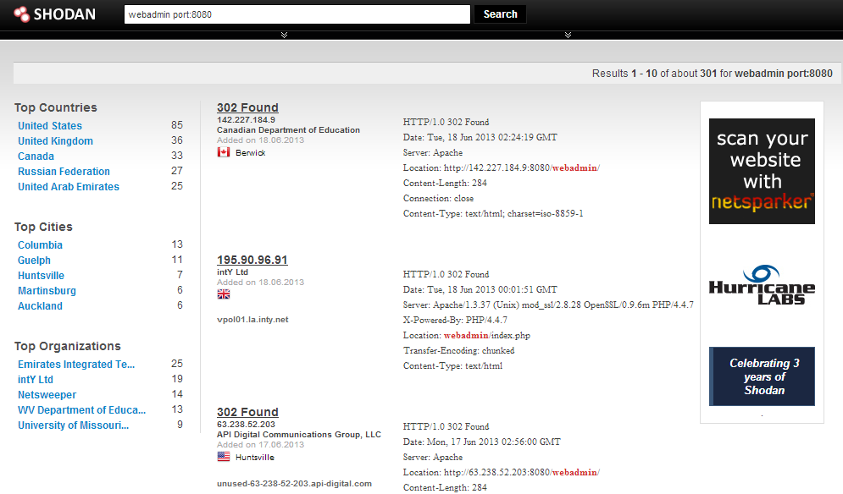
Need to confirm that these IPs are actually still hosting the product

Slide 86

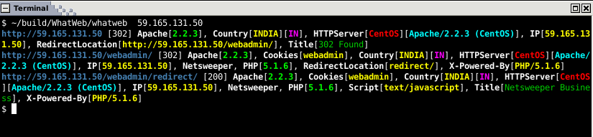

Slide 88
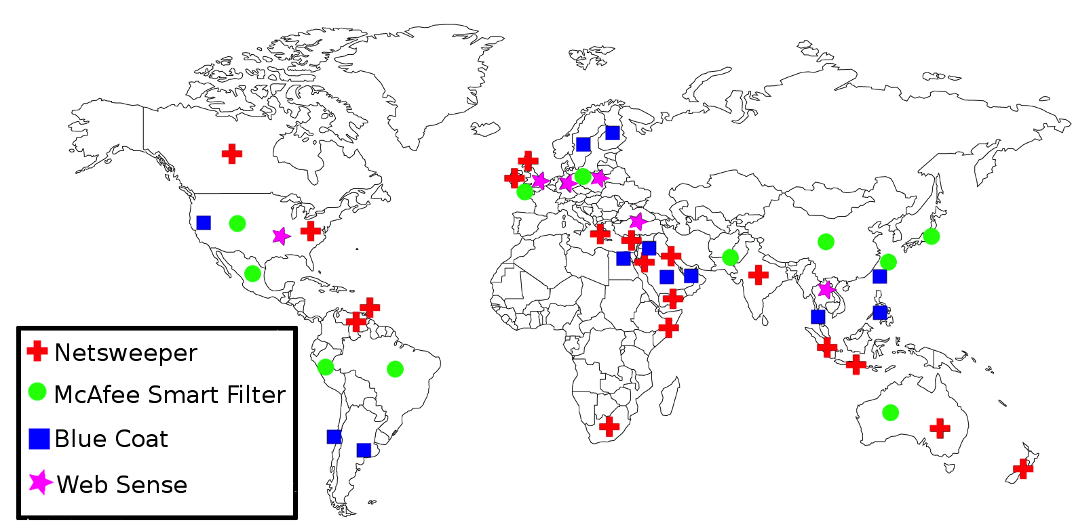
Where we found installations

Slide 89
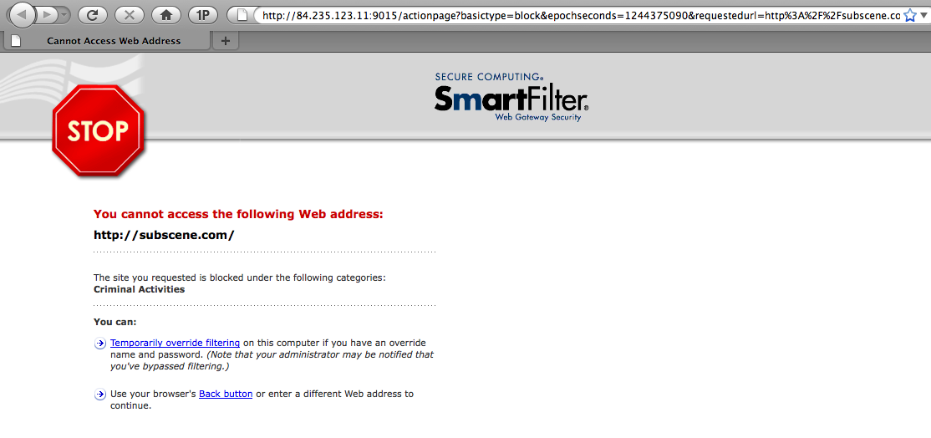
OK … so we’ve found an installation
Is it being used for censorship?
Can be easy ….

Slide 90
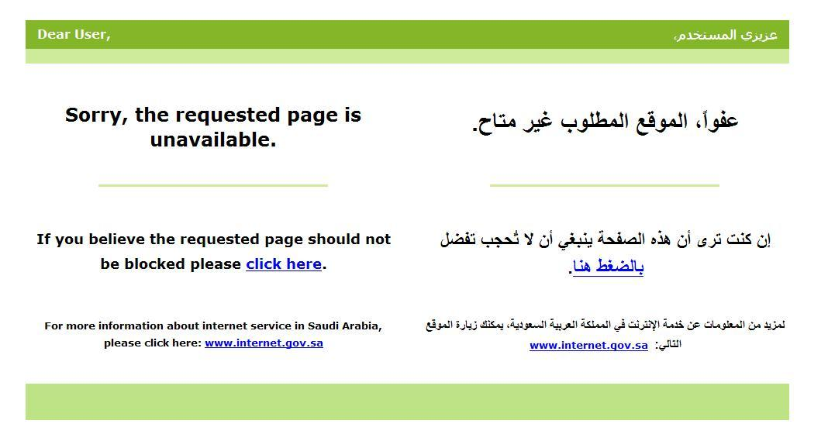
Or not …

Slide 91
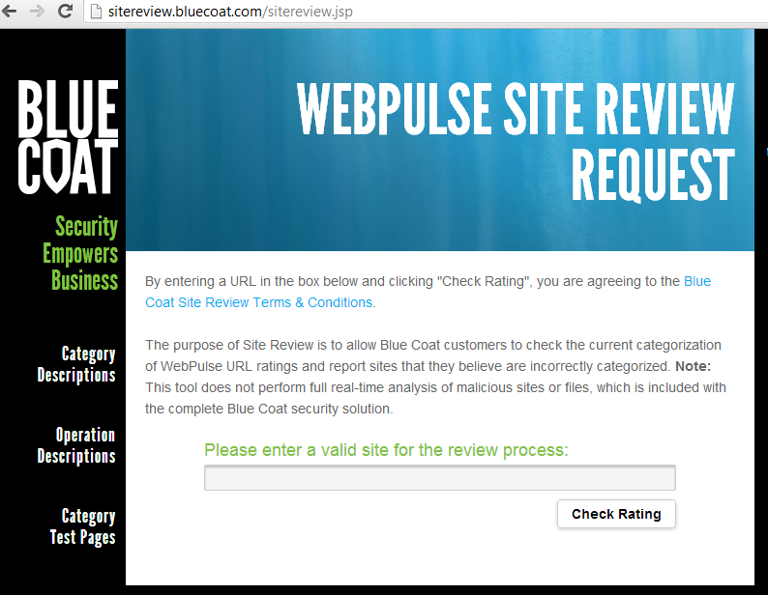
How to confirm censorship
… even if the logo is not on the block page
  Leverage the fact that URLs are a key piece of the censorship product’s features

Slide 92
Identifying Commercial Filtering Devices
Create 10 proxy Web sites (have these domains host a simple proxy script, Glype)
Check that these sites are not blocked (shouldn’t be since they are created just for this purpose).
http://bargaindeputy.com
http://zipzoodle.com
http://thatsit.com
http://steamrafts.com
http://notabigdeal.com
http://electroacoustic.com
http://whatandthehow.com
http://elasticmanniquin.com
http://swimstartz.com
http://evadingape.com

Slide 93
Identifying Commercial Filtering Devices
Take 5 domains
http://bargaindeputy.com
http://zipzoodle.com
http://thatsit.com
http://steamrafts.com
http://notabigdeal.com
http://electroacoustic.com
http://whatandthehow.com
http://elasticmanniquin.com
http://swimstartz.com
http://evadingape.com

Slide 94
Identifying Commercial Filtering Devices
And submit them for classification on the suspected device categorization page.
http://bargaindeputy.com
http://zipzoodle.com
http://thatsit.com
http://steamrafts.com
http://notabigdeal.com
http://electroacoustic.com
http://whatandthehow.com
http://elasticmanniquin.com
http://swimstartz.com
http://evadingape.com

Slide 95
Identifying Commercial Filtering Devices
http://bargaindeputy.com
http://zipzoodle.com
http://thatsit.com
http://steamrafts.com
http://notabigdeal.com
http://electroacoustic.com
http://whatandthehow.com
http://elasticmanniquin.com
http://swimstartz.com
http://evadingape.com
Submitted Sample
Control Group

Slide 96
Identifying Commercial Filtering Devices
Check again in Country X if they are blocked
http://bargaindeputy.com
http://zipzoodle.com
http://thatsit.com
http://steamrafts.com
http://notabigdeal.com
http://electroacoustic.com
http://whatandthehow.com
http://elasticmanniquin.com
http://swimstartz.com
http://evadingape.com
Submitted Sample
Control Group

Slide 97
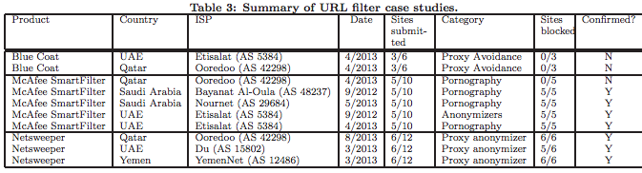
Results

Slide 98
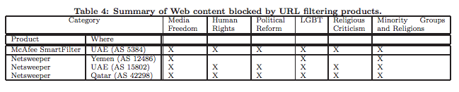
What are these products censoring?
Many of these categories of speech protected under UN declaration of human rights

Slide 99
Other approaches to fingerprinting
Challenge of site submission is that it relies on the site submission interface existing for a product.
…Also need the product to be globally routable to find it’s IP address.
Other approaches
  Look for HTTP header changes (hit your own server see what the headers are passed on as)
    CoNteNT LeNGth -> content length
  HTML structure of block pages
    Common templates for the same product.
    Easy to identify via html tag frequencies

Slide 100
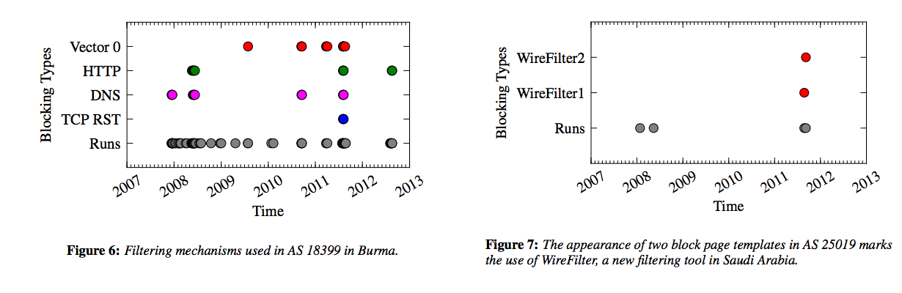
HTML block page fingerprinting
HTML structure of block pages
  Common templates for the same product.
  Easy to identify via html tag frequencies
  Sometimes mapping to product is tricky
  Enables historical analysis

Slide 101
Hands on activities
Some interactive activities you can try ☺

Slide 102
Hands on activity
http://netalyzr.icsi.berkeley.edu/restore/id=43ca208a-16353-81bcc662-d580-4088-824f
http://netalyzr.icsi.berkeley.edu/restore/id=36ea240d-13470-a97f9d6d-ef09-4b43-b19b
Where were these Netalyzr tests run?
Do they seem to use the same censorship product?
What can you learn about these connections from Netalyzr?

Slide 103
Hands on activity
Look up a filtering product in Shodan
  (will need to make a free account if you want to search in a specific country)
Download/run WhatWeb on the IP you find
  Is it still running the product?
What network is it in?
Check out the Internet census data
  Anything interesting there?
http://internetcensus2012.bitbucket.org/paper.html

