Slide 1
Distributed Data: Challenges in Industry and Education
Ashish Goel
Stanford University

Slide 2
Distributed Data: Challenges in Industry and Education
Ashish Goel
Stanford University

Slide 3
Challenge
Careful extension of existing algorithms to modern data models
Large body of theory work
  Distributed Computing
  PRAM models
  Streaming Algorithms
  Sparsification, Spanners, Embeddings
  LSH, MinHash, Clustering
  Primal Dual
Adapt the wheel, not reinvent it

Slide 4
Data Model #1: Map Reduce
An immensely successful idea which transformed offline analytics and bulk-data processing. Hadoop (initially from Yahoo!) is the most popular implementation.
MAP: Transforms a (key, value) pair into other (key, value) pairs using a UDF (User Defined Function) called Map. Many mappers can run in parallel on vast amounts of data in a distributed file system
SHUFFLE: The infrastructure then transfers data from the mapper nodes to the “reducer” nodes so that all the (key, value) pairs with the same key go to the same reducer
REDUCE: A UDF that aggregates all the values corresponding to a key. Many reducers can run in parallel.

Slide 5
A Motivating Example: Continuous Map Reduce
There is a stream of data arriving (eg. tweets) which needs to be mapped to timelines
Simple solution?
  Map: (user u, string tweet, time t) →
      (v1, (tweet, t))
      (v2, (tweet, t))
      …
      (vK, (tweet, t))
  where v1, v2, …, vK follow u.
  Reduce : (user v, (tweet_1, t1), (tweet_2, t2), … (tweet_J, tJ)) → sort tweets in descending order of time

Slide 6
Data Model #2: Active DHT
DHT (Distributed Hash Table): Stores key-value pairs in main memory on a cluster such that machine H(key) is responsible for storing the pair (key, val)
Active DHT: In addition to lookups and insertions, the DHT also supports running user-specified code on the (key, val) pair at node H(key)
Like Continuous Map Reduce, but reducers can talk to each other

Slide 7
Problem #1: Incremental PageRank
Assume social graph is stored in an Active DHT
Estimate PageRank using Monte Carlo: Maintain a small number R of random walks (RWs) starting from each node
Store these random walks also into the Active DHT, with each node on the RW as a key
  Number of RWs passing through a node ~= PageRank
New edge arrives: Change all the RWs that got affected
Suited for Social Networks

Slide 8
Incremental PageRank
Assume edges are chosen by an adversary, and arrive in random order
Assume N nodes
Amount of work to update PageRank estimates of every node when the M-th edge arrives = (RN/ε²)/M which goes to 0 even for moderately dense graphs
Total work: O((RN log M)/ε²)
Consequence: Fast enough to handle changes in edge weights when social interactions occur (clicks, mentions, retweets etc)
[Joint work with Bahmani and Chowdhury]

Slide 9
Data Model #3: Batched + Stream
Part of the problem is solved using Map-Reduce/some other offline system, and the rest solved in real-time
Example: The incremental PageRank solution for the Batched + Stream model: Compute PageRank initially using a Batched system, and update in real-time
Another Example: Social Search

Slide 10
Problem #2: Real-Time Social Search
Find a piece of content that is exciting to the user’s extended network right now and matches the search criteria
Hard technical problem: imagine building 100M real-time indexes over real-time content

Slide 11

Current Status: No Known Efficient, Systematic Solution...

Slide 12
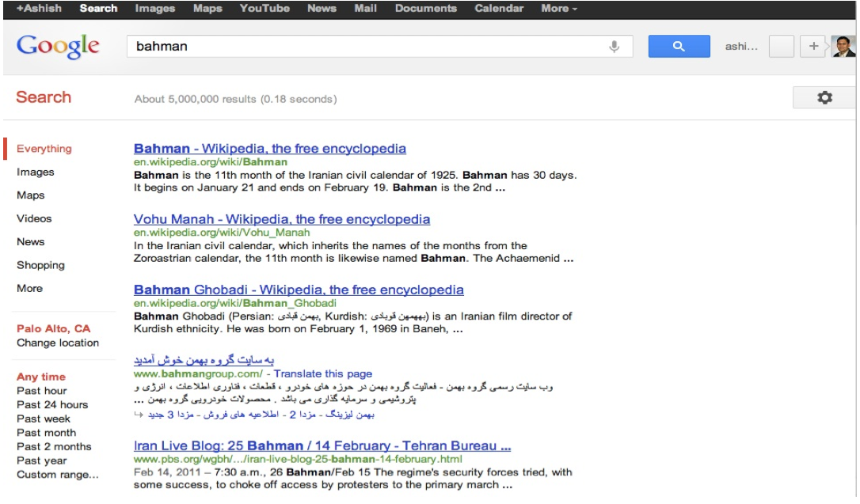
... Even without the Real-Time Component

Slide 13
Related Work: Social Search
Social Search problem and its variants heavily studied in literature:
  Name search on social networks: Vieira et al. '07
  Social question and answering: Horowitz et al. '10
  Personalization of web search results based on user’s social network: Carmel et al. '09, Yin et al. '10
  Social network document ranking: Gou et al. '10
  Search in collaborative tagging nets: Yahia et al '08
Shortest paths proposed as the main proxy

Slide 14
Related Work: Distance Oracles
Approximate distance oracles: Bourgain, Dor et al '00, Thorup-Zwick '01, Das Sarma et al '10, ...
Family of Approximating and Eliminating Search Algorithms (AESA) for metric space near neighbor search: Shapiro '77, Vidal '86, Micó et al. '94, etc.
Family of "Distance-based indexing" methods for metric space similarity searching: surveyed by Chávez et al. '01, Hjaltason et al. '03

Slide 15
Formal Definition
The Data Model
  Static undirected social graph with N nodes, M edges
  A dynamic stream of updates at every node
  Every update is an addition or a deletion of a keyword
    Corresponds to a user producing some content (tweet, blog post, wall status etc) or liking some content, or clicking on some content
    Could have weights
The Query Model
  A user issues a single keyword query, and is returned the closest node which has that keyword

Slide 16
Partitioned Multi-Indexing: Overview
Maintain a small number (e.g., 100) indexes of real-time content, and a corresponding small number of distance sketches [Hence, ”multi”]
Each index is partitioned into up to N/2 smaller indexes [Hence, “partitioned”]
Content indexes can be updated in real-time; Distance sketches are batched
Real-time efficient querying on Active DHT
    [Bahmani and Goel, 2012]

Slide 17
Distance Sketch: Overview
Sample sets S_{i} of size N/2^{i} from the set of all nodes V, where i ranges from 1 to log N
For each S_{i}, for each node v, compute:
  The “landmark node” L_{i}(v) in S_{i} closest to v
  The distance D_{i}(v) of v to L(v)
Intuition: if u and v have the same landmark in set S_{i} then this set witnesses that the distance between u and v is at most D_{i}(u) + D_{i}(v), else S_{i} is useless for the pair (u,v)
Repeat the entire process O(log N) times for getting good results

Slide 18
Distance Sketch: Overview
Sample sets S_{i} of size N/2^{i} from the set of all nodes V, where i ranges from 1 to log N
For each S_{i}, for each node v, compute:
  The “landmark” L_{i}(v) in S_{i} closest to v
  The distance D_{i}(v) of v to L(v)
Intuition: if u and v have the same landmark in set S_{i} then this set witnesses that the distance between u and v is at most D_{i}(u) + D_{i}(v), else S_{i} is useless for the pair (u,v)
Repeat the entire process O(log N) times for getting good results
BFS-LIKE

Slide 19
Distance Sketch: Overview
Sample sets S_{i} of size N/2^{i} from the set of all nodes V, where i ranges from 1 to log N
For each S_{i}, for each node v, compute:
  The “landmark” L_{i}(v) in S_{i} closest to v
  The distance D_{i}(v) of v to L(v)
Intuition: if u and v have the same landmark in set S_{i} then this set witnesses that the distance between u and v is at most D_{i}(u) + D_{i}(v), else S_{i} is useless for the pair (u,v)
Repeat the entire process O(log N) times for getting good results

Slide 20
Distance Sketch: Overview
Sample sets S_{i} of size N/2^{i} from the set of all nodes V, where i ranges from 1 to log N
For each S_{i}, for each node v, compute:
  The “landmark” L_{i}(v) in S_{i} closest to v
  The distance D_{i}(v) of v to L(v)
Intuition: if u and v have the same landmark in set S_{i} then this set witnesses that the distance between u and v is at most D_{i}(u) + D_{i}(v), else S_{i} is useless for the pair (u,v)
Repeat the entire process O(log N) times for getting good results

Slide 21
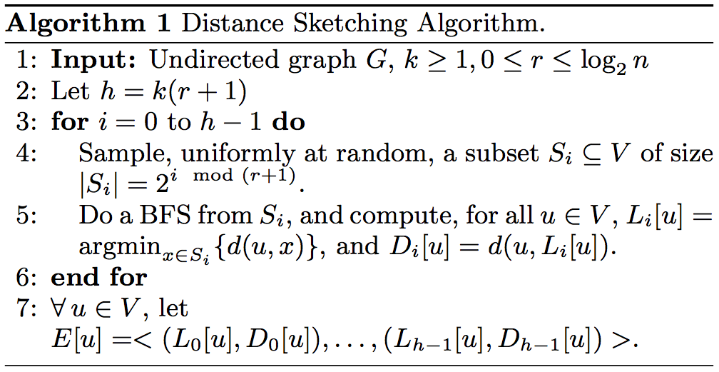

Slide 22
Node
S_{i}
u
v
Landmark

Slide 23
Node
S_{i}
u
v
Landmark

Slide 24
Node
S_{i}
u
v
Landmark

Slide 25
Node
S_{i}
u
v
Landmark

Slide 26
Node
S_{i}
u
v
Landmark

Slide 27
Node
S_{i}
u
v
Landmark

Slide 28
Node
S_{i}
u
v
Landmark

Slide 29
Node
S_{i}
u
v
Landmark

Slide 30
Node
S_{i}
u
v
Landmark

Slide 31
Node
S_{i}
u
v
Landmark

Slide 32
Node
S_{i}
u
v
Landmark

Slide 33
Node
S_{i}
u
v
Landmark

Slide 34
Partitioned Multi-Indexing: Overview
Maintain a priority queue PMI(i, x, w) for every sampled set S_{i}, every node x in S_{i}, and every keyword w
When a keyword w arrives at node v, add node v to the queue PMI(i, L_{i}(v), w) for all sampled sets S_{i}
  Use D_{i}(v) as the priority
  The inserted tuple is (v, D_{i}(v))
Perform analogous steps for keyword deletion
Intuition: Maintain a separate index for every S_{i}, partitioned among nodes in S_{i}

Slide 35
Querying: Overview
If node u queries for keyword w, then look for the best result among the top results in exactly one partition of each index S_{i}
  Look at PMI(i, L_{i}(u), w)
  If non-empty, look at the top tuple <v,D_{i}(v)>, and return the result <i, v, D_{i}(u) + D_{i}(v)>
Choose the tuple <i, v, D> with smallest D

Slide 36
Intuition
Suppose node u queries for keyword w, which is present at a node v very close to u
  It is likely that u and v will have the same landmark in a large sampled set S_{i} and that landmark will be very close to both u and v.

Slide 37
Node
S_{i}
u
w
Landmark

Slide 38
Node
S_{i}
u
w
Landmark

Slide 39
Node
S_{i}
u
w
Landmark

Slide 40
Node
S_{i}
u
w
Landmark

Slide 41
Node
S_{i}
u
w
Landmark

Slide 42
Node
S_{i}
u
w
Landmark

Slide 43
Distributed Implementation
Sketching easily done on MapReduce
  Takes O~(M) time for offline graph processing (uses Das Sarma et al’s oracle)
Indexing operations (updates and search queries) can be implemented on an Active DHT
  Takes O~ (1) time for index operations (i.e. query and update)
  Uses O~ (C) total memory where C is the corpus size, and with O~ (1) DHT calls per index operation in the worst case, and two DHT calls per in a common case

Slide 44
Results
2. Correctness: Suppose
  Node v issues a query for word w
  There exists a node x with the word w
Then we find a node y which contains w such that, with high probability,
d(v,y) = O(log N)d(v,x)
Builds on Das Sarma et al; much better in practice (typically,1 + ε rather than O(log N))

Slide 45
Extensions
Experimental evaluation shows > 98% accuracy
Can combine with other document relevance measures such as PageRank, tf-idf
Can extend to return multiple results
Can extend to any distance measure for which bfs is efficient
Open Problems: Multi-keyword queries; Analysis for generative models

Slide 46
Related Open Problems
Social Search with Personalized PageRank as the distance mechanism?
Personalized trends?
Real-time content recommendation?
Look-alike modeling of nodes?
All four problems involve combining a graph-based notion of similarity among nodes with a text-based notion of similarity among documents/keywords

Slide 47
Problem #3: Locality Sensitive Hashing
Given: A database of N points
Goal: Find a neighbor within distance 2 if one exists within distance 1 of a query point q
Hash Function h: Project each data/query point to a low dimensional grid
Repeat L times; check query point against every data point that shares a hash bucket
L typically a small polynomial, say sqrt(N)
[Indyk, Motwani 1998]

Slide 48
Locality Sensitive Hashing
Easily implementable on Map-Reduce and Active DHT
  Map(x) → {(h₁(x), x), . . . , (h_{L}(x), x,)}
  Reduce: Already gets (hash bucket B, points), so just store the bucket into a (key-value) store
Query(q): Do the map operation on the query, and check the resulting hash buckets
Problem: Shuffle size will be too large for Map-Reduce/Active DHTs (Ω(NL))
Problem: Total space used will be very large for Active DHTs

Slide 49
Entropy LSH
Instead of hashing each point using L different hash functions
  Hash every data point using only one hash function
  Hash L perturbations of the query point using the same hash function [Panigrahi 2006].
Map(q) → {(h(q+δ₁),q),...,(h(q+δ_{L}),q)}
Reduces space in centralized system, but still has a large shuffle size in Map-Reduce and too many network calls over Active DHTs

Slide 50
Simple LSH

Slide 51
Entropy LSH

Slide 52
Reapplying LSH to Entropy LSH

Slide 53
Layered LSH
O(1) network calls/shuffle-size per data point
O(sqrt(log N)) network calls/shuffle-size per query point
No reducer/Active DHT node gets overloaded if the data set is somewhat “spread out”
Open problem: Extend to general data sets

Slide 54
Problem #4: Keyword Similarity in a Corpus
Given a set of N documents, each with L keywords
Dictionary of size D
Goal: Find all pairs of keywords which are similar, i.e. have a high co-occurrence
Cosine similarity: s(a,b) = #(a,b)/sqrt(#(a)#(b))
    (# denotes frequency)

Slide 55
Cosine Similarity in a Corpus
Naive solution: Two phases
Phase 1: Compute #(a) for all keywords a
Phase 2: Compute s(a,b) for all pairs (a,b)
  Map: Generates pairs
  (Document X) → {((a,b), 1/sqrt(#(a)(#b))}
  Reduce: Sums up the values
  ((a,b), (x, x, …)) → ((a,b, s(a,b))
Shuffle size: O(NL²)
Problem: Most keyword pairs are useless, since we are interested only when s(a,b) > ε

Slide 56
Map Side Sampling
Phase 2: Estimate s(a,b) for all pairs (a,b)
  Map: Generates sampled pairs
  (Document X) → for all a, b in X
  EMIT((a,b),1) with probability p/sqrt(#(a)(#b))
  (p = O((log D)/ε)
  Reduce: Sums up the values and renormalizes
  ((a,b), (1, 1, …)) → ((a,b, SUM(1, 1, …)/p)
Shuffle size: O(NL + DLp)
  O(NL) term usually larger: N ~= 10B, D = 1M, p = 100
  Much better than NL²; phase 1 shared by multiple algorithms
Open problems: LDA? General Map Sampling?

Slide 57
Problem #5: Estimating Reach
Suppose we are going to target an ad to every user who is a friend of some user in a set S
What is the reach of this ad?
  Solved easily using CountDistinct
Nice Open Problem: What if there are competing ads, with sets S_{1,} S₂, … S_{K}?
  A user who is friends with a set T sees the ad j such that the overlap of S_{j} and T is maximum
  And, what if there is a bid multiplier?
Can we still estimate the reach of this ad?

Slide 58
Recap of Problems
Incremental PageRank
Social Search
  Personalized trends
Distributed LSH
Cosine Similarity
Reach Estimation (without
competition)
HARDNESS/NOVELTY/
RESEARCHY-NESS

Slide 59
Recap of problems
Incremental PageRank
Social Search
Distributed LSH
Cosine Similarity
Reach Estimation (without
competition)
HARDNESS/NOVELTY/
RESEARCHY-NESS

Slide 60
Recap of problems
Incremental PageRank
Social Search
Distributed LSH
Cosine Similarity
Reach Estimation (without
competition)
Personalized Trends
PageRank Oracles
PageRank Based Social Search
Nearest Neighbor on Map-Reduce/Active DHTs
Nearest Neighbor for Skewed Datasets
HARDNESS/NOVELTY/
RESEARCHY-NESS

Slide 61
Recap of problems
Valuable Problems for Industry
Solutions at the level of the harder HW problems in theory classes
Rare for non-researchers in industry to be able to solve these problems
Incremental PageRank
Social Search
Distributed LSH
Cosine Similarity
Reach Estimation (without
competition)
HARDNESS/NOVELTY/
RESEARCHY-NESS

Slide 62
Challenge for Education
Train more undergraduates and Masters students who are able to solve problems in the second half
  Examples of large data problems solved using sampling techniques in basic algorithms classes?
  A shared question bank of HW problems?
  A tool-kit to facilitate algorithmic coding assignments on Map-Reduce, Streaming systems, and Active DHTs

Slide 63
Example Tool-Kits
MapReduce: Already exists
  Single machine implementations
  Measure shuffle sizes, reducers used, work done by each reducer, number of phases etc
Streaming: Init, Update, and Query as UDFs
  Subset of Active DHTs
Active DHT: Same as streaming, but with an additional primitive, SendMessage
  Active DHTs exist, we just need to write wrappers to make them suitable for algorithmic coding

Slide 64
Example HW Problems
MapReduce: Beyond Word count
  MinHash, LSH
  CountDistinct
Streaming
  Moment Estimation
  Incremental Clustering
Active DHTs
  LSH
  Reach Estimation
  PageRank

Slide 65
THANK YOU

