Slide 1
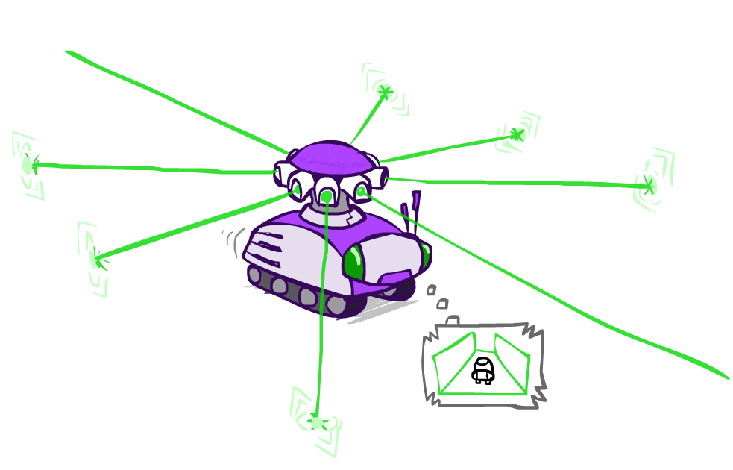
Example: Robot Localization
Example from Michael Pfeiffer
Prob
0
1
t=0
Sensor model: can read in which directions there is a wall, never more than 1 mistake
Motion model: may not execute action with small prob.

Slide 2
Example: Robot Localization
Prob
0
1
t=1
Lighter grey: was possible to get the reading, but less likely b/c required 1 mistake

Slide 3
Example: Robot Localization
Prob
0
1
t=2

Slide 4
Example: Robot Localization
Prob
0
1
t=3

Slide 5
Example: Robot Localization
Prob
0
1
t=4

Slide 6
Example: Robot Localization
Prob
0
1
t=5

