Slide 1
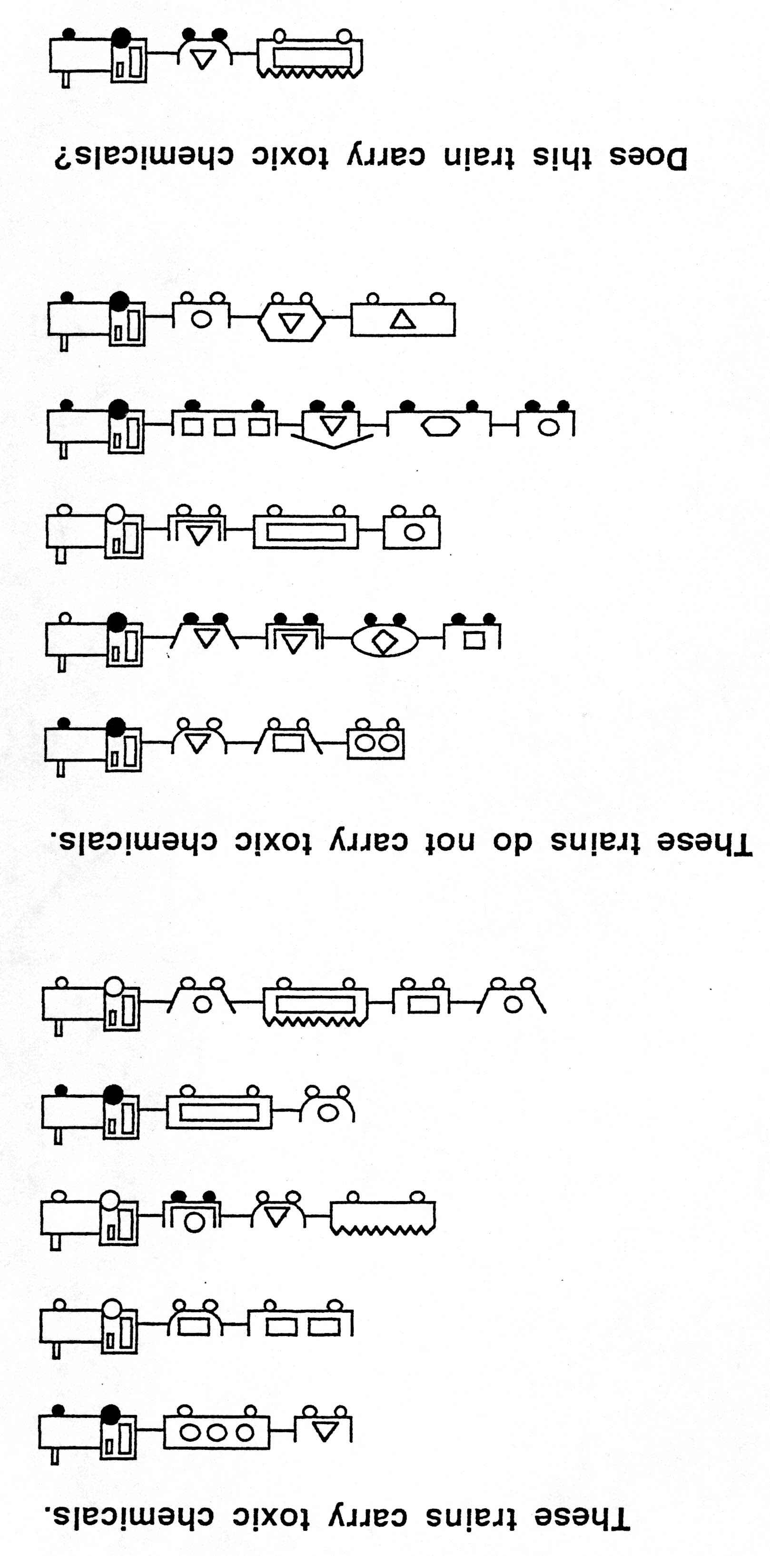
Example problem

Slide 2
Example rule (1)
Trains with small closed cars do not carry toxic chemicals

Slide 3
Example rule (2)
Trains with with only a small and large car, or a jagged-top car, carry toxic chemicals

