Slide 1
Example: map coloring

Slide 2
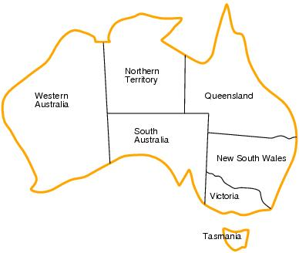
Example: Map coloring
Variables —
WA, NT, Q, NSW, V, SA, T
Domains — D_{i}={red,green,blue}
Constraints — adjacent regions must have different colors.
    E.g. WA ≠ NT (if the language allows this)
    E.g. (WA,NT) in {(red,green),(red,blue),(green,red),…}
    E.g. (WA,NT) not in {(red,red),(blue,blue),(green,green)}

Slide 3
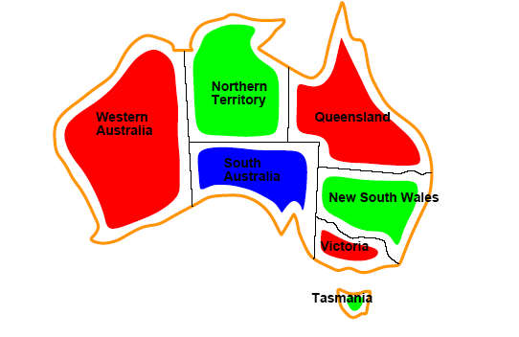
Example: Map coloring
Solutions are assignments
satisfying all constraints, e.g.
{WA=red,NT=green,Q=red,NSW=green,V=red,SA=blue,T=green}

Slide 4
DFS on Australia

Slide 5
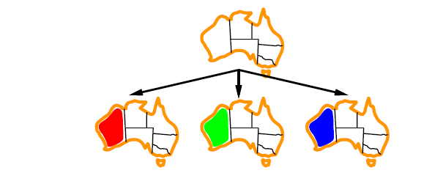
Search example

Slide 6
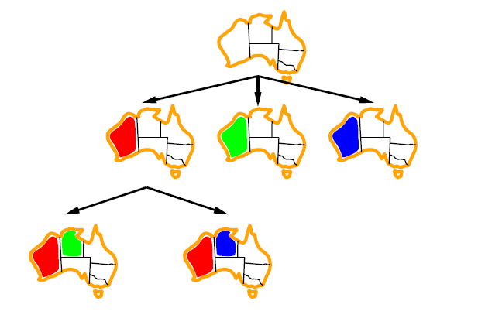
Search example

Slide 7
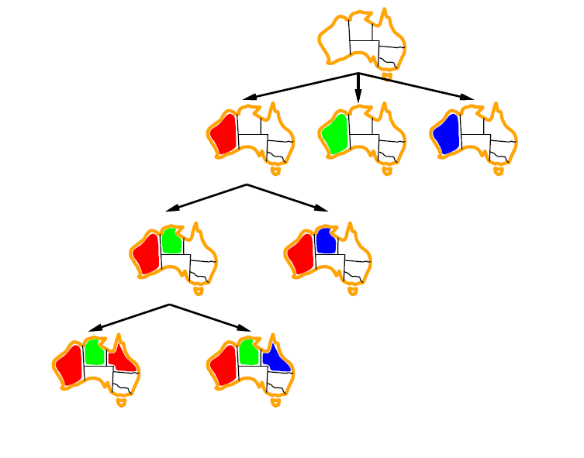
Search example

Slide 8
DFS node ordering heuristics

Slide 9
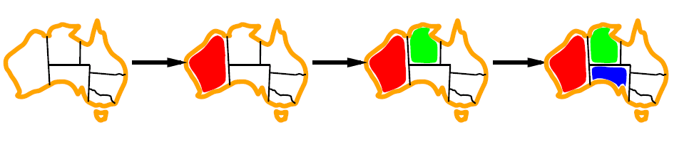
Minimum remaining values heuristic
Select the most constrained variable
(the variable with the smallest number
of remaining values)

Slide 10

Degree heuristic
Select the variable that is involved in the largest number of constraints with other unassigned variables
A useful tie breaker.
In what order should its values be tried?

Slide 11
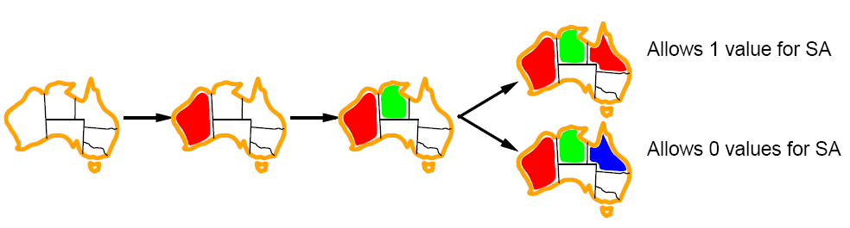
Least constraining value
Allows 1 value for SA
Allows 0 value for SA
Given a variable, choose the least constraining value — the value that leaves the maximum flexibility for subsequent variable assignments.

Slide 12
Propagating information through constraints

Slide 13
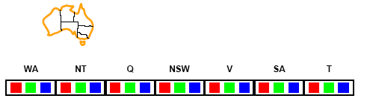
Forward checking
Can we detect inevitable failure early?
  And avoid it later?
Yes — track remaining legal values for unassigned variables
Terminate search when any variable has no legal values.

Slide 14
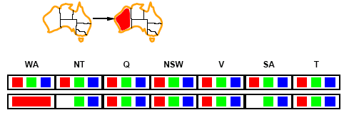
Forward checking
Assign {WA=red}
Effects on other variables connected by constraints with WA
  NT can no longer be red
  SA can no longer be red

Slide 15
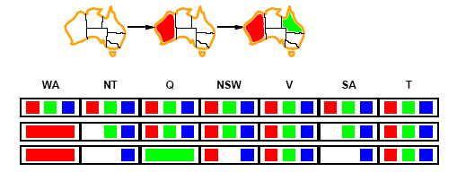
Forward checking
Assign {Q=green}
Effects on other variables connected by constraints with WA
  NT can no longer be green
  NSW can no longer be green
  SA can no longer be green

Slide 16
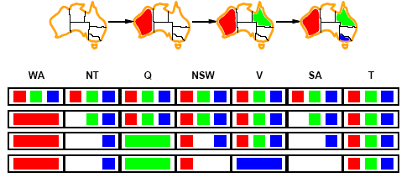
Forward checking
If V is assigned blue
Effects on other variables connected to WA
  NSW can no longer be blue
  SA is empty (no valid assignment is possible)
FC has detected a partial assignment that is inconsistent with the constraints.

Slide 17
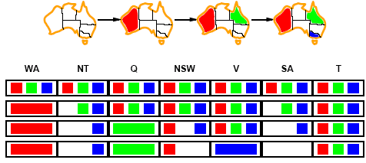
Forward checking
Solving CSPs with heuristics + forward checking is more efficient than either approach alone
FC checking propagates information from assigned to unassigned variables but does not provide detection for all failures.
  FC misses the fact that NT and SA cannot be blue
We need constraint propagation to enforce constraints locally

Slide 18
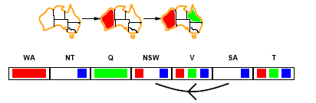
Arc consistency
X → Y is consistent iff
for every value x of X there is some allowed y
SA → NSW is consistent iff
SA=blue and NSW=red
What about the other direction NSW → SA?

Slide 19
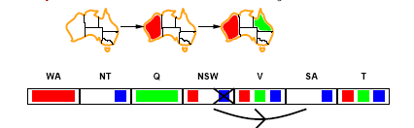
Arc consistency
X → Y is consistent iff
for every value x of X there is some allowed y
NSW → SA is consistent iff
NSW=red and SA=blue
NSW=blue and SA=???
Arc can be made consistent by removing blue from NSW

Slide 20
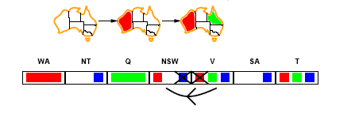
Arc consistency
Arc can be made consistent by removing blue from NSW
Recheck neighbours
  Remove red from V

Slide 21
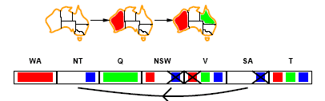
Arc consistency
Arc can be made consistent by removing blue from NSW
Recheck neighbours
  Remove red from V
Arc consistency detects failure earlier than forward checking
Can be run as a preprocessor or after each assignment.
  Repeated until no inconsistency remains

