Slide 1
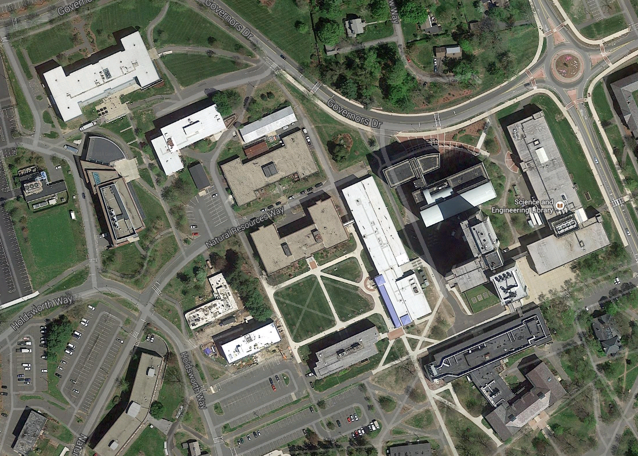

Slide 2
Start
Goal

Slide 3
Start
Goal

Slide 4
Start
Goal

Slide 5
Goal

Slide 6
Fitness landscape
From: http://classes.yale.edu/fractals/CA/GA/Fitness/Fitness.html

Slide 7
Fitness landscape
From: Richard Wein (2002). Not a Free Lunch But a Box of Chocolates. http://www.talkorigins.org/design/faqs/nfl/

Slide 8
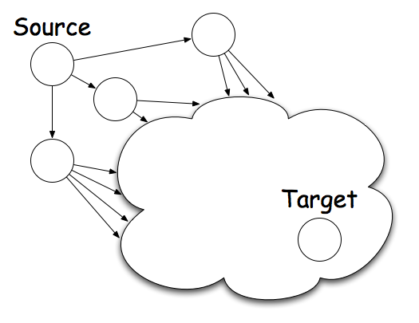
expected value navigation
At each node, minimize expected path length to target:
probability that
neighbor n links to target (p_{n→t} )
degree
probability that a single link from n ends at t
from: https://kdl.cs.umass.edu/papers/simsek-jensen-in-progress.pdf
Notes:
Each node aims to minimize expected path length to target
This is difficult to compute.
We approximate …
Works because 1) need only relative values, 2) terms are correlated with each other (even without homophily)

