Slide 2
Start
Goal

Slide 3
Start
Goal

Slide 4
3
2
0
5
6
1
7
8
10
4
11
9
12
13
14

Slide 5
Start
Goal

Slide 6
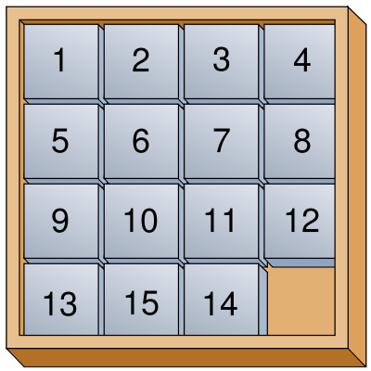
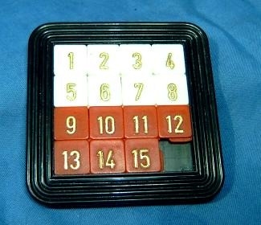
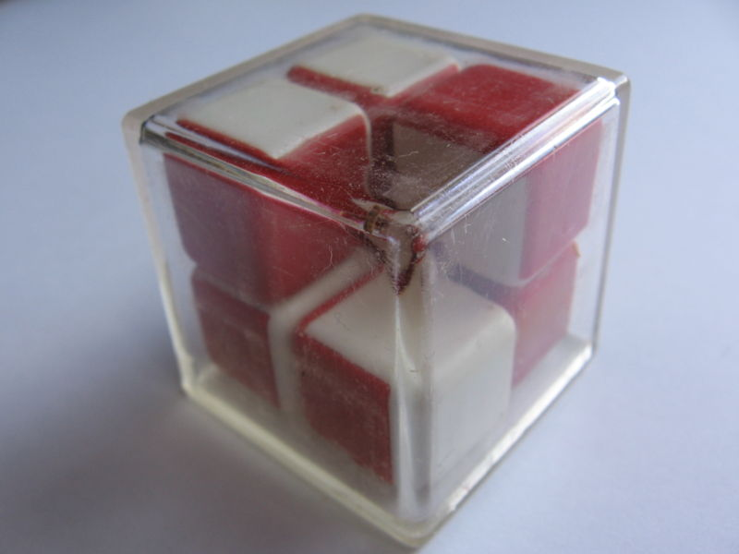
Notes:
Invented in the 1870s by Noyes Palmer Chapman, a postmaster in Canastota, NY.
3-d version (called the Minus Cube) apparently invented in the former Soviet Union prior to 1988.

