Slide 1
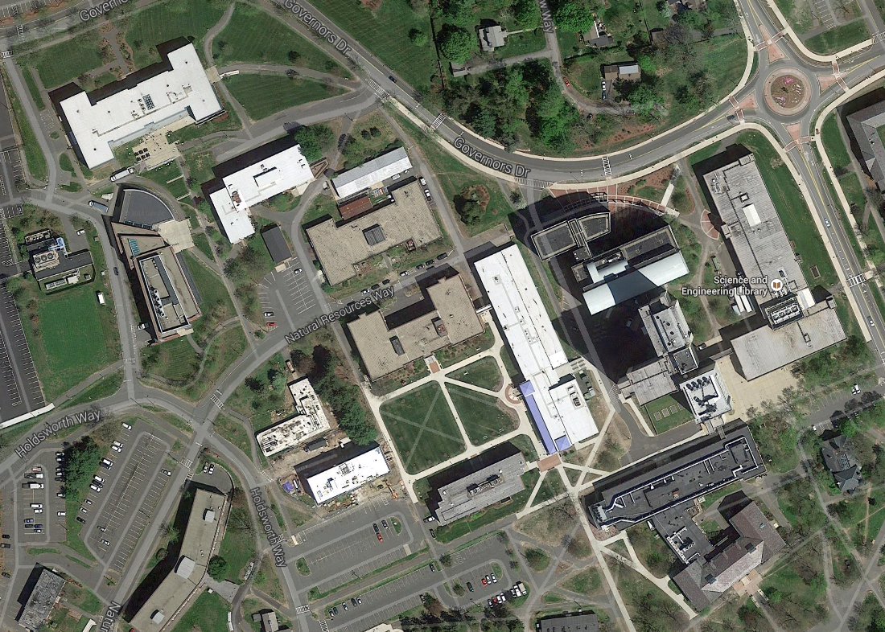

Slide 2
Start
Goal

Slide 3
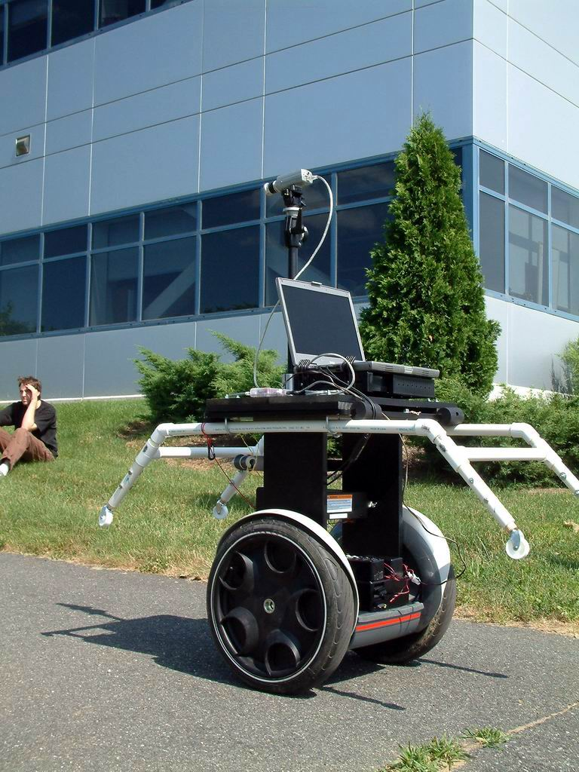
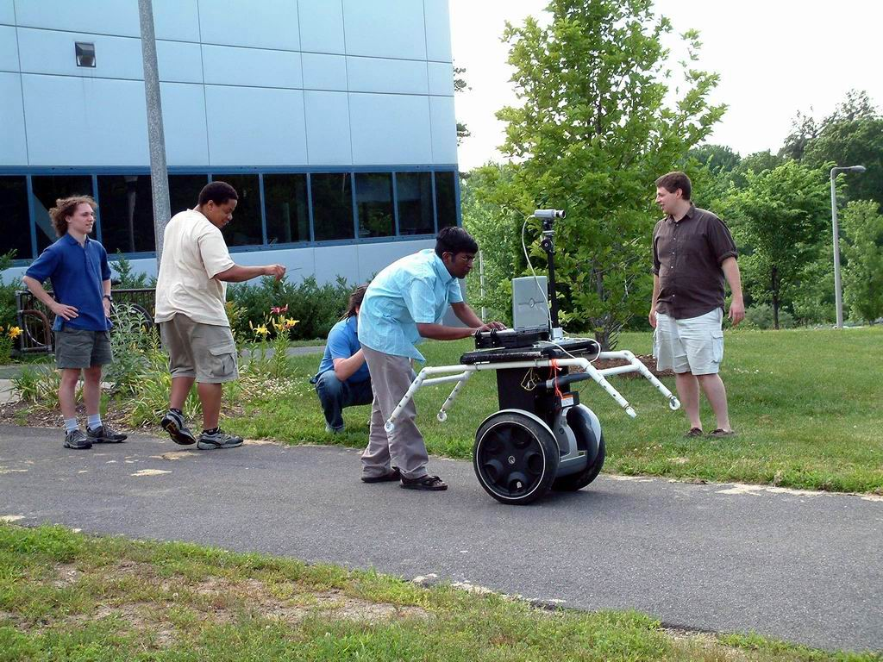

Slide 4
Start
Goal

Slide 5
Start
Goal

Slide 6
Is O(b^{d}) a big deal?
Depth
Time
Memory
2
4
6
8
10
12
14
.11 msec
11 msec
1.1 sec
2 min
3 hours
13 days
3.5 years
100 kilobytes
10.6 megabytes
1 gigabytes
103 gigabytes
10 terabytes
1 petabyte
99 petabytes
b=10; nodes require ~1kilobyte
Notes:
Suppose b=10, 10,000 nodes per second; 1000 bytes/node

