Slide 1
Dimensionality Reduction For k-means Clustering and Low Rank Approximation
Michael Cohen, Sam Elder, Cameron Musco, Christopher Musco, and Madalina Persu

Slide 2
Dimensionality Reduction
Replace large, high dimensional dataset with lower dimensional sketch
d dimensions
d’ << d dimensions
n data points

Slide 3
Dimensionality Reduction
Solution on sketch approximates solution on original dataset
Faster runtime, decreased memory usage, decreased distributed communication
Regression, low rank approximation, clustering, etc.

Slide 4
k-Means Clustering
Extremely common clustering objective function for data analysis
Partition data into k clusters that minimize intra-cluster variance
We focus on Euclidean k-means

Slide 5
k-Means Clustering
NP-Hard even to approximate to within some constant [Awasthi et al ’15]
Exist a number of (1+ε) and constant factor approximation algorithms
Ubiquitously solved using Lloyd’s heuristic - “the k-means algorithm”
k-means++ initialization makes Lloyd’s provable O(logk) approximation
Dimensionality reduction can speed up all these algorithms

Slide 6
Johnson-Lindenstrauss Projection
Given n points x₁,…,x_{n}, if we choose a random d x O(logn/ε²) Gaussian matrix Π, then with high probability we will have:
d
O(logn/ε²)
x₁
x₁Π
x₂
x₂Π
n
Π
...
...
x_{n}
x_{n}Π
“Random Projection”

Slide 7
Johnson-Lindenstrauss Projection
Intra-cluster variance is the same as sum of squared distances between all pairs of points in that cluster
=
JL projection to O(logn/ε²) dimensions preserves all these distances.

Slide 8
Johnson-Lindenstrauss Projection
d
O(logn/ε²)
A
Π
Ã
n
Can we do better? Project to dimension independent of n? (i.e. O(k)?)

Slide 9
Observation: k-Means Clustering is Low Rank Approximation
μ₁
μ₂
…
μ_{k}
a₁
μ₂
a₁
a₂
a₂
μ_{k}
a₃
μ₁
a₃
μ_{k}
A
C(A)
...
...
a_{n-1}
a_{n-1}
μ₂
a_{n}
μ₁
a_{n}

Slide 10
Observation: k-Means Clustering is Low Rank Approximation
μ₁
μ₂
…
μ_{k}
a₁
μ₂
a₁
a₂
a₂
μ_{k}
a₃
μ₁
a₃
μ_{k}
A
C(A)
rank k
...
...
a_{n-1}
a_{n-1}
μ₂
a_{n}
μ₁
a_{n}

Slide 11
Observation: k-Means Clustering is Low Rank Approximation
In fact C(A) is the projection of A’s columns onto a k dimensional subspace
μ₁
μ₂
…
μ_{k}
a₁
μ₂
a₁
a₂
a₂
μ_{k}
a₃
μ₁
a₃
μ_{k}
A
C(A)
rank k
...
...
a_{n-1}
a_{n-1}
μ₂
a_{n}
μ₁
a_{n}

Slide 12
Observation: k-Means Clustering is Low Rank Approximation
In fact C(A) is the projection of A’s columns onto a k dimensional subspace
μ₂
a₁
a₁
...
μ₁
μ₂
a₂
...
a₂
μ_{k}
μ₁
a₃
a₃
...
...
...
...
μ_{k}
=
μ_{k}
A
C(A)
cluster indicator matrix
...
...
...
...
...
a_{n-1}
a_{n-1}
μ₂
μ₁
a_{n}
a_{n}

Slide 13
Observation: k-Means Clustering is Low Rank Approximation
In fact C(A) is the projection of A’s columns onto a k dimensional subspace
μ₂
a₁
a₁
...
a₂
...
a₂
μ_{k}
μ₁
μ₁
a₃
a₃
...
...
μ₂
...
=
μ_{k}
A
C(A)
cluster indicator matrix
...
...
...
μ_{k}
...
...
...
a_{n-1}
a_{n-1}
μ₂
μ₁
XX^{T}A = C(A)
a_{n}
a_{n}
XX^{T} is a rank k orthogonal projection! [Boutsidis, Drineas, Mahoney, Zouzias ‘11]

Slide 14
Observation: k-Means Clustering is Low Rank Approximation
Here S is the set of all rank k cluster indicator matrices
S = {all rank k orthogonal bases} gives unconstrained low rank approximation. i.e. partial SVD or PCA
In general we call this problem constrained low rank approximation

Slide 15
Observation: k-Means Clustering is Low Rank Approximation
New goal: Want a sketch that, for any S allows us to approximate:
Projection Cost Preserving Sketch [Feldman, Schmidt, Sohler ‘13]
O(k)
2
2
A
XX^{T}
A
≈
Ã
XX^{T}
Ã
⁻
⁻
F
F

Slide 16
Take Aways Before We Move On
k-means clustering is just low rank approximation in disguise
We can find a projection cost preserving sketch Ã that approximates the distance of A from any rank k subspace in R^{n}
This allows us to approximately solve any constrained low rank approximation problem, including k-means and PCA
d
O(k)
O(k) is the ‘right’ dimension
A
Ã
n

Slide 17
Our Results on Projection Cost Preserving Sketches
Technique | Previous Work | Dimensions | Approximation | Our Results
 |  |  |  | Dimensions | Approx
SVD | Feldman, Schmidt, Sohler ‘13 | O(k/ε²) | 1+ε | k/ε | 1+ε
Approximate SVD | Boutsidis, Drineas, Mahoney, Zouzias ‘11 | O(k/ε²) | 2+ε | k/ε | 1+ε
JL-Projection | ‘’ | O(k/ε²) | 2+ε | O(k/ε²) | 1+ε
Column Sampling | ‘’ | O(klogk/ε²) | 3+ε | O(klogk/ε²) | 1+ε
Column Selection | Boutsidis, Magdon-Ismail ‘13 | r, k < r < n | O(n/r) | O(k/ε²) | 1+ε
O(logk/ε²)
9+ε
Not a mystery that all these techniques give similar results – this is common throughout the literature. In our case the connection is made explicit using a unified proof technique.

Slide 18
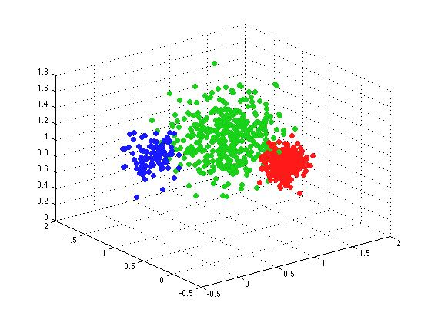
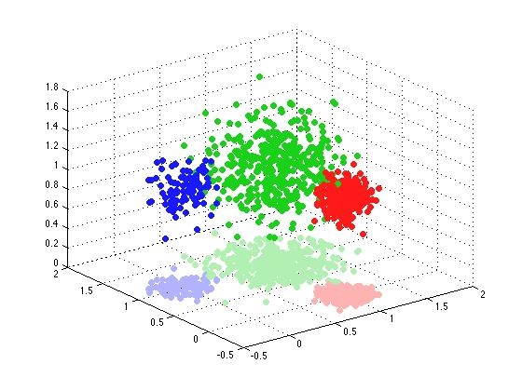
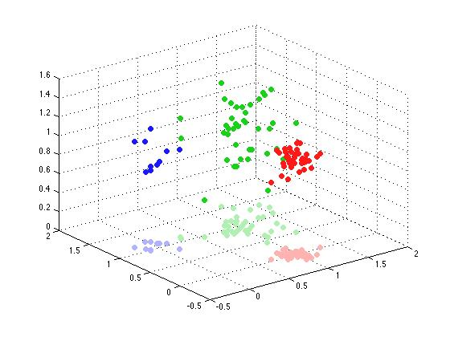
Applications: k-means clustering
Smaller coresets for streaming and distributed clustering – original motivation of [Feldman, Schmidt, Sohler ‘13]
Constructions sample Õ(kd) points. So reducing dimension to O(k) reduces coreset size from Õ(kd²) to Õ(k³)

Slide 19
Applications: k-means clustering
Lowest communication (1+ε)-approximate distributed clustering algorithm, improving on [Balcan, Kanchanapally, Liang, Woodruff ’14]
JL-projection is oblivious
A
=
Π
Ã

Slide 20
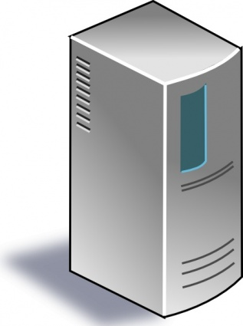
Applications: k-means clustering
JL-projection is oblivious
Gives lowest communication (1+ε)-approximate distributed clustering algorithm, improving on [Balcan, Kanchanapally, Liang, Woodruff ‘14]
A₁
A
A₂
...
...
A_{m}

Slide 21
Applications: k-means clustering
JL-projection is oblivious
Gives lowest communication (1+ε)-approximate distributed clustering algorithm, improving on [Balcan, Kanchanapally, Liang, Woodruff ‘14]
A₁Π
Just need to share O(logd) bits representing Π.
AΠ
A₂Π
...
...
A_{m}Π

Slide 22
Applications: Low Rank Approximation
Traditional randomized low rank approximation algorithm: [Sarlos ’06, Clarkson Woodruff ‘13]
A
O(k/ε)
ΠA
n
Projecting the rows of A onto the row span of ΠA gives a good low rank approximation of A

Slide 23
Applications: Low Rank Approximation
Our results show that ΠA can be used to directly compute approximate singular vectors for A
A
O(k/ε²)
ΠA
n
Streaming applications

Slide 24
Applications: Column Based Matrix Reconstruction
It is possible to sample O(k/ε) columns of A, such that the projection of A onto those columns is a good low rank approximation of A. [Deshpande et al ‘06, Guruswami, Sinop ‘12, Boutsidis et al ‘14]
We show: It is possible to sample and reweight O(k/ε²) columns of A, such that the top column singular vectors of the resulting matrix, give a good low rank projection for A.
Possible applications to approximate SVD algorithms for sparse matrices
A
Ã

Slide 25
Applications: Column Based Matrix Reconstruction
Columns are sampled by a combination of leverage scores, with respect to a good rank k subspace, and residual norms after projecting to this subspace.
Very natural feature selection metric. Possible heuristic uses?

Slide 26
Analysis: SVD Based Reduction
Projecting A to its top k/ε singular vectors gives a projection cost preserving sketch with (1±ε) error.
Simplest result, gives a flavor for techniques used in other proofs.
New result, but essentially shown in [Feldman, Schmidt, Sohler ‘13]
The Singular Value Decomposition:
V_{k}^{T}
=
Σ
V^{T}
A
U
Σ_{k}
A_{k}
U_{k}

Slide 27
Analysis: SVD Based Reduction
=
Σ_{k/ε}
V_{k/ε}^{T}
A_{k/ε}
U_{k/ε}
U_{k/ε}Σ_{k/ε}

Slide 28
Analysis: SVD Based Reduction
Need to show that removing the tail of A does not effect the projection cost much.

Slide 29
Analysis: SVD Based Reduction
Main technique: Split A into orthogonal pairs [Boutsidis, Drineas, Mahoney, Zouzias ’11]
A
=
A_{k/ε}
A_{r-k/ε}
+
Rows of A_{k/ε} are orthogonal to those of A_{r-k/ε}

Slide 30
Analysis: SVD Based Reduction
So now just need to show:
I.e. the effect of the projection on the tail is small compared to the total cost

Slide 31
Analysis: SVD Based Reduction
σ₁
…
σ_{k}
…
k/ε
σ_{k/ε}
σ_{k/ε+1}
…
σ_{k/ε+1+k}
…
k
σ_{d}

Slide 32
Analysis: SVD Based Reduction
k/ε is worst case –when all singular values are equal. In reality just need to choose m such that:
σ₁
…
σ_{k}
…
k/ε
σ_{k/ε}
σ_{k/ε+1}
…
σ_{k/ε+1+k}
If spectrum decays, m may be very small, explaining empirically good performance of SVD based dimension reduction for clustering e.g. [Schmidt et al 2015]
…
k
σ_{d}

Slide 33
Analysis: SVD Based Reduction
SVD based dimension reduction is very popular in practice with m = k
This is because computing the top k singular vectors is viewed as a continuous relaxation of k-means clustering
Our analysis gives a better understanding of the connection between SVD/PCA and k-means clustering.

Slide 34
Recap
A_{k/ε} is a projection cost preserving sketch of A
The effect of the clustering on the tail A_{r-k/ε} cannot be large compared to the total cost of the clustering, so removing this tail is fine.

Slide 35
Analysis: Johnson Lindenstrauss Projection
Same general idea.
≈
Subspace Embedding property of O(k/ε²) dimension RP on k dimensional subspace
≈
≈
Frobenius Norm Preservation
Approximate Matrix Multiplication

Slide 36
Analysis: O(logk/ε²) Dimension Random Projection
E
New Split:
a₁
μ₂
a₁
a₂
a₂
μ_{k}
a₃
μ₁
a₃
=
μ_{k}
+
E
C*(A)
A-C*(A)
A
...
...
a_{n-1}
a_{n-1}
μ₂
a_{n}
μ₁
a_{n}

Slide 37
Analysis: O(logk/ε²) Dimension Random Projection
μ₂
a₁
a₂
μ_{k}
μ₁
a₃
μ_{k}
Only k distinct rows, so O(logk/ε²) dimension random projection preserves all distances up to (1+ε)
C*(A)
...
a_{n-1}
μ₂
μ₁
a_{n}

Slide 38
Analysis: O(logk/ε²) Dimension Random Projection
Rough intuition:
The more clusterable A, the better it is approximated by a set of k points. JL projection to O(log k) dimensions preserves the distances between these points.
If A is not well clusterable, then the JL projection does not preserve much about A, but that’s ok because we can afford larger error.
Open Question: Can O(logk/ε²) dimensions give (1+ε) approximation?

Slide 39
Future Work and Open Questions?
Empirical evaluation of dimension reduction techniques and heuristics based off these techniques
Iterative approximate SVD algorithms based off column sampling results?
Need to sample columns based on leverage scores, which are computable with an SVD.
Approximate Leverage Scores
Sample Columns
Obtain Approximate SVD

