Slide 1



Performance Benchmarking in Systems
L’évaluation de performance en système
Emmanuel Cecchet
University of Massachusetts Amherst
Laboratory for Advanced
Systems Software
& UMass Digital Data Forensics Research

Slide 2
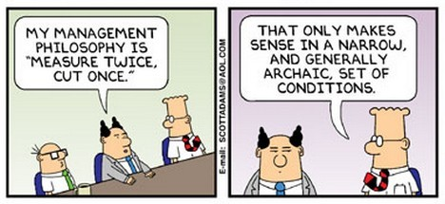
Why are we benchmarking?
Because my advisor told me to do it?
Because others are doing it?
Because I can’t get my paper published without it?
Why am I building a new system?
  What am I trying to improve?
  Does it need to be improved?
  How am I going to measure it?
  What do I expect to see?
  Am I really measuring the right thing?

Slide 3




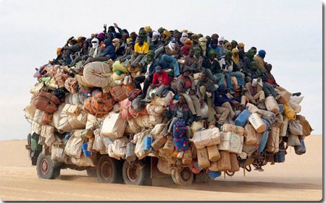
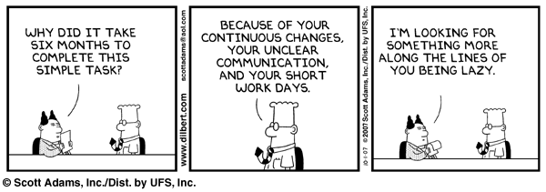
Performance
Faster is better?
Bigger is better?
Scalable is better?
What about manageability?
Which is the right metric?
  Hardware counters
  Throughput
  Latency
  Watts
  $…

Slide 4
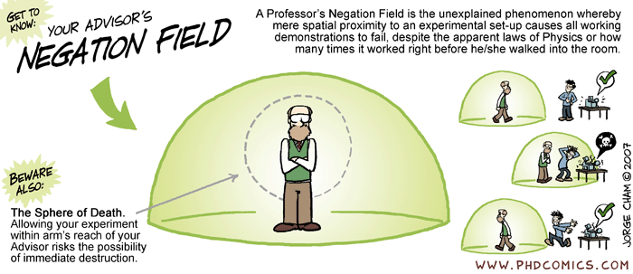
Experimental methodology
Limiting performance bias
Producing Wrong Data Without Doing Anything Obviously Wrong! – T. Mytkowicz, A. Diwan, M. Hauswirth, P. Sweeney – Asplos 2009
  Performance sensitive to experimental setup
  Changing a UNIX environment variable can change program performance from 33 to 300%
  Setup randomization

Slide 5
Experimental environment
Software used
  OS
  Libraries
  Middleware
  JVMs
  Application version
  Compiler / build options
  Logging/debug overhead
  Monitoring software
Hardware used
  Cpu / mem / IO
  Network topology

Slide 6
SCI network performance and Processor stepping

Slide 7



Outline
How Relevant are Standard Systems Benchmarks?
BenchLab: Realistic Web Application Benchmarking
An Agenda for Systems Benchmarking Research

Slide 8
Spec Benchmarks
http://www.spec.org
Benchmark groups
  Open Systems Group
    CPU (int & fp)
    JAVA (client and server)
    MAIL (mail server)
    SFS (file server)
    WEB
  High Performance Group
    OMP (OpenMP)
    HPC
    MPI
  Graphics Performance Group
    APC (Graphics applications)
    OPC (OpenGL)

Slide 9

Typical e-commerce platform
Virtualization
Elasticity/Pay as you go in the Cloud
Frontend/
Load balancer
Internet
App.
Servers
Databases

Slide 10
Typical e-commerce benchmark
Setup for performance benchmarking
  Browser emulator
  Static load distribution
  LAN environment
Internet
Emulated clients
App.
Servers
Database

Slide 11
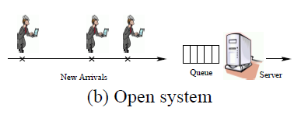
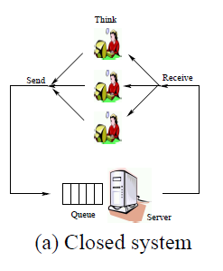
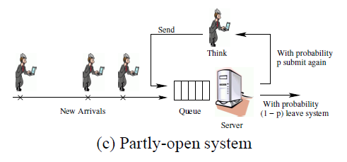
Open vs Closed
Open Versus Closed: A Cautionary Tale –
B. Schroeder, A. Wierman, M. Harchor-Balter – NSDI’06
  response time difference between open and close can be large
  scheduling more beneficial in open systems

Slide 12
Typical DB view of e-commerce benchmarks
Direct SQL injection
Internet
SQL
SQL
SQL
Database

Slide 13
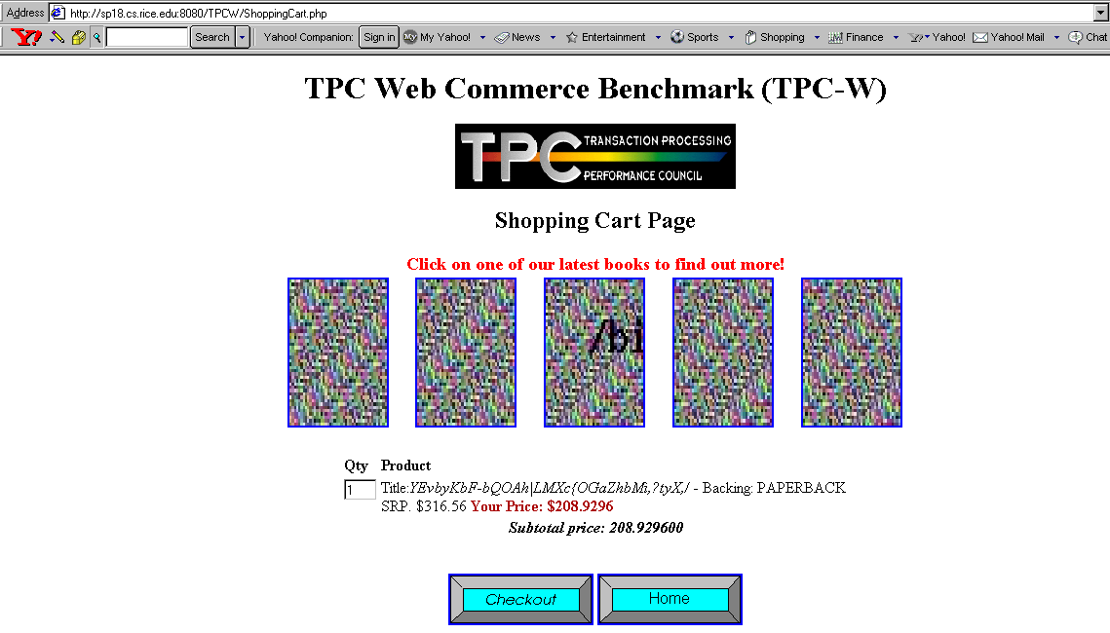
TPC-W benchmark
Open source PHP and Java servlets implementations with MySQL/PostgreSQL
Browser Emulators have significant variance in replay

Slide 14
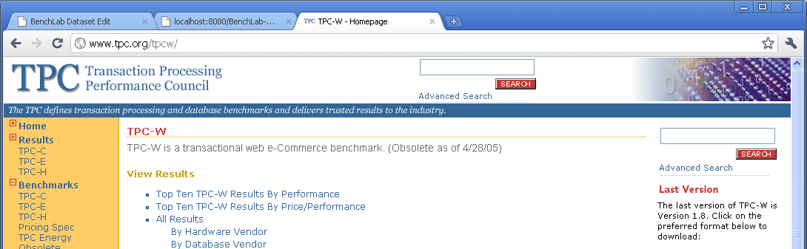
Why is TPC-W obsolete?
HTTP 1.0, no CSS, no JS…
And seriously… did you recognize Amazon.com?

Slide 15

RUBiS benchmark
Auction site (a la eBay.com)
Many open source implementations
  PHP
  Java: Servlet, JEE, Hibernate, JDO…
Everybody complains about it
Everybody uses it
Why?
  It is available
  It is small enough to be able to mess with it
  Others are publishing papers with it!

Slide 16
Web applications have changed
Web 2.0 applications
  Rich client interactions (AJAX, JS…)
  Multimedia content
  Replication, caching…
  Large databases (few GB to multiple TB)
Complex Web interactions
  HTML 1.1, CSS, images, flash, HTML 5…
  WAN latencies, caching, Content Delivery Networks…

Slide 17
More reasons why benchmarks are obsolete?
Benchmark | HTML | CSS | JS | Multimedia | Total
RUBiS | 1 | 0 | 0 | 1 | 2
eBay.com | 1 | 3 | 3 | 31 | 38
TPC-W | 1 | 0 | 0 | 5 | 6
amazon.com | 6 | 13 | 33 | 91 | 141
CloudStone | 1 | 2 | 4 | 21 | 28
facebook.com | 6 | 13 | 22 | 135 | 176
wikibooks.org | 1 | 19 | 23 | 35 | 78
wikipedia.org | 1 | 5 | 10 | 20 | 36
Number of interactions to fetch the home page of various web sites and benchmarks

Slide 18
State size matters
Does the entire DB of Amazon or eBay fit in the memory of a cell phone?
  TPC-W DB size: 684MB
  RUBiS DB size: 1022MB
Impact of CloudStone database size on performance
Dataset size | State size (in GB) | Database rows | Avg cpu load with 25 users
25 users | 3.2 | 173745 | 8%
100 users | 12 | 655344 | 10%
200 users | 22 | 1151590 | 16%
400 users | 38 | 1703262 | 41%
500 users | 44 | 1891242 | 45%
CloudStone Web application server load observed for various dataset sizes using a workload trace of 25 users replayed with Apache HttpClient 3.

Slide 19
Outline
How Relevant are Standard Systems Benchmarks?
BenchLab: Realistic Web Application Benchmarking
An Agenda for Systems Benchmarking Research

Slide 20




Benchmark design
Traditional approach (TPC-W, RUBiS…)
Workload definition
Web Emulator
Application under Test
+
BenchLab approach
Real Web Browsers
HTTP trace
Application under Test
http://...
http://...
http://...
http://...
http://...
http://...
http://...
http://...
http://...
http://...
http://...
http://...

Slide 21
BenchLab: Trace recording
Record traces of real Web sites
HTTP Archive (HAR format)
HA Proxy recorder
Frontend/
Load balancer
Internet
httpd recorder
App.
Servers
SQL recorder?
Databases

Slide 22


BenchLab WebApp
JEE WebApp with embedded database
Repository of benchmarks and traces
Schedule and control experiment execution
Results repository
Can be used to distribute / reproduce experiments and compare results
Upload traces / VMs
Define and run experiments
Compare results
Distribute benchmarks, traces, configs and results
Web Frontend
http://...
http://...
http://...
http://...
http://...
http://...
Results upload
Trace download
Experiment start/stop
Browser registration
Traces (HAR or access_log)
Results (HAR or latency)
Experiment Config
Benchmark VMs
http://...
http://...
http://...
http://...
http://...
http://...
Experiment scheduler

Slide 23
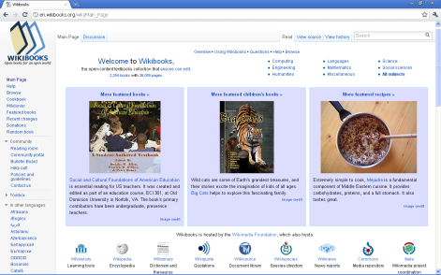
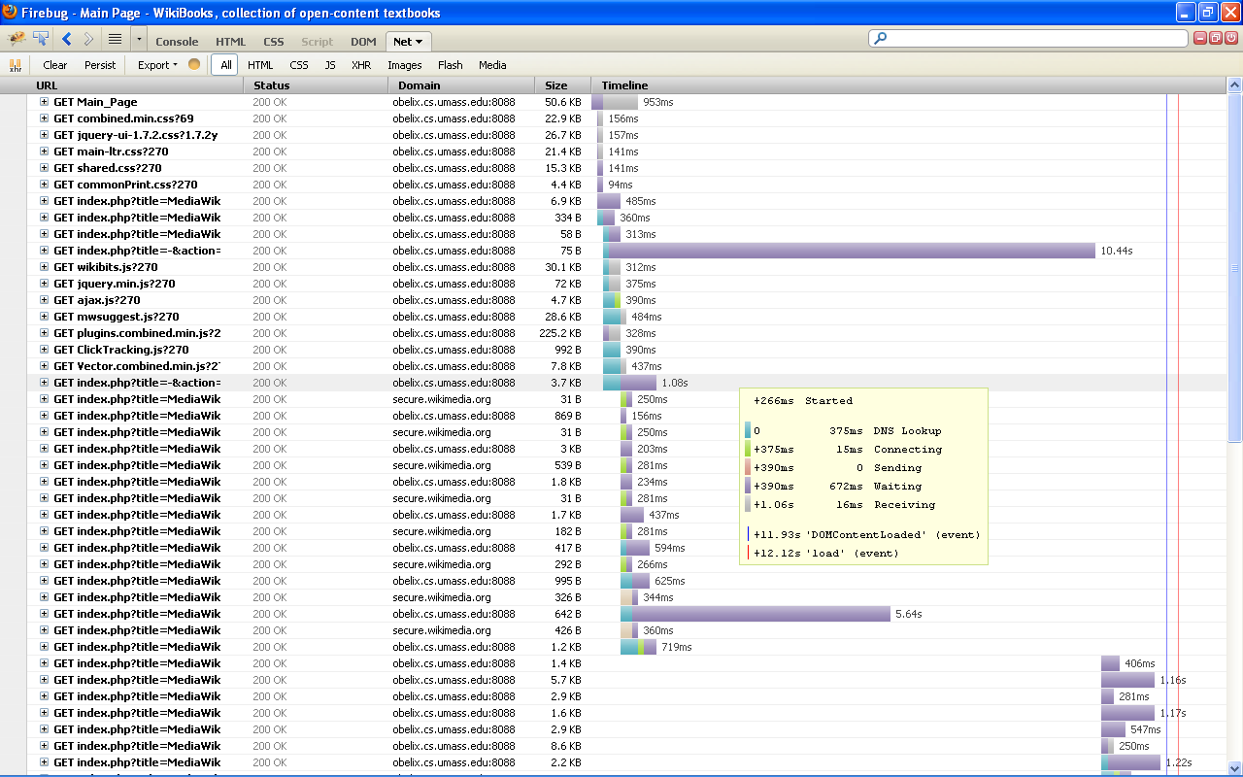


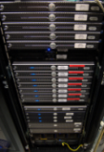


BenchLab Client Runtime (BCR)
Replay traces in real Web browsers
Small Java runtime based on Selenium/WebDriver
Collect detailed response times in HAR format
Can record HTML and page snapshots
Upload results to BenchLab WebApp when done
BCR
Web page browsing
and rendering
HAR results

Slide 24


Wikimedia foundation Wikis
Wikimedia Wiki open source software stack
  Lots of extensions
  Very complex to setup/install
Real database dumps (up to 6TB)
  3 months to create a dump
  3 years to restore with default tools
Multimedia content
  Images, audio, video
  Generators (dynamic or static) to avoid copyright issues
Real Web traces from Wikimedia
Packaged as Virtual Appliances

Slide 25
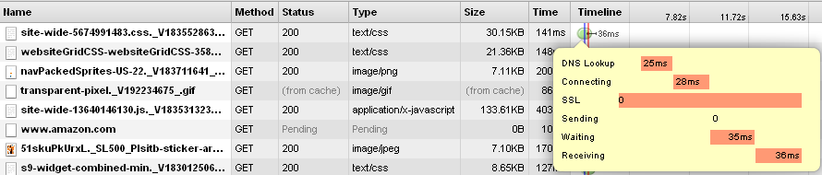
Wikipedia demo
Wikimedia Wikis
  Real software
  Real dataset
  Real traces
  Packaged as Virtual Appliances
Real Web Browsers
  Firefox
  Chrome
  Internet Explorer

Slide 26
HTTP vs Browser replay
Replay
0.25s
0.25s
GET /wiki/page
generate page
0.06s
1
Analyze page
GET combined.min.css
GET jquery-ui.css
GET main-ltr.css
GET commonPrint.css
GET shared.css
GET flaggedrevs.css
GET Common.css
GET wikibits.js
GET jquery.min.js
GET ajax.js
GET mwsuggest.js
GET plugins...js
GET Print.css
GET Vector.css
GET raw&gen=css
GET ClickTracking.js
GET Vector...js
GET js&useskin
GET WikiTable.css
GET CommonsTicker.css
GET flaggedrevs.js
GET Infobox.css
GET Messagebox.css
GET Hoverbox.css
GET Autocount.css
GET toc.css
GET Multilingual.css
GET mediawiki_88x31.png
Browsers are smart
  Parallelism on multiple connections
  JavaScript execution can trigger additional queries
  Rendering introduces delays in resource access
  Caching and pre-fetching
HTTP replay cannot approximate real Web browser access to resources
1.02s
0.67s
send files
0.90s
2
Rendering + JavaScript
GET ExtraTools.js
GET Navigation.js
GET NavigationTabs.js
GET Displaytitle.js
GET RandomBook.js
GET Edittools.js
GET EditToolbar.js
GET BookSearch.js
GET MediaWikiCommon.css
1.19s
0.14s
send files
0.97s
3
Rendering + JavaScript
GET page-base.png
GET page-fade.png
GET border.png
GET 1.png
GET external-link.png
GET bullet-icon.png
GET user-icon.png
GET tab-break.png
GET tab-current.png
GET tab-normal-fade.png
GET search-fade.png
GET search-ltr.png
GET wiki.png
GET portal-break.png
1.13s
0.70s
send files
0.28s
4
Rendering
0.27s
0.12s
GET arrow-down.png
GET portal-break.png
GET arrow-right.png
send files
3.86s
1.88s
+ 2.21s total rendering time
Total network time

Slide 27
Typing speed matters
Auto-completion in search fields is common
Each keystroke can generate a query
GET /api.php?action=opensearch&search=W GET /api.php?action=opensearch&search=Web GET /api.php?action=opensearch&search=Web+ GET /api.php?action=opensearch&search=Web+2 GET /api.php?action=opensearch&search=Web+2. GET /api.php?action=opensearch&search=Web+2.0

Slide 28
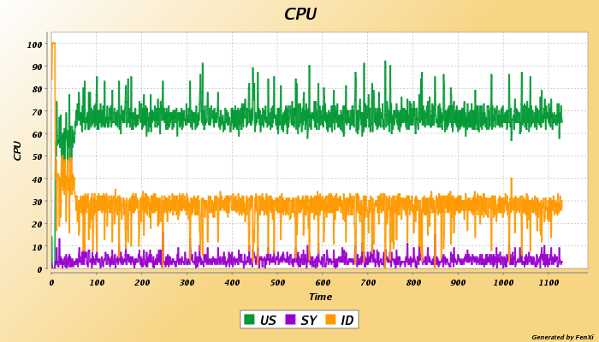
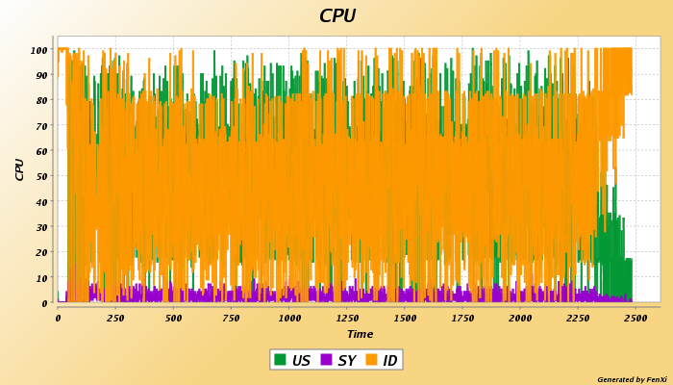
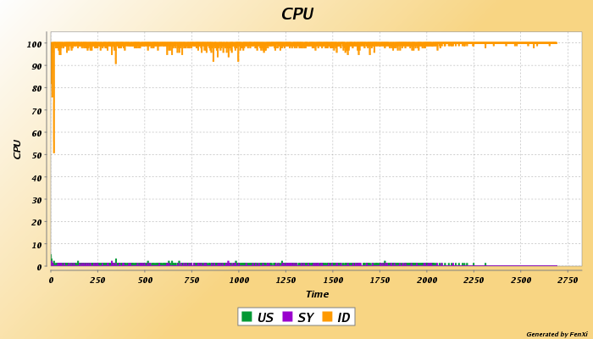
JavaScript effects on Workload
Browser side input validation
Additional queries during form processing
Emulated Browser
Real Browser
Good
Input
Bad
Input

Slide 29
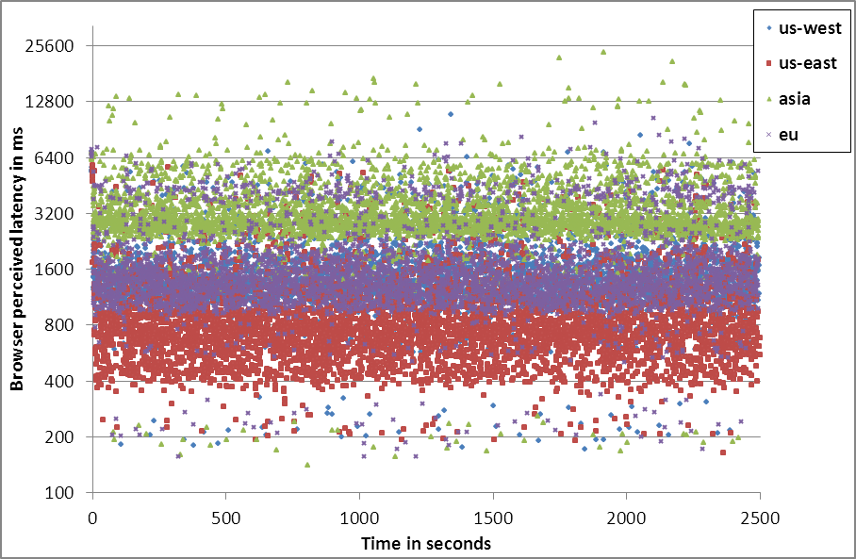
Lan vs Wan load injection
Deployed BCR instances in Amazon EC2 data centers
  As little as $0.59/hour for 25 instances for Linux
  Windows from $0.84 to $3/hour
Latency
  WAN latency >= 3 x LAN latency
  Latency standard deviation increases with distance
CPU usage varies greatly on server for same workload
(LAN 38.3% vs WAN 54.4%)
 | US East | US West | Europe | Asia
Average latency | 920ms | 1573ms | 1720ms | 3425ms
Standard deviation | 526 | 776 | 906 | 1670

Slide 30
Outline
How Relevant are Standard Systems Benchmarks?
BenchLab: Realistic Web Application Benchmarking
An Agenda for Systems Benchmarking Research

Slide 31
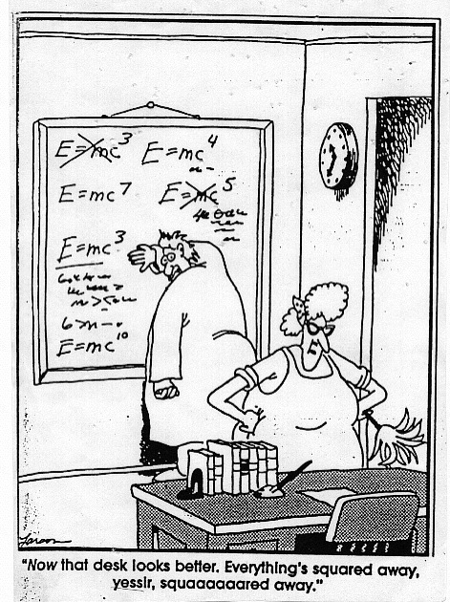
Open challenges - Metrics
Manageability
  Online operations
  Autonomic aspects
HA / Disaster recovery
  Fault loads
  RTO/RPO
Elasticity
Scalability
  Private cloud
  Internet scale
Cacheability
  Replication
  CDNs

Slide 32
Open challenges - Workloads
Capture
  Quantifiable overhead
  Complex interactions
  Correlation of distributed traces
Separating trace generation from replay
Scaling traces
Security
  Anonymization
  Content of updates
Replay
  Complex interactions
  Parallelism vs Determinism
  Internet scale

Slide 33

Open challenges - Experiments
Experiment automation
  Capturing experimental environment
  Reproducing experiments
  Minimizing setup bias
Experimental results
  Certifying results
  Results repository
  Mining/comparing results
Realistic benchmarks
  Applications
  Workloads
  Injection

Slide 34
Conclusion
Benchmarking is hard
Applications are becoming more complex
  Realistic workloads/interactions
  Realistic applications
BenchLab for Internet scale Benchmarking of real applications
A lot to explore…

Slide 35
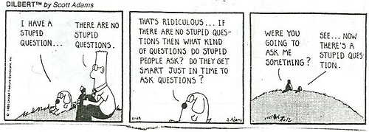
Q&A
http://lass.cs.umass.edu/projects/benchlab/

