Slide 1
MapReduce: Simplified Data Processing on Large Clusters
Jeff Dean, Sanjay Ghemawat, Google, OSDI 2004
Slides based on those by authors and other online sources

Slide 2
Motivation
Large scale data processing
  Using hundreds or thousands of machines but without the hassle of management
MapReduce benefits
  Automatic parallelization & distribution
  Fault tolerance
  I/O scheduling
  Monitoring & status updates

Slide 3
Programming model
Input & Output: each a set of key/value pairs
Programmer specifies two functions:
map(in_key, in_value) -> list(out_key, intermediate_value)
  Processes each input key/value pair
  Produces set of intermediate pairs
reduce(out_key, list(intermediate_value)) -> list(out_value)
  Combines all intermediate values for a particular key
  Produces a set of merged output values (usually just one)
Inspired by similar primitives in LISP and other languages

Slide 4
Example: Count word occurrences
Input: (URL, content) pairs
map(key=URL, value=content):
  for each word w in content, output (w, 1)
reduce(key=word, values=uniq_counts_list)
  sum all 1’s in uniq_counts_list
  output(word, sum)

Slide 5
Word count example illustrated
  map(key=url, val=content):
    For each word w in contents, emit (w, “1”)
  reduce(key=word, values=uniq_counts_list):
    Sum all “1”s in values list
    Emit result “(word, sum)”
  see 1
  bob 1
  run 1
  see 1
  spot 1
  throw 1
  bob 1
  run 1
  see 2
  spot 1
  throw 1
  see bob throw
  see spot run

Slide 6
Grep
Input consists of (url+offset, single line)
map(key=url+offset, val=line):
  if line matches regexp, emit (line, “1”)
reduce(key=line, values=uniq_counts_list):
  Just emit line as-is

Slide 7
Reverse web-link graph
Map
  For each URL linking to target, …
  Output <target, source> pairs
Reduce
  Concatenate list of all source URLs
  Outputs: <target, list (source)> pairs

Slide 8
Inverted index
Map ?
Reduce ?

Slide 9
Other example problems
Multiplying a large matrix with
  a large vector
  a large matrix
Find paths of length two in a web link or social network graph
How to translate relational database style operations like selections, projections, union, intersection, difference, joins etc. given a set of tuples to MapReduce operations?

Slide 10
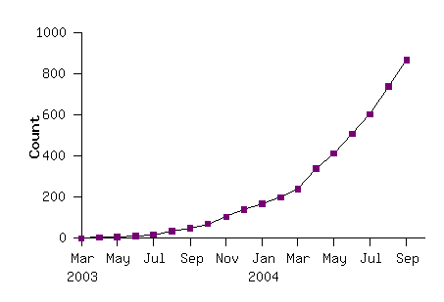
MapReduce model widely applicable
MapReduce programs in Google source tree (2003-04)
Examples
distributed grep |  | distributed sort |  | web link-graph reversal
term-vector / host |  | web access log stats |  | inverted index construction
document clustering |  | machine learning |  | statistical machine translation
... |  | ... |  | ...

Slide 11
Implementation overview
Typical cluster:
  100s/1000s of 2-CPU x86 machines, 2-4 GB of memory
  Limited bisection bandwidth
  Storage is on local IDE disks
  GFS: distributed file system manages data (SOSP'03)
  Job scheduling system: jobs made up of tasks, scheduler assigns tasks to machines
Implementation as C++ library linked into user programs

Slide 12
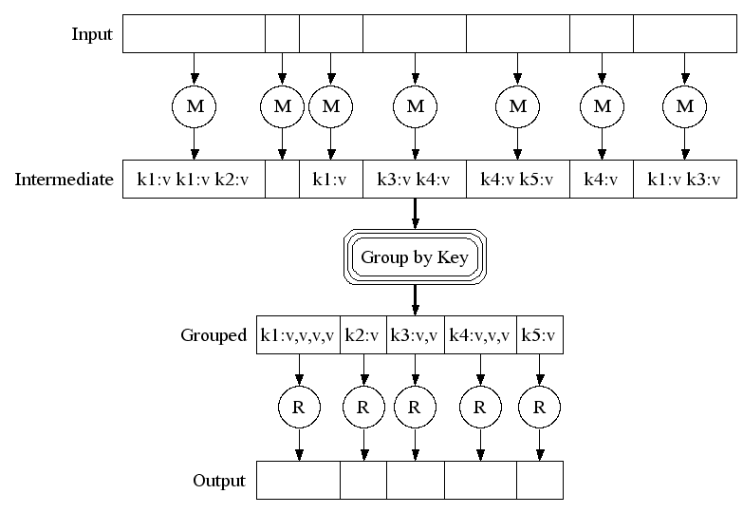
Execution

Slide 13
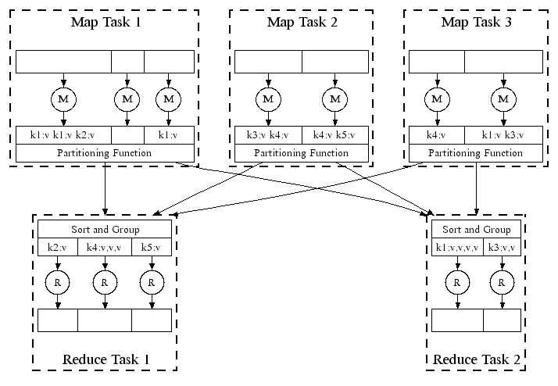
Parellel execution

Slide 14
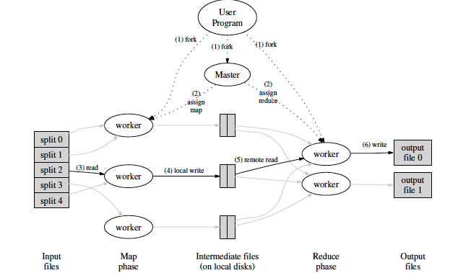
Overall execution workflow

Slide 15
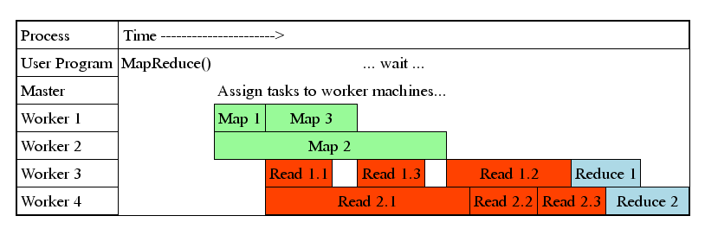
Task Granularity & Pipelining
Fine granularity tasks: map tasks >> machines
  Minimizes time for fault recovery
  Can pipeline shuffling with map execution
  Better dynamic load balancing
Often use 200K map and 5000 reduce tasks running on 2000 machines

Slide 16
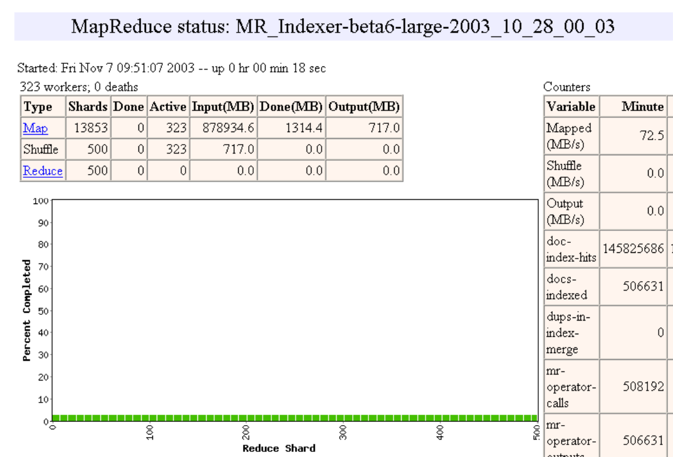
Execution progress illustration

Slide 17
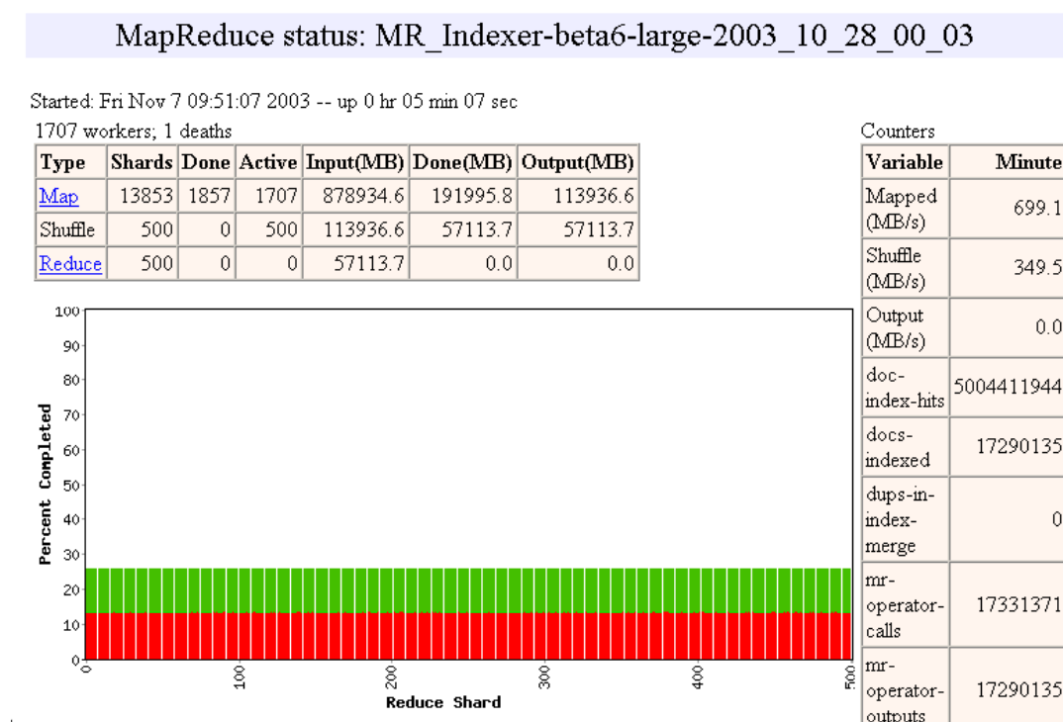

Slide 18
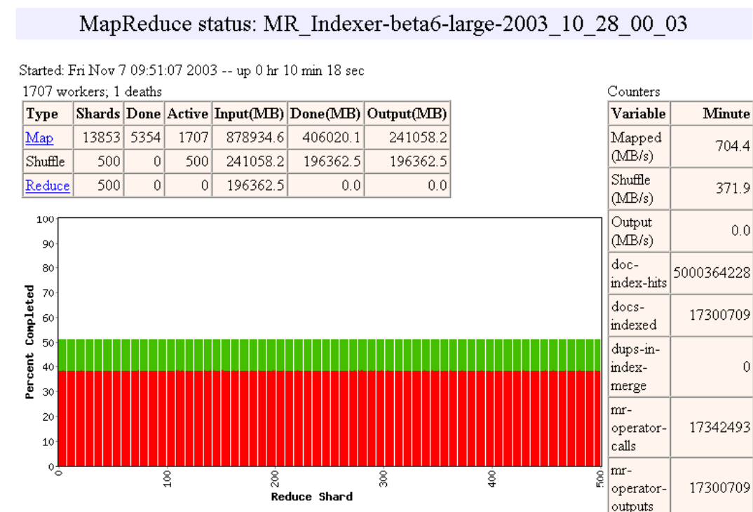

Slide 19
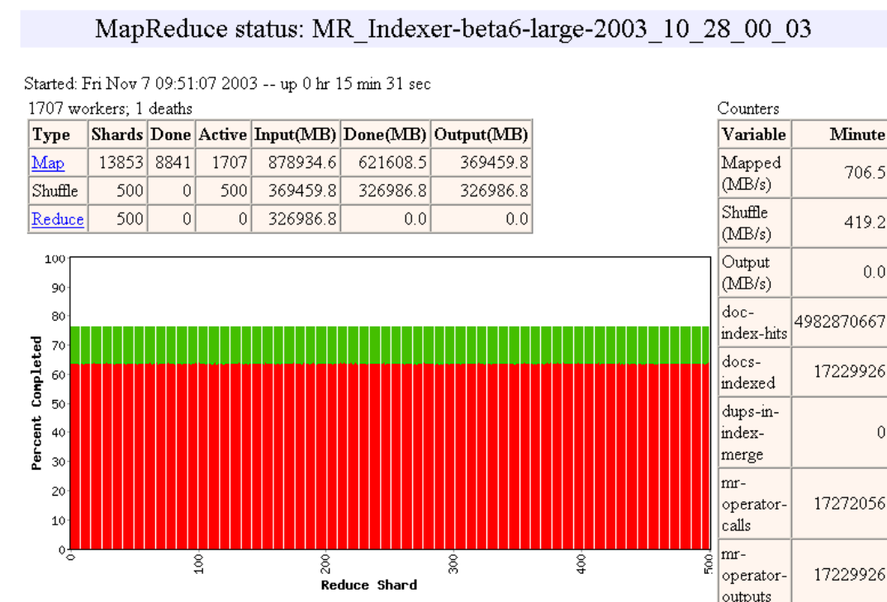

Slide 20
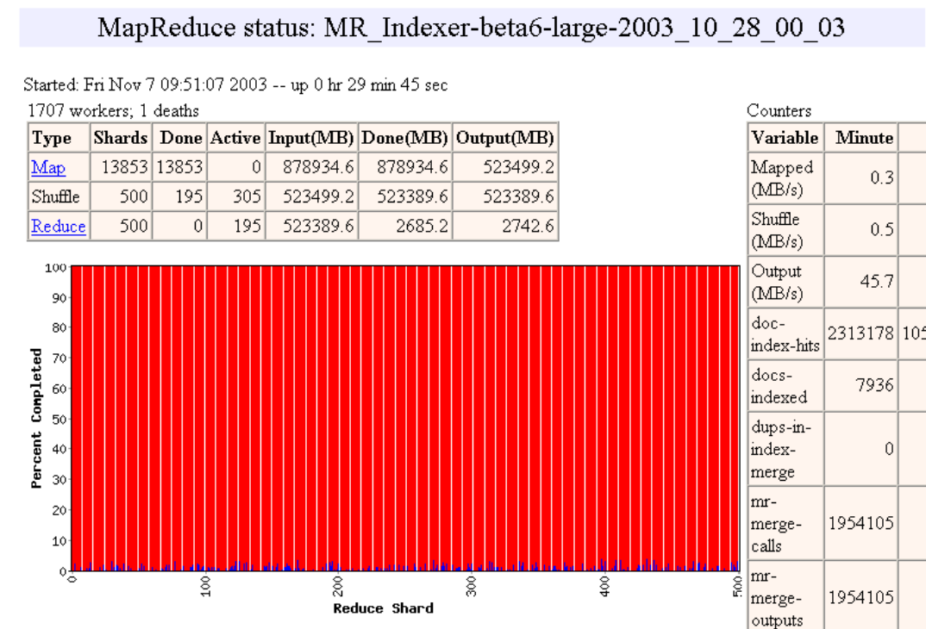

Slide 21
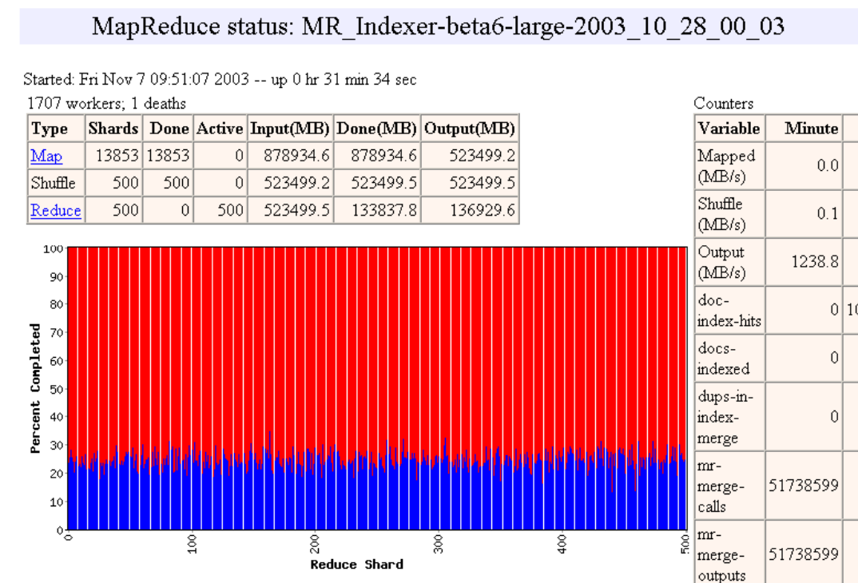

Slide 22
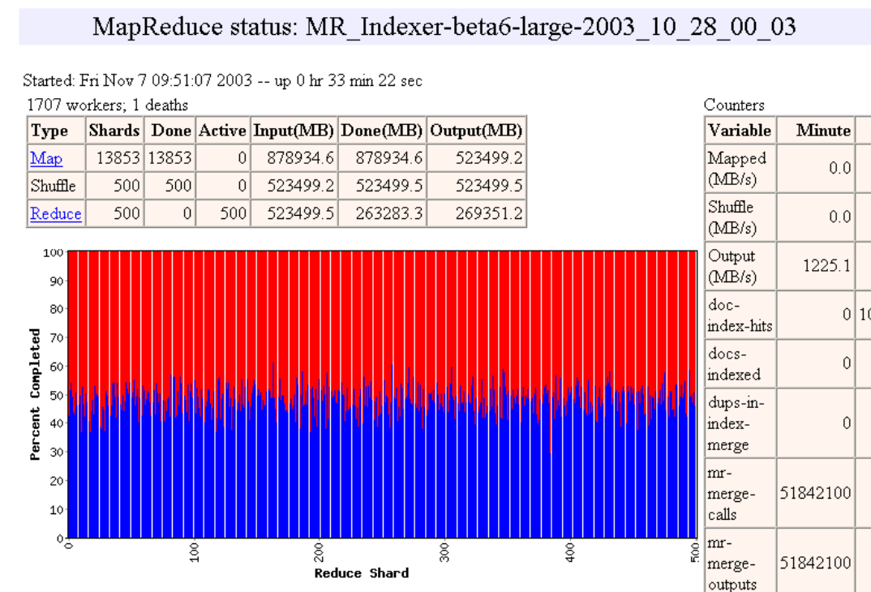

Slide 23
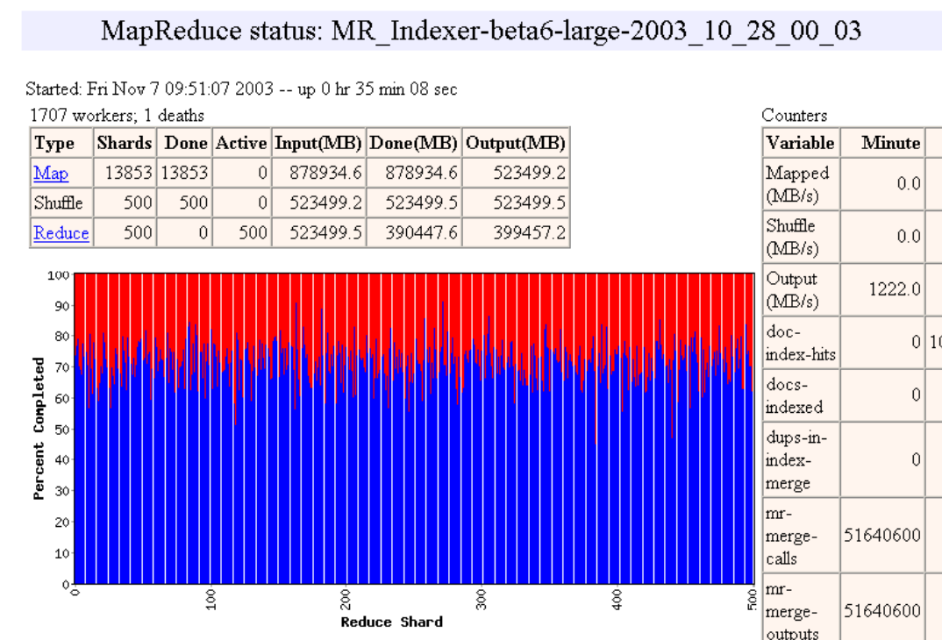

Slide 24
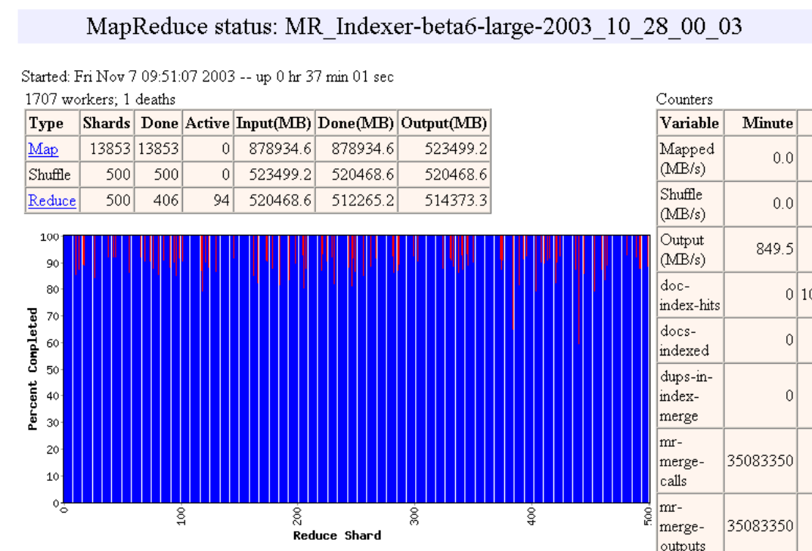

Slide 25


Slide 26


Slide 27
Fault-tolerance via re-execution
On worker failure:
  Detect failure via periodic heartbeats
  Re-execute completed and in-progress map tasks (why?)
  Re-execute in progress reduce tasks
  Task completion committed through master
Master failure:
  Left unhandled as considered unlikely
  Onus on users to restart computation
Robust: lost 1600 of 1800 machines, but finished fine

Slide 28
Refinement: Redundant Execution
Slow workers significantly lengthen completion time
  Other jobs consuming resources on machine
  Bad disks with soft errors transfer data very slowly
  Weird things: processor caches disabled (!!)
Solution: Near end of phase, spawn backup task copies
  Whichever one finishes first "wins"
Benefit: Dramatically shortens job completion time

Slide 29
Refinement: Locality Optimization
Master scheduling policy:
  Asks GFS for locations of replicas of input file blocks
  Map tasks typically split into 64MB (== GFS block size)
  Map tasks scheduled so GFS input block replica are on same machine or same rack
Effect: Thousands of machines read input at local disk speed
  Without this, rack switches limit read rate

Slide 30
Refinement: Skipping Bad Records
Map/Reduce functions sometimes fail for particular inputs
  Best solution is to debug & fix, but not always possible
On seg fault:
  Send UDP packet to master from signal handler
  Include sequence number of record being processed
If master sees two failures for same record:
  Next worker is told to skip the record
Effect: Can work around bugs in third-party libraries

Slide 31
Other Refinements
Sorting guarantees within each reduce partition
Compression of intermediate data
Combiner: useful for saving network bandwidth
Local execution for debugging/testing
User-defined counters

Slide 32
Performance evaluation
Tests run on cluster of 1800 machines:
  4 GB of memory
  Dual-processor 2 GHz Xeons with Hyperthreading
  Dual 160 GB IDE disks
  Gigabit Ethernet per machine
  Bisection bandwidth approximately 100 Gbps
Two benchmarks:
  MR_GrepScan 10¹⁰ 100-byte records to extract records matching a rare pattern (92K matching records)
  MR_SortSort 10¹⁰ 100-byte records (modeled after TeraSort benchmark)

Slide 33
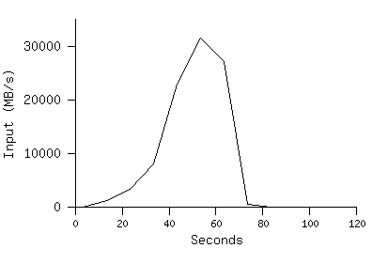
MR_Grep
Locality optimization helps:
1800 machines read 1 TB at peak ~31 GB/s
W/out this, rack switches would limit to 10 GB/s
Startup overhead is significant for short jobs

Slide 34
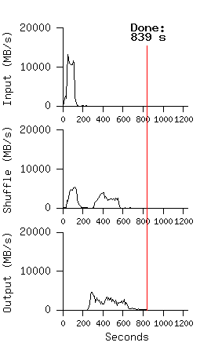
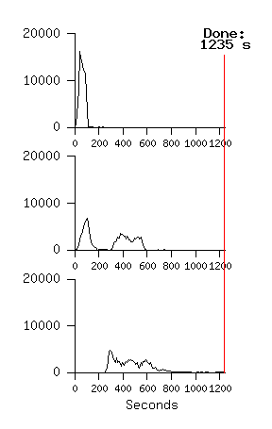
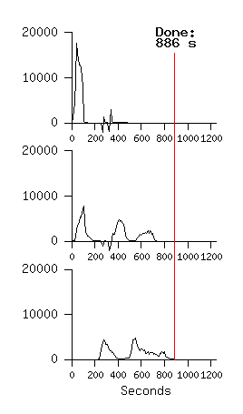
MR_Sort
Normal No backup tasks 200 processes killed
Backup tasks reduce job completion time a lot!
System deals well with failures

Slide 35
Google Experience: Rewrite of Production Indexing System
Rewrote Google's production indexing system using MapReduce
  Set of 10, 14, 17, 21, 24 MapReduce operations
  New code is simpler, easier to understand
  MapReduce takes care of failures, slow machines
  Easy to make indexing faster by adding more machines

Slide 36
Google usage: MapReduce jobs in Aug’04
Number of jobs 29,423
Average job completion time 634 secs
Machine days used 79,186 days
Input data read 3,288 TB
Intermediate data produced 758 TB
Output data written 193 TB
Average worker machines per job 157
Average worker deaths per job 1.2
Average map tasks per job 3,351
Average reduce tasks per job 55
Unique map implementations 395
Unique reduce implementations 269
Unique map/reduce combinations 426

Slide 37
Related Work
Programming model inspired by functional language primitives Partitioning/shuffling similar to many large-scale sorting systems
  NOW-Sort ['97]
Re-execution for fault tolerance
  BAD-FS ['04] and TACC ['97]
Locality optimization has parallels with Active Disks/Diamond work
  Active Disks ['01], Diamond ['04]
Backup tasks similar to Eager Scheduling in Charlotte system
  Charlotte ['96]
Dynamic load balancing solves similar problem as River's distributed queues
  River ['99]

Slide 38
Conclusions
MapReduce has proven to be a useful abstraction
Greatly simplifies large-scale computations at Google
Fun to use: focus on problem, let library deal w/ messy details

